Slide 1
A Fresh Look at Inpatient Palliative Care
Allison Silvers
Chief, Health Care Transformation
January 3, 2025

Slide 2
Today’s Agenda
Palliative Care and its Benefits to Hospitals
The Current Status of Inpatient Palliative Care in the US
Meeting Recommendations When Resources are Scarce
Remote Palliative Care?

Slide 3
What is Palliative Care and Why Is it Necessary for Inpatient Care?

Slide 4

Palliative care is specialized medical care for people with serious illness
Palliative care focuses on providing relief from the symptoms, pain, and stress of a serious illness
It can be provided at any stage of disease and can be provided alongside curative treatment
The goal is to improve quality of life for both the patient and the family.
E

Slide 5
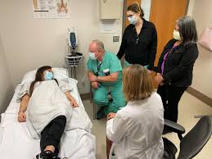
Palliative Care specialists provide . . .
Expert pain and symptom management
  Expert management of pain, dyspnea, depression, anxiety, nausea, vomiting, fatigue, constipation
  Patient/family communication
  Clarifying what to expect with their illness
  Clarifying values, goals, and treatment preferences in light of those expectations
  Coordinating with treating providers to help match treatment and services to patient values and goals
Psychological, social, and spiritual support for patient and family caregivers
E

Slide 6
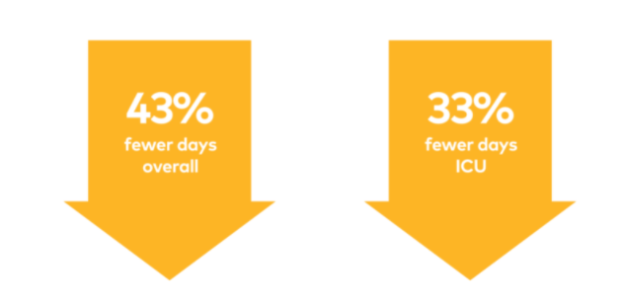
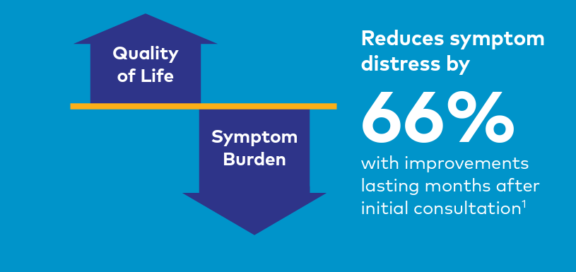
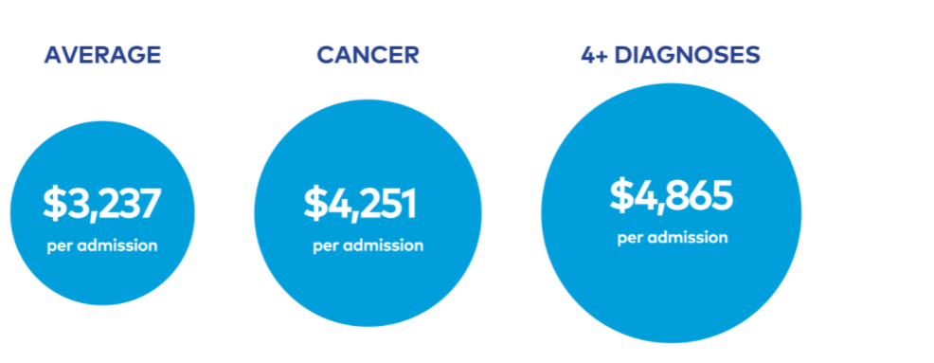
Palliative Care has a strong evidence base proving benefits to patients and hospitals
DIRECT
COST
SAVINGS

Slide 7
Current Prevalence of Inpatient Palliative Care and Average Operations in US Hospitals

Slide 8
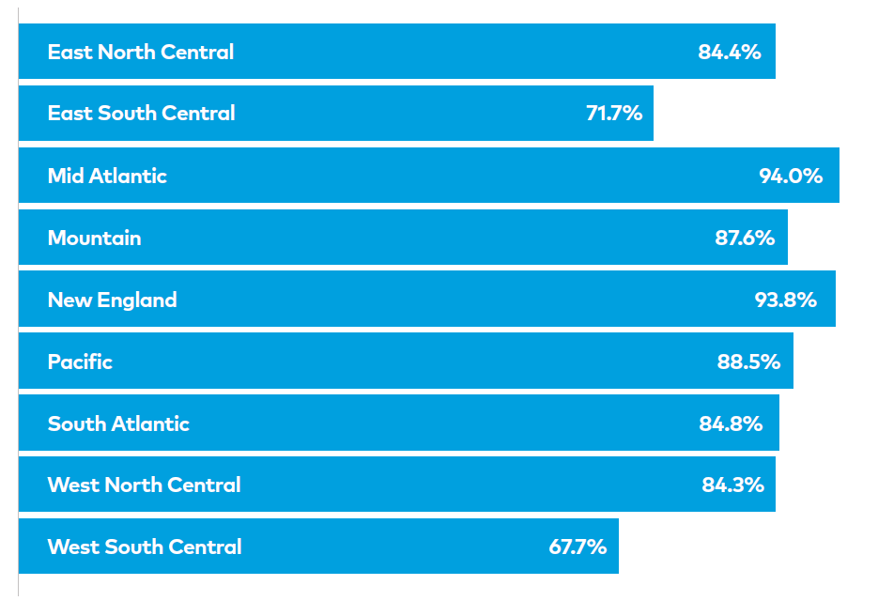
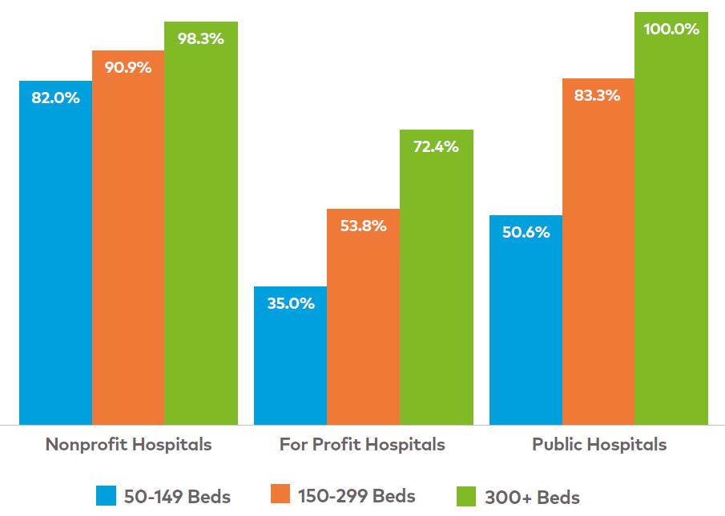
Inpatient Palliative Care is standard practice in larger US hospitals, but for-profit and Southern hospitals lag
Nationally, 83.6% of hospitals 50+ beds report palliative care
Source: AHA 2022 Survey
Database; CAPC Analysis

Slide 9
Notably, a sizable portion of smaller US hospitals also report specialty palliative care availability
Source: AHA 2022 Survey
Database; CAPC Analysis

Slide 10
Most Common Referral Source to Inpatient Palliative Care Service
Source: PCQC 2021 Survey and
2022 Quality Matters presentation

Slide 11
Most Common Primary Diagnosis for Patients Seen by Inpatient Palliative Care
Source: PCQC 2021 Survey and
2022 Quality Matters presentation

Slide 12
The median size of an inpatient palliative care team is 4.7 FTEs.
However, there is significant variation in both team size and composition
Median team composition:
APP 1.3FTE
MD 1.0FTE
RN 0.7FTE
Chaplain 0.3FTE
Admin 0.3FTE
SW 1.0FTE
Source: PCQC 2021 Survey and
2022 Quality Matters presentation

Slide 13
48.9%
35.3%
Hospitals with standardized referral processes (aka “triggers”) for palliative care consultation
Hospital palliative care programs that provide 24/7 coverage
Source: PCQC 2021 Survey and
2022 Quality Matters presentation

Slide 14
CAPC Recommendations for Acute Care Hospitals
Standardized process in place to identify patients for palliative care consultation
An interdisciplinary team with at least two disciplines, including at least one prescriber
At least one prescriber on the team should have specialty certification; others should have specialty certification or documentation of specific competencies
Clinical staff training programs leading to demonstrated competency in serious illness communication and pain/symptom management for all relevant clinicians

Slide 15
Quality Inpatient Palliative Care When Resources Are Scarce:
Insights from Rural and Safety Net Palliative Care Leaders

Slide 16
“Borrow” staff from other services where skills and goals align
Examples include:
Hospital social workers/care managers are all trained in goals of care conversations, leaving palliative care specialists for complex physical and emotional distress
Add Psychiatry residents to palliative care team
Strong partnerships with the Oncology team allow the palliative care prescriber to collaborate with Oncology nurses and social workers to ensure interdisciplinary care
Patients/families interested in hospice are referred to the collaborating hospice agency directly for discussion and shared decision-making
Create a “palliative care liaison” to add temporary FTE to the team while building palliative capacity in nursing, pharmacy, psychiatry, etc.

Slide 17
Use “Triggers” to focus on patients with the likeliest highest impact
Examples include:
Trigger best practice alerts for patients with high risk of prolonged length-of-stay and/or re-admission based on your EHR risk assessments
  Consider “opt-out” consultations rather than requiring an order from the treating team (based on hospital culture)
  Be judicious with follow-up visits. Make it crystal clear that palliative care is a consultative service
  When declining referrals outside the area of focus, be sure to clarify why with the referring clinician, and ideally, document alternative options for them in the EHR

Slide 18
Other Strategies to Optimize Limited Palliative Care Resources
Use non-billable clinicians for initial ‘triage’ visits, as well as for a majority of follow-up visits, to optimize the time of the billable clinician(s)
Hone the team’s ability for efficient and effective patient encounters
  As one leader noted, “don’t substitute time for skill”
  A full-time billable clinician can do 3 new and 8 follow-ups per clinical day
Hone the team’s ability to optimize billing revenue
  Get advice from your medical coders for what they need to see (and what doesn’t matter!) in the documentation to justify higher complexity

Slide 19
New Programs Are Emerging for Remote Palliative Care to Small, Rural Hospitals
Early innovators have found benefit to all parties:
Palliative care consultations in Critical Access Hospital Emergency Departments can reduce tertiary transfers by roughly 2/3
Rural hospitals benefit from reductions in staff distress, and enhanced services to the community
Tertiary hospitals benefit from reduced mortality in their facility
Tertiary palliative care teams benefit from seeing patients and families at a critical decision-point, increasing job satisfaction

Slide 20
Questions? Comments? Ideas?

Slide 21
55 West 125th Street
13th Floor
New York, NY 10027
capc.org

