Slide 1


Principles of Education and EBP
Diana Kott MSN, RN, OCN
Deborah Baldassarre MSN, RN-BC OCN

Slide 2
Educational Theories
  Behavioral Learning
  Cognitive Learning
  Social Learning
  Motivational Learning
  Humanistic Learning
  Adult Learning
Notes:
Behavioral Learning: learning is based on observable behaviors that are reinforced to increase the strength of the behavior; eg: visual imagery
Cognitive Learning: internal process that leads to learning and requires attention, thought and reasoning for the information to be applied; eg: a mnemonic for symptoms that should trigger an important memory like needing to call your physician
Social learning: learning that takes place based on watching and imitating others and three core concepts exist: individual learns through observation, process involves internal mental states and processing, and something that is learned does not always result in a change in behavior
Motivational learning: describes why and how human behavior is activated and directed; eg: I want to be here for my child, so I have to quit smoking”
Humanistic learning: learner directed approach, knowing that individuals are unique and want to learn in a positive manner; eg: a patient expressing fear of dying and needing better coping mechanisms
Adult Learning: someone who is self-directed and independent and based on past history; eg: independent interent search for info related to new cancer diagnosis

Slide 3
Patient Education
Needs Assessment
  What does the patient know?
  What does the patient want to know?
  Will any cultural or religious beliefs or practices affect the teaching or learning process?
  What language does the patient speak?
  Does the patient have a physical impairment that might impede learning?
  What is the educational background of the patient?

Slide 4

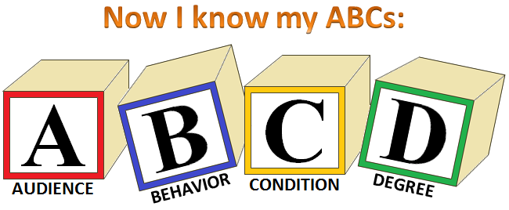
Goals and Objectives
Example: The patient’s ability for self care after discharge.
Example: The learner is able to state four foods with high iron content after reading information regarding foods with high iron content.
Notes:
SMART Goals: Providing a global view of intended outcomes; eg: Ability for self care after discharge
ABCD Rule of Objectives: “Who” will do “what” by “when” and to “what extent”?
Audience (who the learner is) Behavior (what the learner is to do) Condition (Under what circumstances) Degree (to what extent the learner is to perform); eg: The learner is able to state four foods with high iron content after reading information regarding foods with high iron content

Slide 5
Teaching Plan & Evaluation
The Teaching Plan should involve:
  Who is doing the teaching
  How it will be taught
  Preparing for the teaching
  Organizing and practicing
  Planning the teaching to coincide with a teachable moment
The Evaluation of the Education should include:
  Determination of ways to measure learning
  Documentation of learning outcomes
  Reassessment and reinforcement of teaching and learning at the next available opportunity

Slide 6
Other Considerations for Principles of Education
Caregiver Education
  Caregivers may have the same or different learning needs; addressing these learning needs is especially important if the caregiver has a role in caring for the patient at home
  HIPPA – permission from patient to include caregiver
Community Education / Community Health Nursing
  Community defined
  The role of the nurse
  Healthy People 2020
  Community assessment
Staff Education
  Targeted Needs Assessment
  Determination of objectives of the education
  Developing a teaching plan
  Performance Analysis/ Evaluation

Slide 7
Practice Question
After participation in the chemotherapy teaching class, the client will be able to address management of common side effects.
What is this sentence an example of?
A teaching goal that is well-written based on SMART criteria for education
An objective that lacks clear articulation of the degree of performance expected. ABCD objective rule
Evaluation criteria for a chemotherapy class targeting a group of clients
A guide for evaluation of the evaluation of a client’s learning
Notes:
Answer: B
Rationale: The ABCD rule indicates objectives should include audience (who the learner is), behavior (what the learner is to do), condition (under what circumstances), and degree (how much, to what extent the learner is to perform).

Slide 8
Practice Question
Which questions should be addressed before developing an educational program for a client?
What the client knows and wants to know, cultural and religious beliefs and practices that might impact the process for the client, and the content the nurse knows to be important
What the client knows and wants to know, physical and cognitive impairments that might impact learning, preferred learning style, and the budget available
What the client knows and wants to know, the language used by the client (speaking and reading), and the educational background of the client
What the client knows and wants to know, the preferred learning style, the nurse’s understanding of the topic, and the time the nurse has available for teaching
Notes:
Answer: C
Rationale: Questions to answer or discuss include what the client knows or wants to know, cultural or religious beliefs and practice that might impact the process, the language of the client, physical or cognitive impairments that could impact learning, preferred learning style, and educational background. The other concepts listed (the nurses knowledge, the budget available) are important, but initial development should be based on answers to the above questions.

Slide 9
Practice Question
The purpose of the educational component of nursing practice is to help people acquire the knowledge they need in order to:
Comply with the physician’s orders.
Learn what health professionals believe they need to know.
Understand the particular diagnosis.
Participate in their treatment decisions and self care.
Notes:
Answer: D
Rationale: The overall purpose of client education is to enable full participation, acceptance of responsibility, and shared decision making. Compliance often implies instructions that the client is expected to obey. Client education focuses on empowering the individual for self care.

Slide 10
What is Evidence Based Practice (EBP)?
The integration of the best possible research evidence with clinical expertise and patient needs
A lifelong problem-solving approach to clinical practice that integrates the best evidence from well-designed studies
A systemic approach to clinical practice that emphasizes using best evidence in combination with clinical experience
EBP is the key to delivering high-quality health care, achieving improved patient outcomes, and decreasing health care costs
Primary goal of EBP is to guide oncology nursing interventions that are demonstrated to enhance the quality and outcomes of cancer care
EBP is most valuable when clinical practice changes

Slide 11
EBP vs QI vs Research
EBP – appraising and applying the evidence to a clinical problem to improve quality of care and patient outcomes
Quality Improvement – the goal is to improve the processes or outcomes of care being delivered
Research – designed to develop or contribute to generalizable knowledge

Slide 12
Why do we need EBP?
The Institute of Medicine (IOM) mandated that 90% of all health care decisions in the US will be evidence based by 2020
Evidence continues to evolve, and without EBP it can take decades to transition into practice
An EBP culture can increase nurse satisfaction & retention and decrease turnover
Pay-for-performance programs, which means non payment for complications when evidence-based guidelines are not followed
EBP is not consistently implemented at health care institutions throughout the US and globally…this needs to change!

Slide 13
The multistep process of EBP
Question clinical practice for improving health care quality
Identify a problem or trigger
Use internal evidence to describe clinical problems
Use the PICOT format to ask clinical questions
Critically appraise evidence and evaluate for applicability to clinical practice
Collect data for decision making
Use internal and external evidence to plan EBP changes
Implement practice change based on evidence to improve quality of care and patient outcomes
Evaluate outcomes of EBP to determine best practice
Disseminate outcomes to improve quality of care and patient outcomes
Sustain and promote an EBP culture

Slide 14
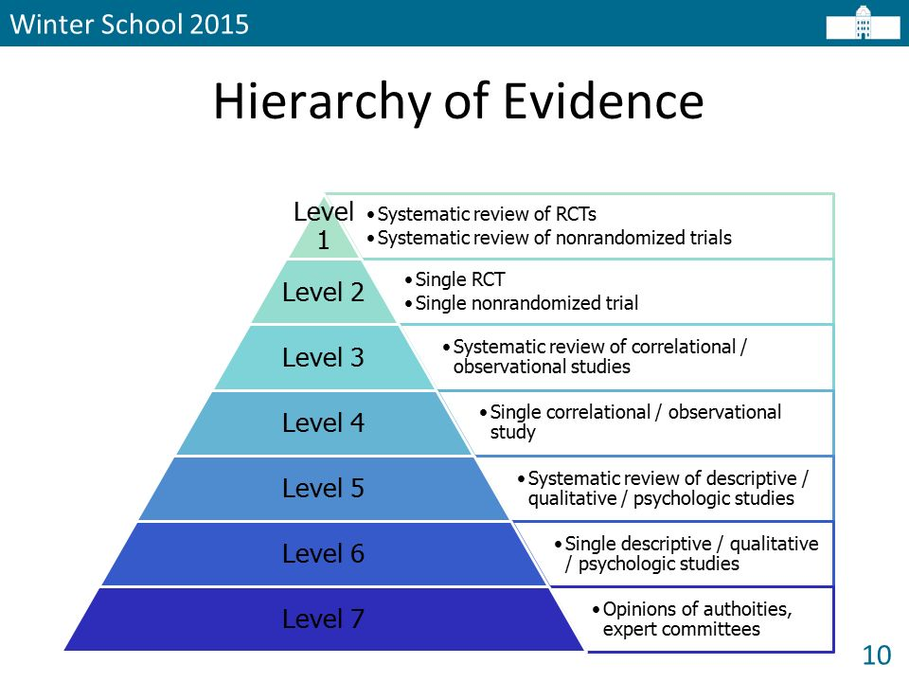
Notes:
This determines the strength of evidence – level 1 is the highest level of evidence on which to base practice change and level 7 is the lowest level on which to base practice change.

Slide 15
PICOT Question…
P ⎯ Population of interest
I ⎯ Intervention or area of interest
C ⎯ Comparison intervention or group
O ⎯ Outcome
T ⎯ Time Frame

Slide 16
PICOT question
Do patients with cancer pain experience improved pain management and decreased pain intensity if cared for by palliative care team, over the next 6 months?
P: Adult patient with cancer pain
I: Palliative care consultation for pain management
C: No referral to palliative care team
O: Improved pain management, decreased pain intensity
T: 6 months

Slide 17
Practice Question
Which of the following statements accurately describes an element of the PICOT format?
P = Patient
I = Improvement
O = Opportunity
T= Theory
Notes:
Answer: A - P = patient population of interest
I = Intervention not improvement
O = Outcomes not opportunity
T = Time not theory

Slide 18
Practice Question
The highest level of evidence is which of the following levels?
Level 1
Level 2
Level 5
Level 7
Notes:
Answer – A = highest level of evidence on which to base practice change – systemic reviews of randomized clinical trials (RCT)
Level 2 = single site RCT
Level 5 = systemic review of descriptive or qualitative studies
Level 7 = lowest level of evidence to base practice change – expert opinion

Slide 19
Practice Questions
EBP is most valuable when which of the following occurs?
outcomes are disseminated
clinical practice changes
incorporated into EBP grand rounds
presented at a national conference
Notes:
Answer – B – impact on clinical practice and patient outcomes are most important and valuable components of EBP
Outcomes should be disseminated such as through grand rounds and national conferences but EBP is most valuable when clinical practice changes occur

Slide 20
References
Brant, J. (2020). Core Curriculum for Oncology Nursing. 6th ed. St. Louis, MO: Elsevier.
Knowles, M. S. (1996). Adult learning. The ASTD Training & Development Handbook: A Guide to Human Resource Development.
Melynk, B. M., Fineout-Overholt, E. (2011). Evidence-based practice in nursing & healthcare: A guide to best practice. Phila. PA: Lippincott Williams & Wilkins.
Melynk, B. M., Fineout-Overholt, E., Stillwell, S. B., Williamson, K. M. (2010). The 7 steps of evidence-based practice. AJN. 110(1), 51-53.

Slide 21

Any Questions?

