Slide 1
Physical Therapist Practice
Stephen Kareha, DPT, ATC, PhD, FASPT
Board Certified in Orthopaedic Physical Therapy
Jeffrey Bays, DPT
Board Certified in Orthopaedic Physical Therapy

Slide 2
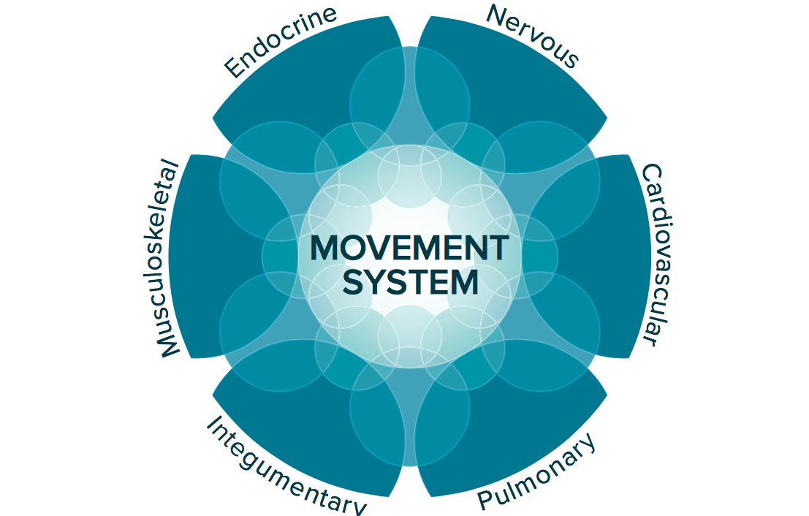
Movement
Essential
Multisystem
Complicated action
Sahrmann SA. Phys Ther. 2014;94(7):1034-1042.
The American Physical Therapy Association.2015:1-4.
Notes:
Movement is essential for interaction of an individual within their environment
Movement is a complicated action comprised of multiple human body systems far beyond the MS and nervous systems

Slide 3
The Movement System
Mobility
Motor Control
Force
Energy
McClure et al, 2021
Notes:
Human movement requires mobility, motor control, force, and energy. Therefore, the movement system is comprised of mobility, motor control, force, and energy.

Slide 4
The Movement System
Mobility
Motor Control
Force
Energy
McClure et al, 2021
Notes:
Human movement requires mobility, motor control, force, and energy. Therefore, the movement system is comprised of mobility, motor control, force, and energy.

Slide 5
Experts in the Movement System
Mobility
Motor Control
Force
Energy
Physiologic
Accessory
Facilitated
Static
Strength
Power
Endurance
Dynamic
Circulation
Breathing
Notes:
Human movement requires mobility, motor control, force, and energy. Therefore, the movement system is comprised of mobility, motor control, force, and energy.

Slide 6
International Classification of Function Model
Health Condition (Pathology)
Body Structures/Function (Impairments)
Activity
(Functional Tasks)
Participation (Social)
Environmental Factors
Personal Factors

Slide 7
International Classification of Function Model
Health Condition (Pathology)
Mobility
Motor Control
Force
Energy
Body Structures/Function (Impairments)
Activity
(Functional Tasks)
Participation (Social)
Environmental Factors
Personal Factors

Slide 8
International Classification of Function Model
Health Condition (Pathology)
Mobility
Motor Control
Force
Energy
Body Structures/Function (Impairments)
Activity
(Functional Tasks)
Participation (Social)
Environmental Factors
Personal Factors

Slide 9
The Movement System within Patient Management
Environmental Factors
Functional Neuroplasticity
Movement System
Pathology
Mobility
Motor Control
Force
Energy
Personal Factors
Notes:
The animations on this slide fade from movement system only into the entire complex of what we evaluate.

Slide 10
The Movement System within Patient Management
Environmental Factors
Functional Neuroplasticity
Movement System
Pathology
Mobility
Motor Control
Force
Energy
Personal Factors
Notes:
The animations on this slide fade from movement system only into the entire complex of what we evaluate.

Slide 11
The Movement System within Patient Management
Environmental Factors
Functional Neuroplasticity
Movement System
Pathology
Personal Factors

Slide 12
Physical Therapists
ARE
the experts of
the Movement System!

Slide 13
A Physical Therapist’s Job
Figure out:
  Patient needs → Diagnosis
  How to meet those needs → Management

Slide 14
What is the purpose
of an evaluation?

Slide 15
Purpose = Do Our Job
Figure out:
  Patient needs → Diagnosis
  How to meet those needs → Management

Slide 16
Physical Therapist Practice
Patient Needs
Diagnosis
Treatment Options
Treat
Reassess
Fears/Concerns
Expectations
Comparable Sign
Dysfunctional Neuroplasticity
Pathology
Movement
Treat & Refer
Refer
Comparable Sign
History & Physical Exam
Cycle must be completed at least once per visit and may occur 10+ times in a single visit
Notes:
Application of patient needs analysis to the movement system within the patient management model. Patient needs including their fears, concerns, expectations, history, and relevant comparable signs are systematically obtained and/or observed qualitatively while diagnostic hypotheses are developed to explain abnormal findings. These hypotheses guide the selection of tests and measures performed during the physical examination. After testing the diagnostic hypotheses to rule out all differential diagnoses, a diagnosis can be provided to the patient to fulfil their needs. The discussion with the patient then encompasses the diagnosis in terms they understand; all relevant options for appropriate care; the expected length, cost, and outcome of each option. Specifically, the diagnosis made by the physical therapist should directly lead to matched intervention strategies and ultimately reassessment of relevant comparable sign.

Slide 17
Physical Therapist Practice
Patient Needs
Diagnosis
Treatment Options
Reassess
History & Physical Exam
Cycle must be completed at least once per visit and may occur 10+ times in a single visit
Notes:
Application of patient needs analysis to the movement system within the patient management model. Patient needs including their fears, concerns, expectations, history, and relevant comparable signs are systematically obtained and/or observed qualitatively while diagnostic hypotheses are developed to explain abnormal findings. These hypotheses guide the selection of tests and measures performed during the physical examination. After testing the diagnostic hypotheses to rule out all differential diagnoses, a diagnosis can be provided to the patient to fulfil their needs. The discussion with the patient then encompasses the diagnosis in terms they understand; all relevant options for appropriate care; the expected length, cost, and outcome of each option. Specifically, the diagnosis made by the physical therapist should directly lead to matched intervention strategies and ultimately reassessment of relevant comparable sign.

Slide 18
Physical Therapist Practice
Patient Needs
Diagnosis
Treatment Options
Reassess
History & Physical Exam
Cycle must be completed at least once per visit and may occur 10+ times in a single visit
Notes:
Application of patient needs analysis to the movement system within the patient management model. Patient needs including their fears, concerns, expectations, history, and relevant comparable signs are systematically obtained and/or observed qualitatively while diagnostic hypotheses are developed to explain abnormal findings. These hypotheses guide the selection of tests and measures performed during the physical examination. After testing the diagnostic hypotheses to rule out all differential diagnoses, a diagnosis can be provided to the patient to fulfil their needs. The discussion with the patient then encompasses the diagnosis in terms they understand; all relevant options for appropriate care; the expected length, cost, and outcome of each option. Specifically, the diagnosis made by the physical therapist should directly lead to matched intervention strategies and ultimately reassessment of relevant comparable sign.

Slide 19
Patient Needs
Fears/Concerns
What is your greatest concern about your [problem]?
Expectations
If I can magically fix you overnight, how would you test it tomorrow morning to prove that it really is fixed
Comparable sign*
Control
Amount
Speed
Symmetry
Symptoms
What do you think is going on?
What do you think will fix the problem?
What have you already tried? Or What do you feel won’t work?
What is wrong with me?
Will it get better?
*AKA
Asterisk sign
Functional Movement Task
Concordant sign
Test-Retest Outcomes
Baseline

Slide 20
Patient Needs
Fears/Concerns
Expectations
Comparable sign*

Slide 21
Fears & Concerns
What is your greatest concern about your [problem]?
  Worry over not knowing what’s wrong
  Concern at no signs of improvement
  Wanting to avoid painkillers or surgery
  Fear of becoming a burden on others
  Fear of no longer being able to perform family/work role
  Fear that this is permanent
  Fear that this will worsen
What is wrong with me?
Will it get better?
Fears/Concerns
Expectations
Comparable sign*

Slide 22
Expectations
Overt Expectations
Hidden Expectations
Fears/Concerns
Expectations
Comparable sign*

Slide 23
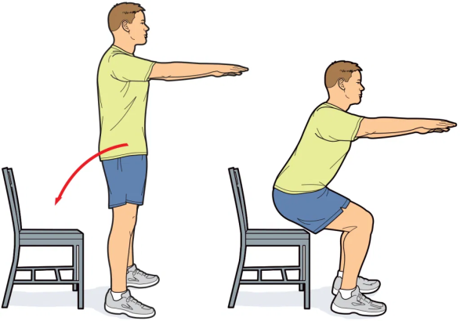

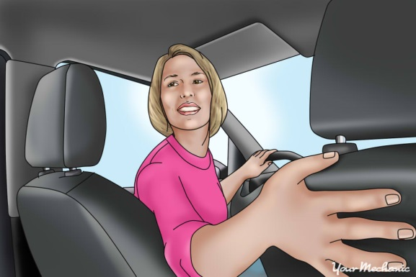
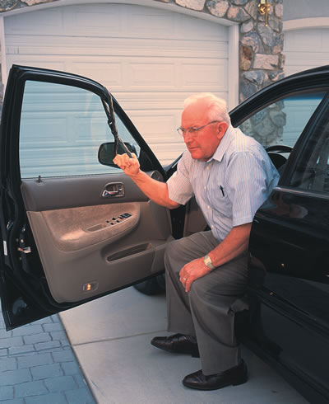
Comparable Sign
Control
Amount
Speed
Symmetry
Symptoms
Fears/Concerns
Expectations
Comparable sign*
*AKA
Asterisk sign
Functional Movement Task
Concordant sign
Test-Retest Outcomes
Baseline
Observable Task
McClure et al, PTJ, 2021
Notes:
Signs to measure to see if progress/regression occurs
*AKA
Asterisk sign
Functional Movement Task
Concordant sign
Test-Retest Outcomes
Baseline

Slide 24


Slide 25
Physical Therapist Practice
Patient Needs
Diagnosis
Treatment Options
Reassess
History & Physical Exam
Cycle must be completed at least once per visit and may occur 10+ times in a single visit
Notes:
Application of patient needs analysis to the movement system within the patient management model. Patient needs including their fears, concerns, expectations, history, and relevant comparable signs are systematically obtained and/or observed qualitatively while diagnostic hypotheses are developed to explain abnormal findings. These hypotheses guide the selection of tests and measures performed during the physical examination. After testing the diagnostic hypotheses to rule out all differential diagnoses, a diagnosis can be provided to the patient to fulfil their needs. The discussion with the patient then encompasses the diagnosis in terms they understand; all relevant options for appropriate care; the expected length, cost, and outcome of each option. Specifically, the diagnosis made by the physical therapist should directly lead to matched intervention strategies and ultimately reassessment of relevant comparable sign.

Slide 26
History & Physical Examination
Build hypotheses based upon history (80%)
Rule out/confirm hypotheses with additional questions & physical exam tests
History & Physical exam must include
  Functional Neuroplasticity
  Review of Systems for Pathology
  Movement System

Slide 27
Diagnosis
Cultural
Social
Environmental Factors
Working Hypothesis
Working Diagnosis
Provisional Classification
Functional Neuroplasticity
Movement System
Pathology
Personal Factors
Beliefs
Psychological

Slide 28
Diagnosis
Environmental Factors
Working Hypothesis
Working Diagnosis
Provisional Classification
Functional Neuroplasticity
Movement System
Pathology
Personal Factors

Slide 29
Personal Factors
Personal Factors
Beliefs
Psychological

Slide 30
Environmental Factors
Cultural
Social
Environmental Factors
Personal Factors
Beliefs
Psychological

Slide 31
Diagnosis
Cultural
Social
Environmental Factors
Working Hypothesis
Working Diagnosis
Provisional Classification
Functional Neuroplasticity
Movement System
Pathology
Personal Factors
Beliefs
Psychological

Slide 32
Diagnosis
Cultural
Social
Environmental Factors
Working Hypothesis
Working Diagnosis
Provisional Classification
Functional Neuroplasticity
Movement System
Pathology
Safety/Precautions
Prognosis
Personal Factors
Beliefs
Psychological

Slide 33
Pathology (Review of Systems)
Safety/Precautions
Prognosis
Best Provider
Integumentary
Musculoskeletal
Lymphatic/ Cardiopulmonary
Gastrointestinal
Endocrine
Genitourinary
Neurologic
Notes:
Purpose of understanding pathology is to know
When and when not to refer to another provider and, more specifically, to the best provider for that patient
What to avoid and how to protect healing tissues
How long recovery will take (or if it will occur

Slide 34
Review of Systems
Constitutional | Negative for chills and fever.
HENT | Negative for drooling, ear discharge, ear pain, facial swelling, hearing loss and sore throat.
Eyes | Negative for pain and visual disturbance.
Respiratory | Negative for cough and shortness of breath.
Cardiovascular | Negative for chest pain and palpitations. See vital signs for details.
Gastrointestinal | Negative for abdominal pain, diarrhea, nausea and vomiting.
Geniotourinary | Negative for dysuria and hematuria.
Musculoskeletal | Negative for arthralgias and back pain.
Skin | Negative for color change and rash.
Neurological | Negative for dizziness, seizures and syncope.
Other | All other systems reviewed and are negative.
Notes:
Example of a full review of systems
Remember, 80% of diagnosis is determined by history. Most, if not all, of the review of systems is completed via a thorough history, observational skills, and vital signs.

Slide 35
Diagnosis
Cultural
Social
Environmental Factors
Working Hypothesis
Working Diagnosis
Provisional Classification
Functional Neuroplasticity
Movement System
Pathology
Intensity of Intervention
Safety/Precautions
Prognosis
Intervention
Type
Personal Factors
Beliefs
Psychological

Slide 36
Functional Neuroplasticity
Prognosis
Broad Scope of Intervention
Intensity of Intervention
Nociceptive
Peripheral Neuropathic
Nociplastic
No Dysfunctional Neuroplasticity
Notes:
Not mutually exclusive, but one is usually dominant
Purpose of understanding pain is to know
How long recovery will take (or if it will occur)
The best overarching focus of intervention (tissue vs. neurodynamic vs. central mechanisms)
Determine intensity of interventions and how fast to progress

Slide 37
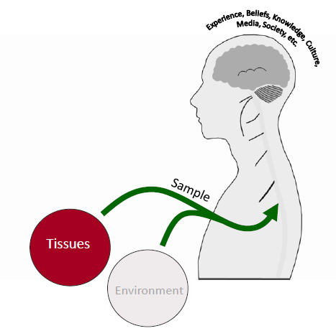
Nociceptive Pain/Symptoms
Tissue Issues
55% of patients are nociceptive dominant
Symptom/Exam Cluster:
  Proportionate pain/symptoms
  Aggravating and easing factors
  Intermittent sharp, dull ache or throb at rest
  No night pain, dysesthesia, burning, shooting or electric
100x
Smart et al, 2012; Gifford 1998; Louw 2022

Slide 38
SINSS
Prognosis
Intensity of Intervention
Severity/Tissue Irritability – low, moderate, high
Nature - Tissue Healing times
Stage – acute, subacute, chronic
Stability – stable, progressing, unstable

Slide 39
Tissue Irritability
 | High | Moderate | Low
Worst Pain | High pain (≥7/10) | Moderate pain (4-6/10) | Low pain (≤3/10)
Resting Pain | Consistent night or resting pain | Intermittent night or resting pain | Absent night or resting pain
Ease of Aggravation | Pain before end of ROM | Pain at end of ROM | Minimal pain with overpressure
Ability to Move | AROM < PROM | AROM ~ PROM | AROM = PROM
Disability | High disability | Moderate disability | Low disability
Kareha et al, 2021
Notes:
The shoulder symptom irritability scale is broken up into three categories: high, moderate, and low. Each category is based upon criteria including pain level, presence of night or resting pain; onset of pain during motion; comparison of active and passive mobility; and disability level. Each category is considered to be mutually exclusive which means while a patient may have some qualities of different categories there will be one particular category that stands out the most for each patient.

Slide 40
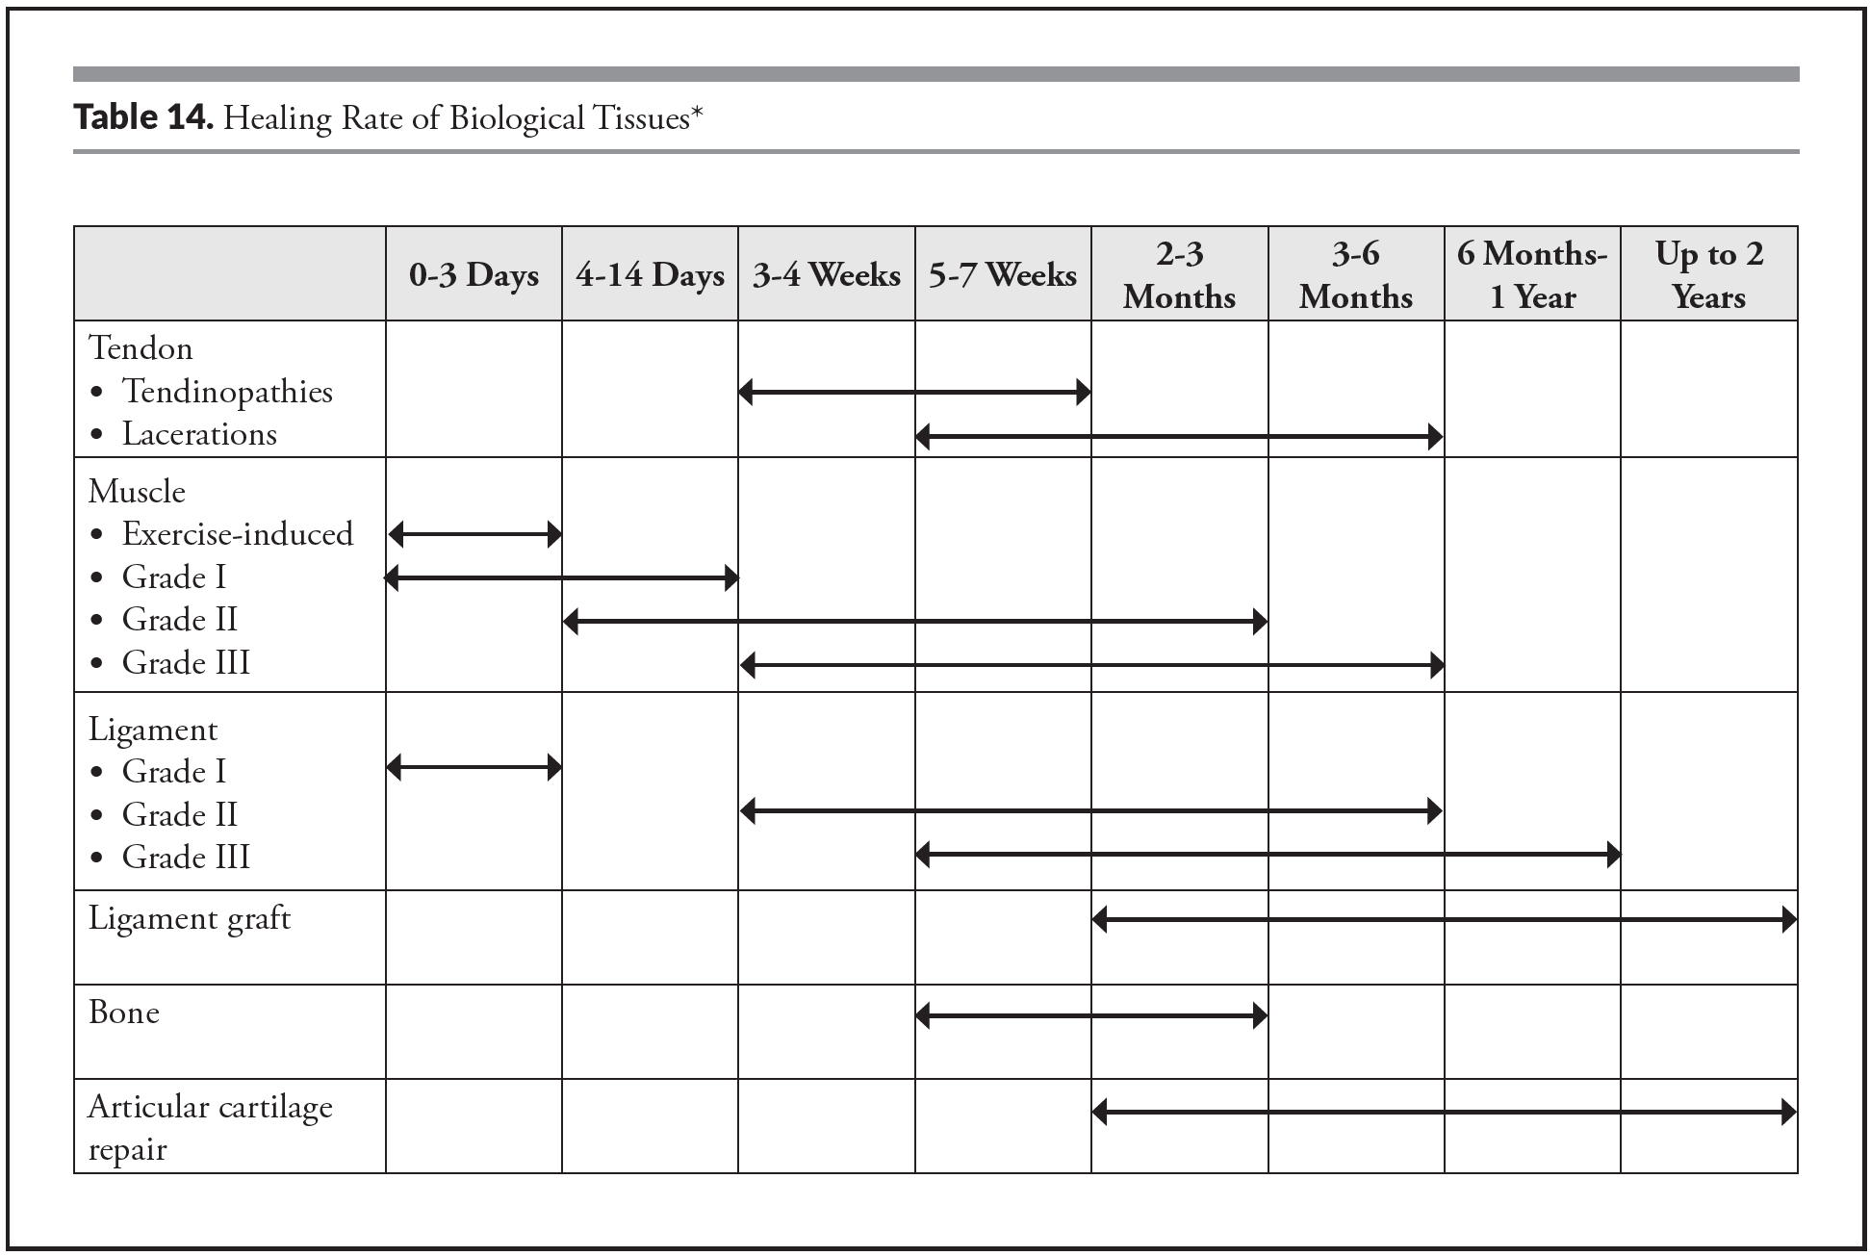
Tissue Healing Times
Seymour et al, 2021

Slide 41
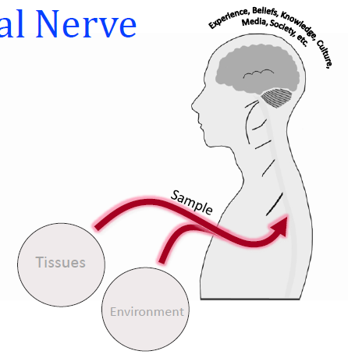
Neuropathic Pain/Symptoms
25% of patients are peripheral neuropathic dominant
Symptom/Exam Cluster:
  Pain/Symptoms in dermatomal or cutaneous distribution
  Positive neurodynamic & palpation (mechanical tests)
  History of nerve pathology or compromise
150x
Smart et al, 2012; Gifford 1998; Louw 2022

Slide 42
SINSS
Severity/Neurodynamic Irritability – low, moderate, high
Nature – neuropraxia, axonotmesis, neurontmesis
Stage – acute, subacute, chronic
Stability – stable, progressing, unstable

Slide 43
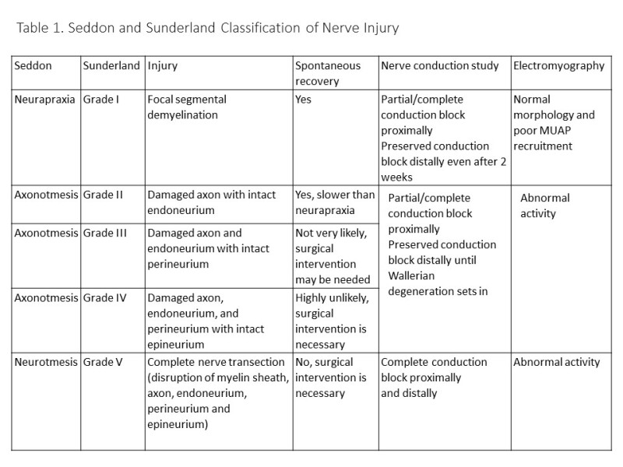
Nature
https://www.ncbi.nlm.nih.gov/books/NBK557746/figure/article-25766.image.f1/

Slide 44
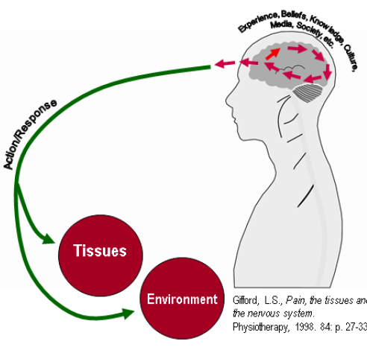
Nociplastic Pain/Symptoms
20% of patients are nociplastic dominant
Symptom/Exam Cluster:
  Disproportionate pain/symptoms
  Disproportionate aggravating and easing factors
  Diffuse palpation tenderness
  Psychosocial issues
486x
Smart et al, 2012; Gifford 1998; Louw 2022

Slide 45
SINSS
Severity/Symptom Irritability – low, moderate, high
Nature – need to fully rule out
Stage – need to fully rule out
Stability – stable, progressing, unstable

Slide 46
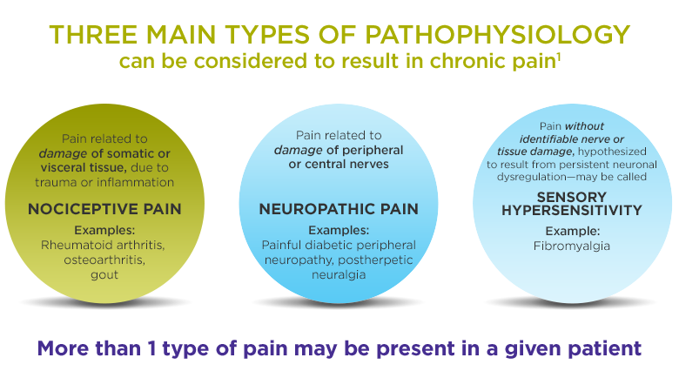
Broad Scope of Intervention
NOCICEPTIVE
NEUROPATHIC
NOCIPLASTIC
Ankle Sprain
Rotator cuff strain
Lumbar lateral shift
Cervical Radiculopathy
Lumbar Radiculopathy
Painful herpetic neuralgia
Phantom Limb Pain
CRPS
Tissue Specific Interventions
  SINSS
PNE only if fear avoidance or pain catastrophizing
Neurodynamic Interventions
  Space
  Movement
  Blood
PNE
Think BIG
PNE+
  Cognitive: PNE, CBT, ACT…
  Movement
  Sleep
  Goals
Louw 2022

Slide 47
Diagnosis
Cultural
Social
Environmental Factors
Working Hypothesis
Working Diagnosis
Provisional Classification
Functional Neuroplasticity
Movement System
Pathology
Intensity of Intervention
Safety/Precautions
Intervention Methods
Prognosis
Intervention
Type
Best
Provider
Personal Factors
Beliefs
Psychological

Slide 48
Movement
Specific Type of Intervention
Best Provider
**Must Stress Fully Rule In/Out**
Motion
Motor Control
Force
Energy
Physiologic
Accessory
Facilitated
Static
Strength
Power
Endurance
Dynamic
Circulation
Breathing
Motion
Motor Control
Force
Energy
Physiologic
Accessory
Facilitated
Static
Strength
Power
Endurance
Dynamic
Circulation
Breathing
Notes:
Purpose of understanding movement is to know
When and when not to refer to another provider and, more specifically, to the best provider for that patient
What movement interventions can be provided to address the problem – this is the aspect of diagnosis a physical therapist is able to provide better than any other provider
It is imperative to stress each component fully given pain and pathology to fully rule in/out.

Slide 49
Movement
Specific Type of Intervention
Best Provider
**Must Stress Fully Rule In/Out**
Motion
Motor Control
Force
Energy
Physiologic
Accessory
Facilitated
Static
Strength
Power
Endurance
Dynamic
Circulation
Breathing
Notes:
Purpose of understanding movement is to know
When and when not to refer to another provider and, more specifically, to the best provider for that patient
What movement interventions can be provided to address the problem – this is the aspect of diagnosis a physical therapist is able to provide better than any other provider
It is imperative to stress each component fully given pain and pathology to fully rule in/out.

Slide 50
Movement
Specific Type of Intervention
Best Provider
**Must Stress Fully Rule In/Out**
Motion
Motor Control
Force
Energy
Physiologic
Accessory
Facilitated
Static
Strength
Power
Endurance
Dynamic
Circulation
Breathing
Notes:
Purpose of understanding movement is to know
When and when not to refer to another provider and, more specifically, to the best provider for that patient
What movement interventions can be provided to address the problem – this is the aspect of diagnosis a physical therapist is able to provide better than any other provider
It is imperative to stress each component fully given pain and pathology to fully rule in/out.

Slide 51
Understanding the Movement System
Motion
Motor Control
Force
Energy
Physiologic
Accessory
Facilitated
Static
Strength
Power
Endurance
Dynamic
Circulation
Breathing
McClure et al, PTJ, 2021
Notes:
We need to understand the movement system inside and out!

Slide 52
Evaluation & Management
Movement Element | Common Tests and Measures | Common Intervention Strategies
Motion | Passive ROM Specific tests for muscle length Accessory Motion tests Soft-tissue mobility tests assessed by palpation Skin mobility Neurodynamic tests | Active stretching Passive stretching Stretching combined with muscle activation followed by relaxation (hold-relax, etc) Manual therapy including joint mobilization/manipulation and soft-tissue techniques Low-load prolonged stress via static positioning or splinting Neural gliding and tensioning techniques
McClure et al, PTJ, 2021

Slide 53
Understanding the Movement System
Motion
Motor Control
Force
Energy
Physiologic
Accessory
Facilitated
Static
Strength
Power
Endurance
Dynamic
Circulation
Breathing
McClure et al, PTJ, 2021
Notes:
We need to understand the movement system inside and out!

Slide 54
Evaluation & Management
Movement Element | Common Tests and Measures | Common Intervention Strategies
Motor Control | Performance based measures ( eg, 5 times sit to stand) Assess task initiation, execution and termination Determine abnormal movement Biomechanical analyses of multi-joint system Determine compensations Change task, environmental demands to determine if patient can change their movements and minimize compensations Feedforward control- measure/characterize speed, accuracy and kinematics Feedback control- determine response to unexpected perturbations Sensory-perceptual and cognitive testing | Impairment restitution- to provide resources (eg, ROM) for task execution. Task practice: Alter task, environmental demands, instructions and manual cues to minimize compensations Allow exploration and movement discovery High-intensity, high-dose skill practice Optimal challenge during practice- altering speed, perturbations, concurrent cognitive challenge Targeted treatments to improve perception and cognition in the context of task practice (eg, virtual reality)
McClure et al, PTJ, 2021

Slide 55
Understanding the Movement System
Motion
Motor Control
Force
Energy
Physiologic
Accessory
Facilitated
Static
Strength
Power
Endurance
Dynamic
Circulation
Breathing
McClure et al, PTJ, 2021
Notes:
We need to understand the movement system inside and out!

Slide 56
Evaluation & Management
Movement Element | Common Tests and Measures | Common Intervention Strategies
Force | Manual Muscle testing Hand-held dynamometry Repetition Maximum testing Isokinetic testing Functional Performance testing | Force generating capacity Isometric muscle activation to restore muscle function, and reduce muscle atrophy following injury or immobilization. Isometric co-contraction to promote joint stability for function. Isolated resisted concentric and eccentric muscle strengthening. Alter range of motion amount and load magnitude to advance force generating capacity demand. Force control Advance movement tasks from simple, single plane movement to complex, multi-plane movement Vary load magnitude and movement duration demands to meet individual functional requirements. Incorporate power training to improve the rate of force development for an individual’s functional demands.
McClure et al, PTJ, 2021

Slide 57
Understanding the Movement System
Motion
Motor Control
Force
Energy
Physiologic
Accessory
Facilitated
Static
Strength
Power
Endurance
Dynamic
Circulation
Breathing
McClure et al, PTJ, 2021
Notes:
We need to understand the movement system inside and out!

Slide 58
Evaluation & Management
Movement Element | Common Tests and Measures | Common Intervention Strategies
Energy | Aerobic capacity/endurance during functional activities, mobility, gait, or standardized exercise test protocols Circulation, including vital signs, electrocardiography, auscultation, signs and symptoms of poor perfusion, at rest and during activity Muscle performance, including strength and endurance Ventilation and respiration, including respiratory rate and depth, auscultation, pulse oximetry, gas analysis, signs and symptoms of dyspnea, increased work of breathing, or poor gas exchange at rest and during activity | Therapeutic exercise, including Continuous or interval exercise programs designed to improve aerobic capacity and/or endurance Resistance training to improve muscle performance Inspiratory muscle training in certain populations Functional training, including gait and mobility training Airway clearance techniques, if retained secretions limit endurance Patient instruction, including Self monitoring of intensity, signs and symptoms Energy conservation techniques, including pacing, modifying tasks and/or the environment, etc.
McClure et al, PTJ, 2021

Slide 59
Movement
Specific Type of Intervention
Best Provider
**Must Stress Fully Rule In/Out**
Motion
Motor Control
Force
Energy
Physiologic
Accessory
Facilitated
Static
Strength
Power
Endurance
Dynamic
Circulation
Breathing
Motion
Motor Control
Force
Energy
Physiologic
Accessory
Facilitated
Static
Strength
Power
Endurance
Dynamic
Circulation
Breathing
Notes:
Purpose of understanding movement is to know
When and when not to refer to another provider and, more specifically, to the best provider for that patient
What movement interventions can be provided to address the problem – this is the aspect of diagnosis a physical therapist is able to provide better than any other provider
It is imperative to stress each component fully given pain and pathology to fully rule in/out.

Slide 60
Physical Therapist Practice
Patient Needs
Diagnosis
Treatment Options
Reassess
History & Physical Exam
Cycle must be completed at least once per visit and may occur 10+ times in a single visit
Notes:
Application of patient needs analysis to the movement system within the patient management model. Patient needs including their fears, concerns, expectations, history, and relevant comparable signs are systematically obtained and/or observed qualitatively while diagnostic hypotheses are developed to explain abnormal findings. These hypotheses guide the selection of tests and measures performed during the physical examination. After testing the diagnostic hypotheses to rule out all differential diagnoses, a diagnosis can be provided to the patient to fulfil their needs. The discussion with the patient then encompasses the diagnosis in terms they understand; all relevant options for appropriate care; the expected length, cost, and outcome of each option. Specifically, the diagnosis made by the physical therapist should directly lead to matched intervention strategies and ultimately reassessment of relevant comparable sign.

Slide 61

Treatment Options
What is wrong with me?
What are my options?
How can you help me?
How long will it take?
How much will it cost?
Gifford 2014
Notes:
The patient’s Greatest Concern must be a consistent throughline in each component

Slide 62
What is wrong with me?
Patient (or you) has [movement problem], [dysfunctional neuroplasticity] and [pathology] resulting in [greatest concern]
Example:
  Patient (or you) has [lumbar hypomobility with directional preference for extension], [peripheral neuropathic pain] and [L5 radiculopathy] resulting in [not being able to sit on a plane for 6 hours to go on vacation]

Slide 63
What are my options?
Throughline: Greatest Concern

Slide 64
How can you help me?
Throughline: Greatest Concern
Treat
Co-Manage
Refer

Slide 65
How long will it take?
Throughline: Greatest Concern

Slide 66
How much will it cost?
Throughline: Greatest Concern
Money
Time
Quality of life

Slide 67
Physical Therapist Practice
Patient Needs
Diagnosis
Treatment Options
Reassess
History & Physical Exam
Cycle must be completed at least once per visit and may occur 10+ times in a single visit
Notes:
Application of patient needs analysis to the movement system within the patient management model. Patient needs including their fears, concerns, expectations, history, and relevant comparable signs are systematically obtained and/or observed qualitatively while diagnostic hypotheses are developed to explain abnormal findings. These hypotheses guide the selection of tests and measures performed during the physical examination. After testing the diagnostic hypotheses to rule out all differential diagnoses, a diagnosis can be provided to the patient to fulfil their needs. The discussion with the patient then encompasses the diagnosis in terms they understand; all relevant options for appropriate care; the expected length, cost, and outcome of each option. Specifically, the diagnosis made by the physical therapist should directly lead to matched intervention strategies and ultimately reassessment of relevant comparable sign.

Slide 68
Comparable Sign
Control
Amount
Speed
Symmetry
Symptoms
McClure et al, PTJ, 2021
Notes:
Signs to measure to see if progress/regression occurs
*AKA
Asterisk sign
Functional Movement Task
Concordant sign
Test-Retest Outcomes
Baseline

Slide 69
Patient 1
Patient Needs
Diagnosis
Treatment Options
Reassess
History & Physical Exam
62 y/o female s/p THA anterior approach,
hx of CRPS in UE.
Currently allodynia & pain t/o anterior thigh

Slide 70
Patient 1: Patient Needs
Fears/Concerns
What is your greatest concern about your thigh pain? That it will never get better
Expectations
If I can magically fix you overnight, how would you test it tomorrow morning to prove that it really is fixed – sleep, work, walk, wear normal clothes
Comparable signs
Walking 2 miles
What do you think is going on? CRPS
What do you think will fix the problem? Not sure
What have you already tried? Or What do you feel won’t work? Last time she did e-stim, eventually improved
Will it get better? Most likely with appropriate treatment
What is wrong with me? CRPS
Working as full-time professor
Wear baggy pants
Sleep through night

Slide 71
Patient 1: History & Physical Exam
Key History
History of CRPS in R UE
Recent THA, rehab not going well
Poor experience with another PT
Allodynia with clothing touching thigh
Pain is getting worse
Location of Pain: Throughout R LE, especially R thigh
Intensity/Quality: Severe, burning, gnawing
Time/Position: Pressure/touch is worse
Aggravating: All positions/movements
Alleviating: Opioids do a little
Environmental: Poor experience with another PT
Personal: Anxiety, depression, history of CRPS in UE
Location of Pain: Throughout R LE, especially R thigh
Physical Exam | Measure
Laterality | 2.4s on R, 50% accuracy on R
Light touch | Poor sensation throughout R thigh
Graphesthesia | Poor throughout R thigh
Hip flexion strength | 2/5 (unable to perform SLR against gravity)
Hip Abd PROM | R 45, L 30
Hip Flex PROM | R 130, L 100
Hip ER PROM | R 45, L 30
Hip IR PROM | R 10, L 10

Slide 72
Patient 1:
Diagnosis
Cultural – pain viewed as damage
Social – stigma, perception of malingering
Environmental Factors
Functional Neuroplasticity:
Nociplastic Dominant
Movement System:
Pathology (ROS): CRPS
Safety/Precautions: Fear/Anxiety
Prognosis: 6-12 months
Best Provider: PCP, DPT, PsyD, Pain Medicine, Sleep Medicine, Nutritionist
Specific: PNE, GMI, Sleep, Nutrition
Best Provider: PCP, DPT, PsyD, Pain Medicine
Prognosis: 6-12 months
Broad: PNE+
Intensity of Intervention: Graded
Personal Factors
Psychological – anxiety, shame due to social implications
Beliefs – never get better

Slide 73
Patient 1: Treatment Options
What is wrong with me?
  Motor control deficits due to nociplastic pain from CRPS resulting in inability to wear pants and sleep with contact with bed sheets
What are my options?
  DRG stimulation, PNE, GMI, Graded exposure, laser
How can you help me?
  Co-manage with PCP, PsyD, Pain Medicine, Sleep Medicine, Nutritionist
How long will it take?
  6-12 months
How much will it cost?
  $4800 for PT, $50,000 for pain mgmt
Treat & Refer

Slide 74
The Movement System
Element | Measure | Intervention
Mobility | Hip Abd 20° | PROM Mobilizations Manual stretching Monitor post-op precautions
 | Hip Flex 70°
 | Hip ER 20°
 | Hip IR 0°
Motor Control | Unable to SLR | Biofeedback
 | Trendelenberg gait | Gait training Biofeedback
Force | Hip flexion 2/5 | Progressive strengthening
 | Hip abduction 1/5
 | Hip extension 3/5
Energy | Amb 200’ w/ RW | Progressive endurance exercise
Mobility
Motor Control
Force
Energy
Notes:
In this case, mobility is the most limiting impairment

Slide 75
Patient 1: Reassess Comparable Signs
Comparable Sign | Current Status
Walking 2 miles | walking better
Working as full-time professor | ¼ time
Wear baggy pants | No better
Sleep through night | Fluctuates, no better
Notes:
Walking 2 miles – walking better
Working as full-time professor – ¼ time
Wear baggy pants – no better
Sleep through night – fluctuates, no better

Slide 76
Physical Therapist Practice
Patient Needs
Diagnosis
Treatment Options
Treat
Reassess
Fears/Concerns
Expectations
Comparable Sign
Dysfunctional Neuroplasticity
Pathology
Movement
Treat & Refer
Refer
Comparable Sign
History & Physical Exam
Cycle must be complete at least once per visit and may occur 10+ times in a single visit

Slide 77
Patient 2
17 y/o male with ACL tear
Patient Needs
Diagnosis
Treatment Options
Treat & Refer
Reassess
Wrestling career is over
I want to get back to running & wrestling in 2 months
Knee ROM
Nociceptive Dominant
ACL tear/repair
Mobility, Motor control, Force, Energy
Comparable Signs as below
Quad lag
Squat
Lateral step down
Hop testing
Running
Wrestling
History & Physical Exam

Slide 78
Patient Needs
Fears/Concerns
What is your greatest concern about your [problem]?
Expectations
If I can magically fix you overnight, how would you test it tomorrow morning to prove that it really is fixed
Comparable sign*
Control
Amount
Speed
Symmetry
Symptoms
What do you think is going on?
What do you think will fix the problem?
What have you already tried? Or What do you feel won’t work?
What is wrong with me?
Will it get better?
*AKA
Asterisk sign
Functional Movement Task
Concordant sign
Test-Retest Outcomes
Baseline

Slide 79
Patient 2: Patient Needs
Fears/Concerns
What is your greatest concern about your knee pain/surgery? I’ll never return to wrestling
Expectations
If I can magically fix you overnight, how would you test it tomorrow morning to prove that it really is fixed – return to wrestling & running
Comparable signs
What do you think is going on? Tore my ACL
What do you think will fix the problem? Surgery
What have you already tried? Nothing, I tore my ACL! What do you feel won’t work? Non-operative treatment
Will it get better? Yes with surgery & rehab
What is wrong with me? ACL tear/reconstruction
Knee ROM
Quad lag
Squat
Hop testing
Running
Wrestling
Lateral step down

Slide 80
Diagnosis
Cultural
Social
Environmental Factors
Working Hypothesis
Working Diagnosis
Provisional Classification
Dysfunctional Neuroplasticity
Movement System
Pathology (Review of Systems)
Safety/Precautions
Prognosis
Best Provider
Prognosis
Broad Scope of Intervention
Intensity of Intervention
Specific Type of Intervention
Best Provider
Personal Factors
Beliefs
Psychological

Slide 81
Patient 2:
Diagnosis
Cultural – pain weakness leaving body
Social – must get back to sport
Environmental Factors
Dysfunctional Neuroplasticity: Nociceptive Dominant
Movement System:
Pathology (ROS): ACL tear/repair
Safety/Precautions: ACL graft protection
Prognosis: 9-12 months
Best Provider: PCP, DPT, Ortho Surgeon, Sports PsyD
Specific: mobility, motor control → ACLR → mobility, motor control, strength, endurance
Best Provider: PCP, DPT, Ortho Surgeon, Sports PsyD
Prognosis: 9-12 months
Broad: Tissue Specific Interventions
Intensity of Intervention: Tissue healing dependent
Personal Factors
Beliefs – will be stronger
Psychological – fear of no return to sport

Slide 82
Treatment Options
What is wrong with me?
What are my options?
How can you help me?
How long will it take?
How much will it cost?
Gifford 2014
Notes:
The patient’s Greatest Concern must be a consistent throughline in each component

Slide 83
Patient 2: Treatment Options
Treat & Refer
What is wrong with me? ACL tear, reconstruction, neuromotor weakness, ROM loss
What are my options? Surgery or non-op
How can you help me? Pre-op – improve mobility & strength; refer to surgeon; post-op restore mobility and motor control, build strength & endurance
How long will it take? 9 months for return to sport
How much will it cost? Surgery – 11K; Surgeon office visits – 1K; PT visits – 10K

Slide 84
Observable Comparable Sign
Control
Amount
Speed
Symmetry
Symptoms
McClure et al, PTJ, 2021
Notes:
Signs to measure to see if progress/regression occurs
*AKA
Asterisk sign
Functional Movement Task
Test-Retest Outcomes
Baseline

Slide 85
Patient 2: Reassess
Comparable Signs
  Knee ROM – full at 3 weeks except residual limitation in full flexion that lasted for 3 months
  Quad lag – resolved at 2 weeks
  Squat – slight decrease in WB on L
  Lateral step down (24 in) – 70% of contralateral side with increased dynamic valgus
  Hop testing – 85% contralateral
  Running – able to return to running 5 miles daily, although gait alteration persists with decreased WB on L
  Wrestling – decreased confidence and increased reliance on R LE

Slide 86
Physical Therapist Practice
Patient Needs
Diagnosis
Treatment Options
Treat
Reassess
Fears/Concerns
Expectations
Comparable Sign
Dysfunctional Neuroplasticity
Pathology
Movement
Treat & Refer
Refer
Comparable Sign
History & Physical Exam
Cycle must be complete at least once per visit and may occur 10+ times in a single visit

Slide 87
Patient 3
55 y/o female with cervical radiculopathy
Patient Needs
Diagnosis
Treat & Refer
Reassess
Will not improve/worsen
RTW without pain/restriction
Neuropathic pain
Cervical radiculopathy
Treatment Options
Comparable Sign
Mobility, motor control
Symptom location/intensity
ULTT – mobility
Sitting tolerance > 4 hour
Restoration of c.spine AROM all planes
Undisturbed sleep
History & Physical Exam

Slide 88
Patient Needs
Fears/Concerns
What is your greatest concern about your [problem]?
Expectations
If I can magically fix you overnight, how would you test it tomorrow morning to prove that it really is fixed
Comparable sign*
Control
Amount
Speed
Symmetry
Symptoms
What do you think is going on?
What do you think will fix the problem?
What have you already tried? Or What do you feel won’t work?
What is wrong with me?
Will it get better?
*AKA
Asterisk sign
Functional Movement Task
Concordant sign
Test-Retest Outcomes
Baseline

Slide 89
Patient 3: Patient Needs
Fears/Concerns
What is your greatest concern about your [problem]? Will not improve/worsen
Expectations
If I can magically fix you overnight, how would you test it tomorrow morning to prove that it really is fixed – Work and Sleep without pain
Comparable signs
Cervical ROM
What do you think is going on? Pinched nerve
What do you think will fix the problem? Not sure
What have you already tried? Or What do you feel won’t work? Conservative management “how can YOU unpinch the nerve?”
What is wrong with me? Cervical radiculopathy
Will it get better? Don’t really know – will I need surgery?
ULTT mobility
Symptoms location/intensity
Sitting for 4 hours at a desk
Sleep throughout the night

Slide 90
Diagnosis
Cultural
Social
Environmental Factors
Working Hypothesis
Working Diagnosis
Provisional Classification
Dysfunctional Neuroplasticity
Movement System
Pathology (Review of Systems)
Safety/Precautions
Prognosis
Best Provider
Prognosis
Broad Scope of Intervention
Intensity of Intervention
Specific Type of Intervention
Best Provider
Personal Factors
Beliefs
Psychological

Slide 91
Patient 3:
Diagnosis
Cultural – People don’t improve conservatively
Social – Need to continue working despite the pain
Environmental Factors
Dysfunctional Neuroplasticity: Peripheral neuropathic
Movement System:
Pathology (ROS): R C5 Radiculopathy
Safety/Precautions: progressive motor weakness
Prognosis:3-6 months
Best Provider: DPT; Pain managament
Specific: directional preference → mobility neurodynamics, motor control (posture),
Prognosis: 3-6 months
Broad: Neurodynamic interventions
Intensity of Intervention: neurodynamic irritability dependent
Best Provider: DPT, Pain management
Personal Factors
Beliefs – Need diagnostic testing
to determine best treatment
Psychological – Fear avoidance

Slide 92
Treatment Options
What is wrong with me?
What are my options?
How can you help me?
How long will it take?
How much will it cost?
Gifford 2014
Notes:
The patient’s Greatest Concern must be a consistent throughline in each component

Slide 93
Patient 3: Treatment Options
What is wrong with me? Cervical radiculopathy with nerve irritability
What are my options? Conservative management, Pain management or surgery.
How can you help me? Abolish symptoms, restore mobility and restore function
How long will it take? 6-8 weeks
How much will it cost? PT = 2.5k; PM = 5k; Cervical Discectomy/Fusion = 15-20K
Treat & Refer

Slide 94
Observable Comparable Sign
Control
Amount
Speed
Symmetry
Symptoms
McClure et al, PTJ, 2021
Notes:
Signs to measure to see if progress/regression occurs
*AKA
Asterisk sign
Functional Movement Task
Test-Retest Outcomes
Baseline

Slide 95
Patient 3: Reassess
Comparable Signs
  C/spine ROM restored
  ULTT mobility restored without symptoms
  Symptoms abolished
  Postural management
  Restoration of all functional activities
  RTW without limitation
  Undisturbed sleep
  Sitting tolerance > 4 hours

Slide 96
Physical Therapist Practice
Patient Needs
Diagnosis
Treatment Options
Treat
Reassess
Fears/Concerns
Expectations
Comparable Sign
Dysfunctional Neuroplasticity
Pathology
Movement
Treat & Refer
Refer
Comparable Sign
History & Physical Exam
Cycle must be complete at least once per visit and may occur 10+ times in a single visit

Slide 97
Patient 4
17 year old female with spastic diplegic cerebral palsy
Patient Needs
Diagnosis
Treatment Options
Treat
Reassess
Fears/Concerns
Expectations
Comparable Sign
Dysfunctional Neuroplasticity
Pathology
Movement
Treat & Refer
Refer
Comparable Sign
History & Physical Exam
Cycle must be complete at least once per visit and may occur 10+ times in a single visit

Slide 98
Patient 4: Patient Needs
Fears/Concerns
What is your greatest concern about your [problem]?
Expectations
If I can magically fix you overnight, how would you test it tomorrow morning to prove that it really is fixed
Comparable signs
Control
Amount
Speed
Symmetry
Symptoms
What do you think is going on?
What do you think will fix the problem?
What have you already tried? Or What do you feel won’t work?
Will it get better?
What is wrong with me?

Slide 99
Patient Needs
Fears/Concerns
What is your greatest concern about your leg weakness and increased muscle tone?
Expectations
What are your goals?
Comparable sign*
Control
Amount
Speed
Symmetry
Symptoms
What do you think you can do at home to walk better?
What do you think will help you walk longer distances?
What have you already tried? Or What do you feel won’t work? (bracing, assistive devices)
How can I improve participation by walking up to the stage in graduation ceremony at end of year?
I don’t want to be stuck in a wheelchair all the time
*AKA
Asterisk sign???
Functional Movement Task
Concordant sign
Test-Retest Outcomes
Baseline
Outcome/participation measures
  6 minute walk test

Slide 100
Diagnosis
Cultural
Social
Environmental Factors
Working Hypothesis
Working Diagnosis
Provisional Classification
Dysfunctional Neuroplasticity
Movement System
Pathology (Review of Systems)
Safety/Precautions
Prognosis
Best Provider
Prognosis
Broad Scope of Intervention
Intensity of Intervention
Specific Type of Intervention
Best Provider
Personal Factors
Beliefs
Psychological

Slide 101
Patient 4:
Diagnosis
Social – close friendship group; enjoys swimming
Cultural- supportive parents and siblings
Environmental Factors
Dysfunctional Neuroplasticity: None
Movement System:
Pathology (ROS):
Safety/Precautions: decreased balance, increased muscle tone
Prognosis: good
Best Provider: PT
Specific: weakness in LE’s, decreased endurance
Prognosis:
Broad:
Intensity of Intervention:
Best Provider: PT
Personal Factors
Beliefs –strong religious beliefs
Psychological –motivated to achieve her goal

Slide 102
Treatment Options
What is wrong with me?
What are my options?
How can you help me?
How long will it take?
How much will it cost?
Gifford 2014
Notes:
The patient’s Greatest Concern must be a consistent throughline in each component

Slide 103
Patient 4: Treatment Options
What is wrong with me? Weakness of LE’s, increased muscle tone, prolonged wheelchair use, decreased postural control in standing, nonadherence to HEP
What are my options? Continue with wheelchair use; put time into improving strength, endurance, and gait with exercise and practice
How can you help me? Strengthening, endurance, postural control during standing and gait training
How long will it take? 3-4 months
How much will it cost? Therapy covered by Medicaid; Opportunity cost-less free time with friends/more time working on exercise program/ambulation
Treat
Treat & Refer
Refer

Slide 104
Observable Comparable Sign
Control
Amount
Speed
Symmetry
Symptoms
McClure et al, PTJ, 2021
Notes:
Signs to measure to see if progress/regression occurs
*AKA
Asterisk sign
Functional Movement Task
Test-Retest Outcomes
Baseline

Slide 105
Patient 4: Reassess
Comparable Signs
  6 minute walk test improved
  Use of loft strands during ambulation
  Orthotist modified AFO’s
  Improved score on Child and Adolescent Scale of Participation (CASP)
  Able to walk 500 feet and climb 3 steps to access stage in auditorium

Slide 106
Physical Therapist Practice
Patient Needs
Diagnosis
Treatment Options
Treat
Reassess
Fears/Concerns
Expectations
Comparable Sign
Dysfunctional Neuroplasticity
Pathology
Movement
Treat & Refer
Refer
Comparable Sign
History & Physical Exam
Cycle must be complete at least once per visit and may occur 10+ times in a single visit

Slide 107
Patient 5
Patient Needs
Diagnosis
Treatment Options
Treat
Reassess
Fears/Concerns
Expectations
Comparable Sign
Dysfunctional Neuroplasticity
Pathology
Movement
Treat & Refer
Refer
Comparable Sign
History & Physical Exam
Cycle must be complete at least once per visit and may occur 10+ times in a single visit

Slide 108
Patient Needs
Fears/Concerns
What is your greatest concern about your [problem]?
Expectations
If I can magically fix you overnight, how would you test it tomorrow morning to prove that it really is fixed
Comparable sign*
Control
Amount
Speed
Symmetry
Symptoms
What do you think is going on?
What do you think will fix the problem?
What have you already tried? Or What do you feel won’t work?
What is wrong with me?
Will it get better?
*AKA
Asterisk sign
Functional Movement Task
Concordant sign
Test-Retest Outcomes
Baseline

Slide 109
Patient 5: Patient Needs
Fears/Concerns
What is your greatest concern about your [problem]?
Expectations
If I can magically fix you overnight, how would you test it tomorrow morning to prove that it really is fixed
Comparable signs
Control
Amount
Speed
Symmetry
Symptoms
What do you think is going on?
What do you think will fix the problem?
What have you already tried? Or What do you feel won’t work?
Will it get better?
What is wrong with me?

Slide 110
Diagnosis
Cultural
Social
Environmental Factors
Working Hypothesis
Working Diagnosis
Provisional Classification
Dysfunctional Neuroplasticity
Movement System
Pathology (Review of Systems)
Safety/Precautions
Prognosis
Best Provider
Prognosis
Broad Scope of Intervention
Intensity of Intervention
Specific Type of Intervention
Best Provider
Personal Factors
Beliefs
Psychological

Slide 111
Patient 5:
Diagnosis
Cultural –
Social –
Environmental Factors
Dysfunctional Neuroplasticity:
Movement System:
Pathology (ROS):
Safety/Precautions:
Prognosis:
Best Provider:
Specific:
Prognosis:
Broad:
Intensity of Intervention:
Best Provider:
Personal Factors
Beliefs –
Psychological –

Slide 112
Treatment Options
What is wrong with me?
What are my options?
How can you help me?
How long will it take?
How much will it cost?
Gifford 2014
Notes:
The patient’s Greatest Concern must be a consistent throughline in each component

Slide 113
Patient 5: Treatment Options
What is wrong with me?
What are my options?
How can you help me?
How long will it take?
How much will it cost?
Treat
Treat & Refer
Refer

Slide 114
Observable Comparable Sign
Control
Amount
Speed
Symmetry
Symptoms
McClure et al, PTJ, 2021
Notes:
Signs to measure to see if progress/regression occurs
*AKA
Asterisk sign
Functional Movement Task
Test-Retest Outcomes
Baseline

Slide 115
Patient 5: Reassess
Comparable Sign | Current Status

