Slide 1
Stress and Burnout in Residency
Meghan Lokay, PT, DPT

Slide 2
Continuing Medical Education Credit Information
Activity Description/Statement of Need:
  This presentation will look at information regarding stress, burn out, and mental health while completing a physical therapy residency program compared to other medical specialties. In addition, this presentation will cover potential options of how to manage the stress to improve overall quality of life and the experience in the program.
Target Audience: All Providers

Slide 3
Designation Statement
It is St. Luke’s University Health Network policy to ensure balance, independence, objectivity and scientific rigor in all of our sponsored educational programs. Faculty and all others who have the ability to control the content of continuing medical education activities sponsored by the St. Luke’s Hospital & Health Network are expected to disclose to the audience whether they do or do not have any real or apparent conflict(s) of interest or other relationships related to the content of their presentation(s).
The St. Luke’s University Health Network is accredited by the Pennsylvania Medical Society to provide continuing medical education for physicians.
The St. Luke’s University Health Network designates this live educational activity for a maximum of 1 AMA PRA Category 1 Credits™. Physicians should only claim credits commensurate to the extent of their participation on the activity.

Slide 4
Disclosure Information
The Planners involved in this activity have no relevant financial relationships to disclose.
The Faculty/Presenters involved in this activity have no relevant financial relationships to disclose.

Slide 5
Learning Objectives
Discuss the benefits of completing a physical therapy residency program
Discuss stress and work life balance while completing a residency program
Compare and contrast a physical therapy residency program to other medical residency programs regrading stress and burn-out
Discuss strategies to deal with stress and burnout during a residency program

Slide 6
Why do a PT Residency?
More efficient and effective care
Mentoring
Improved confidence
Enhance ability to deliver high quality, patient-centered care

Slide 7
Why do a PT Residency?
Employer’s perception
  Increased clinical competence, increased professionalism and maturity, raising the bar for others, increased autonomy, “elitism”
Positive influence on clinical skills and expertise
Leadership, communication, patient outcomes
Notes:
GR new 3
3
-Employers perceive those who graduated from a residency or fellowship to be at a higher level than those who did not

Slide 8
Traits of Success
Shephard et al. 2021 - study looking at traits and attributes of successful PT residents
16 characteristics
  5 were absolutely essential
  Other characteristics
Notes:
GR new 4
-5 absolute essential characteristics = accountable, critical thinker, open to feedback, reflective, and teachable
-Most important out of those 5 was open to feedback
-other characteristics were organization, grit,
-these traits identified are consistent with something called the master adaptive learner = this type of learner is equipped to problem solve, make informed decisions, and learn in a clinical practice envrionment

Slide 9

Notes:
We all work so hard to be “successful” in our own ways, but there is a lot of behind the scenes work that comes into play with everyday work and life
Sometimes all the additional things we have to do start taking over and become problematic and lead to increased levels of stress, burnout, and fatigue

Slide 10

Factors Associated with Burnout and Stress
3 components of burnout
Work related factors
Non-work related factors
Personal factors
Notes:
GR new 2
-3 components of burnout as suggested by Zhou et al are emotional exhaustion, reduced sense of personal accomplishment, and depersonalization
-Work related factors were identified as poor work-life balance, concerns about patient care, work demands, seniority/grade, poor career development, specialties, poor work environment
Non-work related factors = financial, perceived mental/physical health, self-efficacy
-work-related factors were found to contribute more, but both can play an important role
Personal factors fall under non-work related factors but can be considered as personal life and work-like balance, post-grad training requirements also play a role

Slide 11
Burnout in resident physicians
Burnout among physicians has been reported up to almost 30% in teaching hospitals
  Burnout among resident physicians as high as 75%
Errors are reported more often in residents demonstrating increased burnout symptoms
Compromised attitudes towards patient care
Academic achievement
Notes:
GR new 5
-Even more concerning, findings of not just medical errors, but atti- tudes towards patient care and resident physician behaviors have been identified as compromised in the burned-out resident physician.
-self-reported belief of diminished achievement is a part of burnout
-as emotional exhaustion increases, performance decreases
-positive correlation exists between pun- ishment and improvement in scores in those with poor performance. A repeated poor performance often results in negative consequences (and further burnout / mental exhaustion}.
-the above point demonstrates the importance of focusing on helping residents rather than punishing them for a lack of knowledge of difficulty in an area

Slide 12
Burnout among specialties
OPT Residents n = 6
ER n = 16
Family Medicine n = 22
Many other specialties included
Notes:
St. Luke’s study data
2019 burnout study data
Scores 15-18 = no sign of burnout
19-32 = sign of burnout
33-49 risk for burnout
50-59 severe risk for burnout
60-75 very severe risk of burnout
Answered ranged from everyday to never
Red = emotional exhaustion (emotionally drained, fatigued in the morning and have to face another day of work, working with people is straining)
Blue = depersonalization = treating patients as impersonal objects, becoming more callous towards people, not caring what happened to patients)
Green = personal accomplishment = dealing effectively with problems, having a positive influence, feeling happy working closely with patients
OPT residents = higher scores for personal accomplishments
ER = high scores for personal accomplishments but also in the score categories for risk of burnout/borderline severe burnout
Family med = also high personal accomplishment but in the category of severe risk of burnout for emotional exhaustion and in the risk/severe risk of burnout for depersonalization

Slide 13


Burnout and Patient care
Medical Errors
Attitudes towards patients
Suboptimal patient care
Academic achievement in residency
Professionalism
Notes:
GR new 5
-behaviors included, but were not limited to, discharging patients to reduce
the inpatient workload, ignorance towards the impact of an illness, treatment and medical errors, and failure to fully disclose treatment options
Academic achievement in residency – repercussions from failing, feeling behind amidst an overwhelming workload,
lack of devotion to best practice principles could be viewed as failure to practice with integrity and honesty in the best interest of patient care.
-higher levels of burnout may also lead to being less likely to meet professional expectations, which can further the rabbit hole

Slide 14
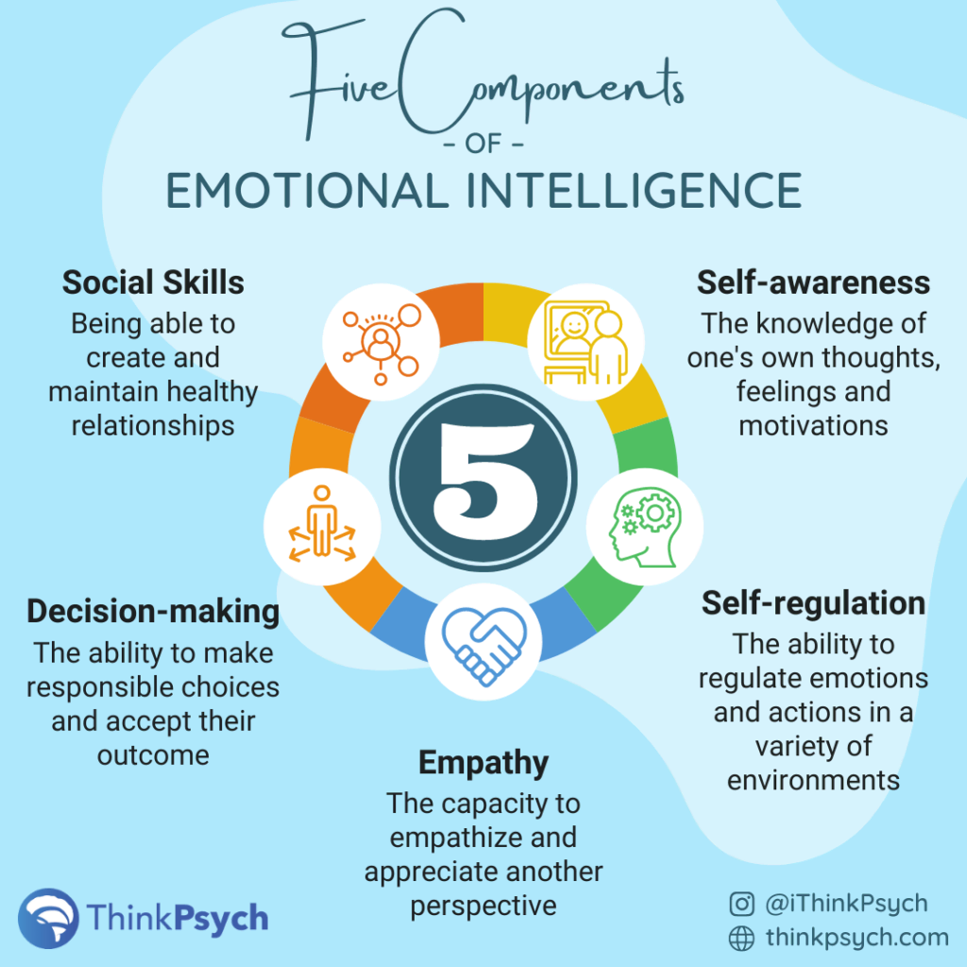

What can we do about it?
Notes:
Old references now #6
Emotional Intelligence training
-high levels of emotional intelligence (EI) may be protected from developing burnout, as they possess more effective coping strategies that enable them to be more resilient and manage stress better
developing the EI skills of physicians-in-training may help prevent burnout and optimize their overall wellness
-EI model emphasizing the four components of self-awareness, self-management, social
awareness, and social skill is commonly accepted

Slide 15
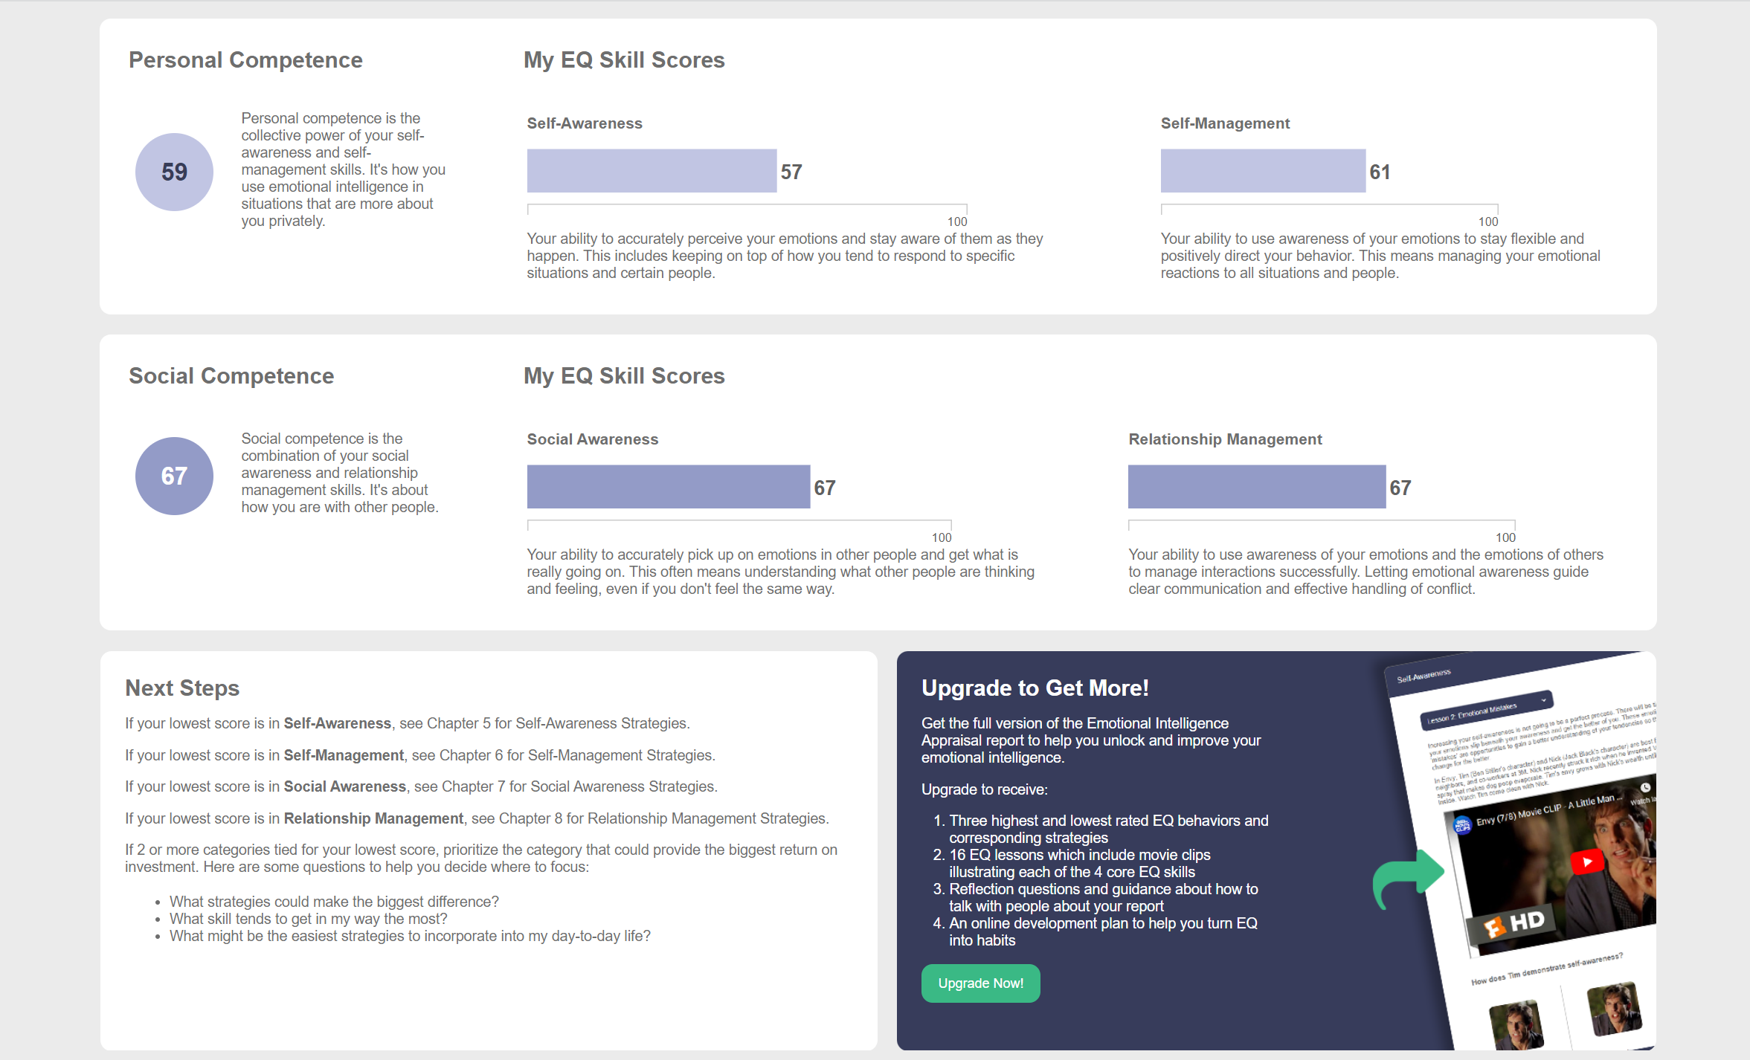
https://www.talentsmarteq.com/

Slide 16
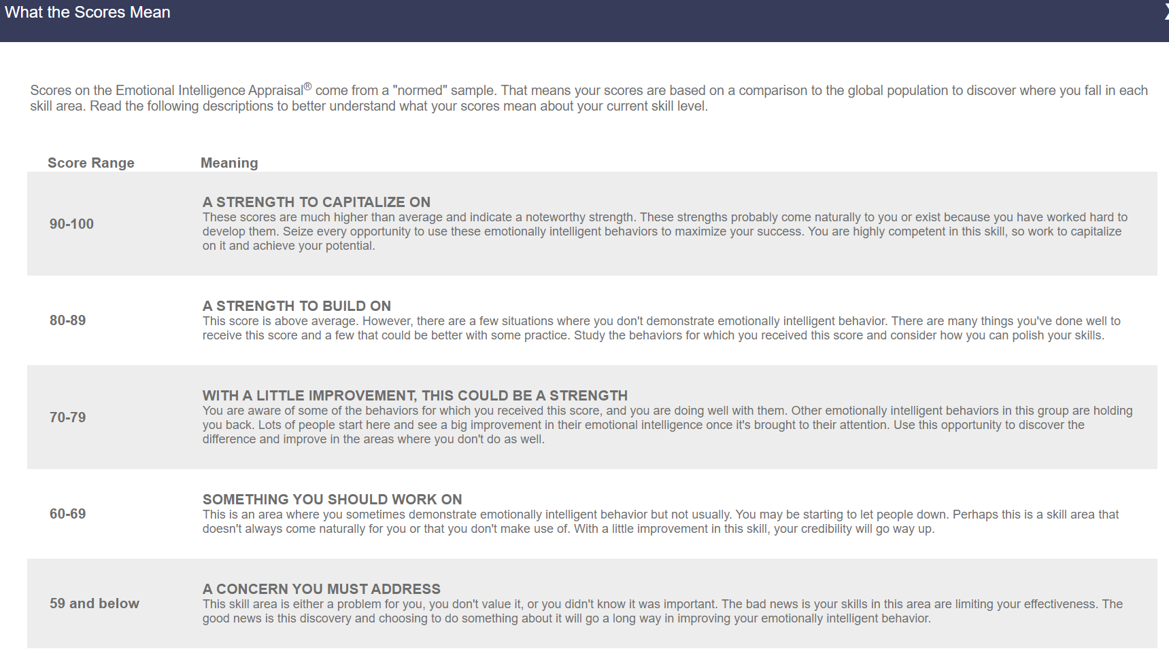
https://www.talentsmarteq.com/

Slide 17

How can faculty/staff help?
Scheduled check-in’s
Find time to help debrief and provide resources
Organizational interventions
Notes:
GR new 5
Bullet 1 – scheduled wellness days to develop a personalized plan to optimize self-care and work-life balance, this may require additional resources such as a licensed therapist
Bullet 2 – everyone is busy, but making sure to stay “human” is important and be able to provide appropriate resources is important
GR new 2
-organizational interventions = improved teamwork, work flow, organizational restructuring → area of research to improve on is to find more resources to target the organizational environment
-these resources may be more costly and time consuming but can be efficient in the long run in relationship to retention of physicians and improved patient care

Slide 18




Resources
And Many More!
Notes:
Silver cloud is an online behavioral health program designed to meet the needs of employees by delivering evidence based education and tools based on cognitive behavioral therapy. Can be used to address issues of stress, anxiety, depression, and work life balance
https://www.silvercloudhealth.com/
betterhelp.com
BetterHelp is a mental health platform that provides online mental health services directly to clients. The online counseling and therapy services are provided through web-based interaction as well as phone and text communication
Headspace – meditation and self-calming strategies
Calm - meditation products, including guided meditations and Sleep Stories

Slide 19
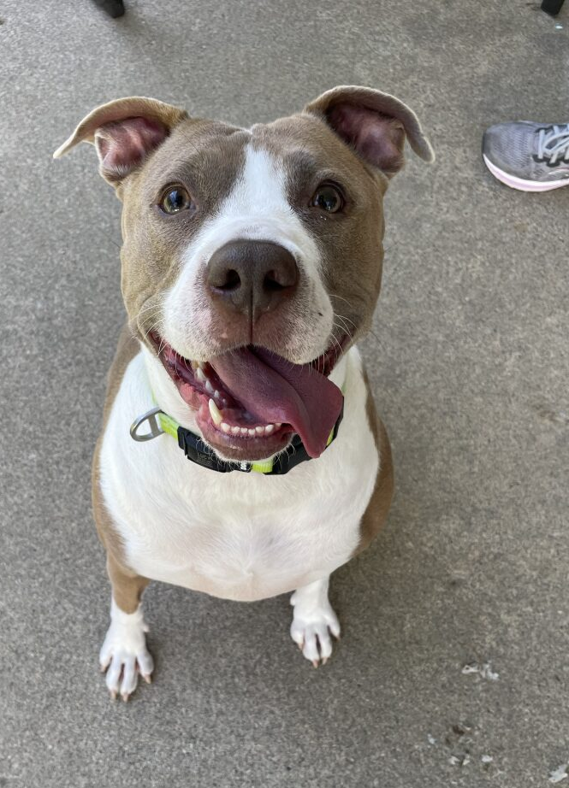
Thank You! Questions?

Slide 20
References
1. Frajerman A, Morvan Y, Krebs MO, Gorwood P, Chaumette B. Burnout in medical students before residency: A systematic review and meta-analysis. European Psychiatry. 2019;55:36-42. doi:https://doi.org/10.1016/j.eurpsy.2018.08.006
2. Zhou AY, Panagioti M, Esmail A, Agius R, Van Tongeren M, Bower P. Factors Associated With Burnout and Stress in Trainee Physicians. JAMA Network Open. 2020;3(8):e2013761. doi:https://doi.org/10.1001/jamanetworkopen.2020.13761
3. Briggs MS, Whitman J, Olson-Kellogg B, et al. Employer Perceptions of Physical Therapists’ Residency and Fellowship Training: Insights for Career Development Planning. Journal of Physical Therapy Education. 2019;33(1):40-48. doi:https://doi.org/10.1097/jte.0000000000000078
4. Shepard R, Haines L, Abraham K, Lievre AJ. Traits and Attributes of a Successful Physical Therapy Resident: A Delphi Study. Journal of Physical Therapy Education. 2021;35(4):315. doi:https://doi.org/10.1097/JTE.0000000000000203
5. McTaggart LS, Walker JP. The Relationship Between Resident Physician Burnout and its’ Effects on Patient Care, Professionalism, and Academic Achievement: A Review of the Literature. Health Sciences Review. Published online August 2022:100049. doi:https://doi.org/10.1016/j.hsr.2022.100049
6. Shahid R, Stirling J, Adams W. Promoting wellness and stress management in residents through emotional intelligence training. Advances in Medical Education and Practice. 2018;Volume 9:681-686. doi:https://doi.org/10.2147/amep.s175299

