Slide 1
Does lifting style increase injury risk?
Lucas McEliece, PT, DPT, CSCS

Slide 2
Continuing Medical Education Credit Information
Activity Description/Statement of Need:
Target Audience: All Providers

Slide 3
Designation Statement
It is St. Luke’s University Health Network policy to ensure balance, independence, objectivity and scientific rigor in all of our sponsored educational programs. Faculty and all others who have the ability to control the content of continuing medical education activities sponsored by the St. Luke’s Hospital & Health Network are expected to disclose to the audience whether they do or do not have any real or apparent conflict(s) of interest or other relationships related to the content of their presentation(s).
The St. Luke’s University Health Network is accredited by the Pennsylvania Medical Society to provide continuing medical education for physicians.
The St. Luke’s University Health Network designates this live educational activity for a maximum of 1 AMA PRA Category 1 Credits™. Physicians should only claim credits commensurate to the extent of their participation on the activity.

Slide 4
Disclosure Information
The Planners involved in this activity have no relevant financial relationships to disclose.
The Faculty/Presenters involved in this activity have no relevant financial relationships to disclose.

Slide 5
Learning Objectives
Understand basic physics concepts relating to movement & spine loading
Discuss forces through the spine in a biomechanical model
Examine correlations between lifting posture, injury, and pain
Review literature regarding best lifting techniques
Discuss influence environmental factors and personal factors on movement
Examine potentials for movement prescription

Slide 6
The problem
Back pain is the leading cause of disability globally
~37% of back pain is from work related issues
Lifting is a risk factor for incidence and prevalence
818,000-21.8 million disability adjusted life years
600,000 back injuries in the U.S.
  14 billion dollars in workers compensation
Notes:
The issue at hand is that back pain is the leading cause of disability globally. Lifting and mechanical loading is considered a risk factor for the development and exacerbation of back pain. Work related low back pain typically occurs due to overload lifting. IT causes substantial disability, excessive medical costs.
Unraveling the complexity of low back pain
Occupational intervntions for prevention of back pain
Flex or not to flex
Questioning value of manual material
Progressive fatigue effects on
Squat lifting imposes higher peak and muscle loading

Slide 7
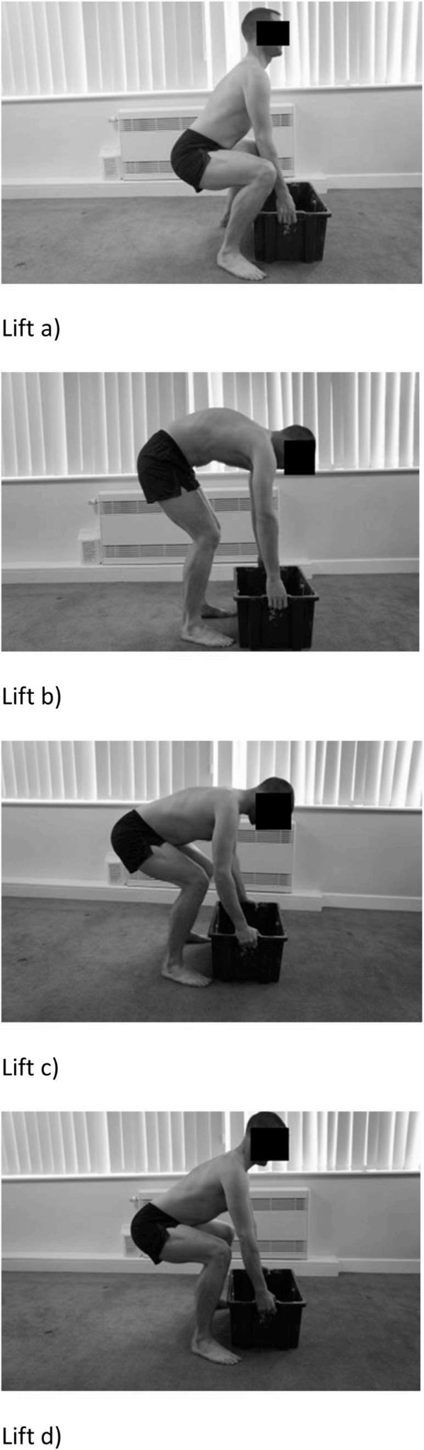
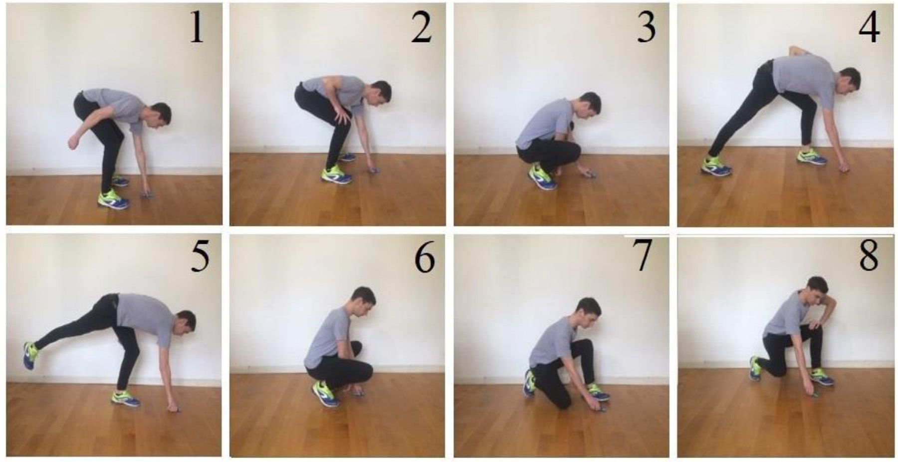
What are your recommendations?
Picking up a key ring
Picking up a heavy box
Notes:
With that in mind, I am going to show you a series of pictures.
With the first serires, I want you to imagine that the person is picking up a key ring from the floor.
If this person did not have back pain, would there any positions you would not recommend that person use. What if this person were symptomatic? Would you recommend against any positions?
IN the second series of pictures, I want you to imagine the person is picking up a box they perceive as heavy, but liftable from the floor.
Are there any positions you would not recommend? What if the person did not have back pain, what if they were symptomatic?
I want you to remember your options as we move to the next slide
Rialet-Micoulau J, Lucas V, Demoulin C, Pitance L. Misconceptions of physical therapists and medical doctors regarding the impact of lifting a light load on low back pain. Braz J Phys Ther. 2022;26(1):100385. doi:10.1016/j.bjpt.2021.100385
Nolan D, O'Sullivan K, Stephenson J, O'Sullivan P, Lucock M. What do physiotherapists and manual handling advisors consider the safest lifting posture, and do back beliefs influence their choice?. Musculoskelet Sci Pract. 2018;33:35-40. doi:10.1016/j.msksp.2017.10.010

Slide 8
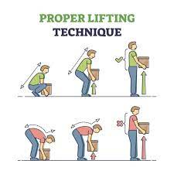
Current recommendations
Weight between your feet
Back flat
Squat down
Lift with your legs
Notes:
Mechanical loading is a risk factor for the development of low back pain. The more stress that is put on our backs, the more risk there is for an injury.
This is why the best and safest lifting posture is to keep a straight back.
The proper steps are: position yourself so the weight is between your feet, and you are directly facing the object.
Bend from your knees while maintaining a neutral spine and grab the object. If your ankles are not mobile enough, go up on the balls of your feet.
When doing the active lifting, keep the weight close and lift with your legs. This technique will reduce the overall forces on the lumbar spine, and allowing the quadriceps to absorb most of the force.
With spinal flexion, especially prolonged or repeated spinal flexion, there is excessive shear and compression across our lumbar spine, leading to microtrauma that will compound and lead to tissue failure and injury.
Providing education regarding proper technique and discussing injury risks will significantly improve their lifting practice, enforce the best posture, and prevent future incidents of injury and reuce prevalance of back pain.
Biomechanics of low back injury
NIOSH 1981
Van der have
DO I need this?

Slide 9
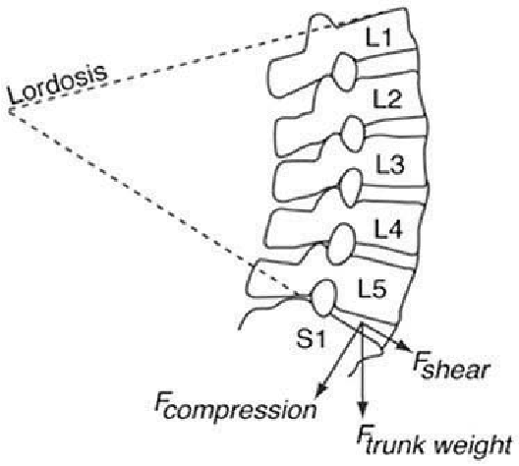
Biomechanical models
Interactions of various force contributors
  Musculature
  ligaments
  Intra abdominal pressure
  Positioning
    Trunk
    Spine
    Object
Notes:
These recommendations are based on biomechanical models. These models have attempted examine a variety of forces simultaneously to quantify the stress on the lumbar spine and associated structures during static and dynamic positions.
This has been in an attempt to find positions or movements that unload the spine the most, or find positions that load the spine the most. They have examined which tissues are stressed with which movements to better understand injuries.
A large portion of the literature has been directed at the L5/S1 junction, with the thought that the forces experienced at this segment would be the largest . However, these forces will occur at every level of the spinal column during movement, and will be influenced by the pull and contraction of musculature, passive stability of ligaments, intra abdominal pressure, and positioning of the object, trunk and spine.
The idea being, the more you flex the spine, the less muscular contribution you get from from your segmental and global musculature because you have put them on a passive insufficiency, you stress your ligaments more, and develop ore compression, shear, and torque.
https://www.researchgate.net/figure/Degree-of-lumbar-lordosis-and-forces-acting-on-the-lower-spine-Castillo-et-al-2015_fig1_283731555
Burgess-Limerick, R. (2003). Squat, stoop, or something in between?. International Journal of Industrial Ergonomics 31 (3) 143-148. https://doi.org/10.1016/S0169-8141(02)00190-7
McGill SM. The biomechanics of low back injury: implications on current practice in industry and the clinic. J Biomech. 1997;30(5):465-475. doi:10.1016/s0021-9290(96)00172-8
Denis D, Gonella M, Comeau M, Lauzier M. Questioning the value of manual material handling training: a scoping and critical literature review. Appl Ergon. 2020;89:103186. doi:10.1016/j.apergo.2020.103186
Ligamenouts structures and lumbar musculature are the predominant contributors to compression and posterior shear, while position, and weight and moment arm were contributors to shear and torque
NIOSH & mcgill

Slide 10
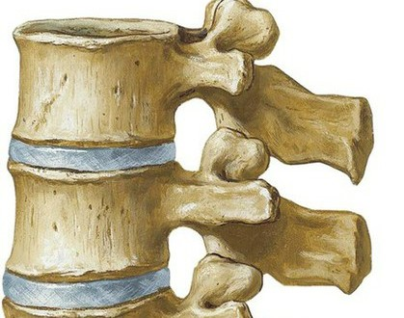
Review of forces
Compression
Notes:
Compression or an axial stress occurs when force acts perpendicularly to the surface of an object. Causes the object to shrink, and puts a force outwards in all directions. Think about if you push a ball straight down.
In the lumbar spine, compression is largely generated by muscular pull, and axial loading
This type of force has been linked to bony failure, and end plate fractures, and the aptly named compression fractures

Slide 11
Review of forces
Shear
Notes:
Shear is a force that acts parallel to the surface of an object. This type of force tends to pulling one part in a direction and a pull in the opposite direction.
If we grab something in front of us, there will be a shear force created pulling the superior vertebral body anteriorly
Slow motoions are linked to ligamentous avulsion fractures, and higher speed shear forces are associated with ligament tears
Facets and neural arch are also succeptibleto shear loading

Slide 12
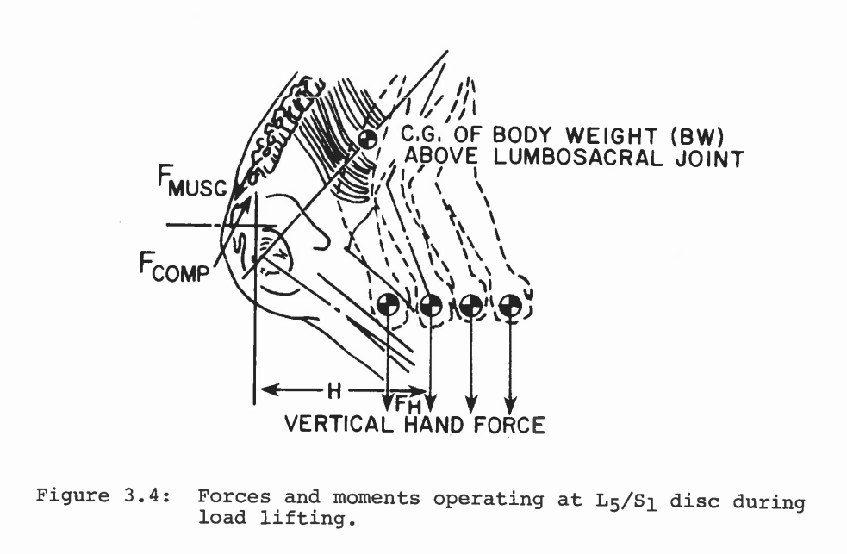
Just a moment
Notes:
The interactions of forces that occur within the lumbar spine can be described with moments. Moment is the perpendicular distance from the point of rotation to the forces line of action. In more simple words, forces located far away from where movement is occurring result in greater moments. Forces closer to areas where motion is occurring result in smaller moments. Think about it like pushing open a door.
With this rationale, a 20kg load held at arms lengh, would produce the same compression of a 40kg load hald directly between the knees, and 20kg load at arms length would produce 1200kg/cm torque at L5/s1
NIOSH

Slide 13
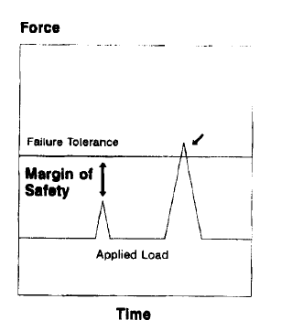
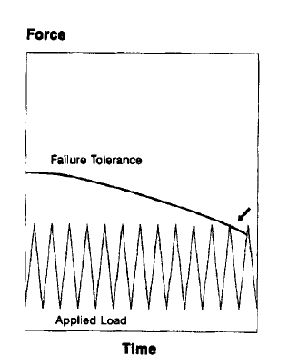
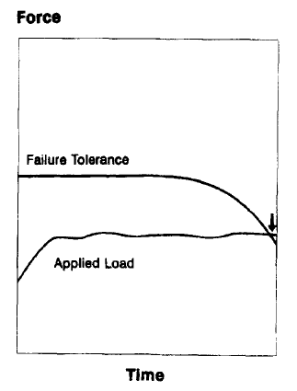
Mechanisms of injury
Notes:
Biomechanics points to the idea that mechanical overload causes pain or injury by localized fatigue or failure of either from bone, disc, ligaments, or muscles.
This force can be from a high magnitude force applied breifly
Medium forces repeated
Or sustained low force
With this presentation focusing on lifting, we will be more along the lines looking at the medium forces that have been repeated.

Slide 14
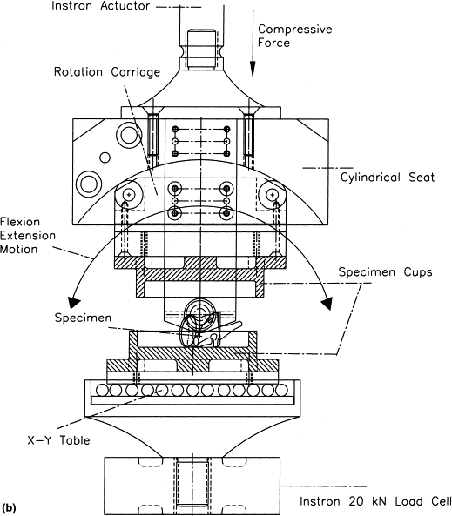
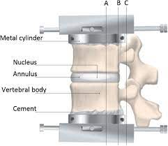
The jig is up
One motion segment
Varying compressive loads
  260N (~26kg)
  867N (~86kg)
  1472N (~1472kg)
Flexion & extension cycles
Rotary force
Notes:
In vitro studies involving cadaveric tissue were generally not successful in inducing disc herniations. Some authors showed that adding in compressive, flexion and rotary moments could be a mechanism of injury, but there were few in-vitro studies to confirm this. One of the more prominent experiments to observe disc herniations stemming from movement utilized a jig to fix one motion segment (inferior lumbar vertebra, disc, and a superior lumbar vertebra into a machine that flexed extended this tissue through a range of motion and incorporated twists and compressive forces.
In their study 24 porcine motion segments went through 86,400 flexion & extension cycles- one per second
Thoreson O, Ekström L, Hansson HA, et al. The effect of repetitive flexion and extension fatigue loading on the young porcine lumbar spine, a feasibility study of MRI and histological analyses. J Exp Orthop. 2017;4(1):16. doi:10.1186/s40634-017-0091-7
Callaghan JP, McGill SM. Intervertebral disc herniation: studies on a porcine model exposed to highly repetitive flexion/extension motion with compressive force. Clin Biomech (Bristol, Avon). 2001;16(1):28-37. doi:10.1016/s0268-0033(00)00063-2

Slide 15
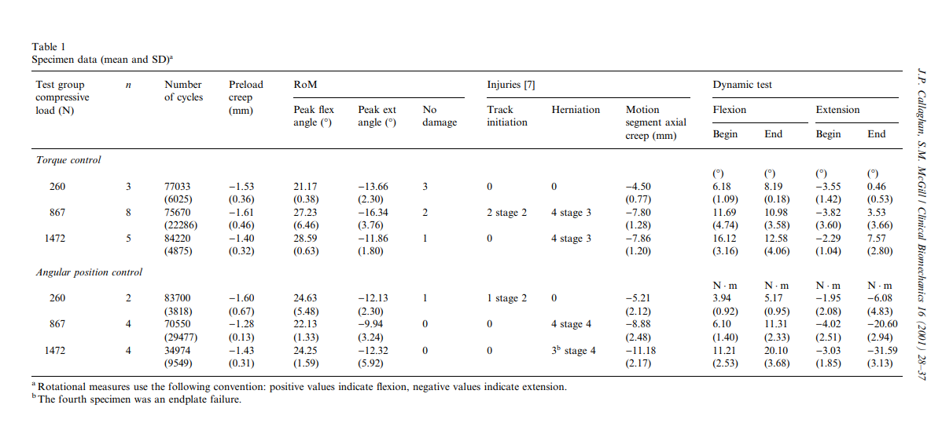
pathomechanics
“Straw that broke the camel’s back”
Notes:
They found that a moderate to light load with repetitive cycles of flexion caused posterior disc herniations, and with increasing weight, can even cause endplate failure. They took this information and concluded that disc tears occur over time, and while it may feel like isolated movements account for discogenic injuries, in reality it is the repetitive loading that causes micro trauma eventually building to tissue failure.
This is the most commonly cited study of this type, but it is not the only study of its type, various authors have done this with varying degrees of flexion, rotation, compression, movement frequency, and speed. They have tried to simulate how people move using different time frames and differing ideas of tasks they are trying to simulate. The commonality with these studies is it does show damage build over time. Even when trying to simulate things like running,
which is interesting considering more recent evidence that running is associated with increased disc height.- SOURCE?
Thoreson O, Ekström L, Hansson HA, et al. The effect of repetitive flexion and extension fatigue loading on the young porcine lumbar spine, a feasibility study of MRI and histological analyses. J Exp Orthop. 2017;4(1):16. doi:10.1186/s40634-017-0091-7
Callaghan JP, McGill SM. Intervertebral disc herniation: studies on a porcine model exposed to highly repetitive flexion/extension motion with compressive force. Clin Biomech (Bristol, Avon). 2001;16(1):28-37. doi:10.1016/s0268-0033(00)00063-2
Mcgill biomechanics of a low back injury

Slide 16

Neutral spine position
Less wear and tear
Education
Notes:
With lifting as a risk factor for low back pain and injury, mathematic support, and cadaveric studies shedding light on patho mechanics and tissue failures, the idea that a neutral spine position is reinforced.
Neutral spine would help reduce the stress on the spine, and keep you in the sub- failure threshold longer

Slide 17
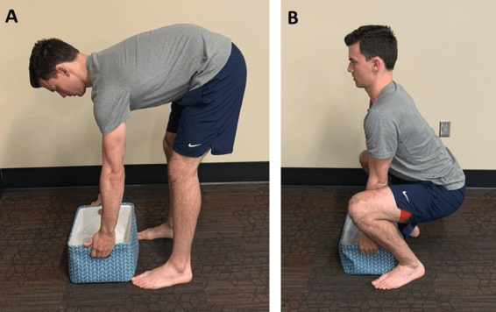
Stoop Vs. Squat
Notes:
Cadaveric and biomechanical studies are nice, but there is a significant difference between cadaveric tissue and living tissue.
Cadaveric studies show that the thoracolumbar column can withstand 60N of force before collapsing, however in living tissue, powerlifters could experience up to 18,000 N of compressive forces during a lift and be fine.
The next question became what are the forces exerted on the spine during various movement styles. There are a lot of options for movement, however the bulk of the literature is focused on polar ends of the spectrum: stoop lifting (knees straight, spine flexed) and squat lifting (knees bent, straight back). There is a wealth of literature measuring these forces, I have tried to reign them in and pick the more recent and what I feel are the higher quality studies with relatively similar methodologies so I am not completely comparing apples to oranges.
Why are we not using evidence to optimize movement

Slide 18
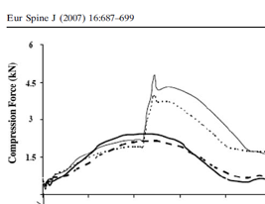
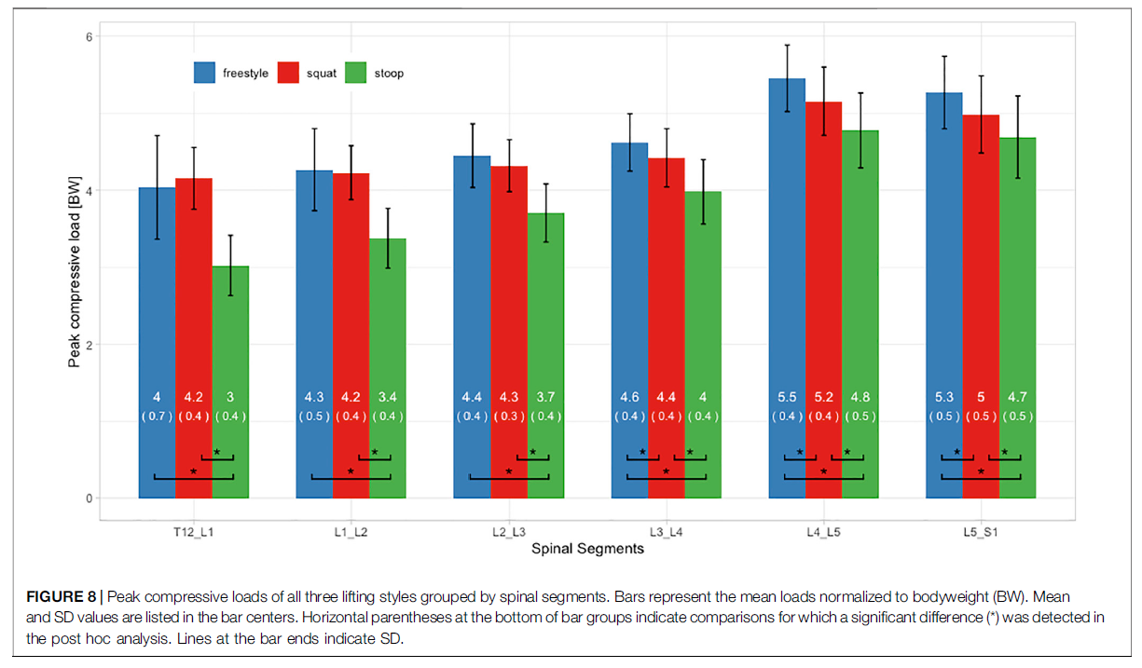
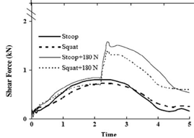
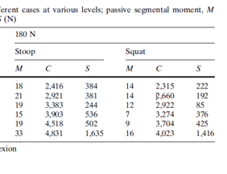

Compression
Stoop
Squat
Notes:
Unlike the previous study I mentioned, there was a significantly lower compression with stoop lifting compared to squat lifting and even free style lifting at all motion segments. Like the phenomena that have previously been demonstrated, there was a gradual increase in force with more caudal segments
Further breaking down forces revealed higher compression and shear throughout the spine. For both styles of lifting, compression and shear gradually increased with more caudal segments, with the most compression and shear occurring at L5/S1. The loaded forces were roughly double of what was seen for unloaded movements.
Bazrgari B, Shirazi-Adl A, Arjmand N. Analysis of squat and stoop dynamic liftings: muscle forces and internal spinal loads. Eur Spine J. 2007;16(5):687-699. doi:10.1007/s00586-006-0240-7
von Arx M, Liechti M, Connolly L, Bangerter C, Meier ML, Schmid S. From Stoop to Squat: A Comprehensive Analysis of Lumbar Loading Among Different Lifting Styles. Front Bioeng Biotechnol. 2021;9:769117. Published 2021 Nov 4. doi:10.3389/fbioe.2021.769117

Slide 19
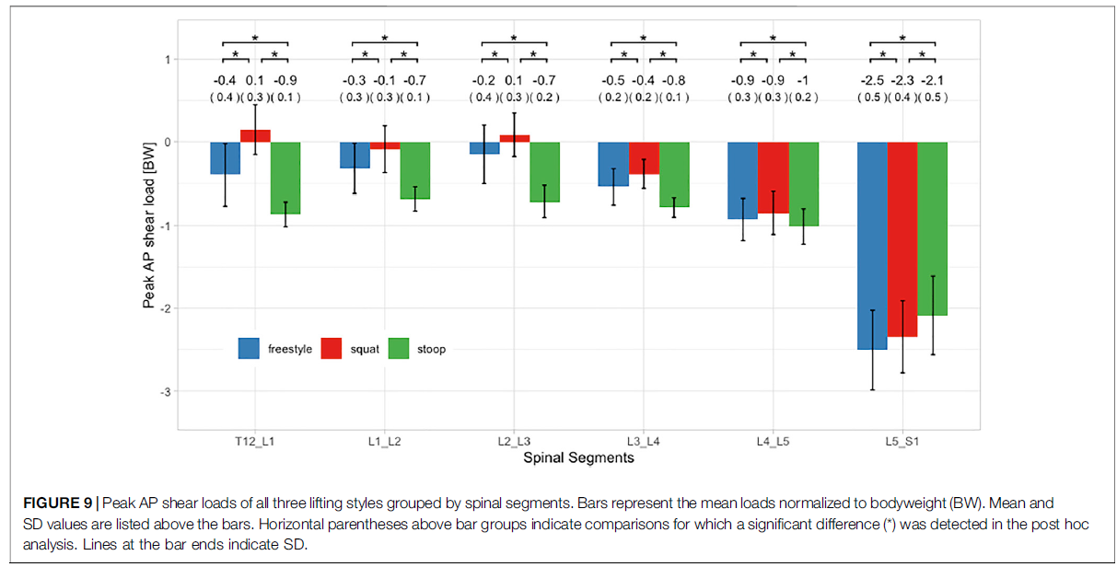
Shear
Stoop
Squat
Notes:
Bazrgari B, Shirazi-Adl A, Arjmand N. Analysis of squat and stoop dynamic liftings: muscle forces and internal spinal loads. Eur Spine J. 2007;16(5):687-699. doi:10.1007/s00586-006-0240-7
Further breaking down forces revealed higher compression and shear throughout the spine. For both styles of lifting, compression and shear gradually increased with more caudal segments, with the most compression and shear occurring at L5/S1. The loaded forces were roughly double of what was seen for unloaded movements.
However, when it comes to shear forces, there is a divide with this study. While overall shear forces were higher at lower segments, there was more shear across other lumbar vertebra- there was a 100% increase at L3/L4, and an 800% increase in shear with stooping at T12/L1. If we’re looking at this from a purely pathoanatomic model, does this shear force matter? 90% of all spondylolisthesis and disc herniations occur at L5/S1.
It is why a majority of research is focused on this area.
Overall these authors demonstrated that with certain scenarios, there is less stress across the lumbar spine
Bazrgari B, Shirazi-Adl A, Arjmand N. Analysis of squat and stoop dynamic liftings: muscle forces and internal spinal loads. Eur Spine J. 2007;16(5):687-699. doi:10.1007/s00586-006-0240-7
von Arx M, Liechti M, Connolly L, Bangerter C, Meier ML, Schmid S. From Stoop to Squat: A Comprehensive Analysis of Lumbar Loading Among Different Lifting Styles. Front Bioeng Biotechnol. 2021;9:769117. Published 2021 Nov 4. doi:10.3389/fbioe.2021.769117

Slide 20
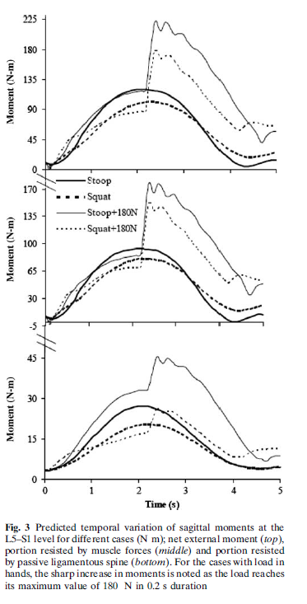
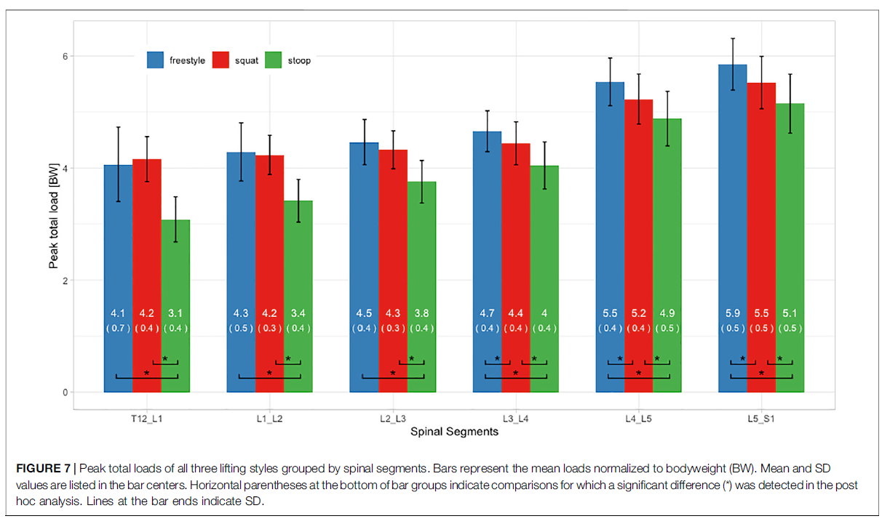
Net Moment
Stoop
Squat
Notes:
This study found that there were significant differences between the movements in terms of overall movement, and forces placed on spinal structures. Overall there was more motion that occurred with stooping in both the thorax and pelvis, and overall higher net moments with similar forces exerted on the musculature and ligamentous structures.
The big peaks that occur are the time where the weight is in the hand
This study found lower peak forces across all lumbar segments, and observed a similar phenomena that forces built with more caudal segments
Bazrgari B, Shirazi-Adl A, Arjmand N. Analysis of squat and stoop dynamic liftings: muscle forces and internal spinal loads. Eur Spine J. 2007;16(5):687-699. doi:10.1007/s00586-006-0240-7
von Arx M, Liechti M, Connolly L, Bangerter C, Meier ML, Schmid S. From Stoop to Squat: A Comprehensive Analysis of Lumbar Loading Among Different Lifting Styles. Front Bioeng Biotechnol. 2021;9:769117. Published 2021 Nov 4. doi:10.3389/fbioe.2021.769117

Slide 21
Additional variables
Vertical distance
Horizontal distance
Energy expenditure
Ranges of motion
Notes:
So far, we’ve covered

Slide 22
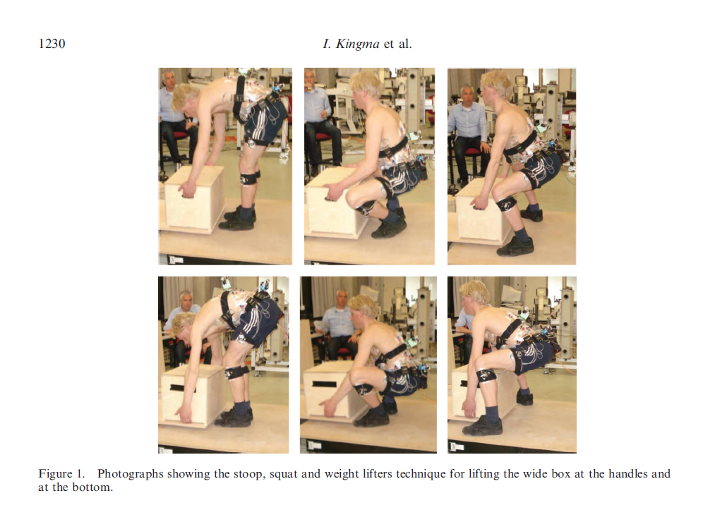
Notes:
How to lift a box that is too big to lift between the legs

Slide 23
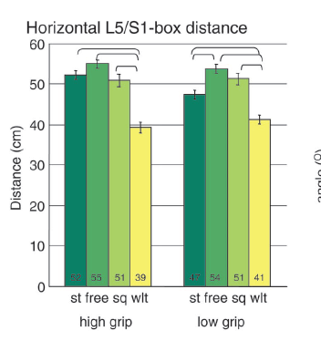
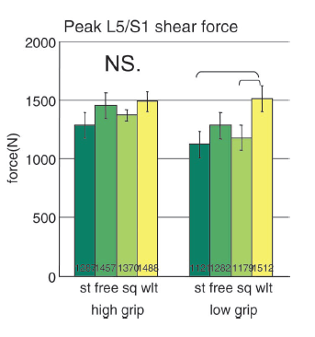
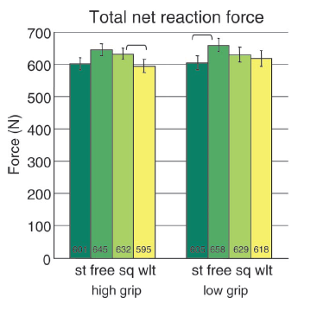
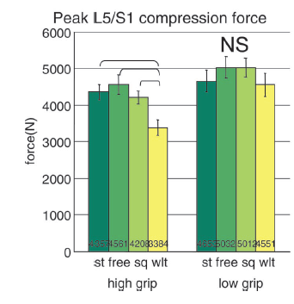
Horizontal & Vertical distances
Notes:
While the weight lifter’s technique had a significantly lower horizontal distance to the object, there wasn’t an overall large difference in net reaction forces, it resulted in greater shear forces for low objects. It did result in less compression for high object.
The weight lifters technique was proposed as a method that could replace the stoop in place of lifting large objects from the floor. One of the reasons the stoop was proposed to be better for larger loads was that it dereased the horizontal distance from the lumbar spine relative to the squat. With the weight lifter’s technique, people were cued to take a wider stance and externally rotate their feet.
How to lift a box too big to fit between the legs
Van der haeve
NIOSH

Slide 24
Energy & Force
Muscular demand
  Squat postures have increased muscle demand
Force output
  Greater force generation in flexion
Efficiency
  Flexed postures are more efficient
Notes:
With lifting, we should try and consider the ultimate goal of actually picking something up, and doing it over and over and over again. Or having to pick up different things.
Squatting postures are associated with increased muscular demand of the quadriceps, upper and lower erector spinae, multifidi, trapezius, and deltoids. Despite these greater muscle demands and activation, they actually don’t develop as much force as flexed postures. Because of the energy demand and low force output, flexed postures are actually more efficient, and can allow people to lift greater loads and help stave off fatigue with repetitive tasks.
It is interesting that the extended posture is thought to be protective against compressive forces, but the increase in paraspinal musculature is actually due to an active insufficiency, and muscular pull is one of the largest contributing factors to spinal compression.
This study, like the others I have presented have discussed how the net moments at l5/s1 are largely the same.
Mawston, Banks,
NIOSH
Van Der Haeve
Does intra lumbar flexion differ?

Slide 25
Motion
Ankle
  Squat>> Stoop
Knee
  Squat>> Stoop
Hip
  Squat>/=Stoop
Spine
  Stoop> Squat
Notes:
Overall, the squat lift has a high mobility tax compared to stoop lifting for the ankle, knee and hip. The hip is closer, but still slightly larger. The only location where more motion is required is with spinal flexion. One thing to note about this is that we still flex when we squat. We have an idea that we are maintaining a perfect lordotic curvature, however all the motion studies we have looked at so far, and will look at moving forward show spinal flexion occurring. The ranges of motion vary significantly depending on the way the investigators measured the motion, however the lumbar spine is still going through flexion and extension cycles.
If it was the flexion and extension cycle that we have been trying to avoid, we’re admittedly not doing a good job against it.
Near intra lumbar flexion is inevitable- saraceni ergonomics
24.2 +/- 7.3 freestyle
25.1+/- 8.2 squat
35.9_/- 10.1 stoop
Von arx
Kingma
64 degrees flexion stoop
52 degres flexion
People tend to move somewhere in between in a semi squat posture
45 degrees of lumbar flexion- burgess

Slide 26
Movement comparison
Stoop Lifting
Squat lifting
  Improved muscular efficiency
  Greater strength
  Less mobility demand
  More lumbar flexion ROM
  Variable shear loads*
  Variable compressive loads*
  High energy expenditure
  High mobility demand
  Less lumbar flexion ROM
  Variable shear loads*
  Variable compressive loads*
Notes:
Furthermore, there are additional implications for each lifting method
With squat lifting, people are still going through flexion and extension cycles.
The flexion and extension cycles when paired with axial loading that are supposedly causing pain.
24.2 +/- 7.3 freestyle
25.1+/- 8.2 squat
35.9_/- 10.1 stoop
Von arx
56.2 flex in stoop
22.7 flex in squat
39 flex mid range
Mawston
NIOSH & box between knees
Forces roughly the same- van der heave

Slide 27
Limitations of biomechanics
Don’t mimic normal movement
Little real world crossover
  Different objects
  Variable locations
  Different speeds
Different measurement models
Saggital focus
Hyper focus on one area
  L5/S1
Notes:
The stoop vs. squat debate and force profiles in literature gets to be pretty old pretty fast. There are an overwhelming amount of variables to to control for, modifying one can have profound implications on the others.
Ways of measuring, measuring isometrics vs. isotonic
In this situation, if you control for everything, you’ve removed some of the point and just looking at forces to look at forces. You could theoretically find the technique for the least force, but It would be impossible to standardize real world practice like we do in lab settings.
Ergonomic literature suggests that most lifting that occurs during a regular workday is awkward due to object size, shape, oritnation, environmental limitations
Regardless of the study I have cited in this section, almost all of the authors agree that this is a complicated area and there may not be a single answer for the best position because of these limitations.
Taking the biomechanical analysis out of your mind for a little, let's shift to real world examples of how people move and what the implications are for movement
If biomechanics and pathology were all that were important, wouldn’t the spines of material handlers reflect greater degenerative changes?
Most of the literature focuses on extreme ends of the spectrum, but people do not tend to move on these extreme ranges without specific cueing
People tend to move somewhere in between in a semi squat posture
45 degrees of lumbar flexion- burgess
This variance appears to be a strategy to reduce fatigue
Burgess limerick
Mawston
Banks
Forces aside, lets move onto the implications of these movements
NIOSH & box between the legs
Sarceni and likely all the
Van der have- discusses complexity

Slide 28
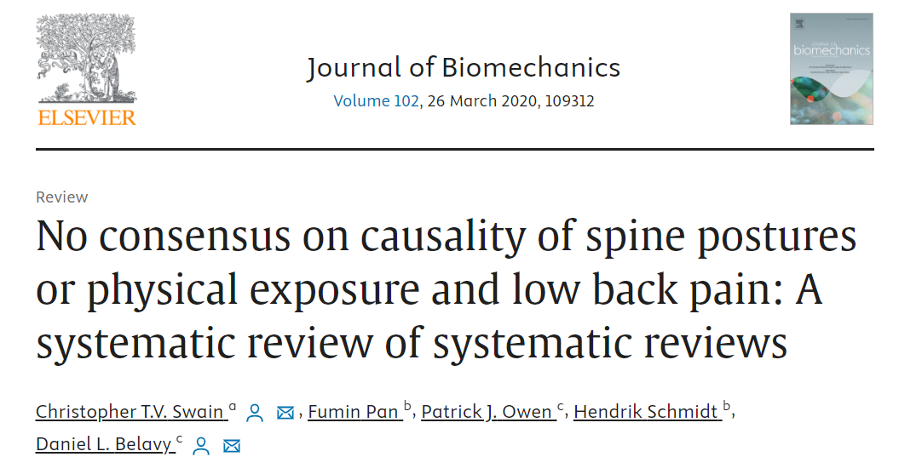
Notes:
Even biomechanists have recognized the disparities in literature

Slide 29
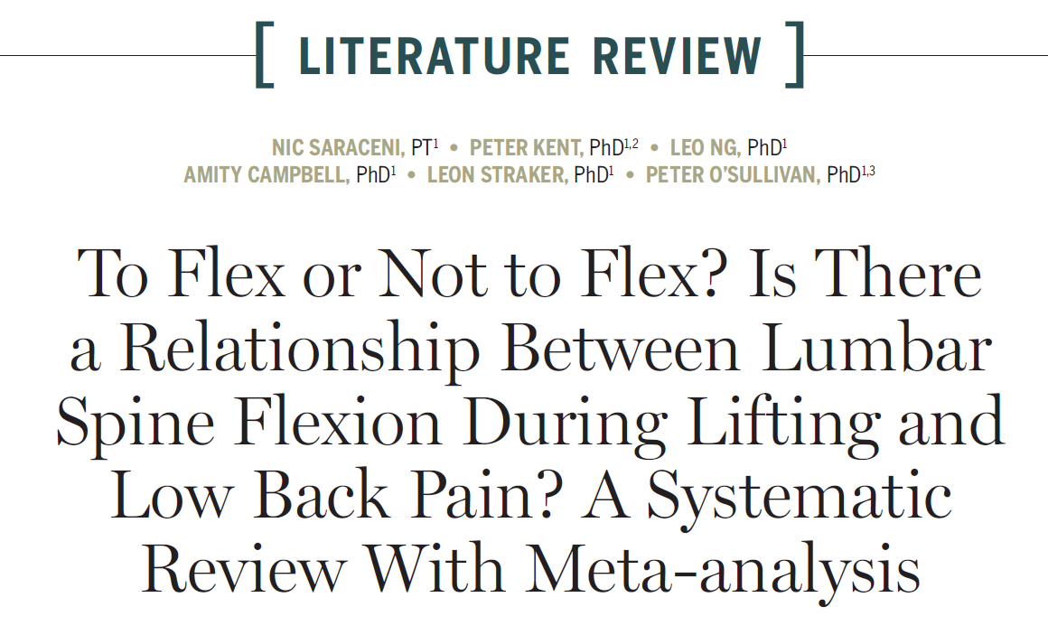
No clear relationship
Notes:
No consensus- article from above slide, but put as a citation.
In 2020, these researchers performed a literature review to determine if lumbar spine flexion while lifting was a risk factor for onset, and or prevalence of back pain.
They reviewed 13 papers with 697 participants
1 longitudinal
11 cross sectional (one study used same cohort twice, but it was only counted once)
Many previous articles have demonstrated that mechanical loading is a risk factor for development of back pain, but we jumped a step, only looked at cadaveric studies and went flexion is bad.
Overall, these authors found low quality evidence linking flexion to back pain incidence and prevalence. They discuss that lifting frequency, intensity are correleated, however flexion isn’t necessairly a risk factor. Its not that there is no evidence, just that it is incredibly low quality due to inconsistent research methods. About half of the articles discussed trunk flexion rather than lumbar flexion, poorly described populations or descriptions of back pain. Only 5 studies discussed power calculation.
None of the lncluded studies showed a strong link between spine position and pain.
Relatively low loads- lifting between a pen and 13kg, few lifts performed
May be possible to determine flexion from video, however PTs aren’t even great at evaluating lumbar ROM
All of the articles utilized different technology to determine flexion angles, and only four were validated against gold standard measurement. They revealed that many studies linking the two looked at self reporting measures of frequency of trunk flexion and reports of back pain or video analysis to examine flexion angles.
This could be possible to determine, however physical therapists, the movement specialists can’t accurately determine if people lifting are flexing their spine or not. – Falk article
Intralumbar flexion angles
No significant difference in peak lumbar spine flexion when lifting in people with back pain and without back pain
Thoracopelvic angles
Seven cross sectional studies found that people with back pain lifted with 6 degrees less motion than people without back pain. These studies had significant heterogeneity
People with low back pain may actually move less than people without back pain

Slide 30
Flexion is not a risk factor
Mechanical loading appears to be a risk factor
Issues with reporting
  Measurement differences
  Individual reporting & video survey
Notes:
IN this review, it is discussed that a greater exposure to mechanical loading is a risk factor, lifting frequency, and lifting intensity are associated with risk factors for low back pain.
However there is no current in vivo evidence to support the idea that flexion is bad.
The two studies that made it into this analysis utilized self report questionnaires and video analysis to determine time spent in bending at work. Have a hard time seperating lumbar flexion from trunk inclination though.
This could be possible to determine, however physical therapists, the movement specialists can’t accurately determine if people lifting are flexing their spine or not. – Falk article

Slide 31
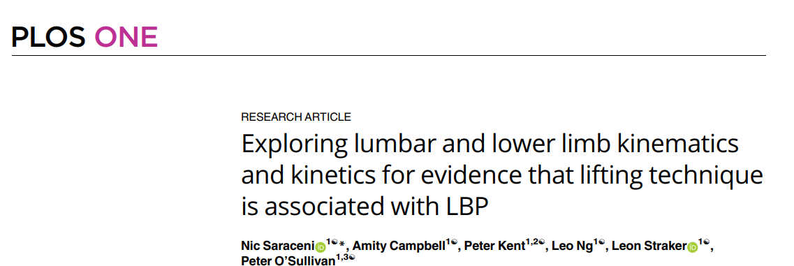
How do people lift?
Notes:
In an attempt to improve clarity of evidence and rectify some of the issues posed by prior evidence, this study tried to correct
Cross sectional observational study.
This study focused on material handlers with more than 5 years of workplace handling experience, performing a minimum of 25 lifts per day. 21 participants with a history of low back pain and 21 participants without a history of low back pain.
Low back pain was described as pain between t12 and the gluteal fold lasting for 3 months duration, where lifting was an aggravating factor, their pain was >3/10 and they either missed work, took medication, sought assistance from a healthcare provider, had to modify work related duties
Participants performed 100 lifts including symmetrical and asymmetrical. Weight was determined by taking 10% of the participant’s mass
Collected NPRS 0-10, borg RPE scale and radial artery pulse after the lifting task
findings
People with low back pain experienced increased fatigue not correlated with heart rate, low back pain group had less lumbar flexion
Flexion both increased with time
Saraceni N, Campbell A, Kent P, Ng L, Straker L, O'Sullivan P. Does intra-lumbar flexion during lifting differ in manual workers with and without a history of low back pain? A cross-sectional laboratory study. Ergonomics. 2022;65(10):1380-1396. doi:10.1080/00140139.2022.2036819
Saraceni N, Campbell A, Kent P, Ng L, Straker L, O'Sullivan P. Exploring lumbar and lower limb kinematics and kinetics for evidence that lifting technique is associated with LBP. PLoS One. 2021;16(7):e0254241. Published 2021 Jul 21. doi:10.1371/journal.pone.0254241

Slide 32
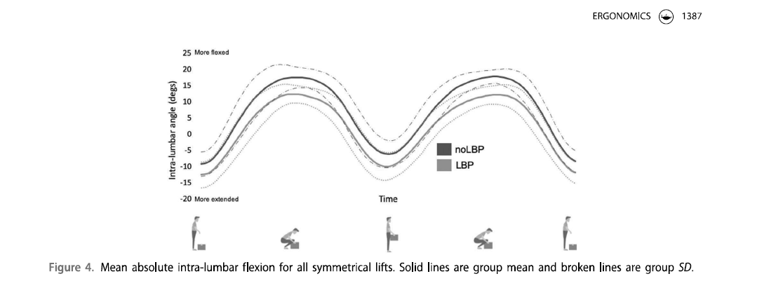
Range of motion
Notes:
Workers with a history of back pain initially started with a more “squatty” posture, but their form changed over time due to fatigue changed 4.5 degrees
Workers without pain started more flexed, and progressively got more flexed- changed 2.5 degrees
People without low back pain used ~90% of their intra lumbar flexion
Both groups flexed more over time, but the low back pain group started with more erect posture, and flexd more over time. But flexion never reached the same value of the people who have not had back pain. Pretty interesting that people who haven’t had back pain for 5 years in a job that requires material handling flexed more
People with low back pain had higher variability in their peak range of motion- may relate to changes in proprioception, and co contraction- seen with other studies

Slide 33
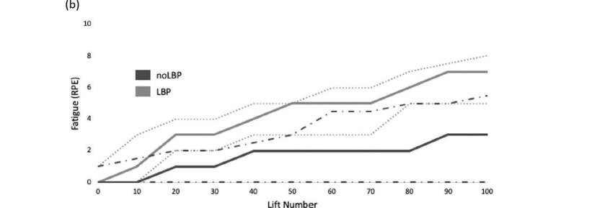
Fatigue
Notes:
Low back pain group had fatigue not correlated with their heart rates
Heart rates similar between groups
Heart rate and perception of fatigue are not related in people with low back pain
Fatigue perception may influence low back pain, but not lumbar flexion

Slide 34
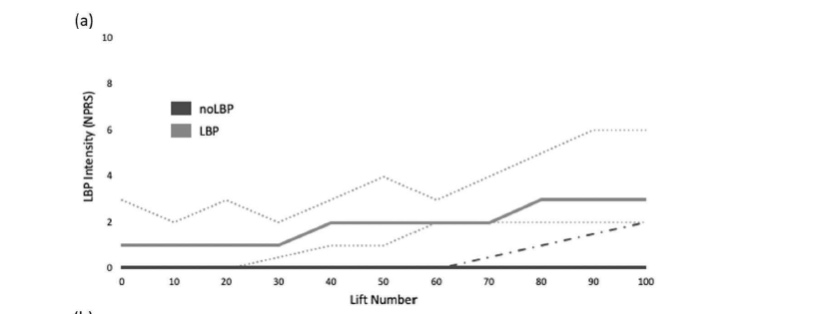
Pain Ramp
Notes:
ON average, there was a 2.2 increase in NPRS score, 2 did not experience an increase, and 1 experienced a decrease
The low back pain group showed an inconsistent relationship to pain. That is, no biomechanical factor had an influence on pain outcomes
Looked at 21 different biomechanical factors, and only one (pelvic inclination at lift off) had a correlation with pain ramp, while their flexion did increase with time, this change was not correlated with increases in pain
Despite the similar biomechanical forces, and back pain, each participant had a different pain ramp suggesting force isn’t everything in the pain experience
The increase in variability previously mentioned is not associated with pain ramp.

Slide 35
Recommendation issues
Homogenous solution to a heterogenous problem
  Different objects
  Different people
  Different environments
Biomechanical oversimplification
Little In Vivo evidence demonstrating the risk
Notes:
The biggest issues with the current recommendations are that we are trying to put a single recommendation to a multifactorial problem. Even if we are going to reduce back pain down to its biomechanical basis, there are far too many variables to truly account for to make the “lowest force” and safest lift recommendation.
Despite the differences in the literature, different methods, almost every author has admitted this problem and used it as a call for more investigation.
Even Stuart McGill who is a biomechanist and has made his livelihood on neutral spine postures has said that taking a one sized fits all model is doomed to failure.

Slide 36
Problems
Force is not pathologic
Little correlation with lifting and imaging
no benefit from education
  Potential harm
Notes:
The initial mcgill study only put 860 N on the spine, and said that when you flex enough, it breaks. Other studies have put far more stress on the spine. 86N on the spine is so low.
We continue to stress the importance of lifting posture, and it has been stressed since before cyriax wrote about lumbago in 1945
Fall of PSB model
Association between occupational loading and spine degeneration on imaging
Robin burgess- limerick
To flex or not to flex
The beneift from education is that people remember the biomechanical stuff.
There is no current link between

Slide 37
What are risk factors for injury?
>25 lifts per day
>25kgs lifted
Notes:
Saraceni

Slide 38
Contributors to pain
Biomechanical & biomedical
Excessive force
Pathology
Biopsychosocial
Fear
Catastrophization
beliefs
Notes:
The other half of this is we also don’t live in a purely biomechanical and biomedical sphere. If we lived and died by forces and excessive force was pathologic, obese people would have more back pain, pregnant women would have more back pain, people with scoliosis would have more back pain, sustained sitting or standing postures would have more back pain.
Is less lumbar range of motion a method to reduce pain, or is it fear of movement?- saraceni articles
We know that there is a large psychosocial component to pain. I would make the argument and many of the authors of articles I have reviewed would make the argument that continuing to say that neutral spine postures and squat styles of lifting are safer perpetuates the idea that the spine is something that needs protecting. It keeps us in a pathoanatomy. It makes people focus on their disc, or on being out of alignment. It perpetuates fear. Which is a more well documented risk factor for low back pain and disability

Slide 39
Kinesiophobia and patients
Proposed that people adopt more rigid postures because of societal influence and recommendations of healthcare providers
Self limit activity
Lower self efficacy
catastrophization
Need for CBT interventions
Notes:
In NZ- 93.5% of surveyed individual believe that lifting without knees bent was bad for their back
Rialet

Slide 40
Graded activity
Reductions in fear associated movement are reliant upon exposure to fearful motion
Self efficacy and all that stuff
Notes:
Wernli K, Smith A, Coll F, Campbell A, Kent P, O'Sullivan P. From protection to non-protection: A mixed methods study investigating movement, posture and recovery from disabling low back pain. Eur J Pain. 2022;26(10):2097-2119. doi:10.1002/ejp.2022
Gibbs MT, Morrison NMV, Jones MD, Burgess D, Marshall PW. Reductions in movement-associated fear are dependent upon graded exposure in chronic low back pain: An exploratory analysis of a modified 3-item fear hierarchy [published online ahead of print, 2022 Jun 6]. Musculoskeletal Care. 2022;21(1)25-34. doi:10.1002/msc.1661

Slide 41
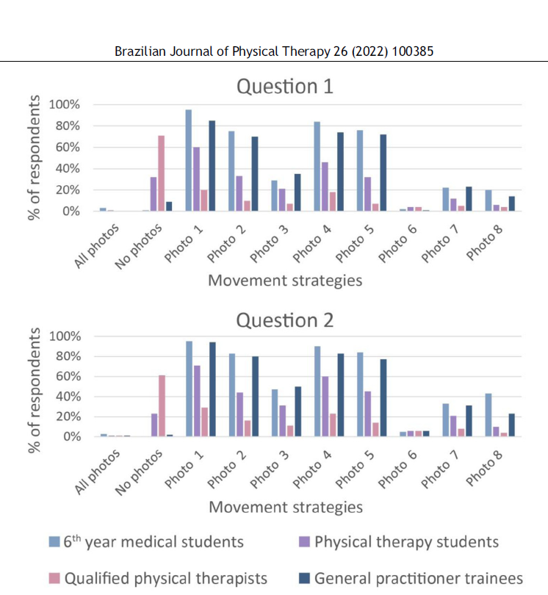
Lifting light loads
Notes:
Lets revisit
When surveying physical therapists, physical therapist students, medical students, and general practitioner residents, it was observed that many make recommendations against certain postures.
Overall, 77% of practicing therapists and 71% of students were aware that none of the postures were unsafe
however there is Almost unanimous support for the squat posture, photo 6, more agreeance on kneeling postures or mostly neutral postures like 3, 7, and 8. I think its incredible to see the agreement on 1,2,4 and 5.
It is theorized that people with more biomechanical reasoning and traditional views on back pain make more stringent recommendations.
Rialet-Micoulau J, Lucas V, Demoulin C, Pitance L. Misconceptions of physical therapists and medical doctors regarding the impact of lifting a light load on low back pain. Braz J Phys Ther. 2022;26(1):100385. doi:10.1016/j.bjpt.2021.100385

Slide 42
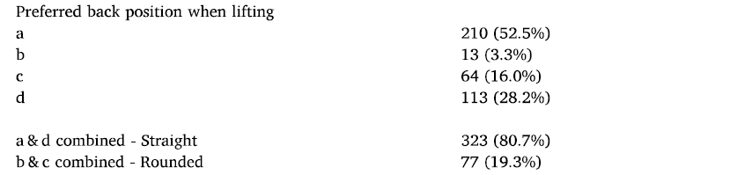
Lifting heavy loads
Notes:
I am going to show you another series of pictures. In this, I want you to imagine the person is picking up a box they would say is heavy, but is still able to lift it.
It seems like the issues are further exacerbated by weight of the object.
In this study, 400 physical therapists and manual handling advisors were surveyed
Gave the participants the back paq- a score 34 likert style survey to highlight beliefs about back pain and injuries
Took pictures of one 37 year old male in different lifting positions,
Gave information to assume the load was heavy to the subject, but he is still able to lift it.
Asked people to rate which lift was the safest
In contrast to the prior study, only 20% of respondents picked some form of rounded posture.
Differences in responses could indicate a variety of differences, like culture, experience, background, or even discomfort with spinal loading.
Nolan D, O'Sullivan K, Stephenson J, O'Sullivan P, Lucock M. What do physiotherapists and manual handling advisors consider the safest lifting posture, and do back beliefs influence their choice?. Musculoskelet Sci Pract. 2018;33:35-40. doi:10.1016/j.msksp.2017.10.010

Slide 43
Kinesiophobia and healthcare providers
Interactions between beliefs and recommendations
  biomedical
  biopsychosocial
Notes:
It is not just patient beliefs that influences movement, but our beliefs. I brought up the recommendation slides to try and get you thinking before we got here about how your beliefs may influene how you practice and the recommendations you make.
There are a handful of studies that have linked recommendations to clinician beliefs.
Generally, physicians and material handling advisors hold more biomedical and biomechanical beliefs and tend to follow the information from the first half of my presentation and encourage neutral spines and squat positions as the safest lifting posture.
Physical therapists generally hold more biopsychosocial beliefs, and are okay with a spectrum of movement, however we’re not immune.
Rialet-Micoulau J, Lucas V, Demoulin C, Pitance L. Misconceptions of physical therapists and medical doctors regarding the impact of lifting a light load on low back pain. Braz J Phys Ther. 2022;26(1):100385. doi:10.1016/j.bjpt.2021.100385
Lakke SE, Soer R, Krijnen WP, van der Schans CP, Reneman MF, Geertzen JH. Influence of Physical Therapists' Kinesiophobic Beliefs on Lifting Capacity in Healthy Adults. Phys Ther. 2015;95(9):1224-1233. doi:10.2522/ptj.20130194
Nolan D, O'Sullivan K, Stephenson J, O'Sullivan P, Lucock M. What do physiotherapists and manual handling advisors consider the safest lifting posture, and do back beliefs influence their choice?. Musculoskelet Sci Pract. 2018;33:35-40. doi:10.1016/j.msksp.2017.10.010

Slide 44
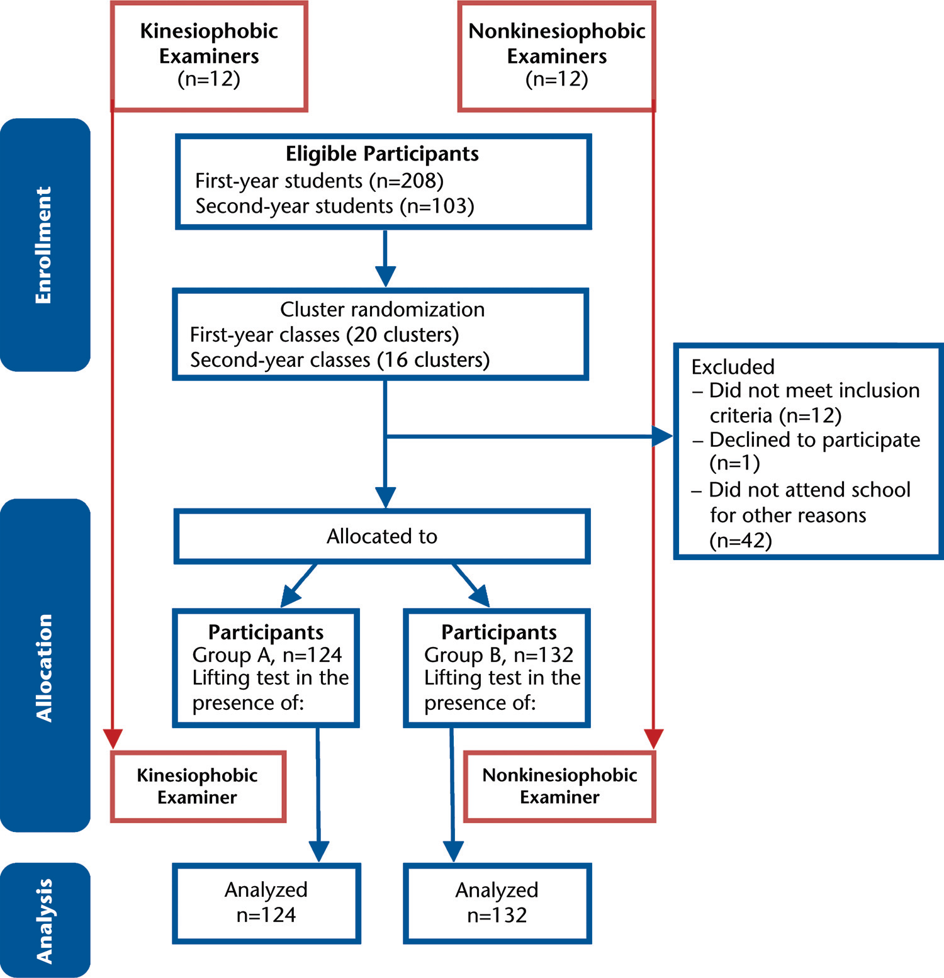
Fearful practice
Notes:
We know that beliefs can impact what we do with patients, but this was the first study to examine how those beliefs influence what we do.
This was a blinded, cluster randomized cross sectional study that involved two groups of participants- examiners and participants- lifters
The examiner group was comprised of second year physical therapist students, and divided by kinesiophobic beliefs.
The lifter group were first year physical therapist students and were randomly allocated to one of two testers to determine the effect examiner beliefs has on lifting performance.
SE, Soer R, Krijnen WP, van der Schans CP, Reneman MF, Geertzen JH. Influence of Physical Therapists' Kinesiophobic Beliefs on Lifting Capacity in Healthy Adults. Phys Ther. 2015;95(9):1224-1233. doi:10.2522/ptj.20130194

Slide 45
Testing and results
Incremental increases in lifting intensity
  Lifting a weighted box to a table
Kinesiophobic examiners
  Kinesiphobic participants lifted 14.4kg less
  Non kinesiphobic participants lifted 8.0kg less
Notes:
Participants performed five repetitions placing a box from the floor to a table. Then weight would be added to the box. During the protocol, examiners and participants rated their perceived RPE with a 1-10 borg scale.
Testing ended if the participant wanted to, participants reached 85% MHR, or observer ended the examination either due to safety, or because they believed the participant could not lift more.
Overall, kinesiphobic examiners reduced the lifting capacity of participants.
Kinesiphobic participants with fearful examiners lifted 14.4kg less
Even non kinesiphobic participants lifted 8.0kg less.
We are potentially harming self efficacy by limiting patients, contributing to underloading tissue
SE, Soer R, Krijnen WP, van der Schans CP, Reneman MF, Geertzen JH. Influence of Physical Therapists' Kinesiophobic Beliefs on Lifting Capacity in Healthy Adults. Phys Ther. 2015;95(9):1224-1233. doi:10.2522/ptj.20130194

Slide 46
What is best?
It depends…
Notes:
Lifting and mechanical loading, especially occupational loading are risk factors for low back pain. While I do not personally believe it particularly matters at higher forces, for the sake of the current recommendations pertaining to this presentation, It appears that for loads up to 25kg, posture does not have a relationship to injuries or the onset of low back pain
“one must conclude that instructions as to lifting postures must reflect concern for the person’s strength, mobility, as well as the size of the object to be lifted”
NIOSH
Unraveling the complexity of low back pain

Slide 47
Prevention
Exercise is protective
Work related stress vs recreational stress
Notes:
While loading is a risk factor, and education regarding posture doesn’t seem to do a whole lot, the best evidence is for people to engage in general exercise. We can build load tolerance, and encourage people to have a greater movement variety to reduce disability of low back pain.
We need to reduce the words that harm

Slide 48
Rehabilitation
Nociceptive
  Vary movement strategies
Nociplastic
  Graded activity
Notes:
We should try to take a staging approach to these issues
With nociceptive dominant pain types, there is tissue that is agitated. It will hurt to move, and we should try to help people find different movement strategies to make movement more comfortable
Part of rehabilitation should be preparation

Slide 49
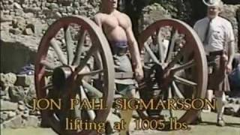
Parting words

Slide 50
References

