Slide 1
Navicular fractures associated with lateral ankle sprains
Dr. Shannon Pennella, PT, DPT
Notes:
Thank you Steve for that introduction. Today we are going to be talking about navicular fractures associated with lateral ankle sprains, a new injury combination.

Slide 2
Conflict of Interest
The presenter has no conflict of interest to disclose
Notes:
I have no conflict of interests in this presentation

Slide 3
Objectives
Review and discuss relevant anatomy of the ankle
Discuss types of navicular fractures
Discuss the prevalence of navicular fractures
Discuss ankle sprain prevalence and associated complications
Review non operative management of a navicular fracture with a case study
Notes:
Our objectives for today are:
To discuss the relevant anatomy of the foot and ankle,
Discuss types of fractures that can occur at the navicular bone, both chronic and acute
Discuss the prevalence of navicular fractures
Discuss ankle sprain prevalence associated complications
And then to close we will review a case study of non operative management of a navicular fracture.

Slide 4
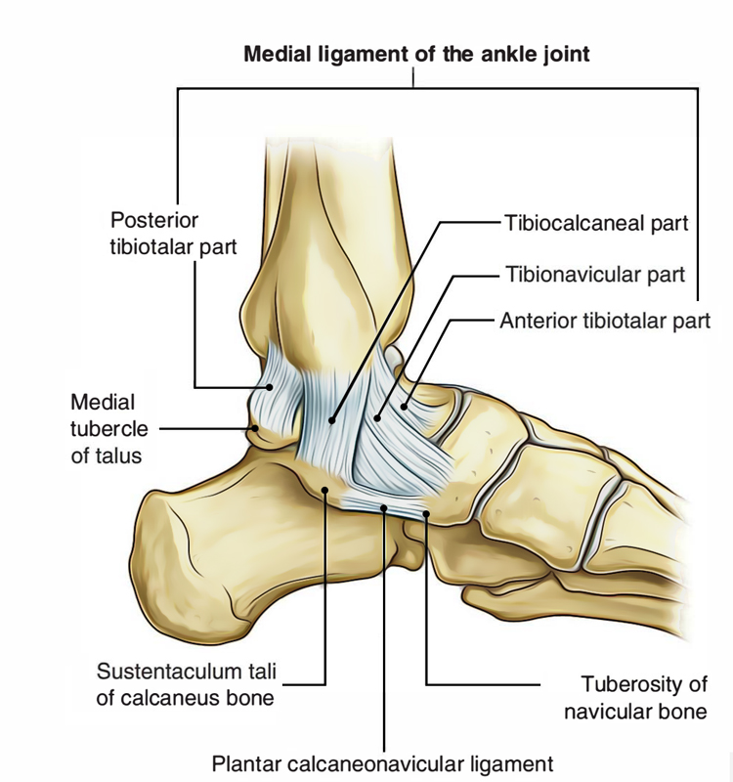
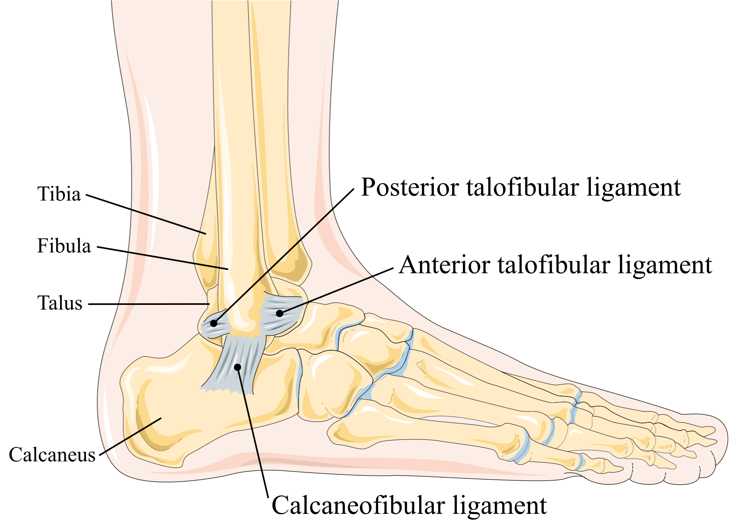
Anatomy
Lateral Ankle
Medial Ankle
Notes:
I included this slide as review of ligamentous complex of both the lateral and medial ankle. On the left hand side is the lateral ankle. The ligaments to highlight are the anterior talofibular ligament, the posterior talofibular ligament and the calcaneofibular ligament, often involved in lateral ankle sprains. On the right hand side of your slide is the medial ankle complex. The deltoid ligament which is composed of the tibiocalcaneal, tibionavicular and anterior and posterior tibiotalar ligament provides stability medially. The plantar calcaneonavicular ligament otherwise known as the spring ligament and the tibionavicular ligament insert on the navicular. The navicular also serves as an important attachment site for the posterior tibial tendon.

Slide 5
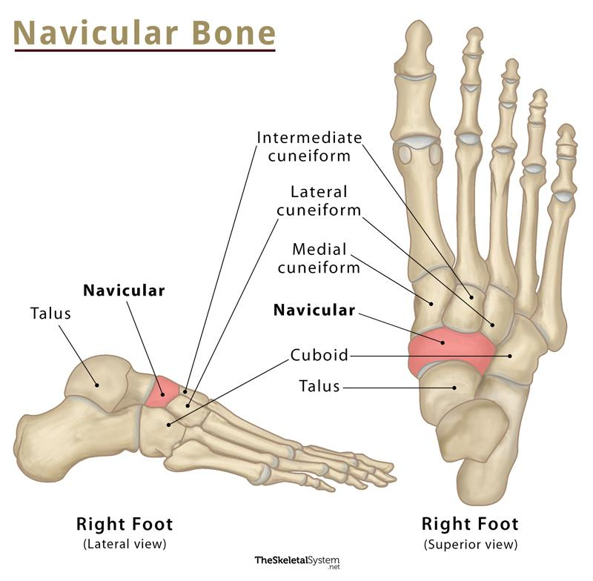
Navicular Anatomy
Saucer shaped
Articulations
  Distally: three cuneiforms
    3 facets and synovial cavity
  Proximally: Talar head
  Laterally: Cuboid
Ligaments reinforce articulations
  Medial longitudinal column of foot
    Dorsal, inferior and plantar calcaneonavicular (spring), anterior fibers of deltoid
    Posterior tibialis tendon
Rosenbaum et al. 2014, Rosenbaum et al. 2015, Marshall et al. 2020, Petrie et al, 2018
Notes:
As we have discussed the ligamentous complexes of the ankle, we are going to focus in on the foot and particularly the navicular bone. The navicular is a saucer shaped bone that is often described as the keystone of the medial longitudinal arch. It articulates with the three cuneiforms distally, talar head proximally, and the cuboid laterally which creates a synovial cavity and reinforced by ligaments. As mentioned earlier, dorsal, inferior and plantar calcaneonavicular ligaments as well as the anterior fibers of the deltoid ligament provide static stability of the foot. The posterior tibialis also inserts on the navicular and create dynamic stability of the medial longitudinal arch during gait.

Slide 6
Navicular Blood Supply
Mostly avascular
Anastomoses
  Dorsalis pedis and medial plantar branch of posterior tibial artery
Rosenbaum et al. 2014, Rosenbaum et al. 2015, Marshall et al. 2020
Notes:
We know that the navicular bone is surrounded by a dense articular capsule. It going to receive blood supply from the anastomoses of the dorsalis pedis and posterior tib artery. Due to this anastomoses the middle 1/3 of the bone is avascular, making it susceptible to non union and stress fractures. This can lead to avascular necrosis of the navicular bone if left untreated.

Slide 7
Biomechanics
Keystone of medial longitudinal arch
Transition from flexible to rigid
  Heel Strike (flexible)
    Talonavicular and calcaneocuboid unlock with calcaneal eversion
  Toe off (rigid)
    Calcaneal inversion creates locking
Coupled with subtalar motion
Rosenbaum et al. 2014, Rosenbaum et al. 2015, Marshall et al. 2020,
Notes:
Multiple sources have referred to the navicular bone as the “keystone” of the medial longitudinal arch due to the ball and socket nature of the joint and it’s role in the transverse tarsal joint complex, which is comprised of the talonavicular and calcaneocuboid joint. Depending on the position of the calcaneus it allows for locking and unlocking of the medial longitudinal arch to allow for proper gait mechanics. During heel strike the transverse tarsal joint unlocks allowing for a flexible foot for shock absorption, and then will lock during toe off to allow for propulsion. The talonavicular joint is coupled tightly with subtalar motion to allow for gait mechanics and ability to ambulate on uneven surfaces. If the subtalar joint is fused only 26% of talonavicular motion is available. Due to the biomechanics and anatomy of the navicular, and its role in ambulation, it requires high forces for injury. It is similar to pelvic ring in that high forces will also damage surrounding soft tissue and adjacent medial and lateral column structures. Dysfunction in the medial longitudinal arch can lead to arch collapse, flat foot deformity, and progressive subtalar valgus all resulting in increased pain and decreased function.

Slide 8
Prevalence of Navicular Fractures
5% of all foot injuries
  Navicular fractures 35.5% of midfoot injuries
    1.7/100,000 each year
  High energy mechanisms
    Motor vehicle Collison
  Rarely in isolation
    Usually with other fractures and dislocation of mid foot
Rosenbaum et al. 2014, Rosenbaum et al. 2015, Marshall et al. 2020, Petrie et al, 2018
Notes:
Based off the biomechanics and anatomy of the foot, injury to the mid foot, and especially the tarsal bones are rare accounting for 5% of all foot injuries. Of the 5% of injuries mid foot injuries 35.5% are to the navicular. They require high energy mechanisms and are often associated with motor vehicle collisions. Due to the high energy mechanism there are often other associating injuries that result in fractures to the navicular being overlooked or missed. Navicular fractures are rarely seen in isolation and are often associated with other fractures or dislocations of the mid foot.

Slide 9
Types of Navicular Fractures
Chronic
  Stress fractures
Acute
  Body fractures
    Stratified into three types
  Tuberosity fractures
  Avulsion fractures
Rosenbaum et al. 2014, Rosenbaum et al. 2015, Marshall et al. 2020, Petrie et al, 2018
Notes:
It can be a site of stress fractures as well, which is going to be more of a chronic injury that is often overlooked. There are some inconsistences in classification of acute fractures however majority of the literature classifies navicular fractures by three types avulsion, tuberosity and body fractures. Classifying and understanding these fractures allows for appropriate management of the fracture and clinical decision making.

Slide 10
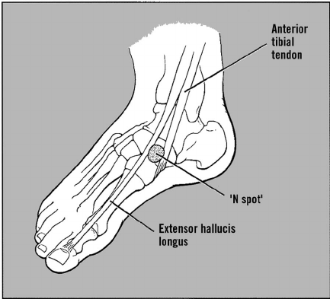
Stress Fractures
Tenderness over the “N” spot
Initially diagnosed as tendonitis
Anastomoses causes watershed
Pes cavus increased risk
Vopat et al. 2017, Marshall et al. 2020,
Notes:
We will talk about chronic fractures first then progress to more of the acute fractures. Stress fractures are the most common type of chronic fracture that can occur at the navicular bone. Stress fractures will often have tenderness over the “N” or the high point of the navicular. The “N” spot is located in between the anterior tibialis tendon and the extensor hallucis longus tendon shown above. It is often diagnosed as a midfoot sprain or tendonitis. Due to the biomechanics and requirements for gait, there is increased load on the navicular. Someone with pes cavus may be at increased risk secondary to the load placed on the navicular. Due to the watershed area of the navicular and poor blood supply it can increase risk of non union, and delayed healing, which often leads to surgical management.

Slide 11
Body Fractures
Type 1
Transverse fracture in coronal plane
Dorsal fragment consisting of <50% of body
No disruption of alignment
Type 2
Most common
Medially displaced fragment
Dorsolateral to plantar medially
Type 3
Grossly comminuted
Lateral displacement
Often involve calcaneocuboid and naviculocuneiform
Rosenbaum et al. 2014, Rosenbaum et al. 2015, Marshall et al. 2020, Petrie et al, 2018
Notes:
Moving into more of the acute fractures we will start with discussing body fractures, where the fracture is through the body of the navicular. Sangezorean sub categorized body fractures based on the main fracture line, direction of displacement of forefoot, and pattern of disruption, into type 1, 2, and 3. Acute body fractures can be caused by direct or indirect forces and can often be associated with other injuries of the midfoot. Body fractures often result in increased risk of developing foot deformity due to displacement of the navicular. Type 1 is usual the most stable based off fracture line and often does not require surgery, however type 2 and 3 are usually displaced and will require surgical fixation. Patients with a body fracture will present with inability to bear weight and will have substantial swelling dorsally and medially.

Slide 12
Tuberosity Fractures
Traction of posterior tibial tendon or spring ligament
  Eversion or hindfoot valgus
Mimic type 2 body fractures
Rosenbaum et al. 2014, Rosenbaum et al. 2015, Marshall et al. 2020, Petrie et al, 2018
Notes:
Tuberosity fractures involve the navicular tuberosity. There is some discrepancy in the literature in terms of classifying it as true tuberosity fracture or an avulsion fracture. Petrie et al. classified it as an avulsion fracture and considers it to be a sub classification of avulsion fractures, where as Marshall et al and Rosenbaum et al, have tuberosity fractures classified into its own category. Approximately 11% of patients present with tuberosity fractures. They are caused with increased forces into eversion, hindfoot valgus, or forefoot abduction of the posterior tibial tendon and the spring ligament results in causing the tuberosity to avulse or fracture. Isolated tuberosity fractures are often managed non operatively. They can sometimes mimic type 2 body fractures on imaging but the primary fracture is smaller in true tuberosity fractures.

Slide 13
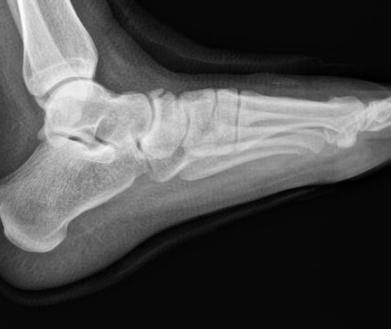
Avulsion Fractures
50% of all acute navicular fractures
Medial Avulsion
  Anterior division of deltoid
  Eversion
Dorsal avulsion
  Talonavicular ligament
  Extreme inversion/plantar flexion
Rosenbaum et al. 2014, Rosenbaum et al. 2015, Marshall et al. 2020, Petrie et al, 2018
Notes:
Avulsion fractures will often present with severe pain in the midfoot during push off. Medial avulsion can involve the posterior tibial tendon or spring ligament with an eversion mechanism of injury, and can often cause the tuberosity to avulse, similar to a tuberosity fracture. Dorsal avulsion are usually low energy and result from the talonavicular ligament being avulsed from the dorsal portion of the navicular, as shown in the image above. They will occur with extreme inversion/plantarflexion and as a result are part of Ottawa ankle rules. Avulsion fractures are usually extra articular and Petrie et al reported that all patients in this group did not require surgical management.

Slide 14
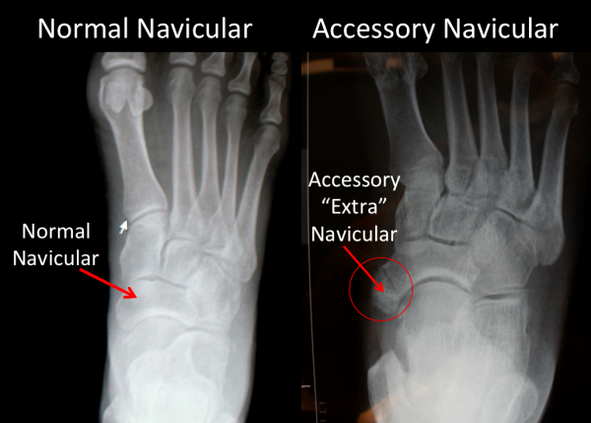
Anatomical Variations
Accessory navicular
  4 -21% in population
Usually asymptomatic
Type II
  Often mistaken for navicular tuberosity fracture
Alsager et al, 2022
Notes:
One thing to keep in mind as we discuss fractures is the anatomical variations that can show up on imaging. The accessory navicular is found in 4-21% of the population. It is usually an asymptomatic bone that can develop symptoms with a twisting injury. A recent study by Alsager et al looked to further classify accessory navicular bones into three types. Type II can often be mistake for a navicular tuberosity fracture, and type II and III can be more likely to be associated with posterior tibial tendon insufficiency and flat foot deformity. This study’s clinical importance helps us add to our differential diagnosis when examining someone with mid foot pain. Patients usually with an accessory navicular will present with tenderness over the medial aspect of mid step, however fracture will be more diffuse with ecchymoses of mid foot. Fractures will present on radiographs as sharp with irregular borders, accessory naviculars will not. The image helps to highlight the difference between a normal navicular and an accessory navicular on radiographic imaging. We can appreciate the smooth borders on the right hand side of the image.

Slide 15
Management
Non Operative
  Non displaced body fractures
  Avulsion fractures
Operative
  Displaced body fractures
  Tuberosity fractures
Rosenbaum et al. 2014, Rosenbaum et al. 2015, Marshall et al. 2020, Petrie et al, 2018
Notes:
In terms of management, body fractures are the most discussed in literature secondary to risk of avascular necrosis, non union, and increased risk of foot deformity. Due to the nature of injury body fractures are often displaced and usually require surgery. Operative management is usually chosen when the joint congruency is >1 mm, shortening medial column >2-3 mm, open fracture and skin compromise. The goal of surgery is to restore the congruency of talonavicular joint for proper ambulation. Usually type 2 and 3 body fractures are managed surgically. Tuberosity fractures are often managed surgically secondary to increased risk of flat foot deformity and posterior tibialis tendon dysfunction. Operative management make up less than a fifth of all acute fractures. Type 1 body fractures can be managed non operatively if it is stable and no mal alignment is present. Avulsion fractures are often managed non operatively especially if the congruency of the joint is maintained.

Slide 16
Non-operative management
Non weightbearing for 6-8 weeks OR weightbearing cast for 4-6 weeks
  No soft tissue injury NWB 1-2 days
Early movement encouraged
Progression to shoe 8-10 weeks
Rosenbaum et al. 2015, Marshall et al. 2020
Notes:
Non operative management of these acute fractures are usually going to have patients non weight bearing for 6-8 weeks or weightbearing CAM boot for 4-6 weeks. Usually they are going to respect fracture healing times and the goal is to offload the stress placed on the foot. If there is no significant soft tissue injury some sources report offloading the area for 1-2 days. Early movement is encouraged, and patients usually progress to a shoe and normal gait mechanics in 8-10 weeks. Repeat imaging is usually taken at those times to see callus formation and healing fracture.

Slide 17
Ankle Sprains
2 million occur annually
  2-7 acute ankle sprains/1000 people
First ranking ankle/foot injury for US Army Soldiers
  35/1000 people
16-40% in sports
  15% of all in injuries in high school and college team sports
Halabachi et al. 2020, Herzog et al. 2019, Rhon et al. 2021, Debieux et al. 2019
Notes:
I want to transition gears here and discuss a more common injury in the foot, which is ankle sprains. Over 2 million ankle sprains occur in the United States annually, with data suggesting that 2-7/1000 people present to the ED with complaints of ankle sprains. That number is probably higher though because not many will seek medical care. This injury is even more highly prevalent in the athletic population and military personal, secondary to increased demand of the ankle and foot.

Slide 18
Anatomy
Lateral ankle
  85% ankle sprains
Medial ankle
  15% ankle sprains
Halabachi et al. 2020, Herzog et al. 2019, Rhon et al. 2021, Debieux et al. 2019
Notes:
As mentioned of those 2 million ankle sprains that occur, 85% involve the lateral ligamentous complex with majority of them involving the anterior talofibular ligament or ATFL. 65% of time lateral ankle sprains are isolated to ATFL and the remaining 20% involves both the calcaneofibular ligament or the CFL and ATFL. The remaining 15% involve either the deltoid complex or syndesmosis injuries. For the purpose of this presentation we are going to focus more on the lateral ankle moving forward

Slide 19
Lateral Ankle Sprains
Mechanism of Injury: Plantarflexion and inversion
Risk factors
  Previous history of ankle sprain, overweight, ankle joint laxity, impaired balance
12-47% recurrence
  3.5x more likely
  70% develop chronic ankle stability
Halabachi et al. 2020, Herzog et al. 2019, Rhon et al. 2021,
Notes:
With the ATFL and CFL being the primary players, the most common mechanism of injury is plantarflexion and inversion. Any other type of foot position may lead to other structures involved. Previous studies have looked at possible risk factors with many having inconclusive evidence that predisposes someone to an ankle sprain, however the biggest risk factor that predisposes someone for an ankle sprain is a previous history of ankle sprain. Being overweight, ankle joint laxity, and impaired balance, can also predisopose someone to a lateral ankle sprain. With the high prevalence of lateral ankle sprains, it can lead to disability and recurrence, as individuals who sustained a previous ankle injury were 3.5 times more likely to sustain another ankle injury, with a recurrence rate of 12-47%. With high rate of recurrence, chronic ankle instability can develop 70% of the time which leads to increased disability.

Slide 20
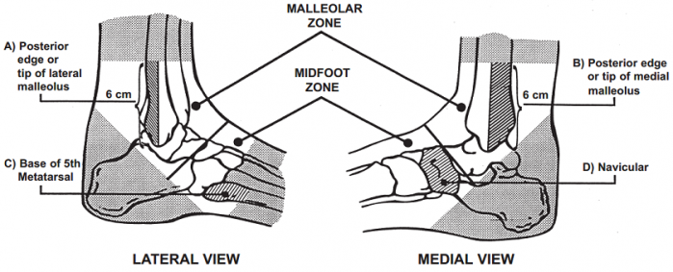
Ottawa Ankle Rules
Inability to bear weight AND tender to palpation
  Malleolar or midfoot zone
Reduces
  Unnecessary radiographs
  Health care cost
Halabachi et al. 2020, Debieux et al. 2019
Notes:
As common as lateral ankle sprains are, when someone presents with an acute ankle injury it is our due diligence to perform a thorough exam including palpation to the surrounding bones and structures. Tenderness to palpation along both malleoli, base of the 5th metatarsal , and the navicular can increase likelihood of fractures. Based off the ottowa ankle rules, which were developed to reduce health care costs and diminish unnecessary radiograph imaging the rules help with clinical reasoning. It allows us to rule in imaging if a patient presents with bony tenderness over those areas and inability to weight bear, patient may have an associated fracture. Although the navicular bone is included in the ottowa ankle rules, it is not a common presentation associated with lateral ankle sprain.

Slide 21
Rhon et al. 2021
Cohort study military personnel reporting ankle injury
  30,910 patients between 2009 and 2012
    22.8% of cases diagnosed with fracture
    Fracture cases were 4x more likely to have surgery
Rhon et al. 2021
Notes:
In a study by Rhon et al. discussed the prevalence of fractures and chronic recurrence in lateral ankle sprains with a retrospective cohort study. They looked at over 30,000 patients who were enrolled in the military in a 5 year span that presented with an ankle injury. They looked at total costs and cases that required surgery. Almost ¼ of the patients had an associated fracture with ankle sprain, and the fracture cases were more likely to require surgery. Although it did not specify type of fracture it gives us an idea of how prevalent associated fractures are with inversion ankle sprains. They discussed that of those patients, individuals with an associative fracture were 4x more likely to undergo operative management.

Slide 22
Debieux et al. 2020
MRI imaging
  Different foot and ankle injuries in emergency department
    1 year, 8-70 years old
Followed Ottawa Ankle Rules
180 ankles assessed
  21.7% of patients fracture
  3 most common: ATFL avulsion (23.5%), anterior calcaneus process (17.6%), Cuboid (13.7%)
  Navicular fractures: 0.016%
Debieux et al. 2019
Notes:
In another study performed by Debieux et al utilized MRI imaging to assess the prevalence of foot and ankle injuries and non diagnosable fractures on radiographs in patients that presented to the ED with an episode of an ankle sprain. Based off the Ottawa ankle rules and clinical exam, patients were given MRI imaging if they met the criteria. Of the patients assessed, fractures were found to occur in 21.7% of patients. This is consistent with Rhon et al that fractures occurred in 22% of all ankle injuries. The most common fractures were ATFL avulsion fractures, calcaneus process fractures, and cuboid fractures. It is important to note that of the 180 patients, there were only 3 navicular fractures giving it a prevalence rate of 0.016%.

Slide 23
Khor et al. 2013
Retrospective study
  64 patients with MRI
  ATFL injuries 75% of patients
  53% concomitant pathologies
    50% bone bruising
    22% associated fractures
      1 patient had a navicular fracture (did not specify)
Khor et al. 2013
Notes:
Khor et al discussed anatomic injuries associated with ankle sprains done with MRI imaging. Of the 64 patients that were scanned, their results are consistent with the previous reported studies of associated fracture of 22%. One patient in this study presented with a fracture of the navicular, but it did not discuss what type of fracture. Based off the previous research we can conclude that fractures occur with approximately 22% of ankle sprains, and navicular fractures have a very low prevalence.

Slide 24
Singh et al. 2021
18 year old female long jumper twisting injury
  Pain in swelling over right ankle of foot and unable to bear weight
  Point tenderness along mid foot and lateral aspect of ankle below lateral malleolus
    X-rays: displaced tarsal navicular fracture classified as a Sangeorzan type II
    MRI: complete ATFL tear with navicular body fracture
Singh et al. 2021
Notes:
Based off those three studies we know fractures are associated 22% of the time, and that navicular fractures have a low prevalence . Singh et al is the first to report a navicular body fracture associated with lateral ankle injury in a case study published in 2021. The patient was an 18 year old female long jumper who sustained a twisting injury, ( did not specify type of twisting injury) with imaging showing a type II navicular body fracture and complete ATFL tear. The patient underwent surgical fixation due to displaced nature of the navicular and was allowed to resume physical activity within 4 months after surgery. This is an operative example of managing a navicular fracture associated with lateral ankle sprain.

Slide 25
Case Study
16 y/o female athlete
  PMH: bilateral ASIS avulsion fractures
March 6th
  Right inversion ankle sprain with audible pop noted
  “Patient able to ambulate home on tip toes and with help of friend at time of injury”
  Pain w/ WB, and mostly on dorsum of the foot
Notes:
As we have discussed surgical case that was reported in literature, I would like to present a nonsurgical case that was seen in our network by a colleague of mine. The patient is a 16 y/o female track and field athlete. Her PMH is unremarkable, with the exception of bilateral ASIS avulsion fractures, that was treated non operatively with physical therapy a year prior. In march she was playing basket ball and had an inversion ankle sprain and heard a pop. At the time she was able to ambulate home on forefoot and had pain primarily with weight bearing mostly on the dorsum of the foot. She had presented to emergency room secondary to inability to bear full weight on her foot.

Slide 26
Imaging
X rays
  “Flake type avulsion fracture on dorsal aspect of the navicular”
Notes:
Due to inability to bear weight on her foot, and tenderness over the navicular she had plain film radiographs taken at the emergency department. Radiologist report read: “flake type avulsion fracture on the dorsal aspect of the navicular” She was referred to pediatric orthopedics, placed in weightbearing CAM boot after leaving the emergency department.

Slide 27
Medical Exam
+ swelling in ankle
Tenderness along ATFL, navicular
Anterior drawer negative
Decreased range of motion
Sensation and motor intact
Notes:
She followed up with pediatric orthopedics 2 days later. Orthopedic examed revealed swelling in the ankle, tenderness to palpation along the ATFL and navicular, negative anterior drawer, decreased range of motion throughout. Her sensorimotor exam was intact.

Slide 28
Medical Treatment
CAM boot
  weightbearing as tolerated for 3 weeks
March 30th
  Cleared to return to sport
Notes:
Pediatric orthopedics kept her in the CAM boot from her ED visit and kept her in the cam boot for 3 weeks. She followed up with pediatric orthopedics at the end of the month and at that time the fracture had formed a callus and was cleared for full return to sport with no restrictions.

Slide 29
Physical Therapy Consult
April 26th
  Chief complaint: pain with jumping and push off during track and field
  Pain ranges from 6/10 -10/10
Notes:
About a month later after she was medically cleared by the physician she had presented to physical therapy for consult via direct access with chief complaint of pain with jumping and push off during a track and field meet, with pain ranging from a 6-10/10. She was still struggling with push off.

Slide 30
Physical Exam
Strength | Left | Right
ANKLE Anterior tibialis | 5/5 | 5/5
Posterior tibialis | 4+/5 | 4/5
Fibularis long/brevis | 4+/5 | 4+/5
Fibularis tertius | 4+/5 | 4+/5
FOOT
Extensor hallicus longus | 5/5 | 5/5
Flexor hallicus longus | 4+/5 | 4+/5
Active ROM | Left | Right
Dorsiflexion (ke) | 10 | 5
Plantar flexion | 40 | 38
Inversion | 10 | 8
Eversion | 8 | 5
Great toe extension | 30 | 30
Notes:
This was her physical exam, in which I have highlighted the limitations found on initial examination. Her primary limitations were dorsiflexion range of motion and weakness in R her posterior tibilias.

Slide 31
Physical Exam
Overall Impairments
  Poor foot posture
    Pes planus
    Early excessive pronator
  Decreased intrinsic strength
  Hypomobility of foot/ankle
  Foto Score: 44
Notes:
Based off the physical exam, her primary impairments that she presented with were foot and ankle hypomobility (primarily the subtalar and talocrual joint), decreased intrinsic ankle strength and poor foot posture. She presented with pes planus and during ambulation was an early excessive pronator. Her Foto score on initial evaluation was 44. Based off FOTO, she reported that she had quite a bit of difficulty with walking a mile, heavy activities and her usual activities. She had moderate difficulty with light activites.

Slide 32
Treatment
Sessions focused on
  Intrinsic
  Posterior tib strengthening
  Stability exercises
  Uneven surfaces with perturbations
HEP
  Plantar fascia stretching, short foot, toe yoga
Notes:
Her initial home program given was plantar fascia stretching, short foot, and toe yoga to help with ankle hypomobility and impaired intrinsic strength of her foot. Her sessions focused primarily on intrinsic and posterior tibialis strengthening, closed chain stability exercises in single leg and was progressed to uneven surfaces, and perturbations.

Slide 33
Discharge
May 25th
  Patient seen for 5 visits
  100% improvement in pain and function
  FOTO: 99
    Predicted: 79
Notes:
The patient was seen for a total of 5 visits over a month time span. Upon discharge she noted 100% improvement and had returned to sport with no pain or dysfunction. Her FOTO on discharge was 99. FOTO is a multifactorial outcome measure that looks at age, comorbidities, activity level and rates it on a scale compared to the national average. The predicted outcome measure for this patient was 79 so she was above the national outcome on discharge day

Slide 34
Take Home Points
Navicular fractures rare
Ankle sprains are common
Navicular fractures with ankle sprains
  Low prevalence
Diagnoses delayed and missed
  Mid foot sprain
Notes:
In conclusion, navicular fractures are rare in isolation and are ofted associated with high energy traumas. In comparison lateral ankle sprains are a common diagnosis that are often treated and seen in both physical therapy clinics and medical offices. Ankle sprains are a diagnosis that often presents to physical therapy direct access. It is important to understand that navicular fractures associated with ankle sprains have a low prevalence, however the navicular is included in the ottowa ankle rules because they can happen. During our physical exam it is important to due our due diligence with ruling out a navicular fracture secondary to the decreased blood flow to the area and the important role the navicular plays in gait. Due to its importance it is a diagnosis that we do not want to miss and can be often overlooked and delayed secondary to the low prevalence. This presentation's goal was to highlight and bring attention to navicular fractures in order to allow us with better clincal reasoning and to provide the best quality patient care.

Slide 35
Questions?
Notes:
Thank you for your time, are there any questions?

Slide 36
References
Rosebaum AJ, Uhl RL, DiPreta J. Acute fractures of the tarsal navicular. Orthopedics. 2014; 37(8)541-546
Rosenbaum AJ, DiPreta JA, Tartaglione J, Patel N, Uhl RL. Acute Fractures of the Tarsal Navicular: A Critical Analysis Review. JBJS Rev. 2015;3(3):e5.
Marshall D, MacFarlane RJ, Molloy A, Mason L. A review of the management and outcomes of tarsal navicular fracture. Foot Ankle Surg. 2020;26(5):480-486.
Petrie MJ, Blakey CM, Chadwick C, Davies HG, Blundell CM, Davies MB. A new and reliable classification system for fractures of the navicular and associated injuries to the midfoot. Bone Joint J. 2018;100-B(2):176-182.
Vopat B, Beaulieu-Jones BR, Waryasz G, et al. Epidemiology of Navicular Injury at the NFL Combine and Their Impact on an Athlete’s Prospective NFL Career. Orthopaedic Journal of Sports Medicine. 2017;5(8).
Alsager GA, Alzahrani K, Alshayhan F, Alotaibi RA, Murrad K, Arafah O. Prevalence and classification of accessory navicular bone: a medical record review. Ann Saudi Med. 2022;42(5):327-333.
Halabchi F, Hassabi M. Acute ankle sprain in athletes: Clinical aspects and algorithmic approach. World J Orthop. 2020;11(12):534-558. Published 2020 Dec 18.
Herzog MM, Kerr ZY, Marshall SW, Wikstrom EA. Epidemiology of Ankle Sprains and Chronic Ankle Instability. J Athl Train. 2019;54(6):603-610.
Rhon DI, Greenlee TA, Cook CE, Westrick RB, Umlauf JA, Fraser JJ. Fractures and Chronic Recurrence are Commonly Associated with Ankle Sprains: a 5-year Population-level Cohort of Patients Seen in the U.S. Military Health System. Int J Sports Phys Ther. 2021;16(5):1313-1322. Published 2021 Oct 1.
Debieux P, Wajnsztejn A, Mansur NSB. Epidemiology of injuries due to ankle sprain diagnosed in an orthopedic emergency room. Einstein (Sao Paulo). 2019;18:eAO4739. Published 2019 Sep 23
Singh A, Gföller P, Ulicki P. A Case Report of Tarsal Navicular Body Fracture with Lateral Ankle Ligament Complex Tear - a New Injury Combination. J Orthop Case Rep. 2021;11(8):63-67
Khor YP, Tan KJ. The Anatomic Pattern of Injuries in Acute Inversion Ankle Sprains: A Magnetic Resonance Imaging Study. Orthop J Sports Med. 2013;1(7):2325967113517078.

