Slide 1
A Pediatric Rehabilitation Perspective on:
Amplified Musculoskeletal Pain Syndrome (AMPS)
Courtney Bucher PT, DPT, PCS & Jessica Zelenak, MS OTR/L
Notes:
Introduce self and topic
Jess start, Courtney introduce
Good afternoon! We are hear to discuss a pediatric rehabilitation perspective on amplified musculoskeletal pain syndrome also known as AMPS
I’m Jessica Zelenak and I’m a pediatric OT at St Luke’s North
I’m Courtney Bucher and I’m a pediatric PT at ST Luke’s North

Slide 2
Continuing Medical Education
Credit Information
Attain a comprehensive understanding of AMPS and provide rehabilitative intervention strategies
Target Audience: All Providers
Notes:
J
Just housekeeping, things for CME credits

Slide 3
Designation Statement
It is St. Luke’s University Health Network policy to ensure balance, independence, objectivity and scientific rigor in all of our sponsored educational programs. Faculty and all others who have the ability to control the content of continuing medical education activities sponsored by the St. Luke’s Hospital & Health Network are expected to disclose to the audience whether they do or do not have any real or apparent conflict(s) of interest or other relationships related to the content of their presentation(s).
The St. Luke’s University Health Network is accredited by the Pennsylvania Medical Society to provide continuing medical education for physicians.
The St. Luke’s University Health Network designates this live educational activity for a maximum of 1 AMA PRA Category 1 Credits™. Physicians should only claim credits commensurate to the extent of their participation on the activity.
Notes:
And continued here

Slide 4
Disclosure Information
The Planners involved in this activity have no relevant financial relationships to disclose.
The Faculty/Presenters involved in this activity have no relevant financial relationships to disclose.
Notes:
Lastly, we have no relevant financial relationships to disclose.

Slide 5
Learning Objectives
Define Amplified Musculoskeletal Pain Syndrome (AMPS) and understand a patient’s clinical presentation
Understand which medical diagnoses coincide with AMPS
Perform an initial evaluation with reliable and valid tests and measures
Synthesize best practice for rehabilitation interventions for patients with AMPS
Formulate appropriate goals, monitor progress, and means for discharge from rehabilitation services, focusing on physical and occupational therapy
Notes:
J
Our learning objectives for this course include:

Slide 6
Amplified Musculoskeletal Pain Syndrome
Notes:
Okay let’s Dive into AMPS

Slide 7

What is AMPS?
“Amplified Musculoskeletal Pain Syndrome (AMPS) is a term that encompasses the spectrum of manifestations of chronic pediatric musculoskeletal pain. The common thread underlying these different subtypes is central and/or peripheral sensory pain amplification, hence the name amplified musculoskeletal pain.” (Sherry et al, 2020)
A “spectrum of chronic, non-inflammatory, pediatric musculoskeletal pain” (Sherry et al., 2020)
“These children have real pain and are not exaggerating but the body is amplifying the pain signal.” (Sherry & Krepcio, 2014)
Notes:
J
What is AMPS? I
AMPS is synonymous with “chronic pediatric pain syndrome”
“AMPS can be described as a descriptive term, in which pain is disproportionate to the stimulus, without other medical explanation such as inflammation or injury”. (Weiss & Kashikar-Zuck, 2021)

Slide 8

AMPS- Umbrella Term
Reflex neurovascular dystrophy (RND)
Pediatric Fibromyalgia
Chronic Regional Pain Syndrome (CRPS)
Reflex Sympathetic Dystrophy
and more…
(Sherry & Krepcio, 2014)
Notes:
J
AMPS is an
Umbrella term for collection of other pain diagnoses such as:
Fibromyalgia
Chronic regional pain syndrome (CRPS)
Reflex sympathetic dystrophy (RSD)
Reflex neurovascular dystrophy (RND)
And more (Sherry & Krepcio, 2014)
WHY WE USE TERM AMPS?:
-We will be using the term AMPS throughout our presentation for two reasons
1. Good descriptor as the pain is amplified in these patients and
1. RSD, CRPS, fibromyalgia are common diagnoses among the adult population but children/adolescents with pain present differently so we want to differentiate that they are different than adults
“We prefer the term amplified musculoskeletal pain since it refers to the fact that the body takes a mild pain signal and makes it very painful, similar to when a guitar amplifier takes a soft sound and makes it very loud” (Sherry & Krepcio, 2014)
“We avoid using the terms RSD, CRPS, or fibromyalgia except for research purposes” because “children are different than adults in their presentation, the responses to treatment, and the long-term prognosis; children fare much better.” (Sherry & Krepcio, 2014)

Slide 9

Symptoms: Pain Presentation
Magnified & amplified pain in any body part lasting 3+ months
Can start in one body part and expand to additional body parts or migrate to a different body part
Constant extreme pain (flare) or intermittent pain attacks followed by periods of no pain (remission)
The pain is very real, not “made up” or “just inside of their heads”
https://professionals.paingone.us/chronic-pain-in-children-has-devastating-effect-on-families/
(Sherry et al., 2015; Sherry & Krepcio, 2014; Weiss & Kashikar-Zuck, 2021)
Notes:
C
It is also important to remember that pain is very subjective and people experience pain differently, especially those who are neurodiverse; sometimes its challenging for neurodiverse individuals as well as parents and medical providers to identify pain
The pain that a person with AMPS is feeling is magnified, or amplified, compared to the level of pain that is expected of a specific injury/condition and greatly affects their ability to participate in their daily routines
Amount of noxious stimuli does not correlate to the degree of pain; The pain experienced by the patient often exceeds clinical expectations, Pain is wide-spread pain & heightened pain response

Slide 10

Symptoms: Medical
Headaches, Migraines
Abdominal pain, Irritable Bowel Syndrome (IBS)
Difficulty sleeping
Skin changes
Allodynia
Weight loss
Hyperalgesia following aerobic and isometric exercises
Decreased strength & endurance
Executive functioning difficulties
Conversion symptoms
Psychological symptoms
  Anxiety
  Depression
  Obsessive Compulsive Disorder
  Suicidal ideations
(Black & Zuck, 2016; Jastrowski Mano et al., 2020; Sherry et al., 2020; Weiss & Kashikar-Zuck, 2021)
Notes:
C
Skin changes
Temperature changes- cold, clammy
Color changes- purple, blue, grey
Edema
Rashes
Allodynia- pain from stimuli that are not normally painful- like clothing, something brushing skin like a blanket and having severe pain
Hyperalgesia- due to neurobiological alterations
Strength/endurance
Children with fibromyalgia are more sedentary, deconditioned, weaker, and have altered biomechanics with more guarded movements when compared to age matched peers
Sometimes results in needing to use ambulatory devices- canes, walkers, wheelchairs to ambulate
Executive Functioning difficulties- higher level thinking
Working Memory
Inhibition
Cognitive flexibility
Conversion Symptoms
Involuntary tremors
Dizziness
Lightheadedness
Fainting
Racing Heart
Memory difficulties
Paralysis
Numbness
Inability to walk
Vision difficulties
Ex: A woman sees her dog get run over by a car and then she is blind (no physical problems with eyes or brain, however the stress of her experience disrupts the communication between her eyes and brain resulting in “blindness”
Emotional/Psychological symptoms
Often emotional/psychological symptoms coincide with AMPS due to the overlap in the neural circuitry and neurotransmitters involved (Weiss & Kashikar-Zuck, 2021)

Slide 11
Symptoms: Functional
Less participation in activities
Many school absences
Spending less time with friends
(Weiss & Kashikar-Zuck, 2021)
Notes:
J
Including those that they really enjoy like- Sports, art, music, playing video games
Cannot make it through a full day without the pain taking over
Pain prevents spending time with friends
Prefer to lay around or in bed because of the pain

Slide 12
Personal & Family Characteristics
Personal
Family
Mature beyond years
Excels at school and extracurricular activities
Perfectionistic
People Pleaser
Parents often speak for child/teen
Family members with pain can (unintentionally) influence how child/teen copes with pain
Parent pain catastrophizing
(Coles & Uziel 2021; Dougherty et al., 2020; Sherry, 2000)
Notes:
J
The family environment plays an important role in a child’s pain experience
Children/teen learn a lot/model many behaviors from parents or other family members- if someone in the family also has a chronic pain condition, they might be imidating how they cope with their pain- good and maladaptive
Many parents, understandably and not intentional, worry about their child/teen with pain- a form of this worry is pain catastrophizing, meaning that the parents are going to the extreme or worst place about their child’s pain. This catastrophizing leads to increased protective behaviors (no, you can’t do that activity) which leads to greater functional disability and inability to cope properly with pain

Slide 13
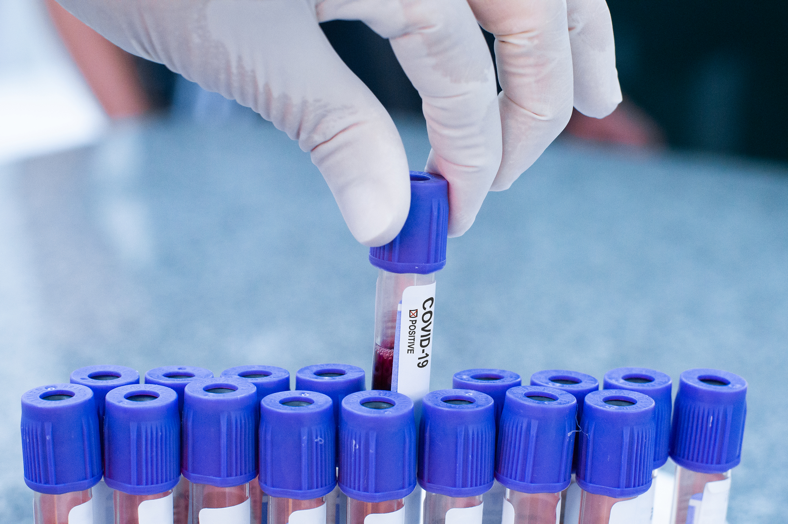
Diagnosing AMPS
Diagnosis criteria:
  Subjective report of amplified, chronic pain in 1 or more body parts causing decreased participation in meaningful occupations
  Pain can be constant or intermittent
  Physical examination results in no abnormalities
  Medical tests (i.e., bloodwork, MRI, X-ray) result in no abnormalities or inflammation
AMPS can be a primary or secondary pain condition
(Daffin, Gibler, &Kashikar-Zuick, 2020; Weiss & Kashikar-Zuck, 2021)
Notes:
AMPS can be a secondary pain condition due to an underlying inflammatory or autoimmune condition (Weiss & Kashikar-Zuck, 2021)
Juvenile idiopathic arthritis
Systematic lupus erythematous
Ehlers- Danlos Syndrome
Postural Orthostatic Tachycardia Syndrome (POTS),

Slide 14

AMPS Causes/Triggers
Acute injury (i.e., broken bone)
Illness (i.e., Mono virus, flu, COVID)
Psychological stress (i.e., change in school, change at home)
Genetics
Age & hormones
Another condition
Having AMPS previously
https://imperfectfamilies.com/is-your-child-stressed/
(Sherry, 2000; Sherry & Krepcio, 2014; Sherry et al., 2020; Weiss & Kashikar-Zuck, 2021)
Notes:
C
The exact cause is not known
10-20% of children have a previous acute injury
Many children who reported an injury often reported said injury with emotionally laden language (ex: “I was kicked by the meanest girl in school” or ”I was injured by someone who did not care”
Less frequent- Illnesses like mono, flu, covid
At least 80% of children have some psychosocial factor that plays a role in AMPS diagnosis; these stressors tend to be typical activities for all children but AMPS pt feel this stress as pain in their bodies

Slide 15
Prevalence
Prevalence
  Occurs in 2-6% of the pediatric population
  Females tend to be more affected (4 females:1 male)
  Most common in adolescents 13-15 years old
  Pain tends to be/start in lower extremity
(Sherry et al., 2015; Weis & Kashikar-Zuck, 2021)
Notes:
J
Adults tend to have pain that starts in upper extremity

Slide 16
Prognosis
Mixed reports on prognosis following participation in intensive program
  Earlier studies
    90% of children were pain free and functional after 5 years
  Recent studies
    After 2 years, 70% of children were not meeting diagnostic criteria anymore
    50-70% of adolescents continued to have physical and psychosocial symptoms into adulthood, although the severity of symptoms tend to decrease over time
Pain catastrophizing and fear of movement lead to poorer prognosis
An AMPS flare can occur, typically in first 6 months following initial diagnosis
(Coles & Uziel 2021; Sherry, 2000; Sherry & Krepcio, 2014; Weiss & Kashikar-Zuck, 2021)
Notes:
J
Limited research on outpatient programs
AMPS can return, usually in first 6 months and symptoms can be the same or different; triggers are the same- injury, illness, or psychological stress

Slide 17
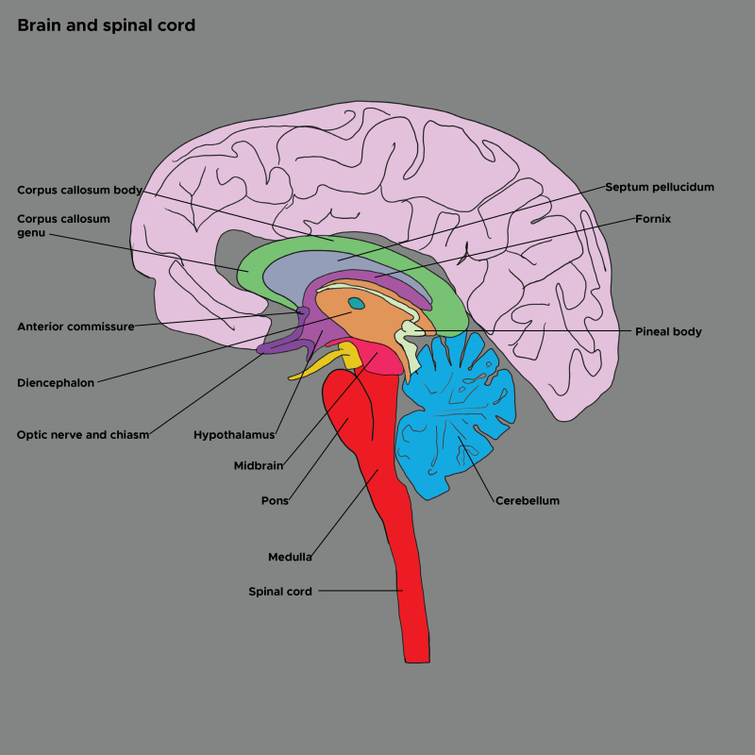
Quick Neuroanatomy Review
https://www.ncbi.nlm.nih.gov/books/NBK525993/figure/article-901.image.f2/?report=objectonly
Notes:
C
So now we know what AMPS is, let’s talk about how this amplified pain happens in their body with a neuroanatomy review

Slide 18
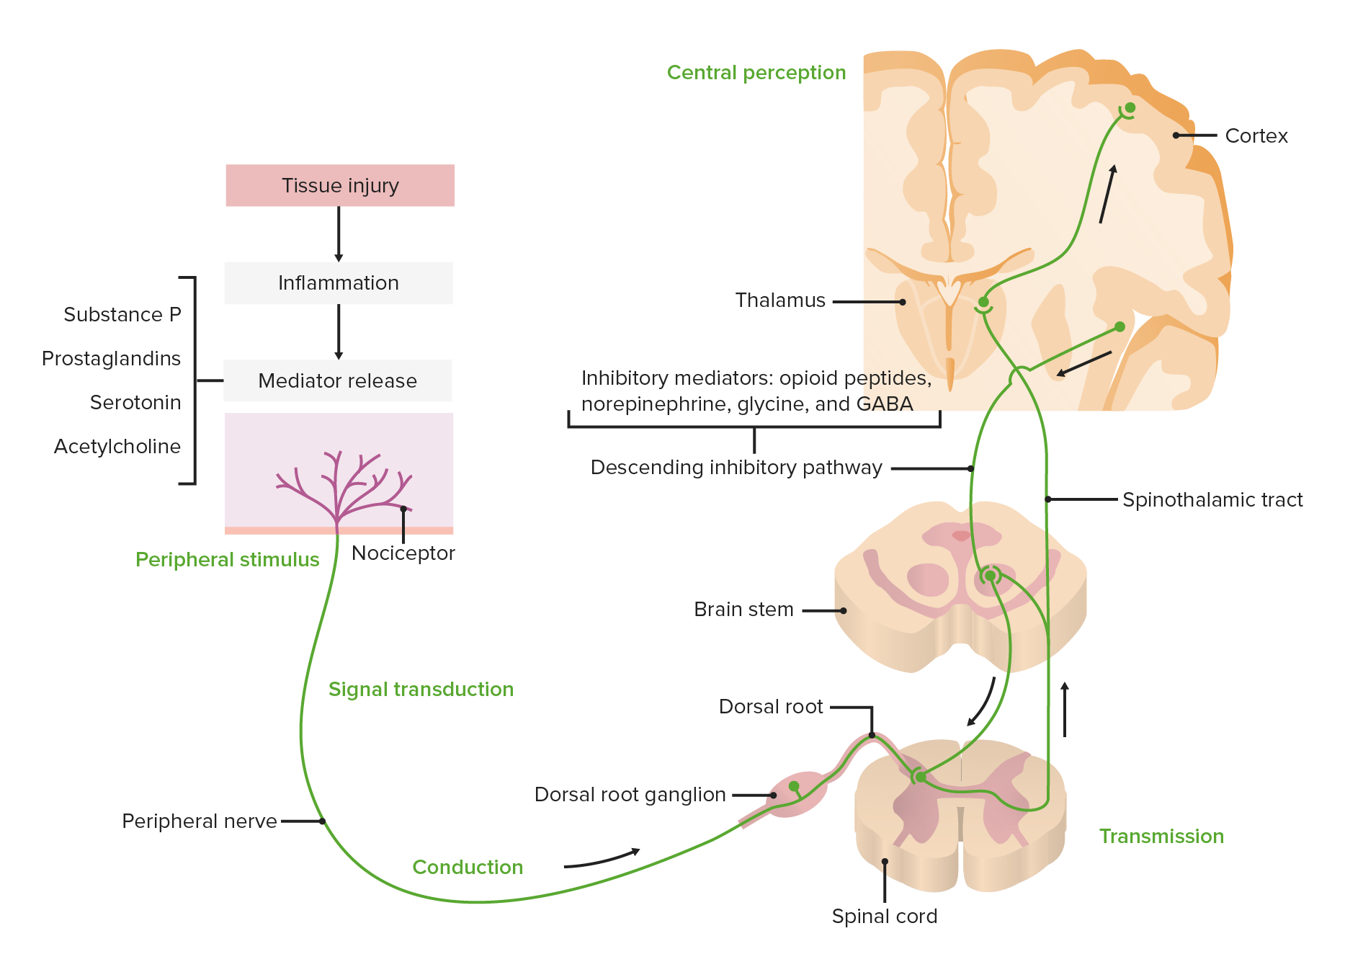
Typical Pain Signal
Louvx, n.d.
Notes:
C
A typical pain response goes like this: (1) some injury/illness/stress occurs in the body (2) the pain signal is sent to the spinal cord and then up to the brain (3) brain recognizes signal as appropriate amount of pain.
Pain signals are initiated in the periphery through nociceptive receptors within tissues. There are three different stimuli which activate nociceptors: mechanical, chemical, and thermal. The sensory information travels through a delta or c fibers within the periphery to the dorsal horn of the spinal cord (Louvw, n.d.)
Pain is processed in the central nervous system. The central nervous system is responsible for processing such sensations as a “threat” to the body, but this does NOT always correlate with actual tissue damage. (Louvw, n.d.)
There are over 9 key areas within the brain that process pain and have other vital functions. This often explains why chronic pain coincides with other compromised functioning- such as impaired sleep or decreased cognition (Louvw, n.d.)
The pain neuromatrix is a term for the individualized brain pathways that process the perception of pain. The neuromatrix is unique for each person, and can be modulated with pain experiences (Louvw, n.d.)
The central nervous system has various outcome mechanism to inhibit incoming pain responses (Louvw, n.d.)
Example: release of endogenous opioid to inhibit incoming afferent information

Slide 19
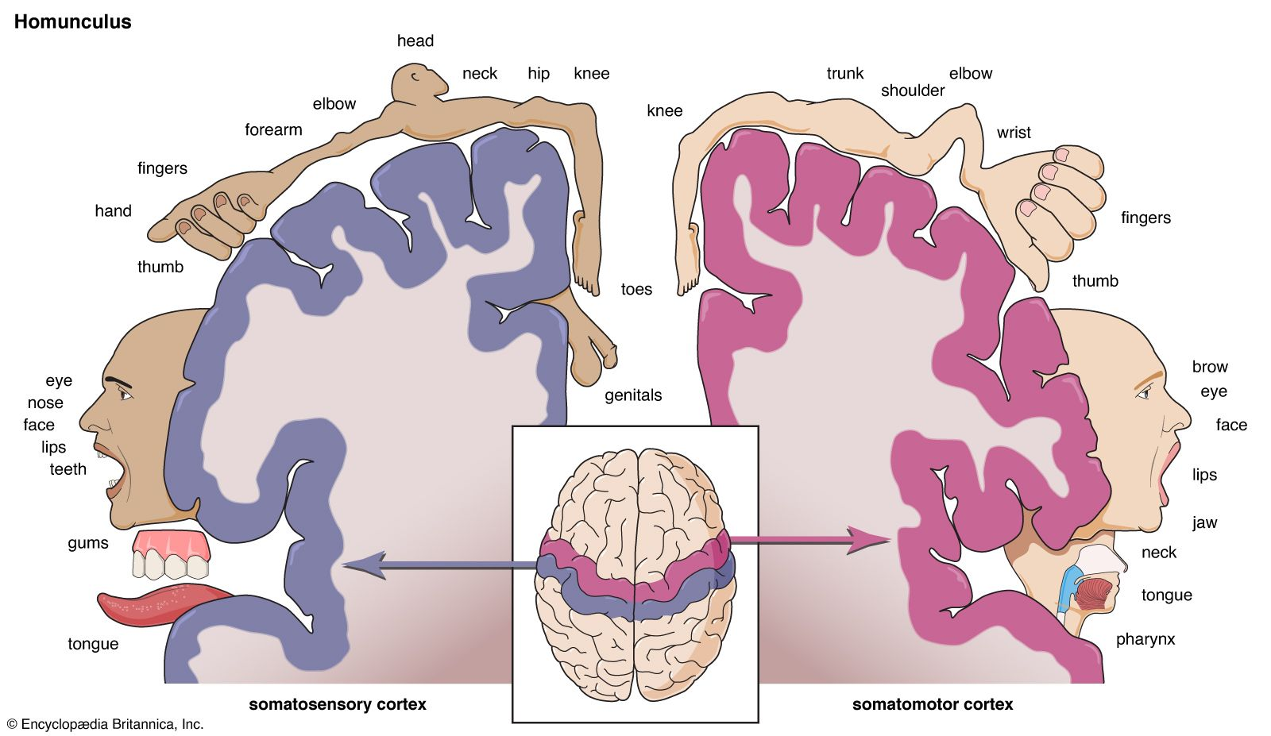
Homunculus
https://www.britannica.com/science/homunculus-biology
Notes:
C
The homunculus is the geographic sensory mapping of the human body located in the sensory cortex. In individuals with chronic pain the homunculus becomes “smudged” , enlarged, and decreased localization of pain occurs (Louvw, n.d.)

Slide 20
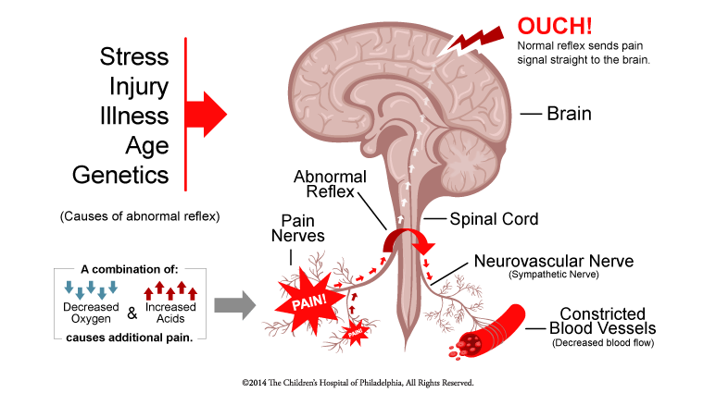
Central Sensitization
https://www.chop.edu/conditions-diseases/amplified-musculoskeletal-pain-syndrome-amps
Notes:
C
Central sensitization is the process by which there are neuroplastic changes within the central nervous system for an amplified pain response (Louvw, n.d.)
(1) Decrease in second order inter-neurons in the dorsal horn, which facilitates sensory information to ascend towards the brain to be processed
Allodynia= “pain in the presence of non-threatening stimulus due to lack of interneuron inhibition”
(2) Increase in sensory fiber synapse, in which pain becomes more global, and inappropriate sensory synapse on the contralateral side of the spinal chord
(3) Decrease in endogenous mechanisms
(4) Smudging homunculus
(5) Vasoconstriction neurovascular nerves, which causes blood flow to slow. This results in decreased oxygen in the body and a build up of acid wastes, which then causes more pain.

Slide 21
Central Sensitization
There are changes in the structural and metabolically activity of the central nervous system. The body interprets pain at a heightened level due to impaired pain modulation. (Weiss & Kashikar-Zuck, 2021)
Notes:
C

Slide 22
Evaluating and Treating AMPS
Notes:
J

Slide 23
Interdisciplinary Team
AMPS Treatment
Physicians
Physical Therapists
Mental Health Providers
Occupational Therapists
Multi-modal/ integrated pain treatment approach of behavioral interventions and exercise-based interventions is best for evaluating and treating AMPS
(Weiss & Kashikar-Zuck, 2021)
Notes:
J

Slide 24
Roles
Physician
Physical exam
Physical Therapist
Occupational Therapist
Using meaningful occupations to heal
Mental Health Provider
Thoughts about/around pain
Medical tests
Diagnose AMPS
Global anxiety, depression, and any other diagnoses
Coping skills
Prescribe medications
Strength/endurance training
Functional exercises
Developing physical, cognitive, psychosocial skills to participate in daily occupations
(AOTA, 2021)
(Cunningham, et al., 2019)
Notes:
J
Physicians
Some doctors will prescribe pain medications to help AMPS pts, but per the research and from our pt’s experiences, it rarely helps; the only supplement that seems to help is Vitamin C, per Dr. Sherry
Mental Health addresses … by
-Using CBT to work on decreasing/replacing catastrophic thinking about pain
-Exposure therapies to help reduce pain related fear
-Adaptive and goal directed coping strategies to increased self-efficfacy- or confidently controlling their motivation/behaviors
-Mindfulness- focusing on experiences in the present moment

Slide 25
Evaluating AMPS:
Combined Outpatient PT and OT Perspectives
Notes:
Now we’re going to dive into more specifics about evaluating AMPS from PT and OT perspectives.
Docs tend to send AMPS pt to intensive outpatient services first to see if outpatient program will help, unless a very severe AMPS case

Slide 26
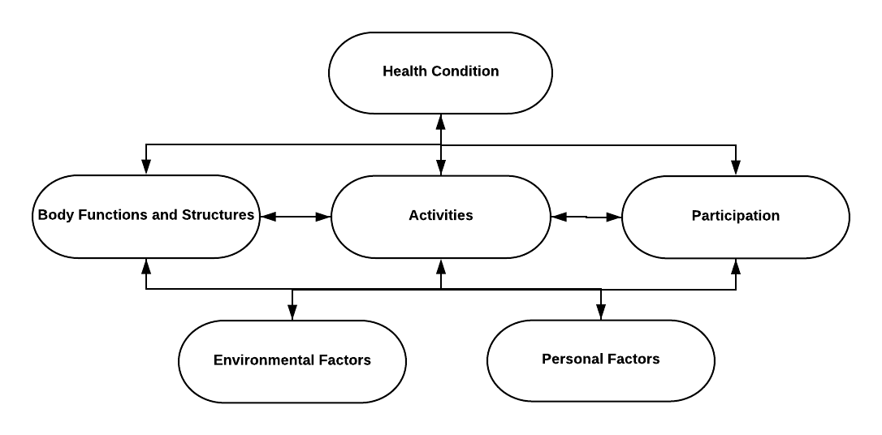
Initial Evaluation
A multidimensional assessment is recommended to best assess pain levels, secondary symptoms and understand the impact on functioning and quality of life (Daffin et al., 2020)
https://www.physio-pedia.com/International_Classification_of_Functioning,_Disability_and_Health_(ICF)#/media/File:ICF_Model_Generic_(correct_version).png
Notes:
J
We need to look at the whole person during an outpatient PT/OT eval including the pain as well as the functional skill levels

Slide 27
History
Medial History
All current diagnoses
Current/past specialists
Pain History
Pain onset
Social History
School attendance
Current participation in extra-curriculars
Medical tests completed and results
Recent acute injury or illness
New stressor or life change
Aggravating or alleviating factors
Previous pain diagnoses
Family history of pain diagnoses
Current participation in social activities
Changes in family dynamics or any big life events
Participation in any other pain programs
Mental Health services
(Weiss & Kashikar-Zuck, 2021)
Notes:
J
First we look at the client’s histories- including their medical, pain and social histories
Medical history
-some common co-diagnoses are EDS, ASD, POTS, mental health diagnoses, GI issues, migraines, headaches
-Blood work, x-rays, CT, any other imaging- knowing that they had these tests completed to rule out other conditions
-Ask about mental health services- as they are apart of the team, a child really should have mental health services on board when receiving OT/PT, otherwise will not get full experience to heal
Pain history
-When discussing family history, is really important to know of any other family members with hx of chronic pain diagnoses (pain households) as well as mental health diagnoses

Slide 28
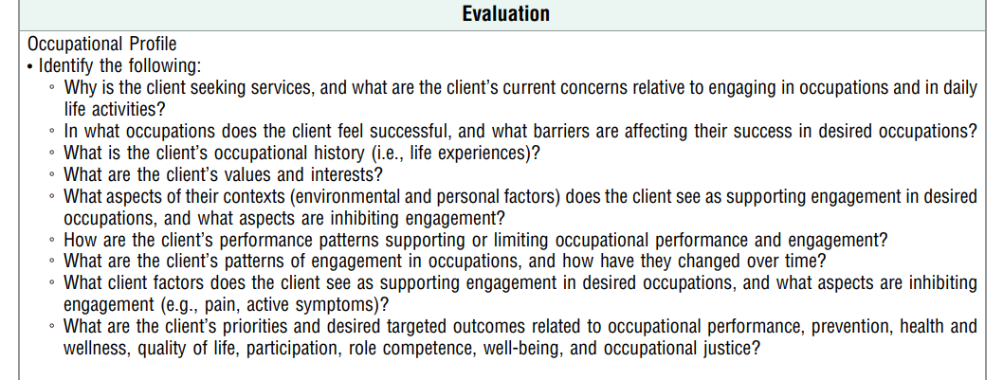
Occupational Profile
(AOTA, 2020)
Notes:
J
Then we need to look at the functional implications of their current pain and what skills and occupations they are having difficulty with

Slide 29
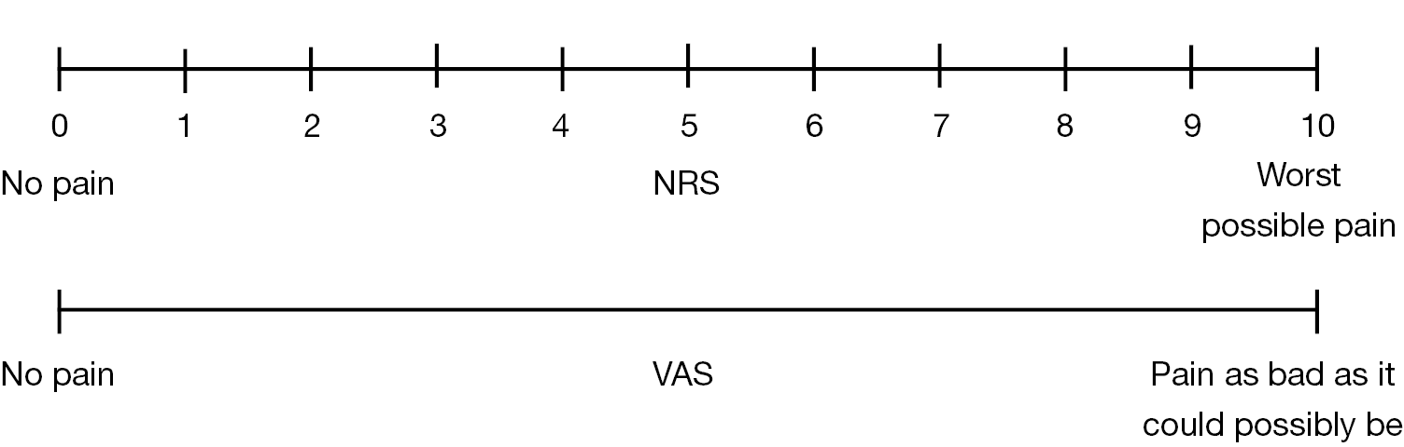
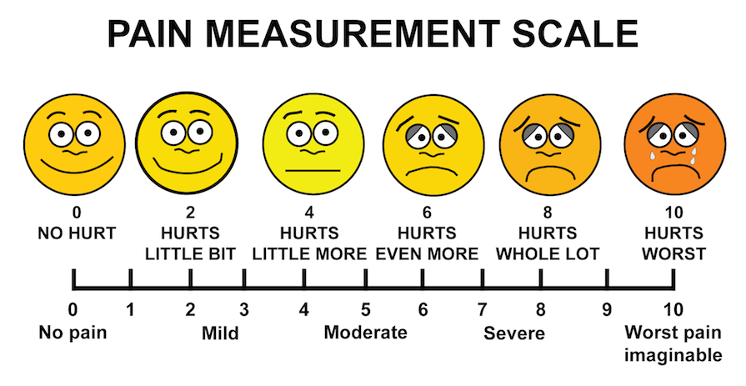
Pain Assessments
Visual analog scale for pain report (Lallo et al, 2020; Sherry et al., 2015)
Faces pain scale revised (FPS-R)
(Lallo et al, 2020)
Pediatric Pain and Symptom Assessment Tool (Sherry et al., 2015)
Eleven Point Numerical Rating Scale (Lallo et al., 2020)
(https://rebelem.com/wp-content/uploads/2018/03/Visual-Analog-Scale.png)
(https://rebelem.com/wp-content/uploads/2018/03/Visual-Analog-Scale.png)
https://anxietysolutionscbt.com/wp-content/uploads/2016/08/Pain-Measurement-Scale.png
Notes:
C
VAS
Designed for self report pain intensity on a 100 mm line to demark pain intensity
The score is the measured distance in millimeters between the left anchor and and mark drawn between the left anchor and the mark drawn by the participant
The minimally important difference on the VAS is 10-12 mm
Faces pain scale revised (FPS-R) (Lallo et al, 2020)
Self-report pain intensity scale with six human faces correlating with pain intensity
One face on the FPS-R is considered the minimal clinically significant difference
Reliable in children aged 4-17 years of age
Pediatric Pain and Symptom Assessment Tool (Sherry et al., 2015)
Diagram for number of body locations where pain was experienced in past week
Subjective report of symptom severity scale
Eleven Point Numerical Rating Scale (Lallo et al., 2020)
Self report tool for pain intensity
Numbered from 0 (“no pain”) to 10 (“worst pain you can think of”)
Valid for children 4-17 year of age
Minimally important clinical difference of 1 point

Slide 30
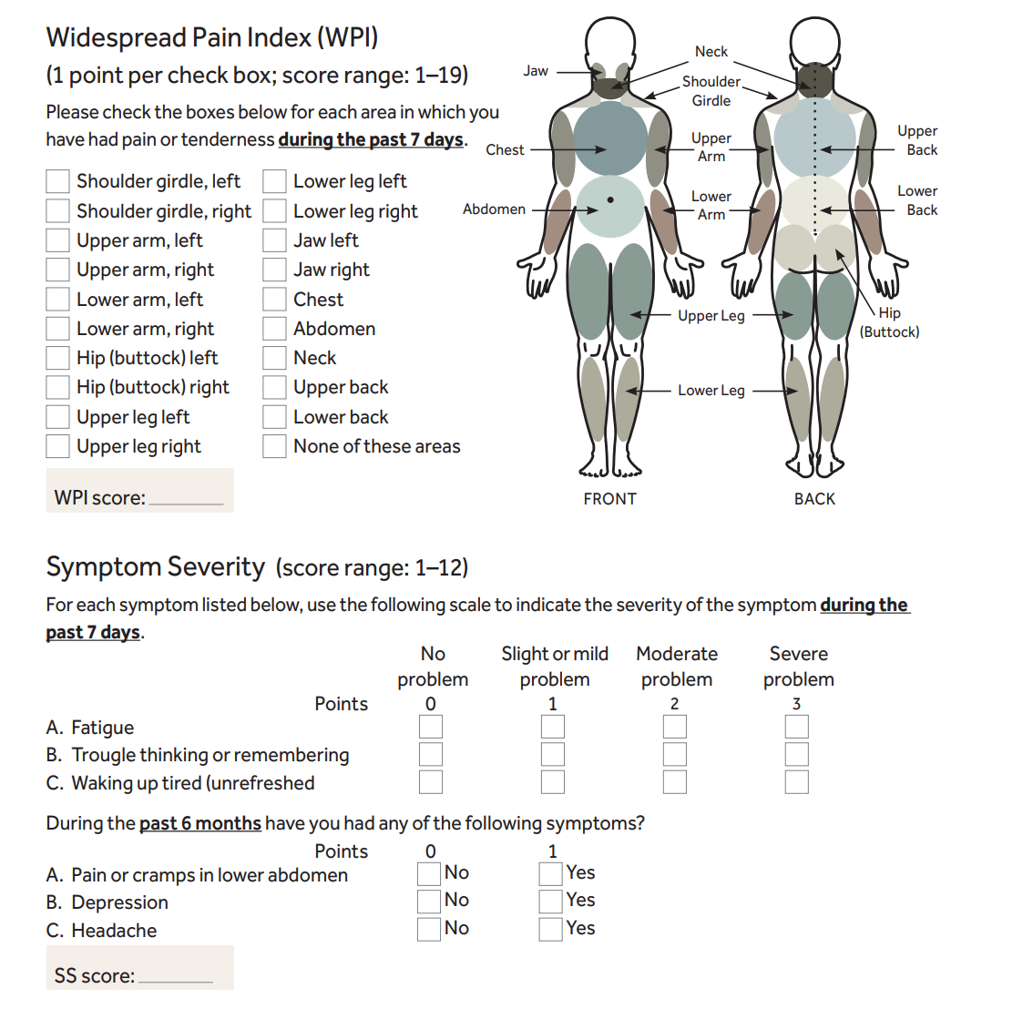
Pain and Symptom Assessment Tool
(Daffin et al., 2020)
Notes:
C
Wide spread pain index-demarks location of pain and severity of pain
Symptom severity scale- denotes severity of three cardinal symptoms for fatigue, tiredness, concentration and memory difficulties & then complete a checklist for additional symptoms experienced: irritable bowel issues, numbness, tenderness, and migraines

Slide 31
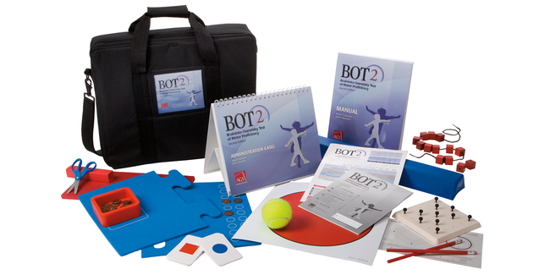
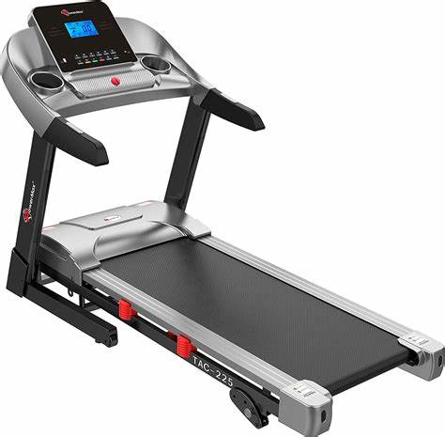
Activity Level Outcome Measures
Bruininks- Oseretsky Test of MotorPerformance- 2nd Ed.
Brue Treadmill Protocol
(Sherry et al, 2015)
Notes:
C
BOT-2
Gross and fine motor functioning: fine motor control, fine motor integration, manual dexterity, bilateral coordination, balance, running, speed & agility, upper limb coordination, strength
Norm referenced for age and sex- matched norms
Bruce Treadmil Test
Maximal cardiovascular endurance test in which the subject is to walk/run to the point of exhaustion or until completion at 21 minutes. The speed and incline is gradually increased every three minutes. The distance ambulated is recorded. This test is also norm- referenced for age and sex- matched norms

Slide 32

Participation Level Outcome Measures
Promis Pediatric Pain Interference Scale (PROMIS)
Functional Disability Index (FDI)
Pediatric Quality of Life Inventory (PedsQL)
Pain Stages of Change Questionnaire
Canadian Occupational Performance Measure (COPM)
The Roll Evaluation of Activities of Life (REAL)
Sensory Profile-2
(Daffin et al. 2015; Sherry et al., 2015)
Notes:
C
Promis Pediatric Pain Interference Scale (PROMIS) (Daffin et al., 2020)
The outcome measure was created for patents with chronic conditions as a self-report measure by the National Insititute of Health
Assessment for the extended to which pain interferes with social, cognitive, emotional, physical, and recreational wellbeing and functioning
Response are on a 5 point liker scale
Scores range 8-40 with higher scores reflecting greater disability
PROMIS Anxiety Scale
Self report measure to assess feeling of fear and worry (Daffin et al., 2020)
PROMIS Depression Scale
Self report measure to assess depressive symptoms, decreased positive affect, and loneliness (Daffin et al., 2020)
Functional Disability Index (Sherry et al, 2015); (Daffin et al., 2020)
Self-report outcome measure for challenges to complete activities of daily living in children and adolescents with chronic pain
Each item ranges from 0-4 on a Likert scale
Assessment to complete activities across a variety of environments home, school, recreational and social settings
Score of 0-60 with higher scores indicating a greater level of disability
The minimally important difference is 7.8 points
Current gold standard measure with robust studies demonstrating reliability, validity, and responsiveness in children with juvenile fibromyalgia
Parent version too, assessing child’s participation in ADL
Pediatric Quality of Life Inventory (PedsQL) (Sherry et al, 2015); (Daffin et al., 2020)
Self-report quality of life for core health dimensions: physical, emotional, social, and school functioning
PedsQL 3.0 Rheumatoltogy Module: Rheumatology module that can be utilized
Subscales: pain, daily activities, physical and emotional impact, worry & fear, communication
Scored on a scale from 0-100 with higher scores indicating a better quality of life
Pain Stages of Change Questionnaire (Sherry et al, 2015)
Score correlates to readiness for cycle of behavioral change: pre-contemplation, contemplation, action, and maintenance
JESS
COPM- evidence based assessment; utilized for kids over 8 years; used toidentify client’s self-perception of performance in everyday living, over time
REAL- Parent questionnaire to determine a child/adolescents participation in ADL and IADL; 2-18 years
Sensory Profiles- Parent/self questionnaires to determine sensory preferences; all ages

Slide 33

Caregiver Outcome Measures
Pain catastrophizing Scale- Child & Parent Version
Adult Response to Children’s Symptoms (ARCS)
(Dougherty et al., 2020)
Notes:
J
Pain catastrophizing scale- child & parent
13- item self report measure (children 8-17 years; parents of a child any age) to assess thought patterns in response to pain , higher scores indicate greater catastrophizing
ARCS
29 item measure assessing frequncey of parntal responses to child pain across three subscales- protectiveness, minimization, encourage/monitor; higher score indicates greater catastrophizing

Slide 34

Collective Goal
Functional restoration
  Return to participating in daily activities, both physically and psychosocially
  It is NOT to eliminate pain
(AOTA, 2021; Durban, 2019)
Notes:
J
Following all of these assessments, we create goals (we will provide some samples of goals in the case study in a bit) but the general over arching goal for both OT and PT is…
Managing pain to a level at which they can return to participating in daily activities

Slide 35
AMPS Treatment:
Combined Outpatient PT and OT Perspectives
Notes:
Now we are going to transition into AMPS Tx

Slide 36
General Guidelines
Individual treatment plans are vital
Education about AMPS (Coles & Uziel 2021; Weiss & Kashikar-Zuck, 2021)
  StopChildhoodPain.org
Don’t discuss their pain in treatment sessions
Parents remain out of sessions (Sherry & Krepcio, 2014)
Building a strong therapeutic relationship grounded in trust is essential (Neville-Jan, 2003)
It is important to reassure that their perceived pain is real (Coles & Uziel 2021)
Movement is essential to reset nerve pathways (Doughtry et al., 2020).
Notes:
J
Individual
Just like all of the other patients/clients with a different conditions, it is essential that our treatment plans are tailored specifically to each AMPS pt based upon skill levels, personal goals, personal factors
Education
-Educate both parents and kids on
AMPS diagnosis
how the abnormal pain cycle works
why we do what we do in therapy to break the pain cycle
- if we don’t explain this, they may not understand the methods and therefore are not as invested
Parents also need to be educated on the importance of reassuring child of pain being real and that modifications need to be completed to daily routines to decrease stress, support sleep, and to include movement
-both disciplines can and should educate on this
No pain
-We know they are in constant pain; there is no need to harp on it and continuously think about it
-we only discuss pain levels in initial evals, during progress reports, and at discharge
No parents
-Can distract the pt, unintentionally
-undermine authority of therapist
-helps patient become own advocate
-help patient take charge of their recover
relationship
As therapists, we need to believe in their pain. They have this intense amount of pain and if we say it’s all in their head, they will not believe or trust us what so ever. We need to have a strong relationship grounded in trust to really help someone in their pain journey; just be there for your patient; listen ; we want to help them meet their goals (from OT, we use occupations tailored to them to help with this pain- not as a distraction, but the power of occupation).
Both OT and PT will integrate movement activities into their sessions

Slide 37
Frequency in Outpatient
2-3x/week of PT for 8-12 weeks
1-2x/week of OT for 8-12 weeks
45 minute sessions
Land and aquatic sessions when available
Notes:
J
This is an intensive program, so AMPS pt’s need to attend both OT and PT (in addition to psych) multiple times a week for 45 minute sessions. Most times we couple sessions together (for schedule convience to ensure they attend, so really they are being see for about 90 minutes 2 times a week.
PT and OT could also integrate aquatic therapy, when possible, into sessions to further help with desensitization, which we will talk about more in a bit

Slide 38
PT Specific Treatment Approaches

Slide 39

PT Interventions
Exercises assist with stimulating brain regions responsible in the descending inhibitory pain pathways, resulting in improved pain modulation.
Functional MRI studies have demonstrated that consistent exercise can reduce pain perception in individuals with fibromyalgia through neurological changes.
(Black & Zuck, 2016)
(Coles & Uziel 2021)
Notes:
C
CV based exercises

Slide 40

PT Interventions
Black & Zuck proposed a new exercise approach, termed “Fibromyalgia Integrative Training” for a tailored and progressive exercise program including:
  (1) Neuromuscular Training: improved movement mechanics with functional based movements progressing from isometric, concentric, eccentric, to the full functional movement
  (2) Cognitive Behavioral therapy
(Black & Zuck, 2016)
Notes:
C
(3)Cohort design study for 8 weeks receiving both services

Slide 41

Encourage Activity!
American Pain Society recommends at least 30 minutes of moderate to vigorous activity 2-3x/week in individuals with fibromyalgia
Resistance exercises have been shown to reduce physical activity, and aerobic exercises to reduce pain levels in children and adolescents with fibromyalgia
Movement is helpful and not harmful in their child’s recovery
(Black & Zuck, 2016)
(Black & Zuck, 2016)
(Weiss & Kashikar-Zuck, 2021)

Slide 42

Frequency Matters!
Psychology on board
PT & OT 3x/week
A cohort of children with fibromyalgia treated with intensive physical and occupational therapy and psychotherapy, demonstrated improvements on standardized testing with improved functioning, endurance, gross motor strength, motivation to address pain, and reported pain levels
(Sherry et al, 2015)
Notes:
Population
64 children with a median age of 16 years old, 95% Caucasian, 94% females
Prior to admission for intensive rehabilitation all children were taken off pain relieving medications
Intervention:
The duration of intensive rehabilitation was patient dependent based on when short and long term goals were met
Physical rehab focused on individualized 1-1 therapy for 5-6 hours a day wand included focus on re-establishing function, aerobic conditioning, strength training, and de-sensitization
Examples for aerobic conditioning: cycling, treadmill, elliptical
Examples for strengthening activities: timed activities for animal walks, squatting
De-sensitization: light pressure, rubbing, local/total body vibration, exposure to various tactile sensations
“The philosophy of our program is that the children treat their own pain while learning the tools for doing so in our treatment program” (Sherry et al., 2015)
Focus on function over pain levels and limitations- limit any inquires about pain levels
Psychotherapy included 1-on-1 session with a focus on cognitive behavioral therapy for
Art /music therapy 4 hours per day
Outcome Measures with results
Bruininks-Oseretsky Test of Motor Performance (BOT-2): statistically significant improvement at completion of program and maintained at 1 year follow up
Bruce Treadmill Test: statistically significant improvements at program completion and 1 year follow up
Pain Stages of Change Questionnaire: shifted towards more active steps that is statistically significant
Pediatric Quality of Life Inventory: total score demonstrates statically significant improvements at program completion and one year follow-up
Functional disability inventory: statistically significant score at program completion
Visal Analog Scale for pain: trends for improvement, but not statically

Slide 43
OT Specific Treatment Approaches

Slide 44

OT Treatment Strategies
Meaningful occupations
  Sports
  Arts and Crafts
  Music
  Video games
  Cooking
Implementing better routines
Self-Advocacy
Education
Therapeutic Use of Self
(AOTA, 2021; Durban, 2019)
Notes:
Utilize meaningful occupations
Sports- set up a mini game of soccer
Arts and crafts- adult coloring book pages, craft kits, adding in physical component or desensitation activity while doing craft
Music- bring in a musical instrument for session
Video games- play a favorite game during session
Cooking- bake cookies, making ice cream sundaes
Implementing better routines, focusing around sleep, hydration, stress relief
Working on self-advocacy skills vs relying on family members to communicate for them; taking charge of own health
Constant education throughout the process-
Building strong rapport using therapeutic use of self

Slide 45

OT Treatment Strategies
Obstacle Courses
Yoga
Theraputty activities
Desensitization activities
Board Games
Puzzles
Mindfulness, Meditation
Interoception Awareness
Graded Motor Imagery
Virtual Realty
(Peelgrane, Spencer, & Mahler, 2022)
(AOTA, 2021; Durban, 2019)
Notes:
Obstacle courses are unlimited
Yoga – cosmic kids, yoga stories, make your own yoga adventure for physical component
Searching for beads or pieces in theraputty for hand strengthing
Vibrating head massager, rubbing towel on affected area, CHOP has desensitization videos online to follow along with, aquatic therapy (which can be OT/PT)
Board games or puzzle games- like rush hour, escape rooms, logic puzzles, decoders for executive functioning and to think
Mindfulness, meditations- go noodle has a zen den time and calming activities
Kelly Mahler’s work on interoception awareness- pain interoception awareness info can floor the body, making it hard to be aware of other essential signals; focusing on the other signals might help to adjust your perception of the pain signals (maybe even decrease them).
Peelgrane, D., Spencer, J., & Mahler, K. (2022). Interoception Supports for Chronic Pain, Health Management & Emotional Well-Being in Adults: It is Never Too Late! [Powerpoint Slides]. https://Kelly-Mahler.com.

Slide 46
Home Exercise Programs
Notes:
J
HEPs are essential to support continued healing; again we are not trying to get rid of pain, but have them get to a tolerable level to participate in all activities and to do that, they need to keep up with a HEP- Sherry et al., 1999 You’ll see an example of one in the case study

Slide 47
Promoting Longterm Adherence
Exercise programs that are self-paced and a lower intensity
Traditional exercise programs of resistance and cardiovascular endurance have shown poor adherence overall for children and adolescents with fibromyalgia.
Movement based complimentary therapies like tai-chi and yoga have improved adherence at long term follow up due to lower intensities and integration of deep breathing techniques
Complimentary and alternative medical exercise such as tai-chi and dance has shown significant improvements on adult patient’s quality of life on the Fibromyalgia Impact Questionnaire
(Black & Zuck, 2016).
(Black & Zuck, 2016).
(Vasileios et al., 2022)
Notes:
C
Overall, there is poor long-term adherence for traditional exercise programs in the pediatric population with JFM.
Exercise programs that are self-paced and a lower intensity have shown improved long-term adherence (

Slide 48

Failed Outpatient Services
Little to no progress following ~12 week outpatient program
Next step: Inpatient program
(Coles & Uziel 2021)
Notes:
J
-We consider an AMPS pt to fail outpatient OT/PT if there is little to no progress with their symptoms/performance following the 12 week program
-This doesn’t mean they will never get better, it just means that they need to try an even more intense program, like an inpatient program
For individuals with intense and persistent symptoms, intensive rehabilitation is more affective than outpatient services for improving pain, function, and quality of life (Coles & Uziel 2021)

Slide 49
Inpatient Programs
Hospital stay for 1-4 weeks
5 hours of therapeutic PT and OT daily
Psychotherapy, music and art therapy
Programs
  Children’s Hospital of Philadelphia
  Children’s Specialized Hospital at RWJ Barnabas Health in NJ
  Children’s Institute of Pittsburgh
https://www.chop.edu/services/therapeutic-hospital-treatment-program-amps
Notes:
J

Slide 50
Case Study: Mary
Notes:
C

Slide 51

Mary
Mild skin changes/irritation on legs
Decreased interest in physical activities- would rather read or play on tablet
8-year-old female
Complaining of varying pain throughout body for 2 years following day of fun outdoor activity (during COVID)
Not attending school regularly
Family history of pain, financial hardships
ODD and Adjustment Disorder diagnoses
Rheumatologist diagnosed with AMPS, Arthralgia- unspecified joint and Musculoskeletal pain
Notes:
C
8 year old female, very intelligent, shy/anxious around other
Pain
Reporting worst pain at 10/10 and least amount of pain at 4/10
Rheumatologist
Imaging, bloodwork all normal
Mental Health
Was seeing a counselor at school, but she is on maternity leave for evaluation (returned half way through treatment to help with program)
Social
Mom is living with chronic pain and anxiety; increased family stress over past 2 years
Dad has been out of work for the past two years- extra stress on family, having some medical challenges too
Younger brother feeling stressed
Pain:
Initially pain was intermittently in her lower extremities, but following a brief illness with a fever, pain started to spread to arms/hands and rest of her body and become constant, affecting her daily life

Slide 52
Physical Therapy
Pain levels
  FACES: 10/10 at worst; 4/10 at eval
  Balance
Gait
  Decreased cadence, decreased plantarflexion push off in terminal swing bilaterally
Fundamental motor abilities
  Decreased fluidity with skipping
  Impaired single limb hopping
Balance
  Impaired single limb stance
Manual Muscle Testing
  Impaired 3/5 strength globally
  Impaired core strength on timed 30 second abdominal crunch
Endurance
  Below average on 3 minute walk test
Notes:
C

Slide 53
Physical Therapy Interventions
Frequency: 3x/week with home exercise program
Cardiovascular endurance:
  Treadmill, seated scooter, biking
Self- paced movement
  Skipping, anterior jumping, hopping, jumping jacks, running across gym (50 feet) for playing board games
Strength training
  Modified push-ups, lateral arm raises, bicep curls
  Squats, bridges, lunges
  Superman hold, side plank, abdominal crunches
Notes:
C
-Self paced movements 10-15 reps
CV endurance progressively increased in intensity: TM incline and speed, time/distance for scooter and biking activity. Goal for 30 consecutive minutes

Slide 54
Physical Therapy Goals/ Means for Discharge
Short Term Goals to be achieved in 6 weeks:
1. Patient will score age appropriate on three minute walk test to display improved age-appropriate endurance
2. Patient will demonstrate ability to perform age matched norms for 30 second sit-up test to demonstrate improve core strength
3. Patient will report baseline pain of 3/10 or less for improved functional mobility.
Long Term goals to be achieved in 12 weeks:
1. Patient will participate in 30 minutes of continuous play activities outside with friends without reporting fatigue for improved endurance.
2. Patient will demonstrate improved gross strength with increased muscle grade to 4/5 globally for improved functioning.
3. Patient and family will be (I) and compliant with HEP.
Notes:
C
Overall goals and means for discharge:
Improved age appropriate functioning, improved age matched norms on strength/ endurance testing, improved functioning, goals for transitioning to physical activity.
Goals for decreased pain to allow for functioning of ADL's/play/ self care, but not necessarily NO pain.
Review of HEP 1x/ through. Transition to girls on the run
- 10 jumping jacks
- 10 squats 4 lb weight
-10 sumo squats with 4 lb weight
- 10 shoulder press with 2 lb weights
- 10 modified pushups
-10 bicep curls
-10 bird dogs
- 20 second side planks, left and right side
- 10 abdominal curls

Slide 55
Occupational Therapy
Self-Regulation
  Difficulty regulating herself and emotions at times
  Combination of over- and under- responding as well as signals being mixed with interoception awareness
Sensory Processing
  Can be a picky eater and has some sensitivities to clothing
  Mild rash on occasion, mild hypersensitivity on legs
Motor skills
  Decreased core strength and motor planning
Assessments completed:
  FACES Pain Scale, FDI, PedsQL
Occupations
  ADL
    Reporting pain with most ADL, still completing, does lack motivation
    Sleep routine: Poor; has a really difficult time falling asleep
    Hydration/Diet- Primarily drinks water but not drinking enough; diet- well balanced
  IADL
    Chores- reporting pain, lack of motivation
    Homework- Enjoys and completes most of the time
  Education
    Attending school most of the time, but still missing some
  Social
    Has some difficulty interacting with peers (anxiety)
  Play/Leisure
    Reading, craft, construction-based tasks-participating in
Notes:
J

Slide 56
OT Goals
Long Term Goals:
  Mary will demonstrate increased participation in all occupations, especially ADL/IADL/leisure, reporting an acceptable level of pain, with less fatigue, across 5/7 days by discharge.
  Mary and her family will integrate her HEP into her/their daily routine 4/5 days, by discharge.
  Mary will identify and consistently implement 2-5 calming strategies during night-time routine, 4/5 nights, to improve sleep by discharge.
  Mary will participate in a 45-minute OT session without reports of fatigue by discharge.
  Mary will demonstrate increased ability to independently recognize her body signals and related body states/emotions to support self-regulation, 80% of the time by discharge.
Short Term Goals:
  Mary will demonstrate increased core strength/endurance by being able to independently maintain “boat position” for 30 (or more) seconds, 5/5 opportunities in 6 weeks.
  Mary will identify and integrate 3-5 activities she finds relaxing (yoga, mindfulness, meditation, arts and crafts, etc) into her daily routine to
  Mary will tolerate desensitization activities for at least 2 minutes, 5/5 opportunities in 6 weeks.
  Mary will consistently implement 2-3 strategies to improve hydration throughout her daily routine in 6 weeks.
  Mary will participate in a 45 minute OT session without reports of fatigue 4/5 opportunities by discharge.
Notes:
J

Slide 57
OT Interventions
Education for Mary and family
Strong therapeutic relationship
Obstacle courses (swings, variety of mats)
Yoga (Cosmic Kids, Make your own yoga story)
Arts and crafts (Adult coloring books, Sticker mosaics)
Building activities (ex: magnatiles, STEM construction tasks)
Board games and puzzles (ex: Rush Hour, logic puzzles, escape rooms)
Desensitization (towel, vibration, CHOP video)
Theraputty
Interoception Awareness Curriculum
Mindfulness, meditation (Cosmic Kids meditation, Calm Go Noodle)
HEP charts for hydration, exercises, sleep routine; Toolbox full of items to help with carryover
Notes:
Jess

Slide 58
Combined PT/OT HEP
Morning
Evening
1 minute of burpees
2 30-second side planks
“Swim” on belly (prone)
1 minute of squats
Find 10 beads in theraputty
Head massager on legs for 1-2 minutes
Body Check In
Crab walk across living room 2 times
20 arm raises
Squeeze stress ball 20x each hand
Body Check In
Calming activity (not reading)
Zen Den Meditation before bed
Notes:
J
Mary successfully completed the 12 week outpatient program; reporting significant decrease in pain and returned to all functional activities.

Slide 59
Resources
American Occupational Therapy Association. (2020). Occupational therapy practice framework: Domain and process (4th ed.). American Journal of Occupational Therapy, 74(Suppl. 2), 7412410010. https://doi. org/10.5014/ajot.2020.74S2001
American Occupational Therapy Association. (2021).Position Statement- Role of occupational therapy in pain management. American Journal of Occupational Therapy, 75(Suppl. 3), 7513410010. https://doi.org/10.5014/ajot.2021.75S3001
Black, W. R., & Kashikar-Zuck, S. (2017). Exercise interventions for juvenile fibromyalgia: current state and recent advancements. Pain management, 7(3), 143–148. https://doi.org/10.2217/pmt-2016-0066
Coles, M. L., & Uziel, Y. (2021). Juvenile primary fibromyalgia syndrome: A review- treatment and prognosis. Pediatric Rheumatology, 19(1). https://doi.org/10.1186/s12969-021-00529-x
Cunningham, N. R., Kashikar-Zuck, S., & Coghill, R. C. (2019). Brain mechanisms impacted by psychological therapies for pain. PAIN Reports, 4(4), e767. https://doi.org/10.1097/pr9.0000000000000767
Daffin, M., Gibler, R. C., & Kashikar-Zuck, S. (2020). Measures of juvenile fibromyalgia. Arthritis care & research, 72 Suppl 10(Suppl 10), 171–182. https://doi.org/10.1002/acr.24197
Dougherty, B. L., Zelikovsky, N., Miller, K. S., Rodriguez, D., Armstrong, S. L., & Sherry, D. D. (2021). Longitudinal
impact of parental catastrophizing on child functional disability in pediatric amplified pain. Journal of pediatric
psychology, 46(4), 474–484. https://doi.org/10.1093/jpepsy/jsaa127

Slide 60
Resources
Durban, N. R. (2019). Pediatric amplified musculoskeletal pain syndrome. Orthopaedic Practice , 31(4), 243–245.
Jastrowski Mano, K. E., Beckmann, E., Fussner, L. M., & Kashikar‐Zuck, S. (2020) Executive functioning in adolescents with chronic musculoskeletal pain. Children, 7(12), 273. https://doi.org/10.3390/children7120273
Lalloo, C., Mesaroli, G., Makkar, M., & Stinson, J. (2020). Outcome measures for pediatric pain: Practical guidance on clinical use in juvenile arthritis. Arthritis care & research, 72 Suppl 10, 358–368. https://doi.org/10.1002/acr.24217
Landry, B. W., Fischer, P. R., Driscoll, S. W., Koch, K. M., Harbeck-Weber, C., Mack, K. J., Wilder, R. T., Bauer, B. A., & Brandenburg, J. E. (2015). Managing chronic pain in children and adolescents: A clinical review. PM & R : The journal of injury, function, and rehabilitation, 7(11 Suppl), S295–S315. https://doi.org/10.1016/j.pmrj.2015.09.006
Louw, Adrian (n.d.). The Neuroscience of Pain [Lecture Notes, Power Point Slides] Medbrige. https://www.medbridgeeducation.com
Neville-Jan, A. (2003). Encounters in a world of pain: An autoethnography. American Journal of Occupational Therapy, 57(1), 88–98. https://doi.org/10.5014/ajot.57.1.88
Notes:
Peelgrane, D., Spencer, J., & Mahler, K. (2022). Interoception Supports for Chronic Pain, Health Management & Emotional Well-Being in Adults: It is Never Too Late! [Powerpoint Slides]. https://Kelly-Mahler.com.

Slide 61
Resources
Peelgrane, D., Spencer, J., & Mahler, K. (2022). Interoception Supports for Chronic Pain, Health Management & Emotional Well-Being in Adults: It is Never Too Late! [Powerpoint Slides]. https://Kelly-Mahler.com.
Sherry, D.D., (2000). An overview of amplified musculoskeletal pain syndromes. The Journal of Rheumatology, 27(58), 44-48.
Sherry, D. D., Sonagra, M., & Gmuca, S. (2020). The spectrum of pediatric amplified musculoskeletal pain syndrome. Pediatric rheumatology online journal, 18(1), 77. https://doi.org/10.1186/s12969-020-00473-2
Sherry, D. D., Brake, L., Tress, J. L., Sherker, J., Fash, K., Ferry, K., & Weiss, P. F. (2015). The treatment of juvenile fibromyalgia with an intensive physical and psychosocial program. The Journal of pediatrics, 167(3), 731–737. https://doi.org/10.1016/j.jpeds.2015.06.036
Vasileios, P., Styliani, P., Nifon, G., Pavlos, S., Aris, F., & Ioannis, P. (2022). Managing fibromyalgia with complementary and alternative medical exercise: a systematic review and meta-analysis of clinical trials. Rheumatology international, 42(11), 1909–1923. https://doi.org/10.1007/s00296-022-05151-y
Weiss, J. E., & Kashikar-Zuck, S. (2021). Juvenile fibromyalgia. Rheumatic diseases clinics of North America, 47(4),
725–736. https://doi.org/10.1016/j.rdc.2021.07.002

Slide 62
Thank you!
Questions?

