Slide 1
Orthotics: Over-the-Counter versus Custom. What to prescribe and when.
Elizabeth Ballard, PT, DPT, OCS, SCS, LAT, ATC

Slide 2
Designation Statement
It is St. Luke’s University Health Network policy to ensure balance, independence, objectivity and scientific rigor in all of our sponsored educational programs. Faculty and all others who have the ability to control the content of continuing medical education activities sponsored by the St. Luke’s Hospital & Health Network are expected to disclose to the audience whether they do or do not have any real or apparent conflict(s) of interest or other relationships related to the content of their presentation(s).
The St. Luke’s University Health Network is accredited by the Pennsylvania Medical Society to provide continuing medical education for physicians.
The St. Luke’s University Health Network designates this live educational activity for a maximum of 1 AMA PRA Category 1 Credits™. Physicians should only claim credits commensurate to the extent of their participation on the activity.

Slide 3
Disclosure Information
The Planners involved in this activity have no relevant financial relationships to disclose.
The Faculty/Presenters involved in this activity have no relevant financial relationships to disclose.

Slide 4
Continuing Medical Education Credit Information
Activity Description/Statement of Need:
  There is little reported in the literature on validity of custom versus over-the-counter orthotics.
  Across professions and manufacturers there are differing terminology and jargon related to the prescription of orthotics.
  New data is emerging regarding technology and rigidity of the prescribed custom orthotics.
  This results in a knowledge gap for many clinicians regarding the prescription of orthotics.
Target Audience: All Providers

Slide 5
Learning Objectives
At the conclusion of this talk:
  Clinicians will demonstrate an understanding of the difference between custom, semi-custom, and off-the-shelf orthotics.
  Clinicians will demonstrate an understanding of the three rigidities of orthotics and what type of patients respond best to each level of control.
  Clinicians will be able to determine when a custom foot orthosis should be prescribed for a patient with LE pathology or deformity.
  Clinicians will be able to describe the changes in gait and lower limb mechanics in the pronated individual with and without the use of foot orthotics.
  Clinician will be able to discuss basic modifications of orthotics including rearfoot and forefoot posting, met rise/met bar, heel cup, clips and cutouts.

Slide 6
What does the evidence say?
Evidence is mixed regarding custom versus semi-custom orthotics^{1,2}
  Both devices were effective at reducing eversion velocity and knee excursion
  Semi-custom orthotics are NOT off-the-shelf devices
Custom orthotics can change foot pressure in stance and during gait
  In both pes planus and pes cavus feet¹
Custom orthotics that include intrinsic or extrinsic posting further decrease ankle inversion, eversion, knee valgus, knee external rotation and vertical loading during gait²
Evidence is clear regarding orthotics impact on decreasing impact, decreasing foot pressure, and correcting foot posture but, it is
unclear if these changes actually prevent future injury³

Slide 7
Foot Posture Index
6 item scale (based on anatomical landmarks) utilized to classify foot type
Foot posture index predicts injury in runners⁴
  Highly pronated foot increases injury risk by 20-fold
  Highly supinated foot increases injury risk by 77-fold
Evidence suggests that lowering foot posture scores in pronated individuals decreases risk of injury⁵
Therefore, if orthotics alter foot posture scores, they should decrease injury risk
-5 to -12 | -1 to -4 | 0 to +5 | +6 to +9 | +10 to +12
Highly Supinated | Supinated | Neutral | Pronated | Highly Pronated
Notes:
A composite FPI‐6 score ranges from −12 to +12, and a foot type is classified as a highly pronated posture with a score of 10 or greater, a pronated posture with scores of +6 to +9, normal posture with scores of 0 to +5, a supinated posture with scores of −4 to −1, or a highly supinated posture with ≤−5.

Slide 8
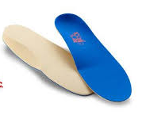
Clinical Experience
Good results from custom orthotics in the treatment of:
  Medial tibial stress syndrome
  Stress reactions / stress fractures
  Pes planus foot
  Toe deformities – Hallux valgus, turf toe, hallux rigidus
  Metatarsalgia
  Plantar fasciitis
  Patellofemoral pain
  Hip impingement
  ITB syndrome

Slide 9
Patient Needs and Customization
Shoe wear
Activity level
Comfort
Weight of patient
Previous experience with an orthotic

Slide 10
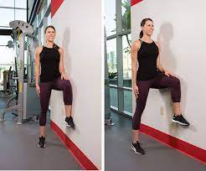
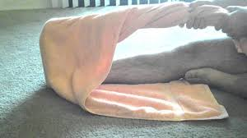
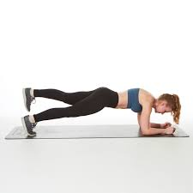
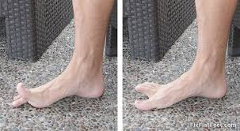
Evidenced Based Practice
Orthotics should be one component of treatment
Orthotics are rarely the only intervention needed*

Slide 11
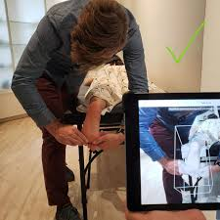
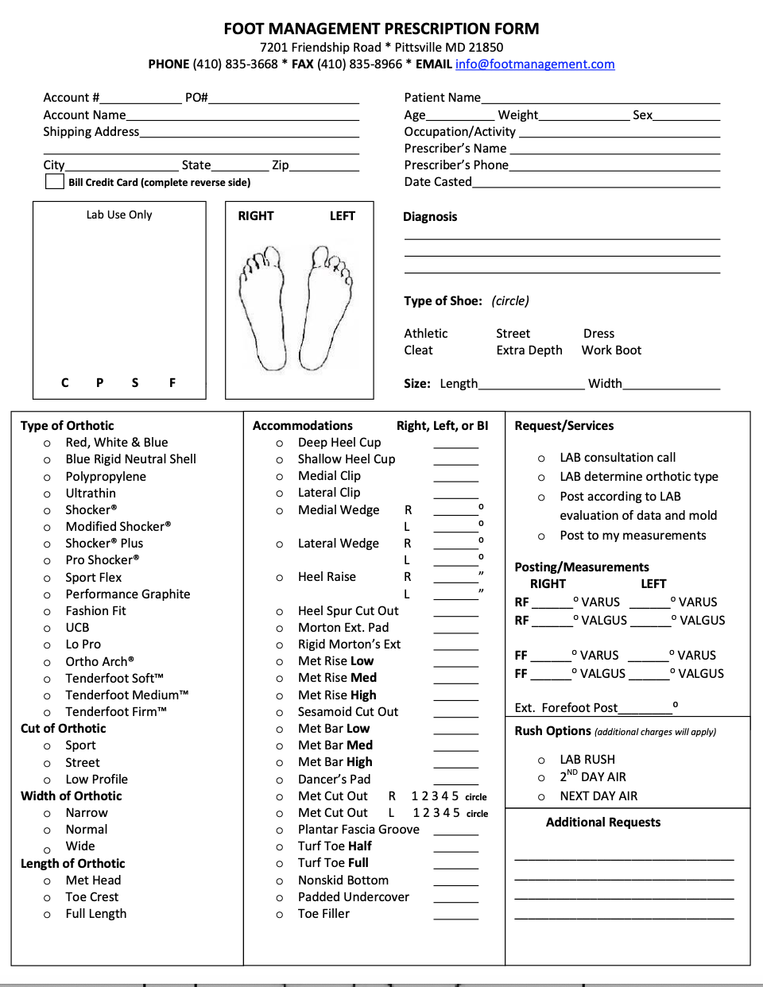
Evaluation and Prescription
Foot posture/ Foot Type
Stance and Gait assessment
Mobility/ ROM assessment
Note Deformities
Activity Level
Type of shoe orthotic will be fitted for
Scanning* of foot

Slide 12
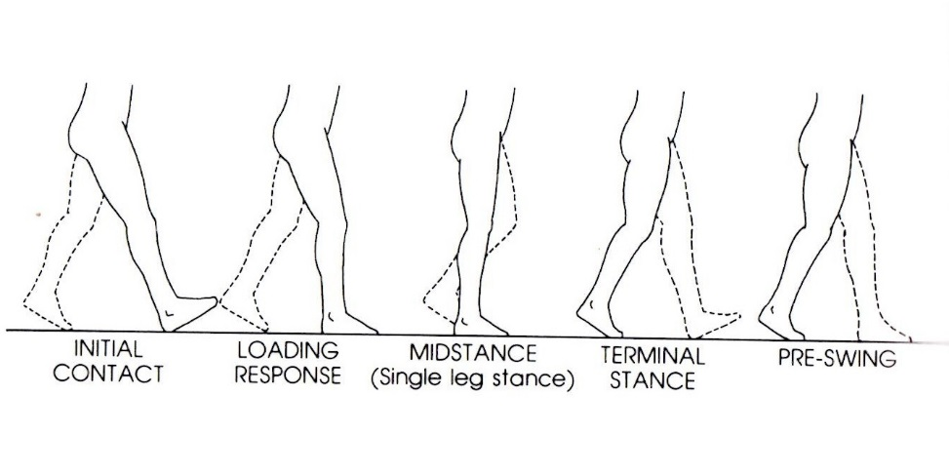
Stance Phase: Rancho/Traditional
Initial Contact/ Heel strike
Loading response/ Foot Flat
Mid-stance/ Mid-stance
Terminal Stance/ Heel Off
Pre-swing/ Toe off - Mid-Swing

Slide 13
Joint Position
 | IC | LR | MS | TS | PS | IS | MS | TS
Hip | 20˚√ | 20˚√ | 0˚ | 20˚/ | 10˚/ | 15˚√ | 25˚√ | 20˚√
Knee | 5˚√ | 15˚√ | 5˚√ | 5˚√ | 40˚√ | 60˚√ | 25˚√ | 5˚√
Ankle | 0˚ | 5˚ PF | 5˚ DF | 10˚ DF | 15˚ PF | 5˚ PF | 0˚ | 0˚
Subtalar | supinated | pronating | pronated | neutral | -- | -- | -- | --
Notes:
Range of motion review.

Slide 14
Strength
 | IC | LR | MS | TS | PS | IS | MS | TS
Hip | Extensors | Extensors/ABD | ABD | nothing | ADD L | Iliopsoas, Gracilis, Sartorious | Hip flexors→ extensors | Extensors
Knee | quads | quads | Quads→ quads turn off | nothing | nothing | Short head biceps | SH biceps | Hamstring→ quads
Ankle | Pre-tib | Pre-tib | calf | calf | Calf→ calf turn off | Pre-tib | Pre-tib | Pre-tib
Subtalar | Post-tib, intrinsic | Post-tib, intrinsic | Post-tib* intrinsic | -- | -- | -- | -- | --
Notes:
Strength review for normal gait.

Slide 15
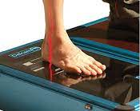
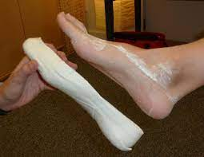
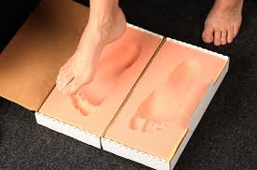
Evidence for scanning, molding, impressions
Practice is moving towards scanning with iPad and Laser scanner
Clinician Training drives accuracy
Both plaster and scanning are more accurate in comparison to impression trays or weightbearing assessment (clinician skill & experience impacts casting outcomes)
3-D LASER scanning results in increased accuracy and validity of measuring a patient for custom foot orthotics.⁶
3-D LASER scanning also results in increased speed of lab production and delivery of custom orthotics to patients.⁶

Slide 16
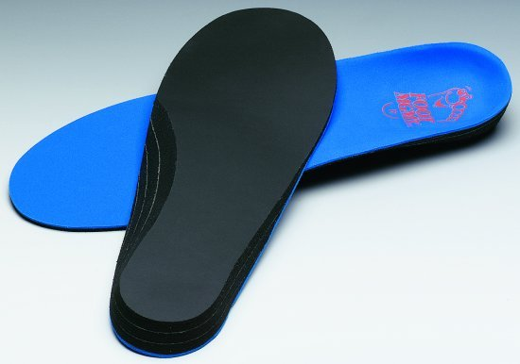
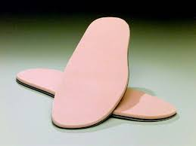
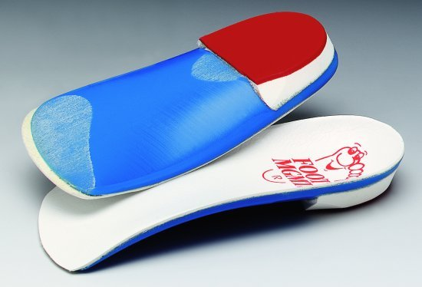
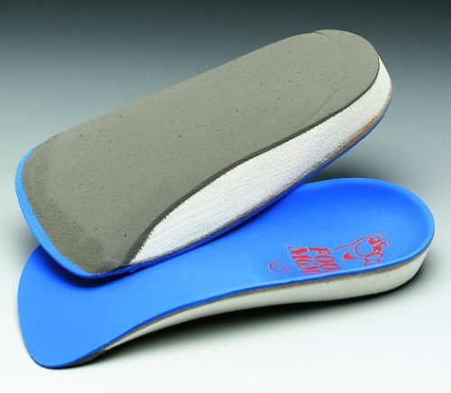
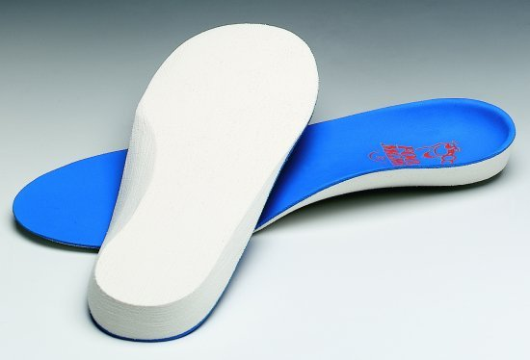
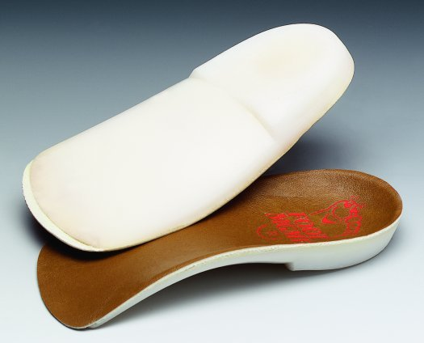
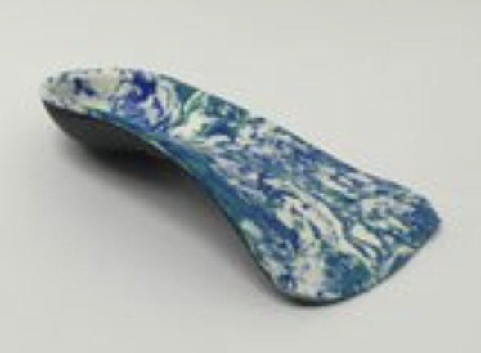
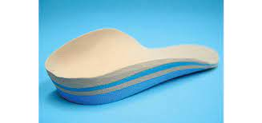
Types of Orthotics
Rigid
Semi-Rigid
Accommodative
Notes:
Rigid- hard, plastic control, great biomechanical control, poor shock absorption, great at controlling for excessive pronation, poor compliance
Semi-Rigid- good control, with excellent adaptability and good shock absorption, lightweight, but, relatively long lasting, lighter weight, can be fitted for a variety of shoe styles, cleats- dress shoes, sneakers, etc
Accomodative- fair- poor biomechanical control, excellent shock absorption, mostly constructed of high-density foam for shock absorption- good for diabetic neuropathy patients

Slide 17
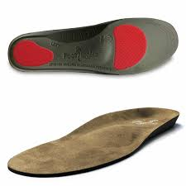
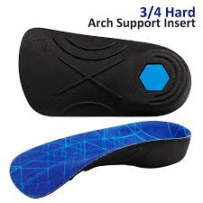
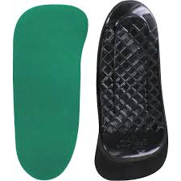
Length of Orthotic
Full Length
Toe Crest
Met Head

Slide 18
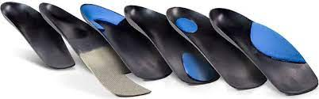
Orthotic Accommodations

Slide 19
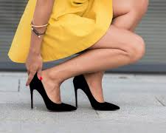
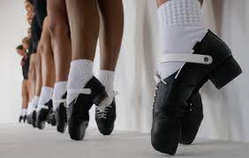
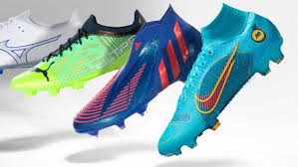
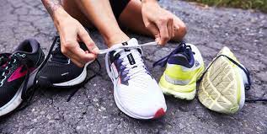
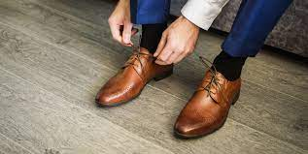
Shoes

Slide 20
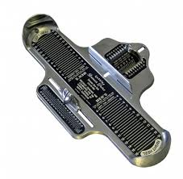
Proper Shoe Fit
80% of running/walking shoes fit ½ size smaller than marked on tongue
Feet get bigger with age & swell during the day
Running/Walking shoe materials do NOT stretch
“Size Matters”
  If the shoe doesn’t fit properly nothing else matters

Slide 21
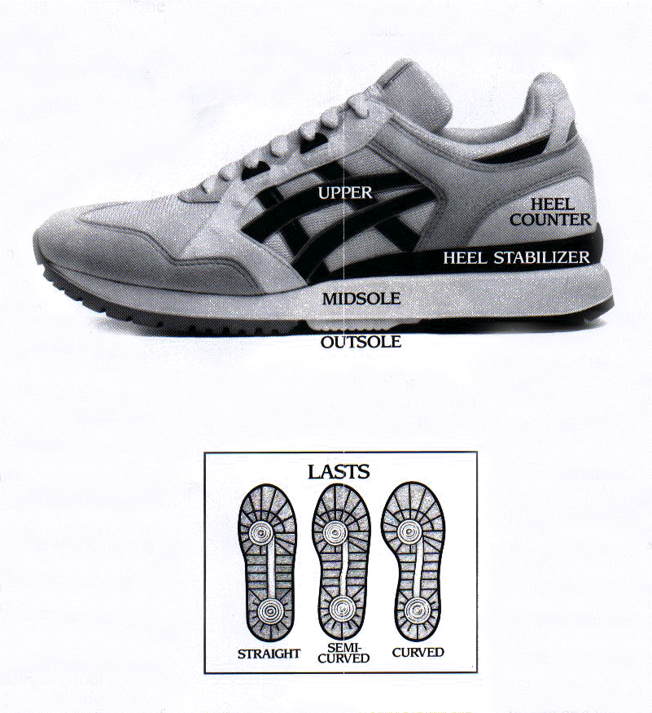
Shoe Components
Heel Counter
Outside Lasting
Inside Lasting (Shoe Construction)
Rearfoot Posting
Midsole Construction
Heel Flare
Toe Box

Slide 22
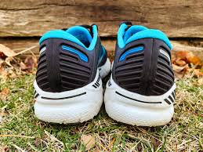
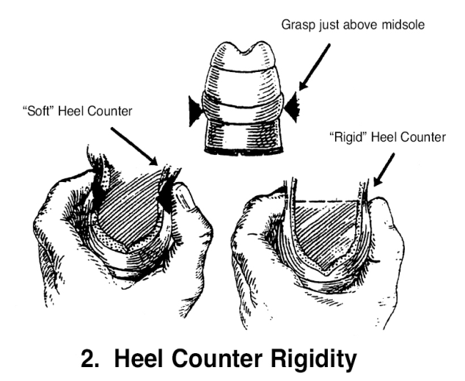
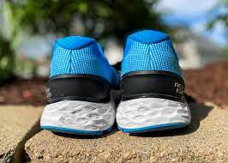
Heel Counter
Provides control of rearfoot*
Rearfoot should be stable when stressed from side to side
Provides rigid support for controlling heel motion
Pinch Test: pinch heel counter to see if it collapses
Custom orthotic = Neutral shoe*

Slide 23
Shoe Recommendations with Orthotics
Wait to recommend shoe wear change until orthotics are made*
Often patients require a larger and wider shoe to fit the device
  The device will be custom to the patient's foot width, deformities, length, etc.
  It will be custom to their needs
    To offload pain, correct mechanics etc
      This, the recommendation is made to place orthotic in a neutral shoe

Slide 24
Putting it all together

Slide 25
SIJ case
Patient with history of chronic L SIJ dysfunction
Completed several bouts of formal PT/AT rehab, focused on core, glut strengthening, lumbopelvic mobility, education on self- correction, avoiding aggravating factors (excessive single leg training and running)
Evaluation finds L foot excessively pronated (FPI = +7) and the R foot neutral (FPI = +3)
LLD L- 1 cm longer
Custom orthotic to control excessive pronation and added heel lift
  Heel lift is more important because changing LLD should decrease pronation

Slide 26
“Medial Shin Splints”
18-year-old female, LAX player, with a chronic history of b/l MTSS and posterior tibialis tendon dysfunction.
Has a previous history of orthotic use (rigid device) but refused to wear them.
FPI- L-6, R-6
Walking Gait-
  Rearfoot- supinated @ IC, midstance- Passes through neutral into pronation, but excessively pronates, never recovers to neutral or supination in late stance
Running gait in sneaker (stability shoe)- same as above
Running gait in cleat – early excessive pronation, remains pronated throughout gait cycle
Single leg squat assessment, hip drop, valgus, excessive pronation
Discussed switching shoes to turf shoe
  Allows for a bulkier more, controlling device
Orthotic recommendation: semi-rigid, full-length device, deepened
heel cup, medial rearfoot and forefoot medial posting

Slide 27
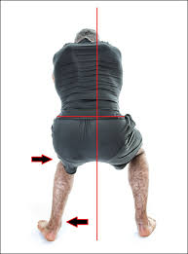
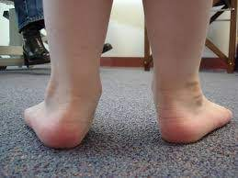
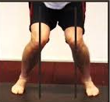
PFP
14 y.o. male with CC of anterior knee pain, worse with descending stairs, squatting, and running.
Has completed 4 weeks of formal rehab with gradual improvement, but still has difficulty with the functional tasks mentioned above
FPI- L = +10, R = + 11
Step down- excessive pronation IR of LE and valgus collapse
Squat mechanics- same as above
Gait- early, excessive pronator
Formal PT has focused on improving DF ROM, as well as glut, post tib, and intrinsic strengthening.
Patient fitted for custom orthotic with deepened heel cup and rearfoot & forefoot medial posting to help control excessive pronation.

Slide 28
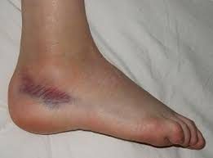
Lateral Ankle Sprain
15 y.o. Male 8-weeks post lateral ankle sprain
CC of sinus tarsi impingement & lateral column pain
Tx: Initially seen for radiographs in ED r/o fracture
Completed 3 weeks of rehab including mobility, balance training, and intrinsic, post tib, & fibularis strength
Goals to return to hiking and recreational soccer
Slightly Pronated Foot, FPI = 6
Gait- mid-stance excessive pronator, involved LE toed out
Recommendation of custom orthotic with 5th met cut out to offload entire 5th met and lateral column

Slide 29
Metatarsalgia
20 y.o. male, track athlete (sprinter) w/ CC of met head pain (2-3) R foot, history of accessory navicular b/l
Worse with activity on toes, worse in spikes, worse in men’s dress shoes
Evaluation – cavus foot in NWB, neutral in stance, excessive mid-stance pronation during gait, extensor tightness, hypomobility of forefoot
Prior treatment includes changing shoes (wider toe box) and use of toe spacer with minimal to no improvement, over the counter orthotic with slight medial clip
Day 1 patient was educated about intrinsic stretching, avoiding aggravating factors, treated with LASER, and clinician added padding to his OTC insert
1 week later 50% improvement in symptoms but, padding had compressed
Custom, low-profile orthotic ordered with metatarsal bar, and medial clip (for accessory navicular), patient provided with progression of intrinsic activation
4 weeks later (after proper break-in) patient was 100% improved, running, and completing pain-free ADL.

Slide 30
Bunion and Hallux Valgus
22-year-old male basketball player with history of hallux valgus, bunions
Complains of pain at 1st met head each season with increased jumping, running activity
Prior Treatment:
  Has switched to shoes with a wider toe box, occasionally wears toe spacer, feels improvement with hallux valgus tape correction for basketball specific activity, completed intrinsic strengthening rehab
FPI- 10 b/l
Great toe extension ROM- 35 degrees
Gait- early excessive pronator, remains excessively pronated throughout gait cycle
Recommendation: semi-custom orthotic with plantarflexed first ray, medial forefoot and rearfoot posting,

Slide 31
What’s Next
Upcoming Continuing Education Events
  EBP Orthotics Talk- April 6-7
Find a specialist near you for consult:
  Bethlehem (North, Moravian, Commons, 3rd & New)
  Allentown (Foglesville)
  Center Valley
  Brodheadsville
  Lehighton
  Forks
  Hillcrest
  Coming Soon:
    Hamburg, Orwigsburg, Whitehall Peds, Reading

Slide 32
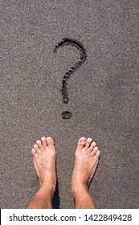
Questions

Slide 33
References
lmsted LC, Hertel J. Influence of Foot Type and Orthotics on Static and Dynamic Postural Control. Journal of Sport Rehabilitation. 2004;13(1):54-66.
Zifchock RA, Davis I. A comparison of semi-custom and custom foot orthotic devices in high- and low-arched individuals during walking, Clinical Biomechanics. 2008; 23 (10): 1287-1293. https://doi.org/10.1016/j.clinbiomech.2008.07.008.
Mündermann A, Nigg MB, Humble RN, Stefanyshyn DJ. Foot orthotics affect lower extremity kinematics and kinetics during running. Clinical Biomechanics. 2003;18(3): 254-262. https://doi.org/10.1016/S0268-0033(02)00186-9.
Perez-Morcillo A, Gomez-Bernal A, et al. Association between the foot posture index and running related injuries: A case-control study. Clinical Biomechanics. 2019;61: 217-221.
Cherati AS, Dousti M, Younespour S. Association between foot posture index and ankle sprain in indoor football players. Global Journal of Health Sciences. 2016; 8(10): 160-166.
Barrios-Muriel J, Romero-Sánchez F, Alonso-Sánchez FJ, Rodríguez Salgado D. Advances in Orthotic and Prosthetic Manufacturing: A Technology Review. Materials. 2020; 13(2):295. https://doi.org/10.3390/ma13020295
Mo S, Leung SHS, Chan ZYS, Sze LKY, Mok KM, Yung PSH, Ferber R, Cheung RTH. The biomechanical difference between running with traditional and 3D printed orthoses. Journal of Sports Sciences. 2019;37(19): 2191-2197. DOI: 10.1080/02640414.2019.1626069 Accessed March 22, 2023.
Costa BL. Magalhaes FA, Araujo VL, Richards J, Viera FM, Souza TR, Treade R. Is there a dose-response of medial wedge insoles on lower limb biomechanics in people with pronated feet during walking and running? Gait & Posture. 2021;90: 190-196. DOI: 10.1016/j.gaitpost.2021.09.163. Accessed March 22, 2023.
Awad, MA, Botla, AF, El-Hamid A, Allah AA, AMR SA. Effect of Arch Support on Prevention of Foot Pain During Pregnancy. Med. J. Cairo Univ. 2019;87(2): 881-888.

Slide 34
References
10. Kosonen J, Julmala JP, Muller E, Avela J. Effects of medially posted insoles on foot and lower limb mechanics across walking and running in overpronating men. Journal of Biomechanics. 2017 54:58-63.
11. Colo G. Fuisini F, Samaila EM, Rava A, Felli L, Mazzola M, Magnan B. The efficacy of shoe modifications and foot orthoses in treating patients with hallux rigidus: a comprehensive review of literature. Acta Biomed. 202; 91 (14) 1-10. DOI: 10.23750/abm.v91i14-S.10969

