Slide 1
Lifestyle Medicine
Maria DeBlasio, DPT
Outpatient Physical Therapist & Facility Director
Physical Therapy at St. Luke’s

Slide 2
Continuing Medical Education Credit Information
Activity Description/Statement of Need:
  Evidence has shown that didactic and lab continuing education does a fantastic job of developing the cognitive knowledge of providers. However, this classic educational model lacks in changing the practice of providers once the knowledge is gained. This course will review the current literature and recommendations regarding mentoring to facilitate the use of that increased knowledge to improve clinical decision-making in practice. Medical professionals, including physical therapists, should expect to achieve enhanced communication skills for other and patients with or without referral.
Target Audience: All Providers

Slide 3
Designation Statement
It is St. Luke’s University Health Network policy to ensure balance, independence, objectivity and scientific rigor in all of our sponsored educational programs. Faculty and all others who have the ability to control the content of continuing medical education activities sponsored by the St. Luke’s Hospital & Health Network are expected to disclose to the audience whether they do or do not have any real or apparent conflict(s) of interest or other relationships related to the content of their presentation(s).
The St. Luke’s University Health Network is accredited by the Pennsylvania Medical Society to provide continuing medical education for physicians.
The St. Luke’s University Health Network designates this live educational activity for a maximum of 1 AMA PRA Category 1 Credits™. Physicians should only claim credits commensurate to the extent of their participation on the activity.

Slide 4
Disclosure Information
The Planners involved in this activity have no relevant financial relationships to disclose.
The Faculty/Presenters involved in this activity have no relevant financial relationships to disclose.

Slide 5



Introduction
University of Iowa 1998-2002
University Of Delaware 2003-2006
St. Luke’s Physical Therapy 2007 – Present
Lifestyle Medicine Certification – 2023

Slide 6
Learning Objectives
To provide a general overview of current state of health.
To provide a general overview of lifestyle medicine.
To describe the 6 pillars that comprise lifestyle medicine.
To provide insight into ways in which we can implement these concepts into our current practice.

Slide 7
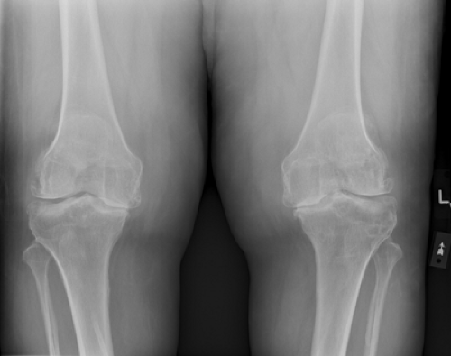
Patient Example
Patient Example:
  57 year-old female with c/o severe bilateral knee pain
      BMI = 55.93 kg/m²
      Prediabetes
      HTN
      RA
Notes:
So, why am I here?
Increase in patient referrals like this example, and difficult to determine an effective plan of care.
Went to orthopedic surgeon, not a candidate for surgery due to medical status.
CSI not effective.
Doesn’t like to exercise.
Referred to PT.
So how can we help this patient?
What kind of improvement can we provide for her?
Are we responsible for fixing her pain?
What is her FOTO outcome going to be?
Is she going to have a satisfactory Press Ganey Survey?

Slide 8
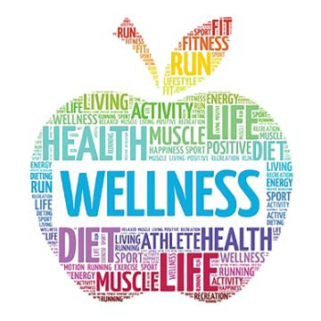
Lifestyle Medicine
Notes:
So, why are WE here?
What IS lifestyle medicine?
Before we talk about what lifestyle medicine is, I think it’s important to discuss our current state of health and why this branch of medicine was developed.

Slide 9
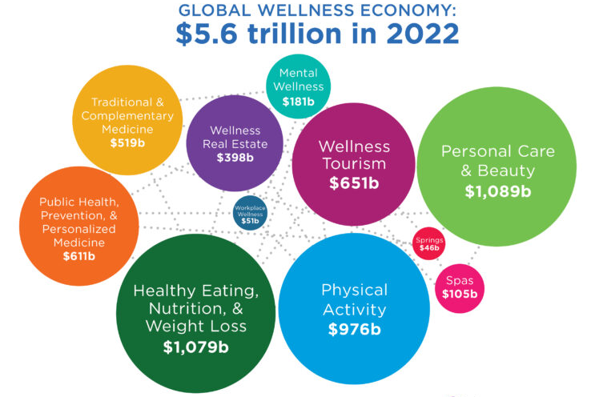
Global Wellness Economy
Notes:
The health and wellness industry is booming.
In 2022, the global wellness economy reached $5.6 trillion, nearly 14% higher than in 2019.
The wellness economy is projected to continue its robust growth, with the wellness economy reaching $8.5 trillion in 2027.
But just because we are investing more money into wellness, are we actually healthier?
Are we benefiting from our financial investments into wellness?

Slide 10

Health Statistics
Eat healthfully - 33%
Active lifestyle – 40%
Healthy weight – 40%
Emotional resilience – 50%
Notes:
Let’s take a look and see.
So with all of that investment into the health and wellness industry, all of the available nutrition supplements, fitness and diet trends, and all of the technological, economic and medical advances of the millennium, we have to be healthy, right?
Do we eat healthfully?
•Not 77% of us
Do we live active days?
•60% of us are sedentary
Are we at a healthy weight?
•60% of us are overweight or obese
Do we have emotional resilience?
•We are split at 50/50

Slide 11

(Un)Healthy Eating
Excess calories
Saturated fats
Trans fats
High fructose corn syrup
Sodium
Artificial ingredients
Notes:
In the United States, poor diet was once associated with undernutrition. Today it is more often associated with excess, particularly excesses in calories, saturated fats, trans fats, added sugars, and sodium.
Unhealthy diet contributes to approximately 678,000 deaths each year in the U.S., due to nutrition- and obesity-related diseases, such as heart disease, cancer, and type 2 diabetes.
In the last 30 years, obesity rates have doubled in adults, tripled in children, and quadrupled in adolescents.

Slide 12

Adult Obesity
41.9% of adults in US have obesity
Notes:
Nationally, 41.9 percent of adults have obesity.
At least 35% of adults in 22 US states are now living with obesity, according to the CDC.
In 3 of those states—Louisiana, Oklahoma, and West Virginia—at least 40% of adults have obesity.
By comparison, 19 states had an adult obesity prevalence at or above 35% in 2019 and NONE did a decade ago.

Slide 13
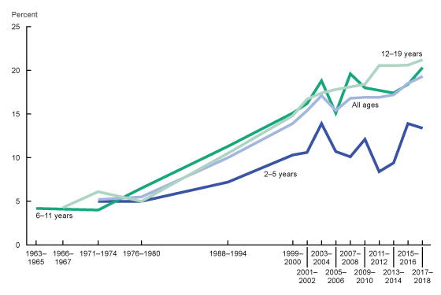
Childhood Obesity
19.7% of children have obesity
  2-5: 12.7%
  6-11: 20.7%
  12-19: 22.2%
Notes:
So if 41.9% of adults are obese, what about children?
For children and adolescents aged 2-19 years:
In 2022, the prevalence of obesity was 19.7% and affected about 14.7 million children and adolescents.
Obesity prevalence:
12.7% among 2- to 5-year-olds
20.7% among 6- to 11-year-olds
22.2% among 12- to 19-year-olds.
Childhood obesity is also more common among certain populations.
(Obesity is body mass index (BMI) at or above the 95th percentile from the sex-specific BMI-for-age 2000 CDC Growth Charts.)

Slide 14
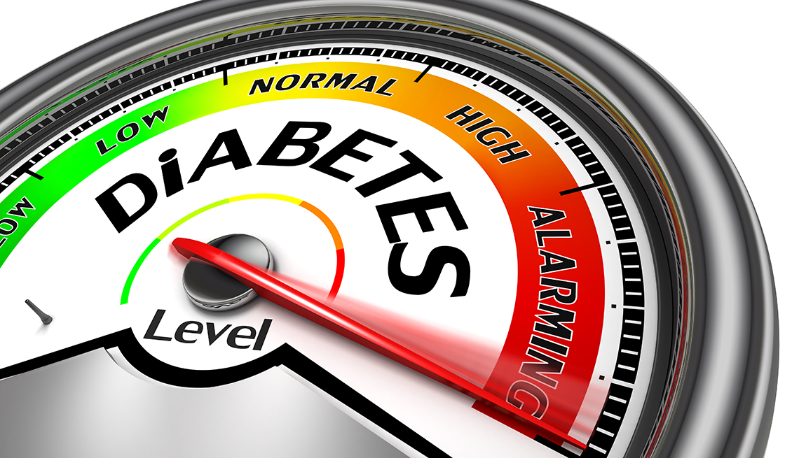
Type II Diabetes
37.3 million people in United States have diabetes.
  1 in 10 diagnosed
  1 in 5 undiagnosed
Projected to increase to 54.9 million by 2030.
Notes:
According to the CDC, 37.3 million people in the US have DM.
1 in 10 are diagnosed.
1 in 5 are undiagnosed.
The overall number of Americans with diabetes is expected to rise to more than 54.9 million by 2030.

Slide 15
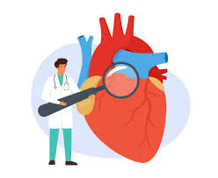
Cardiovascular Disease
121.5 million adults in United States have cardiovascular disease.
  1 in 10 diagnosed
  1 in 5 undiagnosed
116.4 million adults have hypertension
Notes:
This year's report said 121.5 million adults in the U.S. – 48 percent based on 2016 figures – have cardiovascular disease.
116.4 million or 46% of adults in the US are estimated to have hypertension, and many are not aware their blood pressure is elevated.

Slide 16
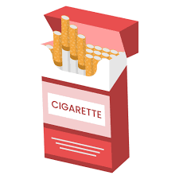
Tobacco Use
22% aged 12 or older use tobacco products, e-cigarettes or vape.
1 in 20 routinely uses vaping product
Notes:
Among people aged 12 or older in 2021:
22.0% (or about 61.6 million people) reported using tobacco products or vaping nicotine
1 out of every 20 Americans routinely u.ses a vaping product

Slide 17
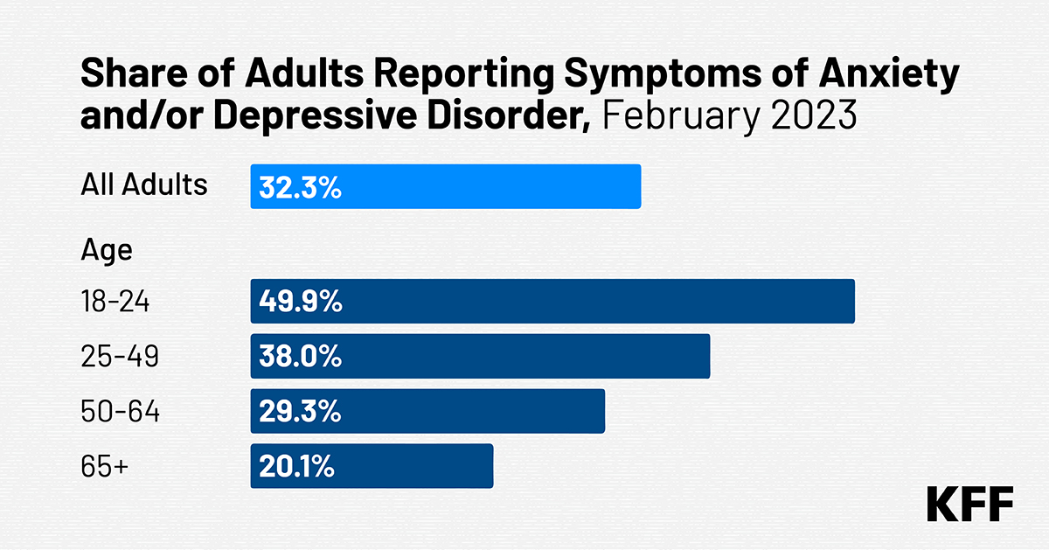
Mental Health
Notes:
Here’s a look at how individuals across the U.S. are affected by mental health conditions.
Anxiety: Anxiety disorders such as generalized anxiety, obsessive-compulsive disorder and panic disorder are some of the most commonly diagnosed mental health conditions in the U.S., affecting 42.5 million adults^{[15]}.
Depression: 21 million U.S. adults are living with depression, while 3.7 million people ages 12 to 17 experience major depression and 2.5 million people ages 12 to 17 experience severe depression^{[16]}.
PTSD: There are 12 million U.S. adults living with post-traumatic stress disorder (PTSD)^{[17]}.
Bipolar disorder: There are 3.3 million U.S. adults with a bipolar disorder diagnosis^{[18]}.
Schizophrenia: Around 1.5 million U.S. adults have a diagnosis of schizophrenia^{[19]}.

Slide 18
Leading Causes of Death
1900:
2018:
Notes:
In order to examine how healthfully we are living, we need to look at the causes of our mortality.
So let’s look the leading causes of death over the past century and see how they’ve changed:
In 1900, the leading cause of death was infectious disease at 53%.
Infectious diseases such as smallpox, cholera, diphtheria, typhoid, and tuberculosis were rampant.
Heart Disease = 12%
Diabetes = 10%
Accidents = 7%
Cancer = 6%
Other = 12%
The life expectancy was 47 years.
In 2018, the leading cause of death was heart disease at 33%.
Cancer = 32% (increased by 26%)
Accidents = 6%
Diabetes = 4%
Infectious disease = 3% (decreased by 50%)
Other = 22% (included 8% for frailty and 4% for Alzheimers)
The life expectancy was 79 years.
So what’s changed? Advances in medicine, development of vaccinations and antibiotics (penicillin was discovered in 1928) have changed the leading cause of death from communicable to non-communicable diseases (cardiovascular disease, cancer, etc.).

Slide 19
Lifestyle Factors
Most deaths from chronic illness in the US are preventable and related to how we live.

Slide 20
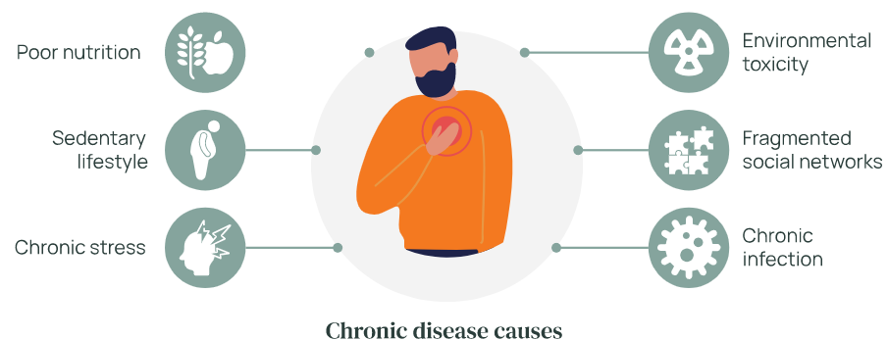
Causes of Chronic Diseases
Notes:
Poor lifestyle choices like dietary patterns, physical inactivity, tobacco use, alcohol addiction and dependence, drug addiction and dependence, as well as psychosocial factors, such as chronic stress and lack of social support, contribute to chronic disease.^{[1][4][5]}

Slide 21
Chronic Diseases
80% of chronic diseases could be prevented with lifestyle factors
80% of heart disease, stroke, type 2 diabetes and 40% of cancer could be prevented with lifestyle factors
80% of healthcare spending directed to health conditions related to lifestyle factors
Notes:
In 2024, with all of these advances in medicine and our opportunities to treat diseases, what’s the big deal?
Our expectations are part of the problem.
With our current approach to healthcare, we expect medication and/or surgery to fix our issues. There is always something new trending, a newer, better, more effective and convenient health or fitness trend, a new diet, weight-loss medication to “cure” our problem.
We expect instant gratification and results with minimal effort. We think there is a quick fix for everything, including our healthcare, fitness, diet and overall health.
We rely solely on these external sources to cure our issues instead of reflecting on our habits, choices and overall lifestyle.

Slide 22

Lifestyle Related Diseases
More than 80% of chronic illnesses can be addressed through lifestyle choices.
Most chronic diseases are due to lifestyle choices, thus, the definition of lifestyle related diseases (LRDs)
  Cardiovascular disease
  Type II diabetes
  Obesity
  Cancer
Notes:
Thus the advent of the term Lifestyle Related Diseases.

Slide 23

US Healthcare Costs
What is the cost to US?
  Healthcare costs related to LRDs = 75%
  Amount spent on healthcare in 2022 = 4 trillion
    $13,413/person
  Projected amount to be spent on healthcare in 2031 = 7.2 trillion
    $20,425/person
Notes:
Healthcare costs related to LRDs = 75%
GNP spent on healthcare in past decade = 18%
Amount spent on healthcare in 2022 = 4 trillion ($13,413/person)
Projected amount to be spent on healthcare in 2031 = 7.2 trillion ($20,425/person)

Slide 24

Global Healthcare Costs
LRDs = 71% of global burden of disease
GBD
  Provides comprehensive picture of mortality & disability across countries, time, age and gender.
  Quantifies health loss from diseases, injuries & risk factors.
  Data utilized to improve healthcare systems.
Notes:
What is the cost globally?
LRDs account for 71% of global burden of disease.
GBD provides comprehensive picture of mortality & disability across countries, time, age and gender.
Quantifies health loss from diseases, injuries & risk factors.
Data utilized to improve healthcare systems.

Slide 25
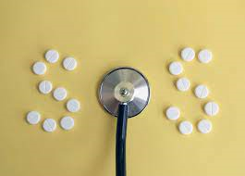
Time for Change
Shift focus from treating symptoms to addressing the root cause.
Decrease reliance to “fix” the problem with medication or surgery.
Promote self-responsibility for our own state of health.
Empower, create and support healthful living.
Notes:
So change is needed in how we view our health and the idea of being healthy.
Although we have an extraordinary healthcare system that is exception at treating the effects of diseases, we need to shift our focus to preventing the diseases from developing or progressing.
We need to be more proactive and less reactive.
We need to create a ripple effect of lifestyle habits and choices as our medicine.
There is always a place for medicine and surgery, but the goal is promote preventative care.
We have to practice what we are preaching to instill what we are teaching.

Slide 26
Where is the Evidence?
  European Prospective Investigation into Cancer and Nutrition – Potsdam Study (2009)
    Objective: Evaluate how 4 healthy lifestyle factors and relative risk reduction of developing:
      Cardiovascular disease
      Type II DM
      CVA
      Cancer
Notes:
Potsdam Study 2009: (23,153 German adults)
Objective: look at 4 healthy lifestyle factors and relative risk reduction of developing
1.CV disease
2.Type 2 diabetes
3.Stroke
4.Cancer

Slide 27
Where is the Evidence?
  European Prospective Investigation into Cancer and Nutrition – Potsdam Study (2009)
    Lifestyle Factors:
      No history of smoking
      BMI < 30
      3.5 hours/week of physical activity
      Healthy diet
Notes:
Lifestyle factors:
•No history of smoking
•BMI <30
•at least 3.5 hr/week physical activity
•Healthy diet
“”
•Those participating in all 4 healthy factors:
•78% lower risk of developing chronic condition
•Diabetes 93%
•Myocardial Infarction 81%
•Stroke 50%
•Cancer 36%
Ford ES, Bergmann MM, KrögerJ, SchienkiewitzA, WeikertC, Boeing H. Healthy living is the best revenge: findings from the European Prospective Investigation Into Cancer and
Ford ES, Bergmann MM, KrögerJ, SchienkiewitzA, WeikertC, Boeing H. Healthy living is the best revenge: findings from the European Prospective Investigation Into Cancer and

Slide 28
Where is the Evidence?
  European Prospective Investigation into Cancer and Nutrition – Potsdam Study (2009)
    Findings:
      Participation in all 4 healthy factors had 78% reduction in risk of developing chronic conditions
        Cardiovascular disease – 81%
        Type II DM – 93%
        CVA – 50%
        Cancer – 36%
Notes:
For those that actively engaged in all 4 healthy lifestyle factors, they had 78% reduction in their risk of developing these 4 diseases.
The main finding is the hazard ratio for developing a chronic disease decreased as healthy factors increased.

Slide 29
“An ounce of prevention is worth a pound of cure.”
~ Benjamin Franklin

Slide 30
“If we could give every individual the right amount of nourishment and exercise, not too little and not too much, we would have found the safest way to health.”
~ Hippocrates
Notes:
The power of lifestyle as medicine was perceived thousands of years ago by Hippocrates.
The antidote for chronic and preventable lifestyle related diseases is lifestyle medicine.
Despite the technological, economic, and medical advances of the new millennium, and to some extent even because of those advances, the world is experiencing a marked increase in chronic diseases including cardiovascular disease, cancer and diabetes.

Slide 31
Lifestyle Medicine
Evidence-based practice utilized to treat, reverse and prevent chronic diseases.
Education, motivation and support to change habits & behaviors that improve overall health & quality of life.
Promotion of healthy lifestyle choices to prevent and treat chronic diseases
Notes:
So now that we know the why behind lifestyle medicine, let’s talk about WHAT this branch of medicine is.
What is Lifestyle Medicine?
It is educating patients on their role in their own health, providing education and support to allow them to replace unhealthy behaviors with health-enhancing behaviors.
It is helping those in our community create and sustain healthy behaviors to positively impact their health and overall quality of life.
Lifestyle medicine focuses on educating and motivating patients to improve the quality of their lives by changing personal habits and behaviors.
Provision of education and motivation to change habits and behaviors that improve overall health and quality of life.
Promotion of healthy lifestyle choices to prevent and treat chronic diseases.
Promotion of living healthier through behavioral change.
In the clinic, major barriers to lifestyle counseling are that physicians feel ill-prepared and are skeptical about their patients' receptivity.^{[6]}
However, by encouraging healthy decisions, illnesses can be better managed, reversed, or prevented in the long term.
LM is similar to preventive medicine in that it also bridges the gap between conventional medicine and public health.
LM interventions such as behavioral change counseling are used in adjunct with pharmacotherapy.^{[17]}
Like all of medicine, LM promotes healthy lifestyle choices to prevent and treat diseases.
Overall wellness and self-management are a crucial components of lifestyle medicine and enforce the idea of living healthier through behavioral change.
Health promotion is the foundation of LM and encourages individuals to participate in their own care and well-being.^{[18]}

Slide 32

Lifestyle Medicine
Similar to preventative medicine.
Proactive vs. reactive.
Holistic approach to overall health and wellness.
Addressing behaviors and choices that directly impact health including nutrition, physical inactivity, chronic stress and self-destructive behaviors (consumption of tobacco products, drug abuse, alcohol abuse).
Notes:
LM is similar to preventive medicine in that it also bridges the gap between conventional medicine and public health.
LM interventions such as behavioral change counseling are used in adjunct with pharmacotherapy.^{[17]}
Like all of medicine, LM promotes healthy lifestyle choices to prevent and treat diseases.
Overall wellness and self-management are a crucial components of lifestyle medicine and enforce the idea of living healthier through behavioral change.
Health promotion is the foundation of LM and encourages individuals to participate in their own care and well-being.^{[18]}
In the clinic, major barriers to lifestyle counseling are that physicians feel ill-prepared and are skeptical about their patients' receptivity.^{[6]}
However, by encouraging healthy decisions, illnesses can be better managed, reversed, or prevented in the long term.

Slide 33

Lifestyle Medicine
What is it not?
  New ideas or research findings.
  Treating only the symptoms of diseases.
  Being embraced and integrated into healthcare practice.
  The first choice to address chronic diseases.
Notes:
1. The concepts of healthful living that constitute the foundational principles of lifestyle medicine (6 pillars) are not new to our understanding of health and wellness.
2. Our current healthcare format focuses on treating the symptoms of diseases instead of addressing the root causes.
3. LM is not being embraced and integrated into healthcare practice, yet.
4. The first choice to address chronic diseases, but it should be.

Slide 34
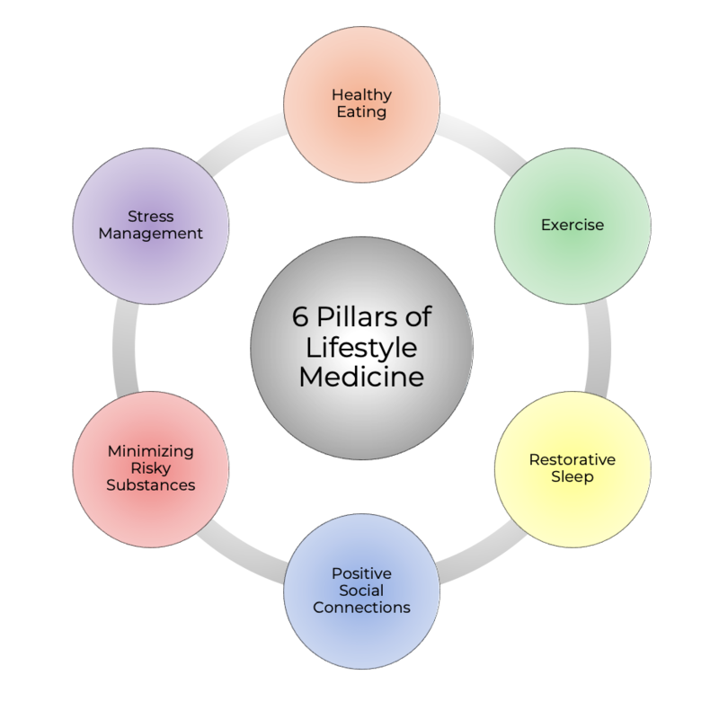
Lifestyle Medicine
6 Pillars
  1. Nutrition
  2. Exercise
  3. Sleep
  4. Stress management
  5. Positive social connections
  6. Avoidance of risky substances
Notes:
Poor lifestyle choices like dietary patterns, physical inactivity, tobacco use, alcohol addiction and dependence, drug addiction and dependence, as well as psychosocial factors, such as chronic stress and lack of social support, contribute to chronic disease.^{[1][4][5]}
These concepts are super simple and really the “common sense” of medical advice.
We inherently know this general advice and routinely briefly mention to our patients.
But is that enough or is it effective?

Slide 35

Lifestyle Medicine Interventions
    Plant-based nutrition
      Predominantly plant-based diet rich in whole vegetables, fruits, beans, nuts and seeds

Slide 36
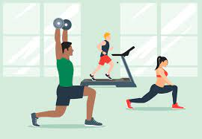
Lifestyle Medicine Interventions
    Exercise
      Daily, enjoyed and maintainable throughout lifetime
      ODP recommends 150 -300 minutes of moderate-intensity or 75-150 minutes of vigorous intensity aerobic activity weekly

Slide 37
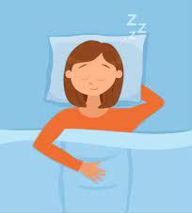
Lifestyle Medicine Interventions
    Sleep hygiene
      Quantity and quality both important for immune function and other health factors

Slide 38
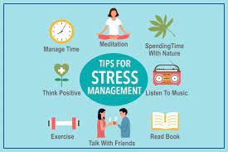
Lifestyle Medicine Interventions
    Stress management
      Reduction methods
      Coping mechanisms

Slide 39

Lifestyle Medicine Interventions
    Positive social connections
      Essential to emotional health

Slide 40
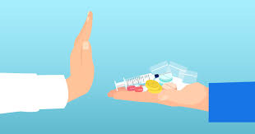
Lifestyle Medicine Interventions
    Avoidance of risky substances
      Tobacco, drugs, alcohol

Slide 41
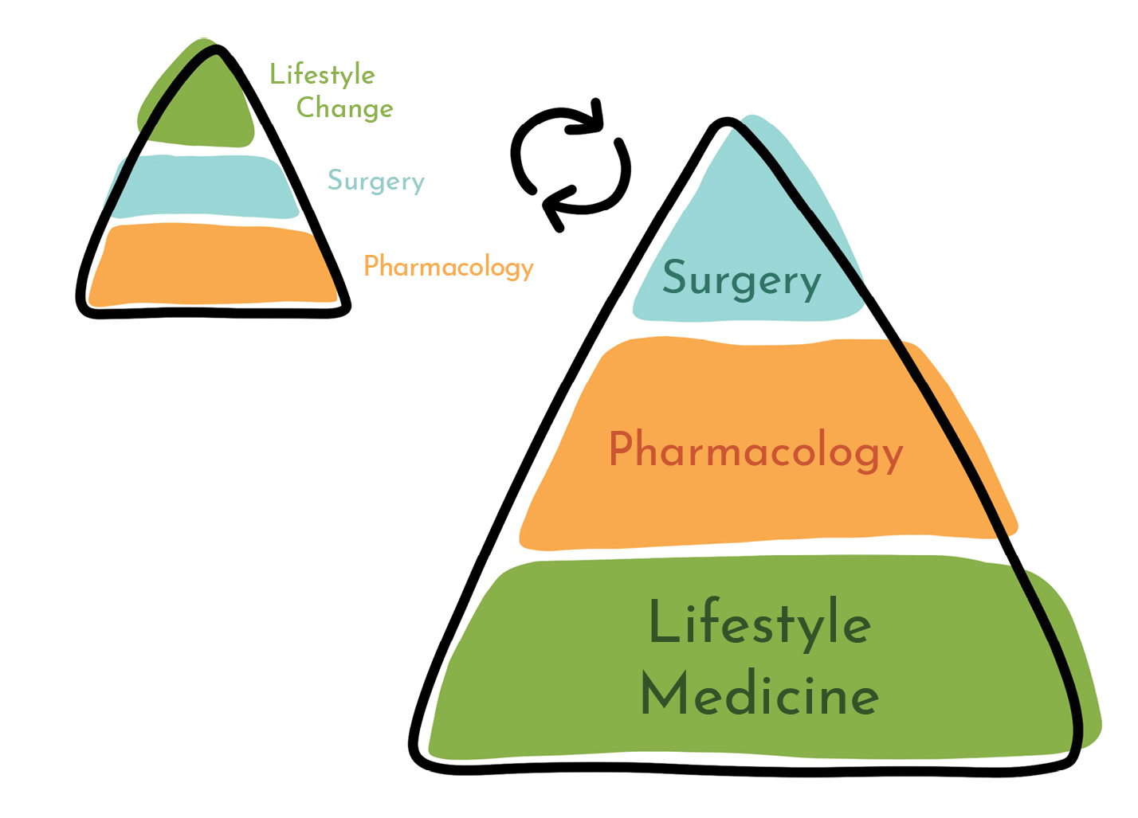
Lifestyle Medicine Goals
Notes:
Give a man a fish, feed him for a day.
Teach a man to fish, feed him for a lifetime.
Doing To:
Medication
Injections
Surgery
Passive Modalities
Doing For:
Educate
Empower
Tools
Resources

Slide 42
Trust
  The physician’s (clinician’s) trusted relationship with the patient, with the support of the family, an interdisciplinary team and the community, is key to improving health behaviors and outcomes. ^{[4]}

Slide 43
Value of Lifestyle Medicine
Lifestyle practices and health habits are among the nation’s most important health determinants.
Changing unhealthy behaviors is foundational to medical care, disease prevention, and health promotion.

Slide 44
Lifestyle Medicine Assessment
Social, psychological and biological predispositions of patient’s behaviors
Patient and their family’s readiness, willingness and ability to make health behavior changes
Physical Exam
Lifestyle Vital Signs
Diet, physical activity, BMI, stress level, sleep, emotional well-being, tobacco use, alcohol consumption.

Slide 45
Lifestyle Medicine Goals
  Promote healthy behaviors as foundational to overall wellness.
    Health Promotion
    Medical Care
    Disease Prevention
  Coordinated team-based approach to healthcare.

Slide 46
Lifestyle Medicine Goals
  Create and sustain healthy behaviors that improve overall wellness and quality of life.
    Education
    Motivation
    Change
      Replace unhealthy behaviors with health enhancing behaviors
  Address root cause of LRDs instead of chasing symptoms

Slide 47

Benefits of Lifestyle Medicine
  Live longer.
  Live longer in better health.
  Live longer in better health with improved quality of life.
Notes:
Live longer in better health with less risk of disease or disability.
Add years to life and life to your years.

Slide 48
Benefits of Lifestyle Medicine
  Increased value to our current healthcare practices.
  Establish partnership for life with our patients.

Slide 49
Lifestyle Medicine Introduction
  Is it new?
    Founded in 2003.
    The American College of Lifestyle Medicine Fellowship was established in 2010.
    2013 Expanded membership beyond physicians and PhD level professionals
    The American College of Lifestyle Medicine began providing board certification in Lifestyle Medicine to qualified physicians in 2017.
    2019 ACLM approved provider of CE for National Board Health and Wellness Coaching
Notes:
•2003 First official founder meeting
•2004 By laws drafted
•2010 ACLM Fellowship established: Seminal article in JAMA “Physician Competencies for Prescribing Lifestyle Medicine”
•2011 First stand alone conference for ACLM
•2013 Expanded membership beyond physicians and PhD level professionals
•2016 Launch of “Lifestyle Medicine Story Project” www.lifestylemedicine.org/StoryProject
•2017 ACLM partners with BS CA to provide LM training for its provider network
•2019 ACLM approved provider of CE for National Board Health and Wellness Coaching

Slide 50
Lifestyle Medicine Introduction
  Why do we need it?
    Lifestyle practices and health habits are among the nation’s most important health determinants.
    Changing unhealthy behaviors is foundational to medical care, disease prevention, and health promotion.

Slide 51
Lifestyle Medicine Values
  Promote healthy behaviors as foundational to overall wellness.
    Health Promotion
    Medical Care
    Disease Prevention
  Coordinated team-based approach to healthcare
    PCP, PT, OT, SLP, RD, PsyD, etc.

Slide 52
Lifestyle Medicine Goals
  Create and sustain healthy behaviors that improve overall wellness and quality of life.
    Education
    Motivation
    Change
      Replace unhealthy behaviors with health enhancing behaviors
  Address root cause of LRDs instead of chasing symptoms

Slide 53
Lifestyle Medicine Assessment
    Social, psychological and biological predispositions of patient’s behaviors
    Patient and their family’s readiness, willingness and ability to make health behavior changes
    Physical Exam
    Lifestyle Vital Signs
      Tobacco use, alcohol consumption, diet, physical activity, BMI, stress level, sleep, emotional well-being

Slide 54
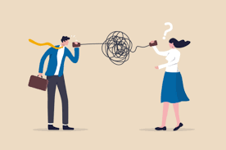
Barriers
Ill-prepared
Ineffective communication
Skeptical
Stress about time
Relationship with patient
Lack of empathy
Not involving patients in decision-making
Notes:
In the clinical setting, major barriers to lifestyle counseling are that physicians feel ill-prepared and are skeptical about their patients' receptivity.^{[6]}
Are we practicing what we are preaching?
We need to take a moment and put on our own oxygen masks first.

Slide 55
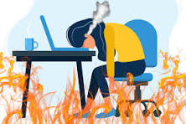
Burnout
Compassion Fatigue
Stages
  Emotional Exhaustion
  Depersonalization
  Reduced Personal Accomplishment
Notes:
Definition:
What started out as important, meaningful and challenging work becomes unpleasant, unfulfilling and meaningless.
Energy turns into exhaustion, involvement turns into cynicism and efficacy turns into ineffectiveness.
Leads to emotional exhaustion, depersonalization in relationships with co-workers, a sense of inadequacy and/or reduced personal accomplishment.
Compassion Fatigue:
Indifference to charitable appeals on behalf of those who are suffering, experienced as a result of the frequency and/or number of appeals.
“Cost of caring” for others in emotional pain.
Stages:
1. Emotional Exhaustion
2. Depersonalization
3. Reduced Personal Accomplishment

Slide 56
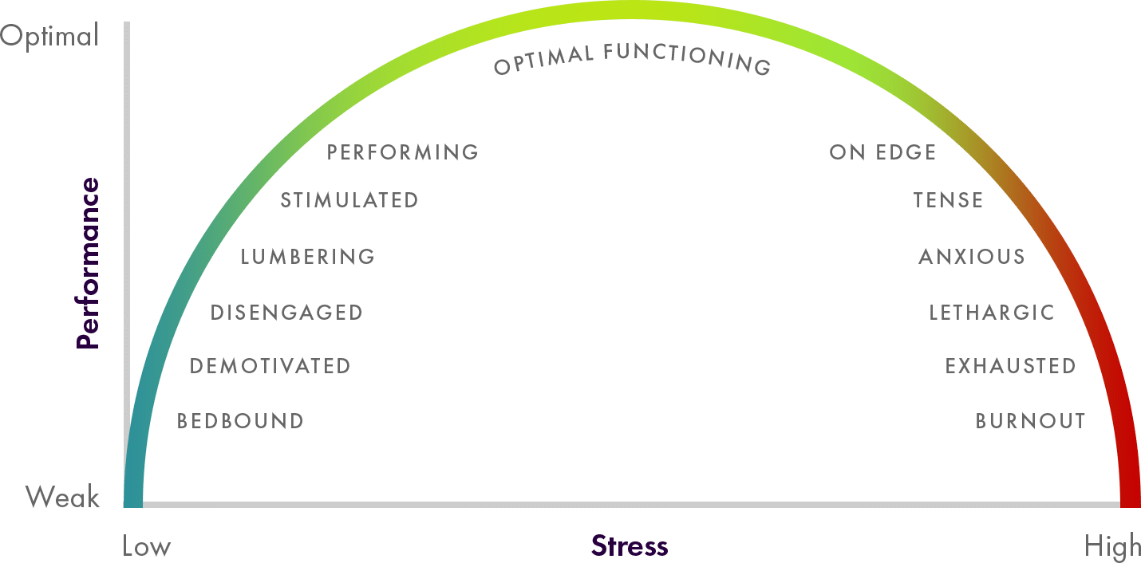
Burnout
Notes:
Definition:
What started out as important, meaningful and challenging work becomes unpleasant, unfulfilling and meaningless.
Energy turns into exhaustion, involvement turns into cynicism and efficacy turns into ineffectiveness.
Leads to emotional exhaustion, depersonalization in relationships with co-workers, a sense of inadequacy and/or reduced personal accomplishment.
Compassion Fatigue:
Indifference to charitable appeals on behalf of those who are suffering, experienced as a result of the frequency and/or number of appeals.
“Cost of caring” for others in emotional pain.
Stages:
1. Emotional Exhaustion
2. Depersonalization
3. Reduced Personal Accomplishment

Slide 57
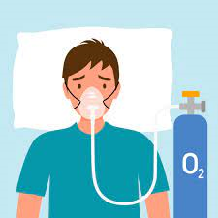
Self-Care for Healthcare
Compassion Fatigue
Stages
  Emotional Exhaustion
  Depersonalization
  Reduced Personal Accomplishment

Slide 58

Lifestyle Medicine Application
Notes:
How do we put all of the pieces together?

Slide 59

Lifestyle Medicine Application
Assess lifestyle factors
Assess desire and readiness for making change
Notes:
Engage patients in deeper conversations about their health and wellness goals, provide education and coaching to assist in comprehensive plan of care
We need to meet patients where they are currently at.
In order to understand where they are in there readiness for change, we need to actively listen to what they are telling us.

Slide 60
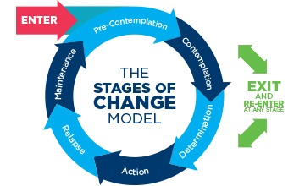
Lifestyle Medicine Application
    Transtheoretical Model of Change
      1. Precontemplation
      2. Contemplation
      3. Preparation
      4. Action
      5. Maintenance
      6. Termination
Notes:
Precontemplation:
-Do not intend to take action in the foreseeable future (defined as within the next 6 months).
-Unaware that their behavior is problematic or produces negative consequences.
-Often underestimate the pros of changing behavior
-Place too much emphasis on the cons of changing behavior.
Contemplation:
-Intending to start the healthy behavior in the foreseeable future (defined as within the next 6 months).
-Recognize that their behavior may be problematic
-A more thoughtful and practical consideration of the pros and cons of changing the behavior takes place
-Even with this recognition, people may still feel ambivalent toward changing their behavior.
Preparation (Determination):
-Ready to take action within the next 30 days.
-Start to take small steps toward the behavior change, and they believe changing their behavior can lead to a healthier life.
Action:
-Recently changed their behavior (defined as within the last 6 months)
-Intend to keep moving forward with that behavior change.
-May exhibit this by modifying their problem behavior or acquiring new healthy behaviors.
Maintenance:
-Sustained their behavior change for a while (defined as more than 6 months) and intend to maintain the behavior change going forward.
-Work to prevent relapse to earlier stages.
Termination
-No desire to return to their unhealthy behaviors and are sure they will not relapse.
-Since this is rarely reached, and people tend to stay in the maintenance stage, this stage is often not considered in health promotion programs.

Slide 61
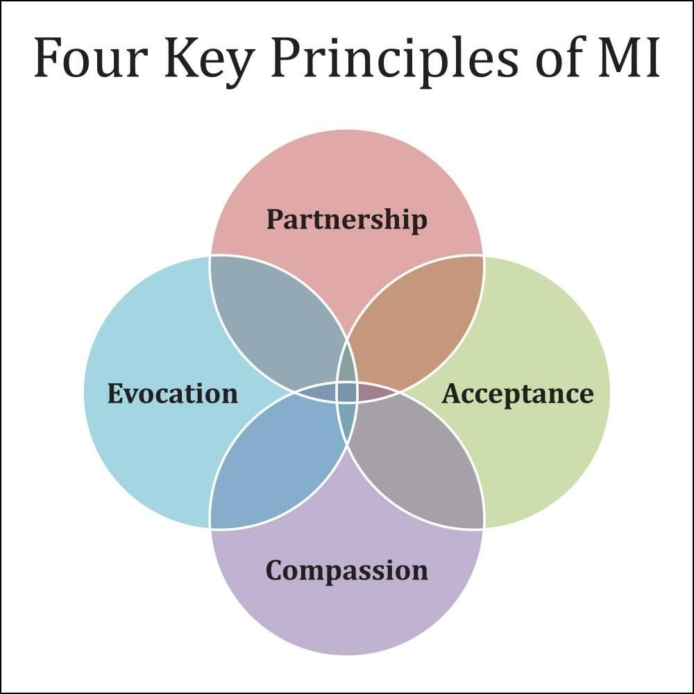
Lifestyle Medicine Application
    Motivational Interviewing

Slide 62
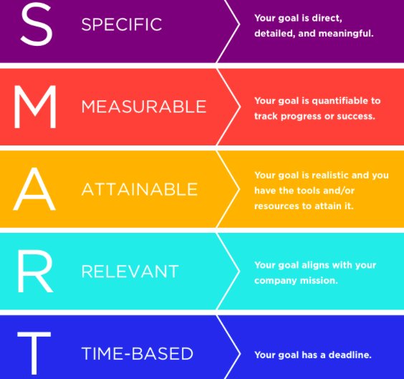
SMART Goals
    SMART Goals

Slide 63
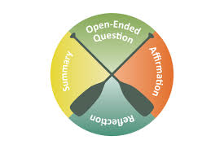
Motivational Interviewing
Open-Ended Questions
Affirmations
Reflection
Summary
Notes:
Motivational interviewing (MI) is a technique that has been specifically developed to help motivate ambivalent patients to change their behavior.

Slide 64
Lifestyle Medicine Application
  How does this help SLPT?
    Improved overall health awareness and involvement for employees
      Improved work-life balance, stress management, mindfulness and reduced burnout.
    Cascade effect of healthier employees
      Improves employee relationships and ability to provide patient quality of care (decreased compassion fatigue).

Slide 65
Lifestyle Medicine Application
  Things to Consider…

Slide 66

Lifestyle Medicine
Quiz
Survey
Lunch & Learn Series
Lifestyle Medicine Program

Slide 67

Questions

Slide 68
“Diseases and symptoms are the body-mind-spirit’s attempt to solve a problem.”
~ John Travis

Slide 69
St. Luke’s Physical Therapy Lifestyle Medicine Program
4. Incorporate Lifestyle Medicine into St. Luke’s Physical Therapy
  Epic IE Lifestyle Questionnaire (LM vital signs)
  Lifestyle factors related to PT outcome (motivation, support)
  Engage patients in deeper conversations about their health and wellness goals, provide education and coaching to assist in comprehensive plan of care including PT diagnosis
    Ex: R knee pain, improving nutrition to assist with weight loss.

Slide 70
References
BodaiBI, Nakata TE, Wong WT, et al. Lifestyle Medicine: A Brief Review of Its Dramatic Impact on Health and Survival. Perm J. 2018;22:17–025. doi:10.7812/TPP/17-025
https://www.lifestylemedicine.org/ACLM/Tools_and_Resources/Case_for_Lifestyle_Medicine.aspx
https://www.who.int/dietphysicalactivity/media/en/gsfs_general.pdf
https://www.lifestylemedicine.org/ACLM/About/What_is_Lifestyle_Medicine_/Lifestyle_Medicine.aspx
Ford ES, Bergmann MM, Kröger J, Schienkiewitz A, Weikert C, Boeing H. Healthy living is the best revenge: findings from the European Prospective Investigation Into Cancer and Nutrition-Potsdam study. Arch Intern Med. 2009 Aug 10;169(15):1355-62. doi: 10.1001/archinternmed.2009.237. PMID: 19667296.
Childhood Obesity Facts | Overweight & Obesity | CDC
Stress in America™ 2023: A nation grappling with psychological impacts of collective trauma (apa.org)
Overview of Health and Diet in America - Front-of-Package Nutrition Rating Systems and Symbols - NCBI Bookshelf (nih.gov)

Slide 71

Thank You!

Slide 72
Lifestyle Medicine
Notes:
Health is an investment, not an expense.
It’s an investment of time into education, understanding, commitment and effort.
It’s being accountable for your own health.
Your state of health will become an expense if you don’t take time to invest in cultivating it.

Slide 73
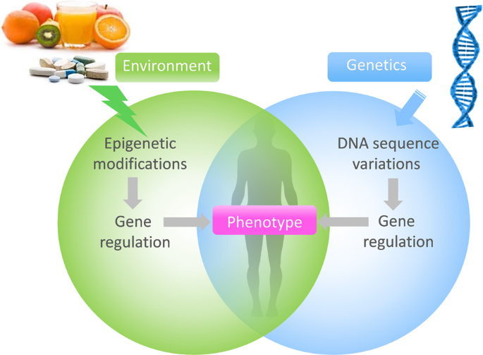
Epigenetics

Slide 74
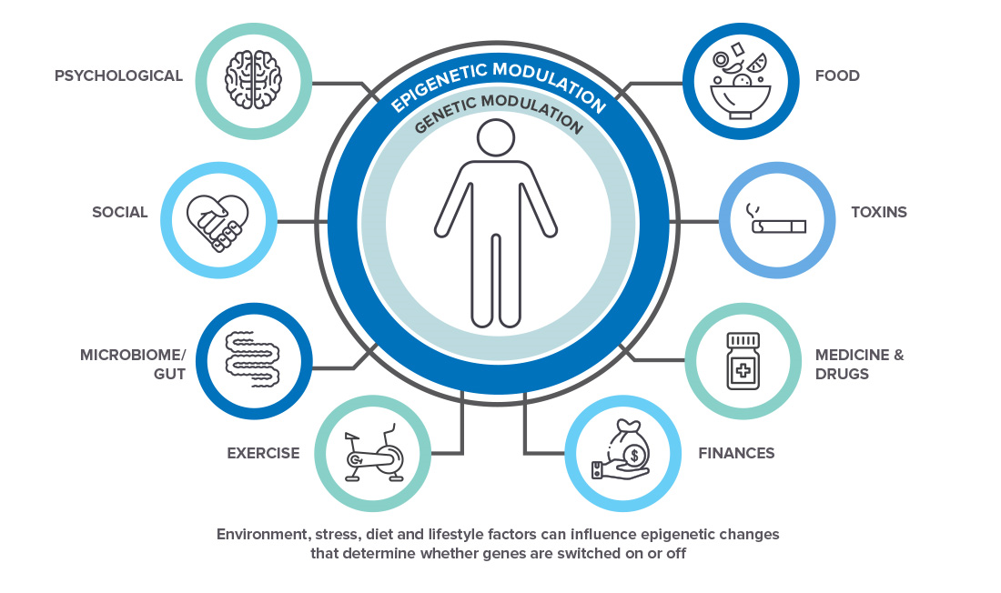
Epigenetics

Slide 75
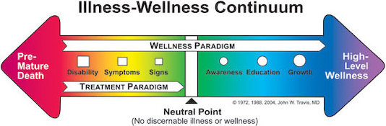
Illness-Wellness Continuum
Notes:
John W. Travis is an American author and medical practitioner. He is a proponent of the alternative medicine concept of "wellness", originally proposed in 1961 by Halbert L. Dunn, and has written books on the subject. In
Travis believed that a medical approach that relied on the presence or absence of symptoms of disease to demonstrate wellness was insufficient. As shown in the Continuum, the right side reflects degrees of wellness, while the left indicates degrees of illness.^{[9]} The model has been used to describe how, in the absence of physical disease, an individual can suffer from depression, anxiety or other conditions.^{[13]}
He contends that medicine typically treats injuries, disabilities, and symptoms, to bring the individual to a "neutral point" where there is no longer any visible illness. However, the Wellness Paradigm requires moving the state of wellbeing further along the continuum towards optimal emotional and mental states.^{[14][15]} The concept assumes that wellbeing is a dynamic rather than a static process.^{[16]}
The Illness-Wellness Continuum proposes that individuals can move farther to the right, towards greater health and wellbeing, passing through the stages of awareness, education, and growth.^{[17]} Worsening states of health are reflected by signs, symptoms and disability.
In addition, a person's outlook can affect wellness. According to the concept, a positive outlook will enhance health and wellbeing, while a negative outlook will hinder it, independent of the current health status. For example, a person who demonstrates no symptoms of disease, but is constantly complaining, will be facing the left side of the Continuum and away from a state of high-level wellness. Conversely, a person with a disability, but who maintains a positive outlook, will be facing to the right, toward a high level of wellness.^{[18]} It is less important where a person is on the Continuum than the direction they are facing.
The Illness-Wellness Continuum has been viewed as promoting preventive treatment, which improves wellbeing before an individual presents with signs or symptoms of illness, as well as educating people to be aware of and avoid risk factors, in order to protect against pathology and premature death.^{[19]}
the 1970s, Travis founded the first "wellness center" in California.^{[1]} He originated the Illness–Wellness Continuum.^{[2]}

Slide 76
Illness-Wellness Continuum
Wellness is…
  Physical
  Emotional
  Intellectual
  Spiritual
  Dynamic
Notes:
Travis believed that a medical approach that relied on the presence or absence of symptoms of disease to demonstrate wellness was insufficient.
As shown in the Continuum, the right side reflects degrees of wellness, while the left indicates degrees of illness.^{[9]}
The model has been used to describe how, in the absence of physical disease, an individual can suffer from depression, anxiety or other conditions.^{[13]}
He contends that medicine typically treats injuries, disabilities, and symptoms, to bring the individual to a "neutral point" where there is no longer any visible illness.
However, the Wellness Paradigm requires moving the state of wellbeing further along the continuum towards optimal emotional and mental states.^{[14][15]} The concept assumes that wellbeing is a dynamic rather than a static process.^{[16]}
The Illness-Wellness Continuum proposes that individuals can move farther to the right, towards greater health and wellbeing, passing through the stages of awareness, education, and growth.^{[17]}
Worsening states of health are reflected by signs, symptoms and disability.
In addition, a person's outlook can affect wellness.
According to the concept, a positive outlook will enhance health and wellbeing, while a negative outlook will hinder it, independent of the current health status. For example, a person who demonstrates no symptoms of disease, but is constantly complaining, will be facing the left side of the Continuum and away from a state of high-level wellness.
Conversely, a person with a disability, but who maintains a positive outlook, will be facing to the right, toward a high level of wellness.^{[18]}
It is less important where a person is on the Continuum than the direction they are facing.
The Illness-Wellness Continuum has been viewed as promoting preventive treatment, which improves wellbeing before an individual presents with signs or symptoms of illness, as well as educating people to be aware of and avoid risk factors, in order to protect against pathology and premature death.^{[19]}
the 1970s, Travis founded the first "wellness center" in California.^{[1]} He originated the Illness–Wellness Continuum.^{[2]}

