Slide 1
Interdisciplinary Collaboration in Low Back Pain: Identifying Key Indicators in Coordinated Patient Care
Alex Stiverson PT, DPT

Slide 2
Objectives
Better understand the complex multimodal nature of low back pain
Develop the ability to identify key indicators in cases of low back pain that warrant interdisciplinary collaboration.
Better understand how other providers approach low back pain and the interventions they offer
Effectively apply this knowledge to provided examples and your own patients

Slide 3
Disclosures
None

Slide 4
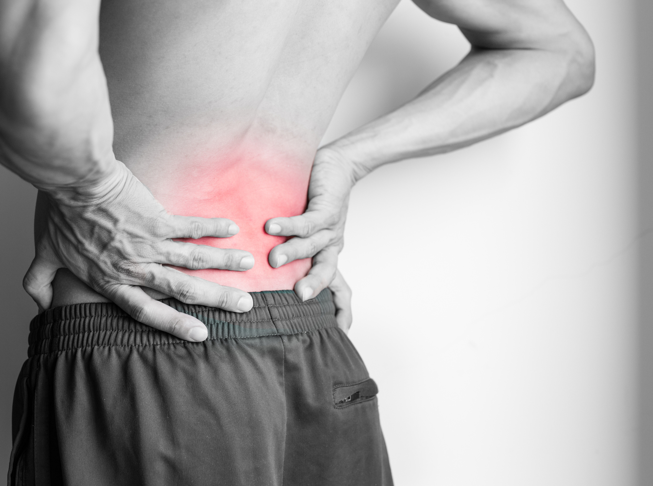
Low Back Pain
Leading cause of years lost due to disability
36% more LBP cases globally by 2050
32% of acute LBP cases turn to chronic
Lancet Low Back Pain Collaborators

Slide 5
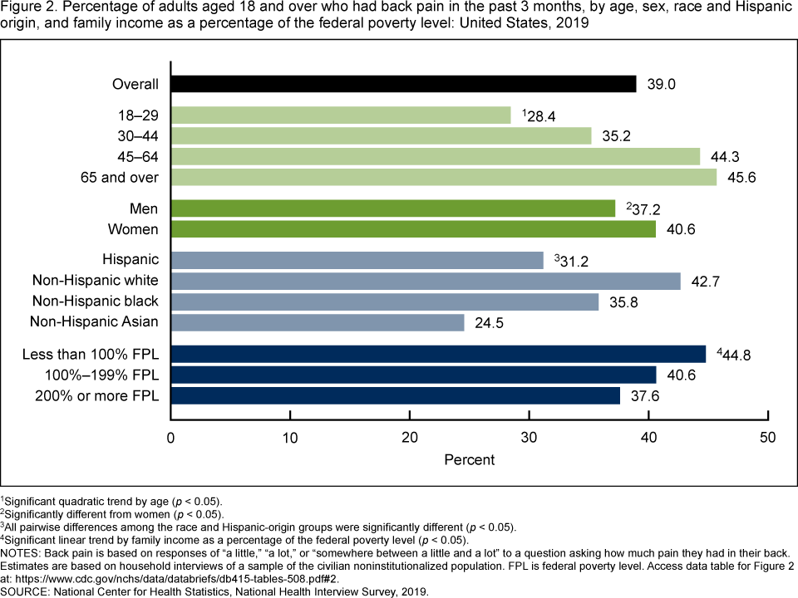
Prevalence
39% of Adults 18 or older have had back pain in the last 3 months…
From CDC NCHS Data Brief No. 415, July 2021

Slide 6
Lancet Article 2021
LBP includes various types of pain
  Nociceptive: tissue
  Neuropathic: nerve
  Nociplastic: central changes
Low specificity of diagnostic imaging – controversy
“It is important to understand pain is distinct from nociception, and includes not just A delta fiber and C delta fiber, but also context dependent emotional, cognitive, and behavioral elements.” – Biopsychosocial Model
Knezevic NN (2021)

Slide 7
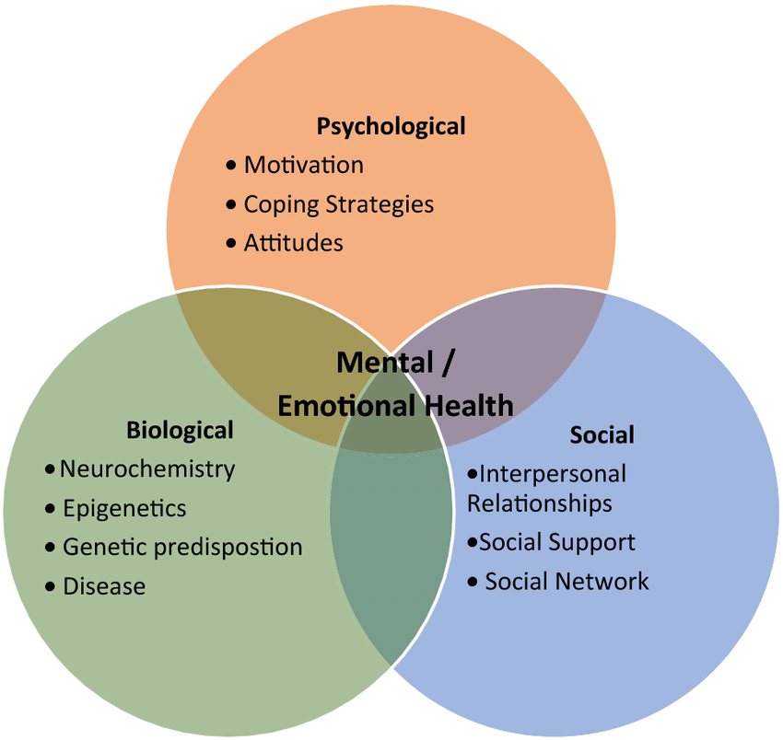
Lancet Article 2021
“…low back pain is a dynamic interaction between social, psychological, and biological factors that can both predispose to and result from injury and should be considered when devising interdisciplinary treatment plans.”
Knezevic NN (2021)

Slide 8
LBP is Complicated
One provider?
Who directs care?
How involved is physical therapy?

Slide 9
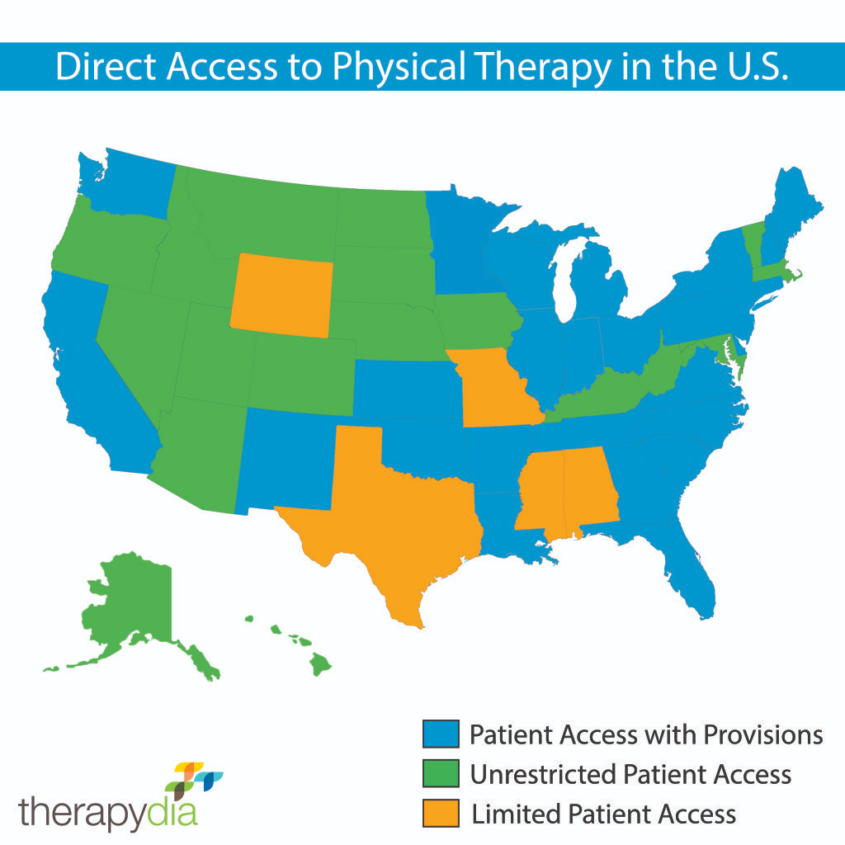
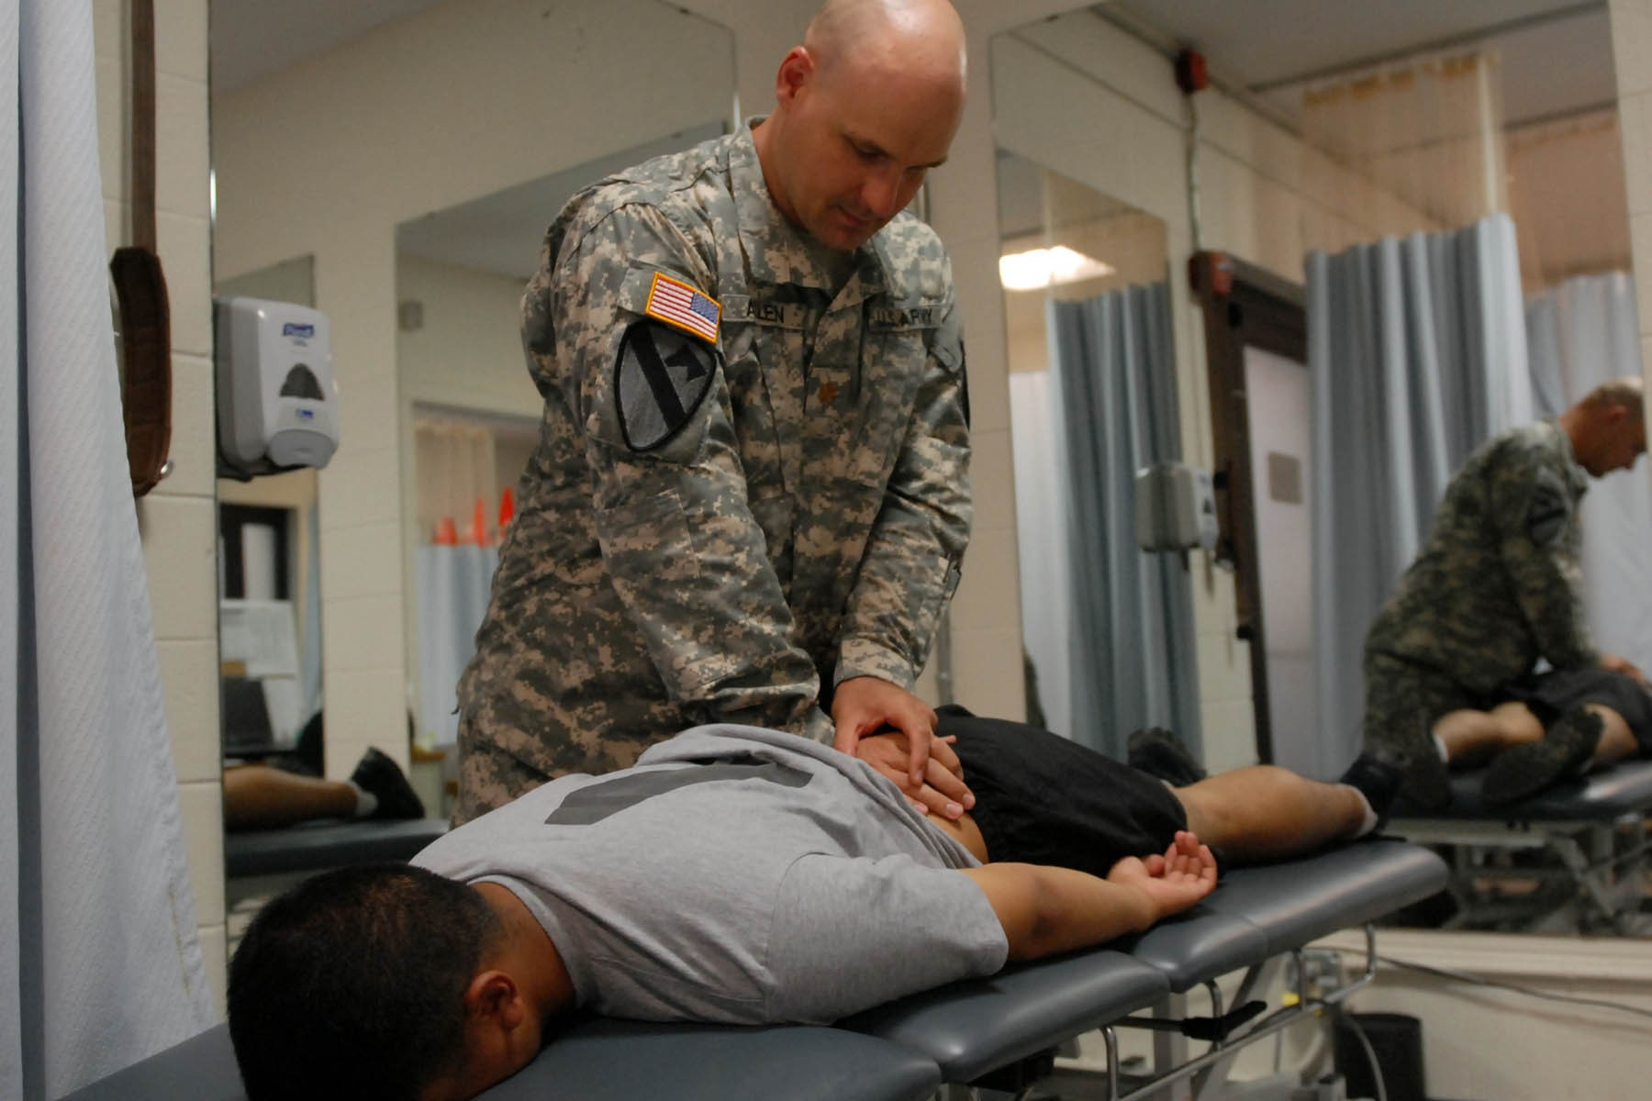
PTs in Direct Access Role - LBP
Overwhelming data over the last 20+ years showing safety, cost savings, effectiveness (Clark B 2022)
Shortage of PCPs between 21,400 and 55,200 by 2033 (From Association of American Medical Colleges)
Increased emphasis on PT as first line treatment (Knezevic NN 2021)

Slide 10
Can we do it alone?

Slide 11
Interdisciplinary Collaboration
Physical Therapy
Neurosurgery
Spine Surgery
Rheumatology
Pain Management
Behavioral Health
Occupational Med.
Dietician
Sleep Medicine
Personal Trainer
Is multidisciplinary care more effective?

Slide 12

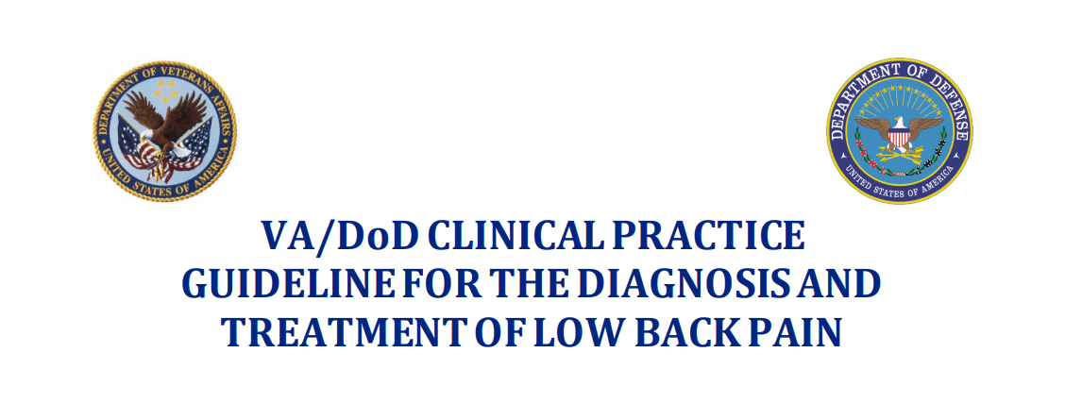




Slide 14

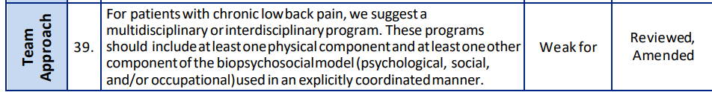

Slide 15

9/11 guidelines reviewed recommended multidisciplinary approach to chronic LBP
1/11 recommended multidisciplinary for all
1/11 recommended multidisciplinary when mono doesn’t work

Slide 16

Do you know when to collaborate?

Slide 17
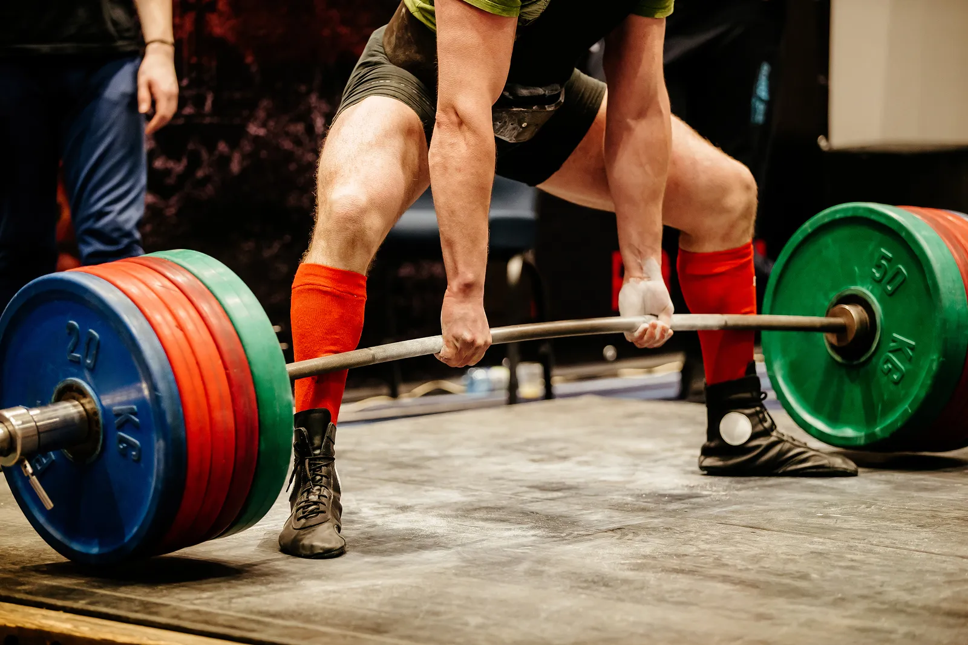
Case Example
28 year old male lifter
Pain began a 4 days after a hard workout
6/10 R paracentral low back Ends up in DA PT a week later
All movements increase pain, wants to get back to lifting

Slide 18

What do you do?

Slide 19

“First Line Defense” – Acute LBP
Improve significantly 6 weeks
Generally good prognosis
“First Line Defense”
  Advice
  Reassurance
  Light Physical Activity
  Active management strategies
(Bailly F 2021, Gianola S 2022, George SZ 2021)

Slide 20
Do we need to collaborate?

Slide 21
Expert Consensus
“With chronic LBP or LBP at risk for chronicity, it is useful to consider a multidisciplinary management, which may involve a physiotherapist, a rheumatologist, a physical medicine and rehabilitation physician, an occupational physician, and then, if necessary, a pain physician or spine surgeon.”
(Bailly 2021)

Slide 22
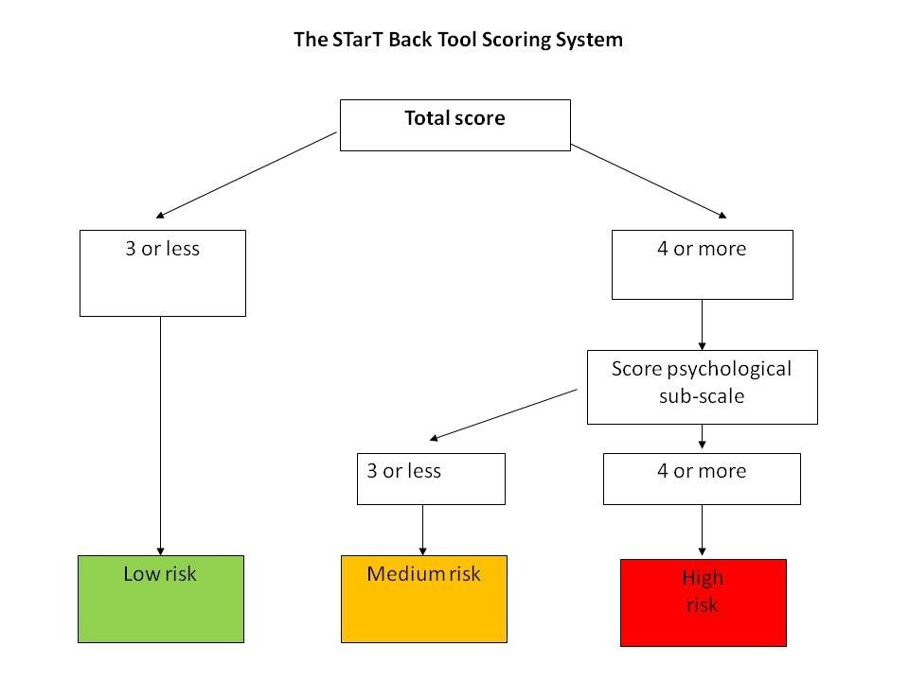
Risk for Chronicity?
Acute to chronic LBP -> 32% Overall
Risks associated
  Outcome of Start Back Tool
  Obesity
  Smoking
  Depression and anxiety
  Severe baseline disability
(Stevans JM 2021 JAMA)

Slide 23
Same Patient
Now 7 months later, returns to DA PT pain same location, still 6/10, occasionally to either glute
Can stand for 10 minutes, sit for 15 minutes
Gets better with exercise, not with rest
Lost his job
Wakes him up 2-3 times per night
Do we just do PT? Do we ask for help?

Slide 24
We should collaborate but…
When?
With who?
Only after PT has failed?
Does it depend on patient goals/expectations?
Is it our responsibility to help them decide?
Are there key indicators to answer these questions? Back to the guidelines….

Slide 26
There is no clear consensus…
No clear guidelines on when and who needs to be included
Collaboration is key and clear and consistent messaging along with multidisciplinary care improves outcomes

Slide 27
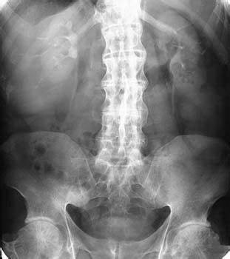

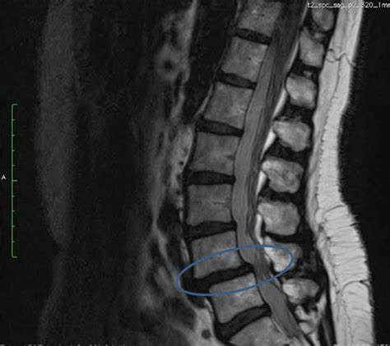
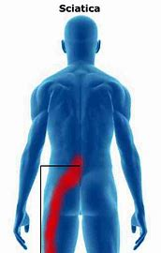
How do we know when to collaborate?
Need to understand what other providers do
Need to be able to identify clear indicators that would direct care towards certain providers
Need to understand chronic LBP is multimodal and tends to do better with multidisciplinary care

Slide 28
Other providers
Pain management
Neurosurgery/Ortho Spine Surgery
Rheumatology
Behavioral Health

Slide 29
PAIN MANAGEMENT
Key Indicators in Referral to

Slide 30

What is Pain Management

Slide 31
Services Offered
Epidural injections
Cervical, thoracic and lumbosacral nerve root blocks
Spinal cord and peripheral nerve stimulation
Caudal epidural injections
Sacroiliac joint injections
Discography
Diagnostic medial branch block (cervical/thoracic/lumbar)
Cervical, thoracic and lumbar medial branch radiofrequency neurotomy (Rhizotomy)
Intercostal nerve blocks
Occipital nerve blocks
Hip joint injections
Stellate injections
Lumbar sympathetic blocks
Notes:
Straight from website

Slide 32
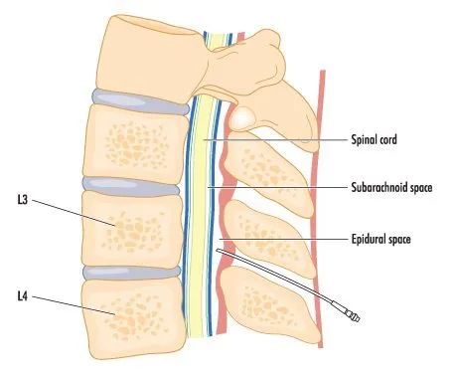
Epidural Steroid Injections
Transforaminal, Translaminar, Caudal – the approach
Epidural meaning around dura
Steroid
  methylprednisolone, triamcinolone, betamethasone or dexamethasone
  With or without local anesthetic

Slide 33
When does it work?
Excellent for radicular pain caused by disc herniations, level 1 evidence (Helm et. al 2021)
For axial low back pain, evidence is less solid, level 5 (Helm et. al 2021)

Slide 34
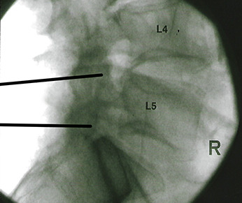
RFA – What is it?
Lumbar Radiofrequency Neurotomy/Ablation, second most common procedure preformed in pain practices
Level/area diagnosed with medial branch block
Small electrical current inserted near facet joint at diagnosed medial branch

Slide 35
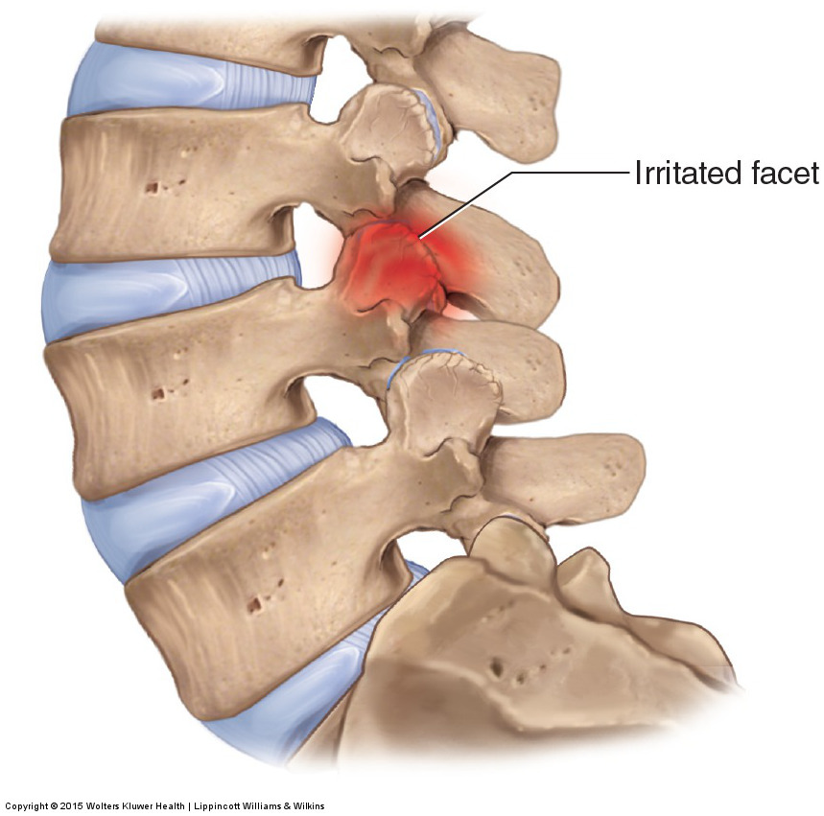
When Does it Work?
…the treatment of axial low back pain when facet joints have been identified as the etiology of pain via diagnostic blocks, GRADE I A.
Notes:
Facet mediated pain

Slide 36
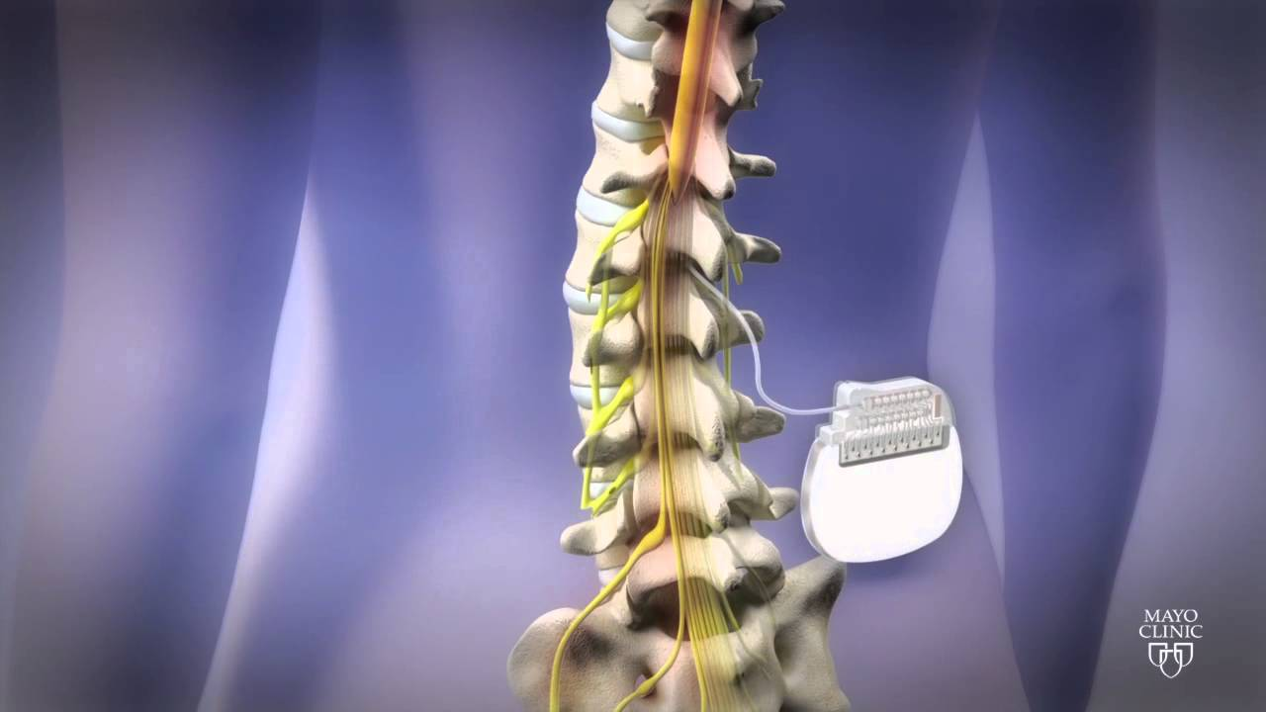
Spinal Cord Stimulation
Done most commonly for individuals with Failed Back Surgery Syndrome

Slide 37
Summary Pain Management
Stable clinical picture, still in pain
Too much pain to be active/participate in PT
ESI are great for radicular sx
RFA for axial pain
Spinal cord stimulation may help someone after failed surgery

Slide 38
Spine Surgery
Key Indicators in Referral to

Slide 39

When is it needed?

Slide 40
Red Flags
New onset, increasing myotomal weakness
Severe neurologic findings
Central signs
Bowel/bladder
Saddle anesthesia

Slide 41

Overall Clinical Picture
Symptom progression
Response to care
Urgency (Consequence of Delay)
Comorbidities
Prevalence of suspected pathology
PMH
(Finucane 2021)

Slide 42
Key indicators
Stable clinical picture but:
  Conservative management has failed (NICE Guidelines 2016)
  Radiographic findings consistent with radicular sx (NICE Guidelines 2016)
Conflicting evidence has challenged relevance of decompression/fusion surgery in LBP (Knezevic 2021)

Slide 43
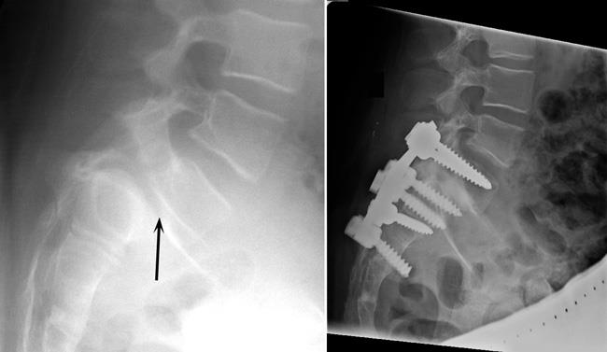
Key Indicators for Surgery
Is it only for failed conservative management and concerning clinical pictures?

Slide 44
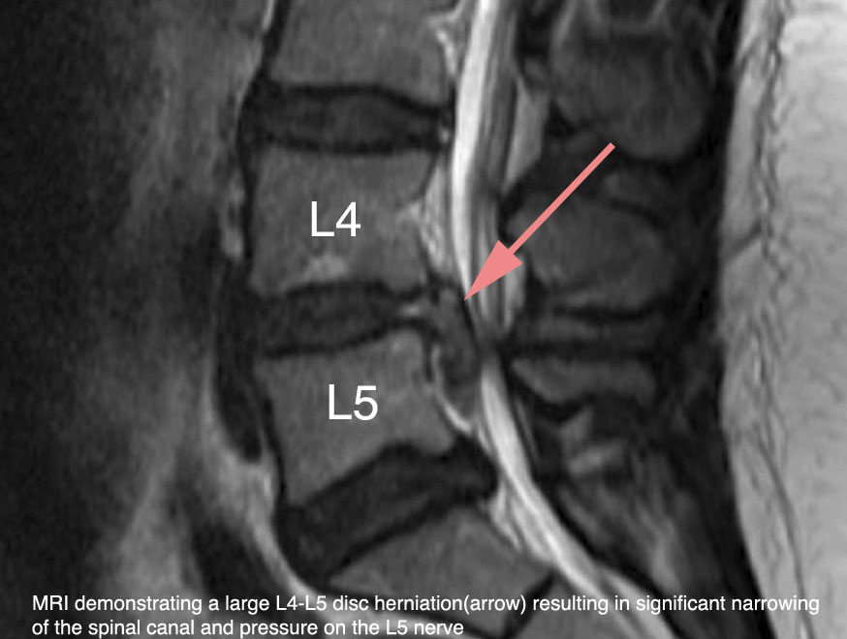
Examples
What if a patient had…
Pain right side of low back
Weakness in hip flexion
Inconsistent Achillies reflex
Stable sx for the past year
Is this MRI consistent with these sx?
What is best for the patient?

Slide 45
How about now?
Pain and parasthesia medial shin/lower leg
Weakness with dorsiflexion
Decreased patellar reflex
3 months of gradually worsening sx
Is this MRI consistent with these sx?
What is best for the patient?

Slide 46
Summary Surgery
Controversy if should be done for just pain
Be aware of red flags and the entire clinical picture
If sx match imagining, may want to suggest seeing surgeon sooner
Helpful when all else has failed

Slide 47
Behavioral health
Key Indicators in Referral to

Slide 48
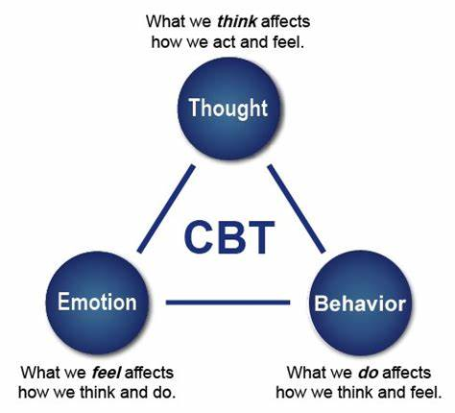
Cognitive Behavioral Therapy
Most guidelines agree on its effectiveness in chronic LBP

Slide 49
What is CBT
Core Principles – Psychological Treatment
Problems based on faulty or unhelpful ways of thinking
Problems based on learned patterns of unhelpful behavior
Coping Strategies
(From American Psychological Association)
Do we use some of these principles?
PNE? Active Management Strat? Activity Modification

Slide 50
Key Indicators
Depression, anxiety, stress, and other mental disorders are common in chronic LBP
Is the above severely effecting the POC?
Multidisciplinary care is effective (all guidelines)

Slide 51
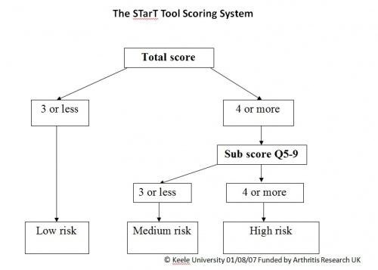
Outcome Measures
FABQ
STarT BACK
PHQ-2 - Depression
GAD-2 – Anxiety

Slide 52
Summary Behavioral Health
Severe anxiety, depression that is affecting plan of care
Allows for opportunity of consistent messaging from providers
Multidisciplinary care is great
Cognitive behavioral therapy is consistently favored in most guidelines in chronic LBP
Addiction

Slide 53
Rheumatology
Key Indicators in Referral to

Slide 54
Inflammatory Back Pain
Seronegative spondyloarthropathies
Ankylosing Spondylitis (Most Common)
Psoriatic Arthritis
Reactive Arthritis
Juvenile Idiopathic Arthritis
Early recognition is key

Slide 55
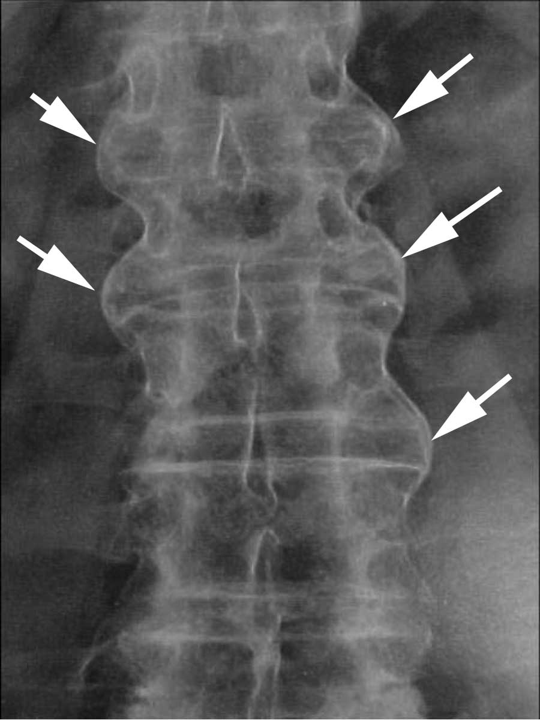
Physical Indicators IBP
Insidious onset
Improves with exercise
Lack of improvement with rest
Pain at night
Trunk AROM
Family Hx
3x more likely in male
Usually dx in 20s-30s

Slide 56
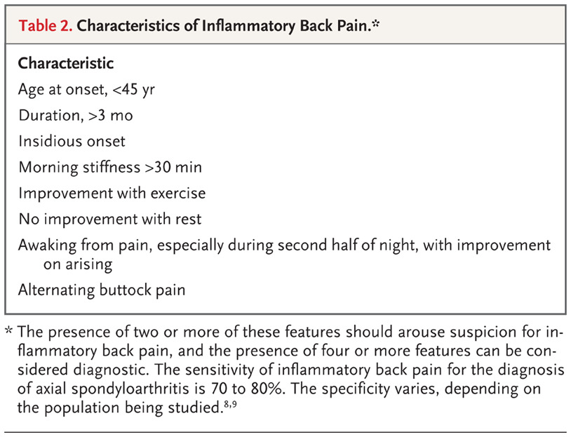
Diagnosis of Inflammatory Back Pain
From NJM (Taurog JD 2016)

Slide 57
Dx of Ankylosing Spondylitis
Elevated ESR and C-Reactive in acute flare (?)
HLA-B27+ (90% of people with AS)
Sacroiliitis
MRI (Early) / Radiograph (Late)
Mean delay of diagnosis has been shown to be as much as 8 years (Gerdan V 2012)

Slide 58
Let's go back to our weightlifter
Now 7 months later, returns to DA PT pain same location, still 6/10, occasionally either glute
Can stand for 10 minutes, sit for 15 minutes
Gets better with exercise, not with rest
Lost his job
Wakes him up 2-3 times per night
Do we just do PT? Do we ask for help?

Slide 59
Rheumatology Summary
Inflammatory Low Back Pain is often misdiagnosed by primary care providers, on average 8 years after onset
Differentiating between mechanical low back pain and inflammatory low back pain is challenging, but a misdiagnosis significantly affects prognosis
Be aware of criteria for diagnosis of inflammatory low back pain

Slide 60
The 7%
Guidelines are not clear but multidisciplinary care is good
Stable picture, consider pain management
Unstable picture, consider surgery
Imagining matches clinical presentation, consider surgery
All else has failed, consider surgery
Stable picture, consider pain management
DON’T FORGET IBP

Slide 61
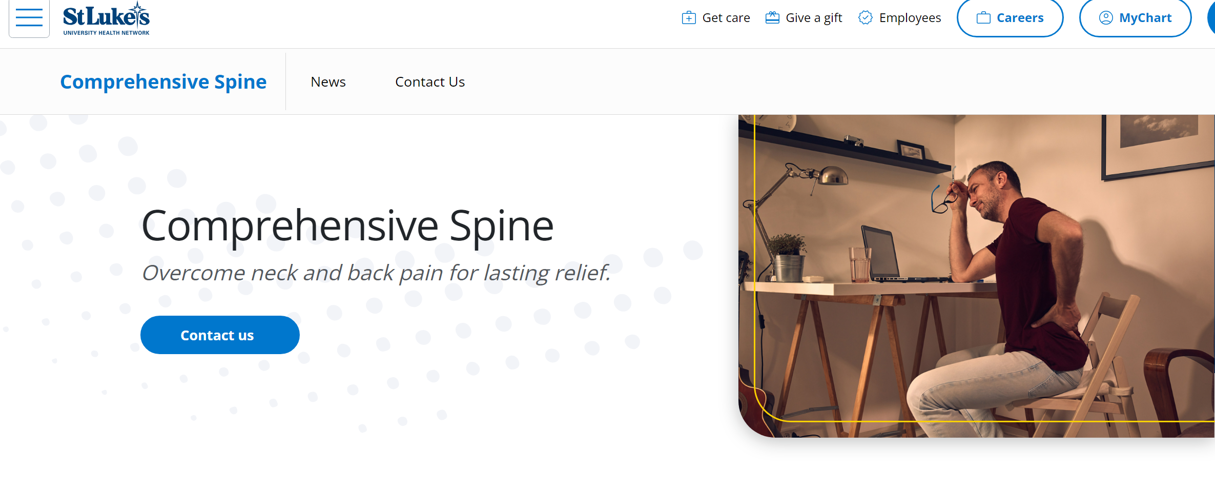
Comprehensive Spine Program

Slide 62
Advanced Spine Care PTs
Allen, Joel – Upper Bucks (Quakertown)
Bays, Jeffrey – Anderson (Anderson)
Betz, Stephen – Bethlehem (Nazareth)
Brown, Alex – Bethlehem (Hellertown)
Buzin, Frank – Warren (Hillcrest)
DeBlasio, Nick – Allentown (Orefield)
Feher, Andrew – Allentown (West End)
Hager, Melissa – Monroe (Kresgeville)
Holmes, Rett – Anderson (Anderson)
Kareha, Stephen – Allentown (West End)
Kushner, Jeremy – Bethlehem (Nazareth)
Rothermel, Laura – Bethlehem (Hellertown)
Stracco, Giovanni – Allentown (West End)
Stiverson, Alex – Upper Bucks (Ottsville)
Wilkens, Katie – Warren (Hillcrest)

Slide 63
References
GBD 2021 Low Back Pain Collaborators. Global, regional, and national burden of low back pain, 1990-2020, its attributable risk factors, and projections to 2050: a systematic analysis of the Global Burden of Disease Study 2021. Lancet Rheumatol. 2023;5(6):e316-e329. Published 2023 May 22. doi:10.1016/S2665-9913(23)00098-X
Knezevic NN, Candido KD, Vlaeyen JWS, Van Zundert J, Cohen SP. Low back pain. Lancet. 2021;398(10294):78-92. doi:10.1016/S0140-6736(21)00733-9
Clark B, Clark L, Showalter C, Stoner T. A call to action: direct access to physical therapy is highly successful in the US military. When will professional bodies, legislatures, and payors provide the same advantages to all US civilian physical therapists?. J Man Manip Ther. 2022;30(4):199-206. doi:10.1080/10669817.2022.2099893
Gianola S, Bargeri S, Del Castillo G, et al. Effectiveness of treatments for acute and subacute mechanical non-specific low back pain: a systematic review with network meta-analysis. Br J Sports Med. 2022;56(1):41-50. doi:10.1136/bjsports-2020-103596
Bailly F, Trouvin AP, Bercier S, et al. Clinical guidelines and care pathway for management of low back pain with or without radicular pain. Joint Bone Spine. 2021;88(6):105227. doi:10.1016/j.jbspin.2021.105227
George SZ, Fritz JM, Silfies SP, et al. Interventions for the Management of Acute and Chronic Low Back Pain: Revision 2021. J Orthop Sports Phys Ther. 2021;51(11):CPG1-CPG60. doi:10.2519/jospt.2021.0304
Stevans JM, Delitto A, Khoja SS, et al. Risk Factors Associated With Transition From Acute to Chronic Low Back Pain in US Patients Seeking Primary Care. JAMA Netw Open. 2021;4(2):e2037371. doi:10.1001/jamanetworkopen.2020.37371
Sen R, Goyal A, Hurley JA. Seronegative Spondyloarthropathy. In: StatPearls. Treasure Island (FL): StatPearls Publishing; July 17, 2023.
Bernstein IA, Malik Q, Carville S, Ward S. Low back pain and sciatica: summary of NICE guidance [published correction appears in BMJ. 2021 Jul 14;374:n1627]. BMJ. 2017;356:i6748. Published 2017 Jan 6. doi:10.1136/bmj.i6748
Gerdan V, Akar S, Solmaz D, et al. Initial diagnosis of lumbar disc herniation is associated with a delay in diagnosis of ankylosing spondylitis. J Rheumatol. 2012;39(10):1996-1999. doi:10.3899/jrheum.120106
Taurog JD, Chhabra A, Colbert RA. Ankylosing Spondylitis and Axial Spondyloarthritis. N Engl J Med. 2016;374(26):2563-2574. doi:10.1056/NEJMra1406182
Finucane LM, Downie A, Mercer C, et al. International Framework for Red Flags for Potential Serious Spinal Pathologies. J Orthop Sports Phys Ther. 2020;50(7):350-372. doi:10.2519/jospt.2020.9971

