Slide 1
Implementing Neuroplastic Principles in Patient Care
George Fischer, PT, DPT

Slide 2
Continuing Medical Education Credit Information
Activity Description/Statement of Need:
This grand rounds presentation will describe the ten neuroplastic principals by researchers Kleim and Jones¹ and how they can be incorporated into patient care with particular consideration of the OPTIMAL Motor Learning Theory. This presentation will inform and empower physical therapists to incorporate these principles into their care for patients with neurologic OR orthopedic impairments/diagnoses and for those who do not work in a neuro “specialty” clinic to have guidance in how to approach patient care.
Target Audience: All Providers

Slide 3
Designation Statement
It is St. Luke’s University Health Network policy to ensure balance, independence, objectivity and scientific rigor in all of our sponsored educational programs. Faculty and all others who have the ability to control the content of continuing medical education activities sponsored by the St. Luke’s Hospital & Health Network are expected to disclose to the audience whether they do or do not have any real or apparent conflict(s) of interest or other relationships related to the content of their presentation(s).
The St. Luke’s University Health Network is accredited by the Pennsylvania Medical Society to provide continuing medical education for physicians.
The St. Luke’s University Health Network designates this live educational activity for a maximum of 1 AMA PRA Category 1 Credits™. Physicians should only claim credits commensurate to the extent of their participation on the activity.

Slide 4
Disclosure Information
The Planners involved in this activity have no relevant financial relationships to disclose.
The Faculty/Presenters involved in this activity have no relevant financial relationships to disclose.

Slide 5
Learning Objectives
Understand the ten neuroplastic principles as they relate to motor learning.
Understand the OPTIMAL Motor Learning Theory and its use with patients spanning from athletes to geriatric populations.
Be able to identify the use of neuroplastic principles in your practice and areas for further use to help maximize patient outcomes.
Notes:
Optimal theory and motivational interviewing

Slide 6
Neuroplasticity
Learning!
Our brain can retain INFINITE pieces of information!
A neuron’s ability to alter their structure and function
  Internal & external stimuli
    Sensory, cognitive, & behavioral experiences
Kleim and Jones, 2008
Notes:
- Includes behavioral training
“We will go so far as to say that neural plasticity is the mechanism by which the brain encodes experience and learns new behaviors. It is also the mechanism by which the damaged brain relearns lost behavior in response to rehabilitation.”
“This neuroplasticity is, itself, driven by changes in behavioral, sensory, and cognitive experiences. In our view, this endogenous process of functionally appropriate reorganization in healthy brains is also the key to promoting reorganization of remaining tissue in the damaged brain.”

Slide 7
WHY Does Understanding This Matter?
We can better understand how our brains learn
We can create more patient-specific treatment approaches
We can improve patient outcomes

Slide 8
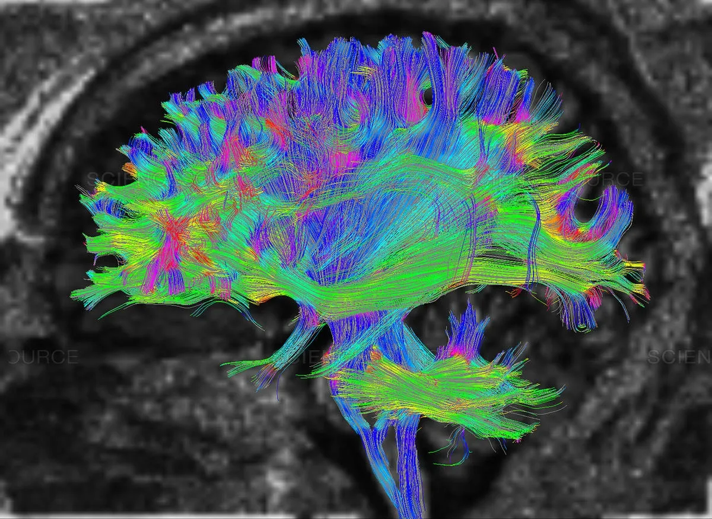
DTI Fiber Tractography
Notes:
Diffusion-tensor MRI Imaging and Fiber Tractography (sanyadiagnosticsdelhi.com)

Slide 9
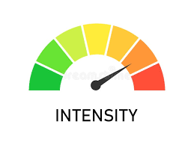


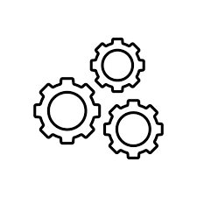
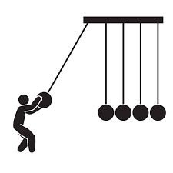

The Ten Neuroplastic Principles
1. Use It or Lose It
2. Use It and Improve It
3. Specificity
4. Repetition
5. Intensity
6. Time
7. Salience
8. Age
9. Transference
10. Interference
Kleim et al., 2008

Slide 10
1. Use It or Lose It
Neural connections degrade if not used regularly
  Injury -> lack of use -> further degradation
Constraint-induced training
  Focus on the task to be worked on
Kleim et al., 2008

Slide 11
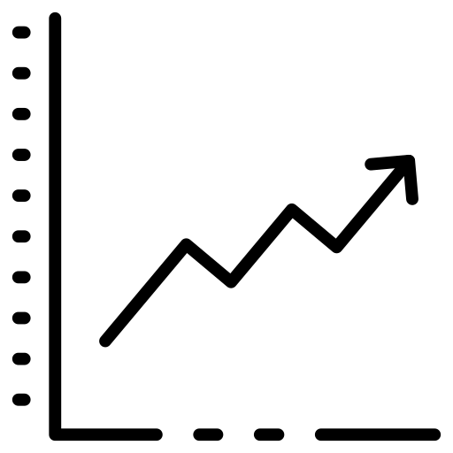
2. Use It and Improve It
Training increases brain representation of a skill
  Cortical reorganization
  Synaptogenesis
  Synaptic responsivity
Kleim et al., 2008
Notes:
https://cdn-icons-png.flaticon.com/512/3731/3731754.png

Slide 12
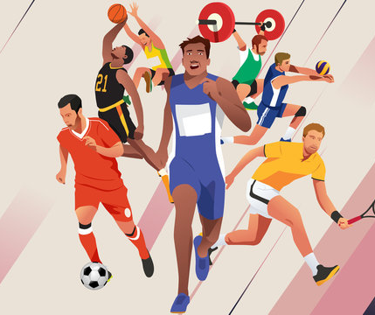
3. Specificity Matters!
“Practice how you play”
Skilled, novel movements
Acquisition of a new skill versus repetition of an old skill
Specific experiences = specific brain changes
Kleim et al., 2008

Slide 13
4. Repetition Matters!
Continued performance of a skill over time
  Learning -> consolidation
Repetition BUT without the repetition
Skill instantiation
  Resistance to skill decay
Kleim et al., 2008

Slide 14
5. Intensity Matters!
Long-term potentiation versus depression
How do we characterize intensity?
  Amount of work being performed during a period of time
  Resistance, cognitive demand, environmental characteristics
Kleim et al., 2008

Slide 15
6. Time Matters!
Plastic changes take time
  Timeline of learning
    Gene expression -> synapse formation -> motor map reorganization
“Time is brain!”
Take initiative to form “good habits” versus delaying leading to “bad habits”
Kleim et al., 2008
Notes:
“Time delays may also allow for the greater establishment of self-taught compensatory behaviors, some of which may interfere with rehabilitative training efforts. As mentioned in the previous section, there are also time-dependent vulnerabilities in use-dependent exaggeration of excitotoxicity”

Slide 16
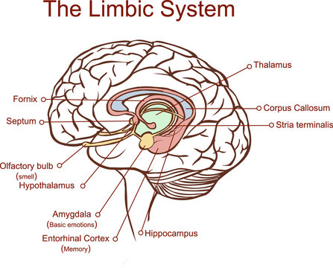
7. Salience Matters!
Consider the behavioral context
What is important is encoded and retained
Attention – emotion – motivation
Patient concerns, needs and goals
Kleim et al., 2008; Wulf and Lewthwaite, 2021

Slide 17
8. Age Matters!
Neuronal and synaptic atrophy
Is plasticity a compensatory adaptation to aging?
  Cognitive decline
Older neurons are not as resilient to metabolic stressors
Kleim et al., 2008

Slide 18

9. Transference
Training one circuit can enhance the development of others
Cortical map representation
Behavioral experiences
  Environmental complexities
Kleim et al., 2008

Slide 19
10. Interference
Plasticity can impair learning
Stimulation outside of training experiences
Learned behaviors -> compensatory
Overcome with greater plastic experiences
  Higher intensity training
Kleim et al., 2008

Slide 20
The Ten Neuroplastic Principles
1. Use It or Lose It
2. Use It and Improve It
3. Specificity
4. Repetition
5. Intensity
6. Time
7. Salience
8. Age
9. Transference
10. Interference
Kleim et al., 2008

Slide 21
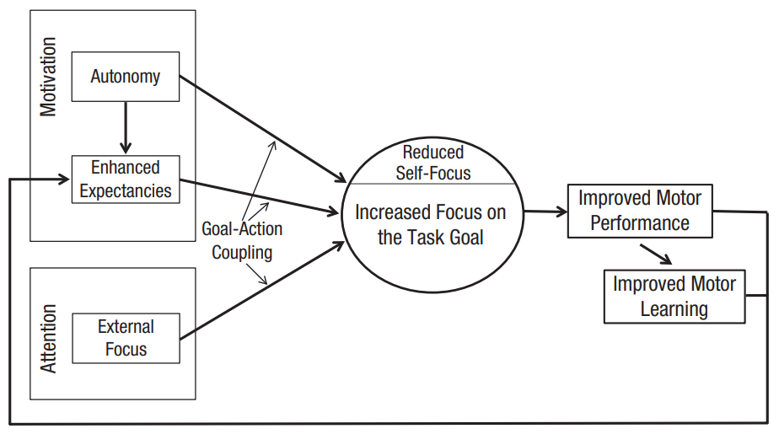
The OPTIMAL Motor Learning Theory
Optimizing Performance Through Intrinsic Motivation and Attention for Learning
Wulf et al., 2021

Slide 22
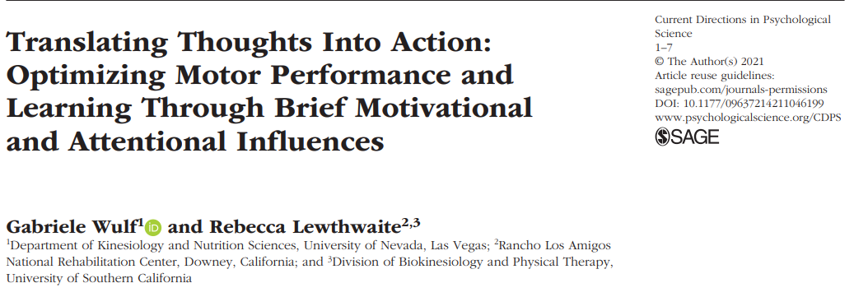
OPTIMAL Application
Wulf et al., 2021
Notes:
Update on components in original 2016 article
Abstract
Skilled motor performance is essential in sports, the performing arts, various occupations, and many daily activities.
Scientists and practitioners alike are therefore interested in understanding the conditions that influence the performance
and learning of movement skills, and how they can be utilized to optimize training. In OPTIMAL theory, three
motivational and attentional factors are key: enhanced expectancies for future performance, the performer’s autonomy,
and an external focus of attention. We review recent evidence suggesting that each factor contributes independently
to strengthen the coupling of goals to actions. This work has implications ranging from fostering more effective skill
development in novice learners, to increasing the efficiency of athletes’ and musicians’ performance, and to facilitating
the success of patients in regaining functional capabilities

Slide 23

Enhanced Expectancies
Defining task success
Early and frequent success
  Accomplishment -> investment
  Maintain a challenging but achievable atmosphere
Portray a sense of progress
Wulf et al., 2021
Notes:
“For example, Ziv and colleagues (2019) asked novice participants to putt standard golf balls to a small target on an indoor putting green. Participants were told that landing a putted ball within a circle around the target should be considered success. They were randomly assigned to experimental groups with either a larger circle or a smaller circle surrounding the target or to a control group without a circle. The group that practiced with the larger circle, and therefore experienced more “success” in practice, performed best 2 days later during a transfer test with a new putting distance. “

Slide 24
Autonomy
Patient influence in their actions enhances expectancies and outcomes
Seemingly irrelevant choices?
  Small choices can make a big difference in performance
Give patients an aspect of control
Wulf et al., 2021
Notes:
In more recent years, studies have included smaller choices or even ones that were ostensibly irrelevant to the task. Small choices can involve the color of objects to be used, the order in which participants perform different tasks, or which pictures to view while performing. In one study (Lewthwaite et al., 2015), incidental choices such as voicing an opinion as to which of two prints (of paintings by the artist Renoir) should be hung on the lab wall, or which of two tasks to perform next, led to enhanced learning of the primary balance task

Slide 25
External Foci
Concentration outside the body schema
Movement efficiency, timing, fluidity & stamina all benefit
Distal versus proximal external foci
  Experts versus novices
Wulf et al., 2021
Notes:
“. In one study (Mornell & Wulf, 2019), skilled musicians immediately showed superior performance with respect to both technical precision and musicality when they were asked to focus on the expressive sound of the music (external focus) rather than the precision of their finger movements (internal focus). In another study (Wulf & Su, 2007), novice and expert golfers hit the target more accurately when they were asked to concentrate on the swing of the club (external focus) rather than the swing of their arms (internal focus)”

Slide 26
Goal-Action Coupling
Incremental improvements in performance seen
  Two factors versus one factor
  Three factors versus two factors
Clarity on action goal avoids excessive self-focus
  Detrimental dwelling on errors
Wulf et al., 2021

Slide 27
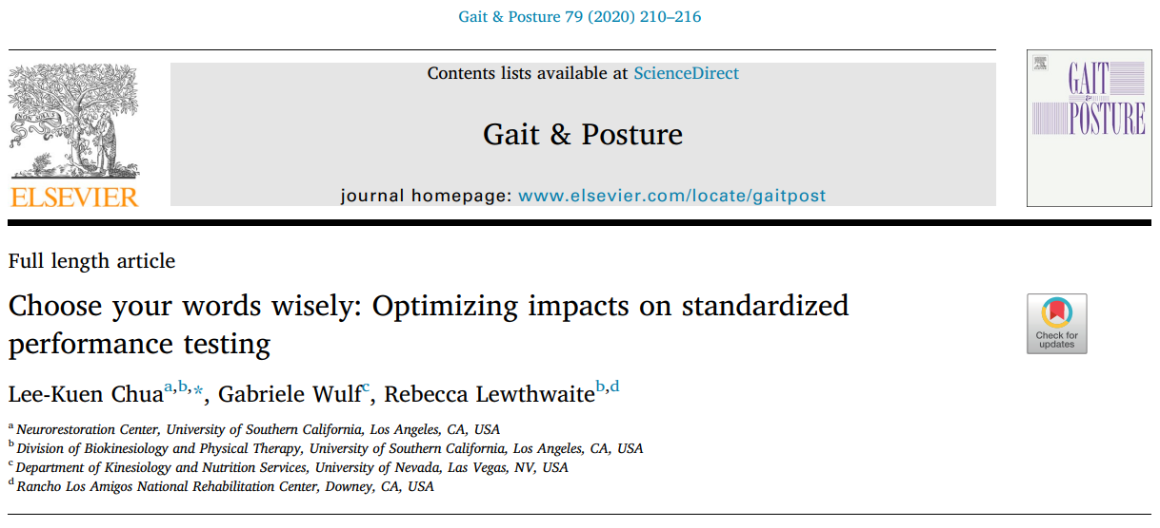
OPTIMAL Assessments
Chua et al., 2020

Slide 28
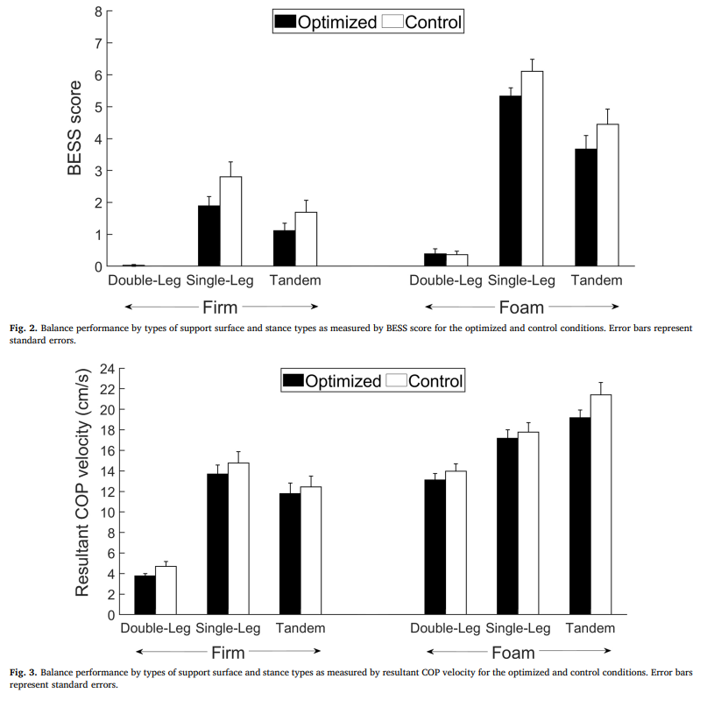
Chua et al., 2020

Slide 29
Life After Brain Damage
Recovery
  Rehabilitation versus compensation
Adaptive versus maladaptive changes
Reactive synaptogenesis
Diaschisis
Cortical Excitability
Kleim et al., 2008
Notes:
“Learning involves changes in genes, synapses, neurons, and neuronal networks within specific brain regions. Brain damage results in many changes in neurons and non-neuronal brain cells that can alter these learning processes. In addition to the loss of tissue at the site of the primary injury, brain damage causes major neurodegenerative and neuroplastic changes in connected regions. When a brain region loses some of its connections, it undergoes a cascade of changes related to the clearance of degenerating debris, the remodeling of S226 Journal of Speech, Language, and Hearing Research • Vol. 51 • S225–S239 • February 2008 neuronal processes, and the production of new neural connections (synapses) by remaining inputs, a process termed reactive synaptogenesis (Kelley & Steward, 1997). Brain damage can also result in both a time dependent disruption of function (diaschisis) and long lasting functional changes, such as the altered cortical excitability reported after cerebral stroke (Bütefisch, Netz, Wessling, Seitz, & Homberg, 2003; Murase, Duque, Mazzocchio, & Cohen, 2004; Witte, Bidmon, Schiene, Redecker, & Hagemann, 2000). It is not surprising that learning would be dramatically altered when it involves the very neurons and neural connections that are undergoing regenerative and degenerative responses to the injury or that have been chronically altered in excitability. These effects of brain damage may be related to both deficiencies and enhancements in learning that need to be considered when translating rules of learning to individuals with brain damage.”

Slide 30
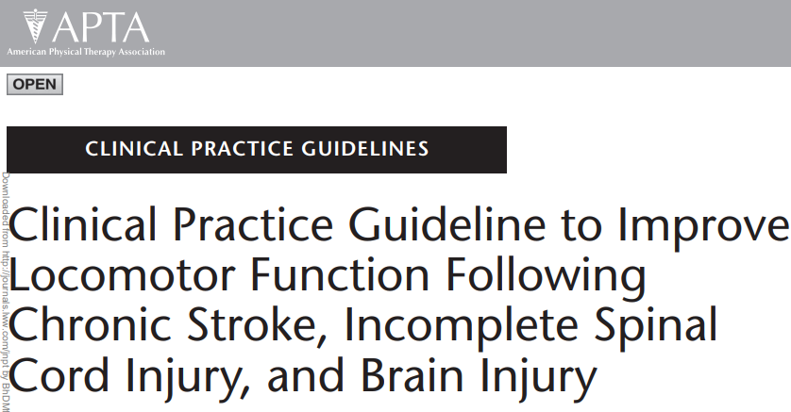
Stroke, Incomplete Spinal Cord Injury, and Brain Injury
Hornby et al., 2020

Slide 31
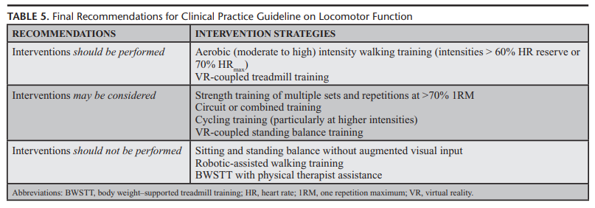
Stroke, Incomplete Spinal Cord Injury, and Brain Injury
Hornby et al., 2020

Slide 32
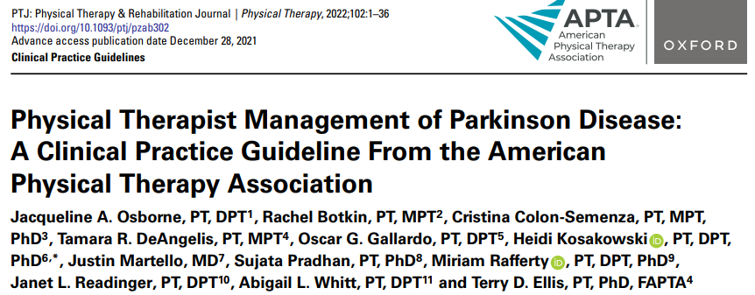
Neuroplasticity and Parkinson’s Disease
Osborne et al., 2022

Slide 33
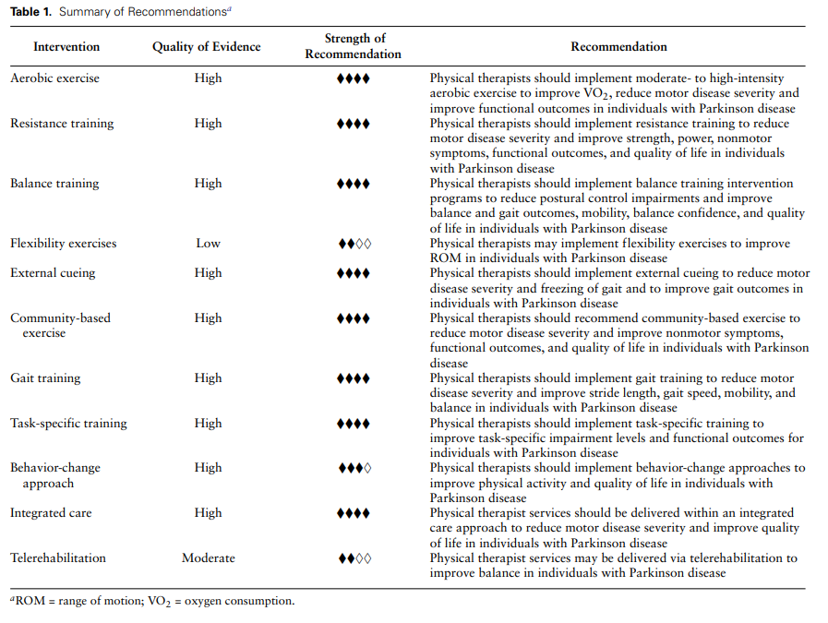
Osborne et al., 2022
Notes:
“External Cueing Physical therapists should implement external cueing to reduce motor disease severity and FOG and to improve gait outcomes in individuals with PD. Evidence quality: high; recommendation strength: strong. Action Statement Profile Aggregate evidence quality: 13 high-quality studies93,111, 145–155 and 16 moderate-quality studies.69,137,156–169 Rationale Thirteen high-quality and 16 moderate-quality studies examined the benefits of external cueing in individuals with PD. External cueing was defined for the purposes of this CPG as an external temporal or spatial stimuli, 151 including rhythmic auditory cueing,93,146,152,154 visual cues,111,148,150,155verbal cues, or attentional cues.170,171 These studies varied considerably regarding sample size, comparison group, outcomes measured, mode, frequency, duration, and type of external cueing.”

Slide 34
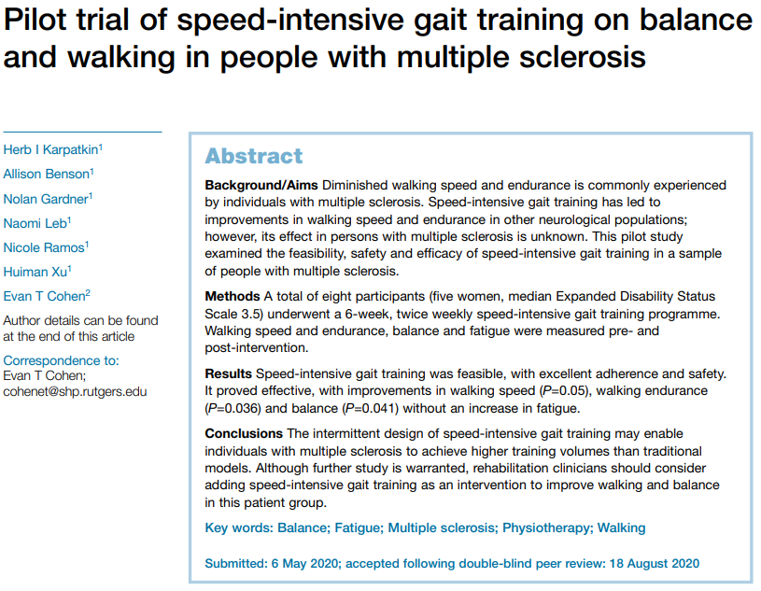
Neuroplasticity and Multiple Sclerosis
Karpatkin et al., 2020

Slide 35
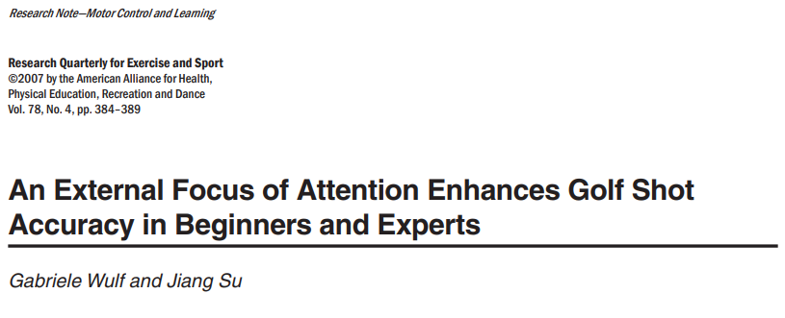
Neuroplasticity and Sports
Wulf and Su, 2007

Slide 36
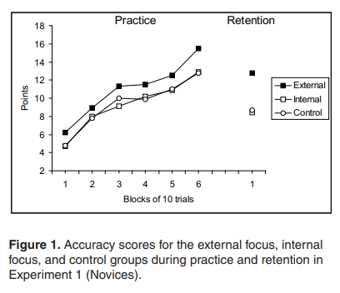
Neuroplasticity and Sports
Wulf et al., 2007

Slide 37
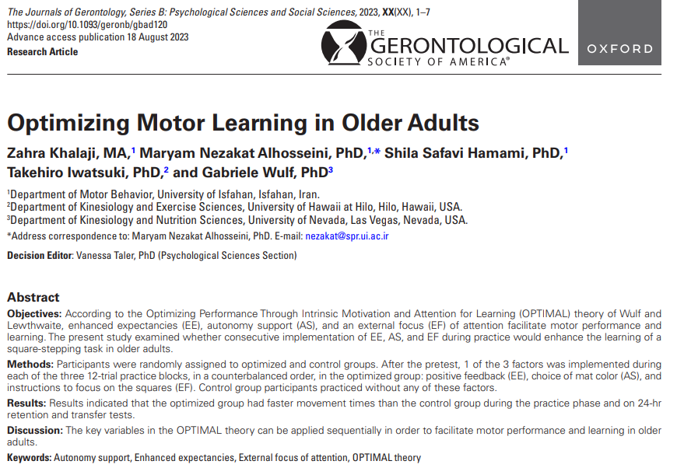
Neuroplasticity and Geriatrics
Khalaji et al., 2024

Slide 38
Neuroplasticity: Behavioral Influences
Life context
Motivational interviewing
Music as a motivator
What is your patient telling you?
  Prioritize addressing their concerns first

Slide 39
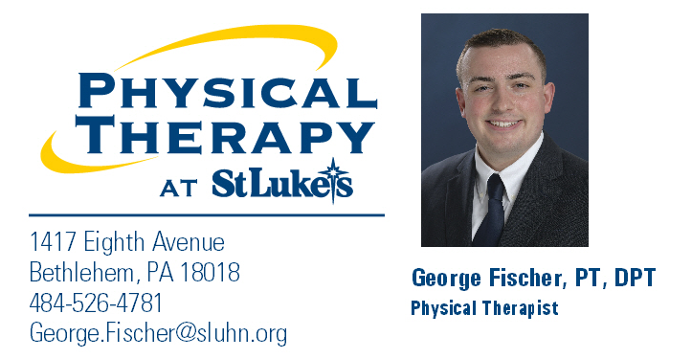
Thank you!

Slide 40
References
Kleim JA, Jones TA. Principles of experience-dependent neural plasticity: implications for rehabilitation after brain damage. J Speech Lang Hear Res. 2008;51(1):S225-S239. doi:10.1044/1092-4388(2008/018)
Wulf, G., & Lewthwaite, R. (2021). Translating Thoughts Into Action: Optimizing Motor Performance and Learning Through Brief Motivational and Attentional Influences. Current Directions in Psychological Science, 30(6), 535-541.
Chua LK, Wulf G, Lewthwaite R. Choose your words wisely: Optimizing impacts on standardized performance testing. Gait Posture. 2020;79:210-216. doi:10.1016/j.gaitpost.2020.05.001
Hornby TG, Reisman DS, Ward IG, et al. Clinical Practice Guideline to Improve Locomotor Function Following Chronic Stroke, Incomplete Spinal Cord Injury, and Brain Injury. J Neurol Phys Ther. 2020;44(1):49-100. doi:10.1097/NPT.0000000000000303
Osborne JA, Botkin R, Colon-Semenza C, et al. Physical Therapist Management of Parkinson Disease: A Clinical Practice Guideline From the American Physical Therapy Association [published correction appears in Phys Ther. 2022 Aug 1;102(8):]. Phys Ther. 2022;102(4):pzab302. doi:10.1093/ptj/pzab302
Karpatkin, Herb & Benson, Allison & Gardner, Nolan & Leb, Naomi & Ramos, Nicole & Xu, Huiman & Cohen, Evan. (2020). Pilot trial of speed-intensive gait training on balance and walking in people with multiple sclerosis. International Journal of Therapy and Rehabilitation. 2020. 1-10. 10.12968/2020.0059.
Wulf G, Su J. An external focus of attention enhances golf shot accuracy in beginners and experts. Res Q Exerc Sport. 2007;78(4):384-389. doi:10.1080/02701367.2007.10599436 https://doi.org/10.1177/09637214211046199
Khalaji Z, Nezakat Alhosseini M, Safavi Hamami S, Iwatsuki T, Wulf G. Optimizing Motor Learning in Older Adults. J Gerontol B Psychol Sci Soc Sci. 2024;79(1):gbad120. doi:10.1093/geronb/gbad120

