Slide 1
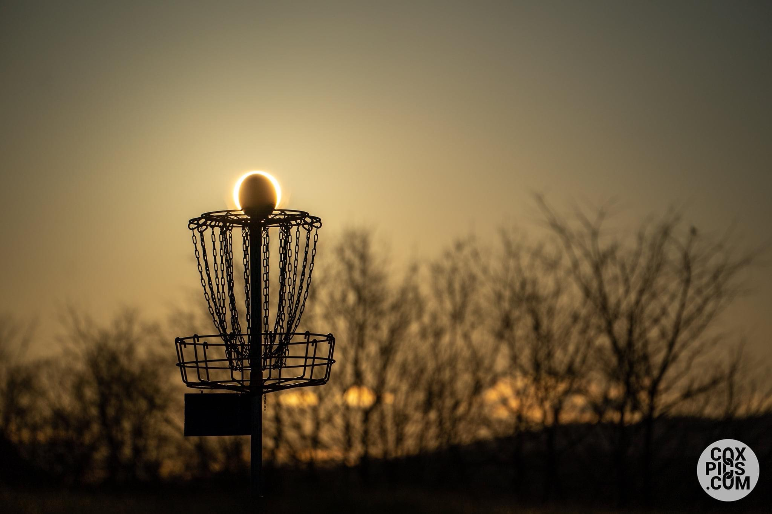

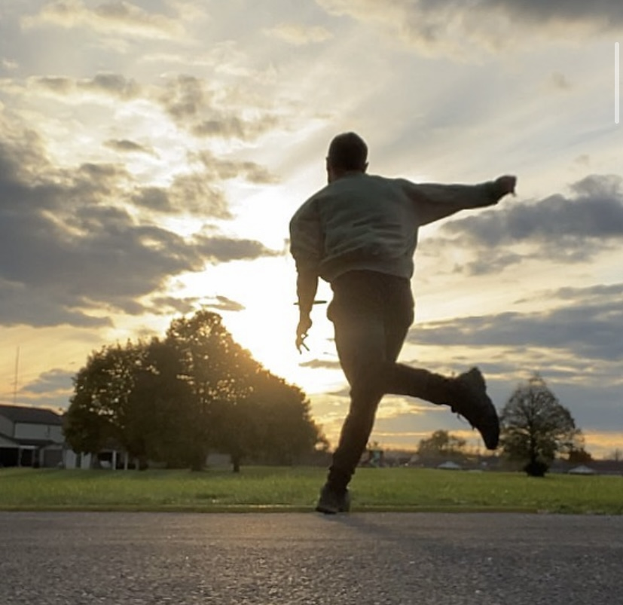
Movement Science of Disc Golf
Gabriel Lamm PT, DPT

Slide 2
Continuing Medical Education Credit Information
Activity Description/Statement of Need: Disc golf is a sport that has been experiencing exponential growth - especially since the COVID-19 pandemic. The conception of the sport can be dated back to 1927, but modern-day disc golf as it is known today did not take off until the 1970’s. As of January 2024, there have been over 276,000 people to sign up for a Professional Disc Golf Association membership, allowing those individuals to compete in tournaments and be ranked among the world. This number does not include individuals who play for fun. According to UDisc, which is an app that allows players to keep score, there are over a million disc golfers who use the app alone and have recorded over 19 million rounds played. This does not take into consideration those who do not play competitively or use the app, which is also estimated to be in the millions. Considering this, the likelihood of a physical therapist or any medical provider encountering an injured disc golfer in their clinic is drastically increasing. This grand rounds presentation will dive deeper into brief disc golf history, biomechanics, common injuries, and clinical considerations for these athletes.
Target Audience: All Providers

Slide 3
Designation Statement
It is St. Luke’s University Health Network policy to ensure balance, independence, objectivity and scientific rigor in all of our sponsored educational programs. Faculty and all others who have the ability to control the content of continuing medical education activities sponsored by the St. Luke’s Hospital & Health Network are expected to disclose to the audience whether they do or do not have any real or apparent conflict(s) of interest or other relationships related to the content of their presentation(s).
The St. Luke’s University Health Network is accredited by the Pennsylvania Medical Society to provide continuing medical education for physicians.
The St. Luke’s University Health Network designates this live educational activity for a maximum of 1 AMA PRA Category 1 Credits™. Physicians should only claim credits commensurate to the extent of their participation on the activity.

Slide 4
Disclosure Information
The Planners involved in this activity have no relevant financial relationships to disclose.
The Faculty/Presenters involved in this activity have no relevant financial relationships to disclose.

Slide 5

Objectives
Define disc golf and discuss the history and growth of the sport
Discuss the various throwing mechanics used in disc golf
Discuss various disc golf injuries, their prevalence, and anatomical locations
Compare and contrast disc golf to golf and ultimate frisbee
Discuss clinical components/considerations when evaluating and treating disc golfers

Slide 6
My Disc Golf Experience
Playing for 10+ years
Involved with various clubs/organizations in the Lehigh Valley
Competing in amateur/pro tournaments/leagues since 2020
Treated several disc golfers with various injuries
  Shoulder, Ankle, Hip, Low Back
Numerous friends and competitors playing through pain/injury
Developed preliminary disc golf injury prevention screen with colleague Matthew Johnson PT, DPT, OCS, SCS

Slide 7
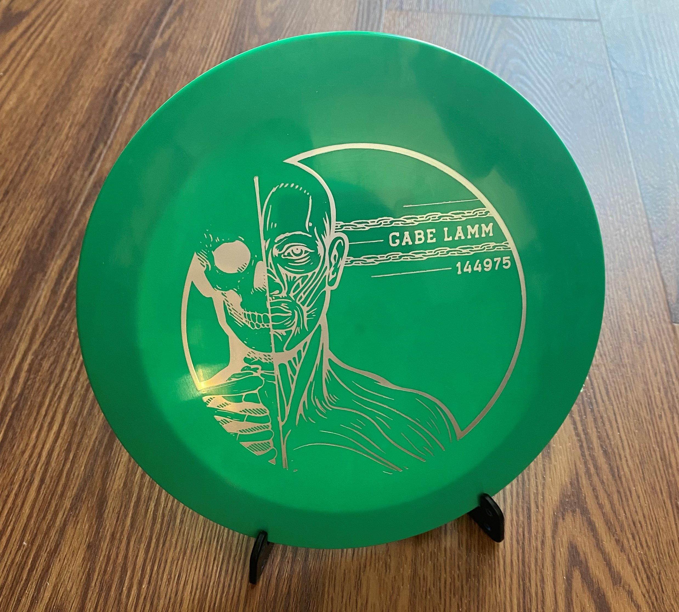
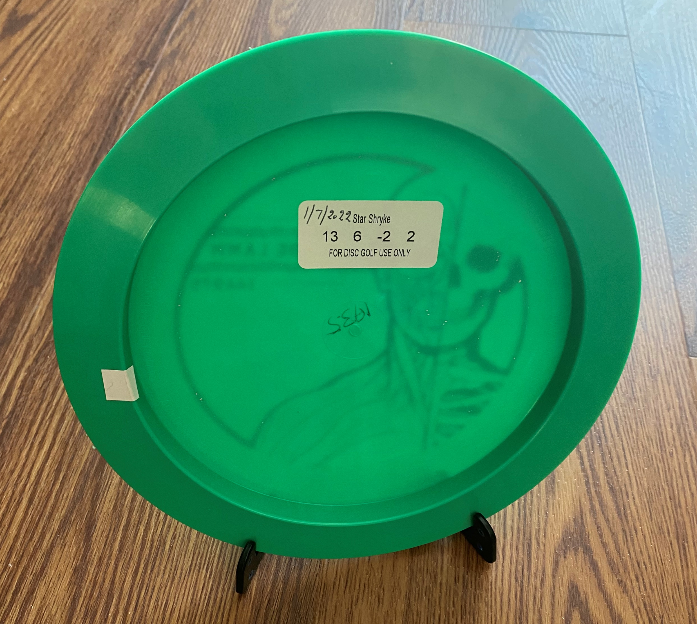
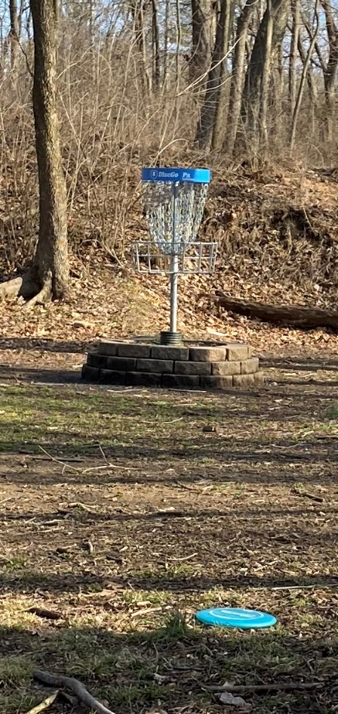
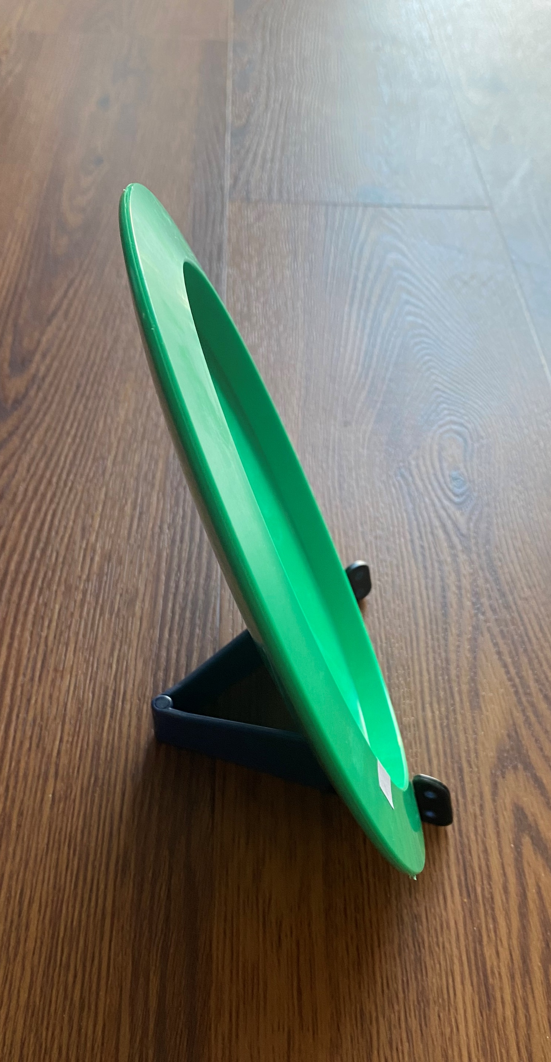
What is Disc Golf?¹
Disc golf is played similarly to golf
Disc = ball and clubs
  Disc types: drivers, fairways, mid-ranges, putters
Basket and chains = golf hole
18 holes, front/back 9
Fewest number of strokes (throws) wins

Slide 8
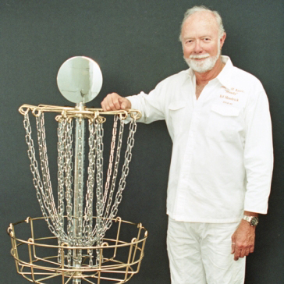
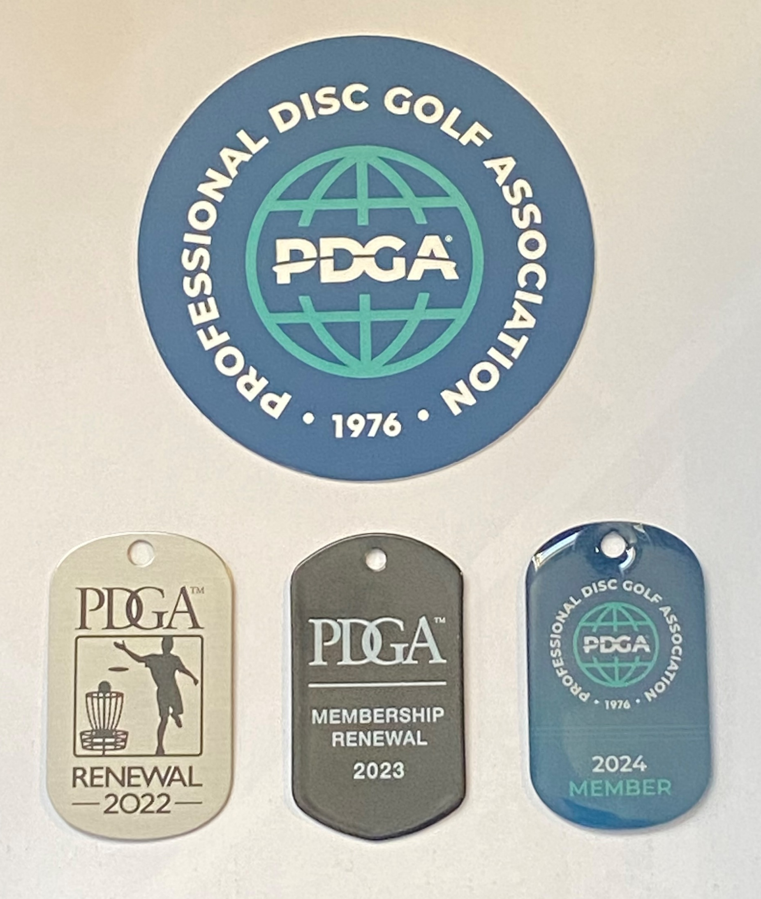
Disc Golf History²
Father of Disc Golf (“Steady” Ed Headrick) patented:
  Modern Day Frisbee (1966)
  Disc Golf Pole Hole (1975)
“Steady” Ed founded the Professional Disc Golf Association (PDGA) in 1976
Today, over 277,000 PDGA members worldwide (active/non-active) compete in sanctioned tournaments
  My PDGA # 144975
https://www.pdga.com/DGHOF/1993/steady-ed-headrick

Slide 9
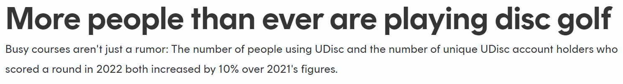
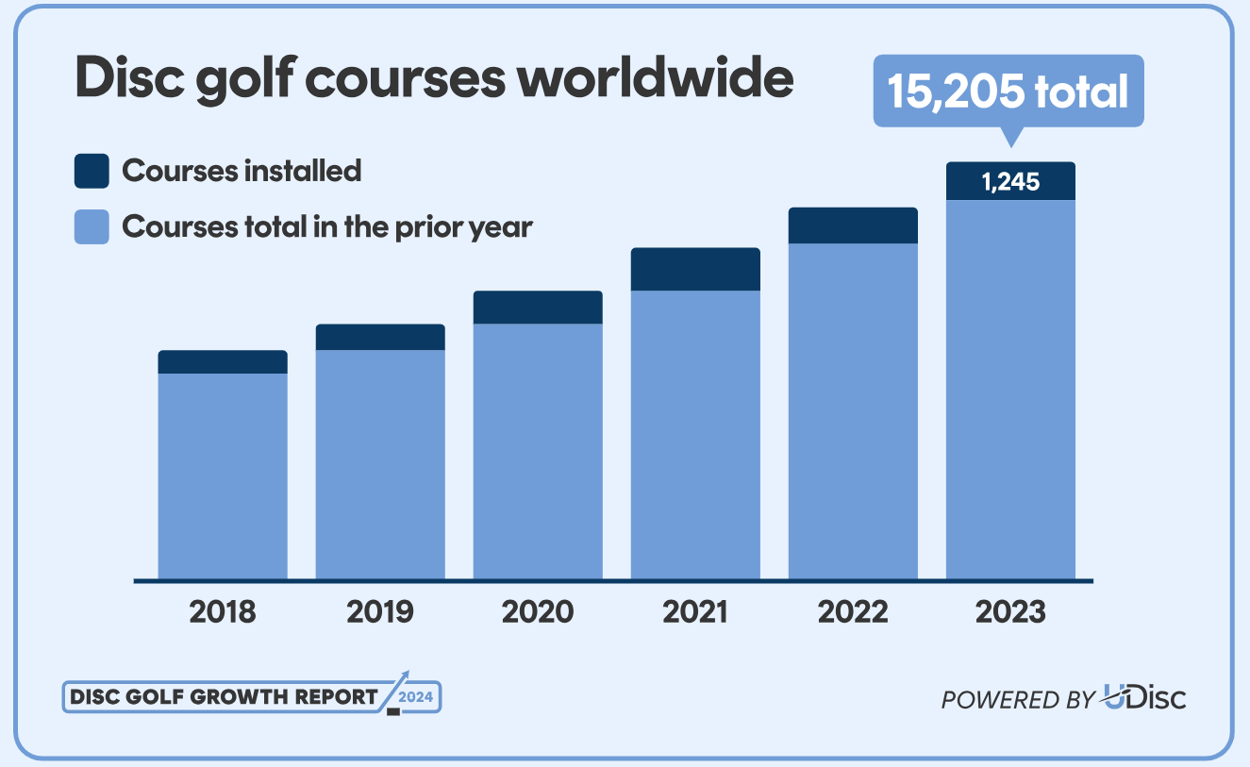

Disc Golf Growth³⁻⁴
1.4 million disc golfers on UDisc in 2023
21.9 million rounds scored on UDisc in 2023
Notes:
UDisc is an app used to find disc golf courses nearby and record your score during or after your round

Slide 10
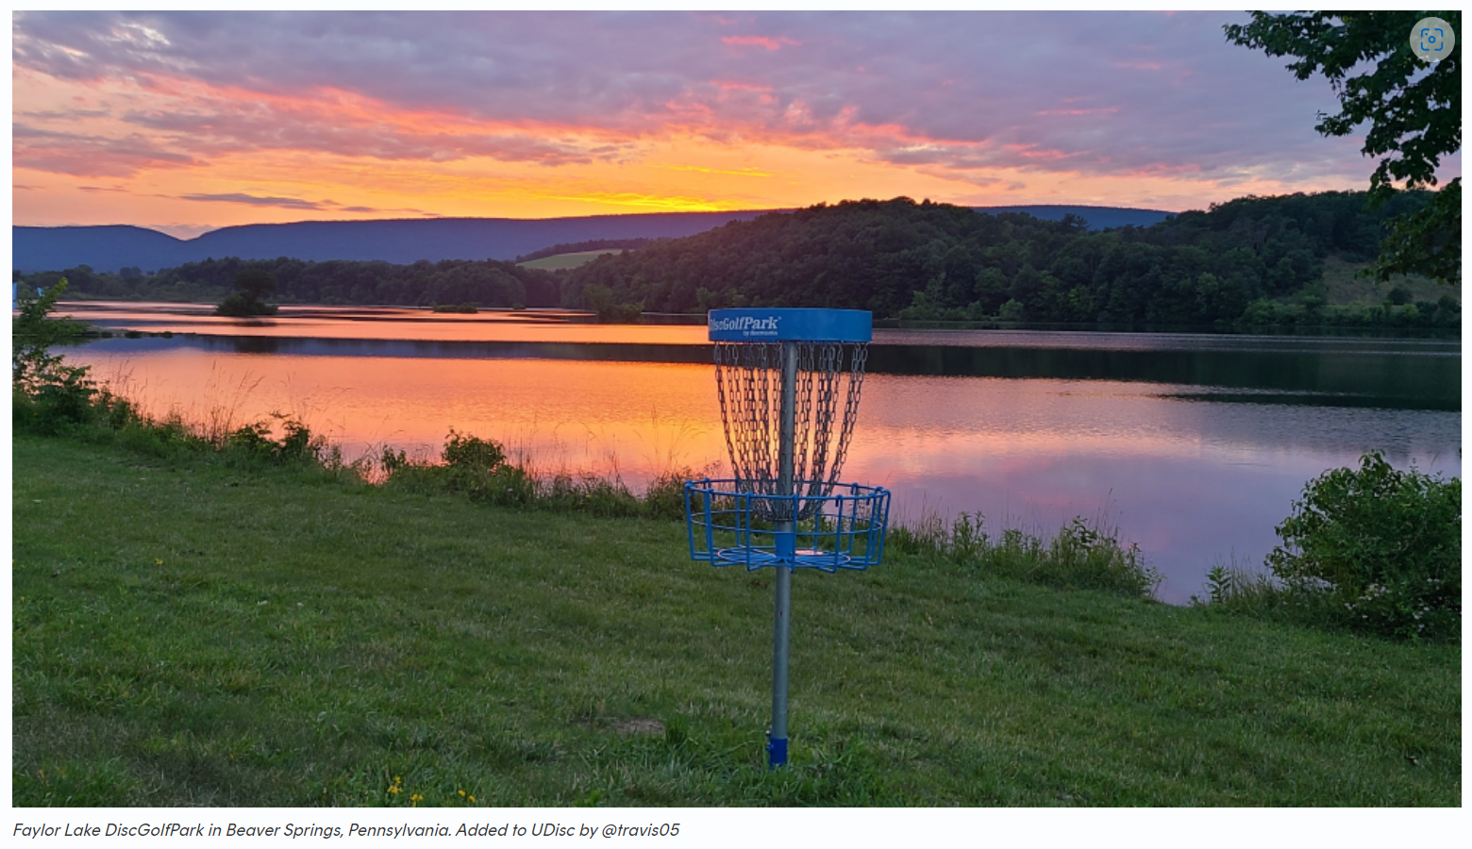
Disc Golf Growth³
Currently the #1 free to play course in the world!

Slide 11
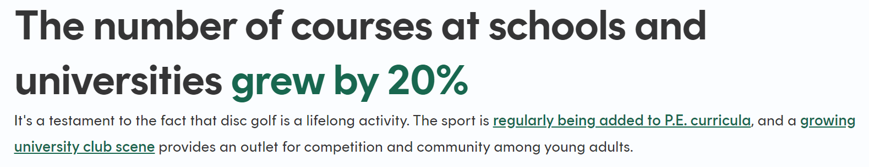
Disc Golf Growth³⁻⁴
DeSales University – Center Valley, PA
Public Parks: 6,431
Schools/Universities: 1,862
Camps: 808
Ski Areas: 470
Breweries/Wineries: 125
Long Trout Winery – Auburn, PA
Northampton Community College – Bethlehem, PA
Blue Mountain – Danielsville, PA
Bear Creek – Macungie, PA

Slide 12
Throw Types/Basic Grips
Backhand (most common/primary focus today)
Forehand aka “flick” or “sidearm”
Overhand
  Tomahawk aka hammer, thumber
Rollers (backhand or forehand)
Grenade
Various putting styles/grips (push versus spin)

Slide 13
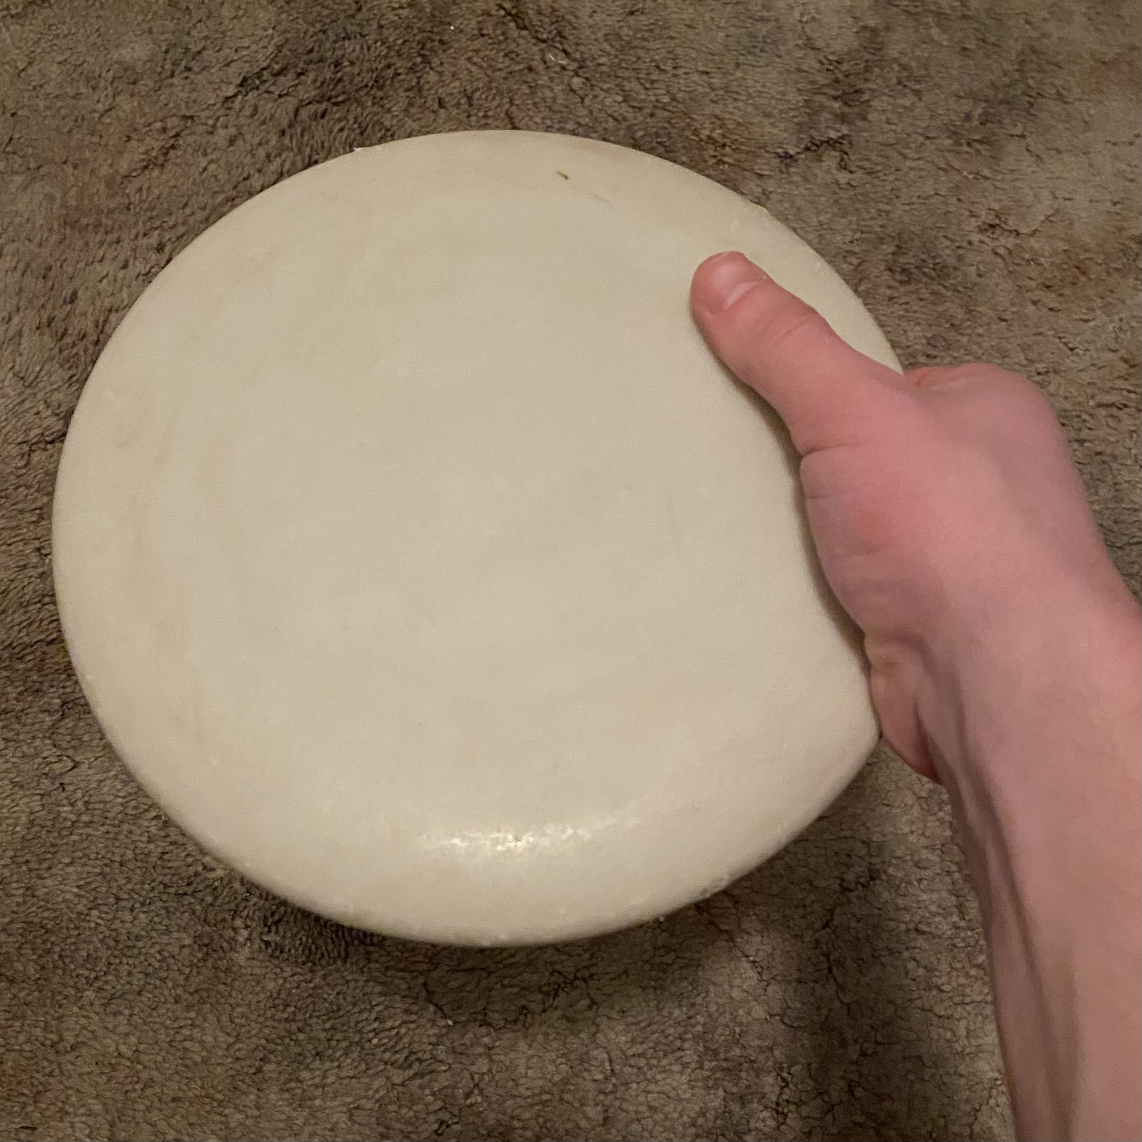
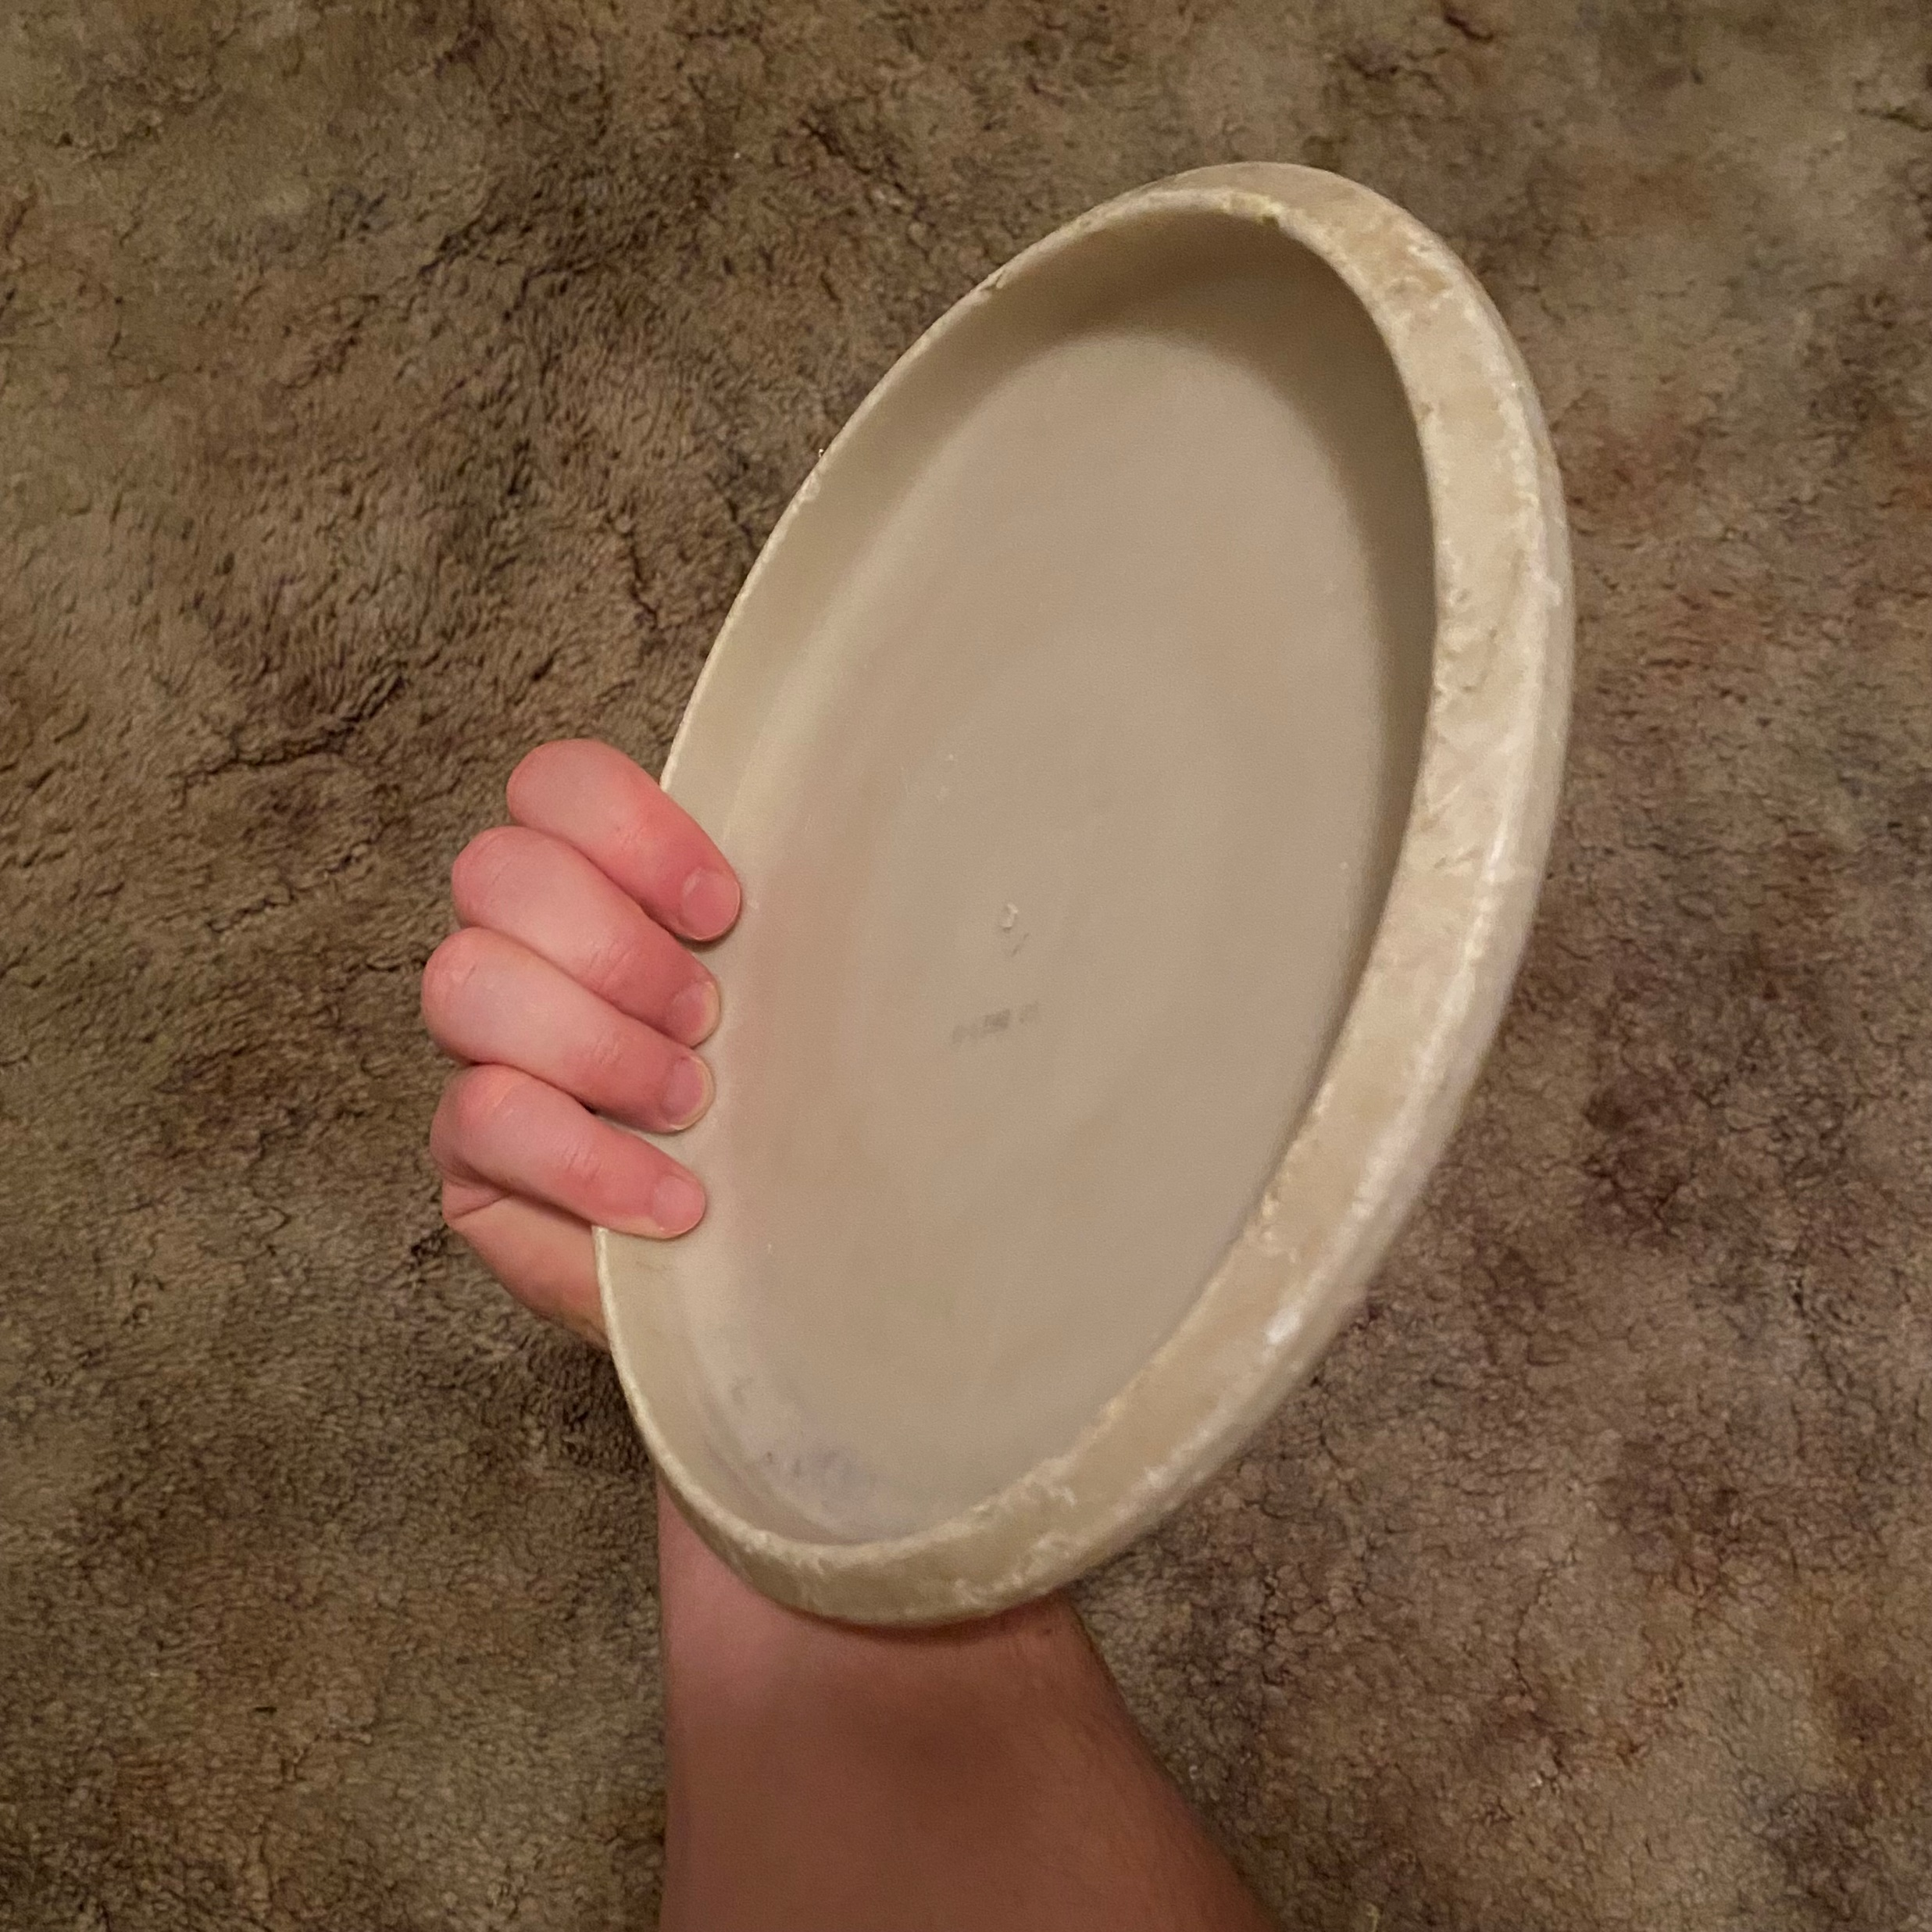
Throw Types/Basic Grips
Backhand Top
Backhand Bottom, Power Grip

Slide 14
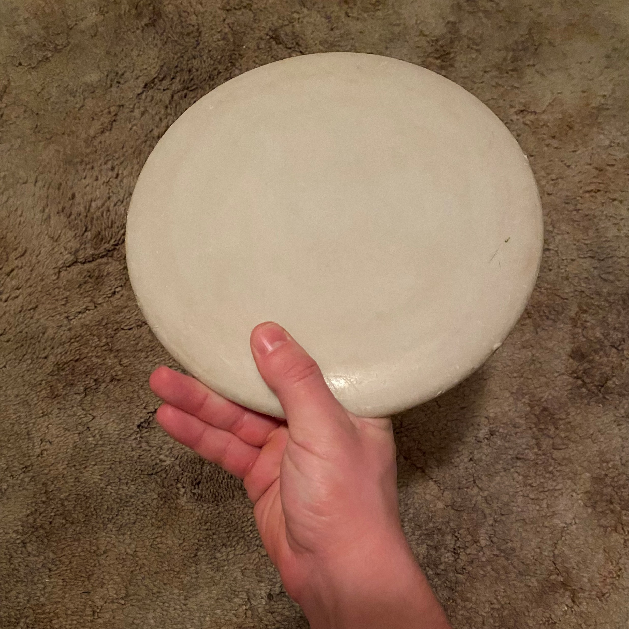
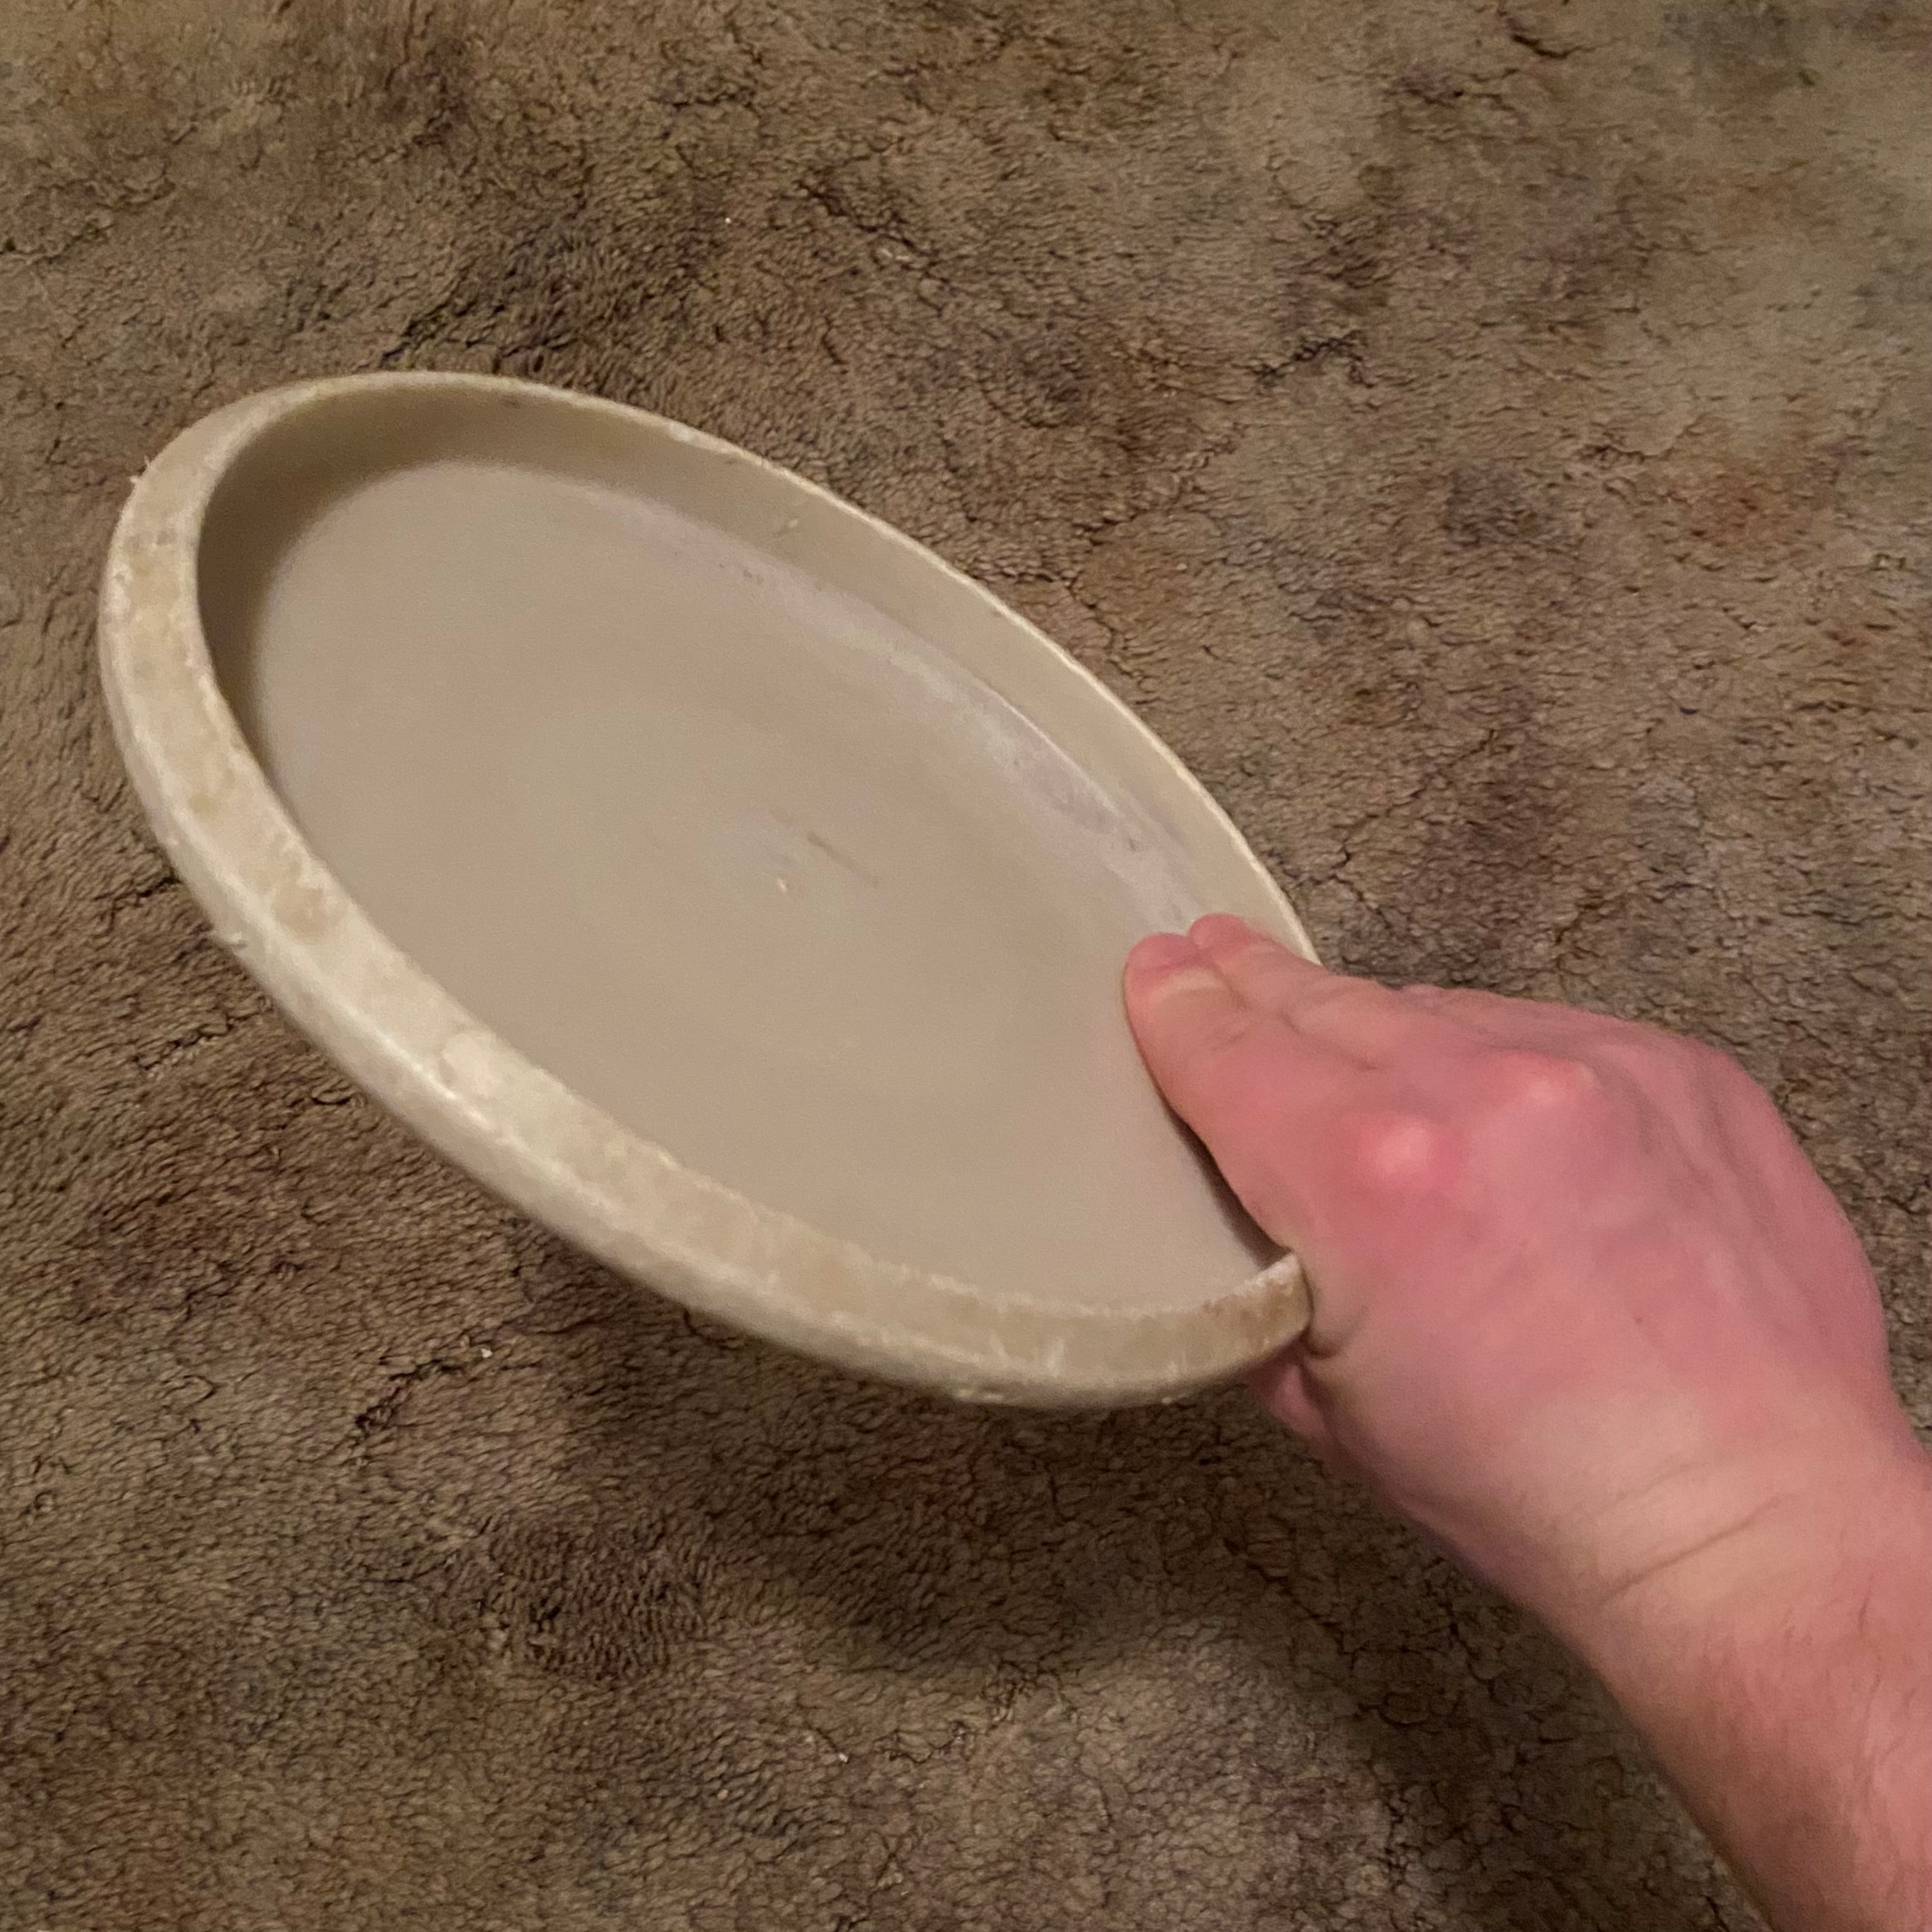
Throw Types/Basic Grips
Forehand/ Hammer Top
Forehand/Hammer Bottom

Slide 15
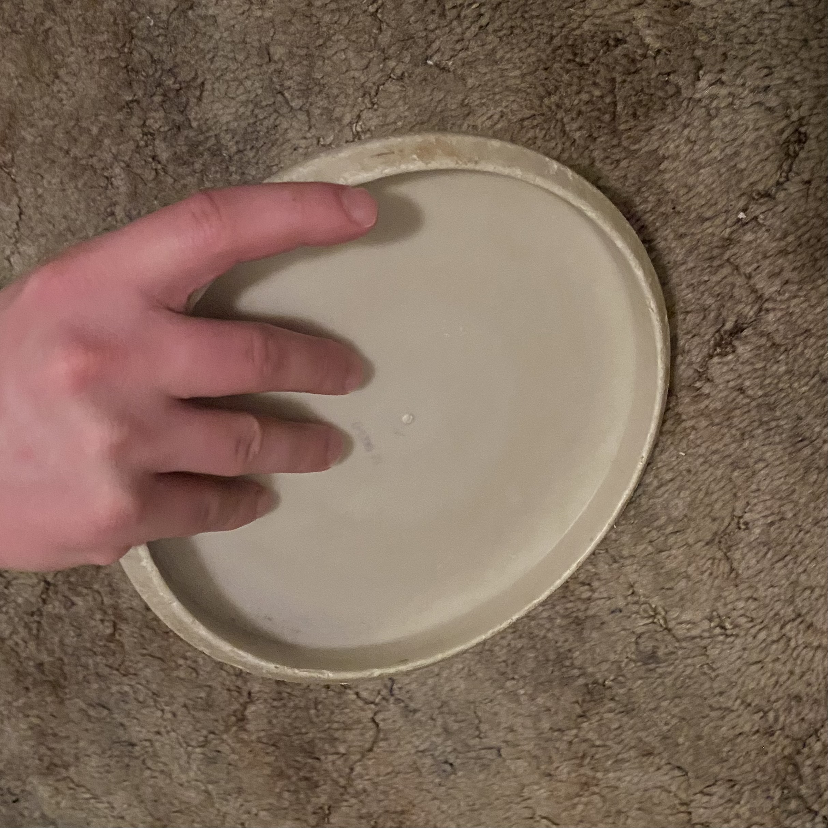
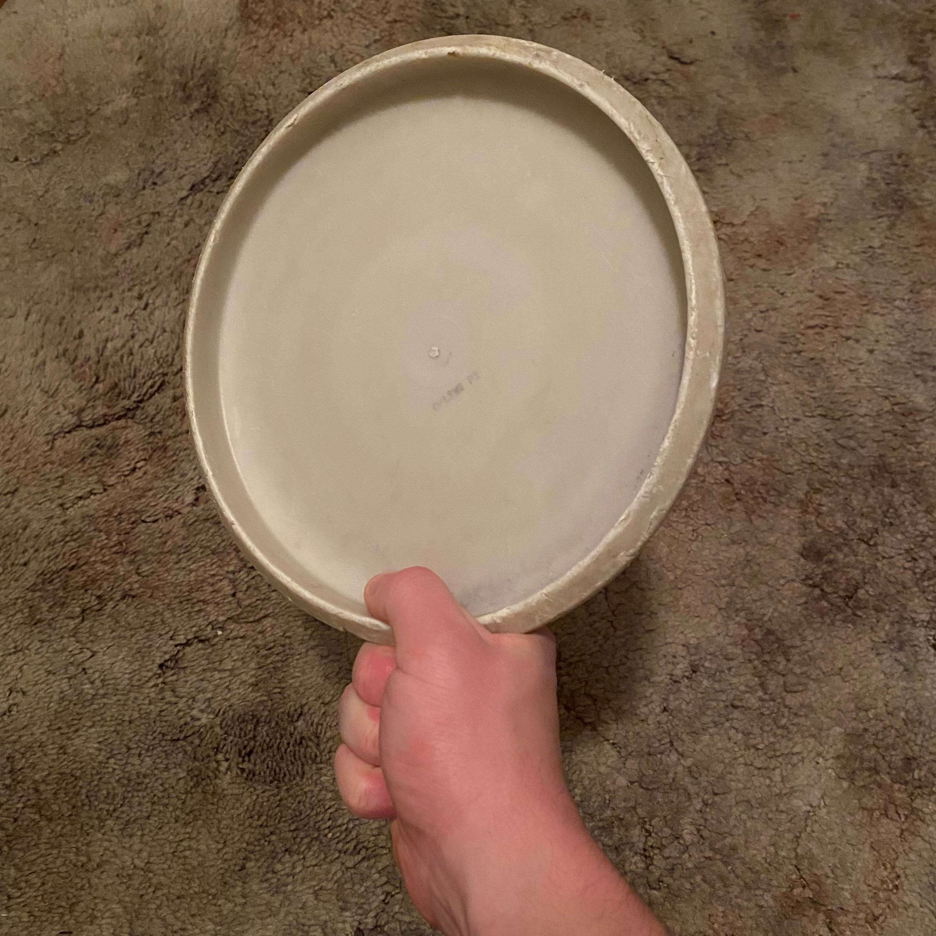
Throw Types/Basic Grips
Thumber Bottom
Putting, Fan Grip

Slide 16
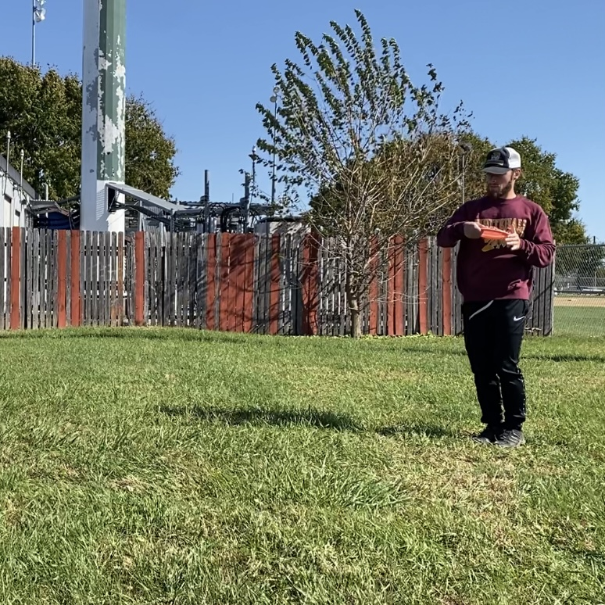
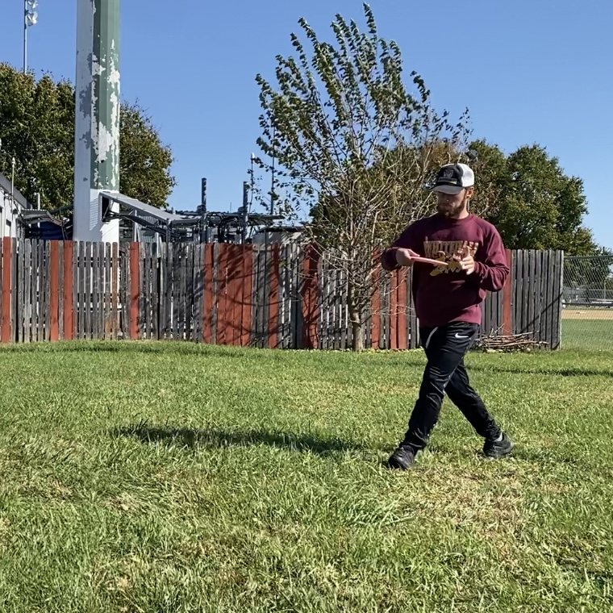
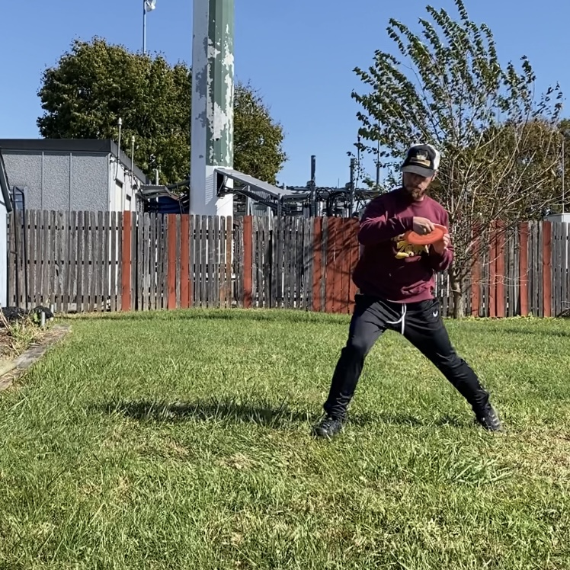
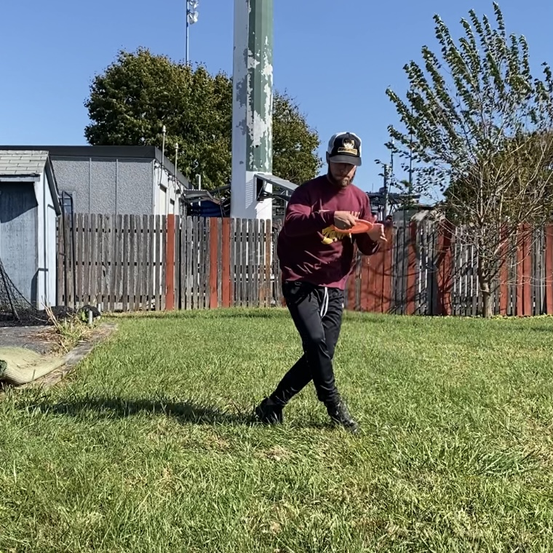
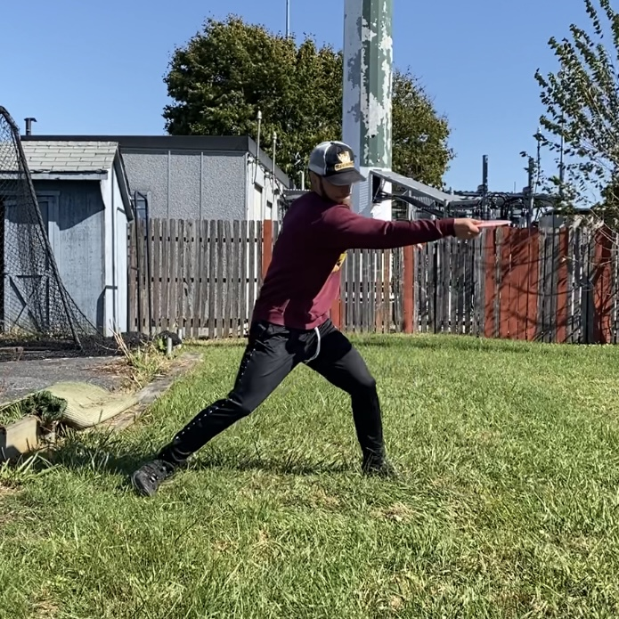
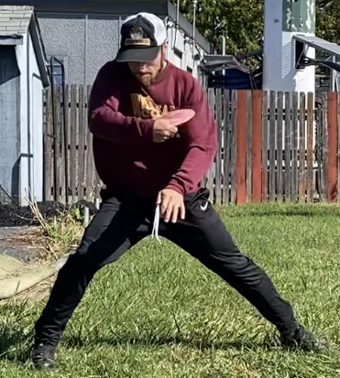
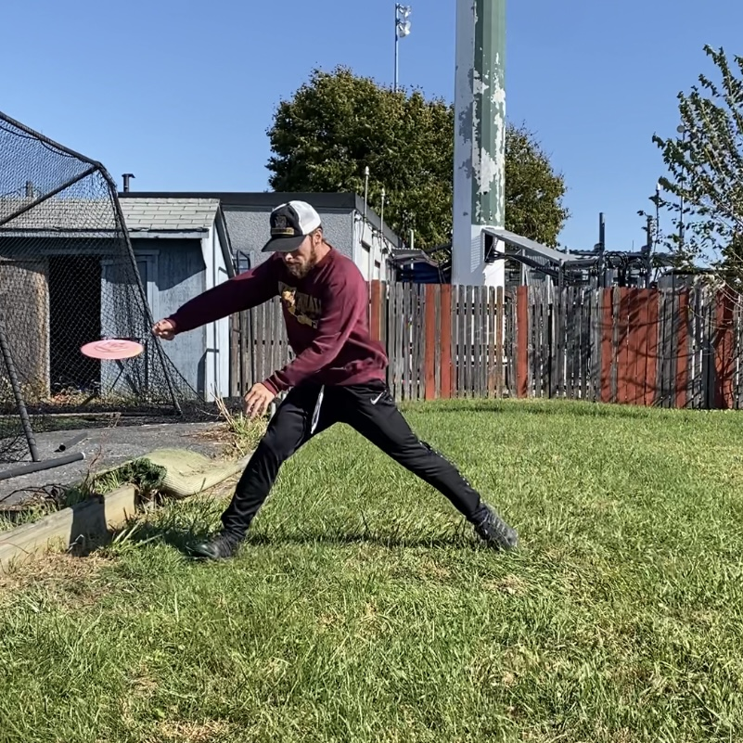
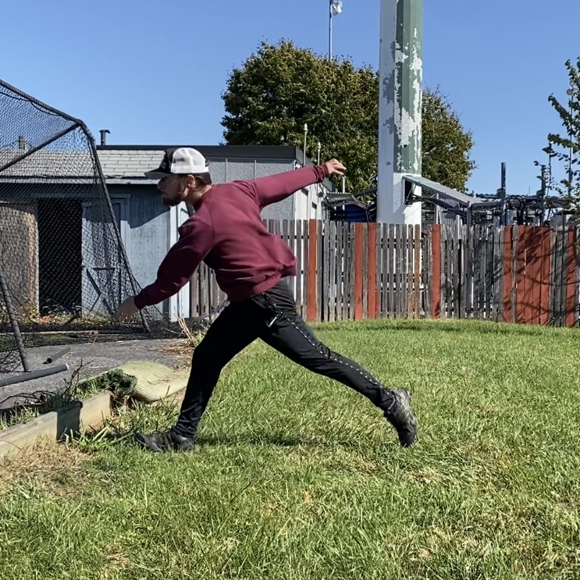
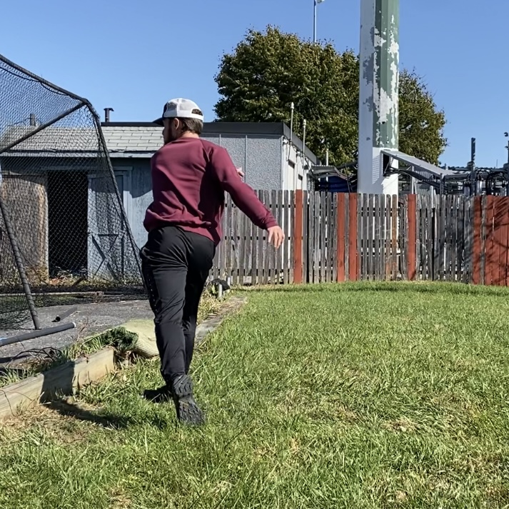
Backhand Task Analysis

Slide 17
Backhand Task Analysis
“Preparation”
Shot Selection
Line up to basket or spot in fairway
Set Grip
Commit

Slide 18
Backhand Task Analysis
“X-Step” – 1st step
Toward target
Lower body movement to generate forward momentum
Coordination and timing

Slide 19
Backhand Task Analysis
“X-Step” – 2nd step
Start to turn away from target → coiling/loading
Continuing forward momentum
Thoracolumbar/hip rotation, mobility

Slide 20
Backhand Task Analysis
“X-Step” –3rd step loading/cross-over
Continuing to coil/rotate, generating potential energy
Timing/coordination
Dynamic balance, especially on uneven terrain

Slide 21
Backhand Task Analysis
“Reach Back”
Final step in the “x-step”
However, think of body moving around the disc and letting arm be loose, acting as whip
Final loading of energy before transfer into disc

Slide 22
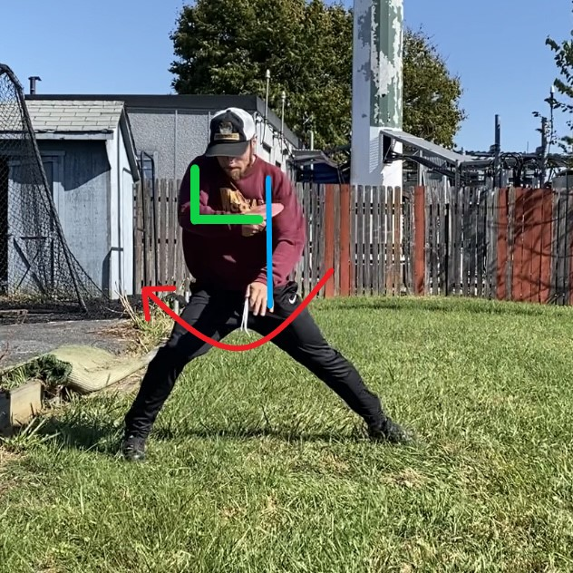
Backhand Task Analysis
“Power Pocket”
Rotational movement brings lever arm close to body, increasing angular velocity like a dancer/baseball swing
Right internal/left external abdominal obliques for right-handed backhand (RHBH)
Lower body/glutes/core transfer kinetic energy

Slide 23
Backhand Task Analysis
“Release”
Cracking the whip
Transfer of energy into the disc

Slide 24
Backhand Task Analysis
“Follow Through”
Prevent injury – can be missed in novice disc golfers
Deceleration

Slide 25
Backhand Task Analysis
“Follow Through” Continued
Deceleration continues until coming to a balanced stop

Slide 26
Backhand Mechanics Key Points
Letting the arm act as a whip – utilizing lower body, core/hips to generate torque/power to “crack” the whip
Rotation is crucial – hip/thoracolumbar mobility and stability
Follow-through/deceleration for injury prevention
Dynamic balance as disc golf is played on various terrains/weather conditions… even ice/snow

Slide 27
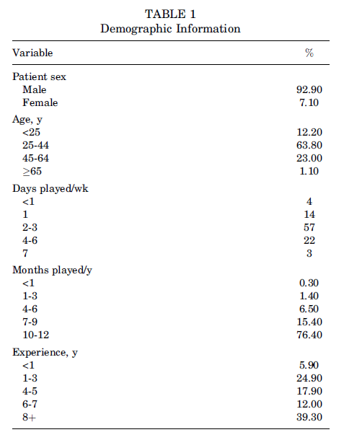
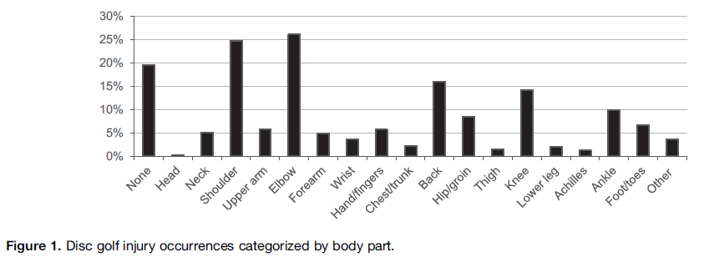
Disc Golf Injuries⁵
Notes:
Nelson et al. 2015 one of two major peer reviewed studies on disc golf/injuries

Slide 28
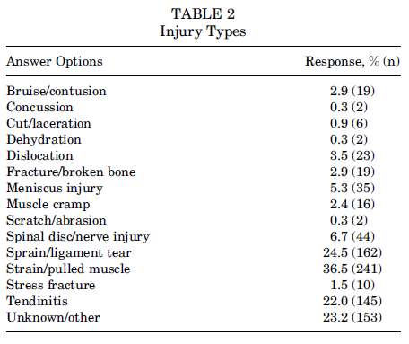
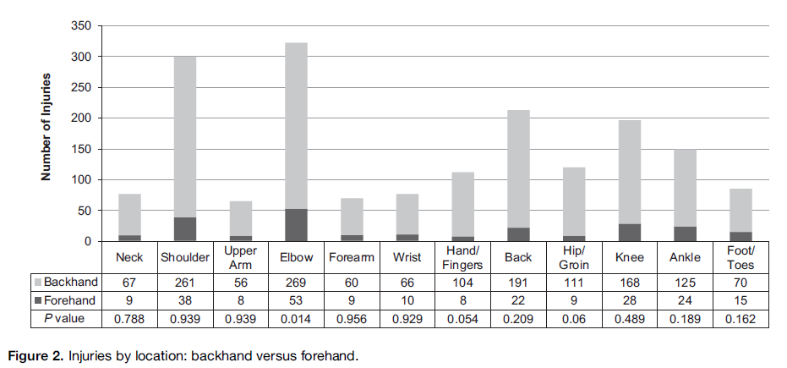
Disc Golf Injuries⁵

Slide 29
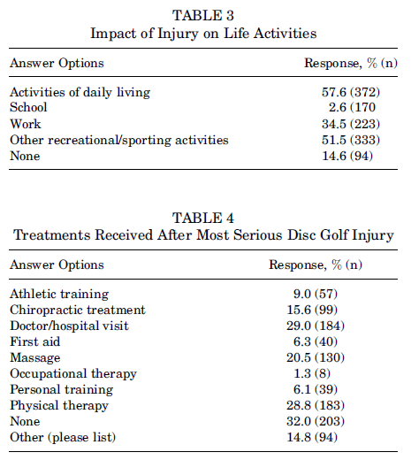
Disc Golf Injuries⁵
Notes:
This is OUR wheelhouse (ADL’s, work, recreation/sports)

Slide 30
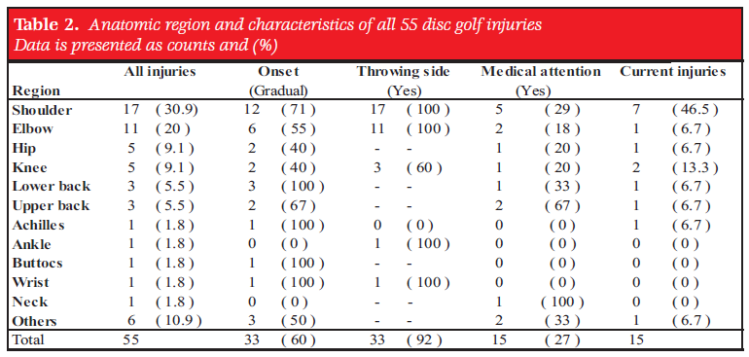
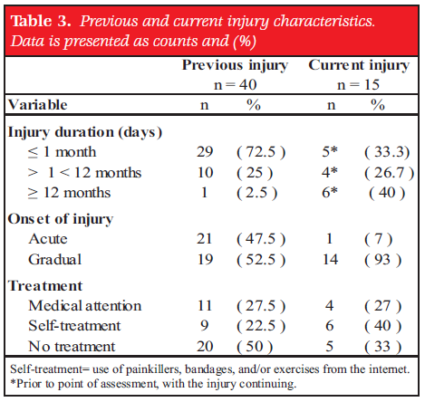
Disc Golf Injuries⁶
Notes:
Rahbek et al 2016

Slide 31
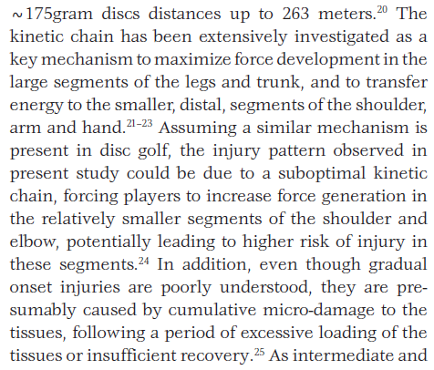
Disc Golf Injuries⁶
Lack of appropriate biomechanics can lead to injury
Throwing with arm instead of transfer of energy (typically beginners)

Slide 32
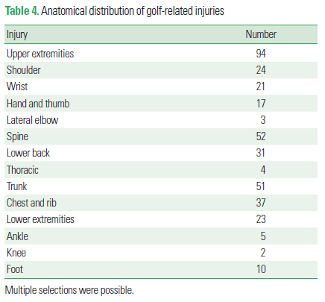
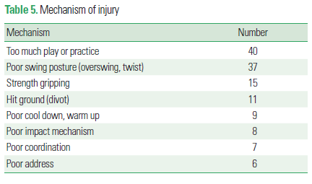
Disc Golf versus Golf⁷

Slide 33
Injury Summary⁷⁻⁹
Disc Golf
Golf
Majority of injuries involve the UE’s followed by back/knees
Strains/sprains/tendinitis
Mechanism – inefficient biomechanics/potential overuse
Majority of injuries spine/low back, and UE’s
Mechanism = overuse/poor swing mechanics

Slide 34
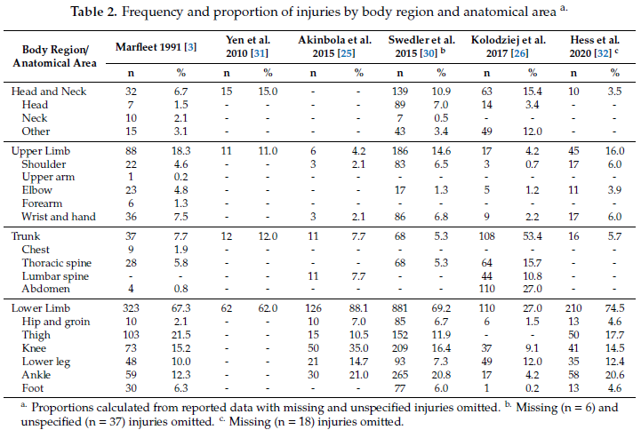
Disc Golf versus Ultimate Frisbee¹⁰

Slide 35
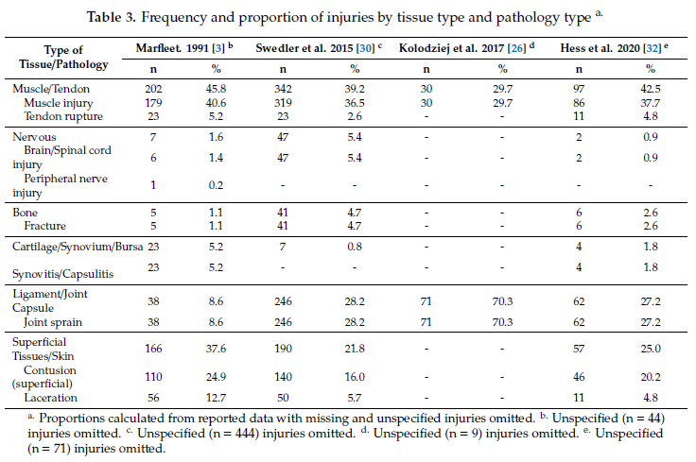
Disc Golf versus Ultimate Frisbee¹⁰

Slide 36
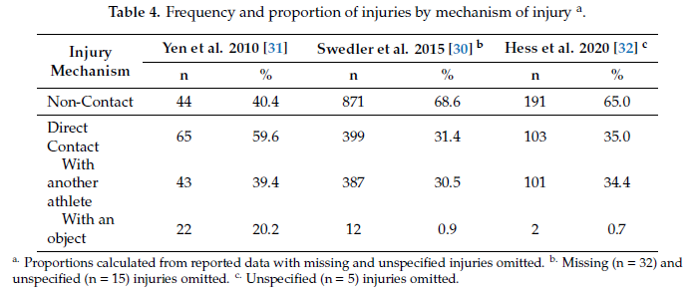
Disc Golf versus Ultimate Frisbee¹⁰

Slide 37
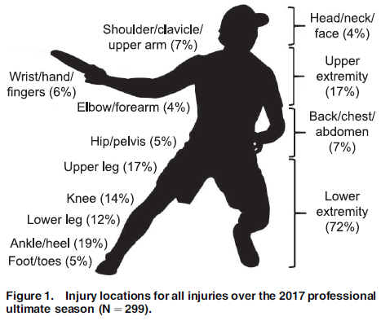
Disc Golf versus Ultimate Frisbee¹¹

Slide 38
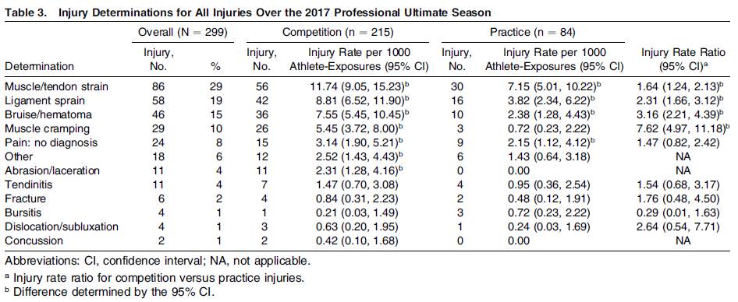
Disc Golf versus Ultimate Frisbee¹¹

Slide 39
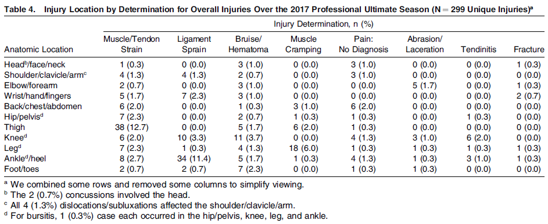
Disc Golf versus Ultimate Frisbee¹¹

Slide 40
Injury Summary¹⁰⁻¹¹
Disc Golf
Ultimate Frisbee
Majority of injuries involve the UE’s followed by back/knees
Strains/sprains/tendinitis
Mechanism – inefficient biomechanics/potential overuse
Majority of injuries involve the thigh/LE’s
Strains/sprains, bruising/hematoma, muscle cramping
Contact and non-contact injuries are possible

Slide 41
Why should you care?
Disc golf continues to grow each year
  More people playing, higher chance to encounter an injured disc golfer
With growth, increased likelihood a patient will end up in your clinic
  Even neuro with possible concussion (although less than 10% chance of sustaining concussion when suffering disc to head contact)¹²
To be better equipped to treat these patients and educate on proper mechanics

Slide 42
What should you look for?
Mobility/PNF patterns
  transverse/sagittal/frontal planes
Neuro-dynamics (UQS/LQS)
Motor control/Strength/Power
  all planes mentioned prior, especially transverse
Mechanics/movement task analysis
  Arguable most important - is patient utilizing “whip” ?
Dynamic balance

Slide 43
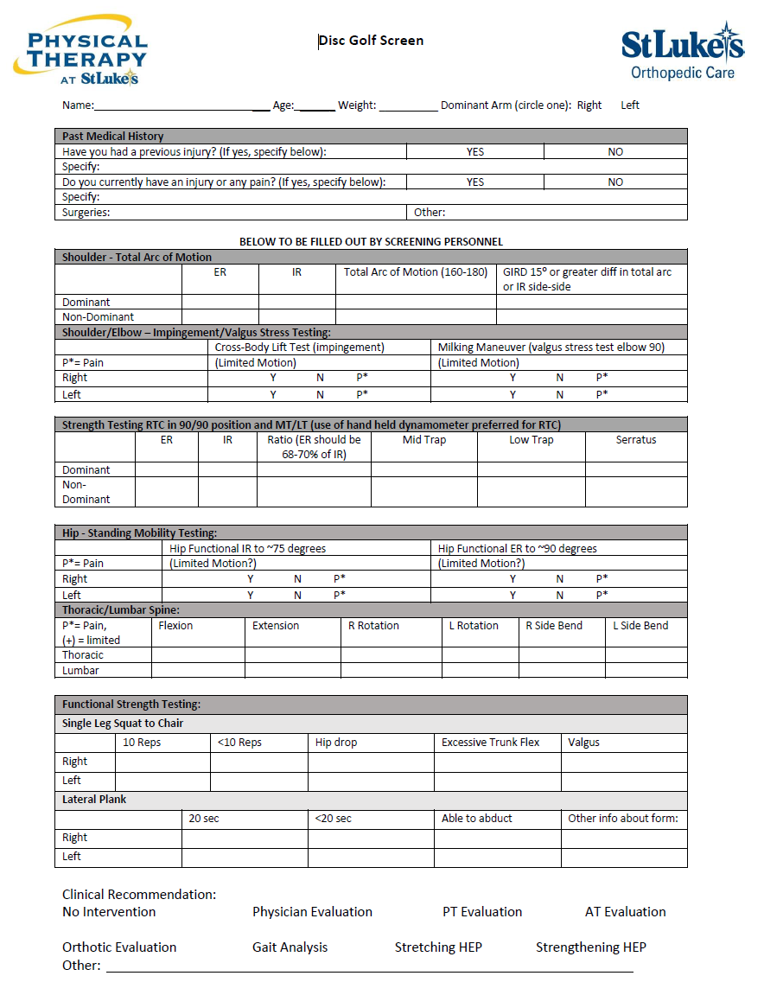
Preliminary Injury Prevention Screen
Don’t forget about task analysis/biomechanics

Slide 44
References
Professional Disc Golf Association. What is Disc Golf? A Complete Beginners’ Guide. https://www.pdga.com/news/what-disc-golf-guide-parents-kids. Accessed January 21, 2024.
Professional Disc Golf Association. Brief History of Disc Golf and the PDGA. https://www.pdga.com/history. Accessed January 21, 2024.
UDisc. Disc Golf Growth Report 2023. https://udisc.com/disc-golf-growth-report/2023. Accessed February 3, 2024.
UDisc. Disc Golf Growth Report 2024. https://udisc.com/disc-golf-growth-report/2024. Accessed February 21, 2024.
Nelson JT, Jones RE, Runstrom M, Hardy J. Disc Golf, a Growing Sport: Description and Epidemiology of Injuries. Orthop J Sports Med. 2015;3(6):2325967115589076. Published 2015 Jun 25. doi:10.1177/2325967115589076
Rahbek MA, Nielsen RO. INJURIES IN DISC GOLF - A DESCRIPTIVE CROSS-SECTIONAL STUDY. Int J Sports Phys Ther. 2016;11(1):132-140.
Moon HW, Kim JS. Golf-related sports injuries of the musculoskeletal system. J Exerc Rehabil. 2023;19(2):134-138. Published 2023 Apr 27. doi:10.12965/jer.2346128.064
Robinson PG, Murray IR, Duckworth AD, et al. Systematic review of musculoskeletal injuries in professional golfers. Br J Sports Med. 2019;53(1):13-18. doi:10.1136/bjsports-2018-099572
Hasley IB, Ostby TD, Fjosne CM, Jelsing EJ. Etiology and Prevention of Common Injuries in Golf. Curr Sports Med Rep. 2023;22(6):210-216. Published 2023 Jun 1. doi:10.1249/JSR.0000000000001075
Fajardo Pulido D, Lystad RP. Epidemiology of Injuries in Ultimate (Frisbee): A Systematic Review. Sports (Basel). 2020;8(12):168. Published 2020 Dec 21. doi:10.3390/sports8120168
Hess MC, Swedler DI, Collins CS, Ponce BA, Brabston EW. Descriptive Epidemiology of Injuries in Professional Ultimate Frisbee Athletes. J Athl Train. 2020;55(2):195-204. doi:10.4085/1062-6050-269-18
Menickelli J, Cooper CA, Withnall C, Wonnacott M. Analysis and comparison of lateral head impacts using various golf discs and a Hybrid III head form. Sports Biomech. 2022;21(3):340-350. doi:10.1080/14763141.2019.1656769

Slide 45
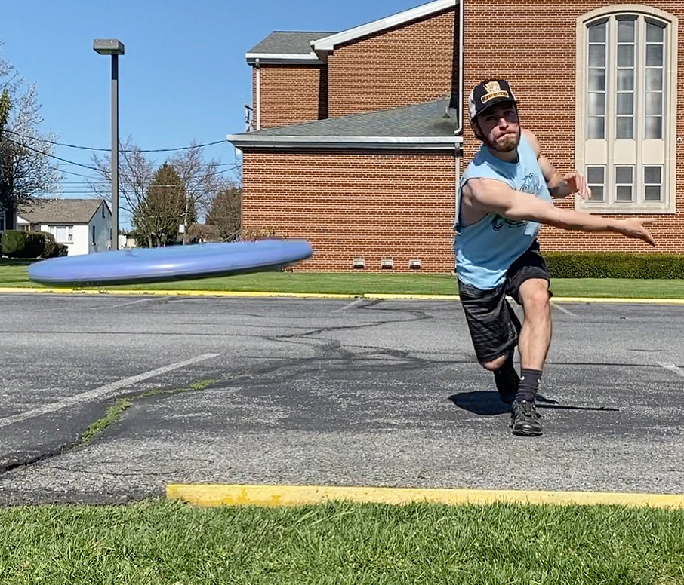
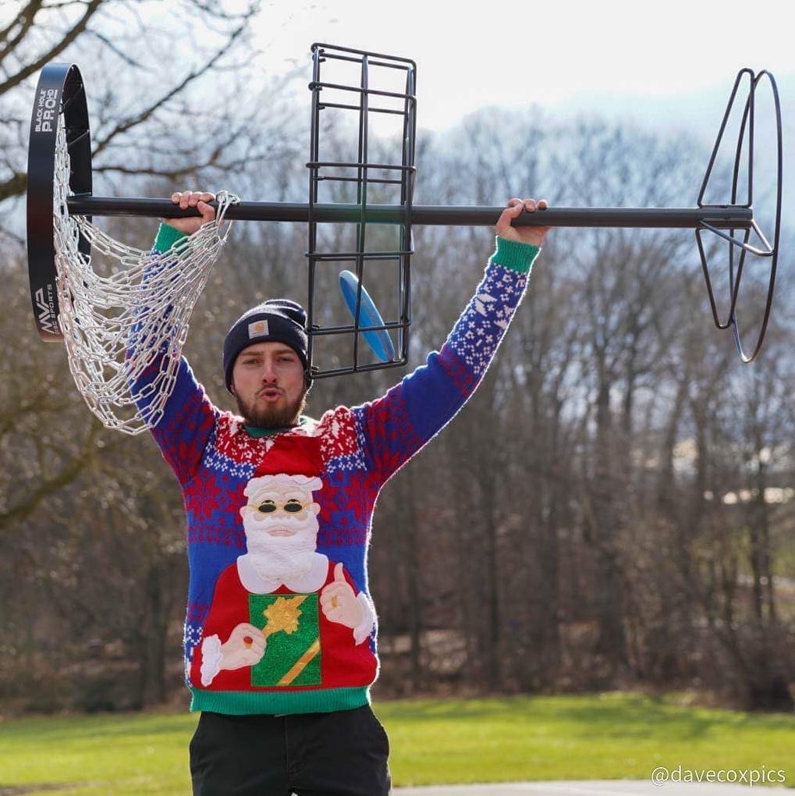
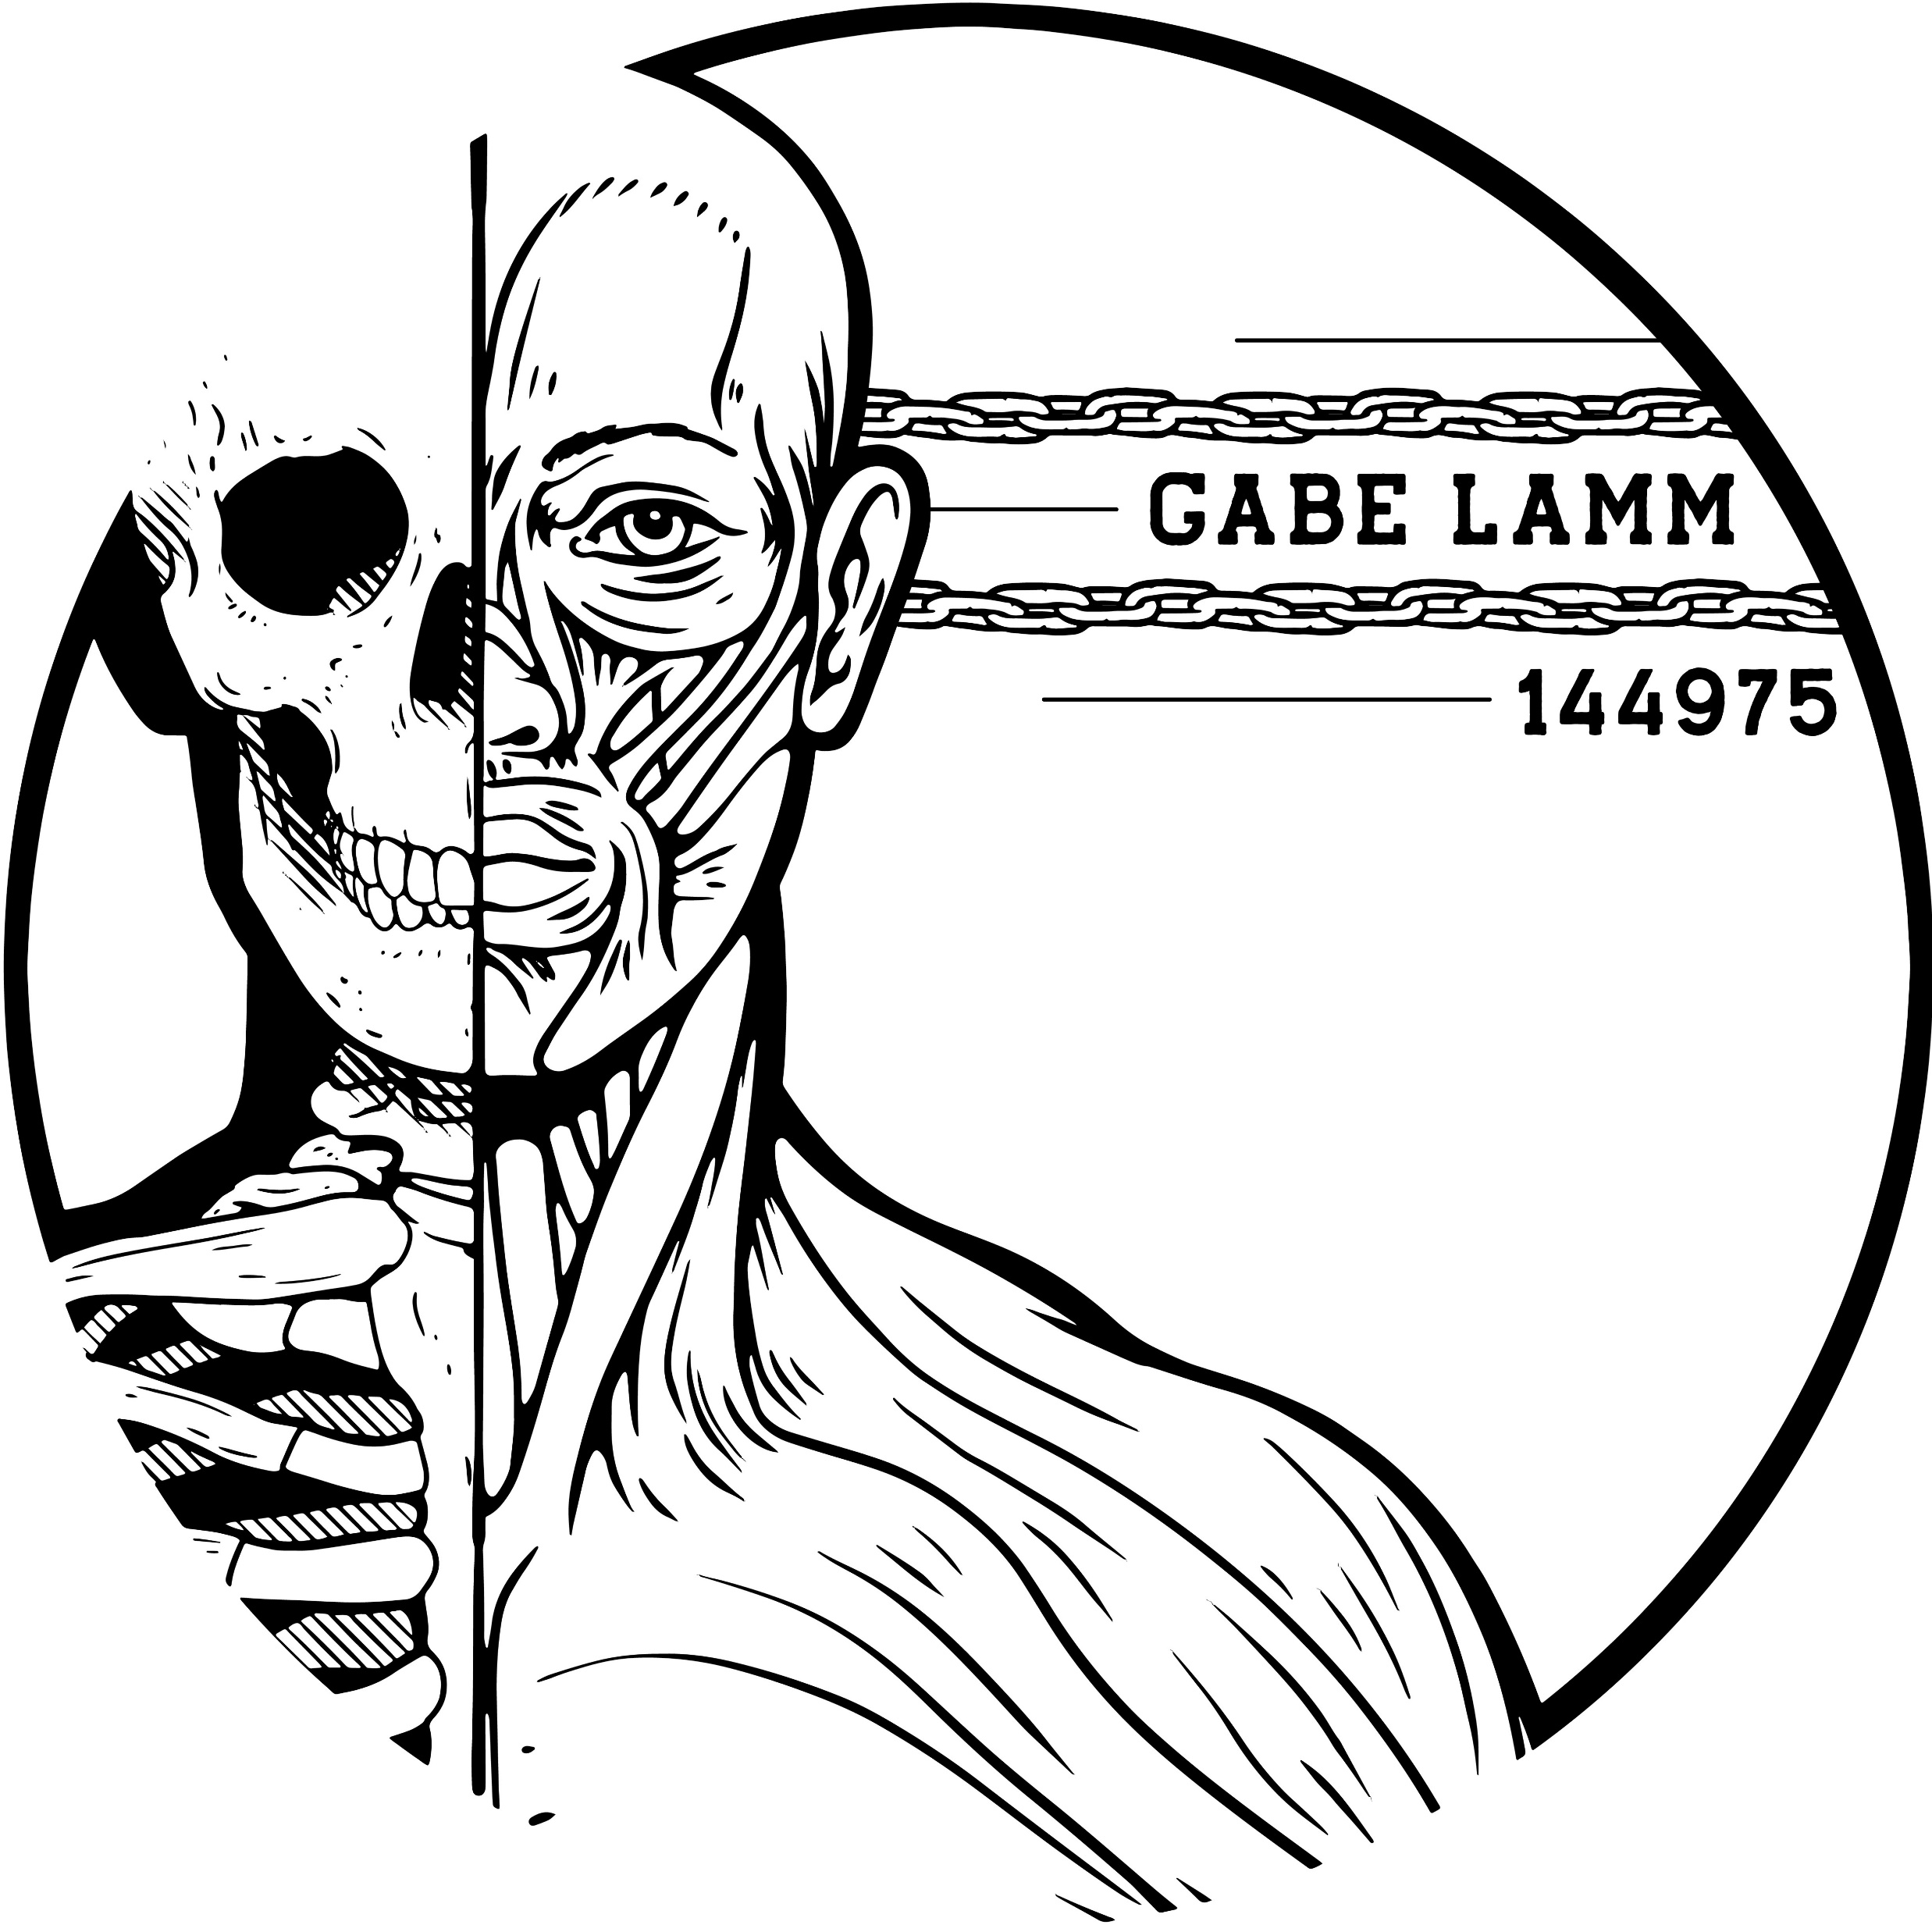
Thank you for listening, questions?

