Slide 1
Demystifying Lymphedema:
A Guide for Healthcare Professionals
Jeff Hashagen, PT, MSPT, CLT

Slide 2
Continuing Medical Education Credit Information
Designed to establish a more detailed knowledge and clinical understanding of the lymphatic system. This includes an entry level introduction to its anatomy and physiology, awareness of disruptions to the lymphatic system, clinical presentation of symptoms, and treatment methods to address.
Target Audience: Advanced practitioners and allied health professionals

Slide 3
Designation Statement
It is St. Luke’s University Health Network policy to ensure balance, independence, objectivity and scientific rigor in all of our sponsored educational programs. Faculty and all others who have the ability to control the content of continuing medical education activities sponsored by the St. Luke’s Hospital & Health Network are expected to disclose to the audience whether they do or do not have any real or apparent conflict(s) of interest or other relationships related to the content of their presentation(s).
The St. Luke’s University Health Network is accredited by the Pennsylvania Medical Society to provide continuing medical education for physicians.
The St. Luke’s University Health Network designates this live educational activity for a maximum of 1 AMA PRA Category 1 Credits™. Physicians should only claim credits commensurate to the extent of their participation on the activity.

Slide 4
Disclosure Information
The Planners involved in this activity have no relevant financial relationships to disclose.
The Faculty/Presenters involved in this activity have no relevant financial relationships to disclose.

Slide 5
Learning Objectives
Comprehend basic anatomy of the lymphatic system and its relationship to other body systems
Identify different lymphedema types and its origin
Identify common comorbidity associated with lymphedema
Identify contraindications associated within administration of care
Understand the basic treatment methods that address lymphedema
Enhance clinical rationale regarding when it is most appropriate to refer to a lymphatic specialist

Slide 6
Who am I?
20+ yrs as a clinician, 17 yrs with St Luke’s, 8 of which I have specialized in lymphedema and oncology rehab.
I’m a Certified lymphedema therapist or CLT for short.
  Who can obtain their CLT?
    Current RN, OT, COTA, PT, PTA, MD, DO, ATC, DC, Massage Therapists w/ certain criteria. – per LANA
  What does it entail?
    Lymphedema certification consists of 135 hrs of intermediate-level education including a 45-hr home study followed by a 90 hr class that includes live lecture and hands on training.

Slide 7
What does a CLT do?
Evaluates, develops, and implements a POC to address symptoms associated with conditions such as:
  Primary lymphedema
  Secondary (acquired) lymphedema
  Sub-acute edema related to trauma or surgery
  Chronic CHF
  CVI
  Lipedema

Slide 8

The Lymphatic System
Discovered in the 17th century by Olaf Rudbeck. Anatomists, physicians, and researchers began to appreciate the complexity of the lymphatic system, it’s importance to bodily function, homeostasis, infection control, and circulation. It wasn’t until 2015 that lymphatics were discovered in the meninges of the brain.

Slide 9
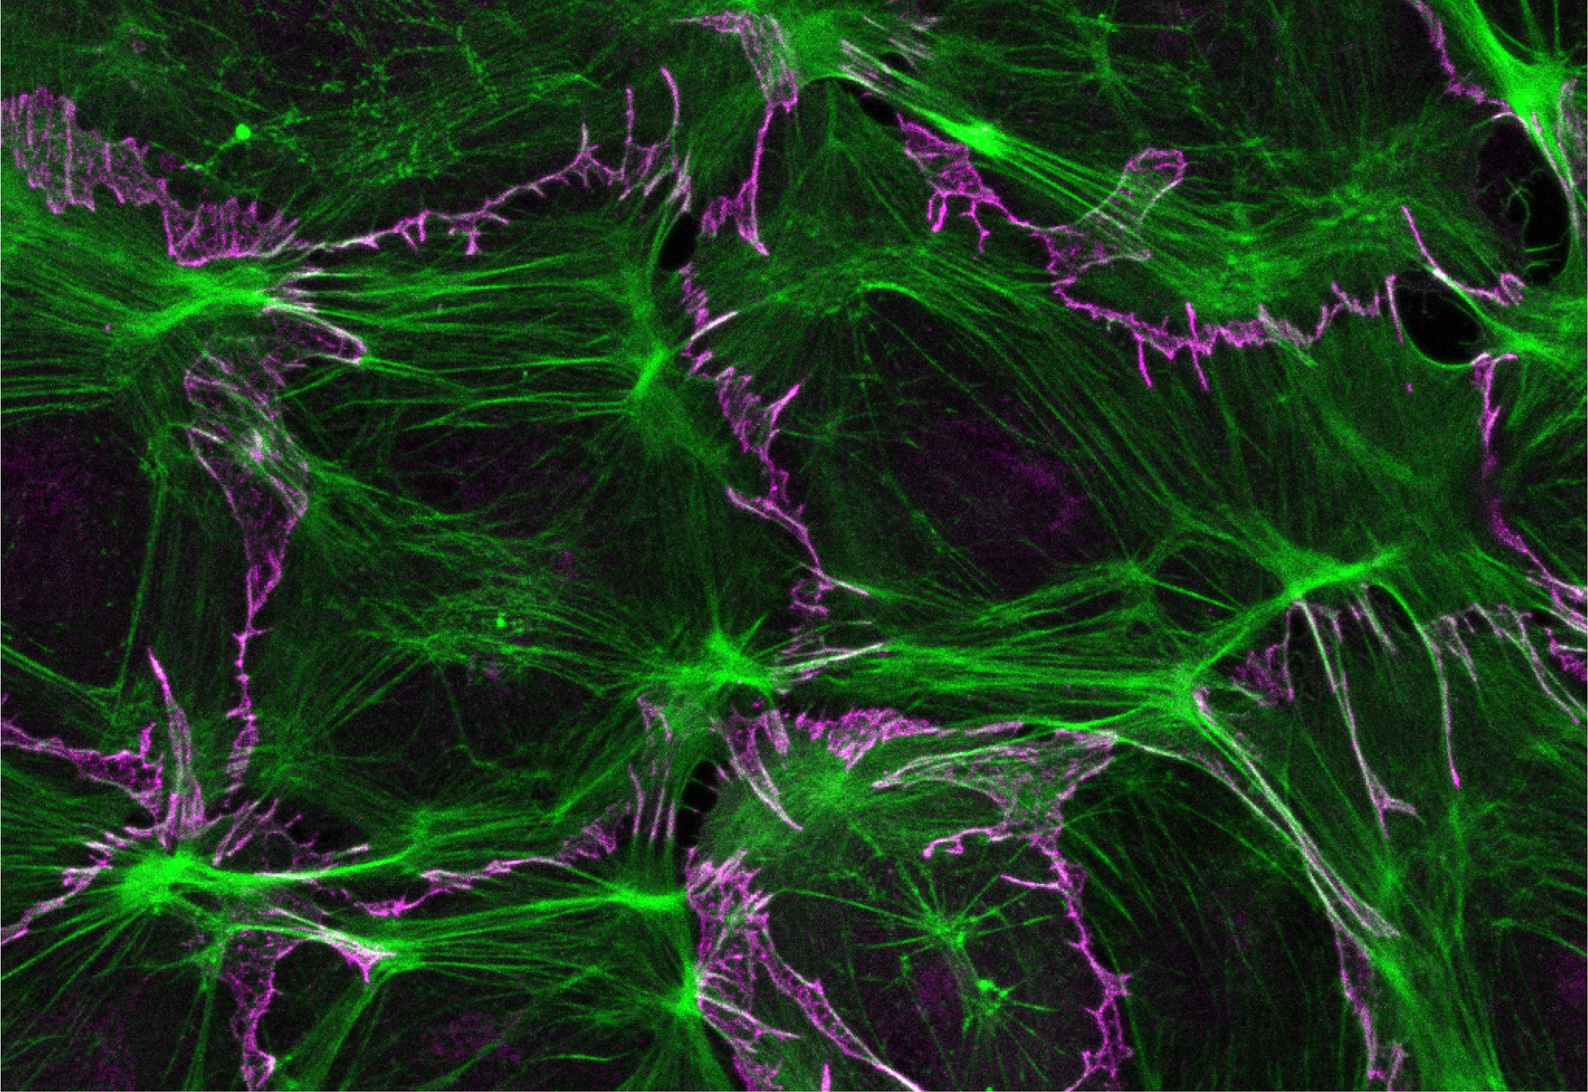
The Lymphatic System
Over 60 thousand miles of lymphatic vessels are present in the human body
Basic Anatomy
Lymphatic capillaries
Lymph vessels
  Afferent (toward)
  Efferent (away)
Lymph nodes
This Photo by Unknown Author is licensed under CC BY

Slide 10
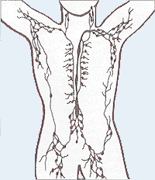
The Lymphatic System
Right lymphatic duct
Lumbar trunks (left and right)
Cisterna Chyli
Thoracic duct
This Photo by Unknown Author is licensed under CC BY-SA

Slide 11
Right Lymphatic Duct
Drains the R upper quadrant of the body including:
R upper trunk
R upper extremity
R head and neck
Returns fluid to the circulation of the R internal jugular, subclavian, and brachiocephalic veins

Slide 12
Thoracic Duct
Cysterna Chyli
Originates from the lumbar and intestinal lymphatic trunks and extends to the thoracic duct.
Fluid filled sac that draws lymph from B LE’s and the intestines
Located approx. L2 of the spine
Largest of the body’s lymphatic vessels
Drains approx 3/4th of the body’s lymphatics (with exception to the R lymphatic duct)
Returns fluid to the L subclavian and L internal jugular veins

Slide 13
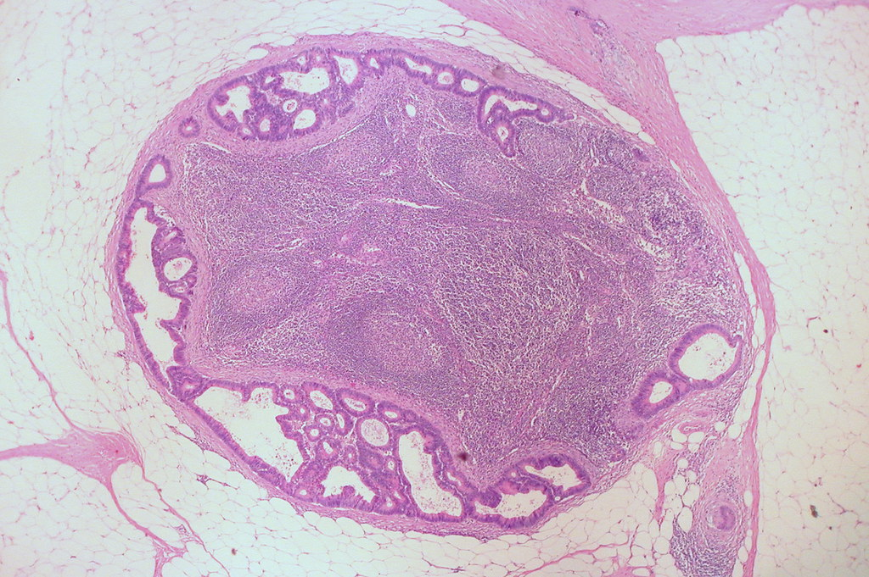
Lymph Nodes
Approx 600-700 throughout the human body
Receive lymph from afferent vessels
Serve as a filter
  Monitor lymph/blood composition
  Drain leaked plasma protein/excessive tissue fluid
  Engulf pathogens
  Augment immune response
  Eradicate infection
Small, bean shaped, can enlarge when more active

Slide 14
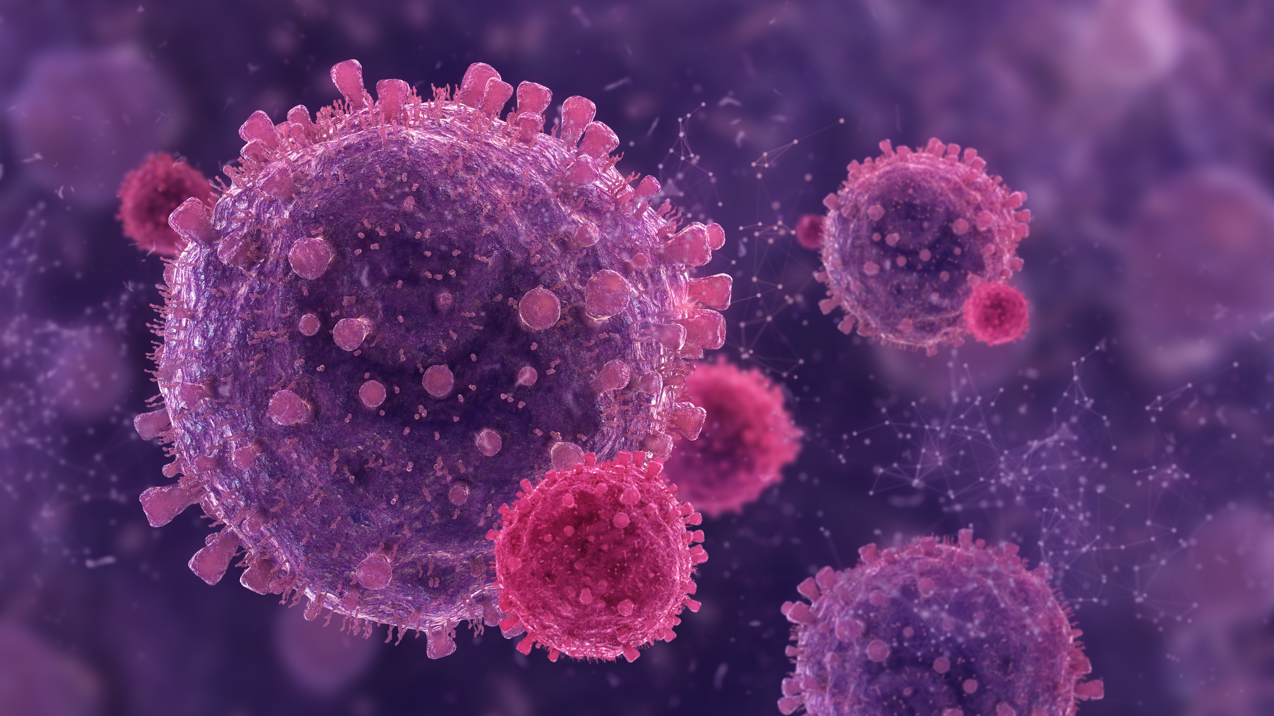
Lymphoid Organs
Primary
Secondary
Bone marrow
Thymus
Produce lymphocytes
Spleen
Tonsils
Lymph nodes
Mucous membranes (intestines)
Territory where immune cells function

Slide 15
What is ‘Lymph’
Composed of:
Lymphocytes
Cellular debris
Bacteria
Plasma proteins
Cholesterol, glycerol, fatty acids when chyle – lymph coming from the intestines
Similar to blood plasma, watery, transparent, slightly yellow in color.
Extracellular fluid leaks from the blood capillary walls.
Interstitial fluid pressure builds then flows into lymphatic capillaries and eventually returns to venous circulation.

Slide 16
Lymphedema (ICD-10: I89.0)
PRIMARY
SECONDARY
Lymphatic system development is disrupted creating absent or malformed vessels.
Often present at birth
Can develop later in life (including at puberty or adulthood)
Acquired. Lymphatic function disrupted from causes including:
  Cancer
  Infection
  Trauma
  Surgery

Slide 17
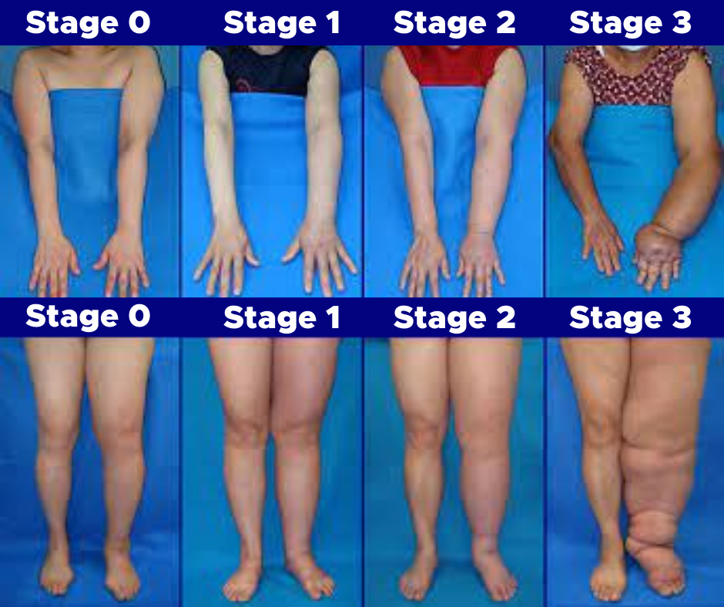
Stages of Lymphedema

Slide 18
Types of Secondary Lymphedema
Phlebo-lymphedema: CVI builds interstitial fluid that overwhelms the lymphatic system
Oncology related: Surgery including removal of lymph nodes and/or radiation treatment compromises lymphatic vessels
Trauma/Post surgical
Lipo-lymphedema: lipedema overwhelms the lymphatic system

Slide 19
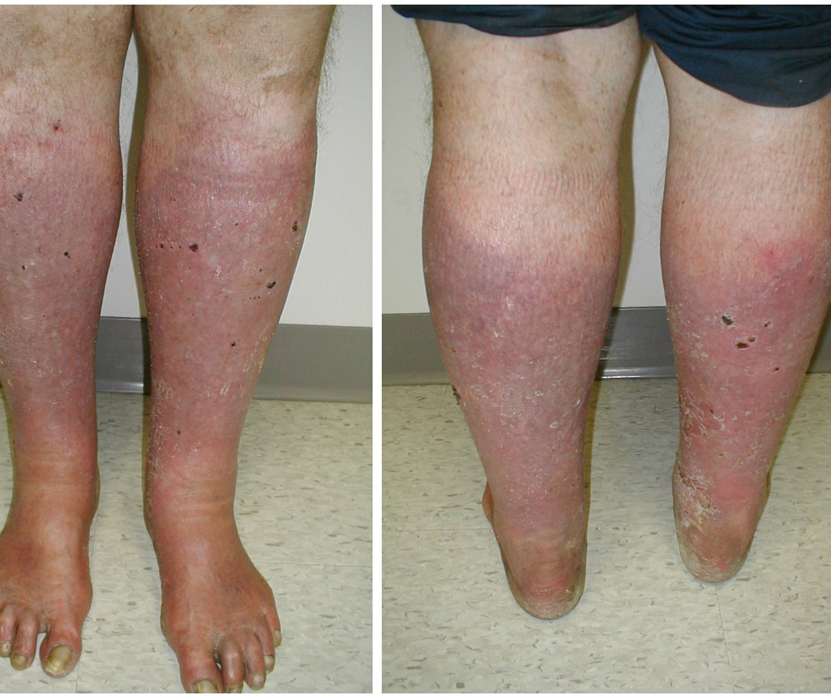
Phlebo-lymphedema
Commonly starts as CVI
  May see varicose veins
  Hx of vascular procedures (ablation)
  Hx of DVT, post-thrombolytic syndrome
Clinical presentation
  Dry scaling skin
  Scars from previous venous ulcers
  Presence of open venous wounds
  Mild to moderate pitting edema
  Hemosiderin staining – a darkening/rusty color appearance to skin
  Increased fibrosis/rigidity to skin and underlying soft tissue
  Common erythema (be able to differentiate from infection signs)

Slide 20
Lymphedema related to Cancer
Upper Extremity
Lower Extremity
Most commonly seen in cases of Breast Cancer with procedures including:
  Biopsy
  Lumpectomy
  Mastectomy
  Reconstruction
  SLNB
  Axillary dissection
  Radiation treatment
Increased risk with abdominal surgeries and/or radiation tx to address CA diagnosis including but not limited to:
  Bladder
  Prostate
  Ovarian
  Vaginal
  Penile
  Testicular
  Pancreatic
  Lymphoma
  Rectal
  Anal
  Intestinal

Slide 21
Incidence rates
The WHO estimated 1 in 30 people have lymphedema worldwide
Up to 250 million people worldwide and 10 million within the US.
Estimates range but approx. 30% incidence is suggested in breast CA cases
Primary lymphedema is significantly more rare 1:100,000 people in the US.
Population frequency has not been identified but incident rate suggested to be as high as 20% in PTL (post-traumatic lymphedema)
10-11% of women (approx. 400 million) worldwide have lipedema with the risk of developing lipo-lymphedema

Slide 22
Lipo-Lymphedema
Appears when Lipedema, obesity, and lymphedema present together
Occurs at stage IV of lipedema when excessive adipose tissue puts pressure on the lymphatic vessels, compromising the lymphatic system
Incidence predominantly in LE’s of women

Slide 23
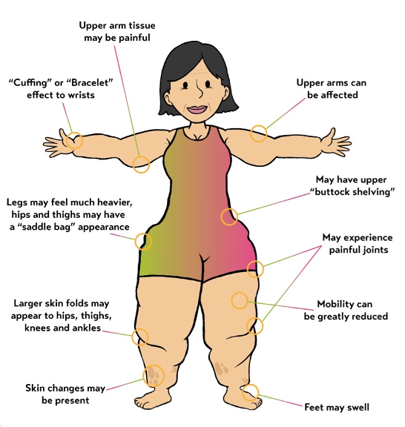
Lipedema
Characterized when adipose tissue is unusually distributed beneath the skin.
Appears predominantly in buttocks and LE’s, generally foot-sparing.
Symptoms include:
  Pain
  Swelling
  Bruising
  Lack of response to traditional weight loss methods

Slide 24
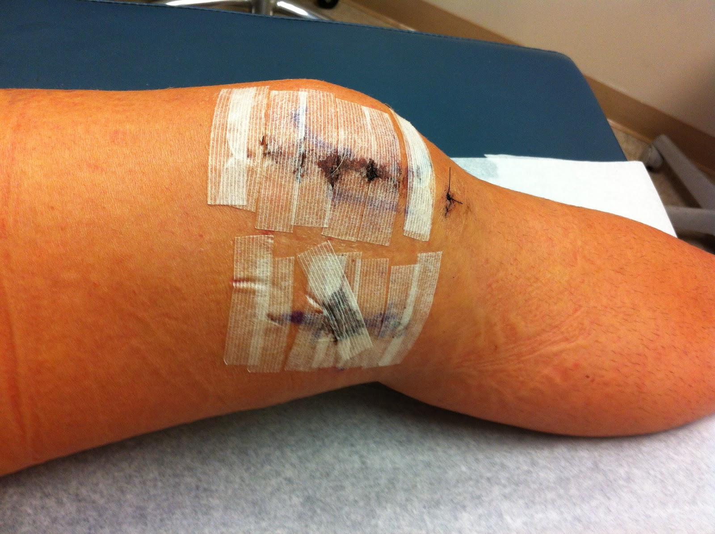
PTL –Post Traumatic Lymphedema
Development of PTL
Injury Patterns
Lymphangiogenesis (lymphatic repair) occurs between 1-3 months after trauma
  Wound healing
  Inflammatory response
  Pain
As scar tissue develops it can potentially disrupt continuous lymphatic vessel flow
Lymphatic disruption occurs beyond 3 months and becomes pathologic
Musculoskeletal
  Fractures
    Non-operative
    Operative
  Amputation
  Severe contusion
Burns
  Prevalence of lymphatic vessels just below the skin yields a high risk of damage in cases of deep burn injuries
Abdominal
  Rare
  Caused by penetrating or blunt trauma
    Surgical
    Liposuction

Slide 25
How this applies to orthopedic PT
Cases of Concern
Critical Lymphatic Areas
Post-operative
  TKR/THR
  Shoulder surgery
  Skin grafts
  Liposuction
Fall
  Contusion
  Fracture
Post-Injury
  Crush injuries
  Spains/strains
Chronic conditions
  Chronic pain Syndrome
  Complex Regional Pain Syndrome
Increased density of lymphatic vessels creates susceptibility to disturbance in these areas
Lower Extremity
  Antero-medial leg
  Medial thigh
  Medial aspect of knee
Upper Extremity
  Medial aspect of arm
  Medial elbow

Slide 26
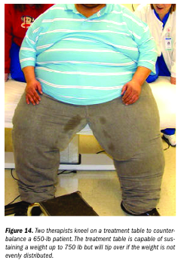
Common Comorbidity
Obesity
Diabetes
Cancer
CVI
Postphlebitic syndrome
Venous disease
CHF

Slide 27


Treating Lymphedema
Precautions
Contraindications
Sensory paralysis
Open wounds
Chronic CHF
Occlusive PAD
Acute CHF
Acute venous thrombosis
Cellulitis
Acute inflammation
Acute renal failure
PAD
Malignant tumors

Slide 28
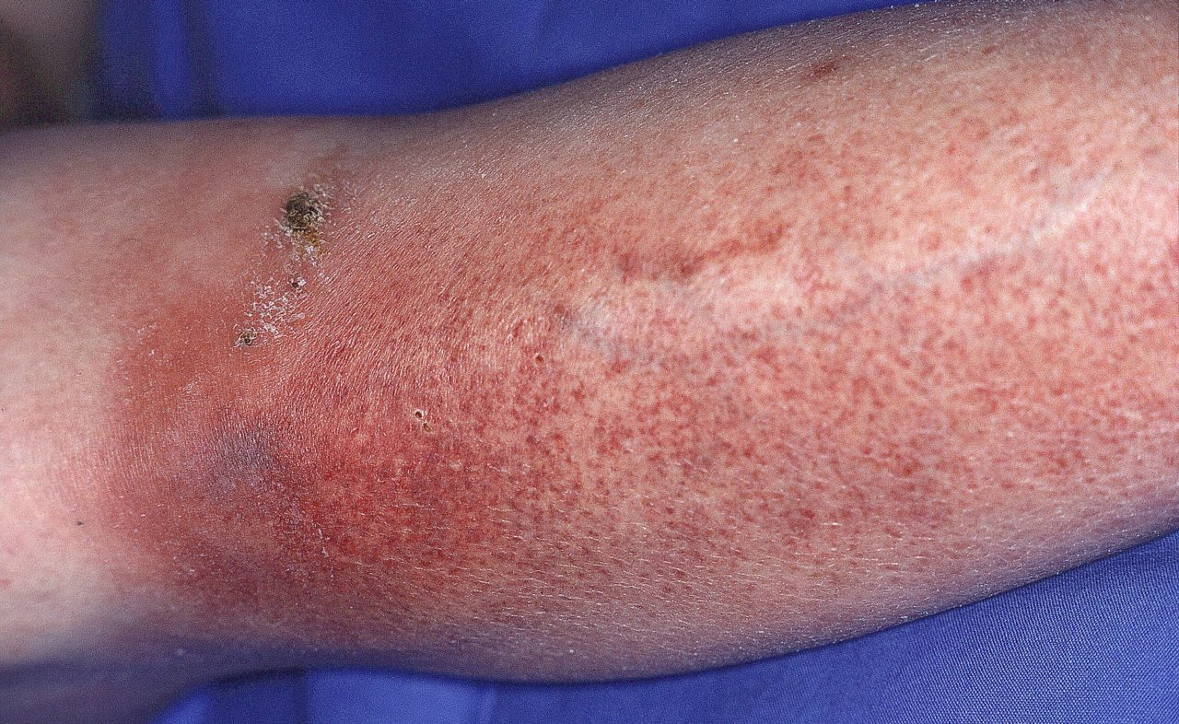
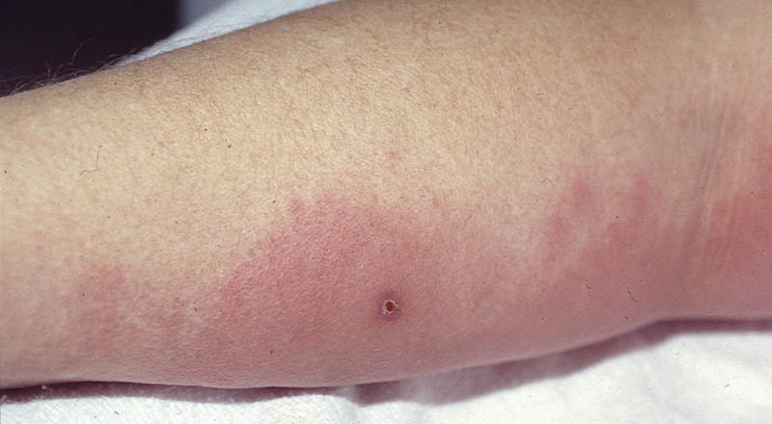
Cellulitis
Redness- ‘non-map-like borders’
Swollen appearance
Pain
Increase warmness
Blistering
Pus-like appearance
Can develop fever, chills, malaise

Slide 29
Complete Decongestive Therapy
Manual Lymph Drainage (MLD)
Compression
Skilled and specific manipulation of the skin to increase lymphangiomotoricity or the movement of lymph
The proper selection of a compression garment and/or compression bandaging will effectively reduce limb volume, contain volume, and prevent worsening

Slide 30
Manual Lymph Drainage (MLD)
Developed in 1936 by Dr Emil Vodder and his wife Estrid
Light, gentle capturing and stretching of the skin
Movement is distal to proximal
Clear proximal (unaffected) segments first
4 main strokes: stationary circles, scoop, pump, and rotary techniques

Slide 31
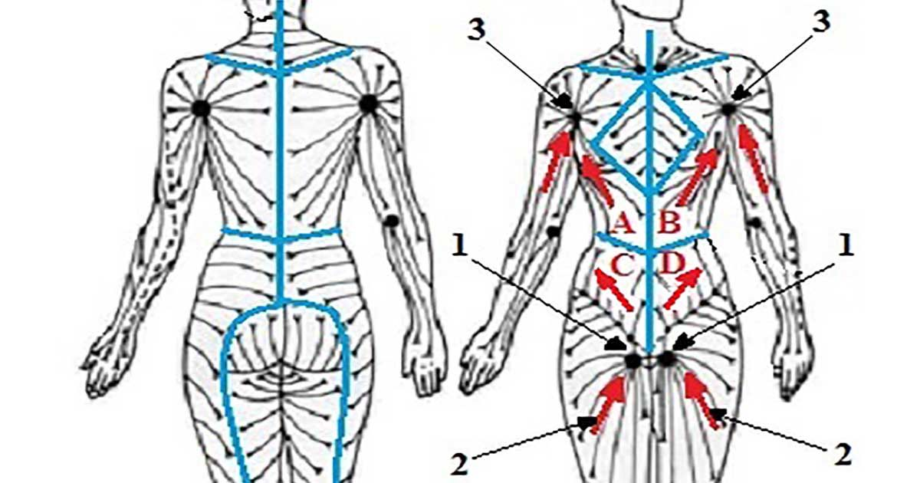
Manual Lymph Drainage
Utilizes healthy anastomoses to cross watersheds – lymphatic boundaries in the body
  Midsagittal
  Transverse
  Clavicular
  Spine of scapula

Slide 32
Manual Lymph Drainage
Intensive phase includes treatment 2-5 sessions per week
Includes education on self or assisted MLD
Has been shown to reduce >300 mL of volume within 3 weeks time
Has proven effective in palliative care and in treating post surgical and post traumatic edema

Slide 33
Compression
Bandaging
Garments
Short stretch bandages
DO NOT use ACE wraps
Can include toe/finger wraps, bandaging from hand/foot thru entirety of limb to axilla or groin
Can create temporary functional deficits such as walking/balance issues, inability to drive, work duty complications
Velcro wraps such as Circaid, Medi, Solaris
Compression stockings
  Knee high
  Thigh high
  Open/closed toe
  Gloves/gauntlets
  Arm sleeves
  Compression bras
  Corsets
  Head and neck
  Range in compression rating 10-15 mmHg to as much as 50-60 mmHg

Slide 34
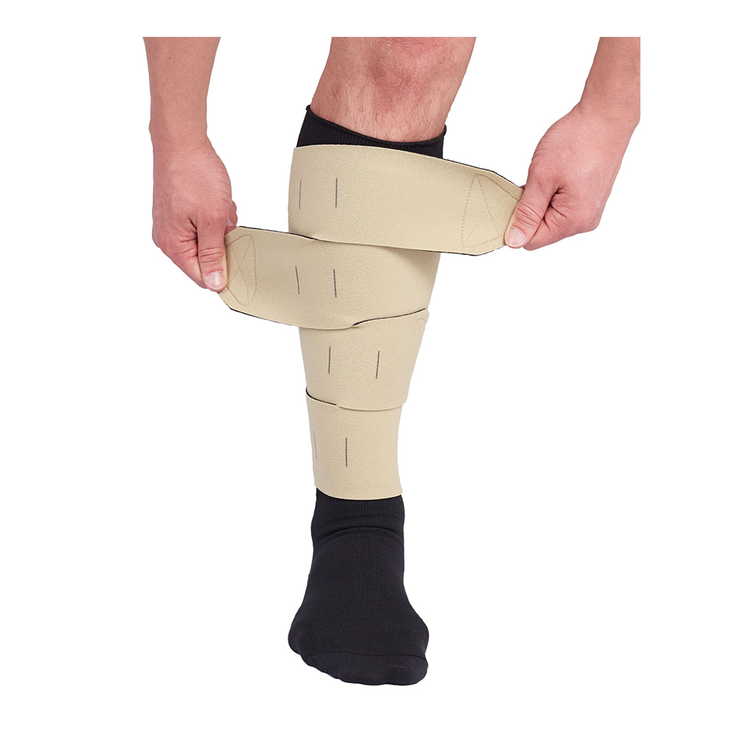
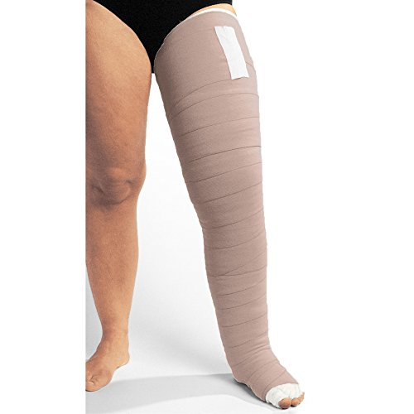
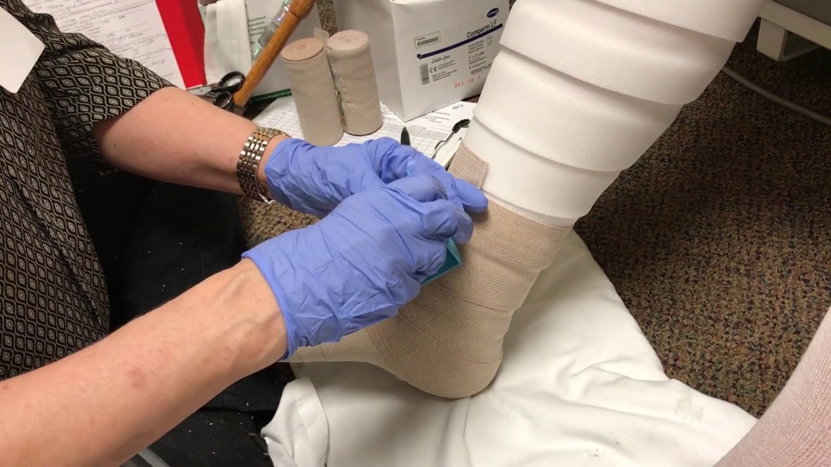
Compression
Velcro wraps
Bandaging

Slide 35
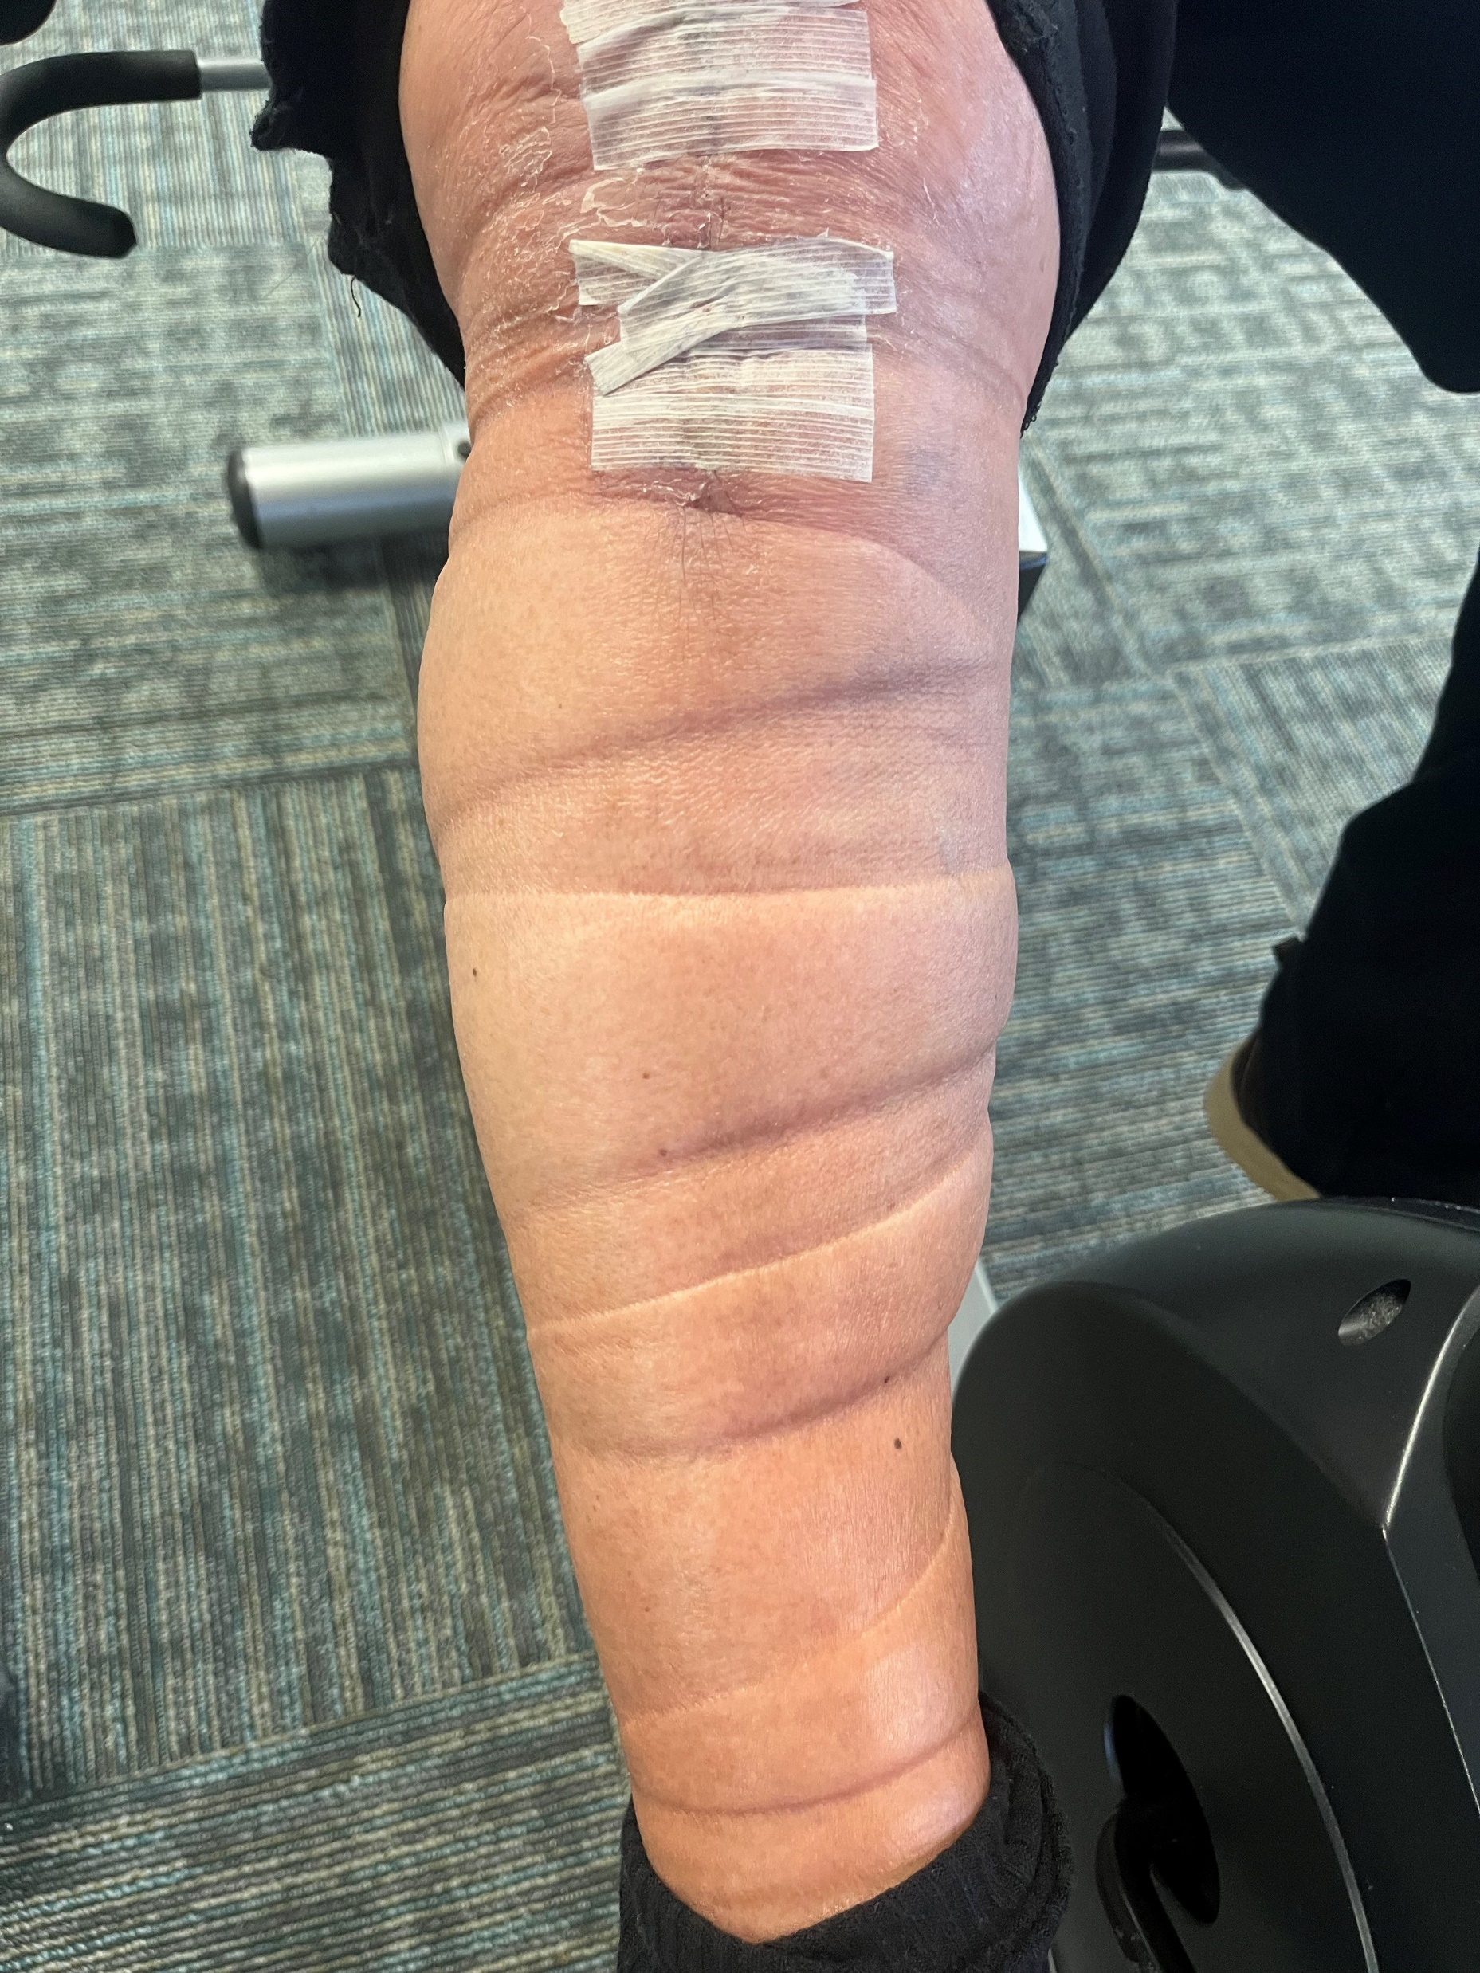
Compression No-No’s
Prolonged ACE wrap use
Layered proximal compression
Folding compression garments to fit
Compression too tight that causes numbness, drastic pigmentation change, restricts blood flow

Slide 36
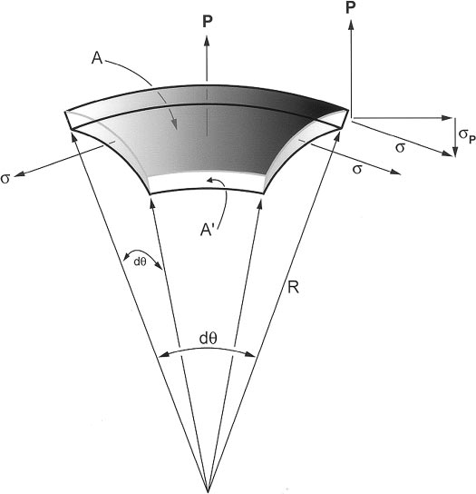

Law of Laplace
If a bandage is applied with constant tension and overlap the pressure applied at the calf will be lower than that applied at the ankle (with the understanding that the ankle circumference is typically smaller than the calf)

Slide 37
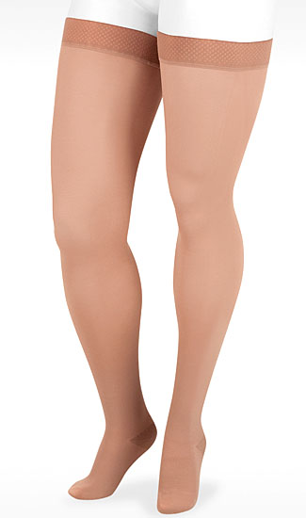
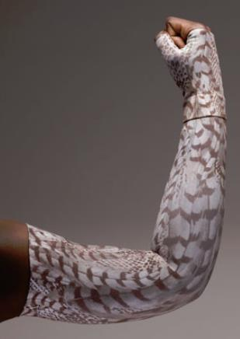
Complete Decongestive Therapy
Compression stocking fitting
  OTS
  Custom
  Day/night
Education
  Skin health/hydration
  Daily skin checks
  Monitor for infection risks
  Don/doffing garments
  Garment care
  Limb hygiene
  Home compression pump
  Lymphedema exercise

Slide 38
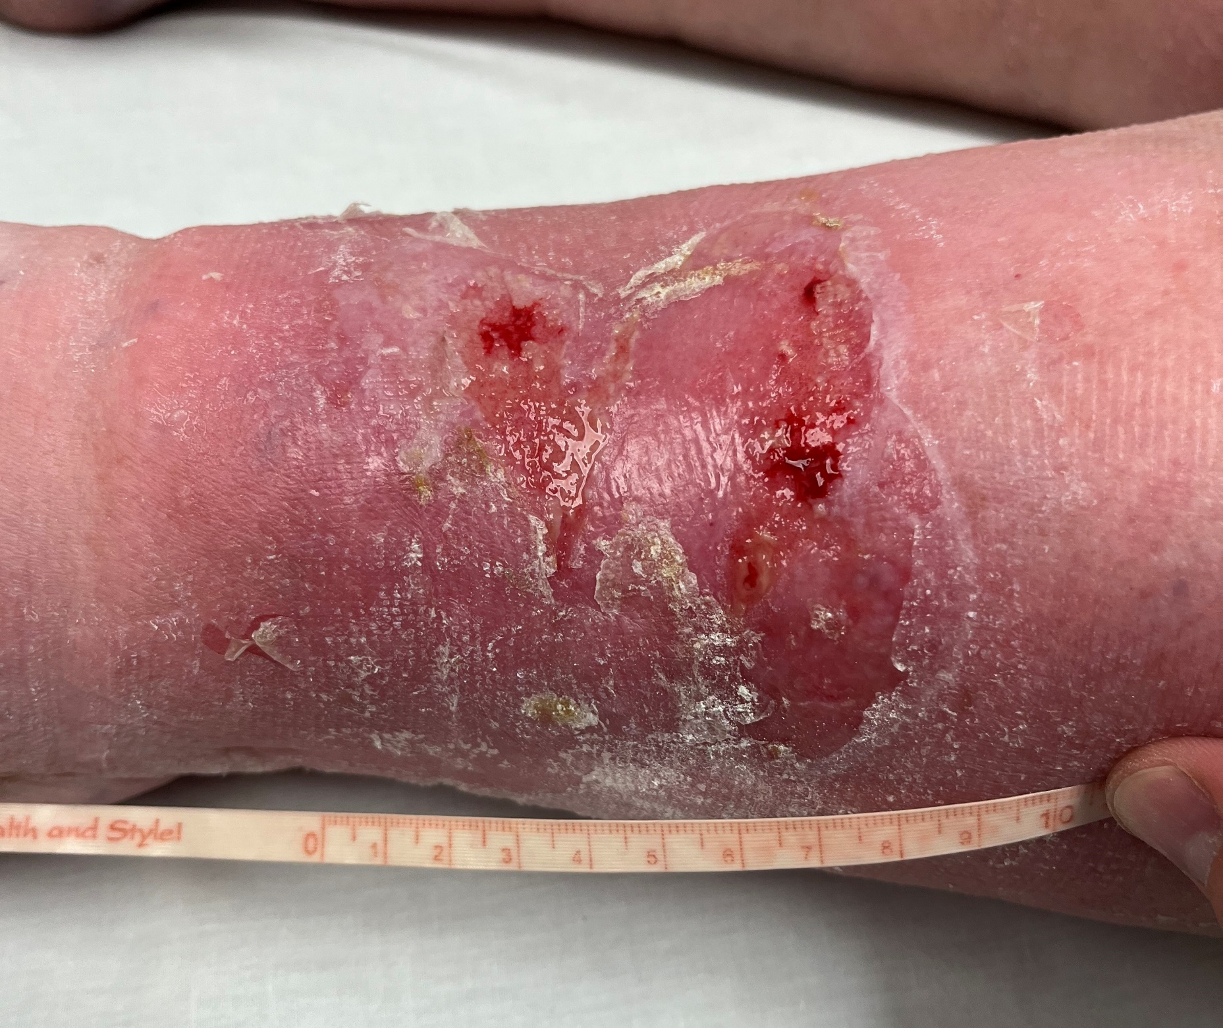
Case Study #1
83 yr old female w/ c/o B LE swelling, L>R, progressively worsened. Now affects walking, balance, yields LE PN and has presentation of superficial weeping wound bed. PMHx includes CVI, HTN, Chronic CHF, peripheral neuropathy, hx of L THR. Lives alone w/ assistance of 72 yr old sister.

Slide 39
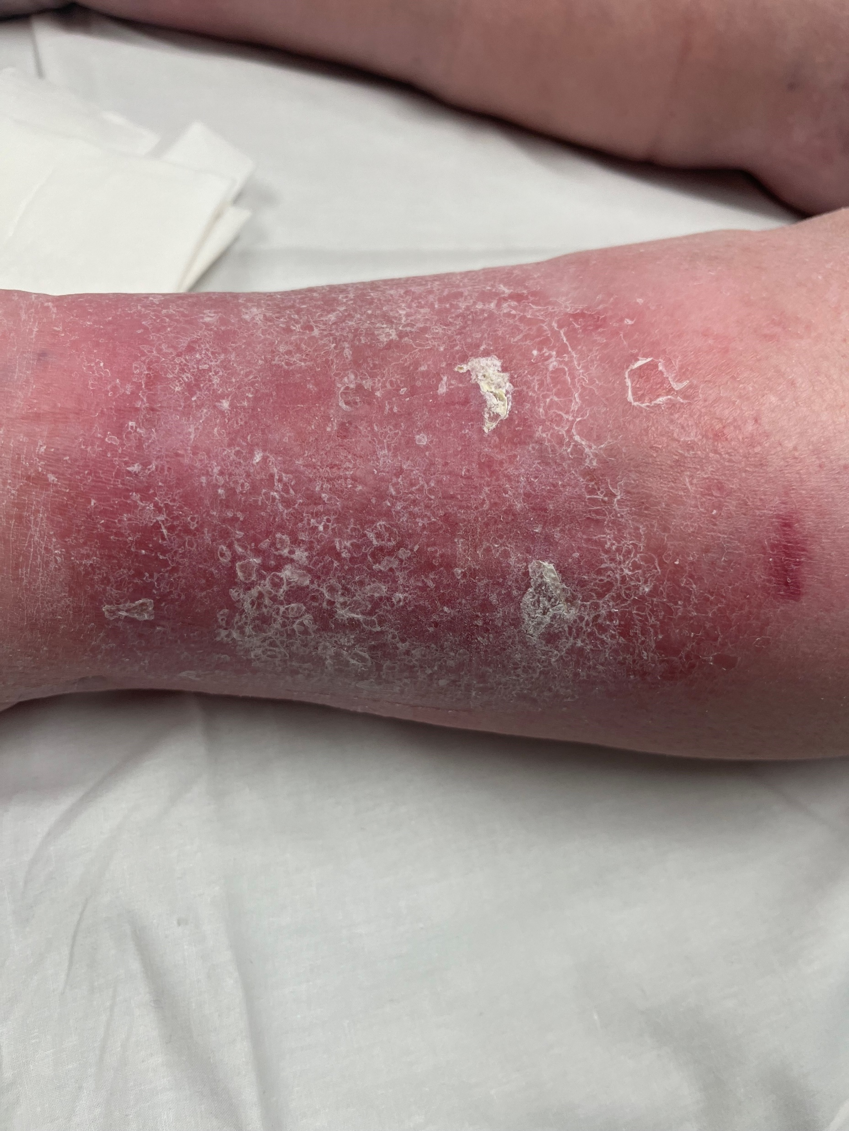
Case Study #1
Dx: B LE phlebo-lymphedema
  Mixed edema due to CVI and acquired lymphedema, L>R likely b/c L THR
POC
  Modified MLD B LE
  Circaid compression wraps B LE
  Wound care
    Zinc-oxide cream
    Non adhesive bandage/gauze

Slide 40
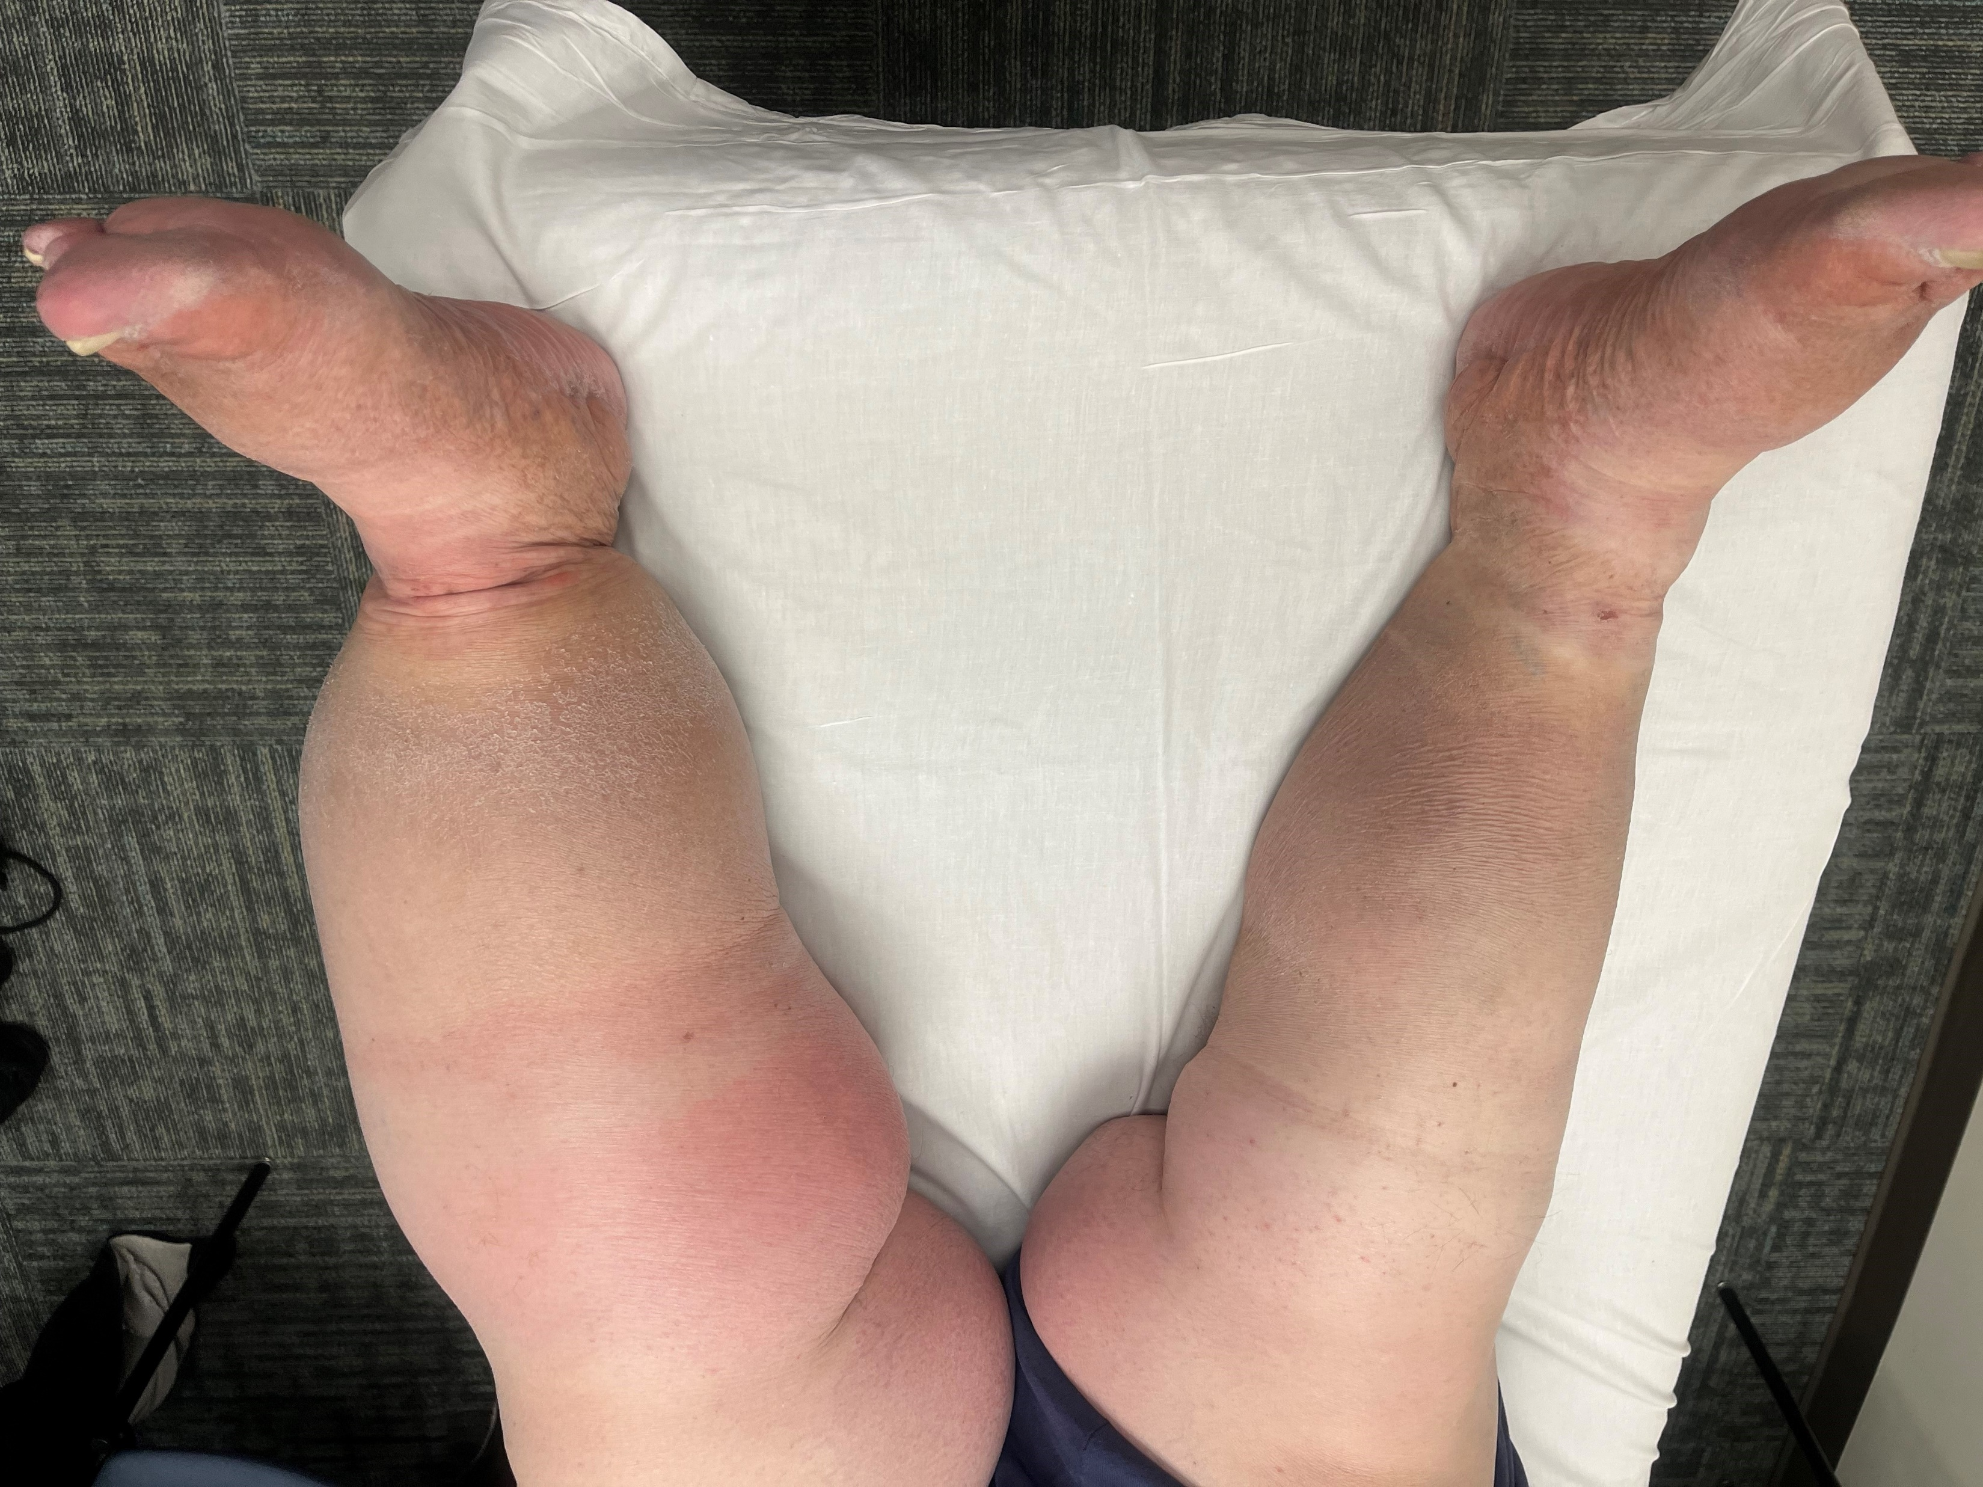
Case Study #2
59 yo male w/ chronic B LE edema, initially presents w/ weeping of L LE, hx of cellulitis infection treated w/ antibiotic Rx. Comorbidity includes severe OA B knees, morbid obesity, HTN, and CVI. Pt works in manufacturing and is in dependent position for prolonged periods.

Slide 41
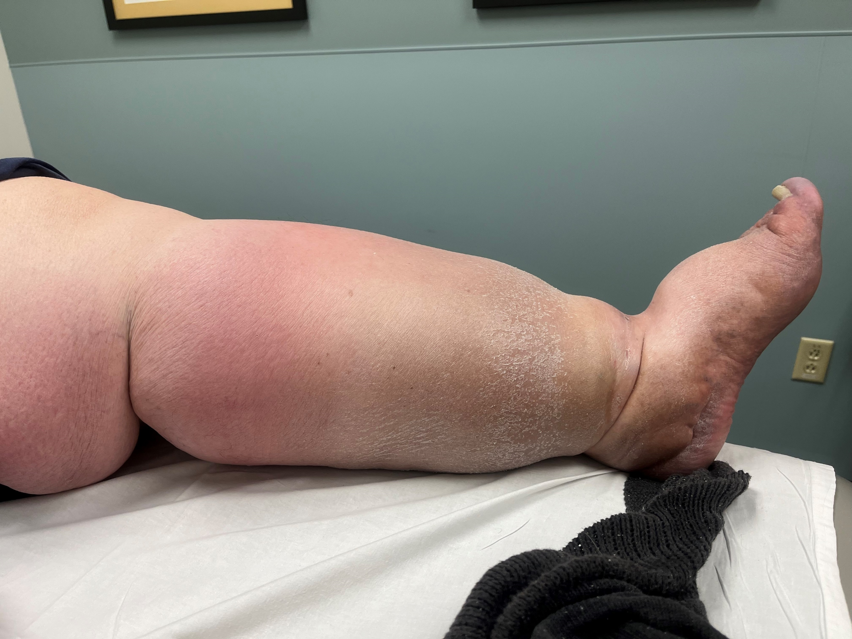
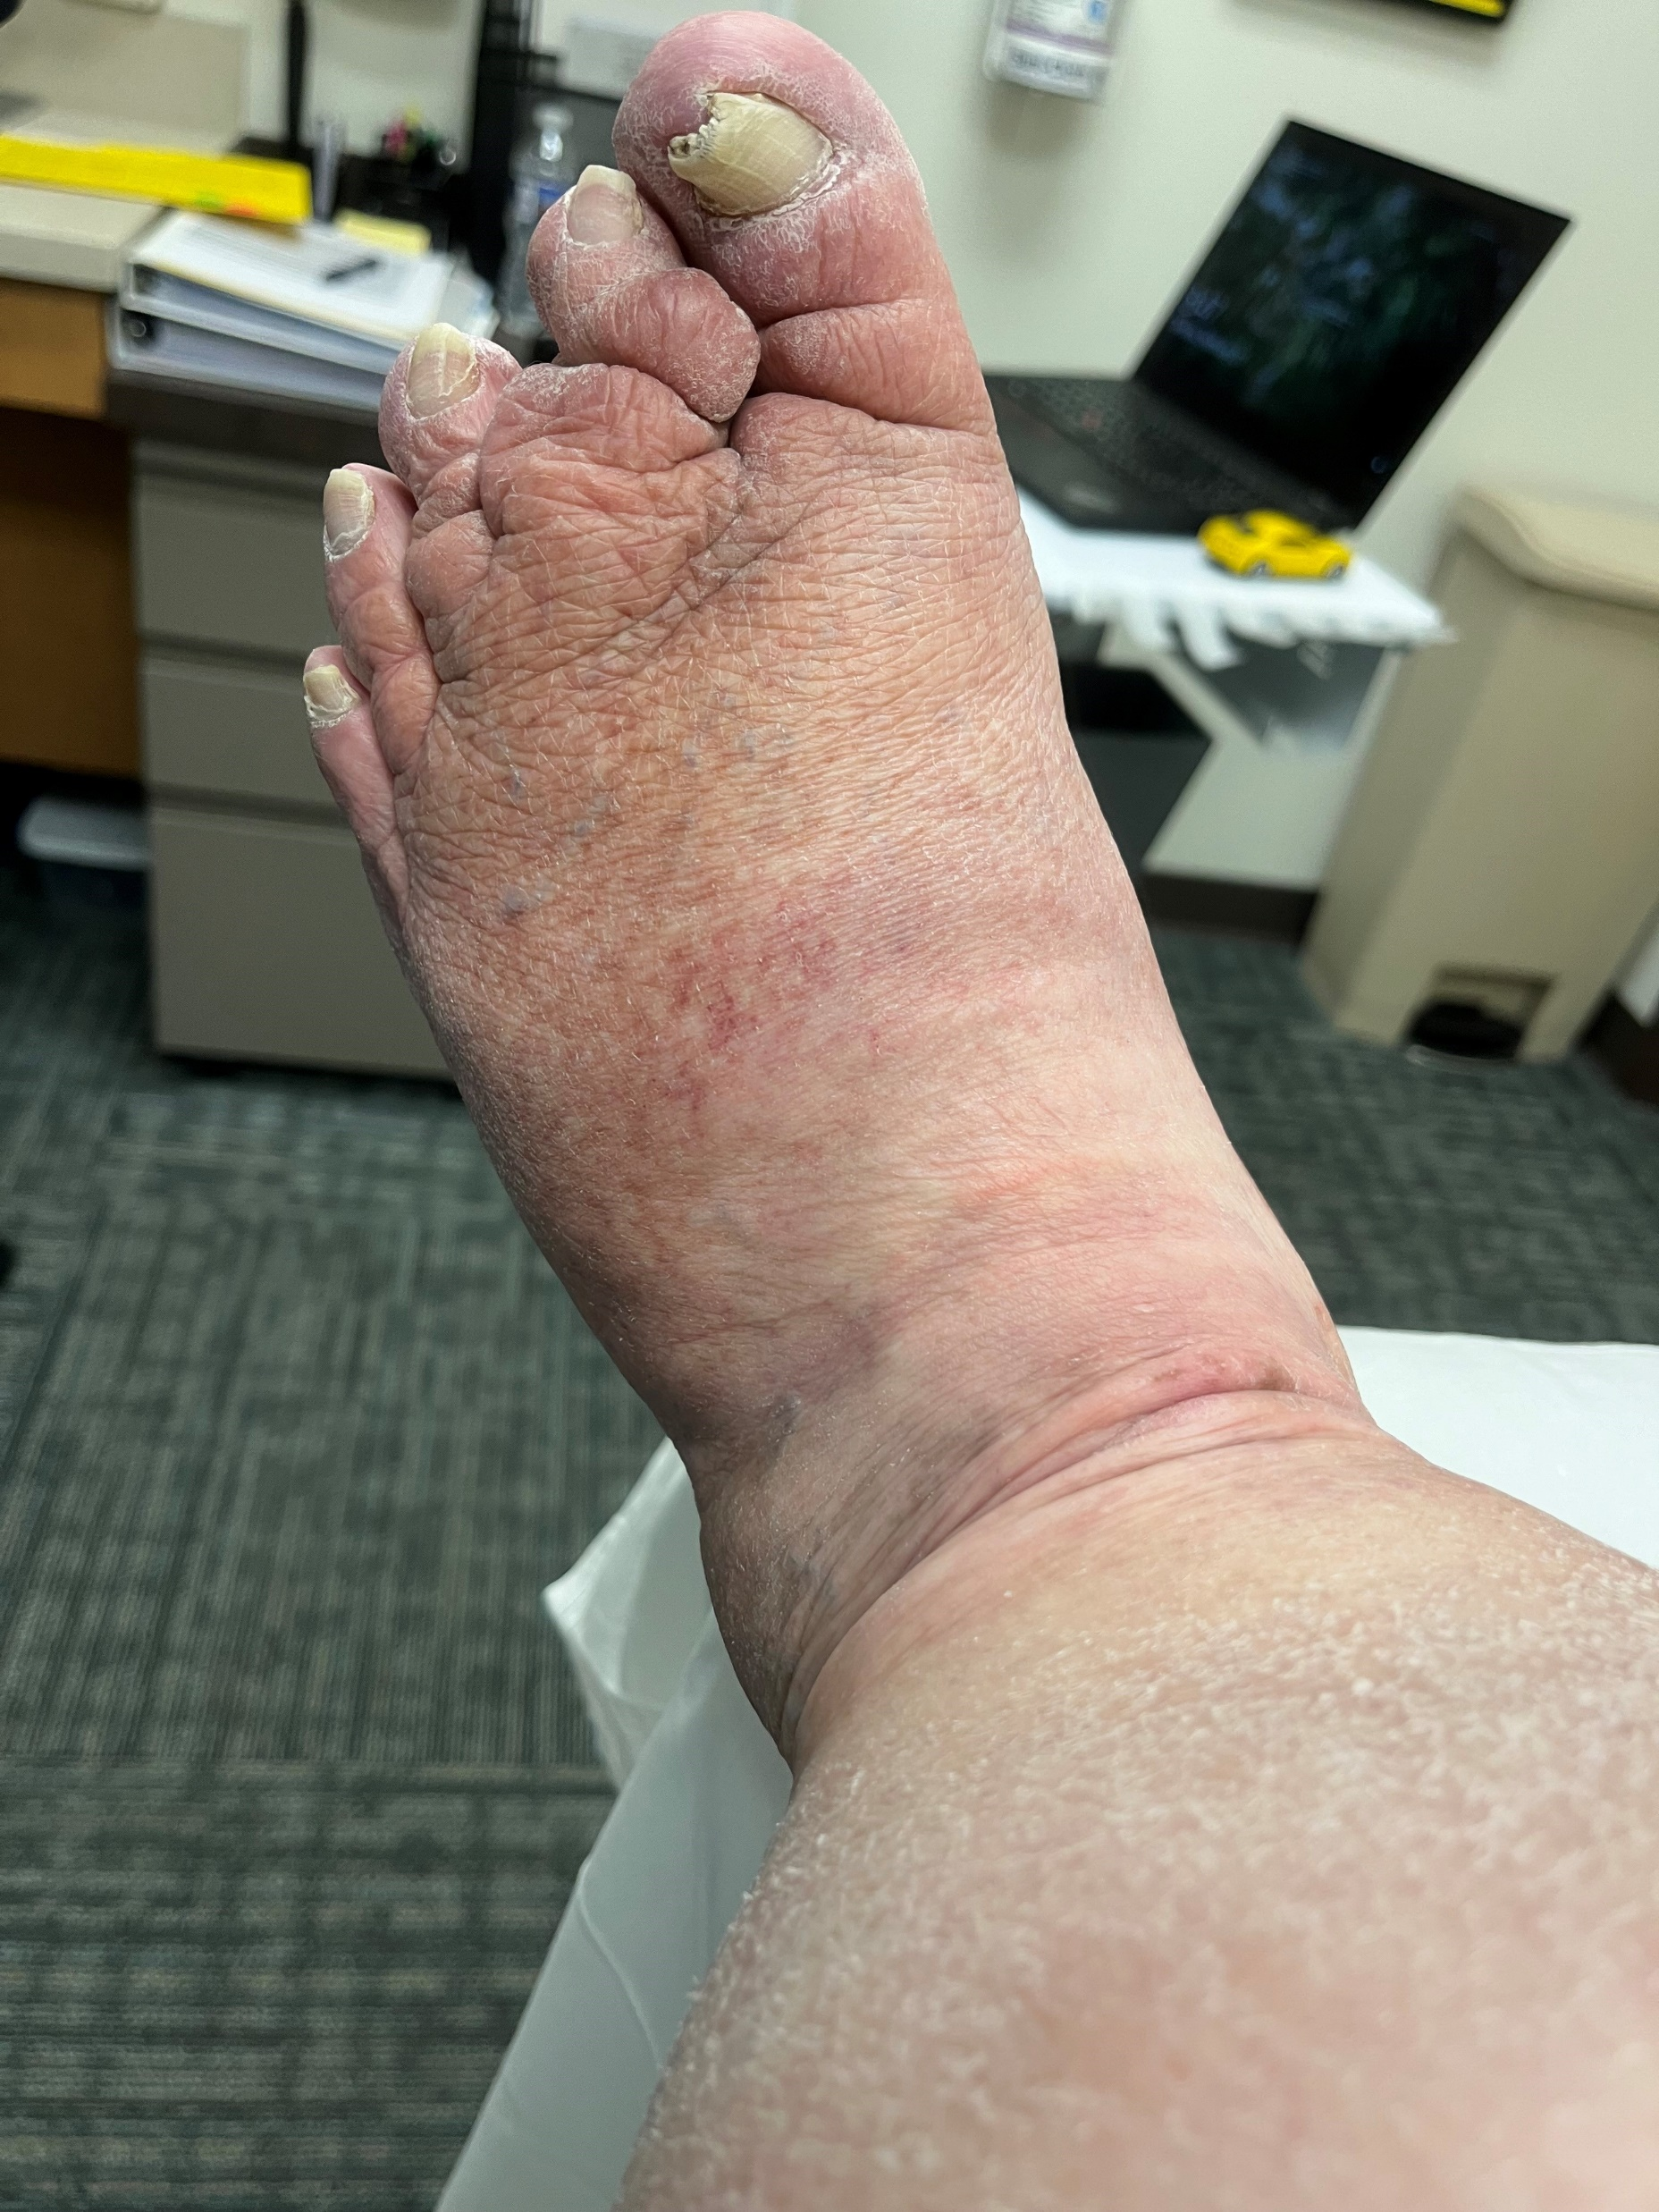
Case Study #2
Concerns:
Dry scaling skin
Hyperkeratosis
Numerous skin folds
Limited ROM
Poor amb potential
Irregularity in limb shape
Edema presence
Toe health
Erythema medial compartment knee/thigh
POC:
Full sequence MLD
Compression bandaging – below knee
Skin care
Circaid compression wraps
Goal of custom compression stocking fitment and self care

Slide 42
Case Study #3
76 yo male with onset of R>L facial edema most prevalent in cheek w/ greatest accumulation below jaw line into anterior neck. Significant scar adhesion R antero-lateral neck along now healed incision site from radical neck dissection to address head and neck CA. Surgery performed 6 months prior. Radiation tx (33 sessions) has yielded significant fibrosis within R antero-lateral neck to supraclavicular fossa. Pt is retired, lives w/ spouse and is otherwise healthy for his age.

Slide 43
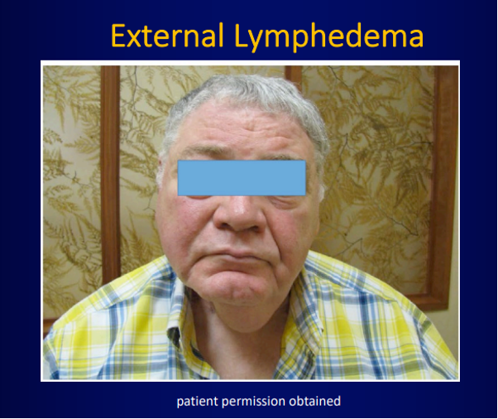
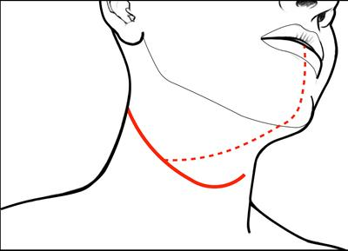
Case Study #3

Slide 44
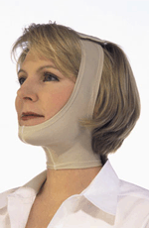
Case Study #3
Key Considerations
POC
Anticipate neck and shldr ROM deficits
Radiation fibrosis and scar adhesion can create skin degradation + poor soft tissue mobility
Pt may have swallowing, speech, or throat clearing issues
Pt’s often self-conscious regarding change in appearance
Pt education including self MLD
HEP to include facial muscle activation exercises, cervical ROM, shoulder ROM
MLD clearing neck, face, w/ anastomoses to B axilla
Scar MS
Compression garment
  Grey foam
  Chip packing

Slide 45
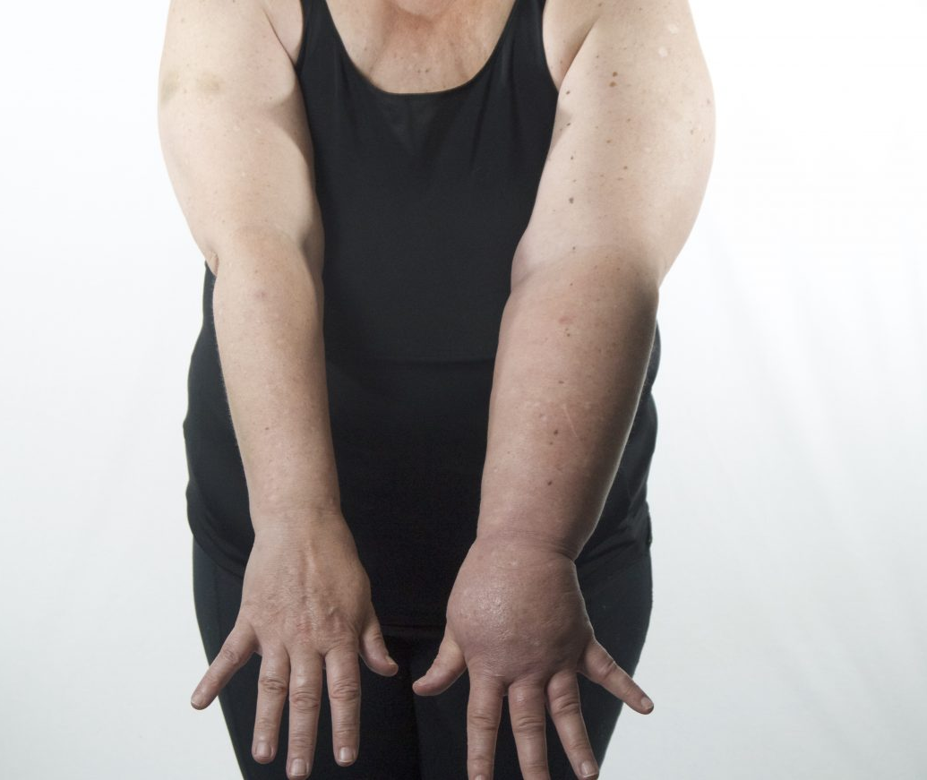
Case Study #4
58 yo female s/p B mastectomy following breast CA diagnosis w/ chemotherapy + radiation (15 sessions) w/ c/o swelling onset L UE unresolved after cellulitis infection which has since subsided w/ antibiotic Rx. No hx of formal PT tx.

Slide 46
Case Study #4
POC:
  Full sequence MLD including abdominal sequencing, axilla-inguinal anastomoses
  Compression bandaging full arm including finger bandaging
  Skin care
  Pt education- managing infection risks
  Exercise routine, muscle pump, elevation, L UE ROM, pectoral stretching, postural strengthening
  Once optimal reduction achieved fitment for daytime/nighttime compression sleeves + gauntlet/glove
  Home compression pump

Slide 47
Thank You
Please direct questions/concerns regarding today’s presentation and lymphedema to
Jeffrey.Hashagen@sluhn.org
(484) 426-2055
Macungie Office

Slide 48
Resources
A. Son, T.F. O’Donnell, J. Izhakoff, T. Niecko, J.A. Gaebler, M.D. Iafrati Lymphedema associated comorbidities and treatment gap. J Vasc Surg Venous Lymphat Disord, 7 (2019), pp 724-730
S. Dean, E. Valenti, K. Hock, J. Leffler, A. Compston, W.T. Abraham The Clinical Characteristics of Lower Extremity Lymphedema in 440 Patients. J Vasc Surg Venous Lymphat Disord, 8 (2020), pp 851-859
L. Fedor, R.D. Malgor, T. Carman, S.M. Dean, M.D. Iafrati, N.M. Khilnani, N. Labropoulos, T.S. Maldonado, P. Mortimer, T.F. O’Donnell, J.D. Raffetto, S.G. Rockson, A.P. Gasparis The American Venous Forum, American Vein and Lymphatic Society and the Society for Vascular Medicine Expert Opinion Consensus on Lymphedema Diagnosis and Treatment. Phlebology, 4 (2022), pp 252-266
L. Byung-Boong Phlebolymphedema: Neglected Outcome of Combined Venous and Lymphatic Insufficency. Vasc Specialist Int, 1 (2020), pp 1-3
S.G. Rockson Advances in Lymphedema. Circulation Research, Vol 128, Issue 12 (2021), pp 2003-2016
Fadhil M, Singh R, Havas T, Jacobson I. Systematic review of head and neck lymphedema assessment. Head Neck 2022;44(10):2301-2315.
Ren Y, Kebede M, Ogunleye A, Emerson M, Evenson K, Carey L, Hayes S, Troester M. Burden of Lymphedema in long-term breast cancer survivors by race and age. Cancer. 2022 Dec 1; 128(23): 4119-4128

