Slide 1
Vocal Wellness and Therapeutic Approaches
[Rachel Panick M.S. CCC-SLP]

Slide 2
Continuing Medical Education Credit Information
This course aims to provide an up-to-date review on voice therapy approaches for all healthcare professionals. A review of the literature on vocal health and hygiene will be discussed as well as treatment approaches for the most common vocal diagnoses and patient concerns.
Target Audience: All Providers

Slide 3
Designation Statement
It is St. Luke’s University Health Network policy to ensure balance, independence, objectivity and scientific rigor in all of our sponsored educational programs. Faculty and all others who have the ability to control the content of continuing medical education activities sponsored by the St. Luke’s Hospital & Health Network are expected to disclose to the audience whether they do or do not have any real or apparent conflict(s) of interest or other relationships related to the content of their presentation(s).
The St. Luke’s University Health Network is accredited by the Pennsylvania Medical Society to provide continuing medical education for physicians.
The St. Luke’s University Health Network designates this live educational activity for a maximum of 1 AMA PRA Category 1 Credits™. Physicians should only claim credits commensurate to the extent of their participation on the activity.

Slide 4
Disclosure Information
The Planners involved in this activity have no relevant financial relationships to disclose.
The Faculty/Presenters involved in this activity have no relevant financial relationships to disclose.

Slide 5
Learning Objectives
Discuss vocal therapy approaches including diaphragmatic breathing, SOVTE, VFE, and RVT
Differentiate which treatment approach(es) is/are most appropriate for patient, given a case scenario
Describe how to convey the importance of vocal hygiene to patients to carry over into everyday life
Describe treatment approaches confidently with voice patients
Discriminate between a healthy voice and a non-healthy voice

Slide 6
Vocal Anatomy Overview
Diaphragmatic breathing
  Abdominal muscles help move diaphragm and give you more power to empty your lungs
  Allows for use of lungs at 100% capacity
  Increases lung efficiency
  Decreases muscular action and tension in shoulder girdle and laryngeal regions
  Mechanical energy

Slide 7
Vocal Anatomy Cont.
Laryngeal Action
  When subglottic pressure reaches 3-5 cm/H2O, vocal folds blow open
  Wave like motion begins (anterior to posterior and superior to inferior)
  Acoustic energy

Slide 8
Vocal Anatomy Cont.
Resonators
  Structures include pharynx, velum, hard palate, tongue, sinuses
  As acoustic energy (i.e. vibration) passes through resonators, sound can be shaped

Slide 9
Vocal Anatomy Cont.
Articulators
  Structures include velum, hard palate, tongue, cheeks, lips, teeth
  Creates actual speech production
  Important for both consonant and vowel sounds

Slide 10
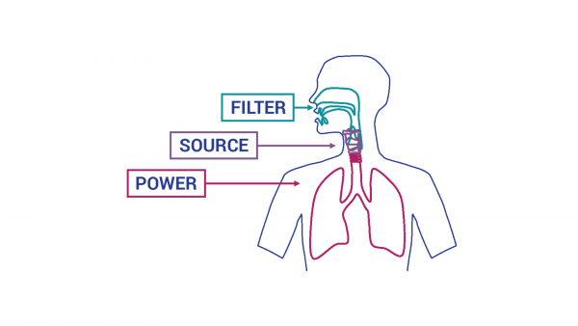
Power Source Filter

Slide 11

Vocal Hygiene
What does “good vocal hygiene” mean to you?

Slide 12
Vocal Hygiene Cont.
Every patient should be educated on what good vocal hygiene looks like
  Please note that this may look different for every person
  Try creating a list with patients of misuses and abuses to help them identify

Slide 13
Professional Voice Users
According to systematic review completed by University of Ghent (Belgium)
  17% (4 studies) linked low awareness of vocal hygiene or insufficient vocal hygiene education to self-reported acute and chronic voice symptoms, as well as a greater perception of voice handicap
  43% (10 studies) showed that adequate voice training or vocal hygiene education was linked to positive vocal outcomes
  6.26% (6 studies) demonstrated that vocal hygiene education is more effective when combined with direct voice therapy
Vermeulen R, Toit M, Lierde K, and Linde J. The Effect of Vocal Hygiene Education Programs on Voice Quality in Professional Voice Users: A Systematic Review. Journal of Speech, Language, and Hearing Research. 2022; 65 (12).

Slide 14

Semi Occluded Vocal Tract Exercises

Slide 15
SOVTE History
SOVTE have been used by vocal scholars dating back to the 1800s
  Titze is credited with the most research dating back to 1988
  Titze explains:
    Acoustic energy intersects with a narrowing anywhere along the vocal tract, some of it is redirected back toward the sound source, creating backpressure and an un-pressing of the vocal folds

Slide 16
How it Works
When vocal fold adduction is neutral (not too harsh or too soft), you can ease hyperfunction
Promoting a “safe zone” to practice voicing without high impact
Creating a relaxed and open sensation of the vocal tract
Tactile and visual feedback in the moment

Slide 17
How it Works Cont.
In a research study focused on musical theater students:
  Semitone range increased after completing water resistance exercises (objective)
  50% of the study group experienced a wider vocal range after completing a vocal warm up with water resistance exercises compared to control group (subjective)
  Subjects reported an easier speaking voice and a relaxed larynx or throat compared to the control group
Meerschman I, Van Lierde K, Gonzales Redman Y, et al. Immediate Effects of a Semi-Occluded Water Resistance Ventilation Mask on Objective and Subjective Vocal Outcomes in Musical Theater Students. Journal of Speech, Language, and Hearing Research. 2020; 63 (3).

Slide 18
SOVTE Cont.
Disorders that can benefit
  Vocal fatigue
  MTD
  Glottic insufficiency
    Nodules, polyps, granuloma, cysts, etc.
  VF mismatch
    Hyper/Hypofunction
  VF paresis
  Presbyphonia

Slide 19
SOVTE and Presbyphonia
According to a study completed in 2020, patients with age related vocal issues were noted to have a significantly less NHR after completing SOVTEs
  Meaning more clarity of voice
Results also found that patients had less of a breathy vocal quality and lower VHI-10 scores
Wu C, Chan R. Effects of a 6-Week Straw Phonation in Water Exercise Program on the Aging Voice. Journal of Speech, Language, and Hearing Research. 2020; 63 (4).

Slide 20
SOVTE in Treatment
Methods can include:
  Cup and straw
  Cup only
  Straw only (with various sized straws)
  Tongue or lip trill
  Kazoo
  Y-buzz
Can use apps to help you with pitch accuracy and range
  Pitch Pipe
  TunerT 1
  Voice Analyst

Slide 21
Demonstration
Get out your cup and straw!

Slide 22
Vocal Function Exercises
Developed by Dr. Joseph Stemple dating back to 1994
Purpose: Strengthening and conditioning vocal folds as well as finding resonant voicing
Research suggests that VFEs can help improve voice issues in children and aging adults, enhance normal voice production, and provide preventative care to those with high vocal demand
Angadi V, Croake D, Stemple J. Effects of Vocal Function Exercises: A Systematic Review. Journal of Voice. 2019; 33 (1).

Slide 23
VFE Cont.
Disorders that can benefit
  MTD
  Glottic insufficiency
    Nodules, polyps, granuloma, cysts, etc.
  VF mismatch
    Hyper/Hypofunction
  VF paresis
  Presbyphonia

Slide 24
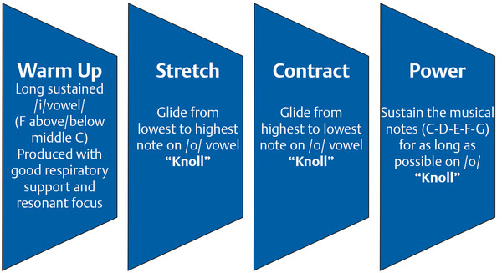
VFE Demonstration

Slide 25
Resonant Voice Therapy
Purpose: To refocus voice away from larynx to the front of the vocal tract (e.g. oral resonance, nasal resonance)
Most common protocols include Stemple’s approach (VFE) Abott’s approach (Lessac-Madsen)

Slide 26
RVT Cont.
Disorders that can benefit
  Vocal fatigue
  MTD
  Glottic insufficiency
    Nodules, polyps, granuloma, cysts, etc.
  VF mismatch
    Hyper/Hypofunction
  VF paresis

Slide 27
RVT Demonstration
Find nasal or oral resonance by using nasal sound or open/rounded vowels
  Work up speech hierarchy (e.g. words, phrases, sentences, conversation)
Use of negative practice
Self-feedback through recordings
Add in suprasegmentals

Slide 28
Duration of Treatment
According to research, an average of 5.32 sessions of voice therapy are needed before discharged can be considered
  Session durations ranged from 4.3 session for presbyphonia to 6.7 sessions for VF lesions
  This is not including voice protocols such as LSVT or SPEAK OUT!
Fujiki R, Thibeault S. Examining Therapy Durations in Adults with Voice Disorders. American Journal of Speech-Language Pathology. 2023; 32 (4).

Slide 29
How to Decide
SOVTE | VFE | RVT
-If patient has a rough, hoarse, or gravely voice -If patient has muscle tension, hyper/hypo function, glottic insufficiency, VF paresis -If voicing improves with the use of SOVTE | -If patient has a rough, hoarse, or gravely voice -If patient has muscle tension, glottic insufficiency, VF paresis -If voicing improves with the use of SOVTE | -If patient has a breathy, weak, back focused voice -If patient has muscle tension, hyperfunction, glottic insufficiency, VF paresis -If voicing improves with a strong, forward focus hum

Slide 30
Case Scenario
42 y.o. female
Kindergarten teacher
Sings in church choir
Vocal nodules resulting in vocal fatigue and hoarse vocal quality

Slide 31
Additional Resources
Websites
  asha.org
  A Tempo Voice Center
    Christine Knickerbocker CCC-SLP
YouTube Channels
  Rejoice in Your Voice
    Tricia Leines
  Melissa Grassia Chisholm CCC-SLP
Books
  The Science of the Singing Voice

Slide 32
Questions
Feel free to ask any questions now…
Or if questions arise later, please feel free to contact me at rachel.panick@sluhn.org

Slide 33
Works Cited
Vermeulen R, Toit M, Lierde K, and Linde J. The Effect of Vocal Hygiene Education Programs on Voice Quality in Professional Voice Users: A Systematic Review. Journal of Speech, Language, and Hearing Research. 2022; 65 (12).
Meerschman I, Van Lierde K, Gonzales Redman Y, et al. Immediate Effects of a Semi-Occluded Water Resistance Ventilation Mask on Objective and Subjective Vocal Outcomes in Musical Theater Students. Journal of Speech, Language, and Hearing Research. 2020; 63 (3).
Wu C, Chan R. Effects of a 6-Week Straw Phonation in Water Exercise Program on the Aging Voice. Journal of Speech, Language, and Hearing Research. 2020; 63 (4).
Angadi V, Croake D, Stemple J. Effects of Vocal Function Exercises: A Systematic Review. Journal of Voice. 2019; 33 (1).
Fujiki R, Thibeault S. Examining Therapy Durations in Adults with Voice Disorders. American Journal of Speech-Language Pathology. 2023; 32 (4).

