Slide 1
Foundations of Augmentative and Alternative Communication: Principles of Speech Generating Device Evaluation and Treatment
Deven Knox, M.A., CCC-SLP/L and Alexandra Newins, M.S., CCC-SLP/L

Slide 2
Continuing Medical Education Credit Information
Activity Description/Statement of Need:
  This will explore evidence-based practice principles of AAC. Participants will learn how to create effective treatment plans tailored to individual needs, establish measurable goals and navigate the clinical decision-making process. This presentation will review a variety of AAC systems, providing insight into the process of selecting and trialing devices to ensure optimal outcomes. Participants will gain practical strategies and tools for integrating AAC into therapy to overall enhance communication for individuals with complex communication needs.
Target Audience: All Providers

Slide 3
Designation Statement
It is St. Luke’s University Health Network policy to ensure balance, independence, objectivity and scientific rigor in all of our sponsored educational programs. Faculty and all others who have the ability to control the content of continuing medical education activities sponsored by the St. Luke’s Hospital & Health Network are expected to disclose to the audience whether they do or do not have any real or apparent conflict(s) of interest or other relationships related to the content of their presentation(s).
The St. Luke’s University Health Network is accredited by the Pennsylvania Medical Society to provide continuing medical education for physicians.
The St. Luke’s University Health Network designates this live educational activity for a maximum of 1 AMA PRA Category 1 Credits™. Physicians should only claim credits commensurate to the extent of their participation on the activity.

Slide 4
Disclosure Information
The Planners involved in this activity have no relevant financial relationships to disclose.
The Faculty/Presenters involved in this activity have no relevant financial relationships to disclose.

Slide 5
Learning Objectives
Participants will recognize and implement best practice when assessing and treating patients who utilize or will utilize augmentative and alternative communication (AAC)
Participants will be able to discuss best practice when assessing and treating patient using AAC
Participants will execute evidence-based treatment techniques to future therapy with AAC
Participants will design treatment plans appropriate for an AAC user
Notes:
These sound the same to me

Slide 6
AAC Vocabulary
Augmentative and Alternative communication (AAC)
  Any external/alternative method for communication that is not verbal speech
High Technology
  A speech generating device with a dynamic display – computer or software technology, typically a tablet-based device
Dynamic Display
  An interactive display that changes upon icon selection (e.g., iPad based or tablet-based device)
Speech Generating Device
  Any AAC device that produces voice, whether dynamic display OR pre-recorded
Mid-Technology
  Non-dynamic display speech generating device and battery operated – such as GoTalk and Switch
Light Technology/Low-Technology
  Non-speech generating device and typically paper-based system, such as core board
Augmentative and Alternative Communication (AAC) (asha.org)

Slide 7
Switches and Alternative Access
4 Types of Access Methods
  Eye Gaze- this is a direct selection strategy that uses eye tracking components to allow individuals to control their AAC device with their eyes
  Switch Scanning- indirect selection technique that allows individuals to access their device by scanning choices with a special button called a switch
  Partner Assisted Scanning- partners provide scanning by systematically speaking the name of items, allow individuals to make selections
  Touch Selection- Direct select strategy that allows an individual to access their device by touching the screen with their finger, fist or sometimes a stylus
Augmentative and Alternative Communication (AAC) (asha.org)

Slide 8
Who Benefits From AAC?
Non-speaking communicators/limited-speaking communicators
Patients with unintelligible speech
Gestalt language processors
Notes:
Do we need this slide?

Slide 9
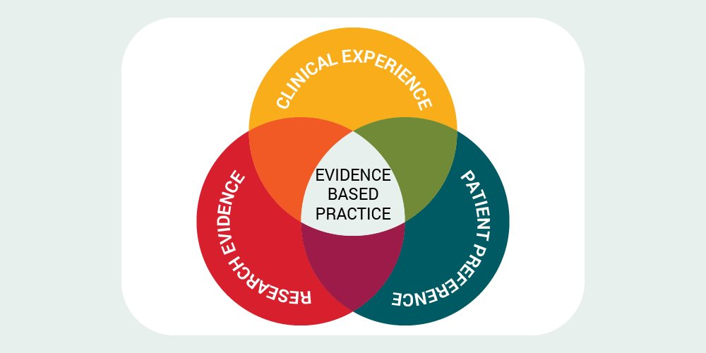
Major Considerations
User, their needs
Environmental factors
Software/Hardware
Feedback from caregivers and users
Trainings
Notes:
Do we need this slide?

Slide 10
Hardware Types
Direct Select/Manual Selection Device
  High tech, mid tech, low tech
Switch
  Head Switch
  Joystick
  Single message button
  Scan to select

Slide 11
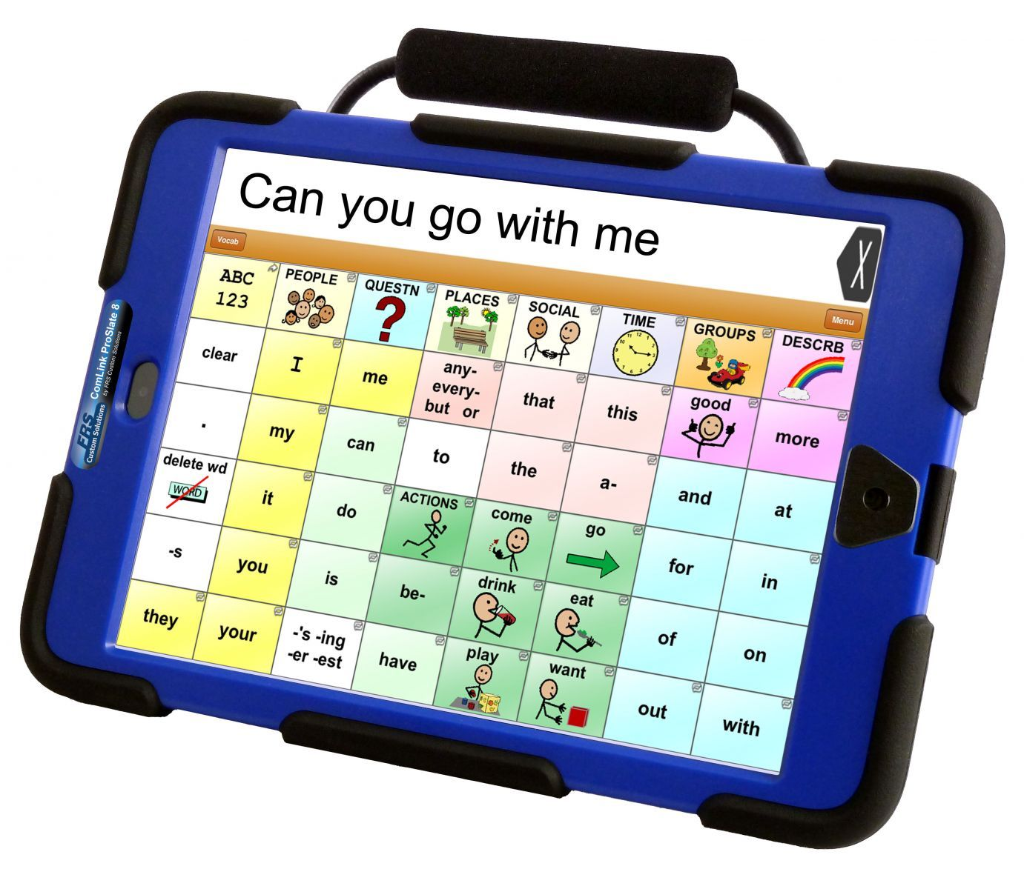
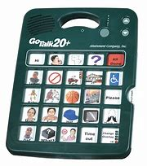
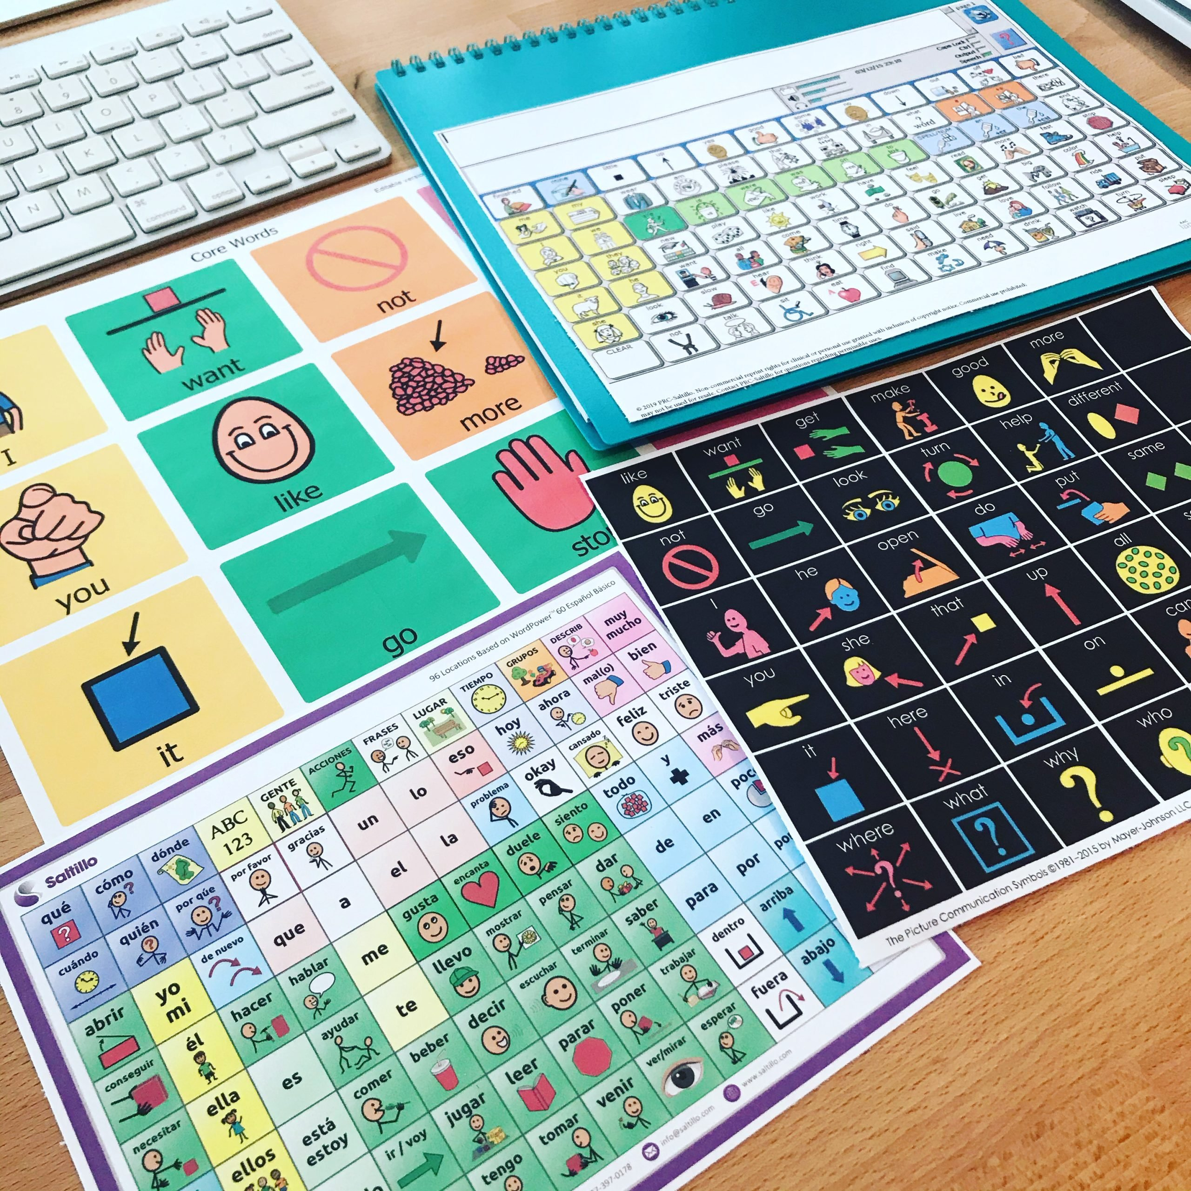
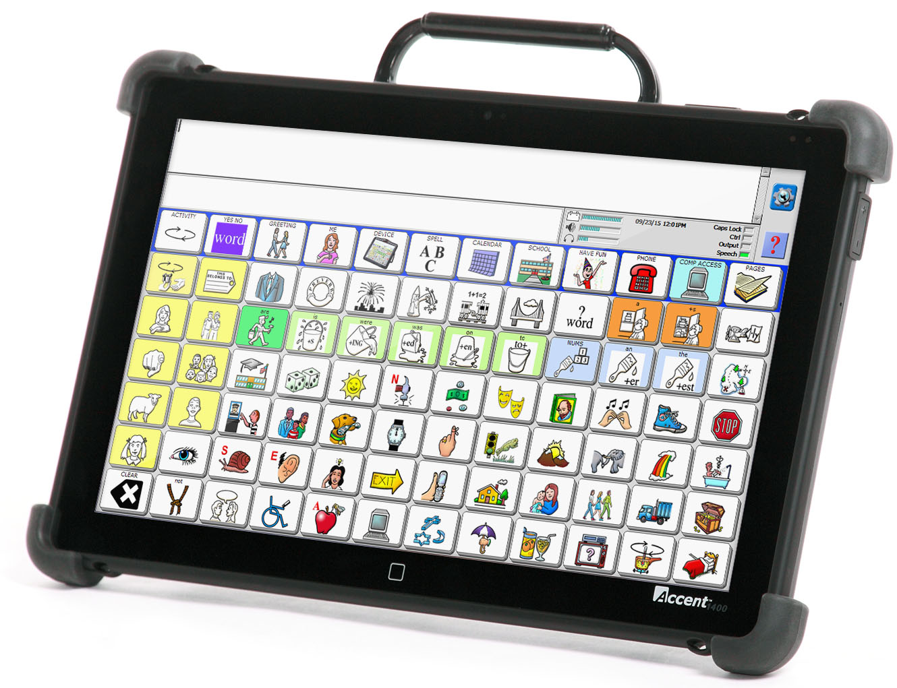
Direct Select Examples

Slide 12
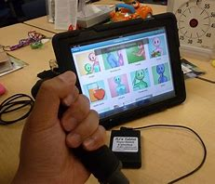
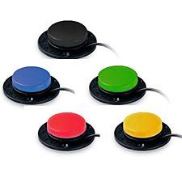
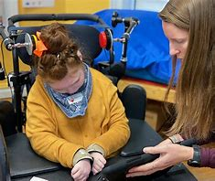
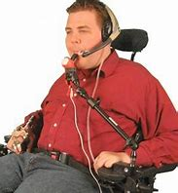
Switch Examples

Slide 13
Software Types
iPad applications:
  TouchChat,LAMP, Grid, ProLoQuo2Go, TDSnap, Lingraphica
Dedicated Device:
  Unity/Accent, NovaChat/WordPower, TobiiDynavox/Snap, Zuvo/Wego

Slide 14
Prerequisites for High Tech AAC
No hierarchical progression required
Goal = effective communication regardless of the mode
Some AAC practitioners believe certain prerequisite skills are needed for AAC including:
  understand cause and effect
  understand that symbols represent objects and actions
  show certain motor skills
  demonstrate a minimum level of language understanding
  demonstrate a minimum level of cognitive skills
This is no longer recommended and high tech AAC can be introduced alongside other communication methods such as sign or PECS, manual boards, etc without the individual having to "prove themselves"
AssistiveWare. (n.d.).
Notes:
https://www.assistiveware.com/learn-aac/roadblock-aac-users-are-required-to-prove-themselves
Receptive > expressive
They are using message combinations
They are using alternative access
Presume competence

Slide 15



Evaluation
Feature Matching- aligning communication needs to the hardware and software of the AAC systems, One Size Does Not Fit All
Vision & Vision Processing
Cogntive & Linguistic Skills
Physical (Motor) Skills
https://praacticalaac.org/praactical/finding-my-words-considerations-in-language-displays-and-organization/
Notes:
AAC Feature Matching Overview (atinternetmodules.org)
https://praacticalaac.org/praactical/finding-my-words-considerations-in-language-displays-and-organization/

Slide 16
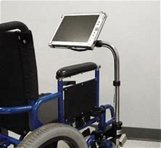
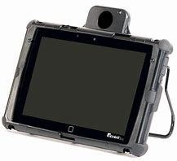
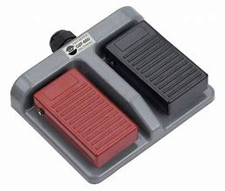
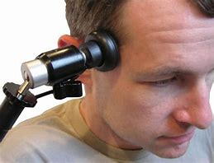
Evaluation- Hardware Considerations
Hardware Selection:
  Gross Motor Skills
    Ambulatory/Non-Ambulatory
    Mounting needs
    Head and limb movements for switch access
    Eye-Gaze
Notes:
Would be cool if we could split this up into three slides with photo examples

Slide 17
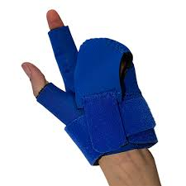
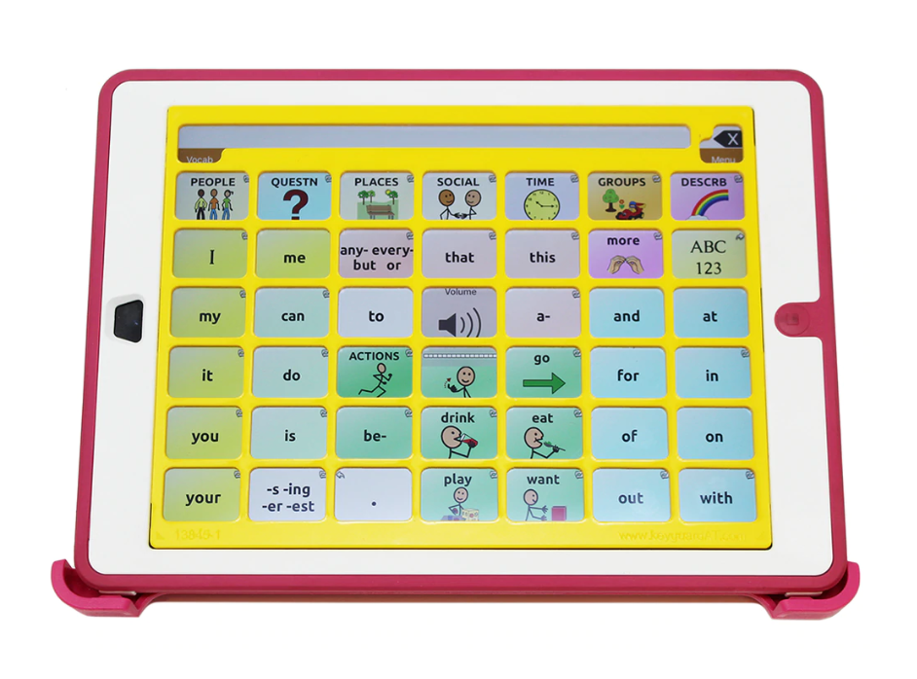
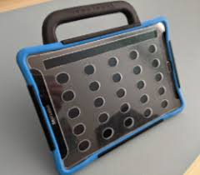
Evaluation – Hardware Considerations
Fine Motor Skills
  Bracing needs
  Keyguard/Touchguide
  Eye Gaze

Slide 18
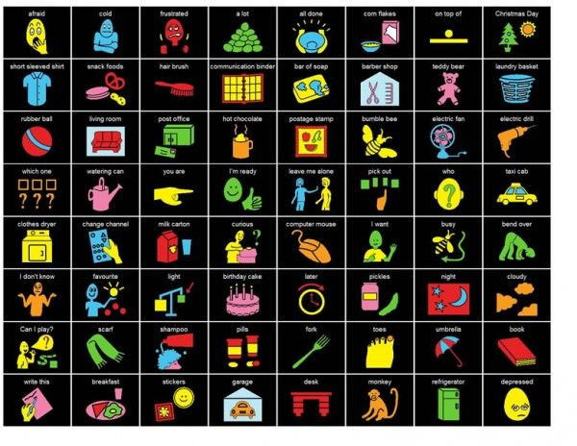
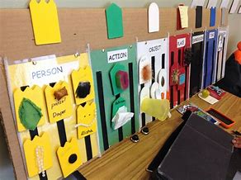
Evaluation – Hardware Considerations
Vision Needs
  High Contrast
  Tactile supports

Slide 19

Evaluation- Software Considerations
Grid Size and Vocabulary
Robust vocabulary
  choose the grid size based on what the AAC learner can see and touch.
  Bigger buttons look easier CAUTION! It may be making it harder!
  Choose a vocabulary set that can grow with the patient
Personalized vocabulary
  Add photos of family, patients, familiar places toys and foods
Light, J. et al.
Notes:
Bigger buttons = less vocab, words needed don't exist
Bigger buttons = more folders, more navigation, longer to form messages
AAC users don't need to prove themselves by first showing they can use a few buttons per page.
AAC users need to have as many buttons per page as they can see and touch. This will give them more words and more opportunities to develop language.
Fewer buttons, fewer opportunities
Patient is doing well with larger buttons, now what?
When you make the grid size bigger, buttons move, motor plans change and need to be relearned
"When using VSDs with children with developmental disabilities, research supports the use of personalized photos that include familiar people engaged in meaningful activities"

Slide 20
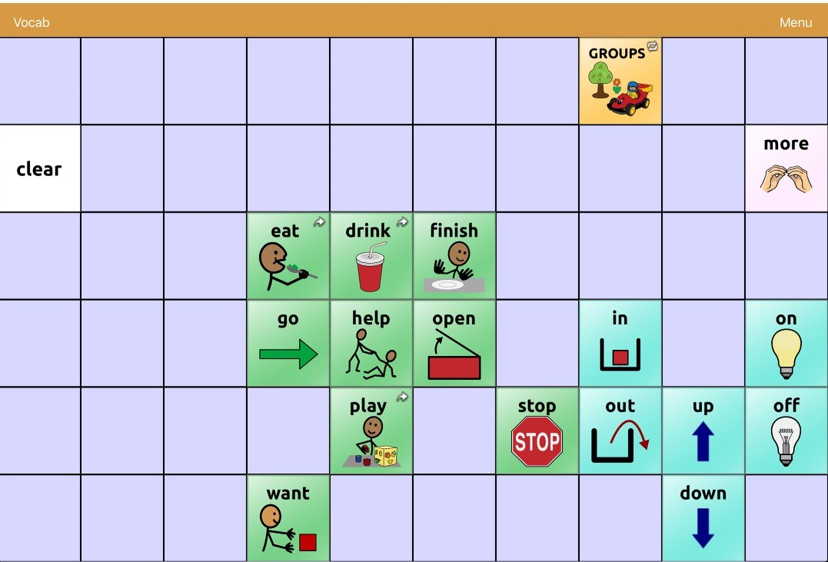
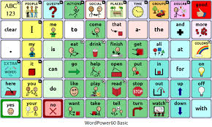
Evaluation – Grid Size and Editing

Slide 21
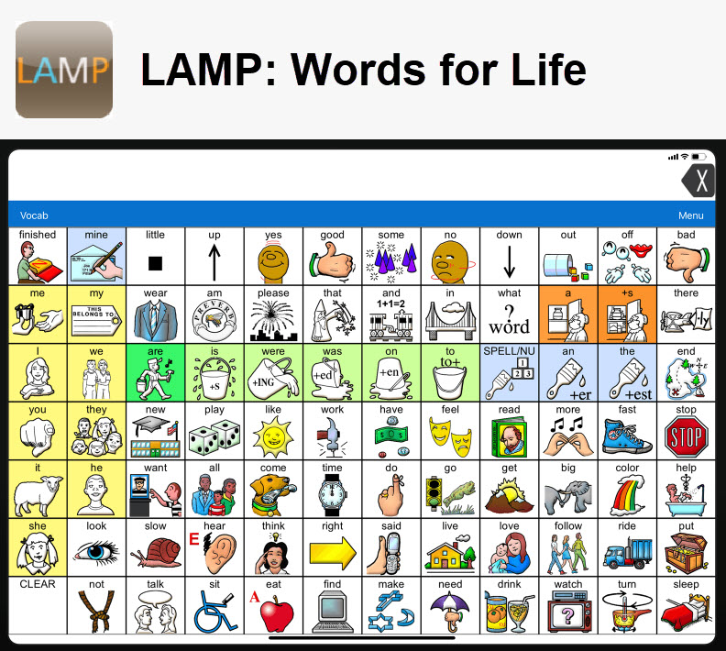
Evaluation- Software Considerations
Consider Motor Planning Navigation if....
  Motor Recall skills are greater than Receptive Language skills
  Visual processing and recall challenges are present
  Patients learn better through repetition of routine
https://praacticalaac.org/praactical/finding-my-words-considerations-in-language-displays-and-organization/
Notes:
https://praacticalaac.org/praactical/finding-my-words-considerations-in-language-displays-and-organization/

Slide 22
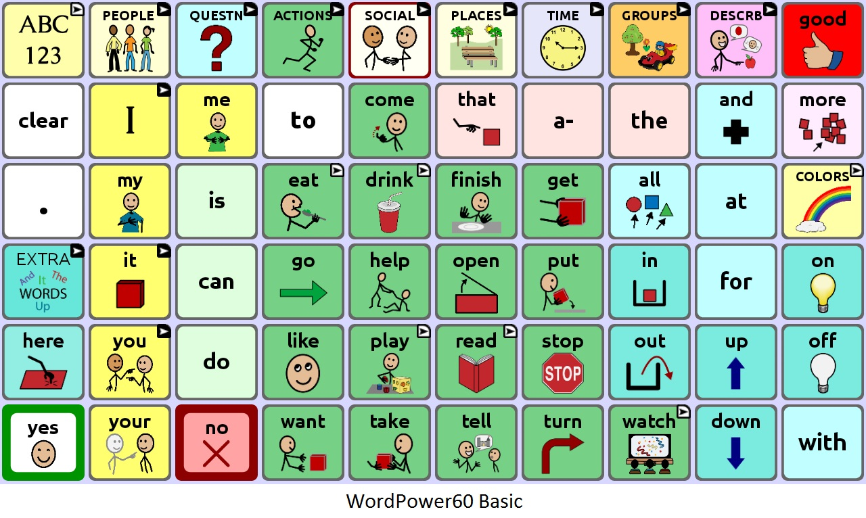
Evaluation- Software Considerations
Consider Linguistic Based Navigation if ...
  Patients demonstrate understanding of semantic/syntactic category (clothing, food, places…) or (actions, people, describing words)
  Receptive skills > Expressive skills
  Parents hesitant about AAC
TouchChat with WordPower 60
https://praacticalaac.org/praactical/finding-my-words-considerations-in-language-displays-and-organization/
Notes:
https://praacticalaac.org/praactical/finding-my-words-considerations-in-language-displays-and-organization/

Slide 23
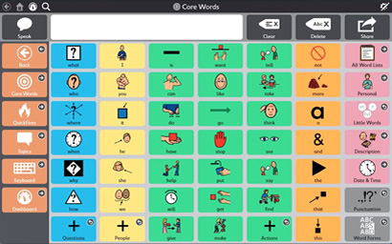
Evaluation- Software Considerations
Consider Environmentally Based Navigation if...
  Patient benefits from the cognitive ease of topic-based pages
  Patient demonstrates the ability to recognize the context/environment
  Benefit from the ability to access quick phrase-based communication (ex. GLP)
  Motor challenges impact the ability to select multiple buttons
https://praacticalaac.org/praactical/finding-my-words-considerations-in-language-displays-and-organization/
Notes:
https://praacticalaac.org/praactical/finding-my-words-considerations-in-language-displays-and-organization/

Slide 24
Evaluation- Multidisciplinary Approach
SETT Framework adapted for Outpatient Therapy
Team Member | Responsibility
Speech Pathologist | Trial AAC device(s). Set up the vocabulary and customize for the student's needs.
Occupational Therapist | Consult with the team on the best means of access to the device (direct touch, keyguard, switches, eye gaze, etc)
Physical Therapist | Determine best positioning for optimal access and attention to the device
Parent | Help determine any specific vocabulary needed to highlight the student's preferred topics of vocabulary, model AAC across daily
Zabala, J.S. (2020)
Notes:
Need access to this thru university website in order to read full article
Zabala, J.S. (2020), "The SETT Framework: A Model for Selection and Use of Assistive Technology Tools and More", Chambers, D. (Ed.) Assistive Technology to Support Inclusive Education (International Perspectives on Inclusive Education, Vol. 14), Emerald Publishing Limited, Leeds, pp. 17-36

Slide 25
Trial – Requirements
Must consider 3 different devices
  "consider" "full-trial"
Insurance requirements
  Ask company representative
Data
Home and clinic trial
  Some insurances require data from multiple settings

Slide 26
Caregiver Training
Person Centered Approach
  Identify patient and family communication priorities
"The identification and development of an AAC system is only the beginning; equally important is the support for the person who uses AAC and his or her communication partners in learning how to use AAC"
(McNaughton et al., 2019)
Notes:
Vocabulary and settings where communication is most motivating

Slide 27
Caregiver Training Methods
Structured Parent Training – During session
  Incorporating 4 communicative interaction skills
Natural Teaching Strategies – Hand-out
Training Videos
Training v Training and Coaching – During session
  Improved outcomes with Training and Coaching
Family-centered intervention
Constransitch, Mia

Slide 28
Caregiver Training
AAC Myths Handout
Caregiver coaching models
  Caregiver attends sessions
  Focus on daily living routines- embed language in routines
  Caregiver practices modeling on AAC device with real time feedback from SLP
  Education on importance of modeling without expectation
  Caregiver demonstrates operational competencies (editing, charging, volume, display) --this can be a therapy goal!
Consider data tracking charts for measuring carryover
Encourage 200 Models without expectation (aided language input) A DAY!
https://praacticalaac.org/praactical/aac-implementation-framework-step-3-take-in/

Slide 29
Treatment Strategies
Aided Language Input
  When a communication partner uses the AAC system to model language for the AAC learner, providing language stimulation in the same modality that we are expecting language to develop
  Plus-one rule
    Patient is Nonspeaking? Model one word at a time
    Patient says 1-2 word phrases? Model 2-3 words
  200 opportunities per day for interaction
Laher, Z., & Dada, S. (2023)

Slide 30
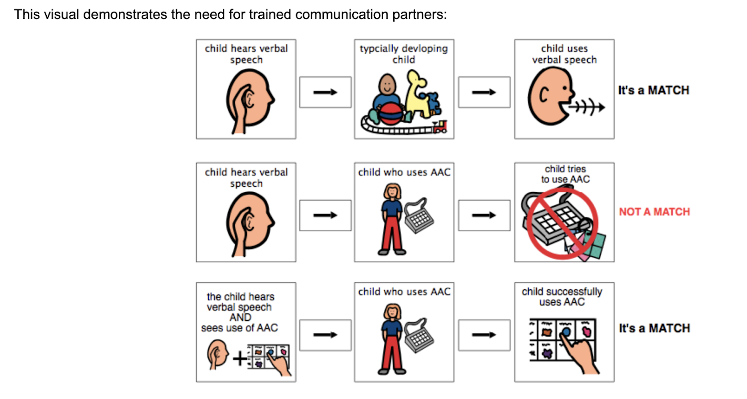
Treatment Strategies
https://thespeechroomnews.com/2022/08/what-is-aided-language-stimulation.html

Slide 31
Treatment Strategies
MASTER PAL Training (https://nwacs.info/master-pal)
  Motivate
  Accept multiple modalities- total communication approach
  Statements over questions
  Time
  Engage Naturally
  Response Not Required
  Presume Potential
  Appropriate Prompting
  Let the Child Lead

Slide 32

Prompting Hierarchy
Hand over Hand Prompting
Model
Modeling selections in the patient's point of view
Direct Point Cues
"you could say want" while therapist is pointing to button
Open Ended or Indirect Cues
Guide towards a response without explicitly telling them what to say
"What should we do now"
Invitation & Wait time
"Let's talk about it (pause)"
Aided Language Input
Notes:
Need to define open ended vs direct cues
Can talk about Hand under hand here

Slide 33
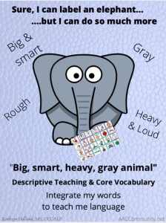
Treatment Strategies
Descriptive Teaching Model
  Using core vocabulary to describe more specific, usually academic word
  Ex: big, gray, heavy, loud when teaching about an elephant
  Descriptive teaching method helps the learner conceptualize specialized vocabulary and learn where nouns and descriptors are on device
https://aaccommunity.net/caac_slp/the-descriptive-teaching-method-and-aac/
Notes:
https://aaccommunity.net/caac_slp/the-descriptive-teaching-method-and-aac/

Slide 34
Treatment Goals
Consider writing goals in all four competency areas
  Linguistic- receptive and expressive language skills
  Social- greetings, farewells, reciprocal communication
  Operational- increasing effective use of SGD, transporting device, Navigation, Volume, Positioning, Battery usage
  Strategic- overcoming limitations, clarifying communication breakdowns, personal safety information, requesting to add vocabulary, introductory strategies
Mooney Mahan et al.
Notes:
https://aaccommunity.net/caac_slp/aac-competencies/
Mooney article

Slide 35
Increasing AAC Access within the clinic
Switch toys
Long Term loaner devices
Request funding for AAC apps/ipads
AAC Clinical track- staff training

Slide 36
Increasing AAC access across settings
Collaborate with school ST
Collaborate with behavior therapy
AAC letters to teachers
Incorporate AAC in community events
Introduction Strategy on the AAC system
(McNaughton et al., 2019)
Notes:
"As people with complex communication needs expand their participation in societal activities, they will increasingly encounter individuals (e.g., store employees, cafe workers) who have had limited, if any, interactions with people who make use of AAC. The use of an introduction strategy on the AAC system (i.e., appropriate information about the individual’s means of communication, instructions on how the new partner can best communicate with the individual who uses AAC) is a common clinical recommendation"

Slide 37
Closing
"AAC can be like magic, providing access to communication and participation for individuals who might otherwise be unable to interact with others.
Unlike magic, however, the full success of AAC intervention is best evaluated not by a single performance under controlled conditions, but rather by the extent to which it improves access and participation in valued activities and experiences of everyday life."
(McNaughton et al., 2019)

Slide 38
Handouts
AAC Myths PDF
AAC Letter to teachers/school therapist PDF
How to adapt a switch toy and QR code to amazon list for switch toys and adapters
Youtube video collections for modeling for parents (QR code handout for TC, LAMP, GRID, TD Snap)
Master PAL training website
AAC Training Manual for Parents PDF
Door Hanger PDF
Communication Bill of Rights Poster
Mid Tech- go talk now website to purchase
Prompting Hierarchy with examples
Medical needs core board (for if medical SLPs come to the talk??)
Charts for carryover of data
Goal Ideas PDF
List of websites/IG handles
Notes:
https://www.attainmentcompany.com/technology/gotalks/gotalk-20-lite-touch

Slide 39
Sources
Laher, Z., & Dada, S. (2023). The effect of aided language stimulation on the acquisition of receptive vocabulary in children with complex communication needs and severe intellectual disability: a comparison of two dosages. Augmentative and Alternative Communication, 39(2), 96-109.
Light, J., Wilkinson, K. M., Thiessen, A., Beukelman, D. R., & Fager, S. K. (2019). Designing effective AAC displays for individuals with developmental or acquired disabilities: State of the science and future research directions. Augmentative and Alternative Communication, 35(1), 42-55.
Bruno, J., & Trembath, D. (2020). Implementing augmentative and alternative communication: supporting children and adults with complex communication needs. Perspectives of the ASHA Special Interest Groups, 5(6), 1615-1624.
McNaughton, D., Light, J., Beukelman, D. R., Klein, C., Nieder, D., & Nazareth, G. (2019). Building capacity in AAC: A person-centred approach to supporting participation by people with complex communication needs. Augmentative and Alternative Communication, 35(1), 56-68.
Mooney Mahan, A. M., Bean, A., & Sonntag, A. M. (2023). Language Sample Analysis to Assess Communicative Competence of Children Who Use Augmentative and Alternative Communication. Communication Disorders Quarterly, 15257401231187076.
Constransitch, Mia, "A Systematic Review of Parent Training Effects Children's Use of Augmentative and Alternative Communication Systems" (2021). Undergraduate Honors Theses. 60.
Augmentative and Alternative Communication (AAC) (asha.org)
https://digscholarship.unco.edu/honors/60
https://praacticalaac.org/praactical/finding-my-words-considerations-in-language-displays-and-organization/
https://praacticalaac.org/praactical/finding-my-words-considerations-in-language-displays-and-organization/
https://thespeechroomnews.com/2022/08/what-is-aided-language-stimulation.html
https://www.assistiveware.com/learn-aac/roadblock-aac-users-are-required-to-prove-themselves

