Slide 1
Demystifying CrossFit
Kahli Castagnera, PT DPT

Slide 2
Continuing Medical Education (CME)
Disclaimer
Planning Committee members have no financial relationships to disclose
Presenter has no financial relationships to disclose

Slide 3
Objectives
Understand what CrossFit is
Compare the injury rate of CrossFit versus other popular sports
Review the updated Physical Activity Guidelines for Americans
Highlight national healthcare data and the cost of not being functionally fit
Review the general benefits of exercise
Highlight the benefits of CrossFit
Distinguish benefits of CrossFit across the lifespan

Slide 4
What this presentation is NOT
A CrossFit sales pitch
Tips on how to break your personal record in the clean and jerk
An opportunity to mock kipping pull-ups

Slide 5
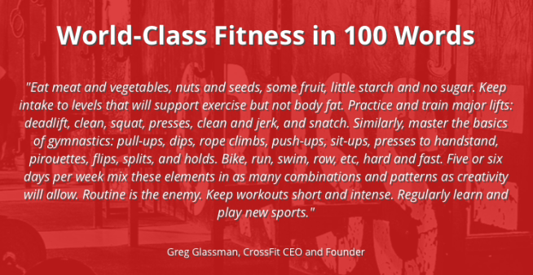
What is CrossFit?

Slide 6
What is CrossFit?
High intensity functional training
Used to optimize physical competence in ten fitness domains: cardiovascular/respiratory endurance, stamina, strength, flexibility, power, speed, coordination, agility, balance, accuracy
Focused on constantly varying functional movements, using the main elements of gymnastics, weightlifting exercises, and cardiovascular activities
CrossFit workouts called “workout of the day” are executed quickly, repetitively, and with little or no recovery time between sets ^{1, 2}

Slide 7
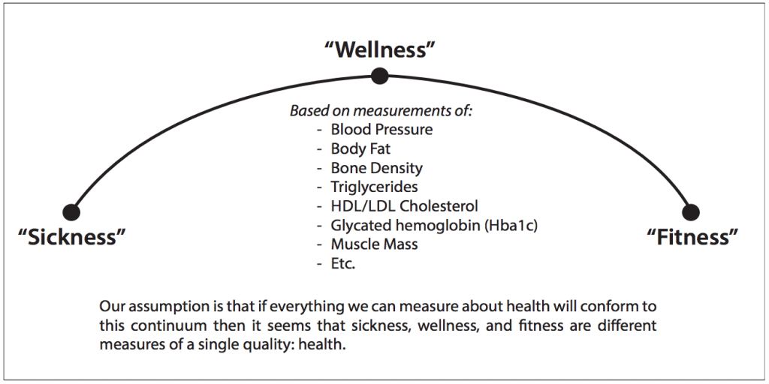
What is CrossFit?
The brand of CrossFit is forged upon the concept of “super-wellness” in the continuum of health from sickness to wellness to fitness by promoting the optimization of all body systems ²

Slide 8
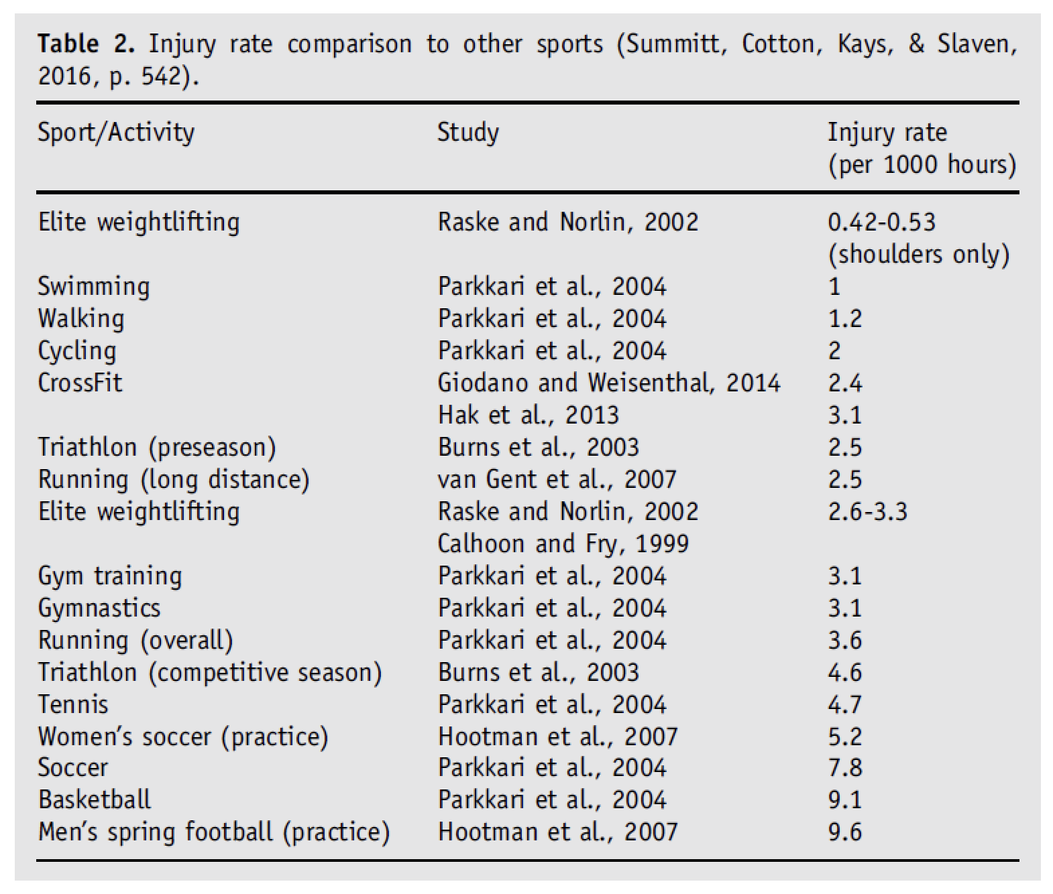

CrossFit Injury Rates
Wagener et al, 2020 ³

Slide 9
CrossFit Injury Rates
Approximately 74% of all runners experience a moderate or severe injury each year ⁴ compared to the 19.4% injury rate for CrossFit athletes per year ⁵

Slide 10
CrossFit Injury Rates
The shoulder, knee and lower back are the most frequently reported injury locations ⁶
Length of participation in CF, physical activity outside of CF, weekly athlete-exposures to CF were associated with injury ⁶
No significant difference in injury rate across age ⁵
Males injured more frequently than females ⁵
Females more likely to seek help from a trainer ⁵
Injuries occurred more frequently when the activity was unsupervised ⁷

Slide 11
Physical Activity Guidelines for Americans
(2018 update) ⁸
Preschool aged children (3-5 yrs)
  Physically active throughout the day
Children and adolescents (6-17 yrs)
  60 minutes or more of moderate to vigorous physical activity daily
  Aerobic activity 3 days/wk, muscle strengthening 3 days/wk, bone strengthening 3 days/wk
Adults
  At least 150-300 minutes a week of moderate intensity or 75-150 minutes of vigorous intensity aerobic physical activity or combo of both
  Muscle strengthening 2 days/wk
Older adults
  At least 150-300 minutes a week of moderate intensity or 75-150 minutes of vigorous intensity aerobic physical activity or combo of both
  Multicomponent physical activity: balance training, aerobic and muscle strengthening activities

Slide 12
Benefits of Regular Physical Activity ⁸
Reduce blood pressure
Improve insulin sensitivity
Improve sleep
Reduce anxiety and depression symptoms
Improve aspects of cognition: memory, attention,
executive function, academic performance
Disease risk reduction
Improved physical function for ADLs
Improved bone health and weight status for children
Improved cognitive function for youth
Reduced risk of cancer (bladder, breast, colon, endometrium, kidney, lung, stomach)
For pregnant people, reduced risk of excessive weight gain, gestational diabetes and postpartum depression
For older adults, reduced risk of fall-related injuries
For people with various chronic medical conditions, reduced risk of all-cause and disease-specific mortality

Slide 13
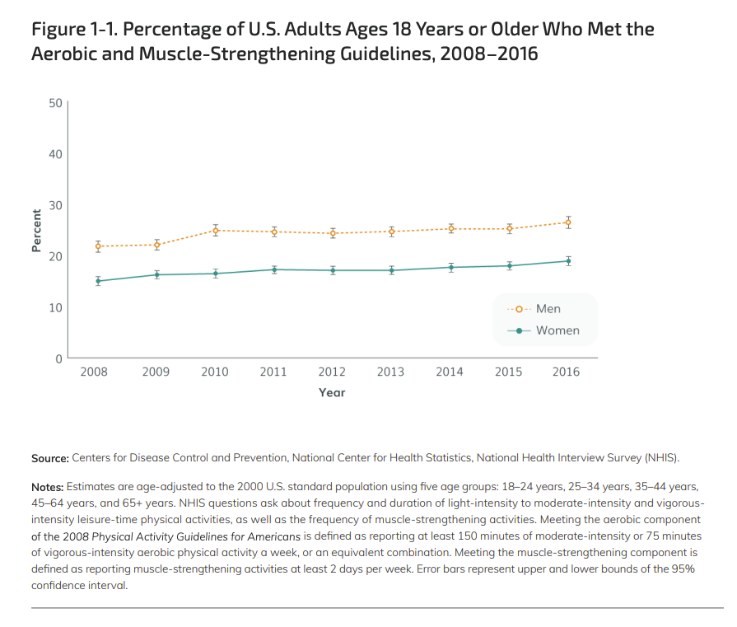
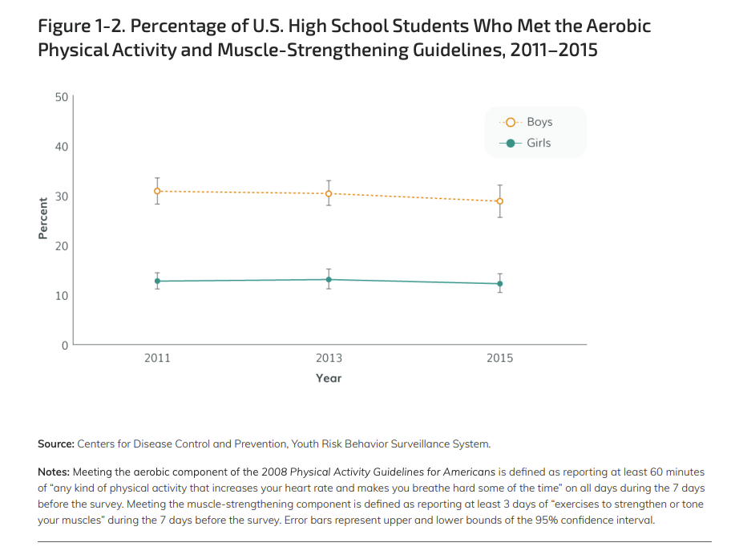
Physical Activity Guidelines for Americans
Notes:
CDC:
Percentage of US adults and children that meet the 2008 Aerobic and muscle-strengthening guidelines
Adults: less than 30% of adult males and less than 20% of adult females
High school aged youth: less than 40% of boys and less than 20% of girls

Slide 14
The Cost of NOT Being Functionally Fit
U.S. health care spending grew 4.1 percent in 2022, reaching $4.5 trillion or $13,493 per person ⁹
Chronic diseases are the leading causes of illness, disability, and death in the United States. They are also the leading drivers of our nation's $4.5 trillion in annual health care costs ¹⁰
  Diseases: heart disease and stroke, cancer, diabetes, obesity, arthritis, Alzheimer’s disease, epilepsy, tooth decay
  Risk factors: cigarette smoking, physical inactivity, excessive alcohol use
Notes:
Sources: CMS and CDC

Slide 15
Benefits of CrossFit
Wagener et al, 2020³
  Enhanced endurance, increased maximal aerobic capacity VO2 max, aerobic and anaerobic capacity and positive influence on participants’ body composition, strength, flexibility, power and balance, BMI, fat mass and waist circumference in adults and adolescents
  Positive effects on mood state
  Positive influence on motivation factors and sense of community

Slide 16
Benefits of CrossFit
Smith et al, 2013 ¹¹
  HIPT (high intensity power training) significantly improves VO2 max and body composition in subjects of both genders across all levels of fitness

Slide 17
Benefits of CrossFit
Davies et al, 2016 ¹²
  Participants who attended CF more frequently (>3 sessions per wk) had significantly higher levels of basic need satisfaction across all three needs (autonomy, relatedness, competence)
Notes:
Autonomy: the choice surrounding the behavior as being derived by the self – individuals feel that they have the opportunity to make selections, that their beliefs are valued and that they are self-controllers
Competence: perceived ability to interact effectively with one’s environment; the desire to be effective, efficient and masterful with the environment
Relatedness: a sense of belongingness with significant others; a desire to have satisfying and consistent involvement with others

Slide 18
Benefits of CrossFit
Fisher et al, 2017 ¹³
  CF participants more likely to report higher levels of intrinsic motives such as enjoyment, challenge and affiliation, whereas personal training clients reported higher values for health-related motives such as positive health, ill-health avoidance and weight management

Slide 19
Functional Fitness Across the Lifespan
Eather et al ¹⁴ CrossFit Teens
8 wk CF program, twice weekly workouts
  Significant improvements in body composition, flexibility, cardiorespiratory fitness and muscular fitness (standing jump)
  No significant change in resistance training skill, grip strength, curl-up or push up
  Students were highly satisfied with the program, recruitment and retention levels were high, adherence was excellent
  Students liked partner (93.9%) and team (83.7%) strength activities/challenges vs individual (59.2%) strength activities
  Majority of students (89.8%) enjoyed participating in circuits of activities
Notes:
A typical session included a dynamic warm-up (10 min), a technique-based skill session (10 min), a workout of the day (10-20 min), and a stretching session = 40-50 mins total

Slide 20
Functional Fitness Across the Lifespan
Watson et al, 2018 LIFTMOR study
  Postmenopausal women (n=101) with low bone mass (t-score < -1.0)
  randomized to either 8 months of twice-weekly 30-minute, supervised high intensity resistance and impact training (HiRIT) (5 sets of 5 reps, >85% 1RM) or a home-based, low-intensity exercise program (CON)
  Pre and post testing:
    Lumbar spine and proximal femur BMD
    TUG
    Functional reach
    5xSTS
    Back and leg strength
Notes:
“All participants were able to perform the 4 fundamental exercises of the intervention within 2 months. Resistance exercises (deadlift, overhead press, and back squat) were performed for the remainder of the intervention period in 5 sets of 5 repetitions, maintaining an intensity of >80% to 85% 1 RM. Participants performed up to 2 sets of deadlifts at 50% to 70% of 1 RM to serve as a warm-up, as required. Impact loading was applied via jumping chin-ups with drop landings. Participants were instructed to grasp an overhead bar with their shoulders and elbows flexed to 90 degrees, and their hands shoulder width apart with an underhand grip. The participant then jumped as high as possible while simultaneously pulling themselves as high as possible with their arms. At the peak of the jump, the participant dropped to the floor, focusing on landing as heavily as comfortably possible.”

Slide 21
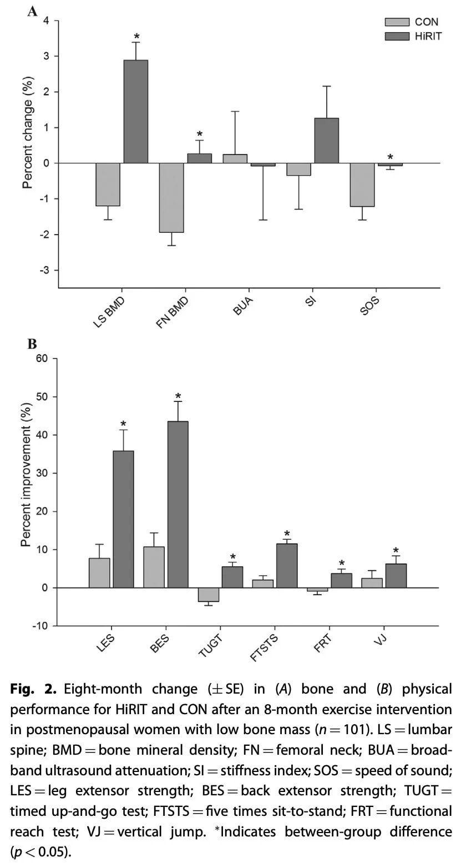
Functional Fitness Across the Lifespan
Notes:
HiRIT was superior to CON for bone mass, FN geometry, and physical function compared with a low-intensity home exercise program

Slide 22
Functional Fitness in the Clinic
HiRIT was superior to CON for bone mass, FN geometry, and physical function compared with a low-intensity home exercise program
No fractures or other serious injuries were sustained by any participant, suggesting that HiRIT does not pose a significant risk for postmenopausal women with low BMD when closely supervised
Notes:
the LIFTMOR trial is the first to show that a brief, supervised, twice-weekly HiRIT exercise intervention was efficacious and superior to previous programs for enhancing bone at clinically relevant sites, as well as stature and functional performance of relevance to falls in postmenopausal women with low to very low bone mass

Slide 23
What does this mean?
CrossFit is appropriate for all genders and age groups
CrossFit is safest when performed to an appropriate scale, under supervision of a trainer
CrossFit can be a safe and effective way to:
  Meet physical activity guidelines
  Stay connected to a community
  Improve clinically significant health outcomes
  Reduce healthcare-related costs

Slide 24
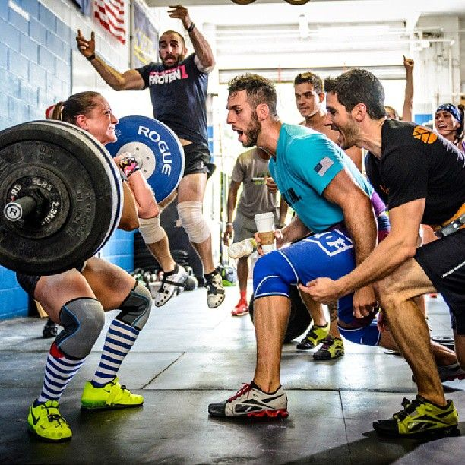
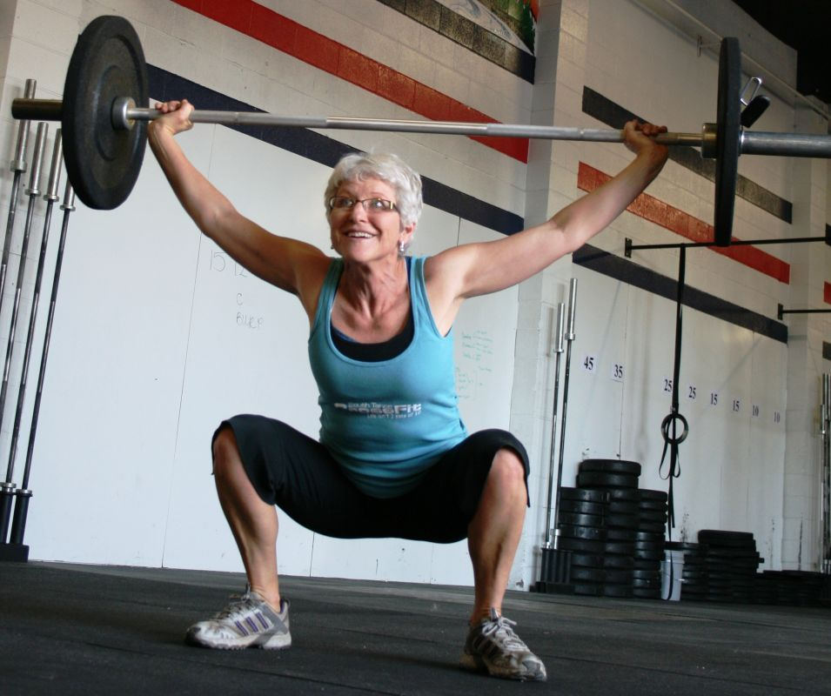
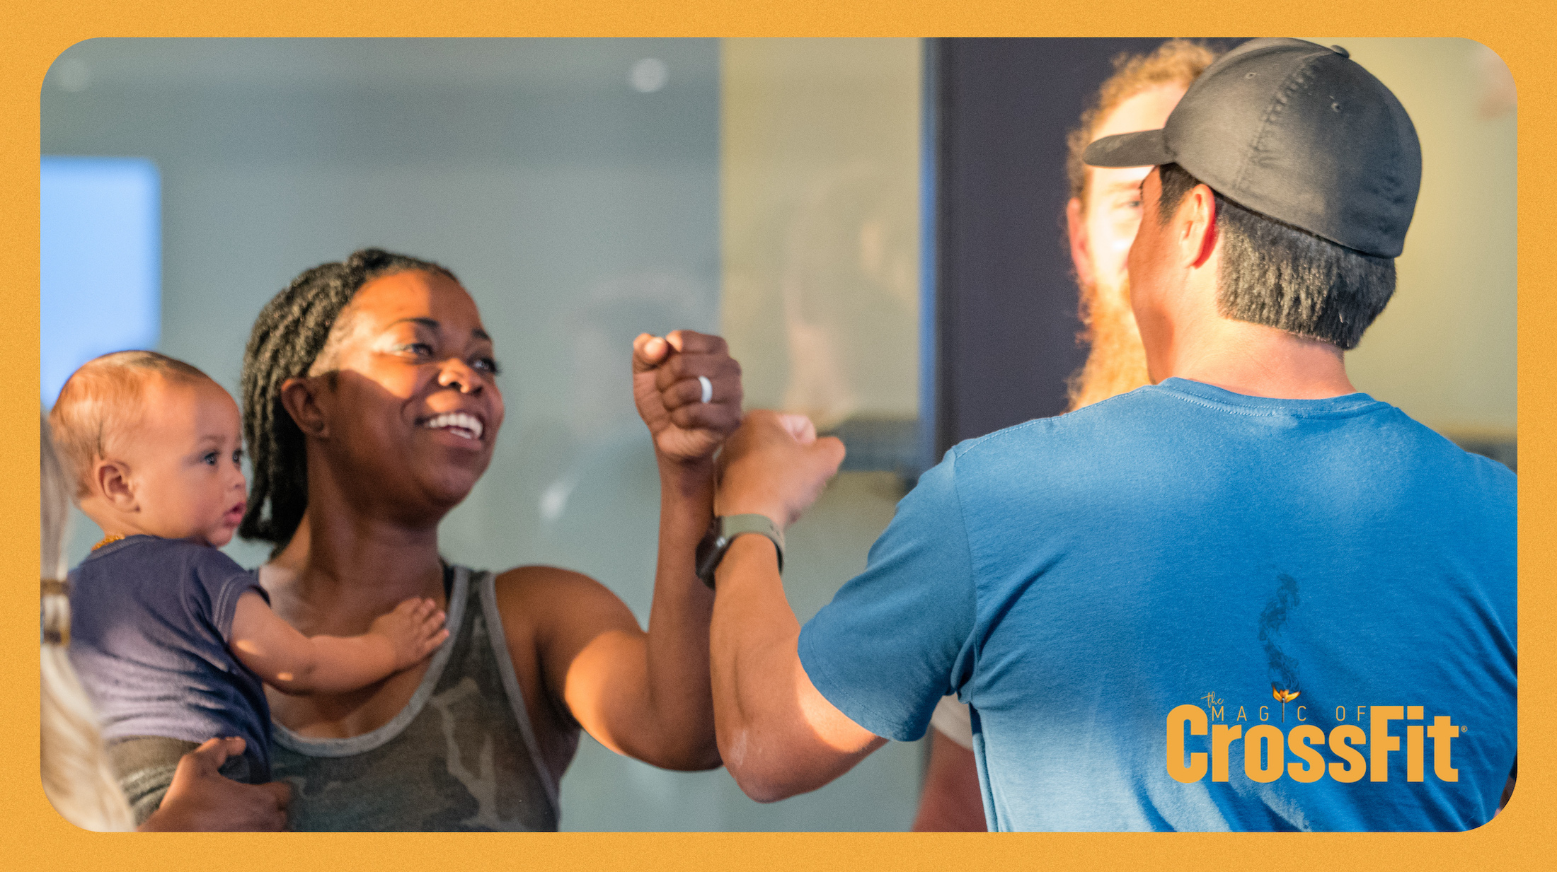
What do we do about it?
Be understanding
Be educational
Be supportive!
Notes:
Understand what the sport is and why patients might want to participate in it
Educate on how to safely and effectively participate
Support patients in this sport

Slide 25
References
Claudino, J.G., Gabbett, T.J., Bourgeois, F. et al. CrossFit Overview: Systematic Review and Meta-analysis. Sports Med - Open 4, 11 (2018).
Glassman G. What is Fitness?. CrossFit Journal. 2022.
Wagener S, Hoppe MW, Hotfiel T, Engelhardt M, Javanmardi S, Baumgart C, Freiwald J. CrossFit® – Development, Benefits and Risks. Sportorthopa¨die-Sporttraumatologie. 2020 Sep;36(3):241–9.
Daoud AI, Geissler GJ, Wang F, Saretsky J, Daoud YA, Lieberman DE. Foot strike and injury rates in endurance runners: a retrospective study. Med Sci Sports Exerc. 2012 Jul;44(7):1325-34.
Weisenthal BM, Beck CA, Maloney MD, DeHaven KE, Giordano BD. Injury Rate and Patterns Among CrossFit Athletes. Orthopaedic Journal of Sports Medicine. 2014;2(4).
Montalvo AM, Shaefer H, Rodriguez B, Li T, Epnere K, Myer GD. Retrospective Injury Epidemiology and Risk Factors for Injury in CrossFit. J Sports Sci Med. 2017 Mar 1;16(1):53-59.
Klimek, C., Ashbeck, C., Brook, A. J., & Durall, C. (2018). Are Injuries More Common With CrossFit Training Than Other Forms of Exercise?. Journal of Sport Rehabilitation, 27(3), 295-299.
U.S. Department of Health and Human Services. (2018). Physical Activity Guidelines for Americans, 2nd edition.
National health expenditure data: historical. Center for Medicare & Medicaid Services. Updated December 13, 2023. Accessed October 2, 2024. https://www.cms.gov/data-research/statistics-trends-and-reports/national-health-expenditure-data/historical
Fast Facts: Health and Economic Costs of Chronic Conditions. Updated July 12, 2024. Accessed October 2, 2024. https://www.cdc.gov/chronic-disease/data-research/facts-stats/index.html
Smith, Michael M.; Sommer, Allan J.; Starkoff, Brooke E.; Devor, Steven T.. Crossfit-Based High-Intensity Power Training Improves Maximal Aerobic Fitness and Body Composition [RETRACTED]. Journal of Strength and Conditioning Research 27(11):p 3159-3172, November 2013.
Davies, M. J., Coleman, L., & Babkes Stellino, M. (2016). The relationship between basic psychological need satisfaction, behavioral regulation, and Participation in CrossFit. Journal of Sport Behavior, 39(3), 239–254.
Fisher J, Sales A, Carlson L, Steele J. A comparison of the motivational factors between CrossFit participants and other resistance exercise modalities: a pilot study. J Sports Med Phys Fitness. 2017 Sep;57(9):1227-1234.
Eather N, Morgan PJ, Lubans DR. Improving health-related fitness in adolescents: the CrossFit Teens™ randomised controlled trial. J Sports Sci. 2016;34(3):209-23.

