Slide 1
Diagnosing Pain Phenotype: A Case Report

Slide 2
Continuing Medical Education (CME)​
Disclaimer​
Planning Committee members have no financial relationships to disclose
​
Presenter has no financial relationships to disclose​

Slide 3
Objectives
Understand basic pain neuroscience
Understand the importance of diagnosing and considering the pain phenotype that is the primary source of symptoms during patient care
Know the clinical prediction rules in order to improve ability to accurately diagnose each pain phenotype
Discuss appropriate interventions for each pain phenotype
Review a patient case as an example of misdiagnosing pain phenotype that led to ineffective patient care

Slide 4
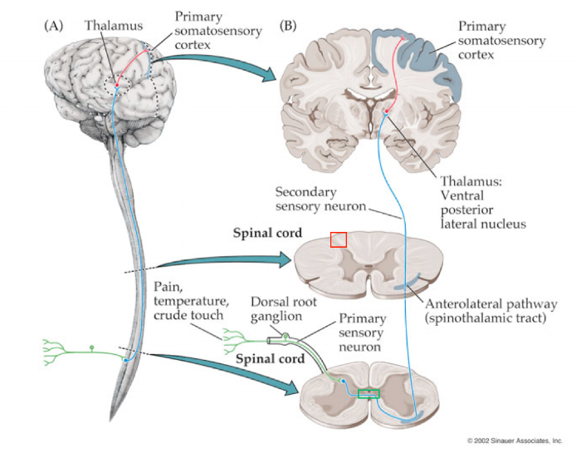
Pain
Notes:
Anterolateral spinothalamic tract
Pain is sensed by myelinated A delta fibers (faster signal- short lived, sharp, localized pain) and unmyelinated C fibers (slower signal- dull, aching, burning, delayed, poorly localized pain)
A delta fibers sense mechanical and thermal stimuli
C fibers sense mechanical, thermal, chemical stimuli
Pain is initially sensed by nociceptors in the peripheral nervous system, the signal is sent through the dorsal root ganglion
First synapse is in the dorsal horn gray matter
2nd order neuron crosses over to the anterolateral funiculus and ascends up the tract
Second synapse is in the thalamus
3rd order neuron ascends to the primary somatosensory cortex

Slide 5
Why Pain Phenotyping is Important
Misdiagnosing pain phenotype leads to erroneous clinical reasoning, treatment prescription and prognosing, resulting in ineffective care. ^{(9,10,11)}
Notes:
Evidence shows that diagnosing pain phenotype optimizes patient care because clinicians can select interventions proven in the literature to target the neurobiological mechanism of each pain phenotype that is driving the patient’s pain symptoms (example: nerves like blood space and movement)
Understanding pain phenotype can help us improve not only intervention selection, but dosage as well, and that goes our interventions as well as our examination. Most experienced clinicians are familiar with the sensitivity of the nervous system , in that nerve tissue and neural structures tend to be more sensitive than soft tissue structures
Understanding pain phenotype gives us insight into and the ability to predict how the system will respond to our exam and to our treatment, which we can use to dose our exam or treatment appropriately, for example we are likely to provide lower dosages for an exercise like nerve tensioners compared to an exercise like prone press ups

Slide 6
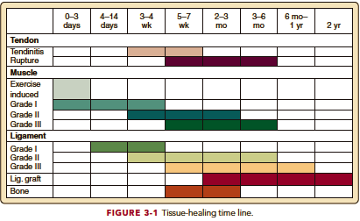
Why Pain Phenotyping is Important
Prognosis- nociceptive
Notes:
Jumping a head a bit here, but will go over more detail in the next few slides exactly what these pain phenotypes are if youre not familiar yet

Slide 7
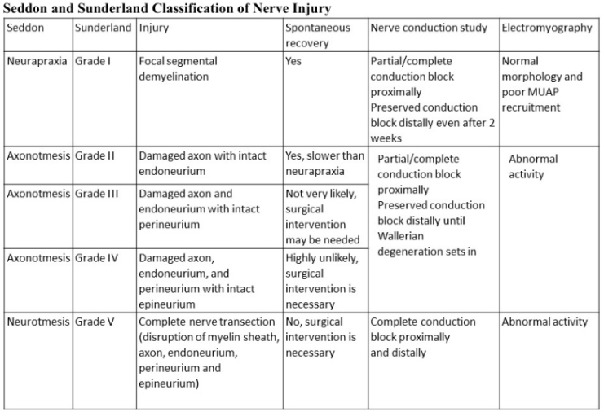
Why Pain Phenotyping is Important
Prognosis- neuropathic
https://www.ncbi.nlm.nih.gov/books/NBK557746/figure/article-25766.image.f1/
Notes:
Nerves regenerate on average at 1mm per day

Slide 8
Why Pain Phenotyping is Important
Prognosis- nociplastic
Longer timeframe
Highly individualized
Shift focus away from pain relief and towards functional achievements
Notes:
Chronic central sensitization pain
Goes to show how prognosis can vary greatly just on pain phenotype alone let alone acuity and severity of injury- if we can communicate accurate prognosis to patients from intial evaluation were going to have much better outcomes if patient expectations are set appropriately

Slide 9
Pain Phenotypes
Nociceptive pain
  Pain that arises from actual or threatened damage to non-neural tissue and is due to the activation of nociceptors
Neuropathic pain
  Pain caused by a lesion or disease of the somatosensory nervous system
Nociplastic pain
  Pain that arises from altered nociception despite no clear evidence of actual or threatened tissue damage causing the activation of peripheral nociceptors or evidence for disease or lesion of the somatosensory system causing the pain
Notes:
International association for the study of pain
Central sensitization is the process to which nociplastic pain is derived
Now of course this isn’t going to be cut and dry in every patient- our patients are likely going to have a combination of all three pain phenotypes contributing to their symtpoms, however our job is to diagnosis and treat the primary pain phenotype first and can progress from there

Slide 10
Diagnosing Pain Phenotype: Nociceptive
Cluster by Smart et al, 2012
  Pain levels proportionate to the injury
  Clear mechanical nature to aggs and easing factors
  Intermittent sharp with movement, dull ache throb at rest
  Absence of pain associated with other dysesthesia
    Night pain
    Burning sharp shooting electric
Other Common Findings^{(7,8)}
  Responsive to NSAIDs
  Signs of inflammation
  Pain recovery corresponds with tissue healing timeframes
  Localized pain
Sensitivity 90.9%
Specificity 91.0%

Slide 11
Diagnosing Pain Phenotype: Neuropathic
Cluster by Smart et al, 2012
  Cutaneous or dermatomal distribution
  History of nerve injury
  Positive mechanical tests for adverse neural dynamics or compressive tests
Other Common Findings ^{(7,8)}
  Diagnostic evidence of lesion or disease to nervous system (MRI, EMG)
  Sensory deficits
  Myotomal weakness
  Altered deep tendon reflexes
  Burning, electric, shock-like quality
  Thermal, pins and needles, prickling, itchy quality
Sensitivity 86.3%
Specificity 96.0%

Slide 12
Diagnosing Pain Phenotype: Nociplastic
Cluster by Smart et al, 2012
  Disproportionate and unpredictable pattern of pain provocation with aggs and easing factors
  Pain disproportionate to the extent of the injury
  Diffuse, non-anatomic tenderness to palpation
  Maladaptive psychosocial factors
Other Common Findings ^{(7,8)}
  Diffuse, widespread pain
  Multi-site pain (3 or more)
  Somatic symptoms
Sensitivity 91.8%
Specificity 97.7%
Notes:
Fatigue, concentration issues, sleep disturbances, mood disturbances

Slide 13
Interventions: Nociceptive
Treat specific tissue impairments
  Pain modulation, POLICE prn
  Mobility
  Motor Control
  Strength
  Endurance
  Functional Activity

Slide 14
Interventions: Neuropathic
Blood, Space, Movement
Nerve gliders, tensioners
Desensitization
Modalities: TENS, LLLT
Gentle ROM and strengthening in order to restore function and increase cortical body representation
Bernetti et al, 2021
Notes:
Literature supports the use of desensitization, transcutaneous electrical nerve stimulation or low level laser therapy, gentle range of motion and strengthening to restore function and increase cortical body representation, are effective interventions for neuropathic pain.

Slide 15
Interventions: Nociplastic
Cognitive: PNE, CBT
Overall wellbeing: stress management, sleep, nutrition
Movement: aerobic exercise, strengthening
Graded Motor Imagery
Shift focus away from pain and towards functional goals
Bowering et al, 2015
Ferro et al, 2021
Notes:
Cognitive Behavioral Therapy
Be aware of thoughts emotions and beliefs
Identify negative or inaccurate thinking
Reshape thinking
Graded Exposure
Desensitization
Exercise
Functional movements
Graded Motor Imagery
Laterality training
Motor imagery
Mirror therapy

Slide 16
Patient Case
46 year-old male
PMH: sarcoidosis following COVID-19 infection, HTN
  Sarcoidosis: lungs, spinal cord → asthma, arachnoiditis
MSK History:
  GSW as an adolescent required RLE surgery to remove fragments with remaining paresthesias
  R ankle ORIF 2011 following motorcycle accident
  Chronic LBP with SCS placed in October 2017 entering posteriorly at T12-L1
Notes:
arachnoid mater is the middle layer of the meninges of the spinal cord

Slide 17
Patient Case
Personal factors
  Works 2 manual labor jobs
    AM job: standing walking
    PM job: bending down to the ground to open a door on the floor
  $35 copay
  Chronically ill child that requires constant remote monitoring/extensive medical treatment at times
Symptoms
  Constant severe LBP worsens with standing/walking
  Nearly constant bilateral LE burning pain L>R worsens with sitting/bending motions at work
  Most tolerable position, not true relief, is sitting offloading/extending LLE

Slide 18
Patient Case
Objective Exam
  Hyporeflexia globally in lower extremities
  Decreased light touch sensation globally in R lower leg, L1-3 dermatomes in LLE
  Decreased myotome strength at left L1-3 level
  Lumbar spine active range of motion severely restricted in all planes
  Extension directional preference via mechanical assessment
    PPU abolished LLE burning pain, NB upon return to standing
  Positive lower extremity neural tension testing

Slide 19
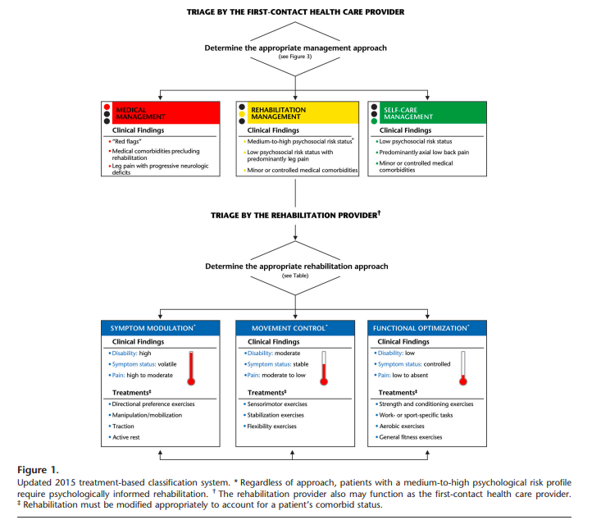
Patient Case
https://www.orthodiv.org/wp-content/uploads/2021/08/Treatment-Based-Classification-System-for-Low-Back-Pain_-Revision-and-Update-watermark.pdf

Slide 20
Patient Case
Initial evaluation
  Symptoms modulation – directional preference exercises
After 3 visits
  No carryover in centralization upon return to standing even with force progressions
  Added motor control in mid-range functional activities
    Lifting mechanics and STS
At 5th visit
  Still no carryover
  Assessed and discovered severe adverse neural dynamics
  Very low level nerve mobilization
    Dorsiflexion AROM in chair
Self-discharged 2/2 lack of progress

Slide 21
Patient Case Reflection
Neuropathic pain targeted interventions
  Patient education: diagnosis, plan of care, prognosis
  Posture
  Nerve gliders > tensioners as able
  Graded exposure to work related activity

Slide 22
References
Bernetti A, Agostini F, de Sire A, Mangone M, Tognolo L, Di Cesare A, Ruiu P, Paolucci T, Invernizzi M, Paoloni M. Neuropathic pain and rehabilitation: a systematic review of international guidelines. Diagnostics. 2021 Jan 5;11(1):74.
Bowering KJ, O'Connell NE, Tabor A, et al. The effects of graded motor imagery and its components on chronic pain: a systematic review and meta-analysis. J Pain. 2013;14(1):3-13. doi:10.1016/j.jpain.2012.09.007
Ferro Moura Franco K, Lenoir D, Dos Santos Franco YR, Jandre Reis FJ, Nunes Cabral CM, Meeus M. Prescription of exercises for the treatment of chronic pain along the continuum of nociplastic pain: A systematic review with meta-analysis. Eur J Pain. 2021;25(1):51-70. doi:10.1002/ejp.1666
International Association for the Study of Pain. Task Force on Taxonomy. IASP Terminology Updated from “Part III: Pain Terms, A Current List with Definitions and Notes on Usage” (pp 209–214), Classification of Chronic Pain, 2nd Edition. Seattle: IASP, 2017. p. IASP.
Kosek E, Clauw D, Nijs J, et al. Chronic nociplastic pain affecting the musculoskeletal system: clinical criteria and grading system. Pain. 2021;162(11):2629-2634. doi:10.1097/j.pain.0000000000002324
Schmid AB, Tampin B, Baron R, et al. Recommendations for terminology and the identification of neuropathic pain in people with spine-related leg pain. Outcomes from the NeuPSIG working group. Pain. 2023;164(8):1693-1704. doi:10.1097/j.pain.0000000000002919
Shraim MA, Massé-Alarie H, Hall LM, Hodges PW. Systematic Review and Synthesis of Mechanism-based Classification Systems for Pain Experienced in the Musculoskeletal System. Clin J Pain. 2020;36(10):793-812. doi:10.1097/AJP.0000000000000860
Shraim, Muath A.a; Massé-Alarie, Hugoa,b; Hodges, Paul W.a,*. Methods to discriminate between mechanism-based categories of pain experienced in the musculoskeletal system: a systematic review. PAIN 162(4):p 1007-1037, April 2021. | DOI: 10.1097/j.pain.0000000000002113
Shraim, Muath A.a; Sluka, Kathleen A.b; Sterling, Michelec; Arendt-Nielsen, Larsd; Argoff, Charlese; Bagraith, Karl S.f; Baron, Ralfg; Brisby, Helenah; Carr, Daniel B.i; Chimenti, Ruth L.j; Courtney, Carol A.k; Curatolo, Michelel; Darnall, Beth D.m; Ford, Jon J.n; Graven-Nielsen, Thomaso; Kolski, Melissa C.p; Kosek, Evaq,r; Liebano, Richard E.s; Merkle, Shannon L.t; Parker, Romyu; Reis, Felipe J. J.v,w; Smart, Keithx; Smeets, Rob J. E. M.y,z; Svensson, Peteraa; Thompson, Bronwyn L.ab; Treede, Rolf-Detlefac; Ushida, Takahiroad; Williamson, Owen D.ae; Hodges, Paul W.a,*. Features and methods to discriminate between mechanism-based categories of pain experienced in the musculoskeletal system: a Delphi expert consensus study. PAIN 163(9):p 1812-1828, September 2022. | DOI: 10.1097/j.pain.0000000000002577
Smart KM, O’Connell NE, Doody C. Towards a mechanisms-based classification of pain in musculoskeletal physiotherapy? Physical Therapy Reviews 2008;13(1):1–10.
Smart KM, Blake C, Staines A, Thacker M, Doody C. Mechanisms-based classifications of musculoskeletal pain: part 1 of 3: symptoms and signs of central sensitisation in patients with low back (± leg) pain. Man Ther. 2012;17(4):336-344. doi:10.1016/j.math.2012.03.013

