Slide 1
Mechanical Low Back Pain in the Neuro Population
Katie Wilkens, PT, DPT, Dip. MDT, FASPT

Slide 2
Continuing Medical Education Credit Information
Activity Description/Statement of Need: This course is designed to address symptoms of low back pain for patients in the Neurological population as seen in the outpatient field. Many patients who are wheelchair bound, diagnosed with Parkinson’s Disease or those who are struggling with balance deficits have comorbidities, of which one is often low back pain or predecessors of low back pain. This course is aimed at targeting strategies for managing mechanical low back pain in this population and how one can adapt a mechanical screen to meet the needs of those in the clinic. This presentation will share cases that share how to identify mechanical low back pain and treat it, as well as how to determine non mechanical LBP and where to go from there.
Target Audience: All Providers

Slide 3
Designation Statement
It is St. Luke’s University Health Network policy to ensure balance, independence, objectivity and scientific rigor in all of our sponsored educational programs. Faculty and all others who have the ability to control the content of continuing medical education activities sponsored by the St. Luke’s Hospital & Health Network are expected to disclose to the audience whether they do or do not have any real or apparent conflict(s) of interest or other relationships related to the content of their presentation(s).
The St. Luke’s University Health Network is accredited by the Pennsylvania Medical Society to provide continuing medical education for physicians.
The St. Luke’s University Health Network designates this live educational activity for a maximum of 1 AMA PRA Category 1 Credits™. Physicians should only claim credits commensurate to the extent of their participation on the activity.

Slide 4
Disclosure Information
The Planners involved in this activity have no relevant financial relationships to disclose.
The Faculty/Presenters involved in this activity have no relevant financial relationships to disclose.

Slide 5
Learning Objectives
  Be able to identify a mechanical pattern of low back pain
  Course participants will be able to indicate a modified treatment progression for mechanical low back pain for a neuro-based patient
  Establish a connection between neuro-based postures and positions and mechanical low back pain
  Determine preventative measure for this population and future episodic pain
Notes:
Hillcrest PT/OT/S extrapolate to network

Slide 6
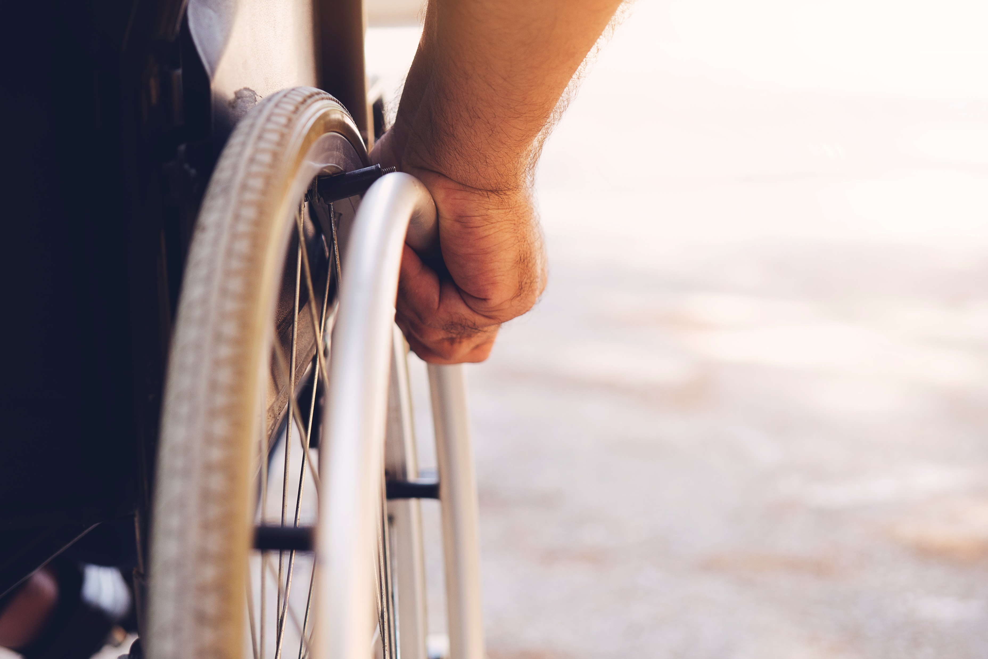
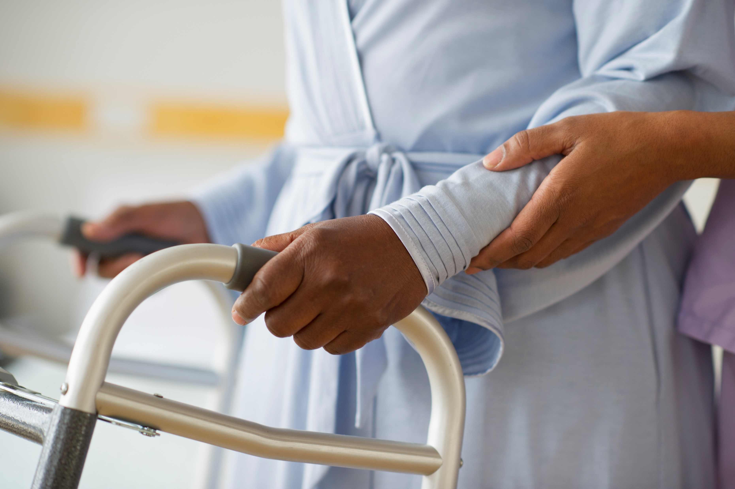
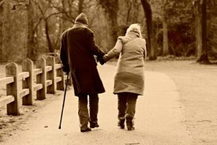

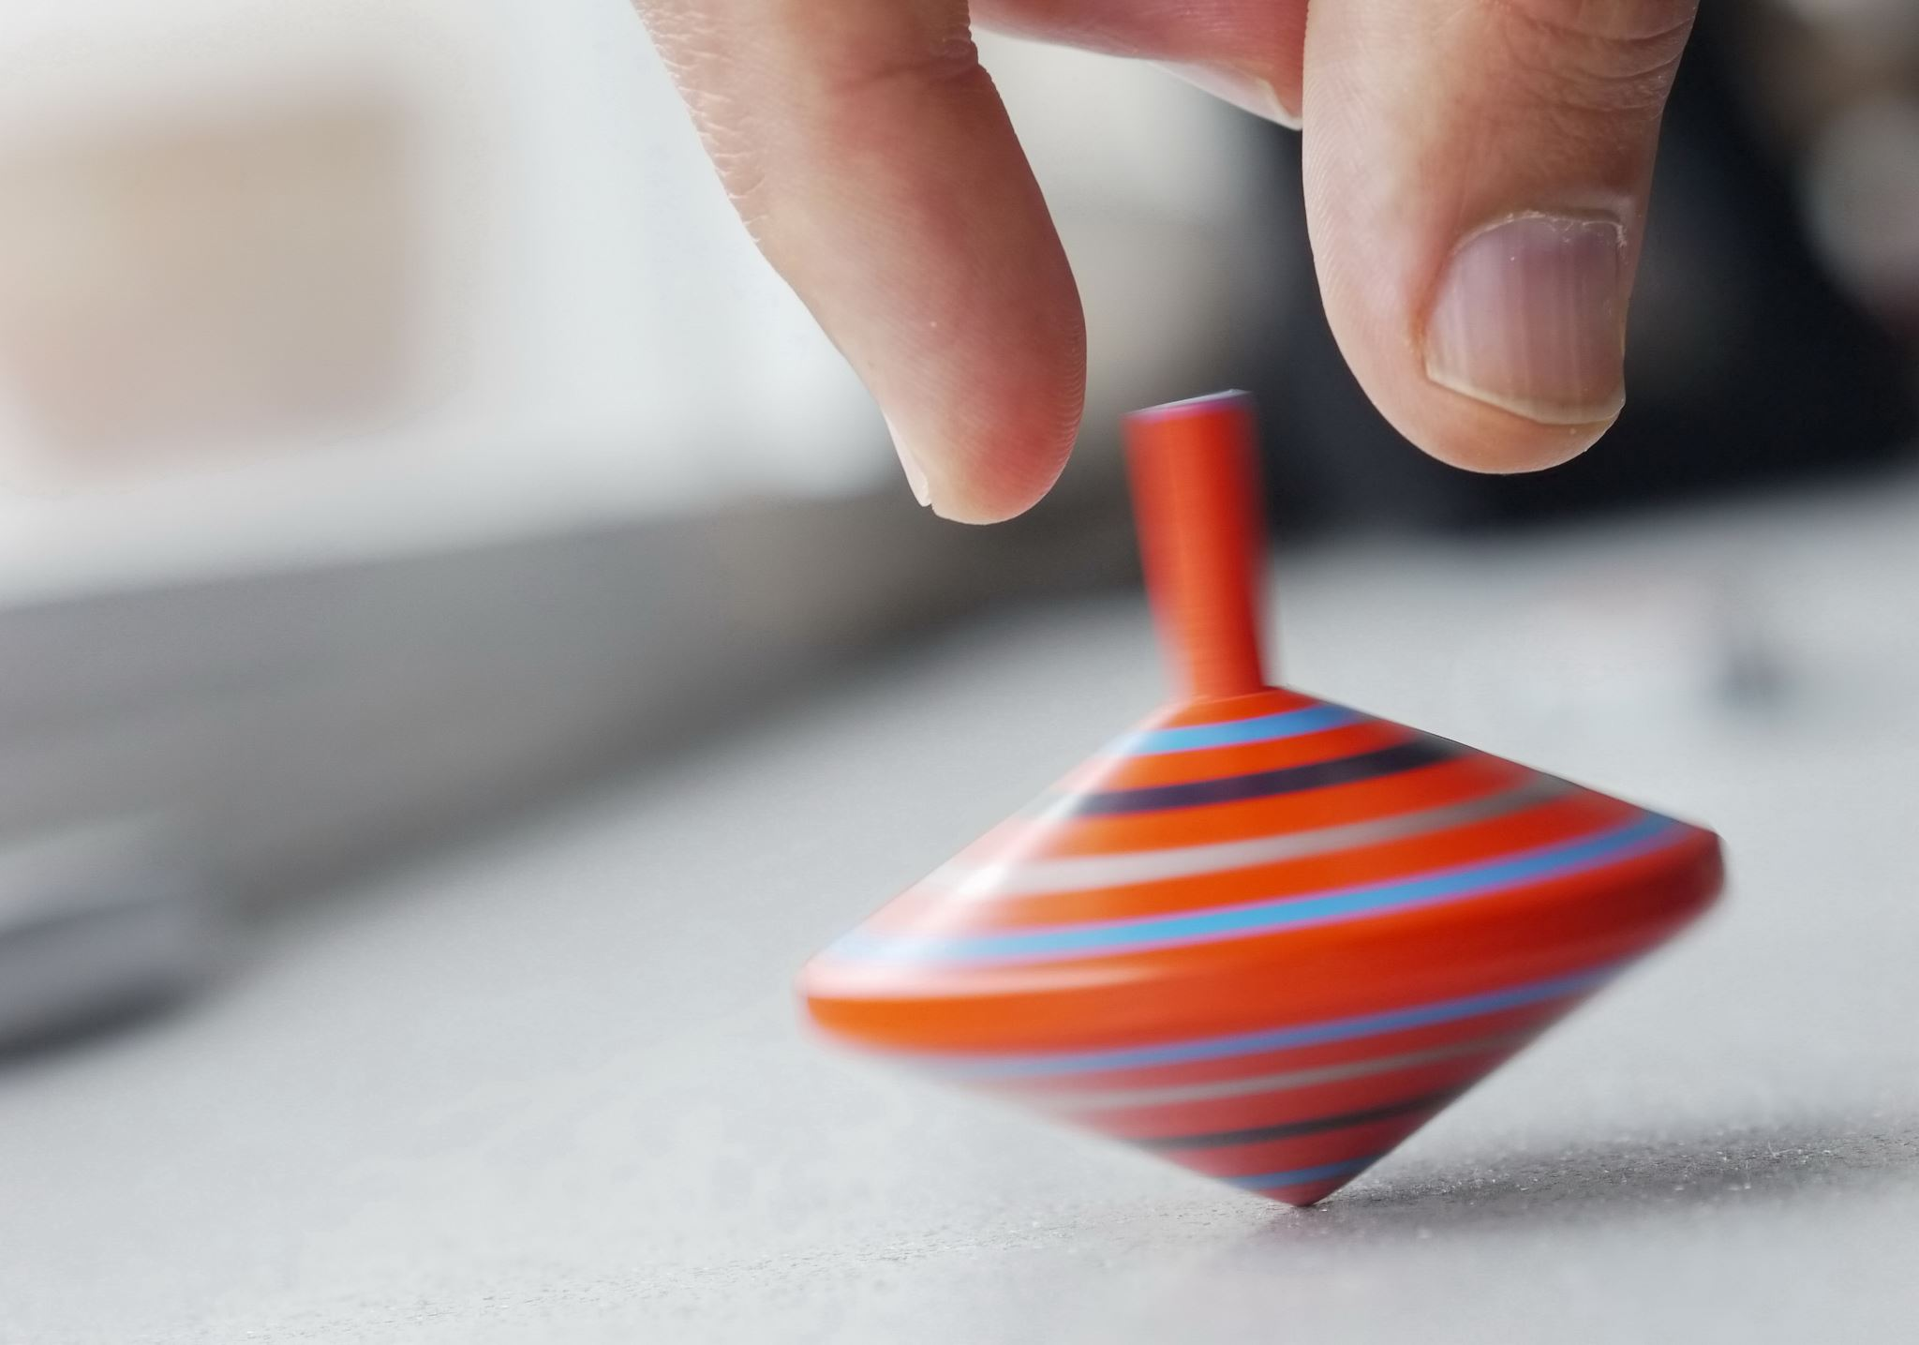
Neuro populations and risk factors for Mech LBP
Notes:
What is mechanical pain? Mechanical low back pain is the most common type of LBP, characterized by pain that varies with physical activity and position.
Mechanical low back pain vs back pain arising from a neuro diagnosis: mechanical meaning non sinister, able to treat and “fix” in clinic.
Mechanical low back pain:
Risk factors
Three classes of risk factor:
1. Individual and lifestyle
▪ History of back pain
2. Physical or biomechanical
▪ Prolonged or frequent bending or twisting
▪ Postural stresses (high spinal load or awkward postures)
3. Psychosocial (sedentary? Fear avoidant?)
Prognostic factors
Overall has a good prognosis
▪ Leg pain, sciatica, previous back pain, lack of centralisation associated with
poor prognosis.
1. Poor sitting posture
2. Frequency of flexion- AFO don/doff, prosthesis, wheelchair, balance right reactions and steadiness, dec tolerance, leaning on ADs
Frequent Diagnoses:
Parkinson’s
Chronic/Acute stroke
Status change/deconditioning
AFO
Amputee
Wheelchair bound due any one of these or other
Seizures
Dizziness

Slide 7
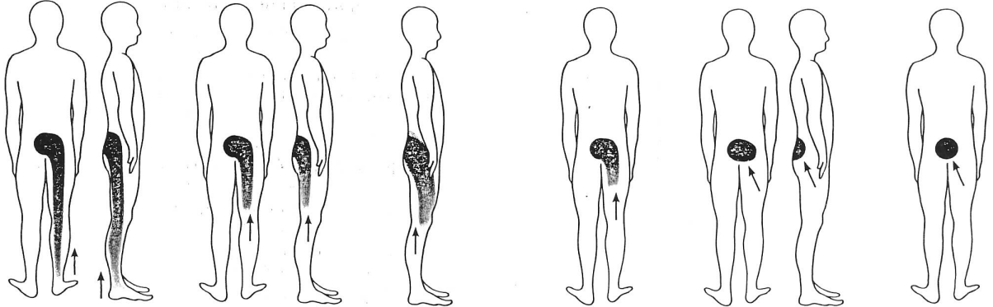
Mechanical vs Not so Mechanical
Correlated loss of motion
Change in range with change in symptoms
Variability, “sometimes”
Change in posture or position changes their symptoms
Notes:
Obstruction vs restriction: long car ride vs: *********
Discuss Centralization wrt Mech LBP
Non-mechanical low back pain (LBP) is pain that is not caused by movement or physical stress on the spine, and is not affected by positioning or activity. It can be caused by a number of things, including:
Systemic diseases, Infections, Tumors, Referred pain from other organs, such as the appendix, kidney, or large intestine, Inflammatory arthritis, Rheumatoid arthritis (RA)
Will discuss big bad ugly stuff shortly
Not so mechanical: rigidity in PD, tone in stroke or CP, let’s discuss how to tease these out

Slide 8
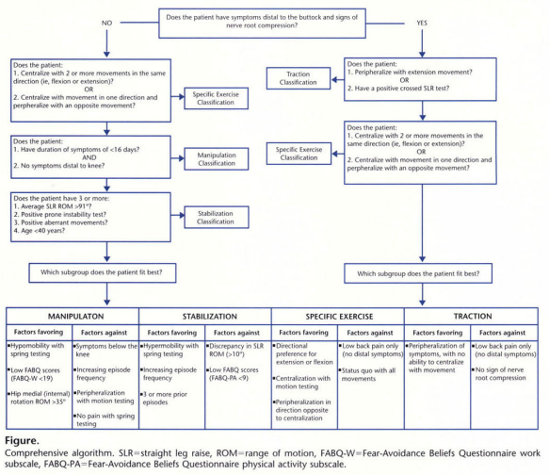
Exam & Eval
History
Baseline/
Comparable signs
Posture correction
Neuro screen
AROM
Strength
Mobility
Centralization
Notes:
History: When did this begin? Did something happen? Start something new? Looking for patterns in environment work and leisure activities. Constant or intermittent? Getting better, worse, staying he same? Agg factors? Relieving factors?
Mobility in wheelchair: repeated motions? Sustained posture?
Pain during an activity? Or after? What are they doing when they noticing? Just sitting on couch?
Posture correction: Change? Good indicator for mechanical
Neuro screen: Debate here, however may have more distal symptoms than originally thought and can be helpful in identified pain phenotype and monitoring centralization. Sensation dermatomes/myotomes, reflexes, SLR/cSLR, Slump
Baselines/Comparable signs: Must be relevant and important to patient, resting pain level, or a functional task or a specific exercise in neuro program
AROM: Is this normal for you? Don’t assume. Avoid guarding because can mask an obstruction or a normal end range.
Strength: Extremity baseline, even just holding upright posture. Core strength: debate woke up with this Tuesday. Lost strength overnight?
Mobility: Compensatory methods? Mobility in amb: unilateral trunk sway or pelvic rotation repeatedly. Favoring one side of spine vs other, leaning due to dec activity tolerance or furniture walking or using AD into flexed or bent over posture?
Centralization: Test via repeated motions. Start by est baseline/comparable sign be clear and concise. Start rep motions in direction that may be obstructed but also opposite that of aggravating factors. Retest baselines. Some of these chronic issues are very stable, might need more reps to see a change. PDM vs Pain as a result of a set of reps. Uni vs B symptoms, stay sagittal for symmetrical symptoms.
Test in positions that patient can reproduce at home. Cannot do standing extension? Offer slouch over correct. Arch over arm of couch, Forearms on wall with hip drop or hands on counter hip drop, or quadruped hip drop. Might need thoracic to nudge lumbar? Can’t do standing flexion? Do it sitting!
If patient centralizes with a set of motions, that’s your treatment! You’ve found their DP, prescribe and include in your Neuro treatment and go about your regular routine.
If they peripheralize with all motions may benefit from traction or stabilization. Might just need education to avoid peripheralization, manage postures. Patients who are more directed toward a manip POC via TBC are those with acute symptoms and no symptoms beyond the knee. Your comfort/knowledge.
Education: perform HEP frequently especially when feeling good, before a provocative task and after a provocative task. This becomes a prevention program to a much lesser intensity and frequency.
What else do I do? Education, environment adaptation equipment adaptation, strength to balance out deviations, neutral spine and postural awareness. Habit forming.

Slide 9

Treatment progressions for mech LBP patients
Restore ROM
Habits
Warning signs
Traffic light guide
Strength
Regular deposits
This Photo by Unknown Author is licensed under CC BY-SA-NC
Notes:
Acute: Symptom modulation vs movement control approach
Chronic: Manip, stabilization, Specific exercise, traction
Pain during activity or afterward when sitting and resting?
Core strengthening: Modify to meet pt needs and capabilities, introduce function as soon as able to.
Soft tissue mobilization: without centralization, be specific about position you have them in for this,
General exercise: pair with traffic light guide
“What directions can I move my patient if they have back pain”- ask them what hurts? What originally began hurting it? What are activities of their typical day like, is it biased toward one direction? May need to avoid it/modify temporarily- bandaid exmaple. Never a bad idea to encourage them to work from a neutral spine if attainable.
SOC
Pain phenotype:
Nociplastic: Central sensitization, phantom limb pain, CRPS, no identifiable nerve or tissue damage, neuronal dysregulation. NOT MECHANICAL.
Neuropathic: Damage to peripheral or central nerves, radiculopathy is an example
Nociceptive: damage to somatic or visceral tissue due to trauma or inflammation, ankle sprain, lumbar deformity
Can have several phenotypes at one time, need to identify which is more prevalent and address each. Match the treatment to the diagnosis.

Slide 10

But their neuro diagnoses won’t change…
But their gait isn’t really going to change
But they aren’t going to regain mobility beyond their wheelchair
But their neuro diagnosis is progressive
Notes:
All the more reason they know what causes their pain and what they can do to turn the volume down and prevent to a degree that makes life more comfortable and manageable.
MAKE DEPOSITS, strive for balance where it’s available
*********

Slide 11
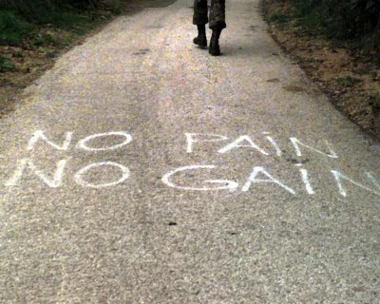
Neuro goals?
Notes:
Thoughts on working through pain to maximize neuro-driven goals versus taking a step back to address pain
Mixed bag
“How much weight can they carry/wear to avoid flaring up their pain?”- ask, test and retest

Slide 12
Karen history
R hip pain primarily with R buttock pain, long history of LBP however cataract surgery and sedentary recovery phase triggered a flare up
Limiting ability to participate in RSB and walk her dog, climb stairs taking anti-inflammatory twice/day
Pain location primarily R hip and groin and occass R SIJ, 0-6/10
VERY adamant it’s not her back
Notes:
History of Present Illness
Mechanism of injury: Pt present with R hip pain, which started approx 30 years ago however has recently had an exacerbation. She is a Rock Steady boxing participant (+ Parkinson’s diagnosis). She had cataract surgery 1 month ago, and with some complications, she had been less active for several weeks following, not doing PT or walking her dogs. When she returned to RSB at a light pace, she felt this R hip pain really became aggravated. Pt reports she feels like there is connective tissue sliding over bone, pt points to sit bone area. Pain can also be on lateral aspect of her hip which disturbs her sleep. Pt reports very rare and short lived groin pain. Not identifying any other symptoms elsewhere in leg, she does report history of "clunking" in her low back which has not been doing so lately. Pt taking antiinflammatory twice/daily which has been helping.
Stair climbing (1 FOS to second floor and 1 FOS to basement) is painful in her hip. Resting/seated can relieve her pain, usually relatively reclined.
Pt reports she has lost 20lbs in the last year, unintentionally, more related to a comorbidity that is being monitored.
Pt goals: Return to RSB pain free, Walk her dog pain free
Quality of life: good
Pain
Current pain rating: 0
At best pain rating: 0
At worst pain rating: 6
Agg factors: bending and twisting like in punches in RSB
Reliving: lounging reclined and laying down

Slide 13
Karen presentation
Loss of lumbar extension
Slight loss R hip ER and extension pain free throughout
R hip flexor strength 4+/5 compared to 5/5 pain free throughout
Rule out spine edu, Repeated motions, C
Notes:
History
Baseline/
Comparable signs
Posture correction
Neuro screen
AROM
Strength
Mobility
Centralization
Baseline slouched sitting with pain in sit bone, slouched and kyphotic
Posture correction:
Challenging, slight change in symptoms, moves from sit bone to R low back/buttock/SIJ
Sensation
Left Hip
Intact: light touch
Right Hip
Intact: light touch
Hypersensation: light touch
R lateral thigh feels like deeper pressure as compared to L lateral thigh during light touch.
Reflexes intact B
SLR (-)
cSLR (-)
Slump (+ mildly provocative)
Baselines: weight shifting “hot spot” in lateral hip on R 2/10
Lumbar Screen
Lumbar AROM:
Flexion WNL pain free
Extension min-mod loss discomfort in R buttock
R SGIS WNL NE
L SGIS WNL lateral R hip discomfort “not stretch but not positive”
Active Range of Motion
Left Hip
Normal active range of motion
Additional Active Range of Motion Details
R hip Trace loss ER, min loss Ext
Strength/Myotome Testing
Left Hip
Normal muscle strength
Additional Strength Details
R strength 5/5 throughout, 4+/5 MMT hip flexion all pain free
Mobility: taking more ginger steps on R but very mildly. No compensation to speak of.
Repeated motions testing: Baseline weight shifting 2/10 "hot spot"
RFIS 2x10 NE
REIS 2x10 NE lateral hip pain
REIS over fulcrum x10 NE
REIL x10 Centralizes to top of R buttock (baseline test with more vigor), improved AROM baselines and hip strength and sensation felt more normal

Slide 14
Karen POC
Repeated motions in DP
Postural stabilizers
RSB
Notes:
3x/week neuro, 1 week 2x/ortho, 1x/neuro
Week 2 and 3 back to 2x neuro and 1x ortho (Ortho PT right before RSB)
Stretch before and after RSB
Spoke with primary PT

Slide 15
George History
1115907624
Power wheelchair user due to complete paraplegia
Low back and thoracic pain, L scapular pain as well
Using biofreeze and lidocaine patches regularly
Nonambulatory, mechanical transfer
Notes:
History of Present Illness
Mechanism of injury: Patient reports continued upper back pain, described as numbness with spiking and sharp pain. Left superior angle of scapular pain and midline thoracic region. No pain with breathing. Symptoms always present but goes away with use of lidocaine patch or biofreeze that lasts about 10-12 hours. Pain has been present for years. Feels better sitting upright and when lying. No peripheralization of symptoms. Occasional sternal discomfort when bent forward for periods of time.
Patient Goals
Patient goals for therapy: decreased pain and increased strength
Pain
Current pain rating: 3
At best pain rating: 0
At worst pain rating: 6
Quality: sharp
Agg factors: not sure
Relieving factors: medications
Progression: no change

Slide 16
George Presentation
Major thoracic kyphosis and FHP
Loss of thoracic and lumbarAROM
Strong throughout, dermatomes and myotomes WNL
Thoracic extension and scapular engagement
Notes:
History
Baseline/
Comparable signs
Posture correction
Neuro screen
AROM
Strength
Mobility
Centralization
Baseline: 3/10 pain in low back and L thoracic
Posture correction: no change
Neuro screen: Modified
AROM
Thoracic % of normal
Flex. 100p!
Extn. 75
ROT Left 75
ROT Right 50
Strength: modified
MMT
Shld L R
Flex. 5 5
Extn. 5 5
Abd. 5 5
Add.
IR. 5 5
ER. 5 5
MMT
Elbow L R
Flex. 5 5
Extn. 5 5
Posture: forward head and shoulders posture in sitting
Palpation: T2 and scapular region
Mobility: power wc
Repetitive testing: thoracic extension= better

Slide 17
George POC
Stretch and scap engagement
2 visits in 6 days
Notes:
Very compliant
Pain free

Slide 18
Beverly History
Referral from Speech therapy
LBP and balance deficits (can’t start neuro PT yet because can’t tolerate standing due to pain)
Spends a lot of time in her recliner
Notes:
**********
History of Present Illness
Mechanism of injury: Pt has had chronic low back pain over the course of >6 months and worse in the past week. Pain with motion. Trouble getting OOB is very challenging and painful, and her son Russell is able to share she is generally very stiff. She feels good sitting in her lounge chair with heating pad. Lidocaine patches occass help her pain. Pt is taking tylenol, gabapentin, and tramadol none of which offer much relief. Pain is only in back, no radiating symptoms. Pt denies sleep disturbance, sleeps on her back (propped up on wedge). Pt feels significant aggravation of pain when in her wheelchair going over small bump or flooring changing or bump while riding in car. Pt had a fall in November, slipped and was caught by her son, didn't injure herself.
Changing position can help her pain. Pt is generally mobile with Rolator in her home, using wheelchair in community lately. She needs help from her son to get up from a sitting position. She did however had shingles in this same area about 5 years ago. Peritoneal dialysis nightly (+). Seeing speech therapy for swallowing. Hx CVA(+). Question of parkinson's type symptoms, to be assessed in future.
Pt was referred to PT from her speech language pathologist.
Quality of life: fair
Pain
At best pain rating: 8
At worst pain rating: 10

Slide 19
Beverly Presentation
Wheelchair, slouched forward, falling asleep
L and midline lower thoracic upper lumbar pain

Slide 20
Beverly POC
Follow up visits more enlightening to set up, less active than initially described, TV and table and all things she looks at and uses and grabs for are on one side
Environment modification limited and resistant
Added thoracic rotation, SOC, postural edu,
Notes:
Refer to neuro PT with request to do thoracic rotation

Slide 21
Eval & Exam (review from earlier)
History
Baseline/ Comparable signs
Posture correction
Neuro screen
AROM
Strength
Mobility
Centralization

Slide 22
How do you know if it isn’t mechanical
Inflammation
Chronic Pain
Tone/rigidity
Medication side effects
Notes:
Mechanical LBP will often change with a change in posture or positions, often change with time of day or activities. Can peripheralize and centralize. Constant or intermittent, radiate or refer or remain local.
Inflammation: from trauma, or MS, RA, Psoriatic arthritics
Chronic Pain: Yellow or red flags, diagnosed with chronic pain syndrome – nociplastic, need to meet them where they’re at
Tone: cerebral palsy, stroke, multiple sclerosis, Parkinson's disease, or posttraumatic brain or spinal cord injury
Meds: bisphosphonates for osteoperosis (Boniva), alendronate (osteoperosis), betablockers for BP (small %), Plavix (blood thinner), propranolol (blood pressure), crestor (cholesterol), simvastatin (cholesterol), atenolol (BP)
Rule it out: No affect via positions or postural changes, no loss of motion or regaining lost motion makes no change on symptoms, symptoms neither centralize or peripheralize- they're more nonspecific in nature, really want to educate traffic light guide to maximize environment

Slide 23

When it isn’t mechanical
Notes:
You identifying that it isn’t mechanical is just as effective as identifying that it is! Get them to the right place!
Next step? Multidisciplinary team: advanced spine practitioner in PT network 1 visit? Or pain management? Rheum? Just exercise but educate to traffic light guide and managing good body mechanics and exercise to level of aerobic capacity
Can always refer to ortho PT: this isn’t a grab at a DA eval (if it is split it), but it’s not a burden if it’s a 1 or 2 visit rule out. Might be all they need and can send right back with a HEP that can be done during neuro PT. How to have this conversation neuro to ortho and ortho to neuro. Sometimes it is simply a matter of cueing to perform exercise in a modified posture or more neutral posture
“If referring to ortho PT what do I need to do?”
Billing: Re-Evaluation, add diagnosis like lumbar radiculopathy or low back pain, update goals, treatment can fall under therex or neuro re-ed, education theract.
May benefit from dry needling, cupping, more involved soft tissue, repex table, extensive list
Or mentorship program!
Referral from Josh example
Referral for ESI example
Other cases: Cases:, joan, jeff h, Ernie (non mech)

Slide 24

Notes:
Spinal fractue .7%
Cancer <.1%
Osteomyelitis <.1%
Cauda equina .1%
Ankylosing spondylitis .2%
Cardiac disease <.1%
Myelopathy <.1%
=<2%
Red flags include progressive motor or sensory loss, new urinary retention or overflow incontinence, history of cancer, recent invasive spinal procedure, and significant trauma relative to age.
Unexplained weight loss
Unremitting pain that is constant
Night pain
Brisk or asymmetrical reflexes
Recent infection
Saddle anesthesia

Slide 25
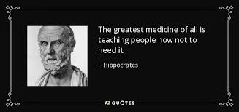
Prevention
HEP
Frequency
Ergonomics
6 months check in
EDUCATION
Notes:
What education can we provide early on in care to prevent/minimize low back pain?
“We should be able to move in all directions comfortably.” Be familiar with how you move and if you feel your motion is different from one day to the next unrelated to your tone etc, but also you feel pain with this, that could be correlated. The body wants balance so take an inventory fo how you move over the course of a day, amputee so move in certain direction primarily, wearing AFOs and balance is off so leaning on things often, find balance.
Traffic light guide

Slide 26

Why does this matter?
QOL
Dec dependency on caregivers
Notes:
Nature of mech lbp- recurrent and episodic, number one pre-disposing factor is a hx of lbp

Slide 27
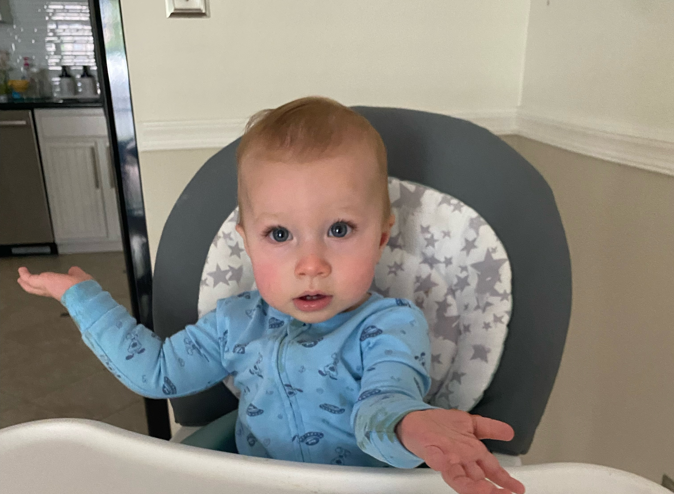
Questions?
Kathryn.Wilkens@sluhn.org
Notes:
Quick review: Change of position or posture affect their symptoms? Ask the questions. Collect baselines and test against them. Inquire about normalcy and affect on symptoms. Consider envoironment and pattersn, find what reduces the symptoms and incorporate. Encourage balance and possibly temporarily avoiding the provoking activity or position. Educate to symptom management and postural awareness. Ask for help where you need it knwing the goal is to prioritize neuro goals.
In patients with PD (e.g. stiff/rigid), should we be looking at more than a mechanical bias (e.g. extension or flexion)?
At what point is it appropriate to refer to ortho versus treat ourselves (as neuro PTs)?
What education can we provide early on in care to prevent/minimize low back pain?
Thoughts on working through pain to maximize neuro-driven goals versus taking a step back to address pain
Red flags for referral
what motions should i avoid / what motions should i do
how much weight can they carry around/ will that flare up their back pain
Is this person's orthopedic impairments causing their pain somethign that should be fixed by utilizing our knowledge of motor learning and neuroplastic principles we can apply to the neurologic diagnosis rather than doing manual therapy or more "orthopedic" interventions
2. Is the patient's pain or orthopedic limitation somethign that is fixable or improveable if their gait/lower extremity coordination likely will not improve in any significant way
3. How do I decide if doing the best thing for their neurologic impairments is more important or of higher priority than addressing their orthopedic impairments when I am limited by their overall tolerance and energy level and my time for activity in a single session

Slide 28
References
1. Liampas A, Neophytou P, Sokratous M, et al. Musculoskeletal Pain Due to Wheelchair Use: A Systematic Review and Meta-Analysis. Pain Ther. 2021;10(2):973-984. doi:10.1007/s40122-021-00294-5
2. Duncan RP, Van Dillen LR, Garbutt JM, Earhart GM, Perlmutter JS. Low Back Pain--Related Disability in Parkinson Disease: Impact on Functional Mobility, Physical Activity, and Quality of Life. Phys Ther. 2019;99(10):1346-1353. doi:10.1093/ptj/pzz094
3. Osama, M. Postural stability, fall risk and sensoryintegration of balance in discogenic lowback pain. Physiotherapy Practice and Research 43 (2022) 91–96. DOI:10.3233/PPR-210593
4. Latheef A, Ramalingam V, Balakrishnan P, Ganesan S. Efficacy of Spinal Extension Exercise and Ergonomic Advice for Non-specific Low Back Pain Among University Population. Indian Journal of Physiotherapy & Occupational Therapy. 2024;18:459-464. doi:10.37506/bjah3t73
5. Terao T, Kato N, Sasaki Y, et al. Multimodal treatment including lumbar facet joint denervation for severe low back pain in patients with neuromuscular disorders. Neurological Sciences. 2022;43(1):593-601. doi:10.1007/s10072-021-05298-9
6. Dunn KM, Jordan KP, Croft PR. Contribution of prognostic factors for poor outcome in primary care low back pain patients. Eur J of Pain 2011;15:313-319.
7. Gilkey DP, Keefe TJ, Peel JL, Kassab OM, Kennedy CA. Risk factors associated with back pain: a cross-sectional study of 963 college students. J Manip Physiol Ther 2010;33:88-95.
8. Hayden JA, Dunn KM, van der Windt DA, Shaw WS. What is the prognosis of back pain? Best Pract & Res Clin Rheum 2010;24:167-179.
9. Hoy D, Bain C, Williams G, March L, Brooks P, Blyth F, Woolf A, Vos T, Buchbinder R. A systematic review of the global prevalence of low back pain. Arth & Rheum 2012;64:2028-2037.
10. Tasha R Stanton et al. PHYS THER 2011; 91: 496-509

