Slide 1
Physical Therapy’s Role in Screening and Treating Hypermobility Spectrum Disorder and Hypermobile Ehlers-Danlos Syndrome
Tyler Shotto

Slide 2
Disclosures
No disclosures to announce.
No financial relationship to any institutions involved or references sourced.

Slide 3
Terminology
Ehlers Danlos Syndrome – EDS
Hypermobile Ehlers Danlos Syndrome – hEDS
Hypermobility Spectrum Disorder – HSD
Generalized Joint Hypermobility – GJH
Joint Hypermobility – JH
Joint Instability – JI
Heritable Connective Tissue Disorder – HCTD
Upper Cervical Instability – UCI
Mast Cell Activation Syndrome – MCAS
Postural Orthostatic Tachycardia Syndrome - POTS

Slide 4
Presentation Objectives
By the end of this presentation, audience will be able to do the following:
Understand current updates on EDS and HSD
Identify and classify a patient with hypermobility
Use appropriate screening tools and outcome measure for EDS and HSD
Treat, educate, and refer a patient with EDS and HSD
Prescribe, refer for, or modify orthoses for hypermobility
Create an appropriate plan of care for patients with EDS or HSD

Slide 5
What is Ehlers Danlos Syndrome?
Hypermobility of tissues throughout the body
13 different types, named for the tissue affected
Hypermobile EDS (hEDS) makes up >90% of all cases
Genetic condition
  Gene mutations identified for 12 of the 13
  No gene for hEDS
Clinical Diagnosis made using 2017 Criteria
“Hypermobility Spectrum Disorder”
  Those with symptomatic hypermobility who do not meet diagnostic criteria
PT’s are the BEST clinicians to identify and manage this condition!

Slide 6
Are Physical Therapists Experts on EDS and HSD?
Knowledge, assessment, and management of adults with joint hypermobility syndrome/Ehlers–Danlos syndrome hypermobility type among flemish physiotherapists
Lies Rombaut, Janet Deane, Jane Simmonds, Inge De Wandele, Anne De Paepe, Fransiska Malfait, Patrick Calders March 2015
Survey Category
General Knowledge
Features Associated
Impact on QOL
Confidence Levels
In Treating
In Assessing
Want to Learn More
Score
34%
30%
“74.6% of therapists reported that they had never evaluated
an JHS/EDS-HT patient”
48%
40%
4%
80%

Slide 7
What is the Treatment for EDS and HSD?
No known cure for EDS
Treatments are symptom-dependent
  Medications
  Psychotherapy
  Pain Management
  Cardiac, GI, OBGYN
  Physical Therapy
No treatment without a diagnosis
– Takes an average of 14 years

Slide 8
What is the Prevalence of EDS and HSD?
Ehlers-Danlos Syndrome
  1 in 5000
    Pyeritz (2000)
  1 in 3100
    Demmler et al. (2019)
Hypermobility Spectrum Disorder
  1 in 500 to 1 in 900
    Hakim & Grahame (2006), Cederlöf et al.(2016)
Joint Hypermobility
  1 in 3 to 1 in 10 in adolescents
    Blajwajs (2023)
Screen these patients!

Slide 9
“The Diagnostic Odyssey” (Halverson, 2021)
Interviews with 22 patients diagnosed with EDS
  Participants described a “precipitating event” that triggered their quest
    Head trauma, Pregnancy, MVA, Depression
  “I became worse,” following PT unaware of EDS
  “They're basically throwing things at a wall to see what sticks,”
  “You get a bad [doctor] and then it'll take years before somebody will
  convince you to go back [to the clinic],”
  Abandoned beloved hobbies and athletic pursuits
  Changed careers because they didn’t believe they could perform the responsibilities
  Seen more than 200 doctors over the course of a decade-long search for a diagnosis.
  “It felt like, once I got the EDS diagnosis, ‘Oh, that makes sense! I make sense!’”

Slide 10



Ehlers-Danlos Society Logo
“When you hear hoofbeats,
think horses, not zebras.”

Slide 11
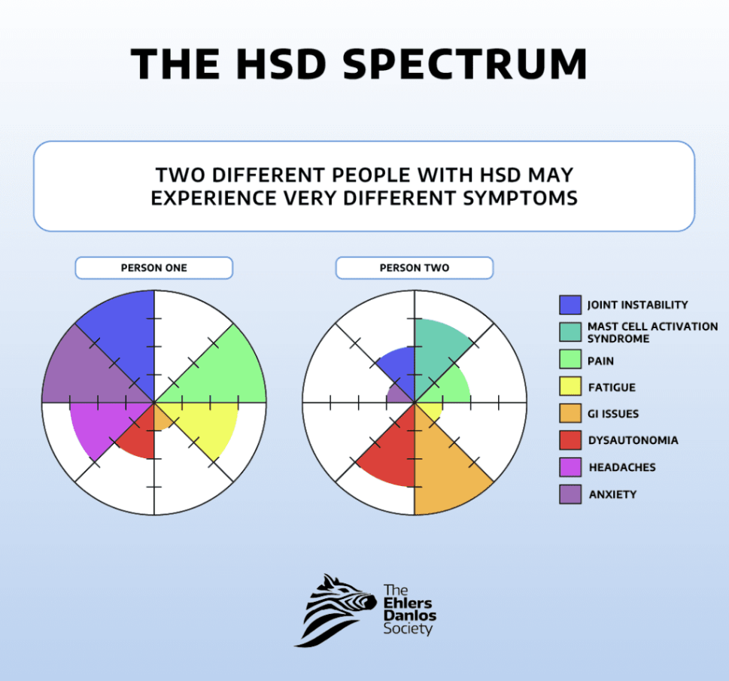

Slide 12
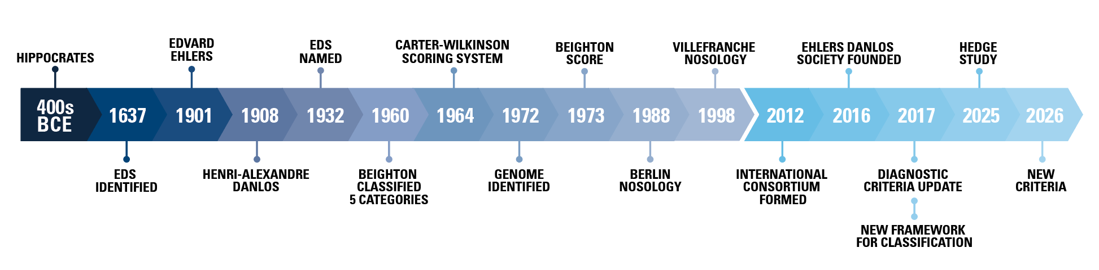
History
“In the UK, rheumatologists’ estimates of the number of cases seen annually strongly suggest that the true diagnosis in a majority of patients with JHS is overlooked (up to 95%). If these data are confirmed,
the specialty of rheumatology worldwide will justly hang its
corporate head in shame.”
- Rodney Grahame, 2007

Slide 13
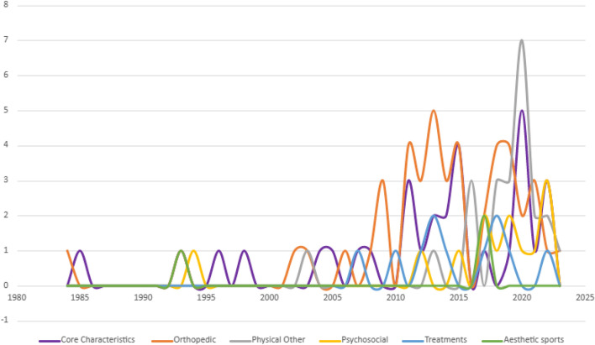


What is New for EDS and HSD?
International Consortium formed 2012
Ehlers Danlos Society Founded 2016
Diagnostic Criteria Update 2017
New Framework for Classification 2017
HEDGE Study 2025
New Criteria in 2026
Studies on Children with GJH per year

Slide 14
A Framework for the Classification of Joint Hypermobility and Related Conditions
Castori M, Tinkle B, Levy H, Grahame R, Malfait F, Hakim A.
2017
3 Groups
1. Asymptomatic Joint Hypermobility
2. Ehlers-Danlos Syndrome
3. Hypermobility Spectrum Disorder

Slide 15
New Terminology
Ehlers–Danlos syndrome type III (EDS III)
Ehlers–Danlos syndrome hypermobility type (EDS-HT)
Hypermobility syndrome (HS)
Joint hypermobility syndrome (JHS)
Benign joint hypermobility syndrome (BJHS)
Replaced with:
Hypermobile Ehlers Danlos Syndrome (hEDS)
Hypermobile Spectrum Disorder (HSD)
  Generalized (G-HSD)
  Local (L-HSD)
  Peripheral (P-HSD)
  Historical (H-HSD)

Slide 16
1. Asymptomatic Joint Hypermobility
Localized Joint Hypermobility (LJH)
  Measured at fewer than 5 joints
  Past trauma, joint disease, or training
  Less often congenital
Generalized Joint Hypermobility (GJH)
  Measured at 5 or more joints (four limbs and axial skeleton)
  More often congenital, but can be acquired
Peripheral Joint Hypermobility (PJH)
  Appreciable at hands or feet only
  More common in toddlers
  Absence of large or axial joint involvement
Historical Joint Hypermobility (HJH)
  Two or more on the Five-point questionnaire
  Negative Beighton Score

Slide 17
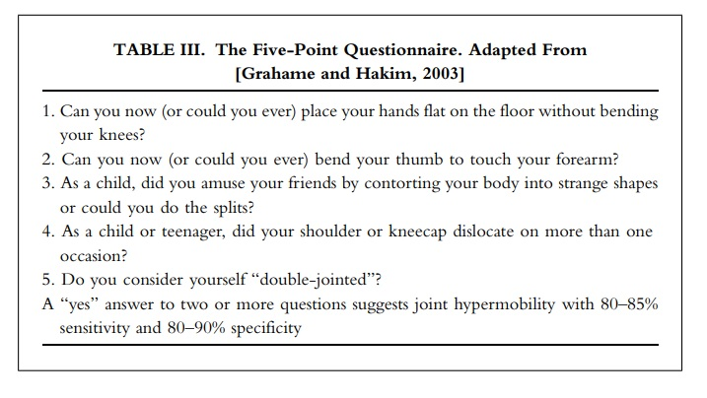
Historical Joint Hypermobility

Slide 18
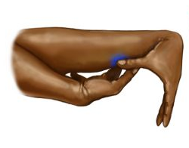

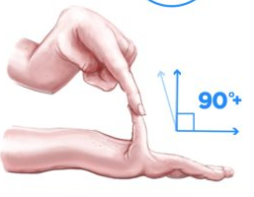
Generalized Joint Hypermobility
Beighton Scale
  ≥ 6 pre-pubertal children
  and adolescents
  ≥ 5 pubertal men and women
  up to age 50
  ≥ 4 men and women
  over the age of 50

Slide 19
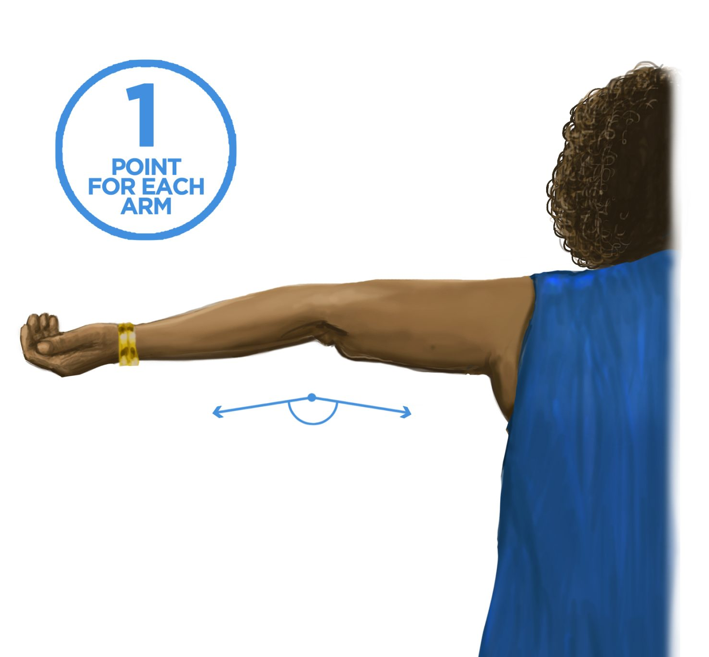
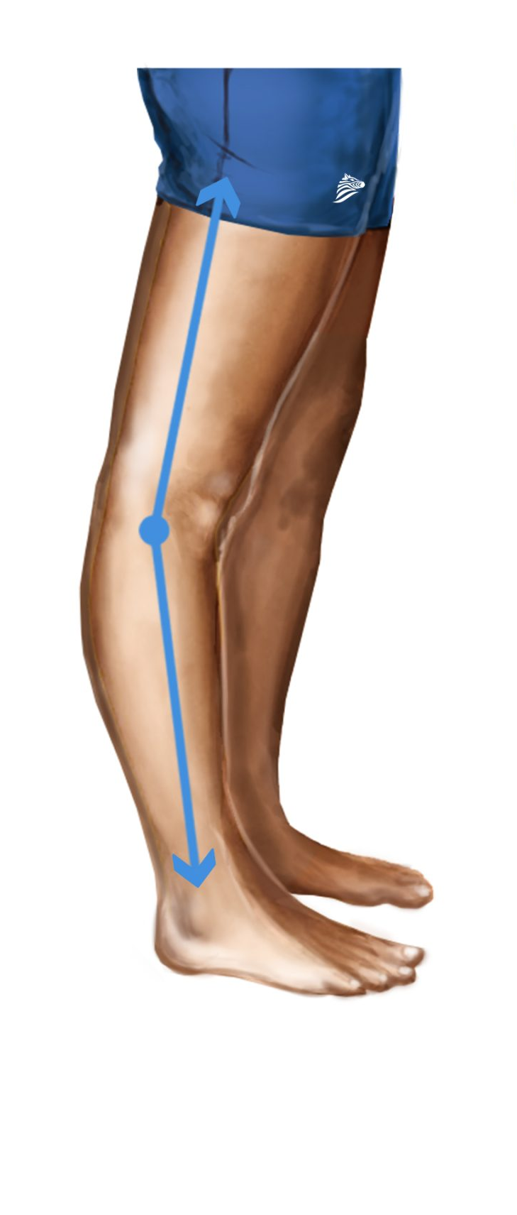
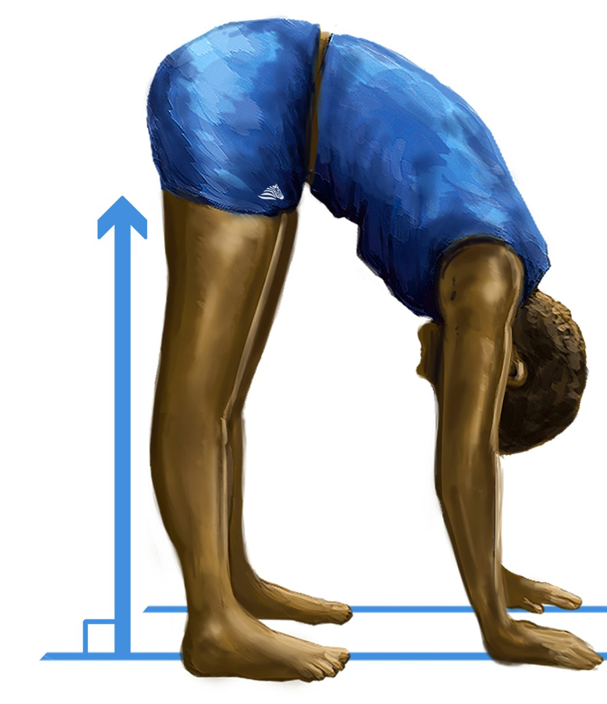
Generalized Joint Hypermobility

Slide 20

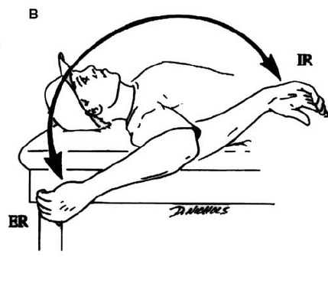
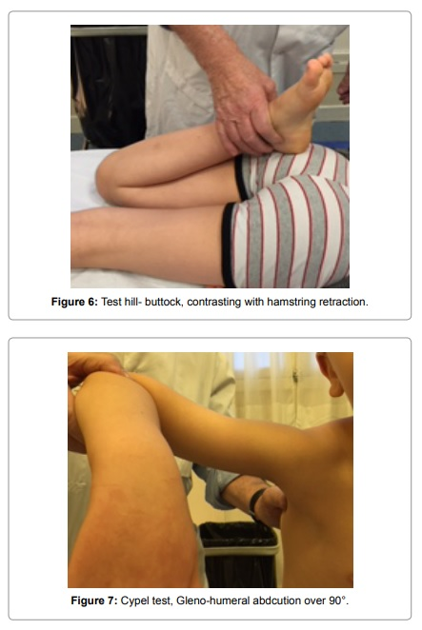
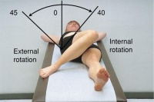
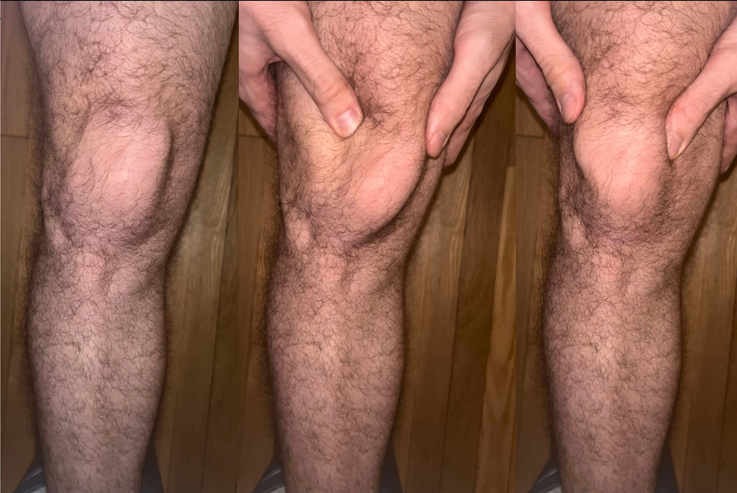
Localized Joint Hypermobility

Slide 21
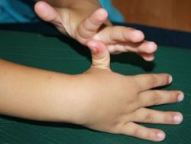
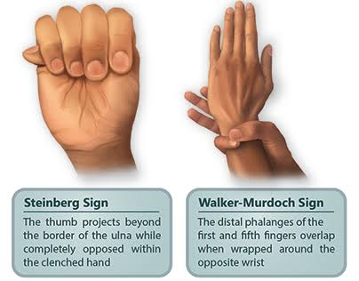
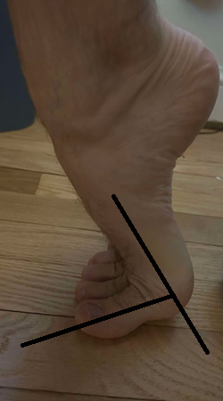
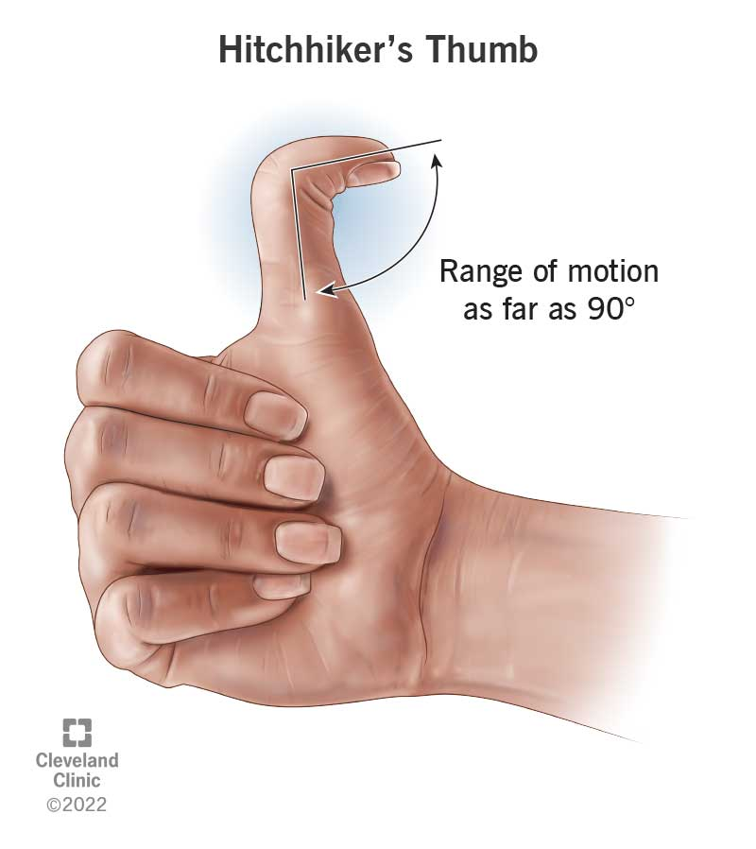
Peripheral Joint Hypermobility

Slide 22
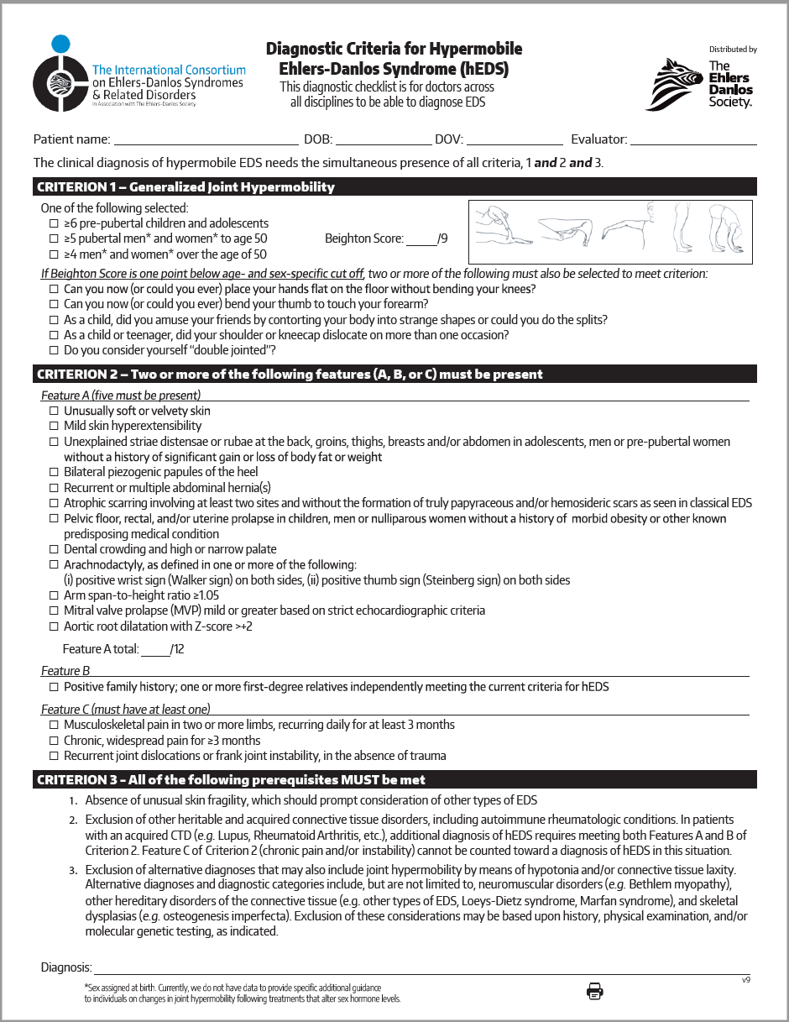
2. Ehlers-Danlos Syndrome
HCTD featuring Joint Hypermobility
2017 Diagnostic Criteria
  Patient must have all criteria 1, 2, and 3
    Criterion 1 – GJH
    Criterion 2 – 2 or more of the following:
      Anthropometric features
      Family Hx
      Pain and/or Hx Dislocations
    Criterion 3 – All Three of the following:
      Absence of skin fragility
      Exclusion of other HCTD’s
      Exclusion of alternative dx

Slide 23
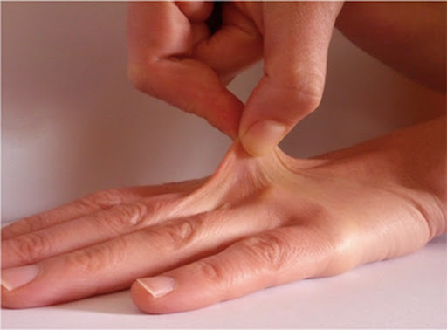
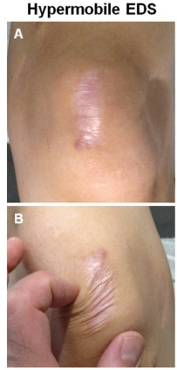
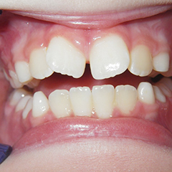

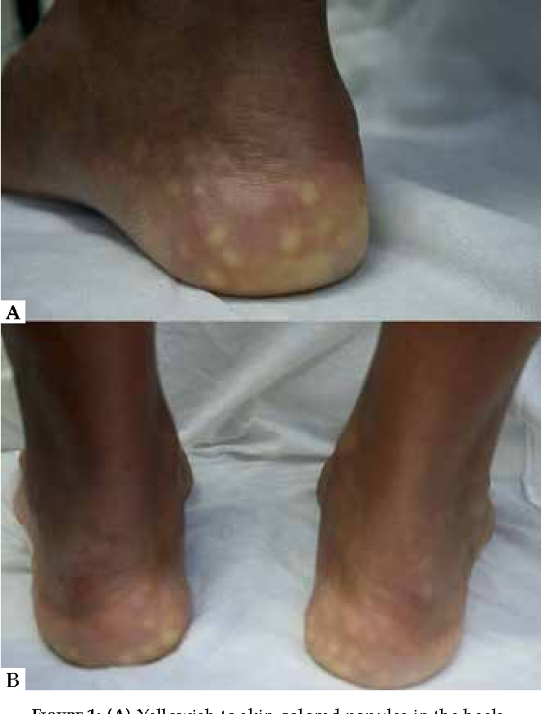

Criterion 2
Feature A (5 must be present)
  Unusually soft or velvety skin
  Mild skin hyperextensibility
  Unexplained stretch marks not at joints
  Bilateral piezogenic papules of the heel
  Recurrent or multiple abdominal hernia(s)
  Atrophic scarring involving at least two sites
  Predisposing medical condition
  Dental crowding and high or narrow palate
  Pelvic floor, rectal, or uterine prolapse
  Arachnodactyly (Walker’s Sign and/or Steinberg sign)
  Arm span-to-height ratio ≥1.05 (>+3 Ape Index)
  Mitral valve prolapse
  Aortic root dilatation with Z-score >+2
+7

Slide 24
3. Hypermobility Spectrum Disorder
Localized Hypermobility Spectrum Disorder (L-HSD)
  Measured at fewer than 5 joints
  Past trauma, joint disease, or training
  Less often congenital
Generalized Hypermobility Spectrum Disorder (G-HSD)
  Measured at 5 or more joints (four limbs and axial skeleton)
  More often congenital, but can be acquired
Peripheral Hypermobility Spectrum Disorder (P-HSD)
  Appreciable at hands or feet only
  More common in toddlers
  Absence of large or axial joint involvement
Historical Hypermobility Spectrum Disorder (H-HSD)
  Two or more on the Five-point questionnaire
  Negative Beighton Score
One or more secondary musculoskeletal manifestations

Slide 25
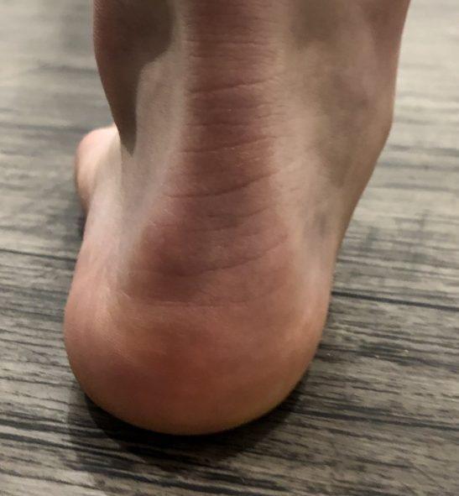
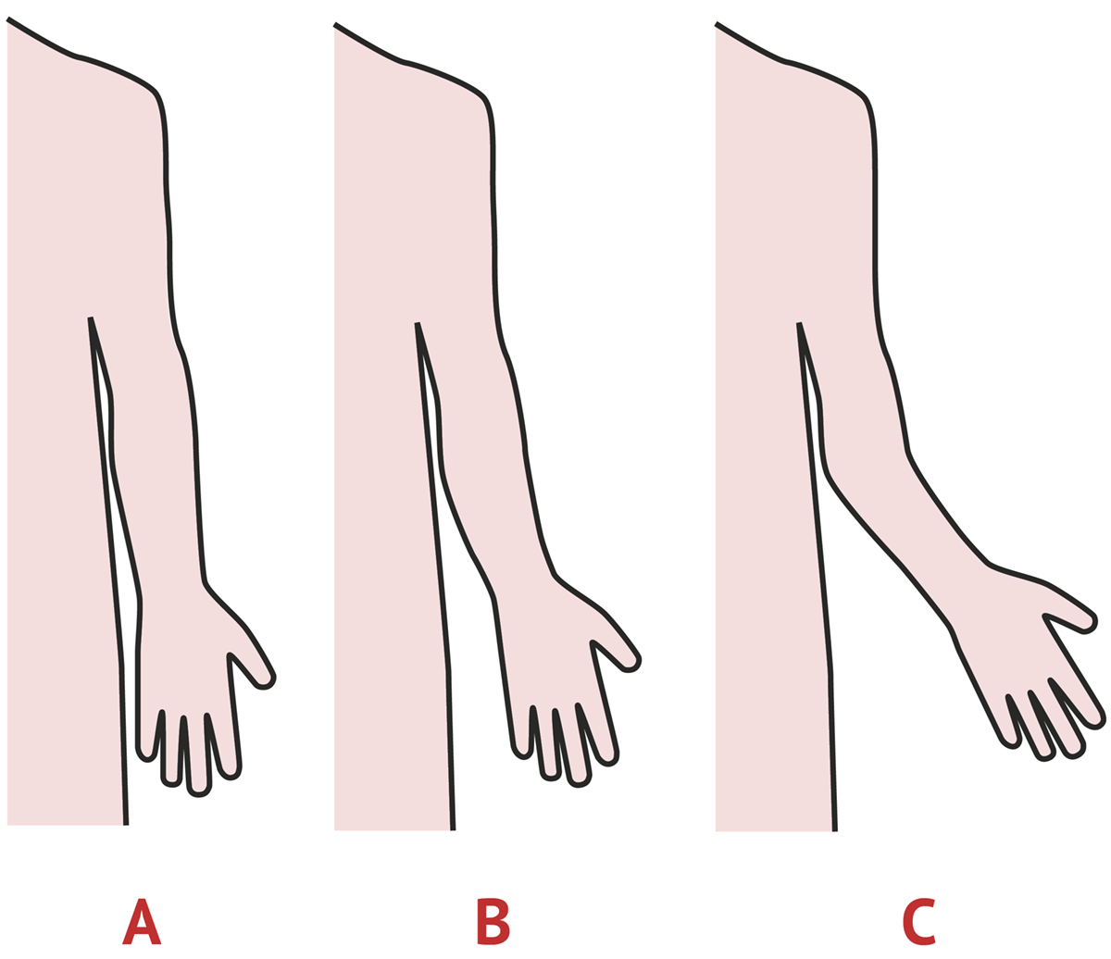
Secondary Musculoskeletal Manifestations
Symptoms and complications resulting from hypermobility
  Trauma
    Macro – dislocations, subluxations, soft tissue injuries
    Micro – beyond end range activity, creep, tissue inflammation
  Chronic pain – Hyperalgesia
  Disturbed Proprioception (“Clumsiness”)
    Muscle weakness? Cortical smudging?
  Musculoskeletal Features
    Dynamically flat feet and Valgus Hindfoot
    Valgus Elbows
    Scoliosis (Cobb > 7) or Kyphosis
    Criterion 2

Slide 26
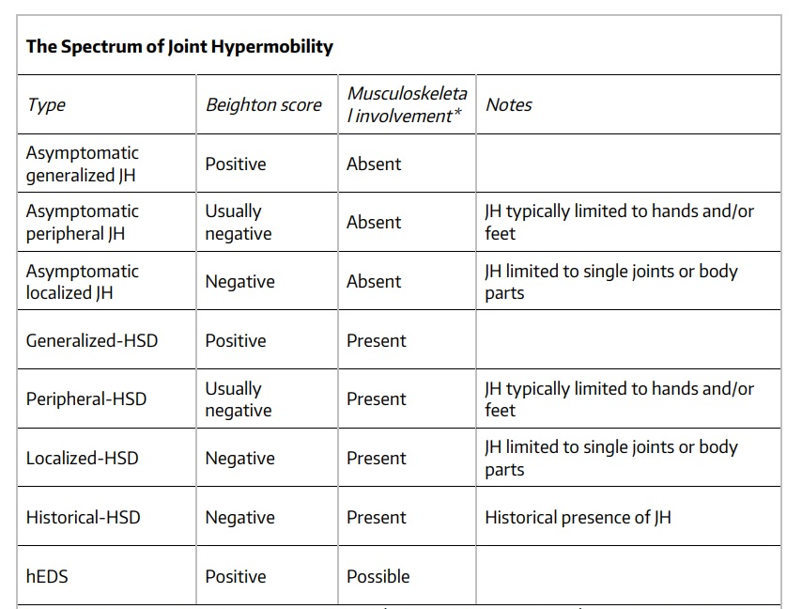
A Framework for the Classification of Joint Hypermobility and Related Conditions
1
3
2

Slide 27
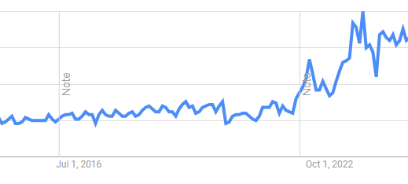
Related Conditions
  Neuromusculoskeletal Complications
  Pain
  Fatigue – Chronic Fatigue Syndrome
  POTS – Postural Orthostatic Tachycardia Syndrome
  Gastrointestinal – SIBO, IBS
  Urogenital – Prolapse, Incontinence
  Anxiety/Depression
  MCAS – Mast Cell Activation Syndrome
  Autoimmune Dysfunction
  Chiari Malformations
  Tethered Cord Syndrome
  Craniocervical Instability
10 year Google Trend for “Hypermobility”

Slide 28













“What is something you thought was normal that turned out to be EDS?”

Slide 29

In Summary

Slide 30
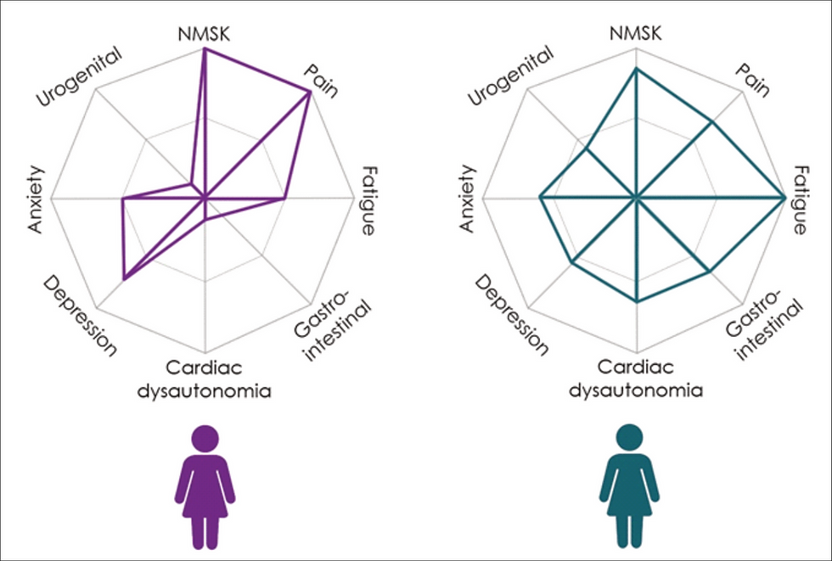
The Spider
Every HSD patient is different.
8 Domains
  Neuromusculoskeletal
  Pain
  Fatigue
  Cardiac dysautonomia
  Gastrointestinal
  Urogenital
  Anxiety
  Depression
TheSpiderTool.com

Slide 31
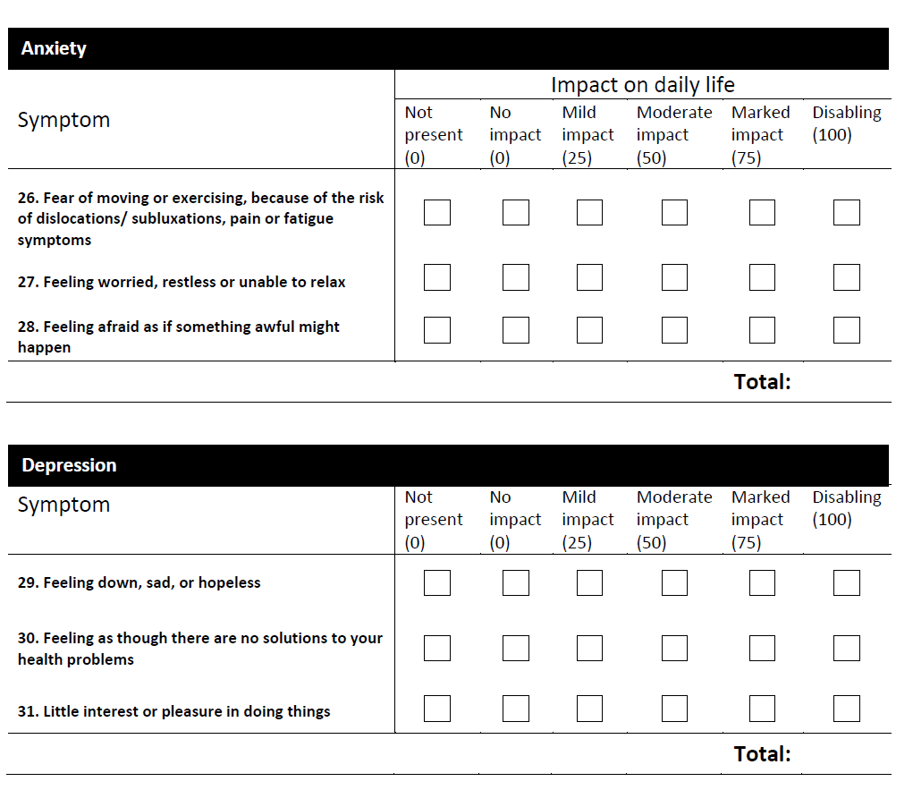

Slide 32
Presentation and physical therapy management of upper cervical instability (UCI) in patients with symptomatic generalized joint hypermobility (S-GHJ): International expert consensus recommendations
Leslie N Russek, Nancy P Block, Elaine Byrne, Susan Chalela, Cliffton Chan, Mark Comerford, Nicole Frost, Sharon Hennessey, Ann McCarthy, Leslie L Nicholson, Jason Parry, Jane Simmonds, Patricia J Stott, Lucy Thomas, Julia Treleaven, Wendy Wagner, Alan Hakim
January 18, 2023
“Although PTs are likely to treat these patients, there are no published guidelines for safe, conservative assessment or management of UCI…”
Mild UCI in S-GJH is common (52–66%); while severe UCI is uncommon (5%) (Malhotra, 2020)
Upper cervical instability (UCI) can result in serious health problems
UCI exists on a spectrum and can quickly change
Determination of UCI requires that two criteria be met:
  Symptoms consistent with musculoskeletal and/or neurological UCI
  Symptoms are altered by neck movement and/or position.

Slide 33
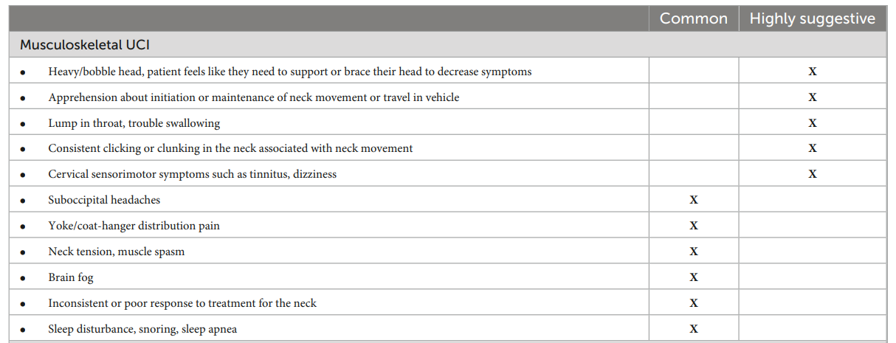
Musculoskeletal UCI Symptoms

Slide 34
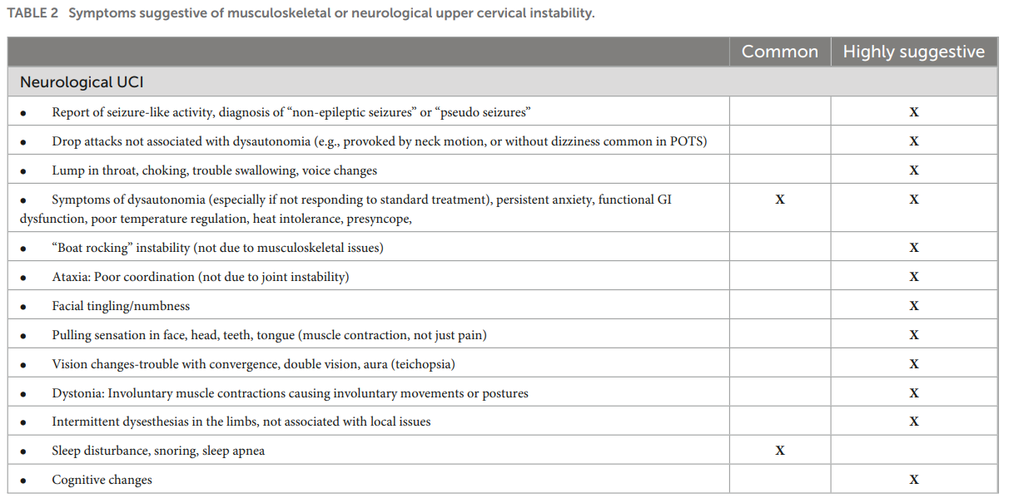
Neurological UCI Symptoms

Slide 35

Physical Therapy’s Role in hEDS and HSD
What Helps?
Education
Pain neuroscience education
Reassurance
Relaxation training
Strengthening
Core stability
Proprioception
Balance
Splints, Orthoses, Tape
Manual Therapy
  Dry needling, STM, TP
What to Avoid?
Dependent end-ranges
Spinal end ranges
Open-chain, high DoF
Manipulations (Grade 5)
High Impact
Dynamic Stretching
Stretching near
hypermobile joints

Slide 36

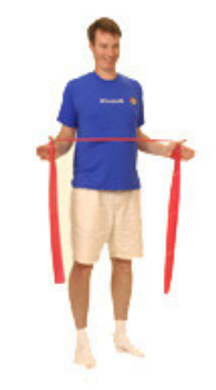

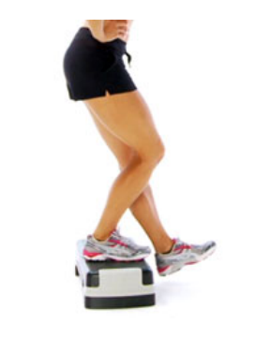
Exercise Considerations
  Progressions
  Small ROM > Large ROM
  Low Load > High Load
  Bilateral > Unilateral
  Symmetric > Asymmetrics
  CKC > Semi CKC > OKC
  Stability > Perturbation
          Approximation
Mid Range Control
  Muldowney Protocol
  Muscle Pump, reduce irritability
  Stabilize the SIJ
  Stabilize UE’s and Neck
  Stabilize LE’s and Balance
  Functional
K. Muldowney, 2015

Slide 37
Physical Therapy’s Role in Educating
Tips
Posture is key!
Patient and caregiver education go
a long way
Stretching is not always a bad thing
Hypermobile joints are often accompanied by tight neighboring joints
Proper bracing will not make a patient weaker
Just because you can do it, doesn’t mean you should. No party tricks!
Start slow, go slow
Work on mid-range control
Vary exercises and avoid high repetition
Use time, not reps
Progress only when proper technique
is mastered
Avoid resting in “locked” positions
Manage post-exertional malaise (PEM)
and fatigue
McKenzie - end range may be farther
than you think

Slide 38
Pediatric Considerations
Promoting participation in school and recreation are key (Birt et al., 2014)
  40% of affected children report handwriting difficulties
  24% report “problems at school”
  41% report missing time from school
  48% were unable to participate in physical education classes
  8–16 y.o children with HSD/hEDS had significantly decreased participation in
    Housework
    Riding a bicycle
    Sports or outdoor games
Finding out about hobbies, ambitions, and sports that a child enjoy is helpful
Problems with gait, falls, and coordination are a common complaint
Use of orthotics may improve the efficiency of gait of children
Best adherence to exercise is through making exercise a family activity
75% of patients develop symptoms prior to age 15

Slide 39
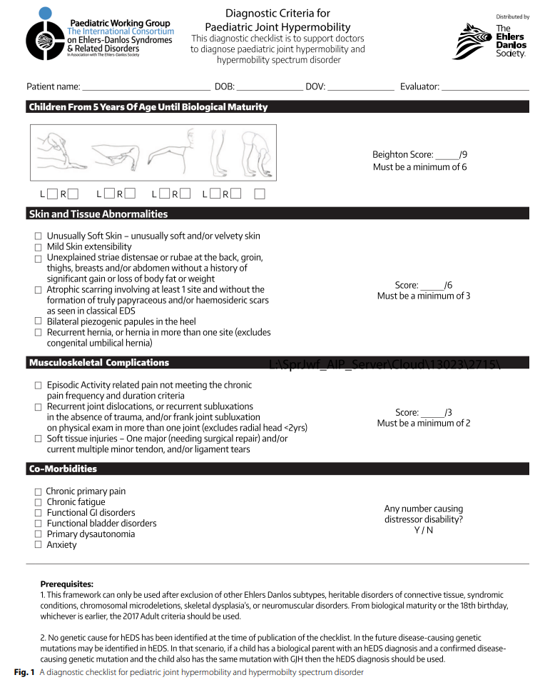

Slide 40
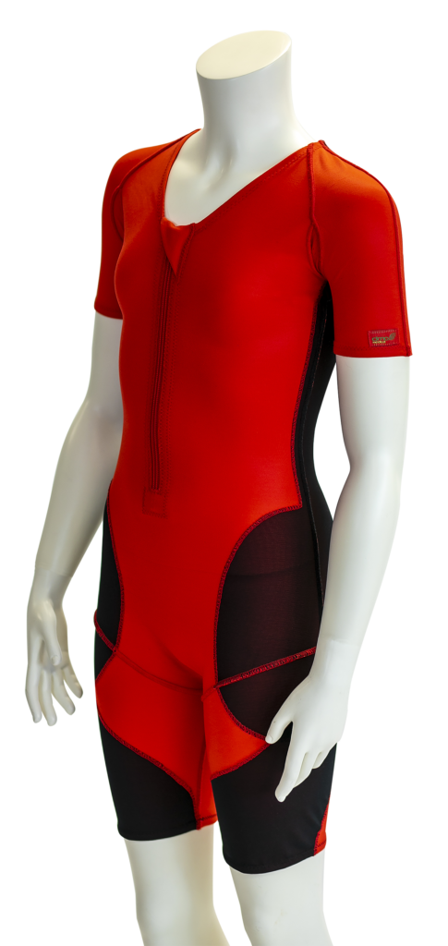
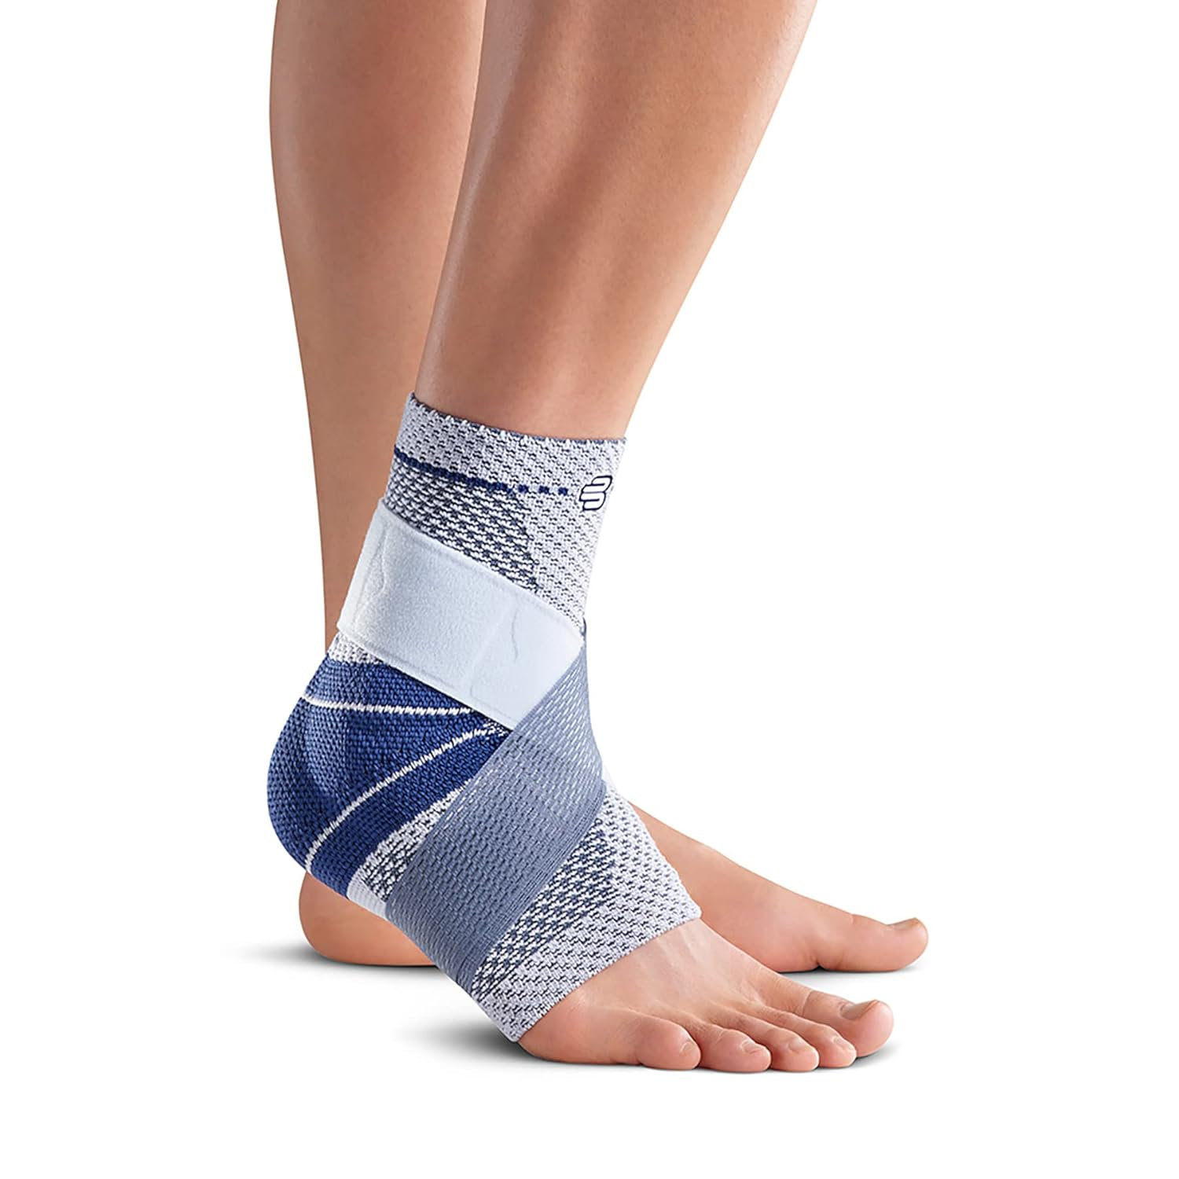
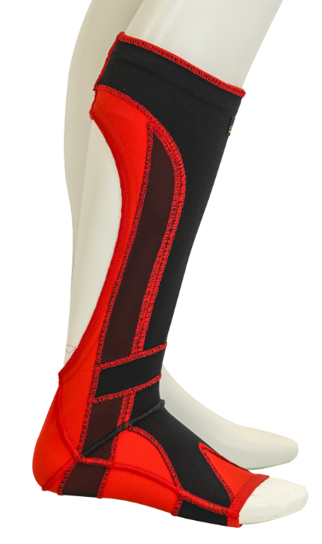
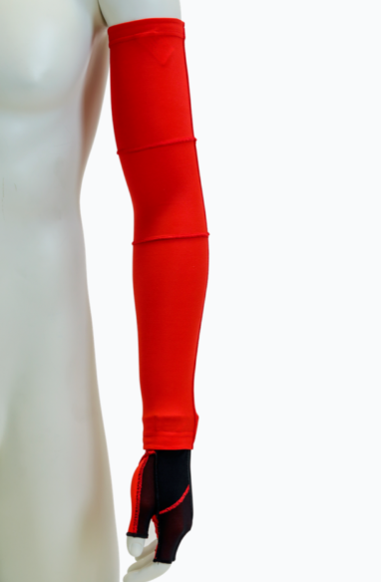
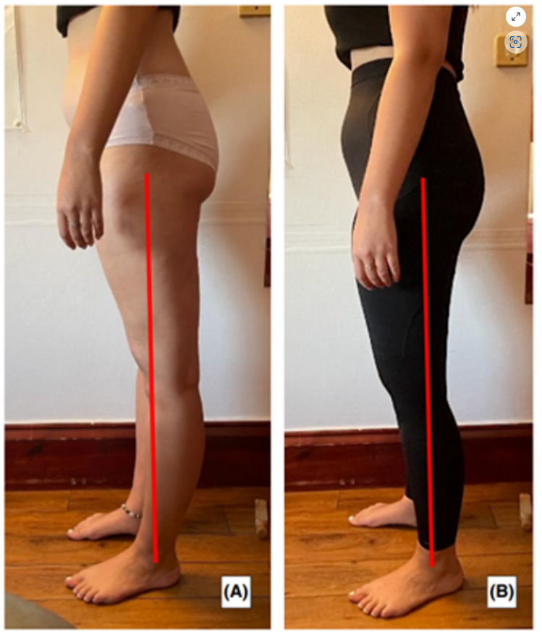
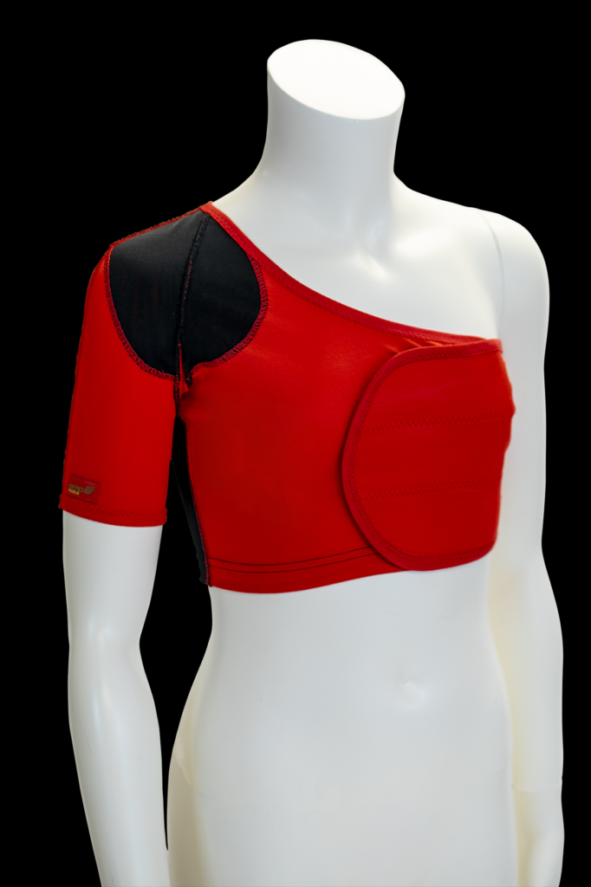
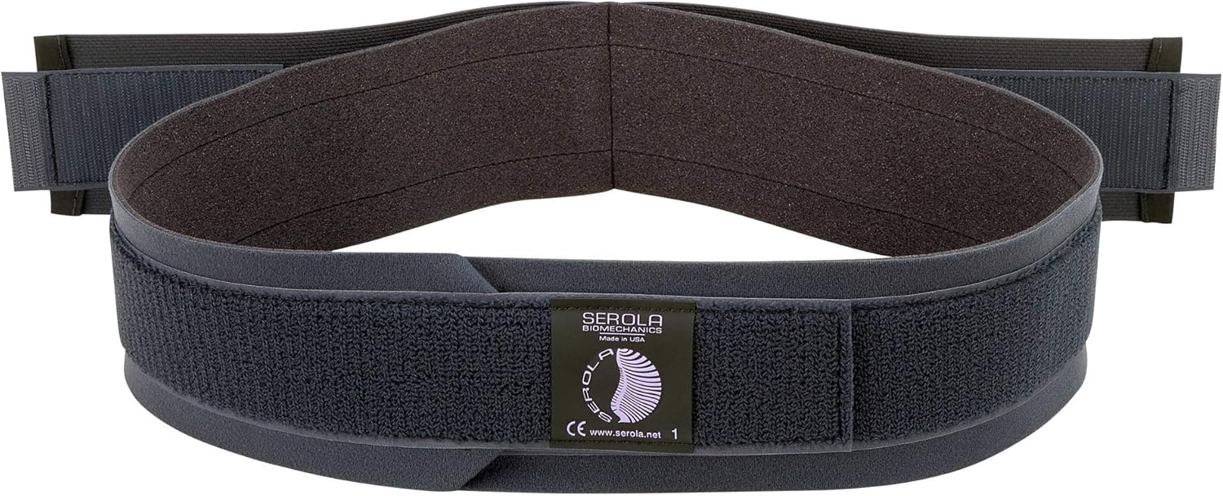
Bracing Approach
Three types of Braces
Proprioceptive Braces
  Don’t restrict motion
  Will not cause atrophy
  Can be used daily
Dynamic Movement Orthoses (Higo, A, 2023)
  Improve Proprioception
  Improve Fatigue
  Improve POTS symptoms
  Improve FAB

Slide 41
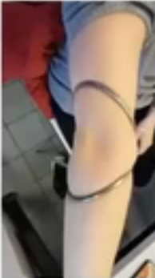
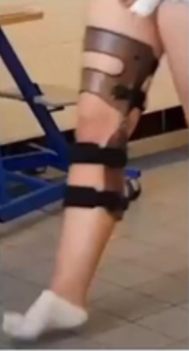
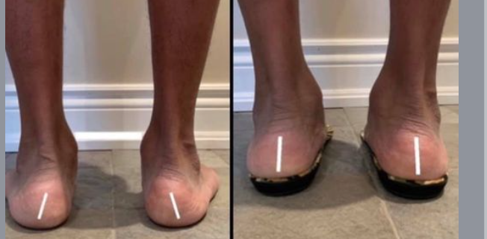
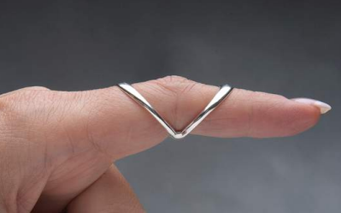
Bracing Approach
Non-immobilizing Braces
  Only restrict end-range motion
  Corrects movement patterns
  Can be used daily

Slide 42
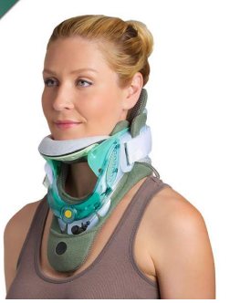
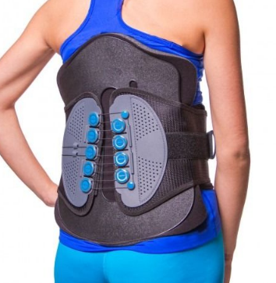
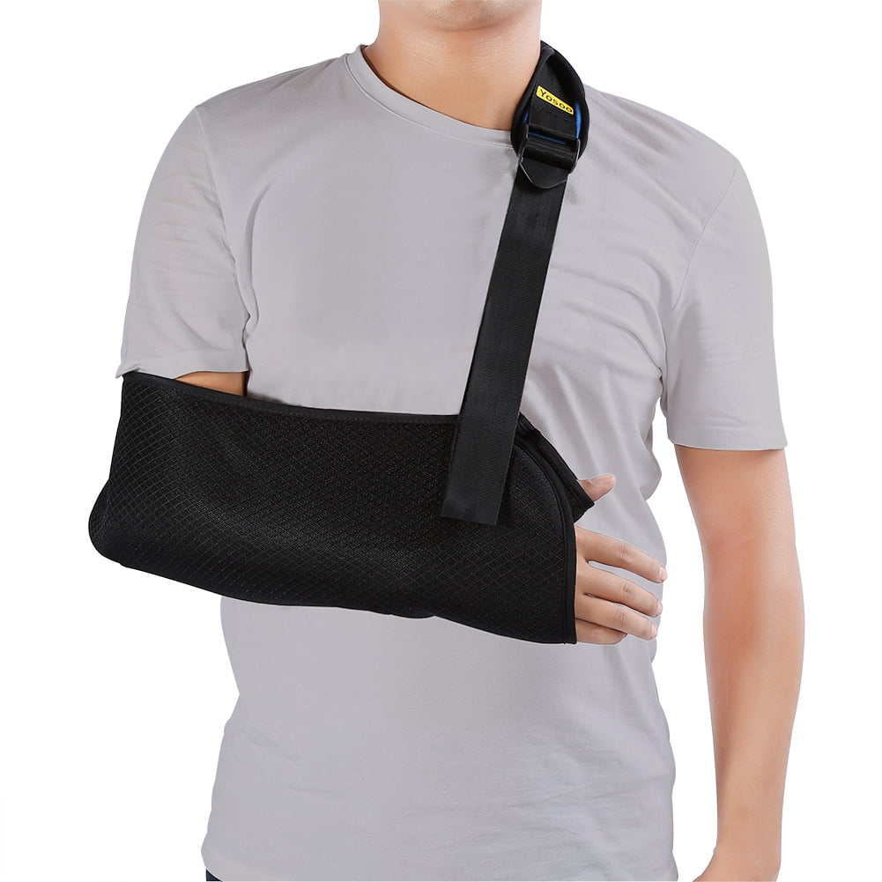
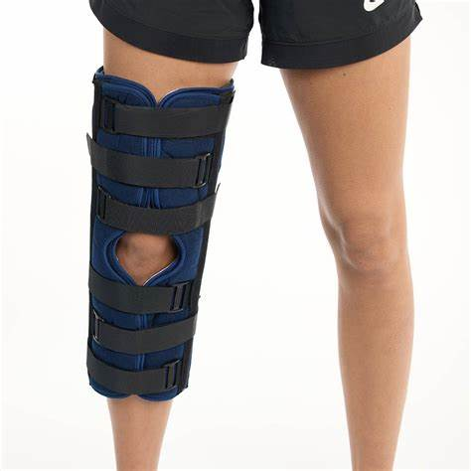
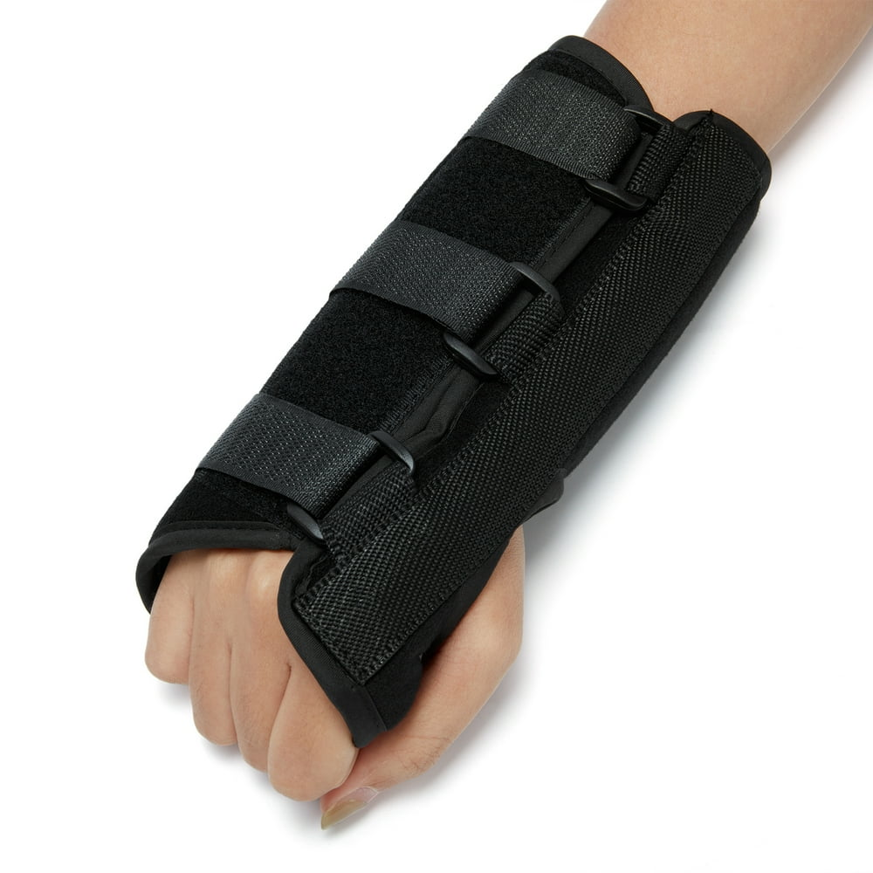
Bracing Approach
Three types of Braces
Immobilizing Braces
  Reduce pain significantly
  Muscle atrophy is a risk
  Should only be used at night or Short periods of recovery

Slide 43
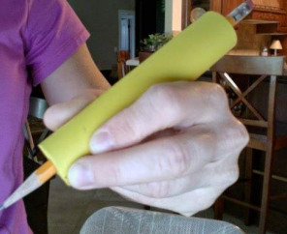






Ergonomic Aids
Chopra, 2019
Lombardi, 2023

Slide 44
Key Takeaways
Take a good history
Screen the neck
Treat the patient
Exercise tolerance is crucial
Avoid flare-ups and over-doing it
PT is a life-long process, encourage independence
Involve the health care team
If not us, then who?

Slide 45
Be Someone’s Answer
“Physiotherapists with knowledge of Joint Hypermobility Syndrome and Ehlers–Danlos Syndrome hypermobility type were cited as sources of support and hope, which helped people to cope with and manage their condition.”

Slide 46
Resources for Patients/Providers
Home - The Ehlers Danlos Society
https://www.ehlers-danlos.com/eds-global-registry/
Physical Therapy - The Ehlers Danlos Society
https://www.thespidertool.com
https://www.dmorthotics.com/
https://www.edhs.info/
The Ehlers-Danlos syndromes (EDS) GP Toolkit
A Clinicians Guide | The HMSA

Slide 47
References
Beighton P, Paepe AD, Steinmann B, Tsipouras P, Wenstrup RJ. Ehlers-Danlos syndromes: Revised nosology, Villefranche, 1997. American Journal of Medical Genetics. 1998;77(1):31-37. doi:https://doi.org/10.1002/(sici)1096-8628(19980428)77:1%3C31::aid-ajmg8%3E3.0.co;2-o.
Bennett SE, Walsh N, Moss T, Palmer S. Understanding the psychosocial impact of joint hypermobility syndrome and Ehlers-Danlos syndrome hypermobility type: a qualitative interview study. Disability and Rehabilitation. 2021 Mar;43(6):795-804. doi: 10.1080/09638288.2019.1641848.
Bloom L, Byers P, Francomano C, Tinkle B, Malfait F. The international consortium on the Ehlers-Danlos syndromes. American Journal of Medical Genetics Part C: Seminars in Medical Genetics. 2017;175(1):5-7. doi:https://doi.org/10.1002/ajmg.c.31547.
Blajwajs L, Williams J, Timmons W, Sproule J. Hypermobility prevalence, measurements, and outcomes in childhood, adolescence, and emerging adulthood: a systematic review. Rheumatology International. 2023 Aug;43(8):1423-1444. doi: 10.1007/s00296-023-05338-x.
Brock CH. Joint mobility and Ehlers-Danlos syndrome, (EDS) new data based on 232 cases. Journal of Arthritis. 2015;04(02). doi:https://doi.org/10.4172/2167-7921.1000148.
Castori M, Tinkle B, Levy H, Grahame R, Malfait F, Hakim A. A framework for the classification of joint hypermobility and related conditions. American Journal of Medical Genetics Part C: Seminars in Medical Genetics. 2017;175(1):148-157. doi:https://doi.org/10.1002/ajmg.c.31539.
Demmler JC, Atkinson MD, Reinhold EJ, Choy E, Lyons RA, Brophy ST. Diagnosed prevalence of Ehlers-Danlos syndrome and hypermobility spectrum disorder in Wales, UK: a national electronic cohort study and case-control comparison. BMJ Open. 2019 Nov 4;9(11). doi: 10.1136/bmjopen-2019-031365.
Ewer E, Kazkaz H, Ninis N, Rowe P, De Pauw R, Tang E, Barrett C, Rombaut L, De Wandele I, Simmonds JV. The Spider; a multisystemic symptom impact tool for people with hypermobility-related disorders. Deleted Journal. 2024;200098–200098. doi:https://doi.org/10.1016/j.jpedcp.2024.200098.
Ewer ER, De Pauw R, Kazkazk H, Ninis N, Rowe P, Simmonds JV, De Wandele I. The Spider: a visual, multisystemic symptom impact questionnaire for people with hypermobility-related disorders-validation in adults. Clinical Rheumatology. 2024 Sep;43(9):3005-3017. doi: 10.1007/s10067-024-07071-7.
Galea V. ISSLS Prize Winner: Smudging the Motor Brain in Young Adults With Recurrent Low Back Pain. Yearbook of Sports Medicine. 2012;2012:81-82. doi:https://doi.org/10.1016/j.yspm.2012.03.003.

Slide 48
References
Grahame R. The need to take a fresh look at criteria for hypermobility. PubMed. 2007;34(4):664-665.
Halverson CM, Clayton EW, Garcia Sierra A, Francomano C. Patients with Ehlers–Danlos syndrome on the diagnostic odyssey: Rethinking complexity and difficulty as a hero's journey. American Journal of Medical Genetics Part C: Seminars in Medical Genetics. 2021;187C:416–424. doi:https://doi.org/10.1002/ajmg.c.31935.
Higo A, Pearce G, Palmer S, Grant L. The value of Dynamic Movement Orthoses in the management of a complex Hypermobile Ehlers-Danlos Syndrome patient: a case report. Clinical Case Reports. 2023;11(1) doi:https://doi.org/10.1002/ccr3.6821.
Leslie NR, Stott P, Simmonds JV. Recognizing and Effectively Managing Hypermobility-Related Conditions. Physical Therapy. 2019;99(9):1189–1200. doi:https://doi.org/10.1093/ptj/pzz078.
Malfait F, Francomano C, Byers P, et al. The 2017 International Classification of the Ehlers-Danlos Syndromes. American Journal of Medical Genetics Part C: Seminars in Medical Genetics. 2017;175(1):8-26. doi:https://doi.org/10.1002/ajmg.c.31552.
Nicholson LL, Chan C. The Upper Limb Hypermobility Assessment Tool: A novel validated measure of adult joint mobility. Musculoskeletal Science and Practice. 2018;35:38-45. doi:https://doi.org/10.1016/j.msksp.2018.02.006.
Pezaro DS, Pearce DG, Reinhold DE. Understanding hypermobile Ehlers-Danlos syndrome and Hypermobility Spectrum Disorders in the context of childbearing: An international qualitative study. Midwifery. 2020 Sep;88:102749. doi: 10.1016/j.midw.2020.102749.
Sobhani-Eraghi A, Motalebi M, Sarreshtehdari S, Molazem-Sanandaji B, Hasanlu Z. Prevalence of joint hypermobility in children and adolescents: A systematic review and meta-analysis. Journal of Research in Medical Sciences. 2020;25:104. doi: 10.4103/jrms.JRMS_983_19.
Steinmann B, Royce PM, Superti-Furga A. The Ehlers-Danlos syndrome. In Royce PM, Steinmann B (Eds.): Connective Tissue and its Heritable Disorders: Molecular, Genetic and Medical Aspects. New York: Wiley-Liss, 1993, pp. 351–407.
Tofts LJ, Simmonds J, Schwartz SB, et al. Pediatric joint hypermobility: a diagnostic framework and narrative review. Orphanet Journal of Rare Diseases. 2023;18:104. doi:https://doi.org/10.1186/s13023-023-02717-2.

Slide 49
Questions?
Tyler.Shotto@sluhn.org

