Slide 1
Upper Cervical Dysfunction: Beyond C1-2.
Alexander Brown PT, DPT
Fellow of the American Academy of Orthopedic Physical Therapists
Fellow of the Academy of Spine Physical Therapists
Board Certified Orthopedic Clinical Specialist
Cert. MDT

Slide 2
Continuing Medical Education Credit Information
  Activity Description/Statement of Need:
  This course explores the therapeutic potential of manual therapy in treating headaches and cranio-facial pain. Participants will gain a deeper understanding of the role the upper cervical spine plays in headaches, temporomandibular joint (TMJ)-related pain and even more obscure presentations such as ear fullness. Emphasis will be placed on how manual therapy techniques—such as joint mobilization—can influence musculoskeletal and neurological factors contributing to pain.
By the end of this session, healthcare professionals will be equipped with evidence-based strategies to assess, treat, and manage cranio-facial pain. The course will blend theoretical knowledge with practical demonstrations, empowering attendees to integrate manual therapy into clinical practice for more for improved patient outcomes.
Target Audience: All Providers

Slide 3
Designation Statement
It is St. Luke’s University Health Network policy to ensure balance, independence, objectivity and scientific rigor in all of our sponsored educational programs. Faculty and all others who have the ability to control the content of continuing medical education activities sponsored by the St. Luke’s Hospital & Health Network are expected to disclose to the audience whether they do or do not have any real or apparent conflict(s) of interest or other relationships related to the content of their presentation(s).
The St. Luke’s University Health Network is accredited by the Pennsylvania Medical Society to provide continuing medical education for physicians.
The St. Luke’s University Health Network designates this live educational activity for a maximum of 1 AMA PRA Category 1 Credits™. Physicians should only claim credits commensurate to the extent of their participation on the activity.

Slide 4
Disclosure Information
The Planners involved in this activity have no relevant financial relationships to disclose.
The Faculty/Presenters involved in this activity have no relevant financial relationships to disclose.

Slide 5
Learning Objectives
  Understand the role that the upper cervical spine plays in nociception.
  Select and apply upper cervical spine assessment and treatment techniques in patients with headaches, cranio-facial pain or other atypical cranial symptoms like ear fullness.
  Identify red flags prior to treating the upper cervical spine with mobilization.
  Apply safe subjective and objective testing prior to treating patients with headaches.
  Review clinical evidence supporting manual therapy interventions for these conditions.

Slide 6
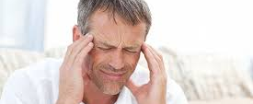
Craniofacial pain
Notes:
As we get started, it is important to understand what constitutes craniofacial pain. This is often pain in the head, face, or neck. Symptoms can range from mild to severe and can include but are not limited to:
Headaches
Earaches/fullness
Facial pain
Dizziness
Jaw discomfort
Common dx we see clinically with patients presenting with craniofacial pain may include: Trigeminal neuralgia/trigeminal neurogenic pain, Headaches, TMJD and neck pain.

Slide 7

Notes:
Most are familiar with this: An Iconic animated series that follows a group of teenagers and their talking Great Dane, Scooby-Doo, as they solve mysteries involving supposedly “supernatural” creatures. I think we would all be lying if we did not feel that some of our patient presentations didn’t seem a little “supernatural” at times, yeah?
Each episode typically follows a formula: the group stumbles upon a mystery typically involving a villain, sometimes a ghost, monster and they investigate to uncover the true culprit. The villain will use different tactics to scare them. This may be a pursuit through the dark woods, other times and intense car chase or as simple as trying to set up a trap for the group.
So, What does scooby do have to do with this presentation? Though all the scare tactics the villain uses are different in nature, it is still the same villain that is culprit behind these shenanigans.
though our patient presentations may be unique (jaw pain, headaches, dizziness), there may be, and often is a “culprit” behind this. And that is what I would like to discuss today.

Slide 8
Upper cervical spine mobility deficits
Headaches
Ear fullness
Trigeminal neuralgia
Notes:
3 different cases, all different in their dx and presentation BUT, 1 common link between them…(SLOW) an upper CS mobility deficit…and not what you would think, not a impairment at C1-2 which has plenty of evidence supporting C1-2 dysfunction and its relationship with craniofacial pain.
In these cases, the impairment was found at C01 (or the OAJ) and C2-3
Historically, when I had patients present with symptoms of craniofacial pain, my first place to assess and treat would often be C1-2. Some patients would get better, some would not. It was near the end of my fellowship training that I began to realize that significant mobility deficits were not found at C1-2, but in stead, mainly C2-3 and then after that C0-1. Now, I am not saying that C1-2 does not play a role with upper CS dysfunction and craniofacial pain but what I am saying is that In a lot of cases, the problem is not at C1-2.

Slide 9
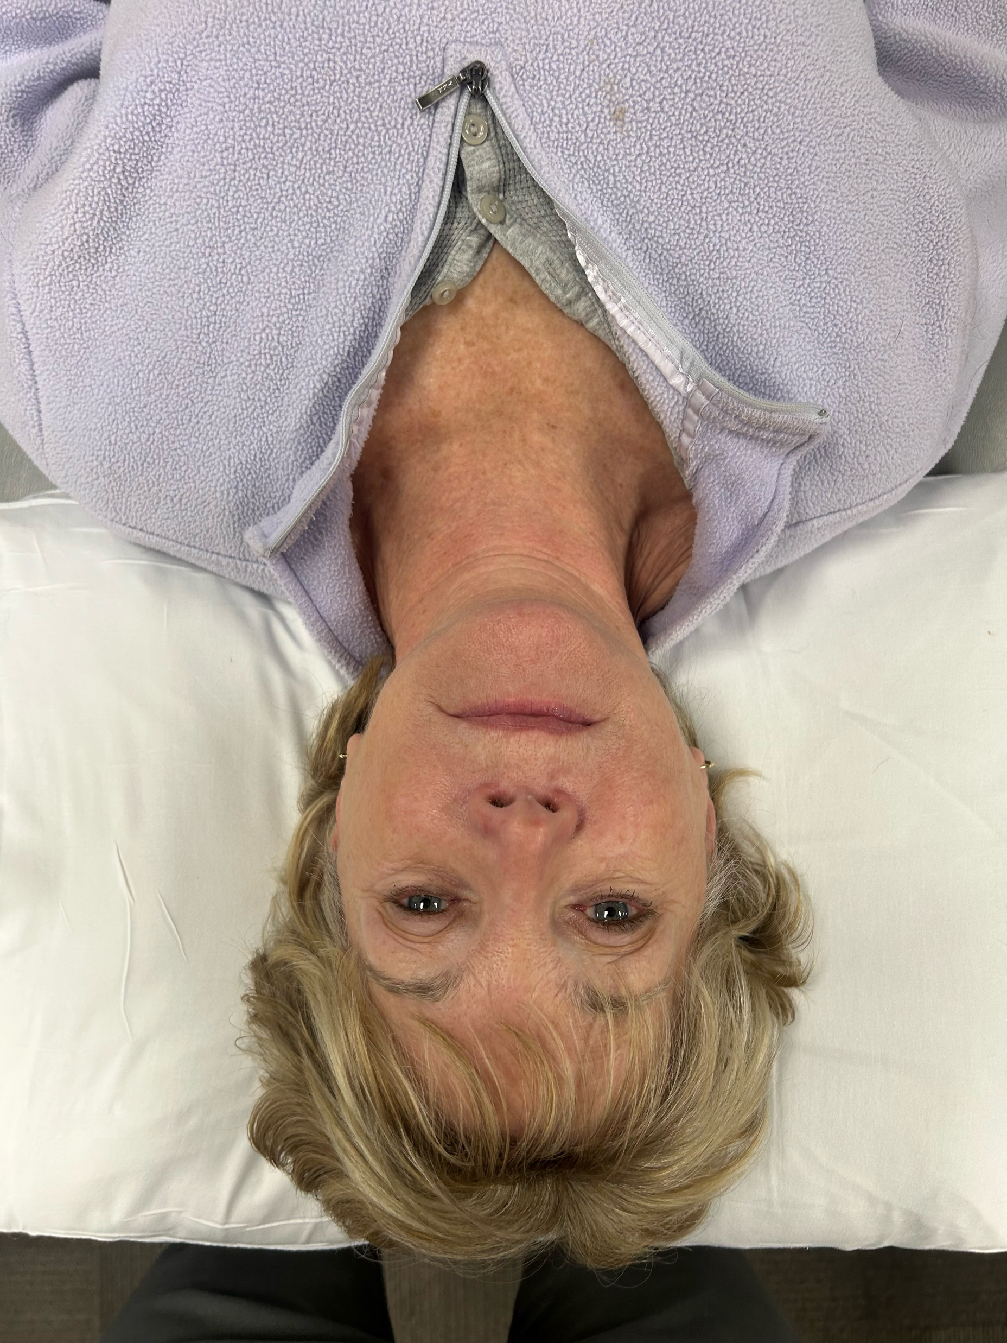
Notes:
L side bend (OAJ)
R sheer (C2-3)
So what does this mean on assessment? In a case like this, PTs are likely to find 1 and/or 2 of the following (Hypomobility at OAJ on L into opening (will lack R SB..just at OAJ) and hypomobility at C2-3 into L SG)
Now, do all of the patients with a mobilidy deficits at C2-3 and C0-1 present with this posture? No? So may even argue that the posture is not relevant…well, you cannot say that because if symptoms change and posture changes with treatment…id say it was relevant!

Slide 10
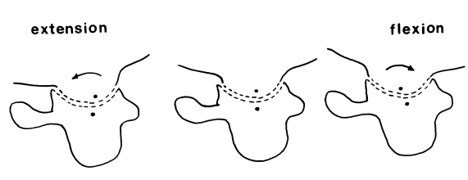
Upper Cervical Spine Biomechanics and Anatomy: C0-1
Notes:
I think it makes sense in a presentation like that is spend just a little time talking about upper CS biomechanics. Do I think that biomechanics play a role in upper CS dysfunction? You bet I do. Do I think it plays as much of a role in the lower CS and or other body regions? I do not, and literature supports that.
Bogduk N, Mercer S. Biomechanics of the cervical spine. I: Normal kinematics. Clin Biomech (Bristol). 2000 Nov;15(9):633-48. doi: 10.1016/s0268-0033(00)00034-6. PMID: 10946096.

Slide 11
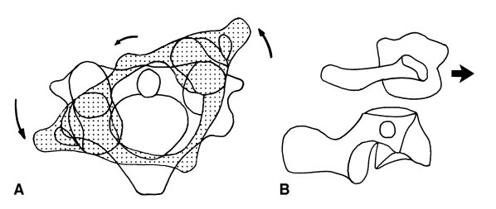
Upper Cervical Spine Biomechanics and Anatomy C1-2

Slide 12
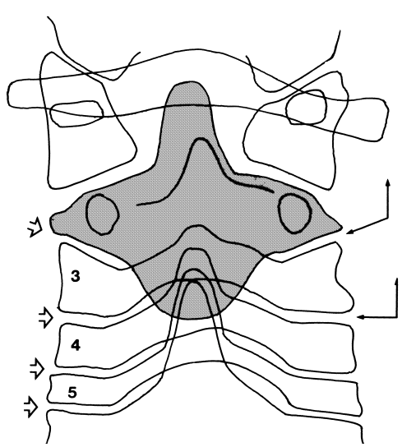
Upper Cervical Spine Biomechanics and Anatomy C2-3
Notes:
Unlike the typical zygapophysial joints whose planes are transverse, the superior articular processes of C3 face not only upwards and backwards but also medially, by about 40°. Because of this orientation, it allows for more frontal plane motion. We see very little if any frontal plane motion at C1-2 and because of the uncinate processes, especially with aging, we see decreasing front plane motion in the lower CS.

Slide 13
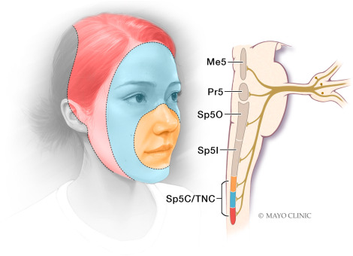
The Trigeminal Nucleus
Notes:
Are a group of nuclei in the brain stem that are associated with the trigeminal nerve
located in the lateral medulla of the brainstem, and extends down to the level of the C3 vertebra.
What we see regarding pain, is that Trigeminal nociceptors will transmit information through the trigeminal nerve to the spinal trigeminal nucleus (STN) in the brainstem. This information may include neurons that carry information on things like pain, temperature, touch, and proprioceptive information from the face and mouth to the brain)
Based on the anatomy, It makes sense how the upper CS may be contributing and even driving symptoms associated with craniofacial pain

Slide 14
Let's keep it safe!
(Rushton 2023)
Risk factors for upper cervical spine instability
History of trauma
Congenital collagenous compromise
Inflammatory arthritides
Recent neck/head/dental surgery.
Exam findings
Bilateral or quadrilateral limb paresthesiae
Hyperreflexia/Clonus
Positive Babinski or Hoffman’s
Arm and leg weakness
Lack of coordination bilaterally
Notes:
So how do we start to treat this? It begins with a safe history and exam. A fantastic paper published by Rushton et al in 2023 looks at risk factors for vascular pathology in the CS.
History of trauma (e.g. whiplash, football neck injury)
Congenital collagenous compromise (e.g. syndromes: Down’s, Ehlers-Danlos, marfans)
Inflammatory arthritides (e.g. rheumatoid arthritis, ankylosing spondylitis)
Recent neck/head/dental surgery due to the potential for infection
The exam findings may indicate an upper motor neuron problem such as CS myelopathy but coordination deficts may also be seen with VBI due to its supply to the cerelbellum

Slide 15
Let’s keep it safe!
(Rushton 2023)
Risk factors for Cervical Arterial Dysfunction
Trauma
Current or past smoker
HTN
High total cholesterol
Exam Findings
Headache ”unlike any other”
gait disturbances
apathy
general malaise
short term memory loss
5 Ds and 3Ns?
Notes:
This is not a full comprehensive list, see IFOMT guidelines by Rushton for full list
Difficulty speaking, swallowing, double vision, blurry vision, drop attacks, numbness, nystagmus, nausea ---HORSE IS OUT OF THE BARN!!

Slide 16
Let’s keep it safe!
(Rushton 2023)
Vascular
Vital signs
Neurological
Cranial nerves
Ligamentous stability of upper cervical spine
Observe gait and coordination
Palpation or auscultation of pulse
Internal carotid artery
Notes:
Vitals patients who present with with risk factors for cervical arterial dysfunction. A cranial nerve screen…it takes 30 seconds. Ligamentous screen of the upper CS and NOT just the sharp pursar test as this is a relocation test and you can simply watch them walk through your doors and analyze their gait.

Slide 17
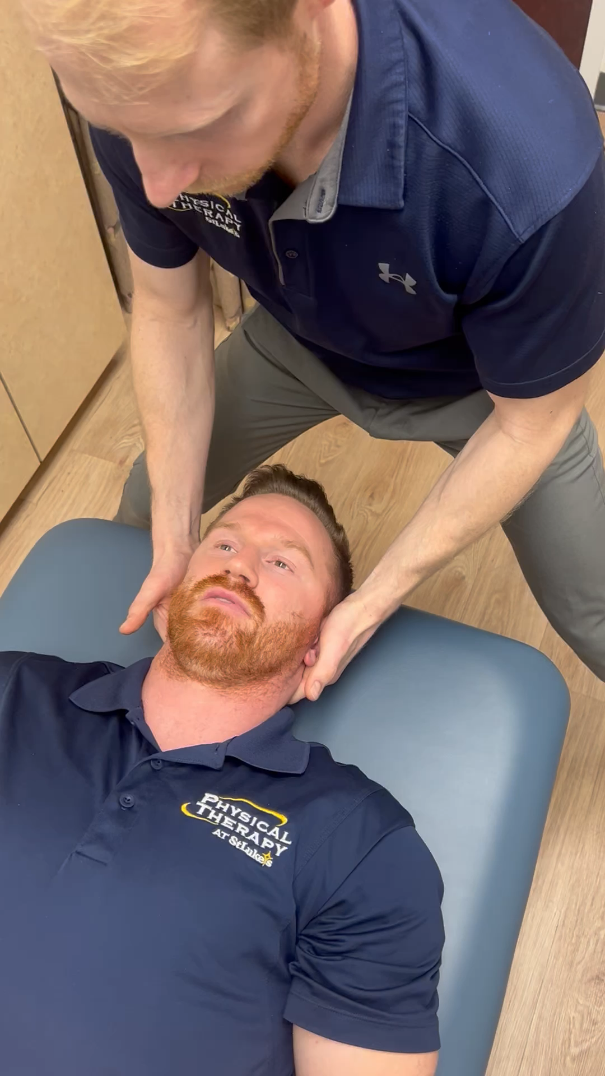
Assessment

Slide 18
Cases
25-year-old female
Chief complaint: Craniofacial pain
Dx: Trigeminal Neuralgia and neck pain
23-year-old male
Chief complaint: Craniofacial pain and headaches
Dx: Headaches and neck pain
32-year-old female
Chief complaint: Craniofacial pain and ear fullness
Dx: Otalgia and TMJD

Slide 19
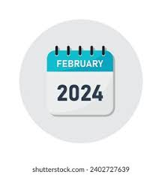
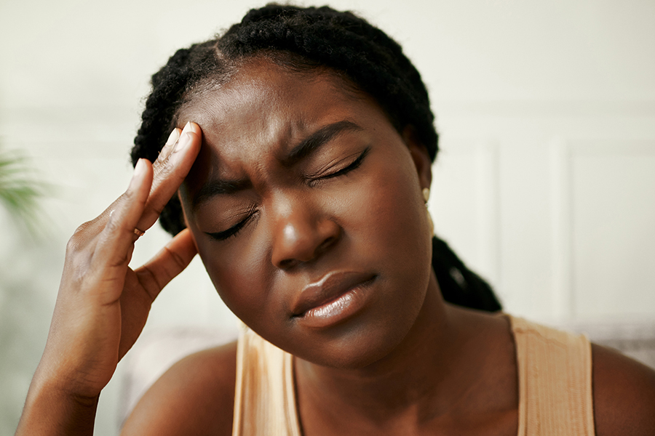
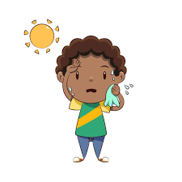

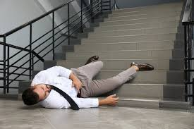
Case 1
25-year-old female with Craniofacial pain and Diagnosis of Trigeminal Neuralgia.
February 2024
Sympathetic nervous system response
Negative imaging
7 month of facial pain and burning
Notes:
25-year-old female with Craniofacial pain and Diagnosis of Trigeminal Neuralgia. If you follow along with the pictures, that will help paint a picture. Their symptoms began in February of 2024 after Chiropractic adjustment to her left upper ribs. That night, the patient had a sympathetic nervous system response with increased sweating, nausea and an increase in HR/BP. She was walking down the steps when she nearly passed out, fell and struck the left side of her head on the wall (dx with a mild concussion). Roughly 5 days later she noticed L sided facial pain. She underwent CS radiographs which were neg for fracture. She noted worsening facial pain and burning as pain with in her V1-V3 distribution of her trigeminal nerve. She was placed on gabapentin (900 mg). She saw mild improvement over a month's time and and due to no improvement, then had a CT with contrast of her head and neck. Imaging was negative and she still had no relief. She finally had seen neurolgy by the end of July so 5 mo later. They then increase gabapentin to 1200 mg as she then began to have mild relief to make symptoms manageable. With time, she was able to decrease her dosage of gaba to 900 mg but still with no true relief through July and August, neurology then ordered an MRI of her head and neck which was…you guessed it, negative. She continued with facial pain (V1-3) and then also began to develop UT pain and medial scap pain.

Slide 20
Case 1
Objective
Finally seen by PT in October
10/10 waking night pain, constant.
Increased sensation along V1-3
Hypomobile C2-3 into right side glide
Normal C1-2 mobility
Normal C0-1 mobility
*Upper CS ligamentous screen performed and cleared.
Notes:
So she was finally seen by PT in later October (10/24, 10/26). As you can see high levels of pain continued. Here are some of the key highlights for this case and to note, upper CS was cleared via subjective and objective testing. We see normal mobility of C0-1 and C1-2 but hypomobility of C2-3 into R SG.
Location: left side forehead, zygomatic region, jaw, medial scapula, left side neck.

Slide 21
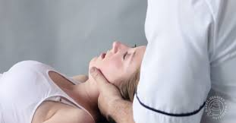
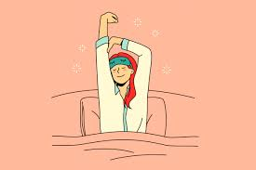

Case 1
Treatment
Treatment 1
Treatment 2
Phone Follow up
11/13/24
Pain 1/10 NPRS
G5 mobilization C2-3 on left
HEP: Repeated left SB
10/10 to 7/10 pain
GROC: 70%
Seeking a PT
Still taking meds
Notes:
Tx 1 (10/24)
G5 mobilization C2-3 into R SG, HEP repeated left side bend of the cervical spine (4-6 reps. 4-5x/day).,10/10 to 7/10 pain, less facial burning
Tx 2 (2 days later)
Pain improved, could get some sleep the last 2 nights. Rates pain 7/10 NPRS in same region as first PT session.
Exam:
Improved C2-3 mobility (still hypomobile)
Normal C1-2 mobility (normal cervical flexion rotation test)
Hypomobile C0-1 on right – not sure why on eval I found this normal but my thought is that she began to move with new mechanics or, her C2-3 was so stiff that it overshadowed the C0-1 mobility deficits, either way…treatment was performed.
Treatment:
G5 mobilization to C2-3 in R SG and to C0-1 distraction on right
Immediate reduction in pain from 7/10 to 5/10 NPRS with resolved scapular and neck pain. Still feeling facial warmth
Follow up: (3 weeks post tx) – she had to return home as she was from Iowa. She continued with REP L SB exercise.
Pain 1/10, Groc 70%, seeking PT for tx, 900 mg of gaba

Slide 22
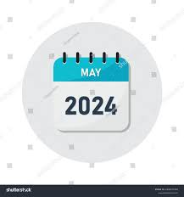
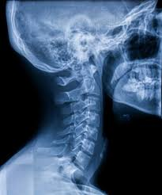
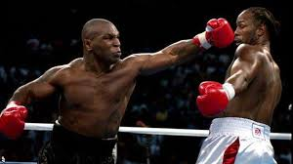
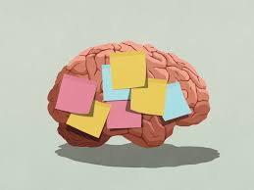
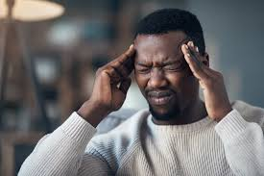
Case 2
23-year-old male with craniofacial pain and headaches
Notes:
Alright, Case 2. here we have a boxer and 2 weeks ago he was sparing with a friend when He took a hit on his left arm. This caused his head to tip left and rotate right. At the time of the hit, he felt immediate eye pressure. Over a 2 week span, symptoms had improved but he had left sided neck pain and left medial scapular boarder pain. His other complaint was a HA. Now, He has had HA’s off and on over 2-3 years, mostly from boxing but symptoms had been increased since the most recent neck injury (which was described above). He has no history of any MVA but has had multiple head hits during his boxing career. When asked about his biggest concern, he stated that it was the left sided headache accompanied with neck pain. He also felt eye pressure and facial tingling at times. He denies b/l or q/l numbness or paresthesia's, denies STM loss. He has not had any dx imaging.

Slide 23
Case 2
Objective
DNF Endurance test = 10 seconds
Cervical spine rotation =no loss
Decreased sensation V2-3 on left
Hypomobile C2-3 into right side glide
Normal C1-2 mobility
Normal C0-1 mobility
*Upper CS ligamentous screen performed and cleared
Notes:
Now this objective may look nearly Identical to the prior case but I promise…its nots, there is a pattern here. The one difference that was seen was the weakness in his DNF endurance test. Just like the last case, the spine was cleared prior to any mobilization/manipulation. We see here that he has not spinal rotation loss and again his C1-2 mobility is normal as is C0-1. BUT C2-3 is hypomobile.

Slide 24
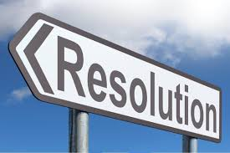
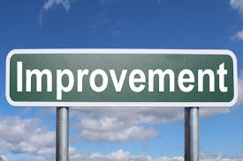


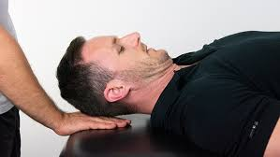
Case 2
Treatment
Treatment 1
Education time
Treatment 2
Treatment 3/4
Notes:
Tx 1 :G5 mobilization C2-3 (R SG). Patient reports improved facial sensation, less eye pressure. Educated to monitor symp, any precipitating factors.
Tx 2: Improvement. Improved HA (reduced from …daily to just 3x since eval with reduced intensity) 9 days between. Still with hypomobility of C2-3 and normal C01 and C1-2 testing. Motor control exercises were added targeting his DNF at that point given deficits found but lack of mobility carryover with mobility testing.
Tx ¾: 1 Headache over the last week. Different headache (from work and sustained posture from sitting at a computer, more back of head vs eye symptoms). Normalized C2-3 mobility but now with TTP and symp reproduction with palp of sub occ. + C1-2 hypomobility, addressed with MET and then business as usual with MC training targeting the DNF. At Discharge, the patient had resolved HA that had brought him in, if he did get a HA at work (again diff then prior HA) this was self manage with CS RET.

Slide 25
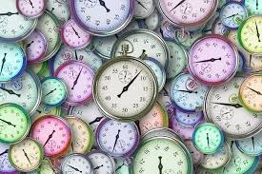

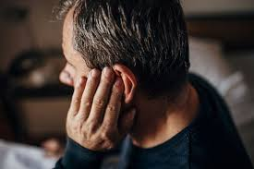

Case 3
32-year-old female with Craniofacial pain and Diagnosis of Otalgia/TMJD
Notes:
And the last case…but not least as this was the case that got me thinking about C2-3 mobility deficits in patients with craniofacial pain. Her onset was “years” ago as she was unable to fully recall when they began. She did however have a fall due to dehydration but again, that was years ago and states that she cannot point to that being why her symptoms started. Her CC was pressure and popping in her ear that no one has been able to figure out as she has seen orthopedics, neurology and ENT without resolution. She will get an occasional pop or click when chewing but never painful. Though she was sent with script for TMJD, that is not her CC. Another complaint is HA 2x/week. HA are only L sided and at the base of her head. She does report feeling off balance and dizzy at times. No diagnostic imaging performed. Her main goal is not having to “pop” her ears due to feeling of fullness.

Slide 26
Case 3
Objective
Normal jaw opening/lateral deviation
Cervical spine rotation =no loss
Normal palpation of muscle of mastication
Hypomobile C2-3 into right side glide
Hypomobile C0-1 on left
Normal C1-2 mobility
*Upper CS ligamentous screen performed and cleared
Notes:
Now, again this may look nearly Identical to the prior 2 case but I promise…its nots, again…there is a pattern here. Though one of her dx was TMJD, she was not having jaw pain and she had normal ROM with testing, no aberrant movement patterns noted. Now unlike the prior 2 cases, she did have mobility deficits at C0-1 and C2-3 but normal C1-2 mobility testing.

Slide 27
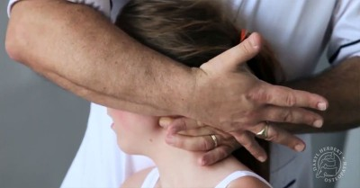
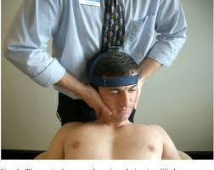

Case 3
Treatment
Treatment 1
Treatments 2-3
Treatments 4-7
Tx C1-2
Continued resolution
Goals Met
?
Notes:
Treatment 1: G5 mob to C0-1 on R, HEP with supine upper CS flexion along with RET and L SB to mobilize C0-1 on R. Left with minimal change day 1.
Treatment 2: She reports that her symptoms have been the same since eval. HA continue, jaw fullness continued but she is more cognizant of her head positioning..for what that is worth. Due to no change, assessment was performed, revealing improved mobility at C0-1 on L but still with hypomobility of C2-3 into R SG. At that time, CS clearing tests were performed and C2-3 was mobilized using a g5 dist technique as in prior cases. This was also followed up with C2-3 MET into L SG for further mobility and neuro-red/motor control.
Treatment 3: Again, no real change in symptoms since last session. She still demonstrated hypomobility at C2-3 with normal C0-1 mobility, normal C1-2 mobility. Again C2-3 was mobilized and during this tx, more emphasis was placed on CS MC with arm movement as she had compensatory patterns with RUE movement (UT/lev).
Treatment 4: Finally, a breakthrough! HA have been reflect and she stated that pressure in her ear has also been less as it feels like her sinuses are draining. C1-2 mobility was addressed this session as she did have a + CFRT…yes I know, this whole time I have been putting the blame not on C1-2 but I treated what I found. Over the next 3 session she noted resolution of ear fullness with only 2 headaches over the last 2 weeks and a 90% GROC. As I reflect back and try to make sense of why C1-2 now had a mobility deficits, I can only think that her mechanics began to normalize but due to chronicity and a lack of MC, maybe C1-2 became dysfunctional…or maybe I just missed it for 3 sessions…or maybe specificity doesn’t matter?

Slide 28
Now What?!
Don’t panic
Proper screening
Assess the upper cervical spine
It is there or it isn’t!...don’t split hairs.
Treat using manual therapy!
Notes:
So, now what? What do you do when a patient comes in with symptoms like these? First, you don’t panic as most cases do not have a serious underlying pathology. You perform screening to ensure safety. You thoroughly assess and clear the CS. Don’t get caught of with the mobility specifics! I either moves..or it doesn’t! that’s it! And lastly, treat using manual therapy, or at least some kind of mechanical therapy such as MDT processes and procedures.

Slide 29
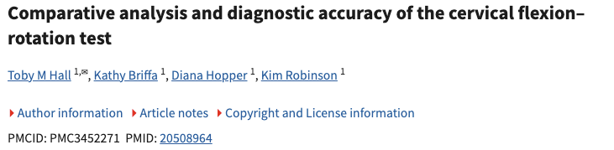
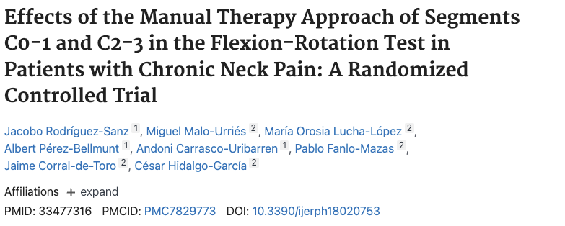
Not C1-2s Fault?
Evidence based on these cases to look beyond C1-2 in patients with craniofacial pain
Notes:
Why is C1-2 not the culprit? Maybe it is? But based on the cases (with exception to case 3 in its entirety). There is evidence to support looking beyond C1-2 in patient with craniofacial pain. looked there is more validity behind assessing C1-2 for ROM deficits but especially for HA. Newer evidence in 2021 looked past C1-2 and they looked at the effects of mobilization to C0-1 and C2-3 and its effects on pain and ROM in patients with chronic neck pain. They found good results with treatment of these regions.
CFRT validated in2010 by toby et al for HA, ROM deficits at C1-2

Slide 30
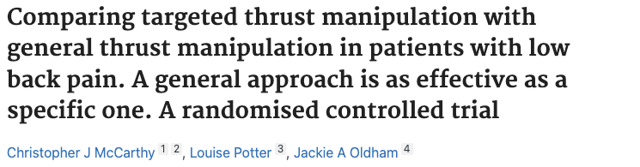
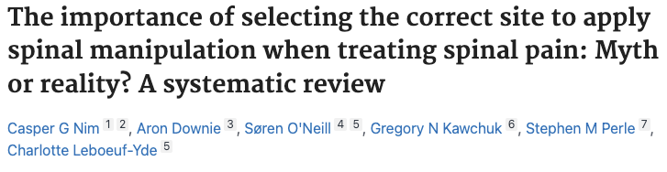
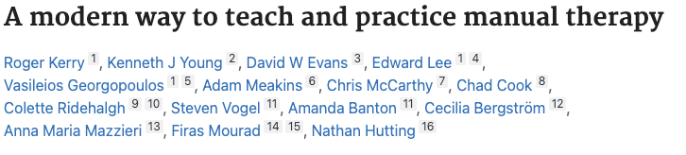
The need for specificity with upper cervical mobilization
Notes:
So I am going to spend a little time talking about this…some listening may disagree strongly with what I am about to say but that is your opinion…as this is mine. The MT world has come under heave scrutiny the last few years and though some of the original beliefs and thought processes of MT may be outdated, it is not all wrong and the field of MT has evolved past the older ways of thinking.
Studies have stated that general MT techniques were just as effective as specific in those with LBP when looking at outcomes like pain pressure threshold
A Study was just released in 24’ calling for a new way to teach and practice manual therapy –Now there are some big names in this paper one such name being chad cook. They have proposed that old ways of thought such as clinician centered treatment (imaging guidance for tx), pathoanatomic reasoning (HNP) and technique specificity need to be done away with. And to an extent on the first 2 points…I do agree, except the last part in certain circumstances…yes, I do agree that it is very challenging to be specific in the LS and TS with manipulative therapy due to the nature of the joint size and type of techniques used. That being said, minimal to no studies have looked at specificity in MT directed to the upper CS and most of these studies are targeted only at the LS and TS. I would argue this is an area, with proper training and practice, can be targeted more closely. At the end of the day, if we are not trying to follow some specificity with techniques with CS mobilization…we might as well just mobilize the foot at that point. It is also a good way for our profession to decrease the value in brings. Think about it…if we keep saying that what we do is no better then general techniques, general exercise and sham treatment…will we even have a profession in 30 years?

Slide 31

Collaborative Approach
Notes:
PT, OT, speech working together for the benefit of the patient.
Ex: coordination with neruo PT or OT on balance exercises for this patient, neuro PT coordinating with ortho on assessing if the upper CS is involved in patients not showing appropriate progress or have plateaued with PT. Again, I think we may be able to work together here.

Slide 32

So…what can we do?
Neurology
Dentistry
ENTs
PCPs
Orthopedics
Notes:
We can talk to the various disciplines and Educate them on what to look for, how PT can help, maybe you provide patient cases if your own…or use these! One of our residents mabry Rittenhouse had an award winning presentation on a similar case a few years ago and im sure she would be happy to discuss as well.

Slide 33
Let's Practice!
Live option
  Hellertown
    2301 Cherry Ln, Bethlehem Pa
    1 Hour of your time
    February 1st
      8-9 am? 9-10 am?
      Email: alex.brown@sluhn.org
    How to assess and treat upper cervical spine conditions like these.
      Muscle Energy Techniques and G5 mobilizations of upper cervical spine to be utilized.

Slide 34
References
Rushton, A., Carlesso, L, Flynn, T., Hing, W.A., Kerry, R. Rubinstein, S,Vogel S. International framework for examination of the cervical region for potential of vascular pathologies of the neck prior to Orthopaedic Manual Therapy (OMT) Intervention: International IGOMPT Cervical Framework.2020. IFOMPT, Auckland NZ..
Hutting et al. Diagnostic accuracy of premanipulative vertebrobasilar insufficiency tests: a systematic review. 2013. Man Ther 18(3):177-182
Kranenburg R. Adverse events following cervical manual physical therapy techniques (dissertation). Groningen, the Netherlands. Rijksuniversiteit Groningen;2020
Hutting, N., Kranenburg, H, Kerry, R. Yes, we should abandon pre-treatment positional testing of the cervical spine, Musculoskeletal Science and Practice 2020,
Reynolds B, Puentedura EJ, Kolber MJ, Cleland JA. Effectiveness of Cervical Spine High-Velocity, Low-Amplitude Thrust Added to Behavioral Education, Soft Tissue Mobilization, and Exercise for People With Temporomandibular Disorder With Myalgia: A Randomized Clinical Trial. J Orthop Sports Phys Ther. 2020 Aug;50(8):455-465. doi: 10.2519/jospt.2020.9175. Epub 2020 Jan 6. PMID: 31905097.
Lerner-Lentz A, O'Halloran B, Donaldson M, Cleland JA. Pragmatic application of manipulation versus mobilization to the upper segments of the cervical spine plus exercise for treatment of cervicogenic headache: a randomized clinical trial. J Man Manip Ther. 2021 Oct;29(5):267-275. doi: 10.1080/10669817.2020.1834322. Epub 2020 Nov 5. PMID: 33148134; PMCID: PMC8491670.
Bista P, Imlach WL. Pathological Mechanisms and Therapeutic Targets for Trigeminal Neuropathic Pain. Medicines (Basel). 2019 Aug 22;6(3):91. doi: 10.3390/medicines6030091. PMID: 31443547; PMCID: PMC6789505.
Patel NM, Jozsa F, Das JM. Neuroanatomy, Spinal Trigeminal Nucleus. [Updated 2024 Sep 10]. In: StatPearls [Internet]. Treasure Island (FL): StatPearls Publishing; 2024 Jan-. Available from: https://www.ncbi.nlm.nih.gov/books/NBK539729/

Slide 35
References
Liberato FM, da Silva TV, Santuzzi CH, Ferreira Fachini de Oliveira N, Nascimento LR. Manual Therapy Applied to the Cervial Joint Reduces Pain and Improves Jaw Function in Individuals with Temporomandibular Disorders: A Systematic Review on Manual Therapy for Orofacial Disorders. J Oral Facial Pain Headache. 2023 Spring;37(2):101-111. doi: 10.11607/ofph.3093. PMID: 37389837; PMCID: PMC10627199.
Cupler ZA, Trager RJ, Daniels CJ. Letter to the Editor: Cervical Spinal Manipulative Therapy Unlikely Cause of Spontaneous Internal Carotid Artery Dissection. Vasc Endovascular Surg. 2022 Jul;56(5):545-546. doi: 10.1177/15385744221088091. Epub 2022 Apr 20. PMID: 35442124.
Pankrath N, Nilsson S, Ballenberger N. Adverse Events After Cervical Spinal Manipulation - A Systematic Review and Meta-Analysis of Randomized Clinical Trials. Pain Physician. 2024 May;27(4):185-201. PMID: 38805524.
de Best RF, Coppieters MW, van Trijffel E, Compter A, Uyttenboogaart M, Bot JC, Castien R, Pool JJM, Cagnie B, Scholten-Peeters GGM. Interexaminer Agreement and Reliability of an Internationally Endorsed Screening Framework for Cervical Vascular Risks Following Manual Therapy and Exercise: The Go4Safe Project. Phys Ther. 2021 Oct 1;101(10):pzab166. doi: 10.1093/ptj/pzab166. PMID: 34174073; PMCID: PMC8494014.
Grgić V. Utjecaj manualne terapije vratne kraljeznice na tipicnu trigeminalnu neuralgiju: prikaz bolesnice [Influence of manual therapy of cervical spine on typical trigeminal neuralgia: a case report]. Lijec Vjesn. 2010 Jan-Feb;132(1-2):21-4. Croatian. PMID: 20359155.
Rodríguez-Sanz J, Malo-Urriés M, Lucha-López MO, Pérez-Bellmunt A, Carrasco-Uribarren A, Fanlo-Mazas P, Corral-de-Toro J, Hidalgo-García C. Effects of the Manual Therapy Approach of Segments C0-1 and C2-3 in the Flexion-Rotation Test in Patients with Chronic Neck Pain: A Randomized Controlled Trial. Int J Environ Res Public Health. 2021 Jan 17;18(2):753. doi: 10.3390/ijerph18020753. PMID: 33477316; PMCID: PMC7829773.
McCarthy CJ, Potter L, Oldham JA. Comparing targeted thrust manipulation with general thrust manipulation in patients with low back pain. A general approach is as effective as a specific one. A randomised controlled trial. BMJ Open Sport Exerc Med. 2019 Oct 5;5(1):e000514. doi: 10.1136/bmjsem-2019-000514. PMID: 31673401; PMCID: PMC6797393.
Nim CG, Downie A, O'Neill S, Kawchuk GN, Perle SM, Leboeuf-Yde C. The importance of selecting the correct site to apply spinal manipulation when treating spinal pain: Myth or reality? A systematic review. Sci Rep. 2021 Dec 3;11(1):23415. doi: 10.1038/s41598-021-02882-z. PMID: 34862434; PMCID: PMC8642385.
Kerry R, Young KJ, Evans DW, Lee E, Georgopoulos V, Meakins A, McCarthy C, Cook C, Ridehalgh C, Vogel S, Banton A, Bergström C, Mazzieri AM, Mourad F, Hutting N. A modern way to teach and practice manual therapy. Chiropr Man Therap. 2024 May 21;32(1):17. doi: 10.1186/s12998-024-00537-0. PMID: 38773515; PMCID: PMC11110311.
Hall TM, Briffa K, Hopper D, Robinson K. Comparative analysis and diagnostic accuracy of the cervical flexion-rotation test. J Headache Pain. 2010 Oct;11(5):391-7. doi: 10.1007/s10194-010-0222-3. Epub 2010 May 28. PMID: 20508964; PMCID: PMC3452271.

