Slide 1


Impact of an Embedded Oncology Pharmacist in an Outpatient Oncology Clinic
Kinjal Patel
Clinical Pharmacy Specialist
5/14/25

Slide 2
OBJECTIVES
  Define the potential roles and responsibilities of a pharmacist in outpatient oncology clinics
  Summarize the clinical impact of this model
  Evaluate cost and efficiency of multidisciplinary approach
  Design humanistic outcomes
  Demonstrate patient and provider satisfaction

Slide 3
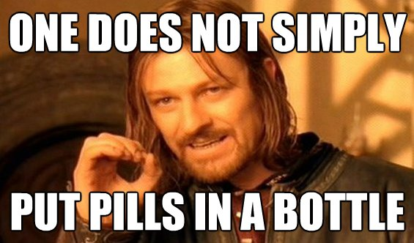
BACKGROUND

Slide 4
BACKGROUND
Need for Oncology Pharmacists in ambulatory oncology settings:
  Reduce care fragmentation
  Decrease incidence of unplanned healthcare utilization
  Reduce burden on oncology team
  Enhance patient satisfaction
  Increase health literacy
  Improve clinical, financial and humanistic outcomes
Notes:
The Centers for Disease Control and Prevention and the US Surgeon General both acknowledge that increasing
demands for access, safety, quality, and cost in the health-care system in the United States
is a challenge.
In the 2004 report from the American Society of Health-System Pharmacists detailing
the characteristics and trends in pharmacy ambulatory practice, oncology services were the second most prevalent setting, after anticoagulation, for
pharmacist involvement in the clinic.

Slide 5
ROLES AND RESPONSIBILITIES
  Supportive care management for prevention and treatment of adverse events (AE)
  Lab monitoring
  Drug-drug interaction (DDI) evaluation
  Chemotherapy regimen selection
  Patient education (for new start)
  Preferred biosimilar switch
  EMR standardization and improvisation
  Medication reconciliation
  Medication shortage awareness and alternatives
  Health care provider education

Slide 6
PILOT (2/2024- 12/2024)
1 Board Certified Clinical pharmacist
Data collection for 8 months
4 hours in Breast Clinics twice a week (256 hours total)
4 Breast Oncologists
About 75 interventions documented (iVENTS)
Examples of iVENTS:
  Supportive care for AE: dose reduction of gemcitabine for edema-added furosemide and steroid before next dose
  HSR management : titration, steroid prep, monitoring
  Lab monitoring recommendation: mag/Phos with cisplatin, Ca with Zometa
  DDI evaluation: 1) patient Tx held due to elevated LFTs-Pt educated to stop OTC/herbs which could increase LFTs 2) : Psych regimen changed due to interaction with hormonal Tx

Slide 7
PILOT (continued)
  Chemotherapy regimen decision making: 1) Trodelvy progression. Next line of choice, based on CARIS 2) How long to wait after radiation to start ADC
  Patient education (for new start): risks, AE prevention and management, administration timing, storage, return/disposal, # of cycles
  Preferred biosimilar switch: Trastuzumab, peg-filgrastim
  Beacon treatment plan standardization project
  Medication reconciliation: including OTC, herbs
  Medication shortage awareness and alternatives: Platinum shortages- capped carboplatin to AUC 5 (for GYN)
  Health care provider education: 1) Zoladex administration technique (clinic nurses)
  2) P&T policies/procedures/SOPs (for providers)- consent requirement change for 1 hormonal therapy

Slide 8
PILOT (continued)
Coordination of care: 1) Pt on oral TKI (Kisquali), transferred care from Einstein Specialty Pharmacy. Coordinated transfer of rx between Einstein Specialty Pharmacy and FCCC retail pharmacy. 2) Confirmed patient’s previous dose of IV chemo (Fam-trastuzumab), by contacting surgical oncology associates.
Additional drugs recommendation: Pt on bisphosphonates – added calcium/vit D
Removed unnecessary drugs: olanzapine dc for a Tx plan when Tx changed from highly emetogenic to moderate
Drug access: 1) Patient lost oral chemo pills- Contacted pt’s specialty pharmacy to coordinate refills and override 2) Compassionate care drug approval process- Pembro, Pertuzumab
Communication with pre-cert department for reimbursement assurance: Monthly Lupron 2 days early

Slide 9
REDUCE CARE FRAGMENTATION and DECREASE INCIDENCE OF UNPLANNED HEALTHCARE UTILIZATION
  Patients on oral agents: Initiation and Follow up (QOPI requirement)
  Patients needing multimodal treatment: coordination of oral and IV agents, alignment with radiation
  Oncology team transition, multidisciplinary team
  Clinical trial patients: needing coordination with CRU
  Coordination of Tx for patients at remote sites
  Prevention of hospitalization and ER visits
  Assist in TCC to prevent extra office visits
Notes:
staffing needs, patient preference
QOPI requirement

Slide 10
CLINICAL/FINANCIAL IMPACT
Interventions: Documentation and quantification of pharmacist-driven clinical interventions
Patient Outcomes: Improved patient satisfaction and health outcomes through direct patient-centered care
Case study: Cost Avoidance: Estimated cost avoidance during study periods (e.g., $363,760) and Net Benefit: Financial benefits resulting from pharmacist interventions (e.g., $753,150 per year).
Medication pricing, alternatives (generic, biosimilars) and compassionate program
Notes:
Re

Slide 11
HUMANISTIC IMPACT
Medication adherence
Medication counseling
Addressing Herbal and non-traditional treatments
Medication disposal
Titration/desensitization/scheduling
Public health promotion
Improved quality of life

Slide 12
PROVIDER AND PATIENT SATISFACTION
Nurses, APPS and providers: Positive feedback on the involvement of pharmacists in outpatient clinics
  Reduced burden on oncology team
  Review/revise EPIC orders
  Collaboration with multi-modal team
  Decrease infusion chair time
Patient satisfaction
  Spend more time to discuss the concerns
  Detailed review of medications after clinics
Notes:
Real time intervention; instead of pharmacy texting providers when patient is in the chair; and thus, interrupting clinics and preventing chair delay
Survey responses from US Oncology Network over 2 weeks were received from 17 practices within The Network and included 61 physicians, 17 nurse practitioners, and 12 physician assistants. The median provider time saved for each intervention type resulted as follows: Business Office Support was 23 minutes, Drug-Drug Interaction was 8 minutes, Drug Dosing was 8 minutes, Drug Information was 23 minutes, and Supportive Care was 23 minutes. In October 2024, 667 interventions were recorded by 14 clinical pharmacists, with 353 (53%) of these interventions falling into categories with known provider time-savings based on survey data. These interventions resulted in a total time-savings of 4489 minutes (75 hours) for practice providers

Slide 13
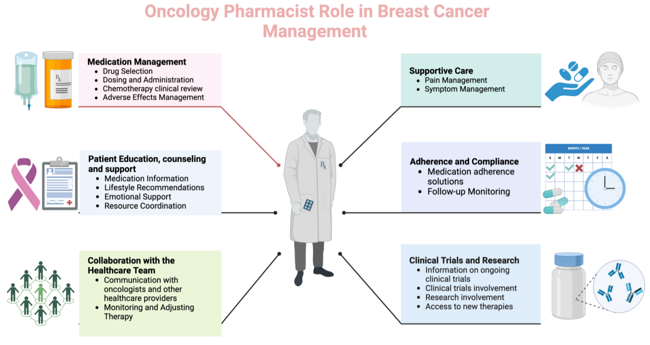
SUMMARY
Notes:
Real time intervention; instead of pharmacy texting providers when patient is in the chair; and thus, interrupting clinics and preventing chair delay
Survey responses from US Oncology Network over 2 weeks were received from 17 practices within The Network and included 61 physicians, 17 nurse practitioners, and 12 physician assistants. The median provider time saved for each intervention type resulted as follows: Business Office Support was 23 minutes, Drug-Drug Interaction was 8 minutes, Drug Dosing was 8 minutes, Drug Information was 23 minutes, and Supportive Care was 23 minutes. In October 2024, 667 interventions were recorded by 14 clinical pharmacists, with 353 (53%) of these interventions falling into categories with known provider time-savings based on survey data. These interventions resulted in a total time-savings of 4489 minutes (75 hours) for practice providers

Slide 14
CHALLENGES AND SOLUTIONS
• Challenges:
  Lack of robust data
  Integration into care teams
  Lack of collaborative practice agreement
  Staffing challenges
  Emerging new data
Solutions:
  Standardized protocols
  Patient education
  Continuous training for pharmacists
Notes:
absence of prescriber status for reimbursement for clinical services provided by pharmacists and unregulated metrics

Slide 15
CONCLUSION
Future Directions:
Need for more robust data
Expanded roles for pharmacists in outpatient oncology settings
Develop patient satisfaction survey and provider survey
Independent patient visits with pharmacist
https://www.youtube.com/watch?v=UmEGQdcLYn4

Slide 16
THANK YOU

Slide 17
Questions?

Slide 18
QUESTIONS
What does a pharmacist in oncology clinic do?
  Dual signature of oncology orders
  Obtain consent from patients for their treatment
  Work with scheduling department to arrange for procedures
  Reviews treatment plan to assure appropriateness of oncology therapy and supportive care

Slide 19
QUESTIONS
What does a pharmacist in oncology clinic do?
  Dual signature of oncology orders
  Obtain consent from patients for their treatment
  Work with scheduling department to arrange for procedures
  Reviews treatment plan to assure appropriateness of oncology therapy and supportive care

Slide 20
QUESTIONS
2. Which one of the following is NOT a challenge for clinic embedded pharmacist?
  Schedule integration within clinic
  Lack of standard protocols
  Pharmacist Staff overflow
  Lack of continuous training of pharmacist

Slide 21
QUESTIONS
2. Which one of the following is NOT a challenge for clinic embedded pharmacist?
  Schedule integration within clinic
  Lack of standard protocols
  Pharmacist Staff overflow
  Lack of continuous training of pharmacists

Slide 22
QUESTIONS
3. How does a pharmacist assist with preventing care fragmentation?
  A. Follow up on patients on oral oncolytic agents
  B. Coordinate with infusion room and retail pharmacy for patients receiving oral and IV oncolytic agents
  C. Communicate with staff members at remote sites within the institution and outside the institution
  D. All of the above

Slide 23
QUESTIONS
3. How does a pharmacist assist with preventing care fragmentation?
  A. Follow up on patients on oral oncolytic agents
  B. Coordinate with infusion room and retail pharmacy for patients receiving oral and IV oncolytic agents
  C. Communicate with staff members at remote sites within the institution and outside the institution
  D. All of the above

Slide 24
REFERENCES
  The Impact of an Embedded Oncology Pharmacist in an Outpatient Oncology Center in the Treatment of Hematologic Malignancies: https://doi.org/10.6004/jadpro.2022.13.7.3
  Effect of Embedded Clinical Pharmacists on Health Utilization Outcomes in a Large Community Oncology Practice
JHOP - March 2025 Vol 15 Special Feature - HOPA Abstracts: Mark Wagner, PharmD, BCOP, and Colton Zwart, PharmD, BCOP, Cowell Family Cancer Center, Munson Healthcare, Traverse City, MI
  Evaluating the Impact of Interactive Ambulatory Care Discussions at an Oncology Center JHOP - March 2025 Vol 15 Special Feature - HOPA Abstracts: Abigail Shockley, PharmD, BCOP, Division of Pharmacy, University of Texas MD Anderson Cancer Center, Houston, TX
  Evaluation of a Decentralized Infusion Pharmacist in an Oncology Infusion Clinic of an Academic Medical CenterJHOP - March 2025 Vol 15 Special Feature - HOPA Abstracts: Sarah Castelo, PharmD, BCOP, Vanderbilt University Medical Center, Nashville, TN
  Evaluation of Services Provided by Pharmacists in Addition to Accredited Patient Management Program Responsibilities in a Health-System Specialty Pharmacy JHOP - March 2025 Vol 15 Special Feature - HOPA Abstracts: Jeremiah Moore, PharmD, BCOP, James P. Wilmot Cancer Institute, University of Rochester Specialty Pharmacy, Rochester, NY
  Justin Gatwood, Katie Gatwood, Ezra Gabre, Maurice Alexander, Impact of clinical pharmacists in outpatient oncology practices: A review, American Journal of Health-System Pharmacy, Volume 74, Issue 19, 1 October 2017, Pages 1549–1557, https://doi.org/10.2146/ajhp160475
  Impact of Pharmacist-Led Oral Chemotherapy Telehealth Clinic at a Community Cancer Center Using the TAMER Model: JHOP - August 2023 Vol 13, No 4 - Practical Issues in Pharmacy Management: Diana Tamer, PharmD, BCOP; Timothy Schieber, PharmD, MBA; Jake Wodtke, PharmD; Samira Zantout, PharmD, BCPS
  Optimizing the Role of Oncology Pharmacists in Outpatient Care for Advanced Therapies: AJMC November 2024: Skylar Jeremias

