Slide 1
What Do Patients with Low Back Pain Need?
Paul Furst PT,DPT
Board Certified Orthopedic Clinical Specialist
Certified Therapeutic Pain Specialist
Current Spine Fellow at Physical Therapy at St. Luke’s

Slide 2
Continuing Medical Education Credit Information
Activity Description/Statement of Need:
This course is an introduction to the nature of chronic low back pain development and how to minimize the risk of chronicity via fostering self-efficacy as a focus. After completing this course, students should be able utilize various approaches on how to build patient self-efficacy and understand how teaching self-management can minimize chronicity risk development.
Target Audience: All Providers

Slide 3
Designation Statement
It is St. Luke’s University Health Network policy to ensure balance, independence, objectivity and scientific rigor in all of our sponsored educational programs. Faculty and all others who have the ability to control the content of continuing medical education activities sponsored by the St. Luke’s Hospital & Health Network are expected to disclose to the audience whether they do or do not have any real or apparent conflict(s) of interest or other relationships related to the content of their presentation(s).
The St. Luke’s University Health Network is accredited by the Pennsylvania Medical Society to provide continuing medical education for physicians.
The St. Luke’s University Health Network designates this live educational activity for a maximum of 1 AMA PRA Category 1 Credits™. Physicians should only claim credits commensurate to the extent of their participation on the activity.

Slide 4
Disclosure Information
The Planners involved in this activity have no relevant financial relationships to disclose.
The Faculty/Presenters involved in this activity have no relevant financial relationships to disclose.

Slide 5
Learning Objectives
Define the chronic pain pandemic of low back pain the risk factors of development.
Identify how the current models of healthcare influence patient chronicity risk.
Discuss how self-efficacy is a key to chronicity risk aversion.
Propose recommendations and current evidence on enhancing pain self-efficacy (PSE) for low back pain.
Gain new ways to foster improved patient pain self-efficacy (PSE) directly into practice.

Slide 6
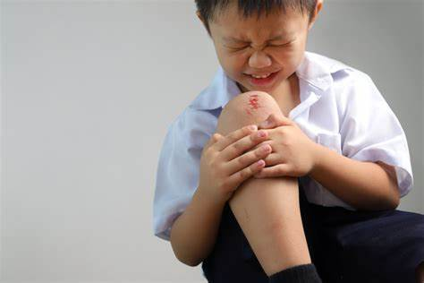
Why Do I Hurt?
Where is mommy? Where is daddy? Helpppp Meeee!

Slide 7
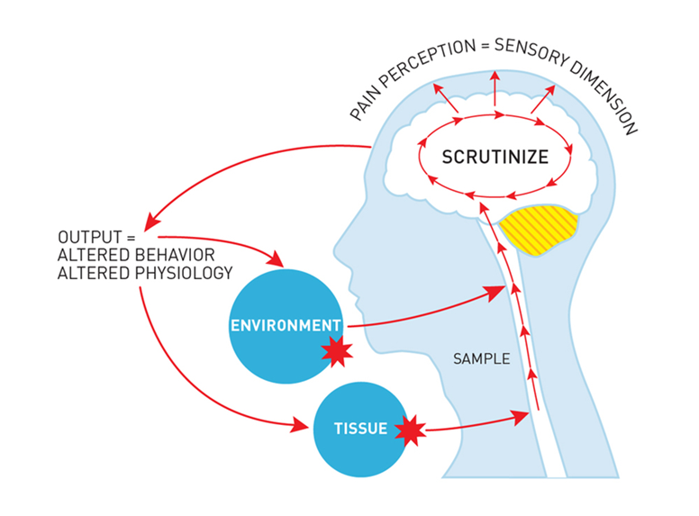
Definition of Pain
Thacker, Mick. (2015). Louis Gifford – revolutionary:the Mature Organism Model,an embodied cognitive perspective of pain. In Touch. 152. 4-9.
“An unpleasant sensory and emotional experience associated with, or resembling that associated with, actual or potential tissue damage,”
Raja, Srinivasa N.a,*; Carr, Daniel B.b; Cohen, Miltonc; Finnerup, Nanna B.d,e; Flor, Hertaf; Gibson, Stepheng; Keefe, Francis J.h; Mogil, Jeffrey S.i; Ringkamp, Matthiasj; Sluka, Kathleen A.k; Song, Xue-Junl; Stevens, Bonniem; Sullivan, Mark D.n; Tutelman, Perri R.o; Ushida, Takahirop; Vader, Kyleq The revised International Association for the Study of Pain definition of pain: concepts, challenges, and compromises, PAIN: September 2020 - Volume 161 - Issue 9 - p 1976-1982doi: 10.1097/j.pain.0000000000001939

Slide 8
Definition of Chronic Pain
Pain that arises from altered nociception despite no clear evidence of actual or threatened tissue damage causing the activation of peripheral nociceptors or evidence for disease or lesion of the somatosensory system causing the pain.
Terminology: International association for the study of pain. International Association for the Study of Pain (IASP). November 12, 2024. Accessed January 25, 2025. https://www.iasp-pain.org/resources/terminology/#pain.

Slide 9
How does chronic pain develop
~ 3 months since DOI -pain persists despite tissue healing
  40% of patients post acute LBP develop CLBP
Peripheral and central sensitization changes
  Stem from movement avoidance, behavior changes and catastrophization of pain or FEAR
Lack of education on pain condition
Lack of self management skills/Poor Self efficacy
Traeger AC, Moseley GL, Hübscher M, et alPain education to prevent chronic low back pain: a study protocol for a randomised controlled trialBMJ Open 2014;4:e005505. doi: 10.1136/bmjopen-2014-005505

Slide 10
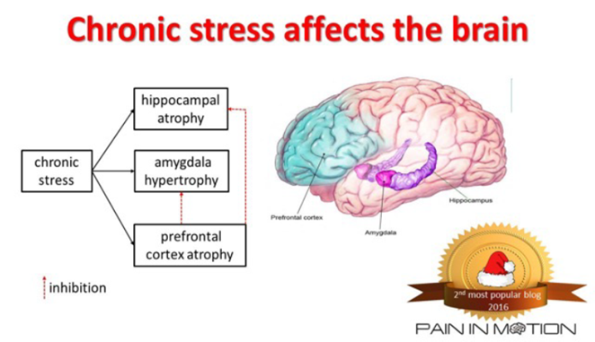
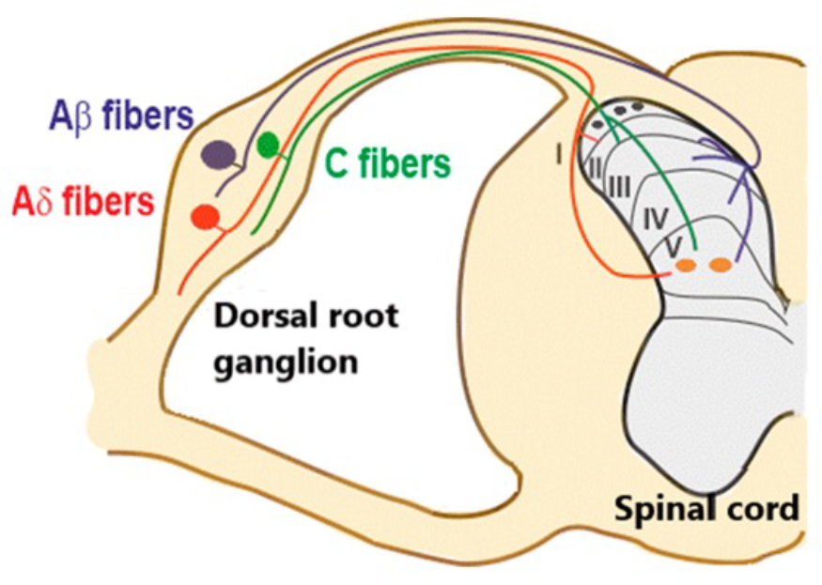
Scrutinization Leads to Plastic Changes
Stress effects cortisol levels
Limbic system hypertrophy
Altered conditioned pain modulation- endogenous opiate depression
Circulating IL-6 cytokines
Lead to altered nerve phenotypes and cortex change
Wong M. Wong Pain Lecture USC Spine Fellowship. lecture presented at: October 28, 2024.

Slide 11

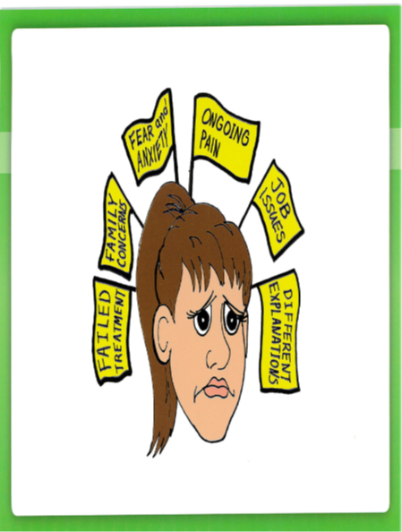


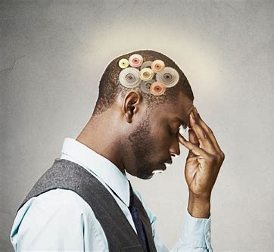
Visual Summation
Why you hurt: Pain neuroscience education system | Adriaan Louw | OPTP. Accessed January 25, 2025. https://www.optp.com/Why-You-Hurt-Pain-Neuroscience-Education-System.

Slide 12
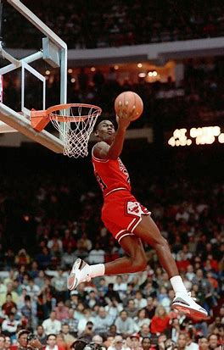
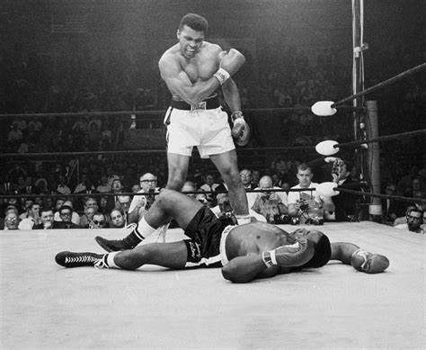
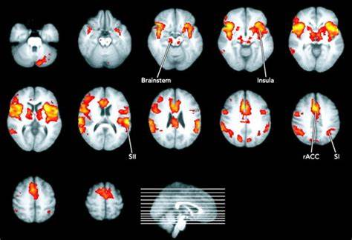

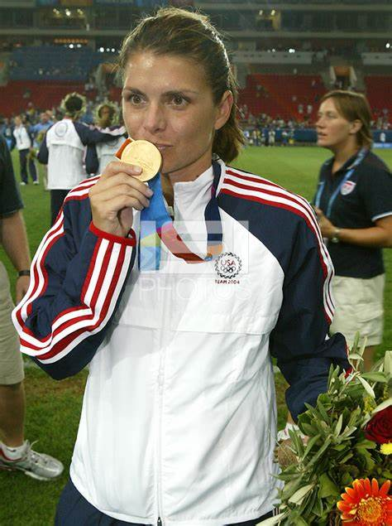

I believe I can…?
Notes:
What is the

Slide 13
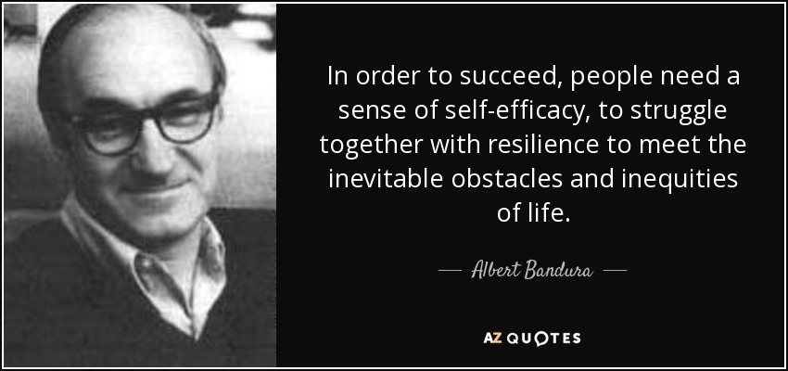

Slide 14
Chronic Pain Epidemic
In 2020, low back pain (LBP) affected 619 million people globally
843 million cases by 2050, driven largely by population expansion and ageing
LBP is the single leading cause of disability worldwide and the condition for which the greatest number of people may benefit from rehabilitation.
LBP can be experienced at any age, and most people experience LBP at least once in their life.
Prevalence increases with age up to 80 years, while the highest number of LBP cases occurs at the age of 50–55 years. LBP is more prevalent in women
Non-specific LBP is the most common presentation of LBP (about 90% of cases).
Has traditionally been treated with prescription pain medication (opioids etc)
Increased morbidity rates related to opioid overdose
Low back pain. World Health Organization. Accessed February 16, 2025. https://www.who.int/news-room/fact-sheets/detail/low-back-pain.

Slide 15
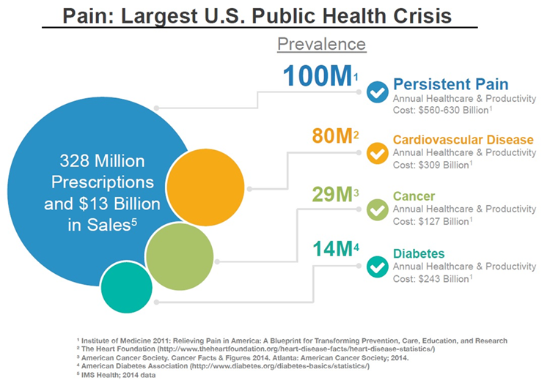
Prevalence of Chronic Pain
Szalavitz M. Report: Chronic, Undertreated Pain Affects 116 Million Americans . Time Magazine. June 2011.

Slide 16
THE LANCET Series 2018
LBP is the #1 cause of disability in the world from children to elderly- most in middle and low income countries and 42.6 million years lived with disability all ages
50% and 48% of people seek LBP care annually in the US and UK
Buchbinder, R., Underwood, M., Hartvigsen, J., & Maher, C. G. (2020). The Lancet Series call to action to reduce low value care for low back pain: an update. Pain, 161, S57-S64.
Notes:
Been around since the 1800’s and has sent the Highest standards for medical science
In 2018 they release the low back pain series comprising 3 papers written by 31 authors from disparate disciplines and 12 different countries, raised unprecedented awareness of the rising global burden of low back pain partly attributable to poor quality health care.
They aimed to
.

Slide 17
What have we done?
Surge in global low-value care
  emergency departments liberal use of diagnostic imaging
  opioids
  spinal injections
  surgery has also led to skyrocketing medical and human costs
A 2012 study in a US Veterans Affairs Health Care facility found that 59% of outpatient lumbar spine scans were inappropriate.
2019 systematic review (14 studies) which found evidence that imaging is associated with:
  Higher medical costs
  Increased health care utilization
  More work absence compared with non-imaged groups
US study estimated that $US 12.8 billion was spent on spinal fusion surgery in 2011, the highest aggregate hospital costs of any surgical procedure.
Overuse of low value care as well as underuse of high-value care and is apparent across all income settings a need for culturally sensitive and context-specific biopsychosocial interventions.
Buchbinder, R., Underwood, M., Hartvigsen, J., & Maher, C. G. (2020). The Lancet Series call to action to reduce low value care for low back pain: an update. Pain, 161, S57-S64.

Slide 18
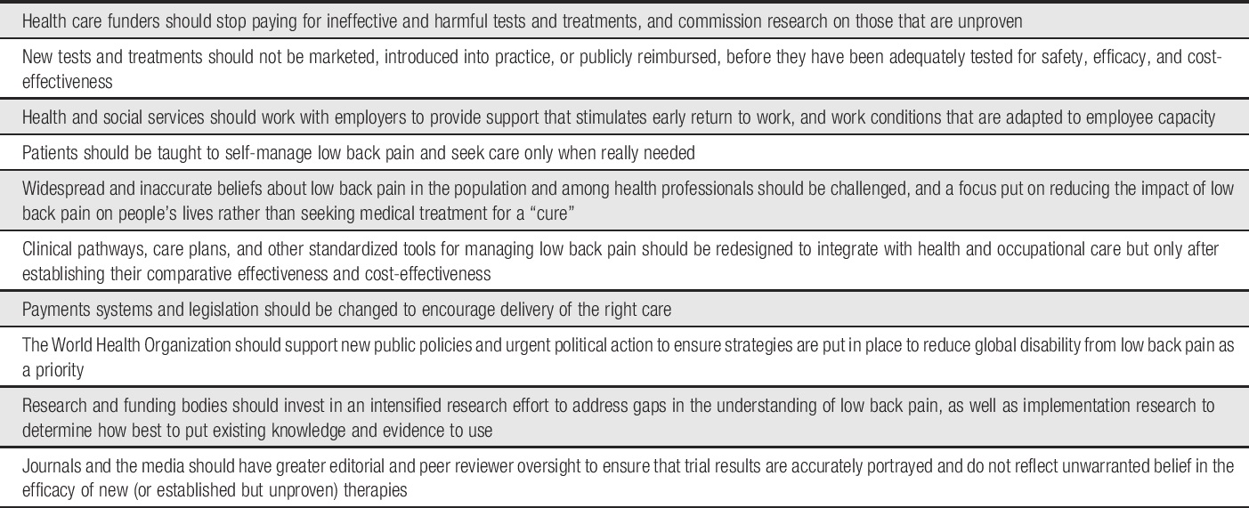
London’s NICE Proposal
Natitional Institute for Clinical Execellece’s Ten proposed actions to improve care for low back pain:
Buchbinder, R., Underwood, M., Hartvigsen, J., & Maher, C. G. (2020). The Lancet Series call to action to reduce low value care for low back pain: an update. Pain, 161, S57-S64.
Notes:
National Insititue for Clinical Excellence

Slide 19
Action Plan Keys
Make sure patients are taught to self manage low back pain
Be sure to seek out care only when needed
Discourage misinformation about LBP among healthcare professionals and patients
Address gaps in research and avoid use of new techniques until it has been tested and studied
Implement strategies and plans to reduce global disability from low back pain

Slide 20
What's the take away?
The Lancet Series identified promising solutions that included focused implementation of best practice, the redesign of clinical pathways, integrated health and occupational care, changes to payment systems and legislation, and public health and prevention strategies.
Yet, we also indicated that most were not yet ready for widespread implementation as the evidence underpinning them was inadequate.

Slide 21
2017 American College of Physicians Guidelines (Update from 2007)
Key Points for Practice:
Acute and subacute low back pain often resolve spontaneously, but superficial heat, massage, acupuncture, and spinal manipulation are initial treatment options.
For patients with chronic low back pain, clinicians and patients should initially select nonpharmacologic treatment with exercise, multidisciplinary rehabilitation, acupuncture, mindfulness-based stress reduction (moderate-quality evidence), tai chi, yoga, motor control exercise, progressive relaxation, electromyography biofeedback, low-level laser therapy, operant therapy, cognitive behavioral therapy, or spinal manipulation
If an NSAID or skeletal muscle relaxant is used, the decision between the two should be based on patient preference and the risks associated with each.
If first-line nonpharmacologic options for chronic low back pain are ineffective, NSAIDs followed by tramadol and duloxetine can be considered.
Opioids are a last line of treatment if above therapies were not effective
Amir Qaseem, Timothy J. Wilt, Robert M. McLean, et al; for the Clinical Guidelines Committee of the American College of Physicians . Noninvasive Treatments for Acute, Subacute, and Chronic Low Back Pain: A Clinical Practice Guideline From the American College of Physicians. Ann Intern Med.2017;166:514-530. [Epub 14 February 2017]. doi:10.7326/M16-2367
Notes:
American College of Physicians addendum their 2007 guidelines – Have recognized there is a need for reform towar rds less opiats and increased use for multidisciplinary medicine as a first line intervention
This opens the door for PTs and other disciplines to make a play .

Slide 22
What is Current PT Best Practice?
Clinical Practice Guidelines (George et al 2021)
Level A evidence for exercise for patients with CLBP and CLBP with leg pain
Level A evidence for use of thrust and non thrust mobilization for CLBP and Level B for CLBP with leg pain
George SZ, Fritz JM, Silfies SP, et al. Interventions for the management of acute and chronic low back pain: Revision 2021. Journal of Orthopaedic &amp; Sports Physical Therapy. 2021;51(11). doi:10.2519/jospt.2021.0304

Slide 23
What is Current Best Practice?
CPG from the AOPT George et al 2021
  Education for Chronic Low Back Pain
  Physical therapists may use standard education strategies for patients with chronic LBP, but not as a stand-alone treatment.
    Standard education strategies include advice related to exercise and advice about staying active.
  Physical therapists should deliver pain neuroscience education alongside other physical therapy interventions, such as exercise or manual therapy, to patients with chronic LBP.
  Physical therapists should use active treatments (ie, yoga, stretching, Pilates, and strength training) instead of stand-alone educational interventions for patients with chronic LBP.

Slide 24
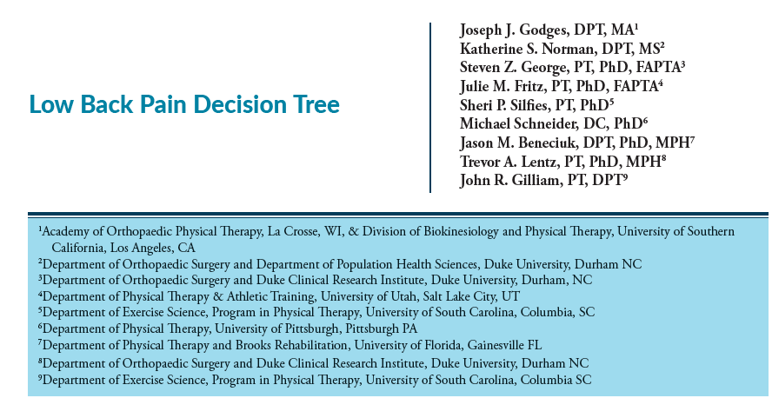
LBP Clinical Decision-Making Tree
All POCs regardless pathology:
  Self Management
  Pain Education
Godges, J.George SZ, Fritz, JM, Silfies SP, Michael Schneider, D. C., Lentz, T. A., & Gilliam, J. R. Low back pain decision tree. Orthopaedic Physical Therapy Practice. 2022; 34(1), 262-267.
(Godges et al 2022)

Slide 25
Another Tidbit from the THE LANCET
Factors and triggers for episodes of nonspecific low back pain:
  previous episodes of back pain
  the presence of other chronic conditions such as asthma, headache, and diabetes, poor mental health (including psychological distress and depression genetic influences, as well as awkward postures, lifting, bending and heavy manual tasks, and being tired or being distracted during an activity.
  Smoking, obesity, and low levels of physical activity, all related to poorer general health, are also associated with occurrence of low back pain episodes

Slide 26
Diagnoses that co-exist with LBP
200 subjects interviewed with chronic low back pain who signed up for a functional restoration program
Depression : 45% of patients have LBP
  39% had depression prior to LBP- also 29% developed depression after low back pain)
Substance abuse: 19% of patients
Anxiety: 14% of patient have LBP
Polatin P.Pschiatric illness and chronic low-back pain. The mind and spine- which goes first? Spine.(1993);18:66-71.

Slide 27
Are we Managing the Individual Cognitive aspects of Pain?
Depression vs Anxiety
Personality traits
  Avoidant vs Paranoid
Pain Catastrophizing/Kinesiophobia
Pain Memories

Slide 28
Mind does matter
What is the best way to educate?
It has been reported that kinesiophobia is present in 92% of patients with CLBP and therefore treatments to reduce kinesiophobia are needed
Patient education has long been explored in the management of pain, anxiety, and stress associated with low back pain
Kinesiophobia, pain catastrophizing
  Generally, people are more attentive to pain signals
  May stem from cognitive errors or exaggerated perception of threat-
  Treat with restructuring and changing attention from catastrophic thinking
  Sullivan MJ, Thorn B, Haythornthwaite JA, et al. Theoretical perspectives on the relation between catastrophizing and pain. Clin J Pain. 2001;17(1):52-64. doi:10.1097/00002508-200103000-00008
Louw, Adriaan, et al. "The effect of neuroscience education on pain, disability, anxiety, and stress in chronic musculoskeletal pain." Archives of physical medicine and rehabilitation 92.12 (2011): 2041-2056
Özyurt, F., Tayfur, A. & Ülger, Ö. The effect of stabilization-based exercises on kinesiophobia in patients with non-specific chronic low back pain: a systematic review and meta-analysis. Sport Sci Health (2024). https://doi.org/10.1007/s11332-024-01254-0

Slide 29
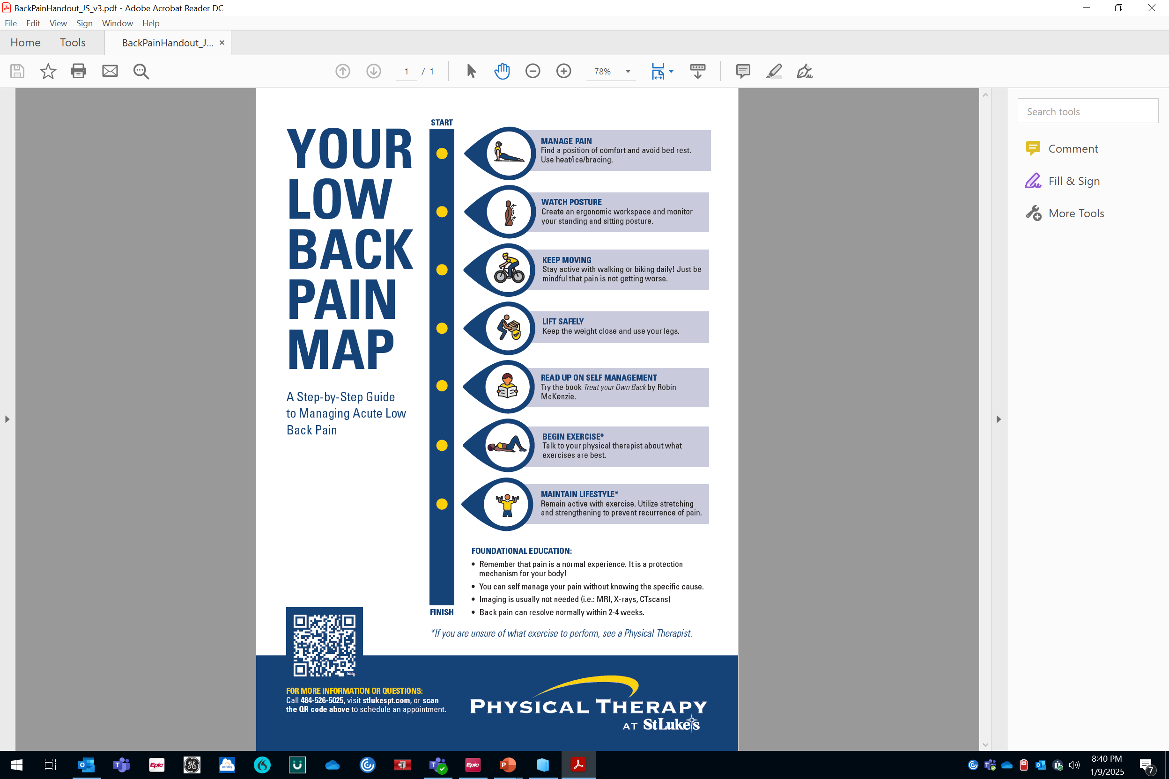
Is this enough?
WHO’s take in 2023 for self care education:
There are several ways to reduce symptoms
and help prevent further episodes of non-specific low back pain:
  Being physically active
  Optimizing mental well-being
  Maintaining a healthy body weight
  Not smoking tobacco
  Getting good sleep
  Being engaged in social and work activities
  Making ergonomic adjustments in the workplace.
Low back pain. World Health Organization. Accessed February 1, 2025. https://www.who.int/news-room/fact-sheets/detail/low-back-pain.
Notes:
Education and support can help people with low back pain to develop strategies to self-manage and cope with the symptoms. This helps to reduce the impact of the disease and improve well-being.

Slide 30
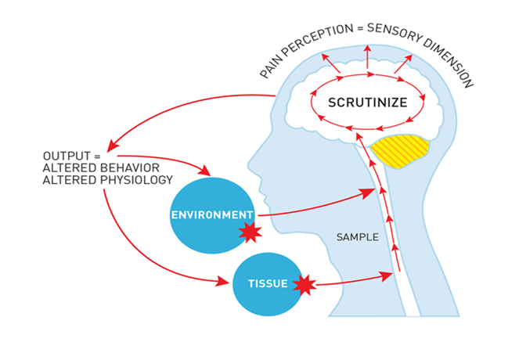
Healthcare Influencing Chronicity Risk
Current Generalized Education Feeds into Fear
Low Back Pain will improve spontaneously with walking or staying active- sometimes we require more
Low Back Pain is individualized- will not improve with general education/general rehab
Low Back Pain is challenging to diagnose- various pain phenotypes (90% is nonspecific LBP)
Imaging is overutilized and overfocused on- Is it still being pushed hard?
  hard to say a specific structure is root of pain
Biomedical approach– telling how to treat and prescribing can fuel catastrophizing, fear, hopelessness- vs Biopsychosocial collaboration
Notes:
decisioThe system has been feeding into the chronicity- if someone takes and x-rays and tells you all the ways you should hurt and what you should do about vs guiding patients to make evidence based ns

Slide 31
Education without Self Efficacy Building=
Increased Risk for Chronicity
General Education/Pain Education is not enough based on CPGs and current best practice
We need to address the cognitive aspects of their pain with self efficacy building
  Low sense of self-efficacy is associated with depression, anxiety, and helplessness.
Self efficacy is a greater predictor of disability than kinesiophobia
Woby, Steve R., Martin Urmston, and Paul J. Watson. "Self-efficacy mediates the relation between pain-related fear and outcome in chronic low back pain patients." European Journal of Pain 11.7 (2007): 711-718.

Slide 32
Self Efficacy and Chronic Pain Risk
Pain-related fear and self-efficacy both appear to contribute to the levels of pain and disability
Self-efficacy beliefs appear to be a stronger predictor of disability than pain-related fear
Less prefrontal activation in the low self-efficacy group than in the moderate self-efficacy group. These findings provide evidence to support the fundamental nature of self-efficacy.
Hirao K. Comparison of hemodynamic responses in the prefrontal cortex according to differences in self-efficacy. Biol Res Nurs. (2017) 19:450–5. doi: 10.1177/1099800417706141
Woby, Steve R., Martin Urmston, and Paul J. Watson. "Self-efficacy mediates the relation between pain-related fear and outcome in chronic low back pain patients." European Journal of Pain 11.7 (2007): 711-718.

Slide 33
Clarity is Kind
Patients/Physicians/PTs need diagnostic and prognostic clarity
  LANCET discourages misinformation for physicians and patients
Patients, have a strong desire to know more about why they continue to hurt
  In order to do this:
    We need to know why they hurt, clearly
Louw, A., Puentedura, E. “Louie” J., & Zimney, K. (2016). Teaching patients about pain: It works, but what should we call it? Physiotherapy Theory and Practice, 32(5), 328–331. https://doi.org/10.1080/09593985.2016.1194669

Slide 34
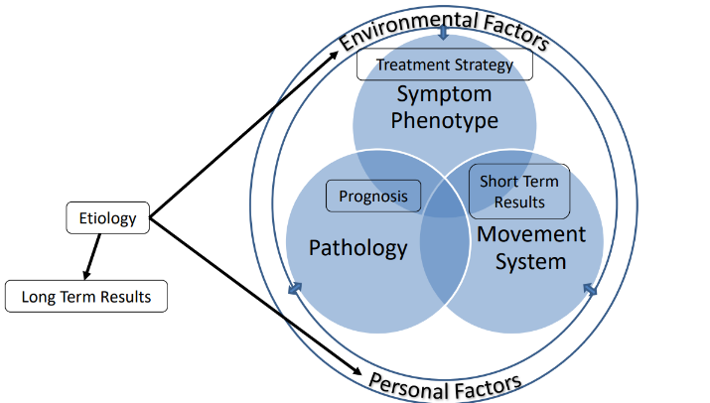

Proposal: Clarity in Identifying Pain Phenotypes
Symptom Phenotype
Where we can fall short in healthcare
Nociceptive- tissue
Neurogenic- nerve
Nociplastic- cortex
Expert PT Model of Thinking (Kareha 2023)
Notes:
If we can be confident and clear in our diagnosis of pain we can better inform our patients
If we are unsure – it will be the blind leading the blind

Slide 35
Diagnosis Clarity: Chronic Pain (Nociplastic)
486x Likelihood
Smart KM, Blake C, Staines A, Thacker M, Doody C. Mechanisms-based classifications of musculoskeletal pain: part 1 of 3: symptoms and signs of central sensitisation in patients with low back (± leg) pain. Man Ther. 2012;17(4):336-344.doi:10.1016/j.math.2012.03.013
Strong association with maladaptive factors (negative emotions, poor self efficacy, maladaptive beliefs, etc)
Pain disproportionate to nature and extend of injury mechanism
Diffuse, non-anatomic areas of pain or tenderness on palpation

Slide 36
OSPRO Yellow Flag Questionnaire
The OSPRO-YF informs treatment decision-making and facilitates treatment monitoring for patients determined to be at high risk for poor outcomes
Allows for quick assessment for psychosocial flags
Has outcome measures for: FABQ-W; FABQ-PA; TSK-11; PCS; STAI; STAXI; PHQ-9; PASS-20; PSEQ; SER; CPAQ
3 forms: 17-items, 10-items, and 7-items with a minimum 85%, 81%, and 75% accuracy, respectively, for identifying yellow flags.
Lentz, T. A., Beneciuk, J. M., Bialosky, J. E., Zeppieri Jr, G., Dai, Y., Wu, S. S., & George, S. Z. (2016). Development of a yellow flag assessment tool for orthopaedic physical therapists: results from the optimal screening for prediction of referral and outcome (OSPRO) cohort. journal of orthopaedic & sports physical therapy, 46(5), 327-343.
Notes:
11 outcome measures

Slide 37
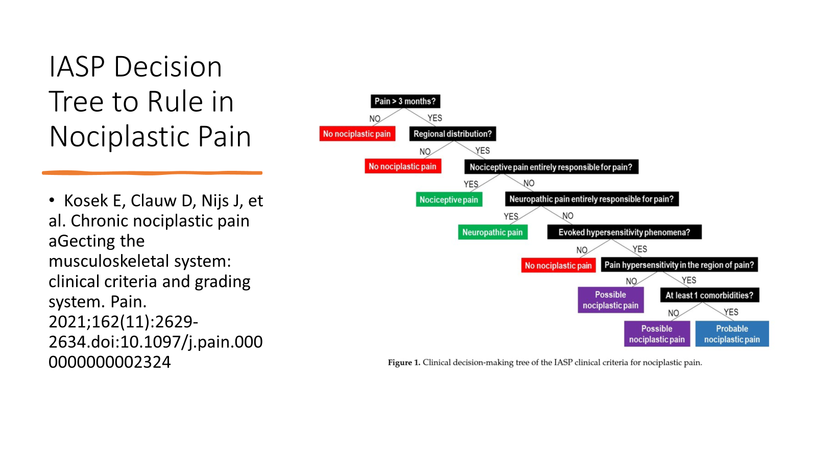
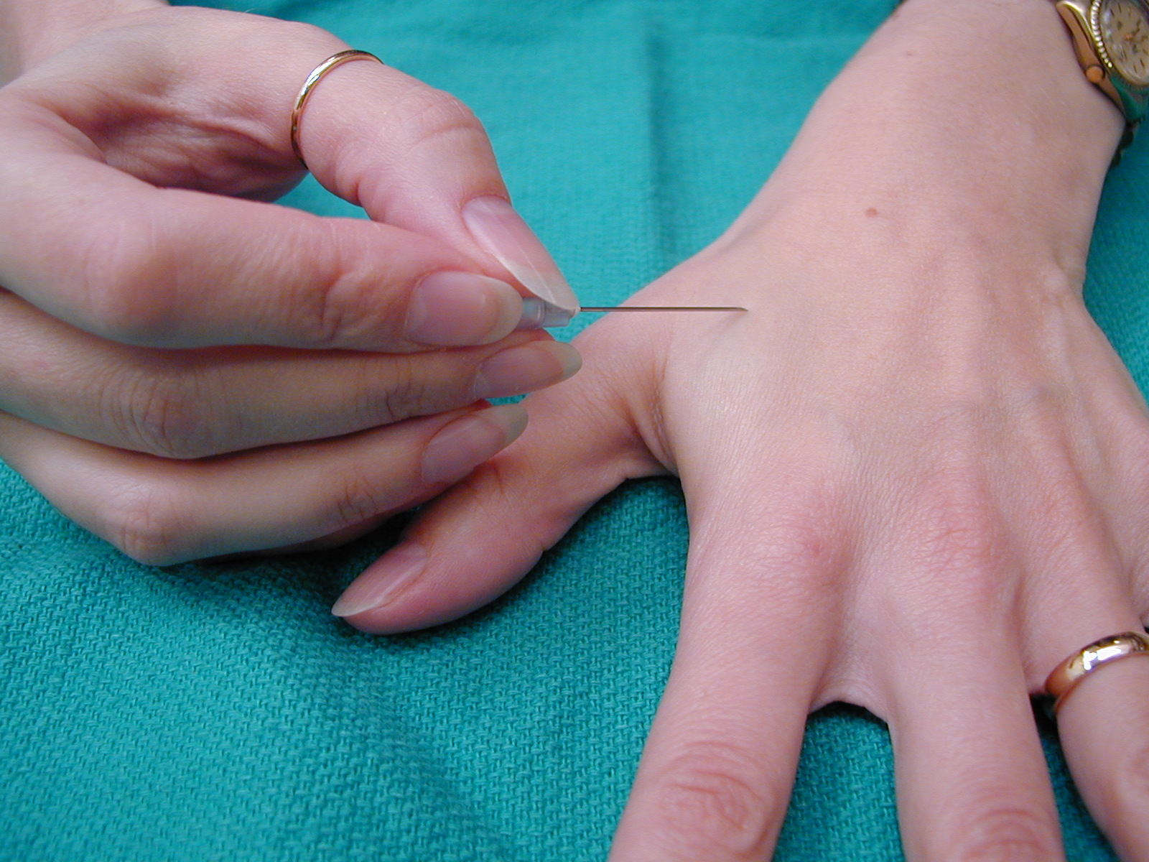
Clarity in Decision Making
Temporal Summation
Notes:
Repeated pin prick- temporal summation

Slide 38
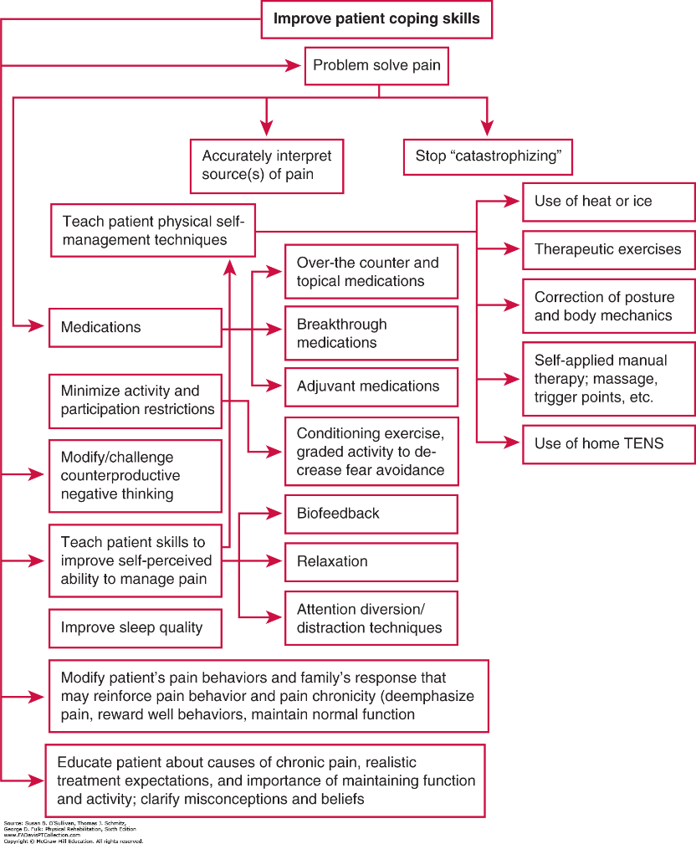
Is it Clear How to Improve Coping?
Chronic Pain Treatment Flowchart:
by O’Sullivan & Schmitz’s Physical Rehabilitation, 8 th Edition

Slide 39


Proposal: Educate to Promote Pain Self Efficacy
Improving PSE can foster self belief and make changes to combat negative thinking/ catastrophization!
Facet 1: Motivational Interviewing/Counseling
Facet 2: Pain Science at various stages of POC
Facet 3: Self Management/Self Efficacy Focused Exercise
Use psych principles/motor learning principles of feedback
Give guidance towards self management through interviewing and self driven exercise

Slide 40
Bandura’s Self-Efficacy Theory
Psychologist Albert Bandura has defined self-efficacy as:
  people’s belief in their ability to control their functioning and events that affect their lives.
One’s sense of self-efficacy can provide the foundation for motivation, well-being, and personal accomplishment.
Notes:
People’s beliefs in their efficacy are developed by four primary sources of influence, including (i) mastery experiences, (ii) vicarious experiences, (iii) social persuasion, and (iv) emotional states.
High self-efficacy has numerous benefits to daily life, such as resilience to adversity and stress, healthy lifestyle habits, improved employee performance, and educational achievemen

Slide 41
Keys to Improve Self Efficacy
Mastering an action
Vicariously experiencing another person’s success/mastery of the action – comparing to oneself
Receiving positive feedback while practicing the action
Managing ones emotional and physiological responses during task execution
Exercise Increases Pain Self-efficacy in Adults With Nonspecific Chronic Low Back Pain: A Systematic Review and Meta-analysis
Yannick L. Gilanyi, Michael A. Wewege, Brishna Shah, Aidan G. Cashin, Christopher M. Williams, Simon R. E. Davidson, James H. McAuley, and Matthew D. Jones
Journal of Orthopaedic & Sports Physical Therapy 2023 53:6, 335-342
Sounds like Motor Learning

Slide 42
Self Belief=Behavior Change
WHY THIS WORKS:
Behavioral change is facilitated by a personal sense of control.
If people believe that they can take action to solve a problem instrumentally, they become more inclined to do so and feel more committed to this decision.
It can also be regarded as an optimistic view of one's capacity to deal with stress.
Self efficacy
Conner, M., & Norman, P. (1995). Predicting Health Behaviour: Research and Practice with Social Cognition Models. Buckingham: Open University Press.
Notes:
Self-efficacy makes a difference in how people feel, think and act.
Such individuals also have low self-esteem and harbour pessimistic thoughts about their accomplishments and personal development. In terms of thinking, a strong sense of competence facilitates cognitive processes and academic performance. Self-efficacy levels can enhance or impede the motivation to act. Individuals with high self-efficacy choose to perform more challenging tasks. They set themselves higher goals and stick to them (Locke & Latham, 1990). Actions are preshaped in thought, and people anticipate either optimistic or pessimistic scenarios in line with their level of self-efficacy
A sense of competence can be acquired by mastery experience, vicarious experience, verbal persuasion, or physiological feedback (Bandura, 1977). Self-efficacy, however, is not the same as positive illusions or unrealistic optimism, since it is based on experience and does not lead to unreasonable risk taking. Instead, it leads to venturesome behaviour that is within reach of one's capabilities.

Slide 43
Pain Self Efficacy
Definition: “Pain self-efficacy” is a belief in one’s ability to handle and accomplish a task despite discomfort
Pain Self Efficacy Questionnaire MDC: 5.5/60 points
Address with:
  Cognitive behavioral therapy, guided imagery, exercise, and multi-component therapies
    May help people with chronic musculoskeletal pain improve their pain self-efficacy
    Study from JOSPT- Yoga is most effective exercise

Slide 44
Pain Self Efficacy and Exercise
Increased Pain Self Efficacy PSE is associated with increased treatment adherence and improvements in pain, disability, depression and emotional distress following treatment.
  (Meta Analysis of 8 studies with moderate confidence)
  Individuals with chronic diseases and high self-efficacy levels have fewer mental problems and higher quality of life
Exercise Increases Pain Self-efficacy in Adults With Nonspecific Chronic Low Back Pain: A Systematic Review and Meta-analysis
Yannick L. Gilanyi, Michael A. Wewege, Brishna Shah, Aidan G. Cashin, Christopher M. Williams, Simon R. E. Davidson, James H. McAuley, and Matthew D. Jones
Journal of Orthopaedic & Sports Physical Therapy 2023 53:6, 335-342

Slide 45
Proposal: Enhance Patient PSE
3 facets to build PSE
  Utilize each t/o POC
  Each with a focus on patient leading and being in control
  This can reduce depression, anxiety and helplessness feelings associated with pain
Facet 1: Motivational Interviewing/Counseling
Facet 2: Pain Science at various stages of POC
Facet 3: Self Management/Self Efficacy Focused Exercise
Use psych principles/motor learning principles of feedback
Give guidance towards self management through interviewing and self driven exercise

Slide 46
Facet 1: Motivational Interviewing
Motivational interviewing is a collaborative, goal-oriented method of communication that empowers people with depression to make behavioral changes
Focus is to facilitate patients' reflection on ambivalence in their logic/theory
Utilize the patient's own motivation, energy and commitment to change behavior
The art of skillful guiding
  (Godges 2024)
“What do you think you makes your pain better? “

Slide 47
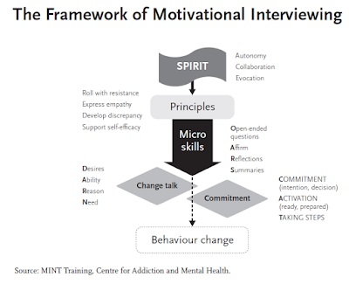
Motivational Mindset
Collaborative – joint decision making- vs telling (only the patient can make the change)
Evocative – changes can be evoked by connecting to what the patient cares about
Honor patient Autonomy
Motivational interviewing, aims to increase the quality of life and self-efficacy behaviors of individuals with chronic diseases.
Uzun, Sevda, and Nermin Gürhan. "The effect of motivational interviewing on quality of life and self‐efficacy behaviors of individuals with chronic illness: A meta‐analysis study." Public Health Nursing 41.5;2024: 901-922.
Notes:
Try to connect and guide and activate their change through their own reflexions and changes –

Slide 48
Motivational Interviewing Skill: Counseling
Counseling is simply an interviewing skill
Use listening skills and action skills
Promotes patient’s self responsibility and self efficacy
Essential Interviewing A programmed approach to effective communication 9th edition, David Evans, Margaret Hearn Max Ullemann, Allen Ivey
Cengage Learning 2017
Notes:
Now by no means am I saying I am an expert in counciling nor does it fall into my scope to manage patient with psychological disorders- but all I am saying is if we can guide patients towards arriving at their own opinions and self treatment by listenening better and giving better advce or education only if they feel they need it- they will have better outcomes

Slide 49
Listening to give them comfort
Focus on Listening, attending (lead them to speak and be comfortable with silence)
  Reflect on their statement- repeat and make the patient feel heard/validated
  Engage patient, develop rapport
  This can help patients take down defenses
  Ask open ended questions instead of closed questions
  Essential Interviewing A programmed approach to effective communication 9th edition, David Evans, Margaret Hearn Max Ullemann, Allen Ivey
  Cengage Learning 2017
“I see…Hmmm I hear you…uhhuhhh”
“Would you be able to explain…
“Tell me what you think…”

Slide 50
Motivational Interview Skill: Confronting
  Confronting is a way to make a change psychologically by pointing out flaws in patient logic
    Need to do so cautiously and non-judgmentally
    The patient should explore the discrepancy to help them gain a clear picture of where they need to make a change
“Tell me if I misheard but you mentioned moving your shoulder to comb your hair will dislodge your ICD?”

Slide 51
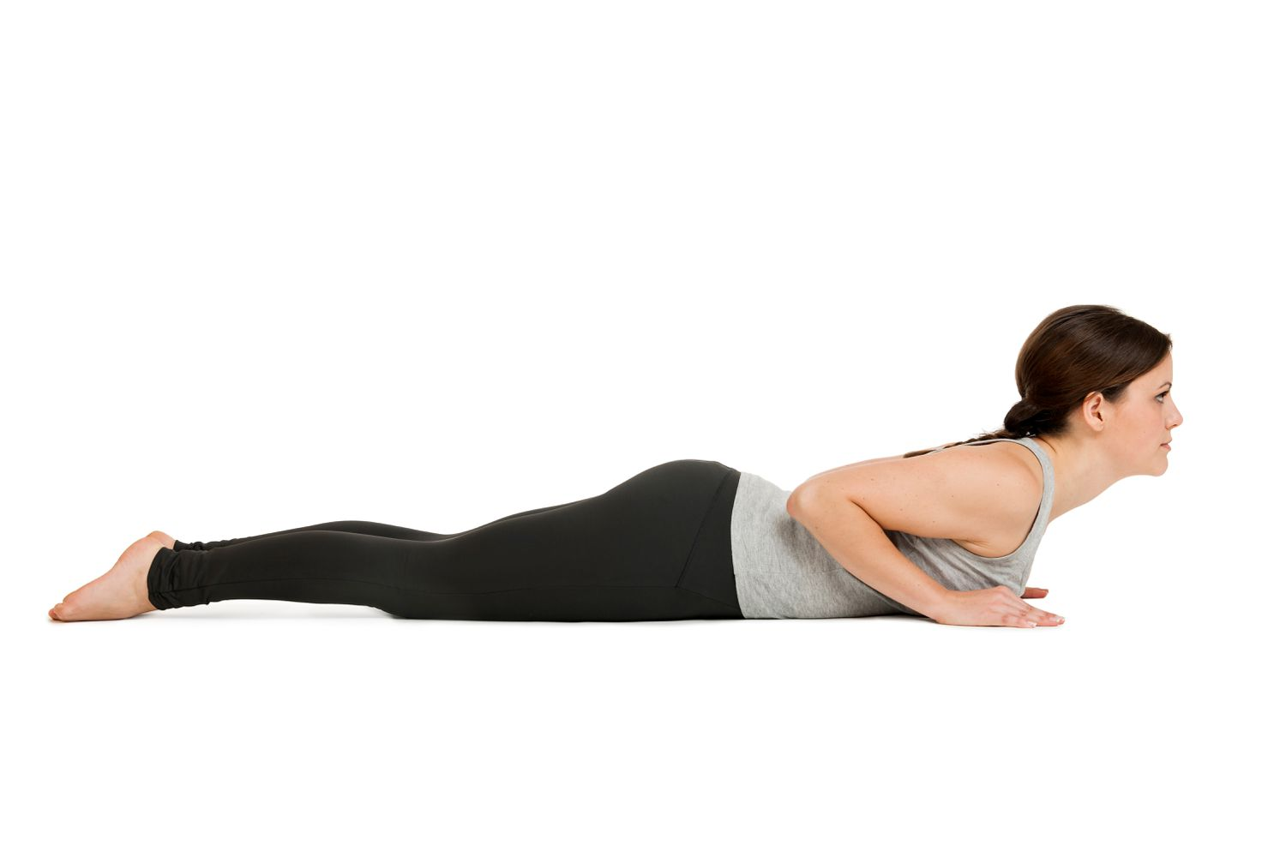
Combine Motivational Interviewing with Pain Education and Exercise?
Patient leads, you guide
Listen first mentality
Restate or clarify
Ultimately have your patient tell you how they will get better- then guide them

Slide 52
Facet 2: Pain Neuroscience Education
“Teaching patients with chronic musculoskeletal pain more about pain from a biological and physiological perspective”
Teaching this has a “positive effect on pain, function, physical movement, and pain catastrophization”
Adriaan Louw & Veronica Riera-Gilley. (2024) Pain Neuroscience Education: Teaching People About Pain. Journal of Pain & Palliative Care Pharmacotherapy 38:3, pages 292-301.

Slide 53
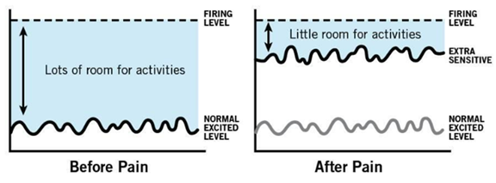
How do we deliver PNE?
Use stories
Use flashcards
Use relatable analogies that make sense
Can Best delivered verbally one on one
Roughly 30 minute sessions
Sensitive nervous system = sensitive alarm system via Adrienne Loew
Louw A, DienerI, Butler DS, PuenteduraEJ. The effect of neuroscience education on pain, disability, anxiety, and stress in chronic musculoskeletal pain. Archives of physical medicine and rehabilitation. Dec 2011;92(12):2041-2056.
Louw A, Puentedura E, Schmidt S, Zimney K. In: Pain Neuroscience Education Teaching People about Pain. 2nd ed. Minneapolis: Orthopedic Physica Therapy Products; 2018:429.

Slide 54
Brain Changes
Reduction of pain sensation allows the brain to better process motor signals, so the effect of PNE can be seen in the ability to perform movements.
After the PNE + exercise treatment= Changes in the motor area after PNE- improved prefontal cortex activation.
Corbo, Daniele. "Pain Neuroscience Education and Neuroimaging—A Narrative Review." Brain Sciences 14.9 (2024): 947.

Slide 55

This all sounds good…
Clinical Practice Guidelines suggests that PNE alone is not enough (George et al 2021)
Talking about pain can lead to biomedical focus, fuel anxiety, kinesiophobia
Guided Self Efficacy based Exercise with PNE that is collaborative→

Slide 56
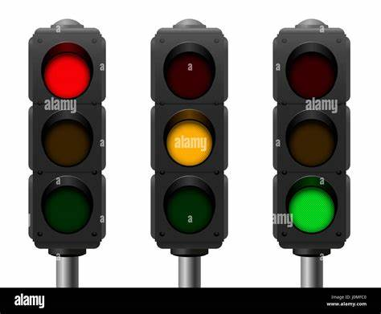
Facet 3: Exercises that build Pain Self Efficacy?
McKenzie
Mulligan
Stabilization
Combine with Facets 1 and 2:
-Use Motivational Interviewing throughout POC to bolster self management/efficacy
-Use PNE throughout POC

Slide 57
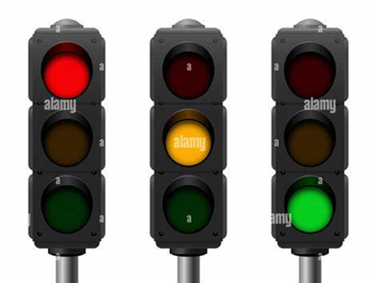

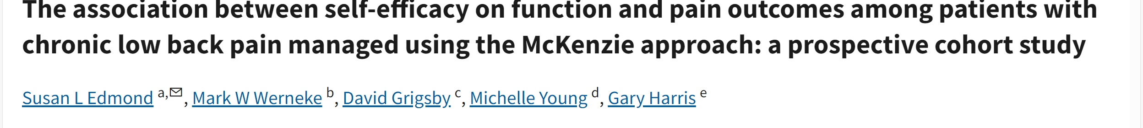
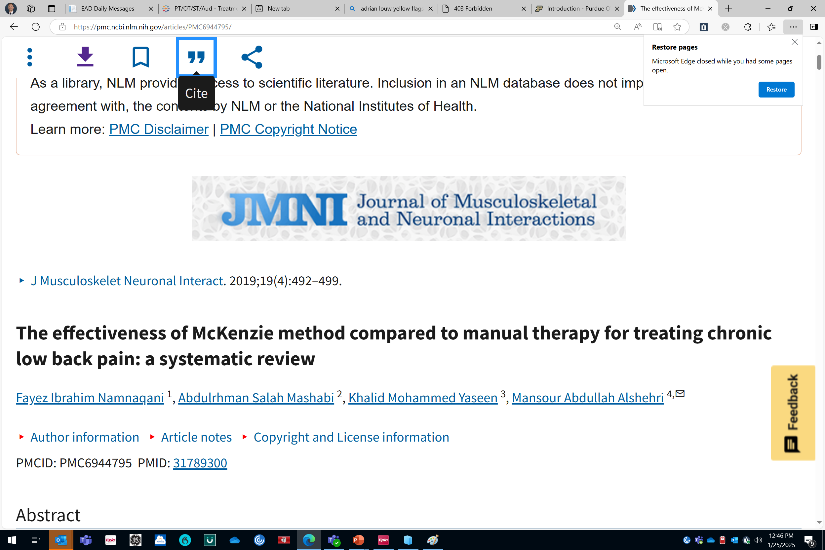
McKenzie to Build Self Efficacy
McKenzie-based patient education empowers patients to attain active self-management strategies and problem-solving techniques to self-control symptoms; all components of self-efficacy.
Guided Interview:
“Tell me what movement you think helps your pain?
“Would it reasonable to avoid the movement that makes you worse?”
Notes:
Self guided exercise with Mckenize after DP or proper categorization was made
Mckenzie self help books

Slide 58
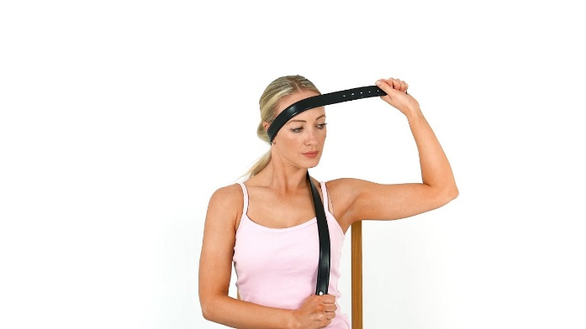
Mulligan and Kinesiophobia
Mulligan or self mobilization with movements showed a decrease in depression pronounced improvement in QoL, kinesophobia in individuals suffering neck pain
It is thought that any increase in ROM results in an increase in the proprioceptive sensation in the neck region, which may result in reduced kinesophobia in patients.
Guided Interview:
“Tell me if you think using this stretch with a towel helps you move better?” “Would it be safe to say its easier to move after?”
Buyukturan O, Buyukturan B, Sas S, Karartı C, Ceylan İ. The Effect of Mulligan Mobilization Technique in Older Adults with Neck Pain: A Randomized Controlled, Double-Blind Study. Pain Res Manag. 2018;2018:2856375. Published 2018 May 15. doi:10.1155/2018/2856375
Notes:
traditional physiotherapy (TP) group and traditional physiotherapy-Mulligan mobilization (TPMM) group. Treatment program was scheduled for 10 sessions. Participants were assessed in terms of pain, ROM, functional level, kinesiophobia, depression, and QoL both pre- and posttreatment. Results. Pain, ROM, functional level, kinesiophobia, depression, and QoL improved in both groups following treatment (p < 0.05). When comparing effects of these two treatment programs, it was observed that the TPMM group had a better outcome (p < 0.05) in terms of ROM, kinesiophobia, depression, and QoL.
Unique because it a self mobilization

Slide 59
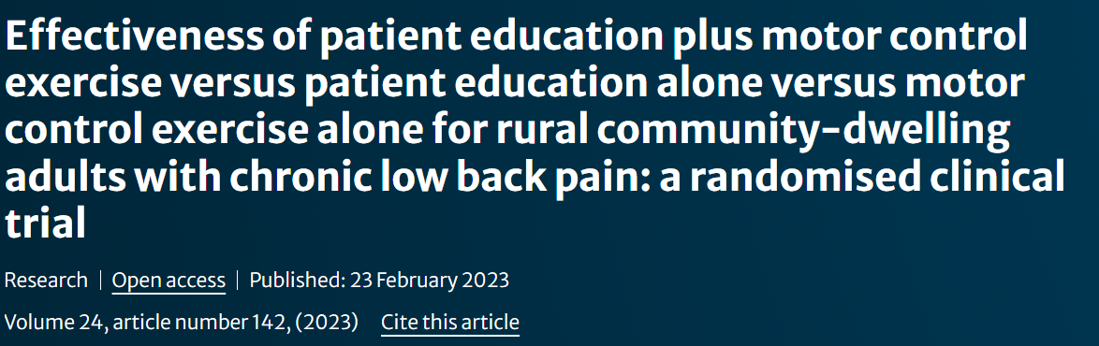
Stabilization and Fear
There is a correlation between pain, disability, quality of life and Kinesiophobia in patients with CLBP.
Stabilization exercises can be an effective method of reducing the fear of movement by reducing pain and disability and improving quality of life.
Stabilization based exercises are easy to do at home without requiring any equipment, hence increases the patient’s self-management
Guided Interview:
“Tell me if you think building control of your back muscles will help your pain?”
Özyurt, Fatih, Abdulhamit Tayfur, and Özlem Ülger. "The effect of stabilization-based exercises on kinesiophobia in patients with non-specific chronic low back pain: a systematic review and meta-analysis." Sport Sciences for Health (2024): 1-13.

Slide 60
Self Belief=Activity Change
When we give exercise prescription and self management strategies with the intention of building self efficacy- this creates a complete shift in behavior of patient
Reduced depression, hopelessness, fear, kinesiophobia
LIMIT CHRONIC PAIN RISK DEVELOPMENT

Slide 61
Patient’s Collaborate to Build Efficacy
Based on Lancet, NICE, CPGs from ACP and AOPT
Treating LBP immediately with conservative measures vs pharma/imaging – patients collaborate with physicians
Addressing the LBP with identifying proper pain phenotype first
Address Nociplastic Phenotype and catastrophization/negative beliefs via PNE and Pain Self Efficacy Education (PSE)
Improving Self Management Skills
  Motivational Interviewing Counseling skills that are patient led
  Movement/Exercise to Desensitize CNS/PNS patient led
  Overall Wellness (Sleep/Nutrition/Stress reduction) patient led

Slide 62
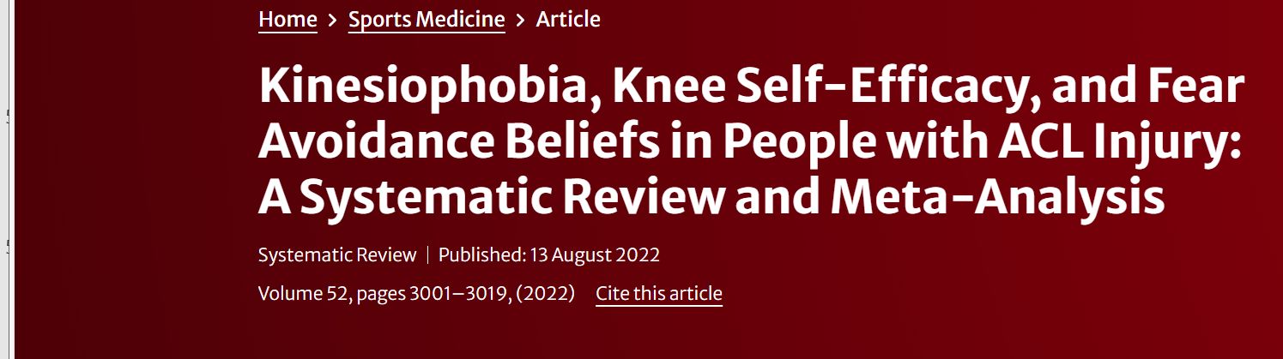
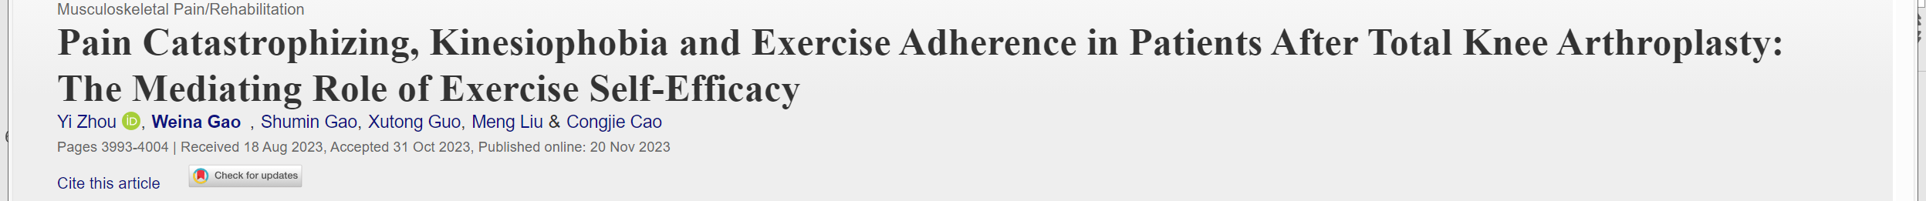
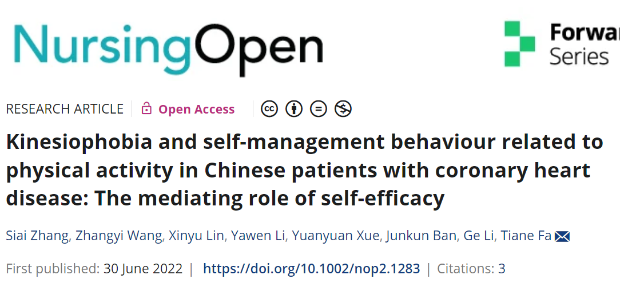
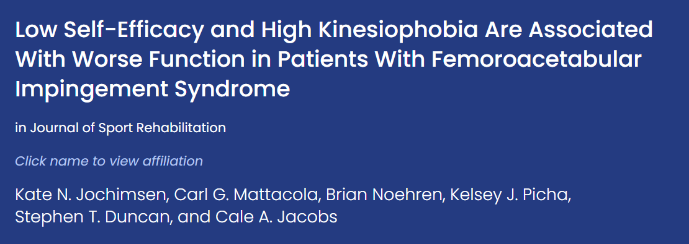
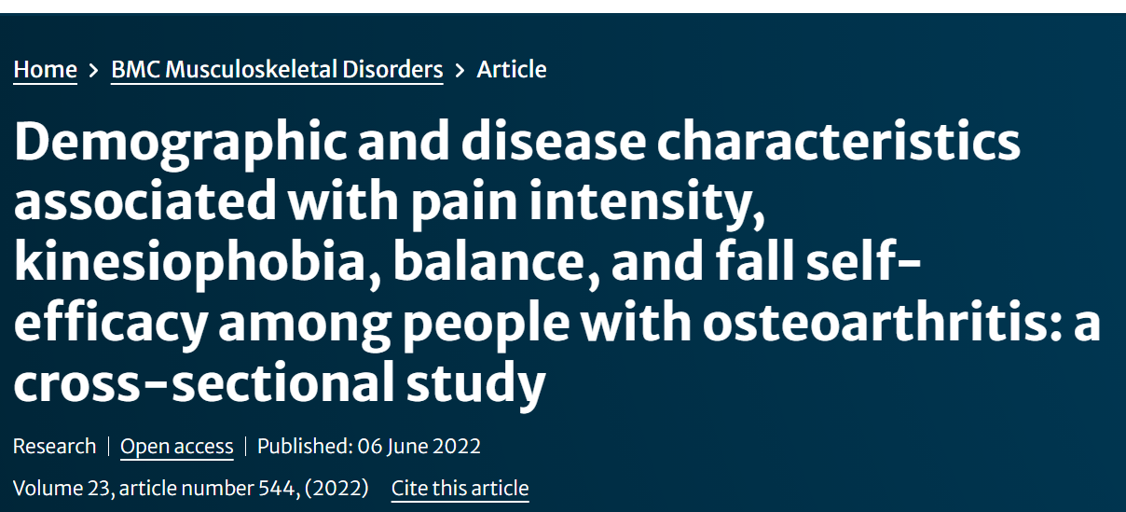
Self Efficacy Global Application
The Biopsychosocial approach is the starting to track!

Slide 63

We Need to Empower

Slide 64
Works Cited
Amir Qaseem, Timothy J. Wilt, Robert M. McLean, et al; for the Clinical Guidelines Committee of the American College of Physicians . Noninvasive Treatments for Acute, Subacute, and Chronic Low Back Pain: A Clinical Practice Guideline From the American College of Physicians. Ann Intern Med.2017;166:514-530. [Epub 14 February 2017]. doi:10.7326/M16-2367
Buchbinder, R., Underwood, M., Hartvigsen, J., & Maher, C. G. 2020. The Lancet Series call to action to reduce low value care for low back pain: an update. Pain.2020; 161, S57-S64.
Corbo, Daniele. "Pain Neuroscience Education and Neuroimaging—A Narrative Review." Brain Sciences 14.9 2024: 947.
Dahlhamer J, Lucas J, Zelaya, C, et al. Prevalence of Chronic Pain and High-Impact Chronic Pain Among Adults — United States, 2016. MMWR Morbidity and Mortality Weekly Report. 2018;67(36):1001-1006. doi:10.15585/mmwr.mm6736a2
Essential Interviewing A programmed approach to effective communication 9th edition, David Evans, Margaret Hearn Max Ullemann, Allen Ivey Cengage Learning 2017
George SZ, Fritz JM, Silfies SP, et al. Interventions for the management of acute and chronic low back pain: Revision 2021. Journal of Orthopaedic &amp; Sports Physical Therapy. 2021;51(11). doi:10.2519/jospt.2021.0304
Gilanyi, Y. L., Wewege, M. A., Shah, B., Cashin, A. G., Williams, C. M., Davidson, S. R., ... & Jones, M. D. Exercise Increases Pain Self-efficacy in Adults With Nonspecific Chronic Low Back Pain: A Systematic Review and Meta-analysis. journal of orthopaedic & sports physical therapy. 2023; 53(6), 335-342.
Godges, J.George SZ, Fritz, JM, Silfies SP, Michael Schneider, D. C., Lentz, T. A., & Gilliam, J. R. Low back pain decision tree. Orthopaedic Physical Therapy Practice. 2022; 34(1), 262-267.
Godges J. Cognitive and Affective Tendencies and The Importance of Subgroup Classification . lecture presented at: October 27, 2024.
Ibrahim, A.A., Akindele, M.O. & Ganiyu, S.O. Effectiveness of patient education plus motor control exercise versus patient education alone versus motor control exercise alone for rural community-dwelling adults with chronic low back pain: a randomised clinical trial. BMC Musculoskelet Disord 24, 142 (2023). https://doi.org/10.1186/s12891-022-06108-9
Kosek E, Clauw D, Nijs J, et al. Chronic nociplastic pain aGecting the musculoskeletal system: clinical criteria and grading system. Pain. 2021;162(11):2629-2634.doi:10.1097/j.pain.0000000000002324
Louw, Adriaan, et al. "The effect of neuroscience education on pain, disability, anxiety, and stress in chronic musculoskeletal pain." Archives of physical medicine and rehabilitation 92.12 2011: 2041-2056.
Louw A, Puentedura E “Louie”, Mintken P. Use of an abbreviated neuroscience education approach in the treatment of chronic low back pain: A case report. Physiotherapy Theory and Practice. 2011;28(1):50-62. doi:10.3109/09593985.2011.562602
Louw, A., Puentedura, E. “Louie” J., & Zimney, K.. Teaching patients about pain: It works, but what should we call it? Physiotherapy Theory and Practice. 2016; 32(5), 328–331. https://doi.org/10.1080/09593985.2016.1194669
Louw A & Veronica Riera-Gilley. Pain Neuroscience Education: Teaching People About Pain. Journal of Pain & Palliative Care Pharmacotherapy. 2024; 38:(3): 292-301.
Namnaqani FI, Mashabi AS, Yaseen KM, Alshehri MA. The effectiveness of McKenzie method compared to manual therapy for treating chronic low back pain: a systematic review. J Musculoskelet Neuronal Interact. 2019;19(4):492-499.
Özyurt, F., Tayfur, A. & Ülger, Ö. The effect of stabilization-based exercises on kinesiophobia in patients with non-specific chronic low back pain: a systematic review and meta-analysis. Sport Sci Health (2024). https://doi.org/10.1007/s11332-024-01254-0
Raja, Srinivasa N.a,*; Carr, Daniel B.b; Cohen, Miltonc; Finnerup, Nanna B.d,e; Flor, Hertaf; Gibson, Stepheng; Keefe, Francis J.h; Mogil, Jeffrey S.i; Ringkamp, Matthiasj; Sluka, Kathleen A.k; Song, Xue-Junl; Stevens, Bonniem; Sullivan, Mark D.n; Tutelman, Perri R.o; Ushida, Takahirop; Vader, Kyleq The revised International Association for the Study of Pain definition of
Smart KM, Blake C, Staines A, Thacker M, Doody C. Mechanisms-based classifications of musculoskeletal pain: part 1 of 3: symptoms and signs of central sensitisation in patients with low back (± leg) pain. Man Ther. 2012;17(4):336-344.doi:10.1016/j.math.2012.03.013pain: concepts, challenges, and compromises, PAIN: September 2020 - Volume 161 - Issue 9 - p 1976-1982doi: 10.1097/j.pain.0000000000001939
Szalavitz M. Report: Chronic, Undertreated Pain Affects 116 Million Americans . Time Magazine. June 2011.
Thacker, Mick. (2015). Louis Gifford – revolutionary:the Mature Organism Model,an embodied cognitive perspective of pain. In Touch. 152. 4-9.
Traeger AC, Moseley GL, Hübscher M, et alPain education to prevent chronic low back pain: a study protocol for a randomised controlled trialBMJ Open 2014;4:e005505. doi: 10.1136/bmjopen-2014-005505
Woby, Steve R., Martin Urmston, and Paul J. Watson. "Self-efficacy mediates the relation between pain-related fear and outcome in chronic low back pain patients." European Journal of Pain 11.7 (2007): 711-718.
Wong M. Wong Pain Lecture USC Spine Fellowship. lecture presented at: October 28, 2024.
Why you hurt: Pain neuroscience education system | Adriaan Louw | OPTP. Accessed January 25, 2025. https://www.optp.com/Why-You-Hurt-Pain-Neuroscience-Education-System.

Slide 65

Thank you

