Slide 1
Time = Function:
Importance of Identifying Axial Spondyloarthropathies Earlier
Shawn Stanislaw PT, DPT, OCS
Physical Therapy Spine Fellow

Slide 2
Course Objectives
At the end of this presentation participants will be able to:
Discover the current epidemiology and common comorbid conditions
Illustrate how the time to Dx directly impacts future healthcare burden and function.
Describe common findings from a AxSpA patient’s subjective and PMH
Identify lab and imaging modalities that
Outline current best practices to screen patients with chronic LBP for AxSpA

Slide 3
Axial Spondyloarthropathies (AxSpA)
Ankylosing Spondylitis (AS) - also known as radiographic axSpA, because the damage it can cause to the sacroiliac joints and spine can be seen on X-rays
Nonradiographic axSpA (nr-axSpA) - causes damage that may not be visible in X-rays but it may show up on magnetic resonance images (MRIs)

Slide 4
Disease Family
Ankylosing Spondylitis
Reactive Arthritis
Psoriatic arthritis
Chronic Irritable Bowel Disease
Undifferentiated SpA

Slide 5
Why We Care
axSpA has high rates of disability, increased morbidity and mortality, lost work time, high lifetime health costs, and significant psychosocial impact.*
2019 Study in France estimated 3.6x cost of healthcare for these patients.**
Delayed diagnosis had higher disease activity, worse physical function, increased structural damage, and higher direct and indirect healthcare costs than those who received earlier diagnosis***
Notes:
*Wendling, D., Claudepierre, P., & Prati, C. (2013). Early diagnosis and management are crucial in spondyloarthritis. Joint bone spine, 80(6), 582–585. https://doi.org/10.1016/j.jbspin.2013.03.003
**Claudepierre, P., Fagnani, F., Cukierman, G., de Chalus, T., Joubert, J. M., Laurendeau, C., Gourmelen, J., & Breban, M. (2019). Burden of severe spondyloarthritis in France: A nationwide assessment of prevalence, associated comorbidities and cost. Joint bone spine, 86(1), 69–75. https://doi.org/10.1016/j.jbspin.2018.04.003
***Barnett, R., Ingram, T., & Sengupta, R. (2020). Axial spondyloarthritis 10 years on: still looking for the lost tribe. Rheumatology (Oxford, England), 59(Suppl4), iv25–iv37.

Slide 6
Epidemiology

Slide 7
Epidemiology
Onset
  20-45 years of age
Incidence Rate of AxSpA
  0.13–1.40%*
  AxSpA is estimated to effect 1 in 200 adults in the UK*
    2x the prevalence of multiple sclerosis or Parkinson’s disease
AS is more common in men than in women. However, nr-axSpA may be just as common in women as in men.**
Notes:
*Barnett, R., Ingram, T., & Sengupta, R. (2020). Axial spondyloarthritis 10 years on: still looking for the lost tribe. Rheumatology (Oxford, England), 59(Suppl4), iv25–iv37. https://doi.org/10.1093/rheumatology/keaa472
**Rusman, T., van Vollenhoven, R. F., & van der Horst-Bruinsma, I. E. (2018). Gender Differences in Axial Spondyloarthritis: Women Are Not So Lucky. Current rheumatology reports, 20(6), 35.

Slide 8
Diagnostic Delays
62% of patients contact a healthcare provider within 12 mth of developing AxSpA symptoms.*
Prior to 2009 the time to definitive Dx was ~10yrs**
Current evidence suggests time to Dx is 6-10yr***
  Improvements likely multifactorial and include increased use of MRI and commonly available screening tools.
What could be causing this delay?
Notes:
Sheer prevalence of back pain
Some pts report not feeling listened to or believed about their symp causing withdrawal from care completely, leading to further diagnostic delay.
1) Hamilton L, Gilbert A, Skerrett J, Dickinson S, Gaffney K. Services for people with ankylosing spondylitis in the UK-a survey of rheumatologists and patients. Rheumatology (Oxford) 2011;50:1991-8
Feldtkeller E, Khan MA, van der Heijde D, etal. Age at disease onset and diagnosis delay in HLA-B27 negative vs positive patients with ankylosing spondylitis. Rheumatol Int 2003; 23(2); 61-66. doi: 10.1007/s00296-00200237-4
***Barnett, R., Ingram, T., & Sengupta, R. (2020). Axial spondyloarthritis 10 years on: still looking for the lost tribe. Rheumatology (Oxford, England), 59(Suppl4), iv25–iv37.

Slide 9
Uncommon Cause for a Common Problem
Primary feature of AxSpA is chronic low back pain (CLBP)
19.6% prevalence of CLBP worldwide in 20-59 year olds³
80% of population experiences LBP in their lifetime.⁴
Comparatively prevalence of AxSpA is 0.13-1.4%⁵
Notes:
First contact providers therefore likely assume pain coming from more common disorders. Suspicion may also be lower due to poor awareness of differences between mechanical spine pain and inflammatory back pain and AxSpA early features.
3) Meucci RD, Fassa AG, Faria NM, Prevalence of chronic low back pain; systematic review. Rev Saude Publica 2015; 49:1
4) Manchikanti L, Singh V, Datta S, Cohen SP, Hirsch JA. Comprehensive review of epidemiology, scope, and impact of spinal pain. Pain Physician 2009; 12:E35-70
5) Stolwijk C, van Onna M, Boonen A, Curtis JR, Golembesky A. Incidence and prevalence of axial spondyloarthritis: a systematic review and meta-regression analysis. Arthritis Care Res (Hoboken) 2016;68:1320-31

Slide 10
Yeah, but PTs definitely refer these patients faster – Right!?!?

Slide 11

Wrong!
Avg time from initial PT visit to Dx with SpA was 6.4yrs!!!
44% of those had 3 or more episodes of care prior to Dx.
Median episode length was 11 visits*
Notes:
*McCrum C, Kenyon K, Cleaton J, Dudley T. An unrecognized masquerader: a retrospective review of people presenting to musculoskeletal physiotherapy with undiagnosed spondyloarthritis. Physiotherapy 2019;105:e102-3

Slide 12
Can we identify AxSpA earlier?
This isn’t a new goal.
A 2016 BJGP study found that specific education for General Practitioners improved recognition and referral of AxSpA by 40%*
Physiotherapist awareness of the 2017 NICE guidance
Notes:
*van Onna, M., Gorter, S., Maiburg, B., Waagenaar, G., & van Tubergen, A. (2017). GPs' patterns of clinical assessment when faced with a patient suspected for spondyloarthritis: a prospective educational intervention study. BJGP open, 1(1), bjgpopen17X100689.

Slide 13
Reported Barriers After Referral*
Long Wait – 77%
Insurance Restrictions – 47.1%
Few Specialists – 35.1%
Patient Reluctance – 25.2%
Distance to Specialist – 21.5%
Only 7.4% reported NO ISSUES with referral process!
Notes:
*Yong CY, Hamilton J, Benepal J et al. Awareness of axial spondyloarthritis among chiropractors and osteopaths: findings from a UK Wed-based survey. Rheumatol Adv Pract 2019;3(2):rkz034

Slide 14
Differential Dx

Slide 15
Mechanical vs Inflammatory Spinal Pain
Mechanical Spine Pain

Slide 16
Mechanical vs Inflammatory Spinal Pain
Inflammatory
IBP not a mandatory criterion for Dx of AxSpA
  Not present in 20-30% of cases*
Notes:
*)Rohas-Vargas M, Munoz-Gomariz E, Escudero A et al. First signs and symptoms of spondyloarthritis—data from an inception cohort with a disease course of two years or less (REGISPONSER-Early). Rheumatology (Oxford) 2009;48:404-9.

Slide 17
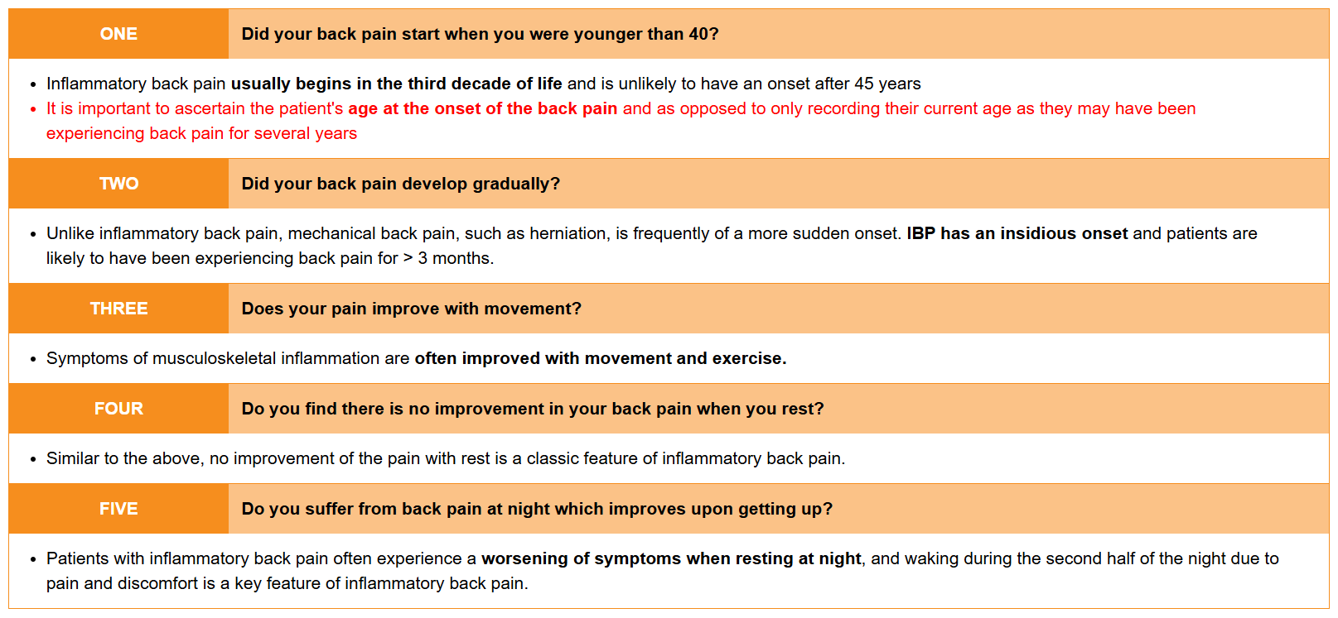
Inflammatory Back Pain (IBP)
Additional features outlined by the ASAS criteria for inflammatory back pain to look out for include:*
Good response to NSAIDs
Alternating buttock pain
Waking during the second half of the night
Morning stiffness : pain and stiffness for > 30 minutes after rising in the morning
Notes:
*Poddubnyy D, van Tubergen A, Landewe R, Seiper J, van der Heijde D. Development of an ASAS-endorsed recommendation for the early referral of patients with a suspicion of axial spondyloarthritis. Ann Rheum Dis 2015;74:1483-7

Slide 18
AxSpA versus RA
54 of which included study populations with SpA and RA. Skin and nail psoriasis, as well as swelling of the fingers and toes, was only seen in patients with SpA. Most studies showed that enhanced imaging allowed for distinguishing between SpA and RA. This study showed that typical signs and symptoms of SpA, including inflammation and joint pain, could also be seen in patients with RA, which suggests that challenges exist for accurately identifying SpA. This highlights the importance of advanced imaging to diagnose and treat patients with SpA in a timely manner.
Notes:
Mease, P. J., Bhutani, M. K., Hass, S., Yi, E., Hur, P., & Kim, N. (2022). Comparison of Clinical Manifestations in Rheumatoid Arthritis vs. Spondyloarthritis: A Systematic Literature Review. Rheumatology and therapy, 9(2), 331–378.

Slide 19
Goal of Screening
ID patients prior to radiographic findings may limit structural disease progression.
Decrease effects on other systems (cardiac and GI) secondary to systemic inflammation.
Limit long-term disability

Slide 20
Axial SpA Symptomology
Axial joint involvement
Enthesopathy
Associated with HLA-B27 (~66%)
Extraarticular manifestations
  Uveitis
  Psoriasis
  IBD
  Cardio/Pulmonary

Slide 21
Enthesopathy
One-third of patients with axSpA present with clinical enthesitis*
Overuse-related pain at the site of the insertion of tendons into the bone*
Higher prevalence of clinical enthesitis in nr-axSpA versus AS*
Inflammation at other functional entheses including those in the eye, lung and aortic root are also common in axSpA
  May explain some of the extra-articular disease manifestations such as uveitis, lung fibrosis, and aortic root disease**
Notes:
*McGonagle, D., Aydin, S. Z., Marzo-Ortega, H., Eder, L., & Ciurtin, C. (2021). Hidden in plain sight: Is there a crucial role for enthesitis assessment in the treatment and monitoring of axial spondyloarthritis?. Seminars in arthritis and rheumatism, 51(6), 1147–1161.
**Watad, A., Bridgewood, C., Russell, T., Marzo-Ortega, H., Cuthbert, R., & McGonagle, D. (2018). The early phases of ankylosing spondylitis: emerging insights from clinical and basic science. Frontiers in immunology, 9, 2668.

Slide 22
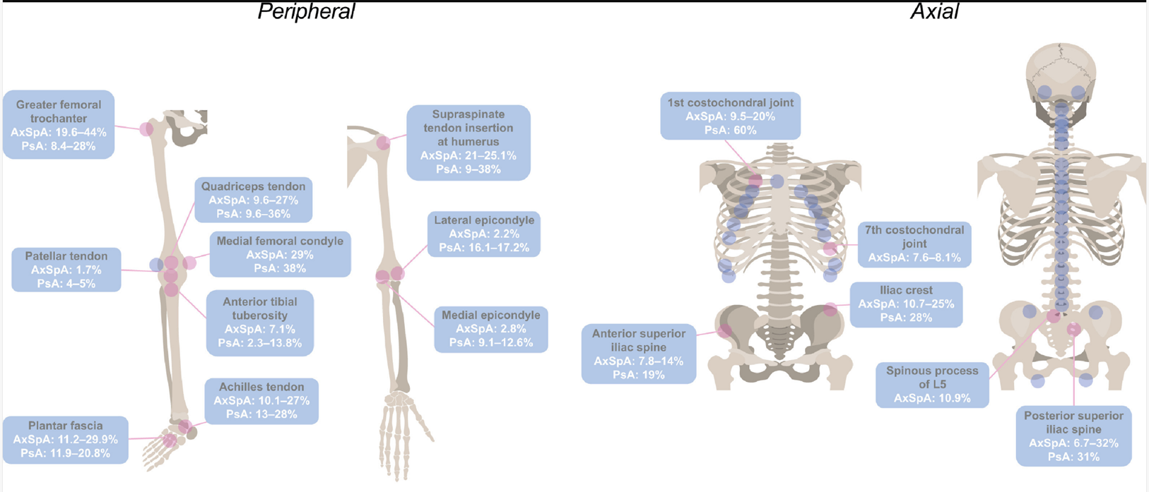
Enthesopathy

Slide 23
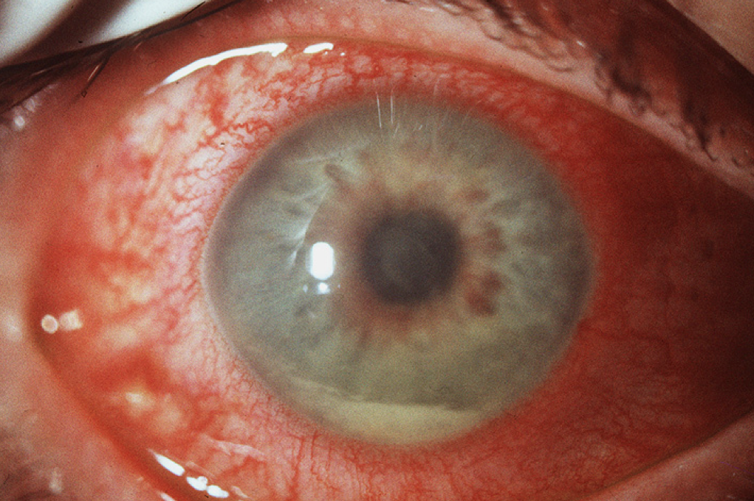
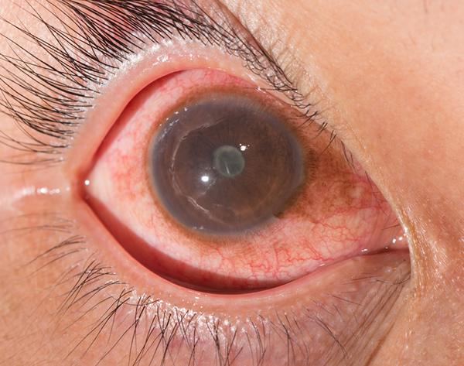
Uveitis
Strongest correlation with AxSpA of the EAM*
Studies have shown 20%-40% of patients with Acute Anterior Uveitis (AAU) met Dx criteria for AxSpA**
1/3 of patients with AAU had active radiologic findings*B
Correlation highest with Hx of CBP and age <45**
Notes:
*Sykes, M. P., Hamilton, L., Jones, C., & Gaffney, K. (2018). Prevalence of axial spondyloarthritis in patients with acute anterior uveitis: a cross-sectional study utilising MRI. RMD open, 4(1), e000553.
*Bubova, K., Hasikova, L., Mintalova, K., Gregova, M., Kasalicky, P., Klimova, A., Brichova, M., Svozilkova, P., Heissigerova, J., Vencovsky, J., Pavelka, K., & Senolt, L. (2022). The Prevalence of MRI-Defined Sacroiliitis and Classification of Spondyloarthritis in Patients with Acute Anterior Uveitis: A Longitudinal Single-Centre Cohort Study. Diagnostics (Basel, Switzerland), 12(1), 161.

Slide 24
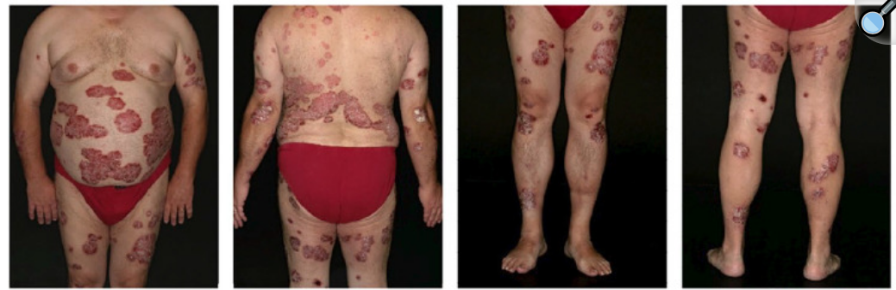
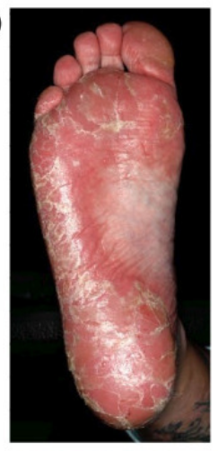
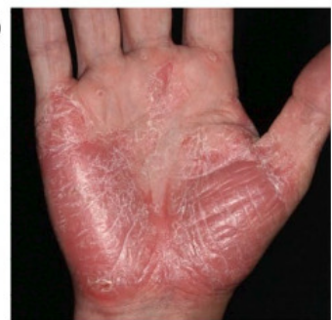
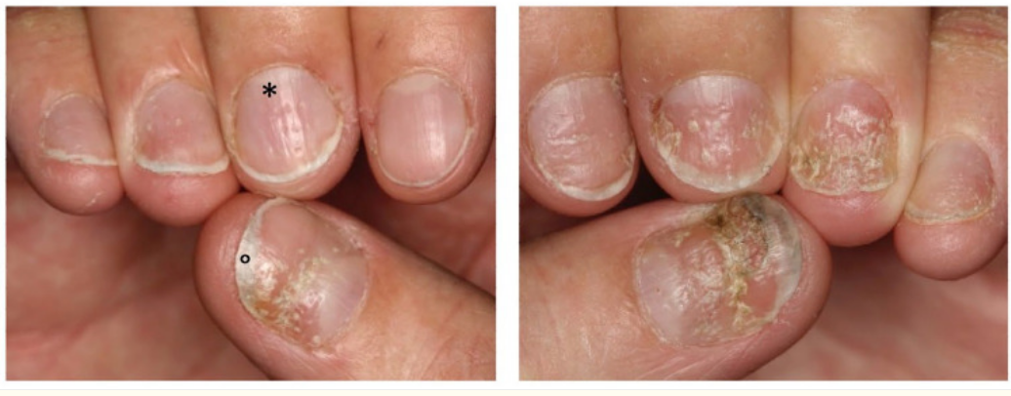
Psoriasis
Psoriasis (PsO)
  1/3 SpA pt affected by PsO*
The ADIPSA Study found 49/201 (23.9%) PsA patients met Dx criteria for AS**
Skin and nail psoriasis seen with SpA and not RA***
  Helpful with differential Dx
PsO plaque type
Palmoplantar PsO with hyperkeratotic plaques
Nail PsO
Notes:
Axial Disease In PSoriatic Arthritis (ADIPSA)
*Meier, K., Schloegl, A., Poddubnyy, D., & Ghoreschi, K. (2020). Skin manifestations in spondyloarthritis. Therapeutic advances in musculoskeletal disease, 12, 1759720X20975915.
**Jadon DR, Sengupta R, Nightingale A et al. Axial disease in psoriatic arthritis study: defining the clinical and radiographic phenotype of psoriatic spondyloarthritis. Ann Rheum Dis 2017;76:701-7
***Mease, P. J., Bhutani, M. K., Hass, S., Yi, E., Hur, P., & Kim, N. (2022). Comparison of Clinical Manifestations in Rheumatoid Arthritis vs. Spondyloarthritis: A Systematic Literature Review. Rheumatology and therapy, 9(2), 331–378.

Slide 25

Irritable Bowel Disease
- SpA can occur in 13% of people with IBD*
Notes:
*Karreman MC, Luime JJ, Hazes JMW, Weel A. The prevalence and incidence of axial and peripheral spondyloarthritis in inflammatory bowel disease: a systematic review and meta-analysis. J Crohns Colitis 2016;11:631-42

Slide 26

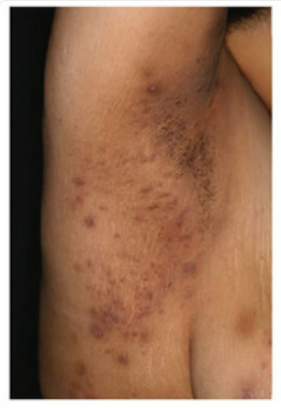
Hidradenitis Suppurativa*
  Chronic inflammatory disease affecting the groin and axillaries. HS leads to purulent discharge and debilitating scars
  1-4% General Population
  Strong HLA-B-27 positivity
  10% of patients with axSpA develop HS
  In SpA patients, HS precedes the diagnosis of SpA in most cases
  Strong association with IBD and SpA
Notes:
*Meier, K., Schloegl, A., Poddubnyy, D., & Ghoreschi, K. (2020). Skin manifestations in spondyloarthritis. Therapeutic advances in musculoskeletal disease, 12, 1759720X20975915.

Slide 27
Importance of EAMs
In the multicentre SASPIC Cohort*:
  Three Stage evaluation approach
    Clinical evaluation, labs (HLA-B27 and CRP), radiography (MRI)
  47% of pt with psoriasis, AAU, or colitis and were <45 years of age with >3 mth of undiagnosed back pain were Dx with AxSpA
  Of those Dx with AxSpA
    68.7% were Dx after clinical evaluation alone
Notes:
screening in axial spondyloarthritis in psoriasis, iritis, and colitis (SASPIC) cohort
*Maksymowych WP, Carmona R, Yeung J et al. SAT0339 what is the impact of imaging on diagnostic ascertainment of patients presenting with undiagnosed back pain and what is the impact of central evaluation? Data from thescreening in axial spondyloarthritis in psoriasis, iritis, and colitis (SASPIC) cohort. Ann Rheum Dis 2019;78(suppl 2):482:1248-9

Slide 28
Diagnostic Testing
Imaging
  MRI
    Radiographically normal foci of inflammation
Labs
  C-Reactive Protein
  HLA-B27 present in 2/3 of cases
  IL-17

Slide 29
Imaging
Radiographs
  Looking at Lumbar and SI joints
  Historically used but no longer gold standard
  High inter- and intra-observer variability*
  Required presence of structural change, delaying Dx
Notes:
*Christiansen AA, Hendricks O, Kuettel D et al. Limited reliability of radiographic assessment of sacroiliac joints in patients with suspected early spondyloarthritis . J Rheumatol 2017; 44:70-7

Slide 30
Imaging
MRI
  Earlier detection of inflammatory foci and structural changes compared to Radiograph
  Limitations
    Still debate over what a “positive” MRI suggestive of AxSpA is*
    Inconsistent application of the recommended MRI protocol for AxSpA*
Notes:
*Maksymowych WP. The role of imaging in the diagnosis of axial spondyloarthritis. Nat Rev Rheumatol 2019;15:657-72
*Bray TJP, Jones A Bennet AN et al. Recommendations for acquisition and interpretation of MRI of the spine and sacroiliac joints in the diagnosis of axial spondyloarthritis in the UK. Rheumatology (Oxford) 2019;58:1831-8

Slide 31
Lets talk about sex
Radiographic disease progression more evident in males *
  Due to reliance on SI Radiographs to Dx Ankylosing Spondylitis, it was thought of as a male disease
Lack of imaging findings in females may result in delayed diagnosis and underreporting of disease incidence *
Notes:
*Kiltz U, Baraliakos X, Karakostas P et al. Do patients with non-radiographis axial spondylarthritis differ from patients with ankylosis spondylitis? Arthritis Care Res (Hoboken) 2012;64:1415-22
*van Onna M, Forter S, van Meerendonk A, van Tubergen A. General practitioners’ perceptions of their ability to identify and refer patients with suspected axial spondyloarthritis: a qualitative study. J Rheumatol 2014;41:897-901

Slide 32
Labs
No definitive biomarkers or immune-phenotyping tools currently exist
HLA-B27 and C-Reactive Protein (CRP) commonly used
CRP utility may be lacking due to sensitivity and responsiveness*
Not all AxSpA patients are HLA-B27 positive
  Leads to delayed Dx for HLA-B27 negative patients*
Notes:
*Landewe R, Numinen T, Davies O, Baeten D. Asingle determination of C-reactive protein does not suffice to declare a patient with a diagnosis of axial spondyloarthritis ‘CRP-negative’. Arthritis Res Ther 2018;20:209
*Fallahi S, Jamshidi AR. Diagnostic delay in ankylosis spondylitis: related factors and prognostic outcomes. Arch Rheumatol 2016;31:24-30

Slide 33
Patient Picture
Family Hx of SpA, Psoriasis, IBD, uveitis, dactylitis
Inflammatory spine pain pattern >3 years
  Episodic (flares)
  Pain greater second half of the night

Slide 34
Classification Tools
Assessment of SpondyloArthritis International Society (ASAS) Criteria
  Not intended to be diagnostic but is often used for that purpose
  Updated in 2015*
Spondyloarthritis Diagnosis Evaluation (SPADE) Tool**
NICE 2017 Guidance***
Notes:
*Poddubnyy D, van Tubergen A, Landewe´ R, Sieper J, van der Heijde D. Development of an ASAS-endorsed recommendation for the early referral of patients with a suspicion of axial spondyloarthritis. Ann Rheum Dis 2015;74:1483–7
**Habibi S, Doshi S, Sengupta R. THU0413 utility of the spade tool to identify axial spondyloarthritis in patients with chronic backpain. Ann Rheum Dis 2016;75:338.2
.***Forster, D., Warburton, L., & O'Flynn, N. (2018). Diagnosis and management of spondyloarthritis in the over-16s: NICE guideline. The British journal of general practice : the journal of the Royal College of General Practitioners, 68(672), 346–347.

Slide 35
ASAS Taskforce Guidelines*
Refer to Rheumatologist if:
  Patient with CBP >3mth and onset before age of 45
  AND at least 1 of the following
  EAM (Psoriasis, IBD, uveitis)
  Positive family Hx for SpA
  Good response to NSAIDs
  Elevated C-RP
  IBP
  HLA-B27 positive
  Sacroiliitis on X-ray or MRI
  Peripheral manifestations (arthritis, enthesitis, dactylitis)
Notes:
*Poddubnyy D, van Tubergen A, Landewe R, Seiper J, van der Heijde D. Development of an ASAS-endorsed recommendation for the early referral of patients with a suspicion of axial spondyloarthritis. Ann Rheum Dis 2015;74:1483-7

Slide 36
SPADE Tool*
Online tool classifies patients into 1 of 4 categories based on presence of 12 symptoms
'Axial SpA improbable’
'Additional tests necessary’
'Probable diagnosis of Axial SpA’
'Definitive diagnosis of Axial SpA'
Notes:
*www.spadetool.co.uk/

Slide 37
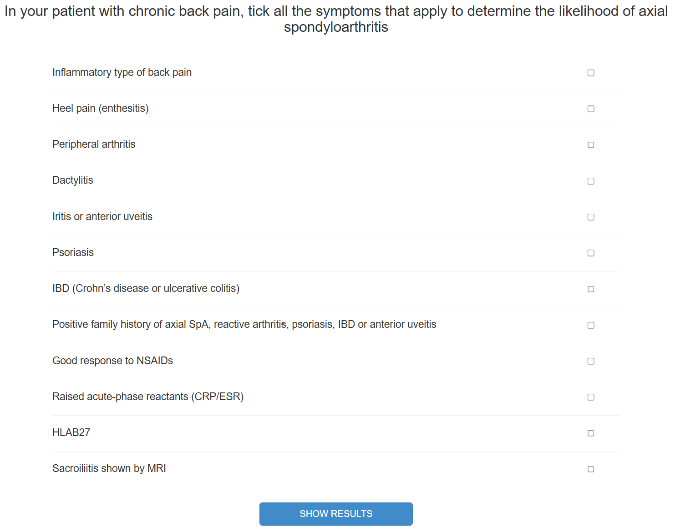
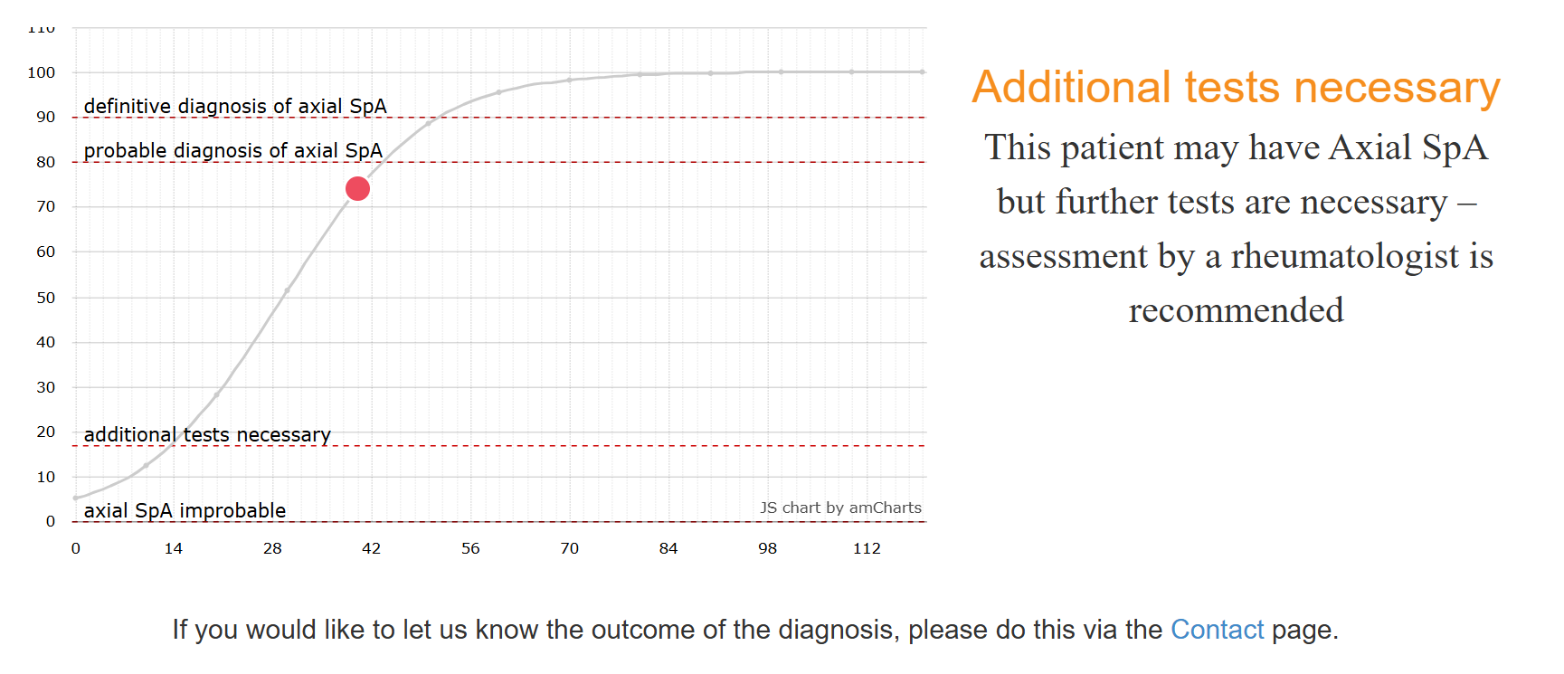
SPADE Tool*

Slide 38
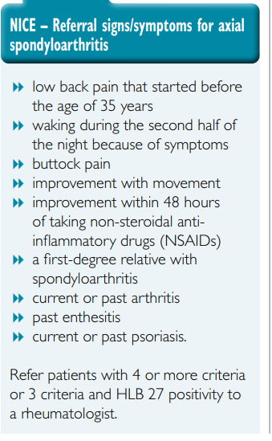
2017 NICE Criteria*
Notes:
*Forster, D., Warburton, L., & O'Flynn, N. (2018). Diagnosis and management of spondyloarthritis in the over-16s: NICE guideline. The British journal of general practice : the journal of the Royal College of General Practitioners, 68(672), 346–347.

Slide 39
Now What?!?
Positive Screens should be referred to Rheumatology for definitive Dx.
Sooner they receive definitive Dx – The sooner pharmaceutical management can begin.

Slide 40
Time to Dx and Pharmacologic Management
Early treatment with NSAIDs, as well as a diagnosis within 4 years from the disease onset in patients starting an anti-TNF therapy, may reduce the progression of the radiographic damage.*
Anti-TNF therapy gives a better response if the duration of the disease symptoms is shorter than 10 years.*
Notes:
*Adshead R, Tahir H, Donnelly S. A UK best practice model for diagnosis and treatment of axial spondyloarthritis. EMJ Rheumatol. 2015;2:103–110.

Slide 41
Looking Ahead

Slide 42
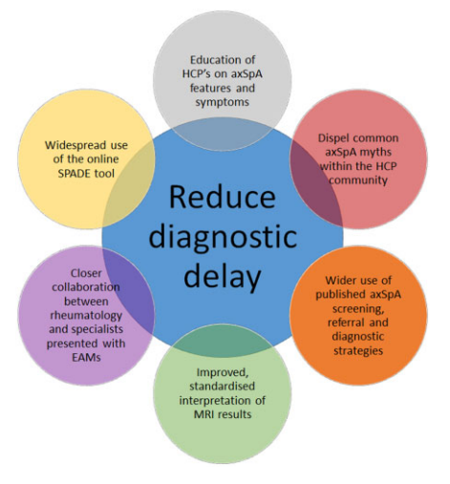
*Barnett, R., Ingram, T., & Sengupta, R. (2020). Axial spondyloarthritis 10 years on: still looking for the lost tribe. Rheumatology (Oxford, England), 59(Suppl4), iv25–iv37.
Notes:
*Barnett, R., Ingram, T., & Sengupta, R. (2020). Axial spondyloarthritis 10 years on: still looking for the lost tribe. Rheumatology (Oxford, England), 59(Suppl4), iv25–iv37.

Slide 43
Ask the Questions
Asking patients about EAM when a <45 year old person with CBP comes to the clinic.
Multi-disciplinary collaboration is key
  PT, GI, Derm, and Optho all have a role to play

Slide 44
PT is needed
ASAS-EULAR recommendations for the management of axSpA, 2022 update
  Recommendation of PT to help patients exercise on regular basis is level 1 evidence.*

Slide 45
Main takeaway:
Patients Dx with Axial Spondyloarthropathy have a high risk for disability and early mortality. Physical therapists have a crucial role as part of a multidisciplinary team to help identify and refer patients earlier in the disease progression. With proper screening and earlier initiation of therapeutic treatment, decreased structural damage and improved functional outcomes are possible.

Slide 46
References

