Slide 1
Platelet rich plasma
Hamad Saleemi, DO, ABPMR, CAQ-SM

Slide 2
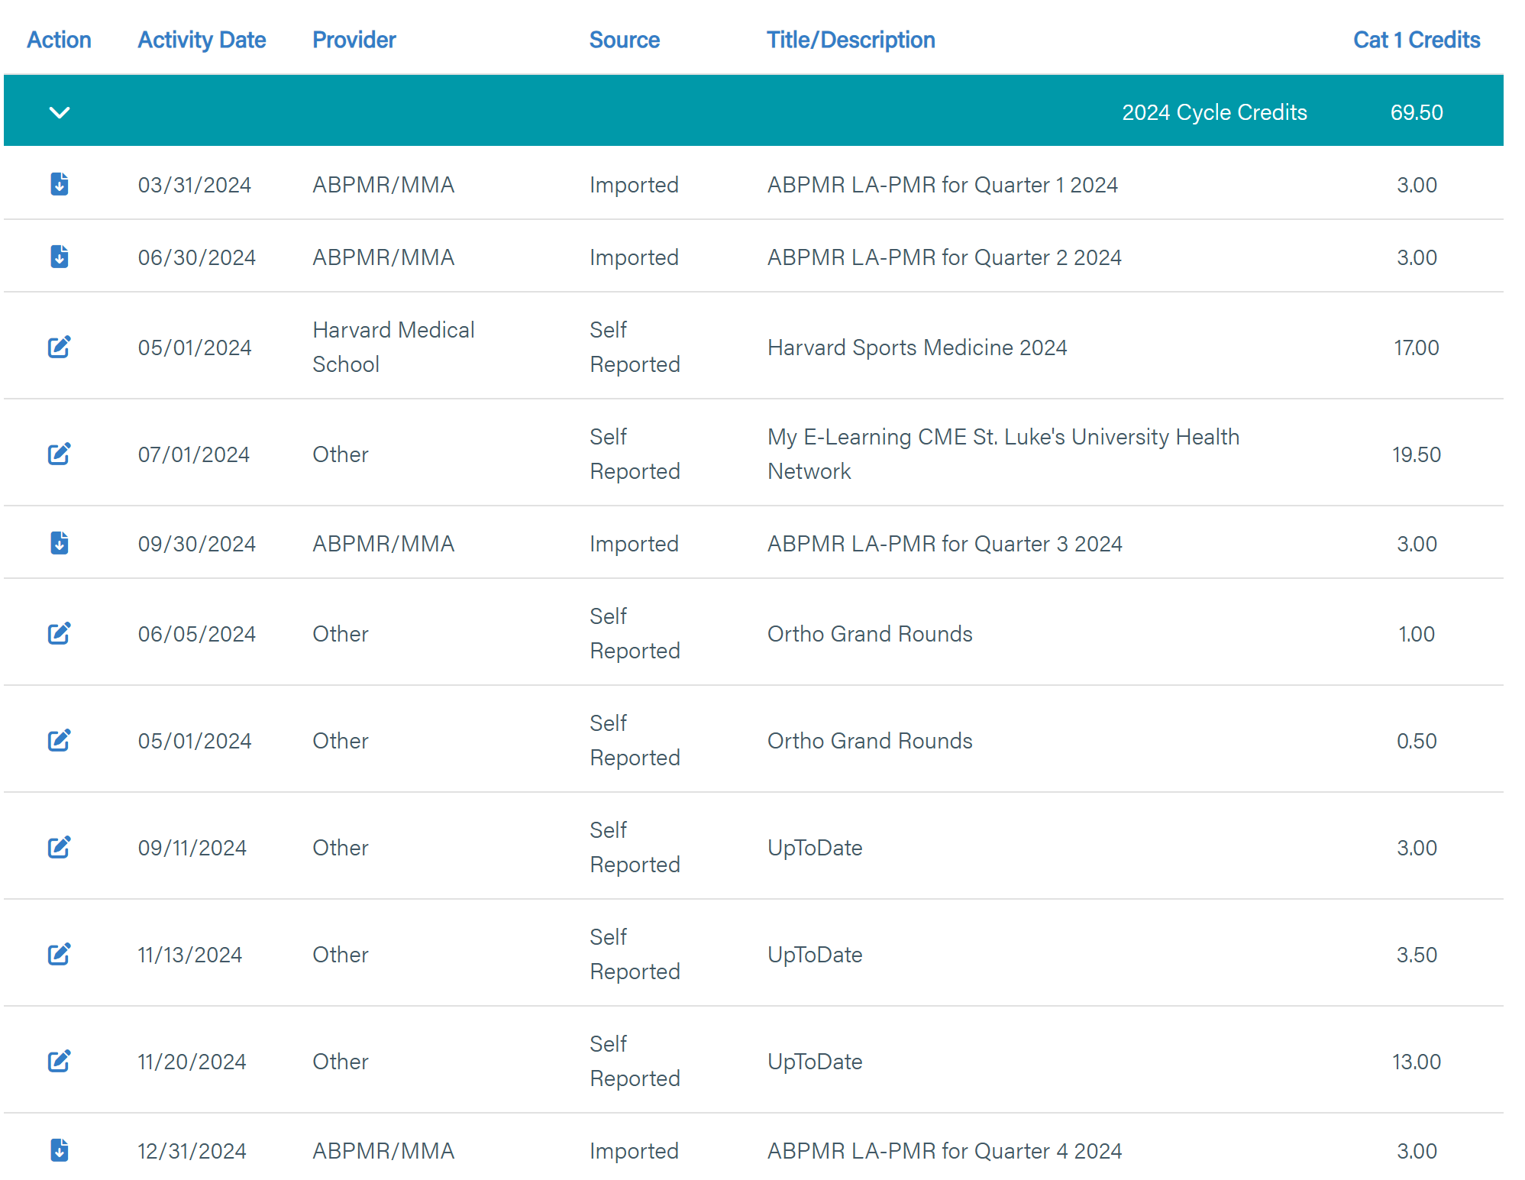
CME

Slide 3
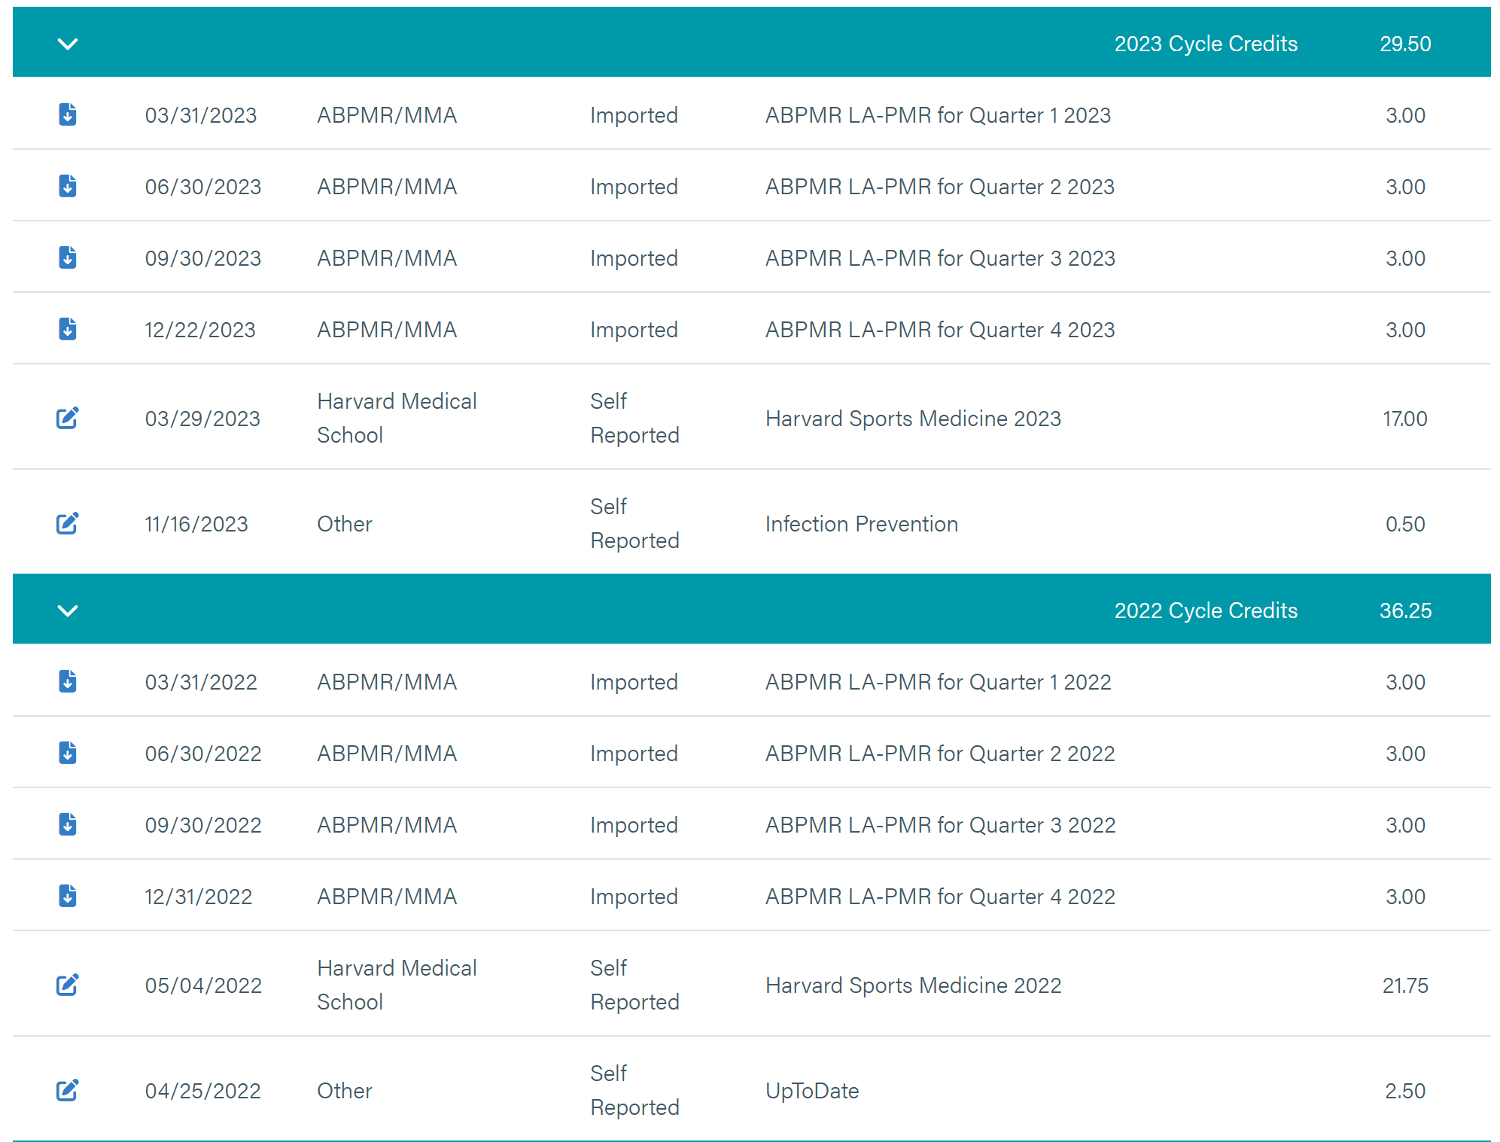
CME

Slide 4
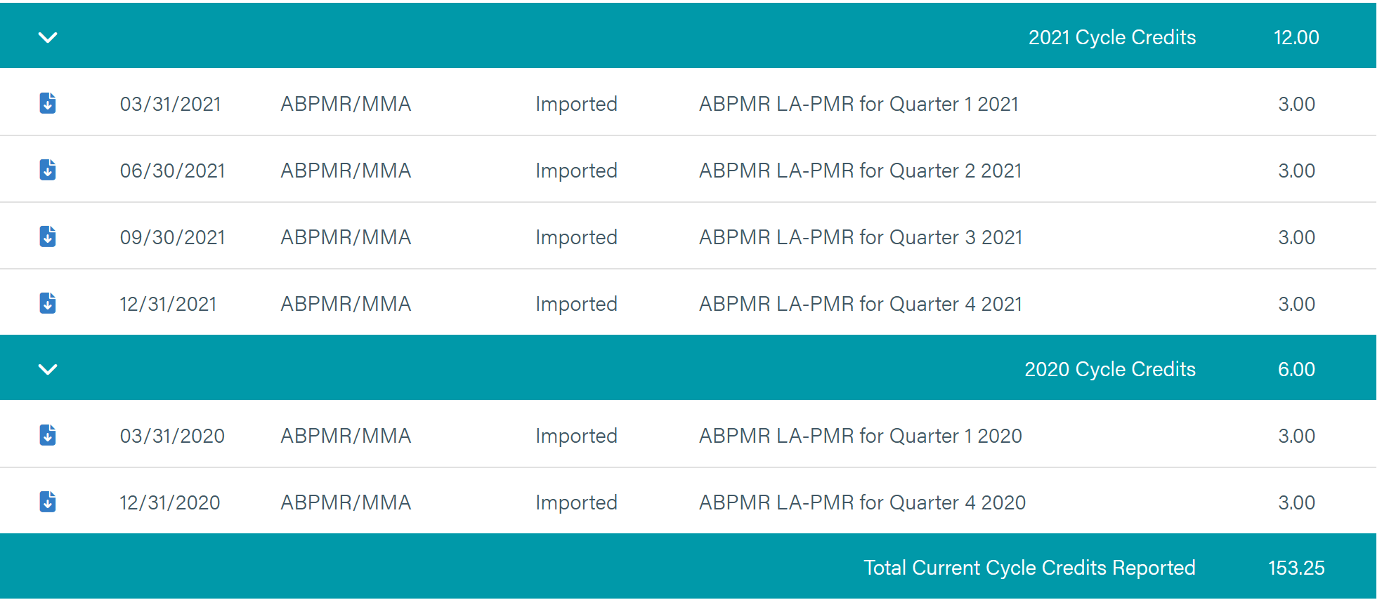
CME

Slide 5
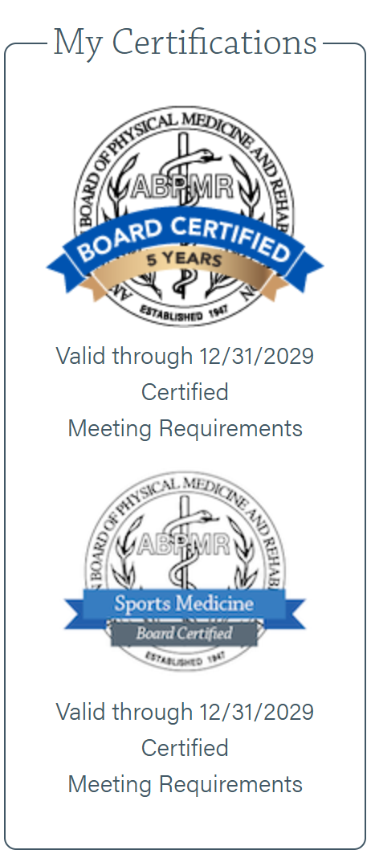
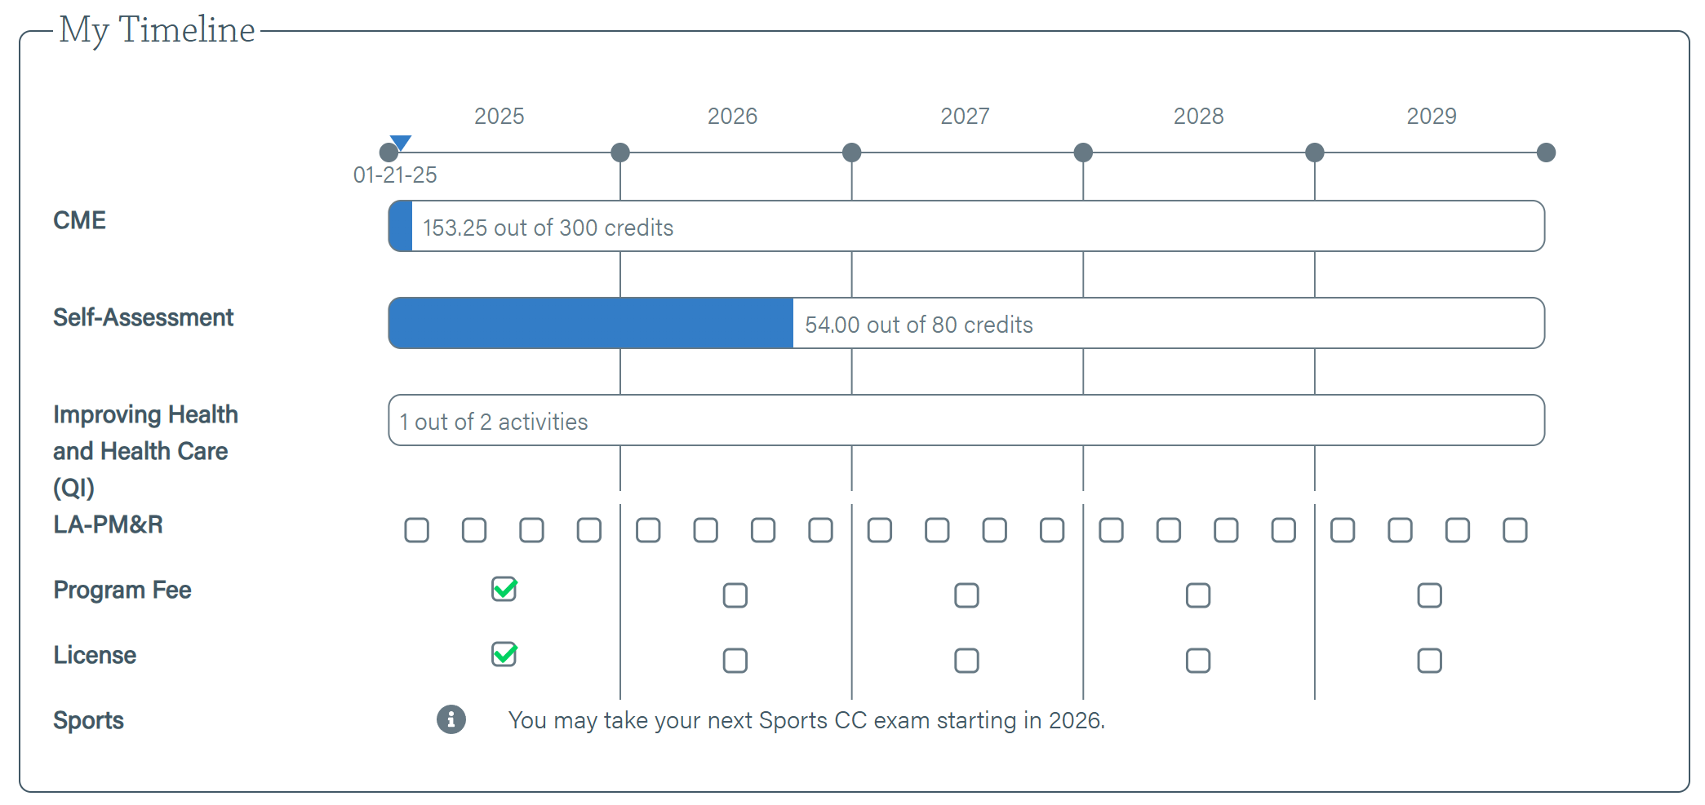
CME

Slide 6
Bio
As a physician, I believe that the physician-patient relationship is very important. To foster this relationship, I like to spend time and listen to my patient in order to provide individualized care. My goal is for you to understand what your injury is and everything that goes behind the treatment of it.
I am a primary care sports and spine medicine physician with dual board certification in physiatry (PM&R- physical medicine and rehabilitation) and sports medicine. I provide treatment for all non-surgical musculoskeletal complaints, including ultrasound guided procedures (injections, tenotomy, barbotage, etc.) and biologic injections like platelet rich plasma (PRP). I enjoy taking care of both young athletes and adults with a wide variety of ailments, from fractures to osteoarthritis to concussions. I truly value exercise and sports as a tool for health in patients of all ages.
I have experience taking care of athletes from the high school level all the way up to the pros. I am currently a member of the American Medical Society of Sports Medicine, the American College of Sports Medicine, Academic Association of Physical Medicine and Rehabilitation and Association of Academic Physiatrists. I have also presented many unique cases at the annual society meetings for these organizations.
I completed medical school at New York College of Osteopathic Medicine in Long Island, NY. After medical school, I completed an internship at Christiana Hospital in Delaware followed by a three-year residency in physical medicine and rehabilitation at Stony Brook University Hospital in NY. I then completed fellowship training in primary care sports medicine at United Health Services in Binghamton, NY where I held an appointment as an assistant clinical professor at SUNY Upstate Medical University.
Outside of work, I enjoy playing basketball and racquetball. I am an avid NY Giants, Knicks and Yankees fan.

Slide 7
Course Description
We will go over platelet rich plasma application in orthopaedics/sports medicine for different ailments.
How does PRP work and how can we achieve the best results with it?

Slide 8
What is PRP?
Platelet‐rich plasma is a fraction of your blood which contains a higher concentration of platelets than whole blood. PRP therapy involves the injection of this platelet rich concentrate, rich in growth factors and nutrients, to enhance the natural healing response of an injured tissue.
What are the different orthopedic conditions for which PRP may be used?
PRP therapy may be used for conditions like osteoarthritis (degenerative joint disease), chronic tendinitis or chronic ligament and muscle injuries. Some examples include knee osteoarthritis, lateral (tennis elbow) or medial epicondylitis (golfer’s elbow) of elbow, patellar or Achilles tendinitis, plantar fasciitis, chronic ligament sprains, etc.
Is PRP therapy right for you?
If you have tried conventional treatment methods (e.g., physical therapy, oral pain medications, bracing, etc.) and persist with chronic joint, muscle or tendon pain; then PRP therapy may be an option. Since every individual and condition is unique, it’s best to be clinically evaluated by your physician to determine if PRP is a good option for you.
What are some contraindications for PRP therapy?
It is best to discuss your medical conditions and medications with your physician prior to receiving PRP therapy. Some medical conditions may not be appropriate for PRP therapy e.g., blood disorders, anemia or low platelet count, immunological problems, cancer, active or prolonged infections, pregnancy, chronic smoking.
Certain medications may lower the efficacy of PRP therapy. Examples include aspirin, NSAID’s (Motrin, Advil, Aleve, Mobic/ ibuprofen, naproxen, diclofenac, meloxicam, etc.), blood thinners.
What is the scientific evidence for PRP therapy?
The scientific evidence for PRP is evolving. The position statement from American Medical Society for Sports Medicine, published in 2021 indicates that PRP is effective in reducing pain and improving function in patients with knee osteoarthritis, particularly in those with mild to moderate disease or younger individuals. Evidence for osteoarthritis of other joints is evolving. There is also some evidence for pain reduction in conditions such as lateral epicondylitis and other tendonitis. The evidence regarding PRP use for muscle or ligament injuries is limited.
What are the risks associated with PRP injection?
PRP injections are minimal risk since it is your own blood. Common risks include transient injection site increased pain, infection risk. You should discuss the potential risks for your PRP injection with your physician since it could vary based on your specific condition and injection site.

Slide 9
What can I do to optimize my PRP therapy?
Pre-procedure:
Discuss with your physician if you need to withhold any medications e.g., blood thinners, pain medications before the procedure.
Stay well hydrated on the day of procedure.
Inform physician of any recent medication change or infection.
If able to, perform some light exercise prior to the procedure. Some studies show improved platelet concentration following physical activity.
Post-procedure:
Avoid/ minimize taking NSAID’s and blood thinners as per the direction of your treating physician.
Keep the injection area clean and dry and avoid submerging under water e.g., bathtub, swimming pool, ocean water for 4-5 days. May take a shower the next day.
You may experience some increased discomfort in the area where PRP was injected. This may last from a few days to 2-3 weeks. You can apply local ice for comfort and discuss medication options with your physician for any increased pain.
It is advisable to have someone accompany you on the office visit as you may need help with driving following the injection.
Avoid strenuous exercise of the injected area until symptoms improve and following the guidance of your treating physician/ physical therapist.
Contact the treating physician immediately if there is significant increase in injection area pain associated with spreading redness, fever, or chills.
How is the procedure performed?
A blood sample is taken from the patient like having a lab test for blood. This sample is then placed in a centrifuge machine which separates the blood into different components. One component, platelet rich plasm (PRP) is carefully extracted from the centrifuged sample. This is then injected in the tissue/joint of concern. Sterile precautions are maintained throughout the procedure. Your physician may use an ultrasound machine to accurately deliver the injection into the tissue/joint of concern.
Do I need to do physical therapy after the PRP injection?
Several studies have demonstrated synergistic effect of physical therapy with PRP injection. Physical therapy after PRP is typically customized based on patient’s individual scenario. Discuss with your physician about the need and duration of physical therapy following your PRP injection.
When can I expect improvement of symptoms, and will I need further PRP injections?
Symptom improvement can be variable among individuals. Commonly, most people will start noticing improvement in 6-8 weeks following the injection. If there is partial improvement of symptoms, you may opt for another PRP injection typically after 6-8 weeks.
Insurance coverage/Cost
Most traditional insurance companies currently do not cover the cost of PRP injection as it is not “FDA approved” and considered “FDA cleared”. Since PRP is derived from a patient’s own blood, it is not considered a drug by FDA. “FDA clearance” means that a device has been noted to be “substantially equivalent” to a currently marketed device. The cost of injection may vary depending on the type and number of PRP injections. Please confirm from your physician’s office the exact cost and mode of payment for your PRP injection prior to scheduling the procedure.

Slide 10
OVERALL GOALS:
Protect the injured tendon to prevent rupture after tenotomy
Implement gradual increase in intensity of therapeutic modalities to stimulate degradation of scar tissue within tendon, muscle hypertrophy, and new collagen growth
Avoid overly vigorous therapeutic modalities that may lead to persistent overuse syndrome, chronic tendinopathy
Procedure Site Care:
No swimming or tub bathing (bathtub, jacuzzi, hot tub) for 2 weeks to reduce risk of infection
showers with running water are permitted
maintain injection site covered with band-aid for 5 days or until skin fully healed
no use of harsh antiseptics to clean injection site; running water and mild soap permitted
PHASE 0: Rest & Binding of PRP (1-3 Days)
Patient Checklist:
Schedule Physical therapy session on day of procedure to begin formal rehab at 2 weeks out from PRP and Tenotomy
Goals During Phase:
Allow for binding of PRP
Protect the injured tendon
Precautions:
Avoid any significant tendon loading; this stage carries greatest risk of tendon rupture
avoid use of anti-inflammatory RX for 2 weeks after procedure (Advil, ibuprofen, naproxen, Aleve, meloxicam, Mobic, Celebrex) and use sparingly for the next 3 months
take pain medications only as directed by physician
Immobilization:
Achilles Tendinitis:
  Consider Non-weight bearing with Crutches for 3 days
  Typical use CAM Boot x 2 weeks
Epicondylitis:
  Consider Shoulder sling x 24 hours and/or Wrist Brace x 3 days PRN
Patellar Tendinitis:
  TROM locked full extension/ Straight Leg Knee Brace x 3 days
  Consider Non-weight bearing with crutches for 3 days
Therapeutic Modalities:
Stretching and range of motion exercises only for all procedures

Slide 11
PHASE I: Inflammatory Cell Recruitment (4 days - 2 weeks)
Goals During Phase:
Progress immobilization
Continue stretching and range of motion exercises
Immobilization:
Achilles Tendinitis:
  cease crutches and continue CAM Boot
Epicondylitis:
  may use wrist brace as needed during high-risk activity (house work, computer, etc)
Patellar Tendinitis:
  Cease crutches and continue Straight Leg Knee Brace
Therapeutic Modalities:
Achilles & Patellar Tendinitis:
  Stretching and range of motion exercises only
Epicondylitis
  May begin gentle isometrics

Slide 12
PHASE II: Proliferative Degradation of Scar Tissue (2-6 weeks)
Patient Checklist:
Physician follow-up visit for Achilles and Patellar Tendinitis @ 2 weeks
Begin Formal Physical therapy at 2 weeks 2-3x/week coupled with home exercise program
Goals During Phase:
Cease immobilization
Begin formal therapeutic modalities to stimulate removal of scar tissue and new tendon growth
return to ADLs with minimal pain
Precautions:
Avoid any heavy lifting with affected extremity due to continued risk of rupture
Avoid any repetitive use of affected extremity that may exacerbate tendinitis (swinging hammer, etc.)
Preventing New Tendinosis:
  All therapeutic modalities should be supervised to limit pain to 2/10 and definitely no more than 5/10
  tune effort to allow for muscle soreness to resolve within 24hrs
Immobilization:
All wrist braces, cam boots, and crutches should be discontinued at this time
Therapeutic Modalities:
ESW (Extracorporeal Shockwave Treatments)
  Begin ESW at week 2 for total of 4-6 sessions and stop by week 6 to avoid degradation of healing tissue
  May substitute Graston if ESW not available
Achilles Tendinitis & Patellar Tendinitis:
  BFR: May begin BFR tendon loading immediately
  Isometric: May begin isometric tendon loading once pain free at rest
  Concentric: begin at week 3 if tolerating isometrics
  Eccentrics:
    may begin sub-maximal eccentrics <50% body weight
    avoid full weight bearing eccentrics until week 6
Epicondylitis:
  BFR: May begin BFR tendon loading immediately
  Isometric: May begin isometric tendon loading once pain free at rest
  Concentric: begin at week 3 if tolerating isometrics
  Eccentrics: may begin with Theraband Flexbar by week 4 if tolerating previous tendon loading (begin with red bar, advance to green as tolerated)

Slide 13
PHASE III: Growth Phase (6-12 weeks)
Patient Checklist:
Physician follow-up visit for Achilles and Patellar Tendinitis @ 6 weeks & 12 weeks
Goals During Phase:
Continue to gradually increase tendon loading
Begin implementing sport specific exercises
Continue to induce muscular hypertrophy and new tendon growth
Precautions:
Avoid any heavy lifting with affected extremity due to continued risk of rupture
Avoid any repetitive use of affected extremity that may exacerbate tendinitis (swinging hammer, etc)
Preventing New Tendinosis:
  All mechanotherapy exercises should be supervised to limit pain to 2/10
  tune effort to allow for muscle soreness to resolve within 24hrs
Therapeutic Modalities:
ESW (Extracorporeal Shockwave Treatments):
  Cease ESW or Graston to avoid damage of new collagen growth within tendon
Tendon Loading:
  Continue with eccentrics for all
Return to Running:
  Follow Guidelines from St Luke’s Running Institute’s
    “Return to Run Program”
  Week 6: beginning walking treadmill or Anti-gravity treadmill
  Week 7: may begin jog-walk interval if tolerating walking
  Week 8: begin sport specific training
Return to Full Run/Play:
  Follow Guidelines from St Luke’s Running Institute’s “Lower Extremity Return to Play Criteria”
  Full Clearance to sport based on PT assessment and physician visit at 12 weeks

Slide 14
Course Objectives
What is platelet rich plasma?
What conditions can it help treat?
What does it not help with?
How can we collaboratively get the best results?

