Slide 1
Negative Pressure Wound Therapy (NPWT): Updates for the Neurologic Population
The Activity Sign-In Code which Expires on Apr 10 @ 12:30 PM is:
33grip
Sign-in Methods
Text Code to 828-295-1144 | Visit eeds.com | eeds iPhone/Android App
Christiana Vandegrift, DPT
Neurologic Physical Therapy Resident
Notes:
Thank you to those joining me today whether in person or virtually. My name is Christiana Vandegrift, I am a physical therapist with St. Luke’s University Health Network and am in the Neurologic Physical Therapy Residency through St. Luke’s. My presentation today is on the use of Negative Pressure Wound Therapy and specifically the updates for use in a neurologic population.

Slide 2
Continuing Medical Education Credit Information
Activity Description/Statement of Need: Patients with neurological conditions are at an increased risk for developing chronic wounds due to decreased mobility, poor peripheral vascular circulation, and impaired sensation that may lead to infection, amputation, and even death if not treated properly. When applied and utilized correctly, NWPT can be an optimal treatment option for this patient population to improve wound healing parameters and ultimately allow for sooner physical rehabilitation to address functional limitations and quality of life. Negative pressure wound therapy (NWPT) is a type of wound care that uses a vacuum-like pressurized system to aide in the removal of wound exudate and promotes regeneration of granulation tissue in the wound bed, which is essential for patients who have delayed or impaired wound healing or are at risk for further complications from developing infections. This course aims to educate various members of the healthcare team about the use of negative pressure wound therapy in patients with chronic neurological conditions due to the development of pressure injuries and related post-surgical incisions. Medical professionals, including physical therapists, should expect to achieve enhanced evaluation, management, and communication skills for patients with or without referral.
Target Audience: All Providers

Slide 3
Designation Statement
It is St. Luke’s University Health Network policy to ensure balance, independence, objectivity and scientific rigor in all of our sponsored educational programs. Faculty and all others who have the ability to control the content of continuing medical education activities sponsored by the St. Luke’s Hospital & Health Network are expected to disclose to the audience whether they do or do not have any real or apparent conflict(s) of interest or other relationships related to the content of their presentation(s).
The St. Luke’s University Health Network is accredited by the Pennsylvania Medical Society to provide continuing medical education for physicians.
The St. Luke’s University Health Network designates this live educational activity for a maximum of 1 AMA PRA Category 1 Credits™. Physicians should only claim credits commensurate to the extent of their participation on the activity.

Slide 4
Disclosure Information
The Planners involved in this activity have no relevant financial relationships to disclose.
The Faculty/Presenters involved in this activity have no relevant financial relationships to disclose.
Images of wounds are included in this presentation

Slide 5
Learning Objectives
After completion of this course, participants will be able to:
  Identify risk factors of wound development in patients with neurological conditions
  Explain the principles, parameters and correct application of negative pressure wound therapy (NPWT)
  Compare the outcomes of using NPWT to other commonly used wound management techniques
  Discuss the possible benefits and complications of NPWT in the neurological population
Notes:
Here are the goals for this presentation. Participants will be able to identify the risk factors of wound development in those with neurologic conditions, explain the principles, parameters and application of negative pressure wound therapy, compare the outcomes of negative pressure wound therapy to other wound management techniques/interventions, and finally discuss the possible benefits and complications of NPWT in neurologic populations. I also have 2 case studies included for us to work through the use of NPWT in real patient cases.

Slide 6
Integumentary Risks for Neurologic Patients
Impaired healing factors
  Co-morbidities
  Impaired circulation
Increased fall risk
  Parkinson's disease, CVA, SCI, TBI, neuropathy, debility
  Results in traumatic and non-traumatic wounds
History of surgical procedures
Peters et al, 2024; Biercewicz 2022; Abou & Rice, 2024
Notes:
Let’s first talk about the risks that patients with neurologic conditions face regarding the integumentary system. In general, neurologic populations often experience impaired healing factors that affect negatively affect the healing rates of wounds and make them so susceptible to acquiring wounds. These patients may present with various co-morbidities and a complex past medical history. For example, a common pre-existing condition is type II diabetes, which most often results in poor wound healing and changes to the integumentary system and a person’s sensation that increases their risk for developing a wound. In a similar fashion, those with neurologic conditions may also present with impaired blood circulation, whether it’s a result from the neurologic conditions itself, a co-morbidity or from decreased mobility. Blood circulation is important to bring nutrients to the wound and carry away waste products during the healing process. Poor circulation may also cause wounds to develop if blood is pooling in a certain area, and these are considered venous ulcers.
Those with neurologic conditions are typically at an increased risk for falls due to impairments in balance, strength, and cognition. Patients that benefit from balance training include those with Parkinson’s disease, post-stroke, spinal cord injuries, traumatic brain injuries, onset of neuropathy and general debility or mobility deficits. Evidence-based research supports certain performance cut off scores that place patients at an increased risk for falls, for example if a patient is walking slower than 1.0m/s. If a person experiences a fall, they risk developing a traumatic wound from the fall itself, skin/tissue breakdown if they aren’t able to get back up for a long period of time, or pressure injuries if they avoid moving around due to fear of falling.
Neurologic patients may have a history of surgical procedures that impact their mobility levels and have a risk of infections.

Slide 7
Pressure Injuries
Localized damage to skin and/or underlying soft tissue over bony prominence or from medical device
Prolonged and intense pressure in one area and possibly in combination with shearing forces
Intact skin or open ulcer that may or may not be painful
Affected by nutrition, tissue condition, tissue perfusion, microclimate, and other co-morbidities
Classified as stages I-IV and unstageable
Yoon & Cho, 2022; Williams, 2025; RNAO, 2016
Notes:
I want to talk more about pressure injuries since these are common wounds seen in those with neurologic conditions. As a review, pressure injuries (previously known as pressure ulcers) are localized damage to skin and soft tissue usually over a bony prominence or an area of the body where a medical device/brace is donned. They occur when there is pressure placed in that area for a long period of time but can also result from constant shearing forces to that area as well, for example if a patient is sliding across a transfer board instead of bumping across it. The skin may be intact of open, and depending on the patient’s sensation, it may not always be painful. Other contributing factors include poor nutrition, the condition of one’s skin/tissue, perfusion to the tissue, the microclimate of that body region (moist and warm). Pressure injuries are classified in stages 1-4 and unstageable.

Slide 8
Risk of Pressure Injuries
Decreased mobility
  Bed bound
  Requires assistance to transfer or reposition
  Increased fall risk when ambulatory
  Wheelchair user
Decreased sensation
  Impaired or absent
  Stroke, spinal cord, and TBI
Ribeiro et al, 2024; Soegaard et al, 2025; Johnson et al, 2019; Yoon & Cho, 2022; Alshehri et al, 2025; Wijker, 2025; Williams, 2025; RNAO, 2016
Notes:
Based on the risk factors of pressure injuries themselves, it’s not surprising that patients with neurological conditions are at increased risk for PI. Mobility is typically decreased, whether that patient is bed bound or maybe they are mobile but at a wheelchair level which still places risk for PI from being a prolonged seated position. They might need someone to help them reposition or transfer to a different surface, which means they aren’t moving around as much as if they could do it on their own, and we’ve already discussed the effect of fall risk.
Neurologic conditions usually have some effect on a person’s sensation levels, whether aspects of their sensation are impaired or completely absent. And it likely changes depending on what area of body is affected.

Slide 9
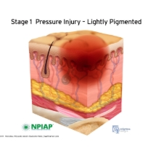
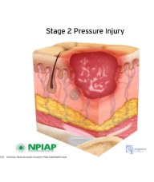
Pressure Injury Stages
  Stage I: non-blanchable erythema
  of intact skin
Stage II: partial thickness skin loss with exposed dermis
Does not include purple/maroon discoloration
May be preceded by changes in sensation, temp, and firmness, as well as blanchable erythema
Pink/red wound bed or intact/ruptured blister
Adipose tissue and deeper tissues are not visible
No slough or eschar present
Usually from poor microclimate or shearing around pelvis and heels
Williams, 2025; RNAO, 2016
Notes:
It’s important that we quickly review the stages of pressure injuries because NPWT isn’t clinically indicated for all pressure injuries.
It’s also important to remember that PI will appear differently on different skin pigments.

Slide 10
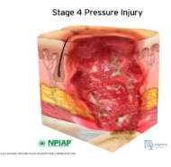
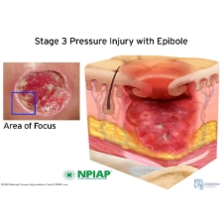
Pressure Injury Stages
  Stage III: Full thickness skin loss
  Stage IV: full thickness skin and tissue loss
Adipose tissue is visible
Epibole often present
Slough and eschar may be present, undermining and tunneling may occur
Bone, tendon, ligament, fascia, muscle and cartilage are not exposed
Bone, tendon, ligament, fascia, muscle and cartilage are either exposed or palpable
Epibole, undermining and tunneling usually occur
Slough/eschar may occur
Williams, 2025; RNAO, 2016
Notes:
These are stages that NPWT is indicated as a possible treatment for.

Slide 11
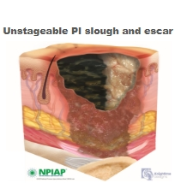
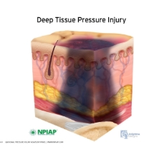
Pressure Injury Stages
  Unstageable
Deep tissue pressure injury
    Either stage III or stage IV that is obscured by amount of slough and/or eschar
Persistent non-blanchable dark red/maroon/purple discoloration
Intact or non-intact localized area, possibly a blood filled blister
Results from prolonged intense pressure and/or shearing forces at bone-muscle interface
Often preceded by pain and temperature changes
Williams, 2025; RNAO, 2016

Slide 12
Negative pressure wound therapy

Slide 13
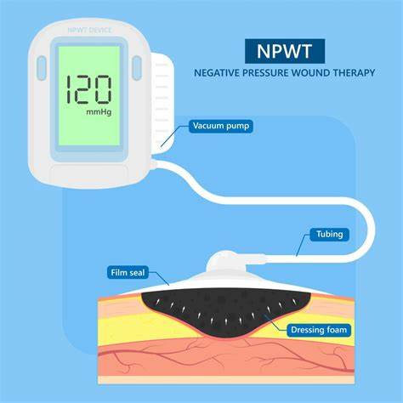
NPWT
Application of sub-atmospheric pressure to a foam dressing within a wound that is connected via tubes to a collection canister
Gefen et al, 2024; Gould et al, 2024; Ciliberti et al, 2023
https://th.bing.com/th/id/OIP.j24KpPLaH11wDh36GAxRJgHaHa?rs=1&pid=ImgDetMain
Notes:
Sometimes called wound “vacs”
Foam or sponge: different kinds depending on the wound bed being treated. The foam varies in density, black foam is less dense than white foam. White foam is less likely to break off into pieces during removal, so typically placed in tunneling. Silver/gray foam that has added microbiological benefits to it for healing and infection control.
Suction pad (circular piece connected to tubing that is placed on the foam dressing, key is to get an air tight seal)
Vacuum pump (typically 120-125mmHg), however some research as low as 110mmHg; built in canister for drainage collection/measurements

Slide 14
Application of NPWT
Cut a piece(s) of specialized foam to fit the entire wound bed
  Fill any tunneling or undermining
  Be cautious of exposed bone, cartilage, tendon/ligaments and muscle tissue
  Foam touching as much wound bed as possible
  No foam touching periwound or intact skin
Secure the foam with semi-occlusive dressing film (drape)
Place suction pad with tubing connected to canister
  Must be in contact with foam in wound
  May be right on top of wound itself or bridged to another area of the body
Gefen et al, 2024; Gould et al, 2024; Ciliberti et al, 2023
Notes:
Similar to an “arts and crafts” project; want the foam to mirror the wound bed as best as possible, this can be very time consuming
Adaptive film covering for some tissues as protection, same with any internal staples or stitches that may be exposed
Dressing film (drape)
Suction pad (may need to cut a circle piece of foam for the pad to sit on of the wound itself is too small/narrow); might be connected to the wound by a foam “bridge” if the wound is in an area of high pressure

Slide 15
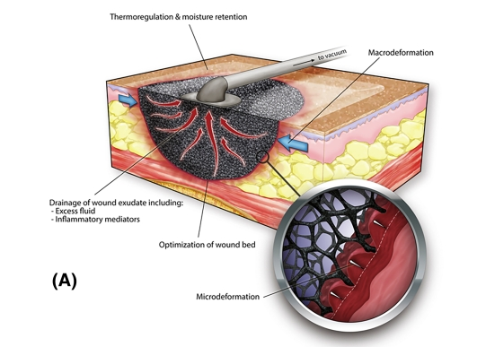
Gefen et al. 2024.
Notes:
Great picture to show how the foam should perfectly fit the wound bed
Macrodeformation vs microdeformation
Drainage (excessive exudate)

Slide 16
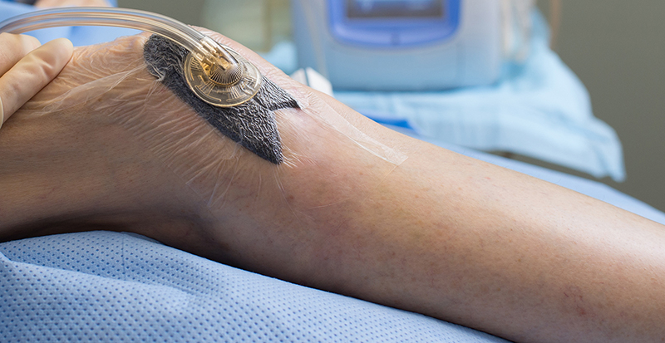
https://medicare-wounddressing.com/Uploads/images/product/2021-09-22/en-VAC-Therapy-135031.jpg
Notes:
Suction pad just fits the size of the foam piece (if it was smaller, likely need a separate circle piece for suction pad itself)
Drape provides an air tight seal
The tubing isn’t kinked/bent over itself

Slide 17
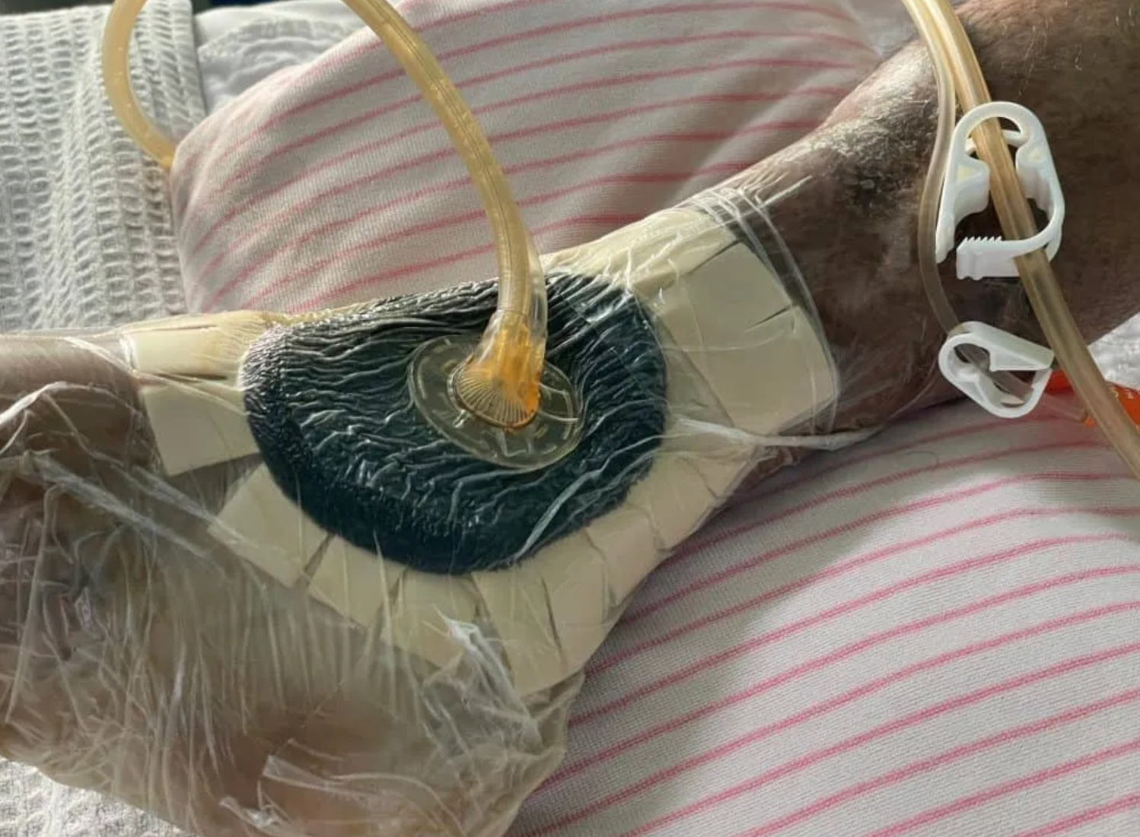
https://pensarmedical.com/wp-content/uploads/2024/06/shutterstock_2289813905-1024x768.jpg
Notes:
Pressure wound on medical malleoli
Sometimes need a lot of drape to keep a seal around these bony areas of the body
Protective barriers for the skin used under the drape
2 tubes seen here (one vacuum, one instillation of fluids)

Slide 18
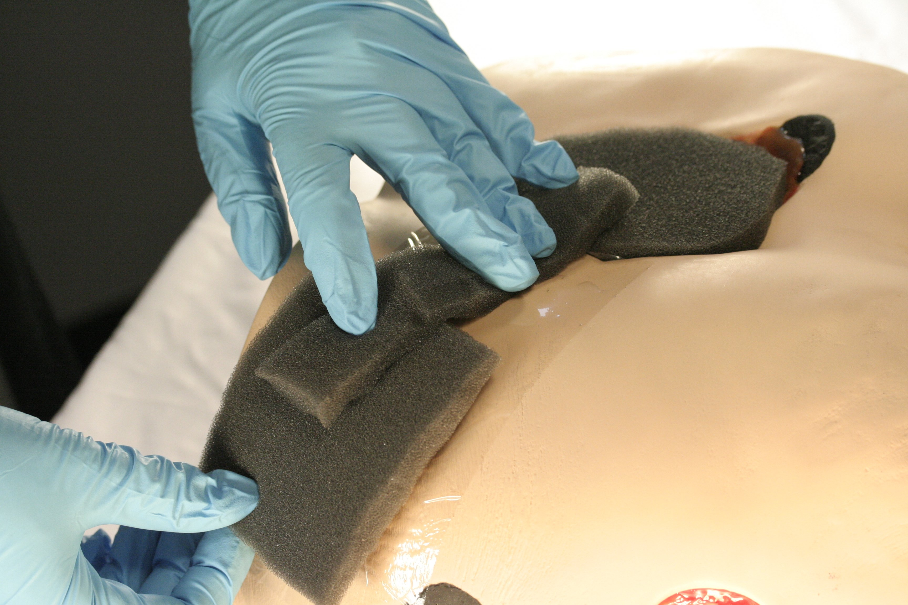
https://th.bing.com/th/id/R.f3c9a82a18783b0fbd35af75be337ee3?rik=wFi3XC6a2QqMXw&riu=http%3a%2f%2fcdn2.hubspot.net%2fhub%2f139055%2ffile-2499557698-jpg%2f_MG_3806.jpg%3ft%3d1445543173142%26width%3d3566&ehk=GKIRXHUyEVTVsmpGED6NLmSZUrqxr6rrnLmwPhdiwmU%3d&risl=&pid=ImgRaw&r=0
Notes:
Example of “bridging”
Suction pad can cause breakdown
Tubing can cause breakdown
Make sure to drape the skin underneath the bridge (like a sandwich)
Again an arts and crafts project

Slide 19
Mechanisms of Action (MOA)
Primary MOA
Secondary MOA
Macro-deformation
Micro-deformation
Removal of fluid/exudate
Optimization of wound environment
Inflammation modulation
Promotion of angiogenesis
Differentiation of cells
Granulation tissue formulation
Peripheral nerve response
Ciliberti et al, 2023
Notes:
Split in primary and secondary
Primary: visible changes
Secondary: controlling inflammatory factors, promoting formation of new blood vessels, causing cells to divide and differentiate, new granulation tissue forms and stimulate surrounding peripheral nerves

Slide 20
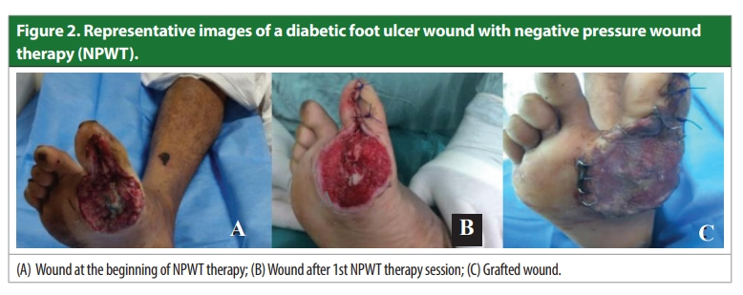
Sagar et al. 2023
Notes:
Diabetic foot ulcer=poor healing factors
First picture: bone exposed, possible slough/eschar present
Second picture: more red/pink tissue=granulation tissue, increased perfusion and blood vessels, less bone exposed, able to stitch the portion under the big toe
Third picture: finished with skin graft

Slide 21
Other Types of NPWT
Single Use NPWT
  Multilayer dressings over wound bed
  Better distributes negative pressure over wound and periwound area
  Can be canister-less
NPWT with instillation
  Introduction and evacuation of intended fluids to further promote wound healing
  Antimicrobial agents
Ciliberti et al, 2023; Leek et al, 2024; Norman et al, 2022; Hölper, 2024

Slide 22
Clinical application

Slide 23
NPWT: Clinical Recommendations
Stage III and Stage IV injuries in exceptional circumstances for quality of life and patient/family-centered circumstances
  Complications after other wound care interventions
  Limited caregiver abilities
  Less frequent dressing changes
  Certain co-morbidities negatively impacting healing factors
NPWT is a safe and effective treatment for chronic Stage III and Stage IV pressure injuries
Single-use NPWT may be more effective than traditional NPWT for non-healing surgical wounds and home/outpatient use
RNAO, 2016; Gould et al, 2024; Gefen et al, 2024

Slide 24
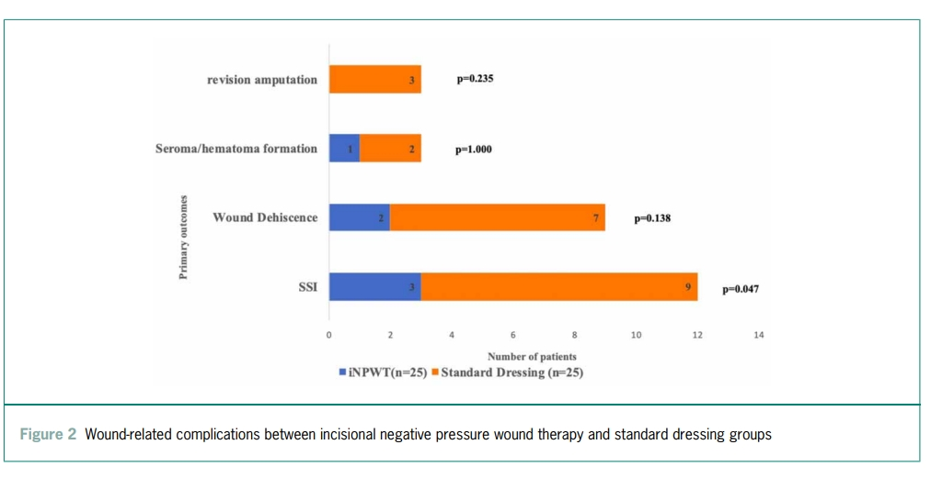
Vaddavalli et al. 2024.
Notes:
In a study by Vaddavalli and colleagues, they compared the likelihood of complications post-amputation in those with peripheral arterial disease who received NPWT vs those with standard gauze dressings. NPWT had less participants who resulted in the formation of hematomas and seromas, wound dehiscence, and surgical site infections, and no participants who received NWPT required a revision amputation. This size of this study was very small and there is a need for larger studies to further compare the risk of these complications, however this does highlight the possible benefits of using NWPT in those with impaired healing factors to potentially avoid future complications, which ultimately improves quality of life for these patients and decreases financial burden.

Slide 25
NPWT in Neurological Population
Use in flap reconstruction of pressure injuries to prevent infection and dehiscence
  Two most common complications with pressure injury healing
Use of irrigation with NPWT in chronic stage III and IV pressure injuries
  Further increase granulation tissue formation and removal of debris/exudate
  Further stimulation of peripheral nerves in surrounding tissue
Allows for regular physical activity while in rehabilitation
  Must manage machine and canister
  Avoid tugging on tubing
Norman et al, 2022; Hölper et al, 2024; Burhan et al, 2022; Sagar et al, 2023; Vaddavalli et al, 2024; Murray-Ramcharan et al, 2024

Slide 26
Possible Complications
Increased pain levels
  During dressing changes
Poorly placed dressing and suction pad
Infection from dressing materials
  Contaminated foam
  Foam left inside wound bed
Pressure injuries from tubing
Lumbers, 2024; Anagnostakos et al, 2021

Slide 27
Case Study #1
52 yr old male s/p SCI T10 ASIA B (about 5 years ago)
  PMHx: DMII, HTN, HLD; admitted to hospital after fall at home/debility
  Lives at home with his wife, mod-I wheelchair level
    No longer going to outpatient physical therapy
  Developed bilateral ischial tuberosity pressure injuries (stage III and stage IV)
    Moderate to high amount of slough and exudate
    Bone exposed in stage IV
  NPWT for both pressure injuries due to co-morbidities affecting wound healing and the severity of the pressure injuries
  Utilized foam bridge to lateral hip/thigh areas
    Avoid placing suction pad on ischial tuberosity
    Avoid having tubes underneath buttocks
Discharged home with traditional NPWT home unit

Slide 28
Case Study #2
68 yr old female s/p R MCA CVA about 1 week prior
  PMHx: DMII, b/l knee OA, CVA about 3 years ago
  Lives alone but adult children (2) live locally; mod-I, used SPC for longer distances
  Developed stage III pressure injury on L lateral malleolus with infection
    Moderate amount of slough and exudate
  NPWT with instillation of antibiotic solution
    Required 2 people for all ambulation; one person to guard patient and second person to manage NPWT unit and tubing
    Progressed to patient carrying unit and only needing one person to guard
Discharged from NPWT to gauze dressing while in acute rehab

Slide 29
Conclusion

Slide 30
Further Research
Prevalence of NPWT in outpatient clinics
  Multidisciplinary neurological rehab centers
Efficiency in application of NPWT in both inpatient and outpatient settings
  Patient use at home and in the community
Advancement in materials for better wound healing and infection prevention
Leek et al, 2024; Norman et al, 2022; Hölper, 2024; Sagar et al, 2023; Vaddavalli et al, 2024; Murray-Ramcharan et al, 2024

Slide 31
Summary
Patients with neurological conditions are at increased risk for development and progression of wounds due to secondary mobility and healing deficits
NPWT is a safe and effective intervention to promote healing factors and subsequently decrease healing time of wounds when applied correctly
Effective wound healing interventions are essential for patients with neurological conditions to avoid further complications and begin rehabilitation
Further research is warranted for the use of NPWT in different settings and in conjunction with other modalities for wound healing

Slide 32
References
Peters J, Lauinger A, Mayr M, Ginell K, Abou L. Dual-Task Assessments for Predicting Future Falls in Neurologic Conditions: A Systematic Review. American Journal of Physical Medicine & Rehabilitation. 2024;103(6):554-560. doi:10.1097/PHM.0000000000002452
Biercewicz, M. Falls as a Common Problem in Elderly People with Neurological Diseases. JNNN 2022;11(3):137–141. DOI: 10.15225
Abou, L., & Rice, LA. Functional balance assessment for predicting future recurrent falls in non-ambulatory individuals with spinal cord injury: a prospective pilot study. PHYSIOTHERAPY THEORY AND PRACTICE 2024;40(11), 2530–2539 https://doi.org/10.1080/09593985.2023.2266741
Ribeiro RN, Oliveira DV, Paiva WS, Sousa RMC, Vieira RCA. Incidence of pressure injury in patients with moderate and severe traumatic brain injury: a systematic review. BMJ Open. 2024;14(12):e089243. Published 2024 Dec 15. doi:10.1136/bmjopen-2024-089243
Soegaard, K., Beeckman, D., Verhaeghe, S., Biering-Sørensen, F. Development of a clinical practice guideline on pressure ulcers in people with spinal cord injuries inspired by the ADAPTE method. Spinal Cord. Feb2025; 63(2): 66-74. 10.1038/s41393-024-01051-z
Johnson S, Ziegler J, Touger-Decker R. An Evidence-Based Approach for the Use of Vitamin C, Zinc, and Arginine in the Treatment of Severe Pressure Injuries: A Case of a Patient with Multiple Sclerosis. Support Line. 2019;41(2):10-20. Accessed March 30, 2025. https://research.ebsco.com/linkprocessor/plink?id=54bf2c76-270e-3560-98f7-8c3e07ab354f
Yoon JE, Cho O-H. Risk Factors Associated With Pressure Ulcers in Patients With Traumatic Brain Injury Admitted to the Intensive Care Unit. Clinical Nursing Research. 2022;31(4):648-655. doi:10.1177/10547738211050489
Alshehri NF, Seyam MK, Sirajudeen MS, Shaik AR. Knowledge and practice of physical therapists regarding positioning for management and prevention of pressure injuries among patients with spinal cord injury in Riyadh region, Saudi Arabia. Physical Therapy Reviews. 2025;30(1):1-7. doi:10.1080/10833196.2025.2451537
WIJKER, B. J. et al. Healthcare Costs of Pressure Injuries among Patients with a Spinal Cord Injury within a Dutch Rehabilitation Center. Advances in Skin & Wound Care, [s. l.], v. 38, n. 1, p. 19–24, 2025. DOI 10.1097/ASW.0000000000000259. Disponível em: https://research.ebsco.com/linkprocessor/plink?id=d5786a82-7986-3776-a243-e7734657bedd. Acesso em: 30 mar. 2025.
Williams, L. At a glance: pressure injuries. British Journal of Nursing. 2024;33(20):S24-S30. https://doi.org/10.12968/bjon.2024.0197
Registered Nurses’ Association of Ontario (2016). Assessment and Management of Pressure Injuries for the Interprofessional Team, Third Edition. Toronto, ON: Registered Nurses’ Association of Ontario.
Gefen A, Russo S, Ciliberti M. Revisiting negative pressure wound therapy from a mechanobiological perspective supported by clinical and pathological data. Int Wound J. 2024;21(12):e70098. doi:10.1111/iwj.70098
Gould LJ, Alderden J, Aslam R, Barbul A, Bogie KM, El Masry M, Graves LY, White-Chu EF, Ahmed A, Boanca K, Brash J, Brooks KR, Cockron W, Kennerly SM, Livingston AK, Page J, Stephens C, West V, Yap TL. WHS guidelines for the treatment of pressure ulcers-2023 update. Wound Repair Regen. 2024 Jan-Feb;32(1):6-33. doi: 10.1111/wrr.13130. Epub 2023 Dec 20. PMID: 37970711; PMCID: PMC11403384.
Ciliberti, M., Gefen, A., Henriksson, AS., Kouhia, S. Using laboratory and clinical data to inform best practice in the delivery of negative pressure wound therapy. Wound International. 2023;14(4):46-53.
Leek K, Murdoch JM & McCarthy CH. The utilisation of a negative pressure wound therapy clinical decision tree in an acute care setting tissue viability service. Journal of Wound Management. 2024;25(1):2-10.
Norman G, Shi C, Goh EL, Murphy EMA, Reid A, Chiverton L, Stankiewicz M, Dumville JC. Negative pressure wound therapy for surgical wounds healing by primary closure. Cochrane Database of Systematic Reviews 2022, Issue 4. Art. No.: CD009261.
Hölper D, et al. Demonstrating negative pressure wound therapy in the management of non-healing surgical wounds: a case series. Journal of Wound Management. 2024;25(3):107-113.
Burhan, A., Ali Khusein, b. A., & Sebayang, S. M. Effectiveness of negative pressure wound therapy on chronic wound healing: A systematic review and meta-analysis. Belitung Nursing Journal. 2022;8(6):470-480.
Sagar, S., Dar, P., Kumar, S., Gupta, A., Improved Bates-Jenson score following negative pressure wound therapy on wounds of various aetiologies: an experience from a tertiary care centre. Wounds International. 2023;14(4):14-21.
Vaddavalli VV, Girdhani B, Savlania A, et al. Effectiveness of incisional negative pressure wound therapy after major lower extremity amputation: a randomised controlled trial. Ann R Coll Surg Engl. 2024;106(5):418-424. doi:10.1308/rcsann.2023.0011
Murray-Ramcharan M, Feltes Escurra M, Engdahl R, Gattorno FL. Negative-Pressure Wound Therapy for the Management of Complex Surgical Wounds in a Minority Population. Cureus. 2024 Mar 22;16(3):e56726. doi: 10.7759/cureus.56726. PMID: 38646389; PMCID: PMC11032736.
Lumbers M. Bringing negative pressure wound therapy to the community: expanding wound care access. Br J Community Nurs. 2024;29(Sup12):S36-S38. doi:10.12968/bjcn.2024.0154
Anagnostakos K, Thiery A, Sahan I. Retained Negative Pressure Wound Therapy Foams as a Cause of Infection Persistence. Adv Wound Care (New Rochelle). 2021;10(12):699-710. doi:10.1089/wound.2019.1088

Slide 33
Questions?
Christiana Vandegrift DPT
christiana.vandegrift@sluhn.org

