Slide 1
Movement Variability: Exploring Valgus and Plyometric Progressions
Wattanai Manasurangkul LAT, DPT, PT
Notes:
Good afternoon everyone.
My name is Wattanai Manasurangkul and the title of my Grand Rounds presentation is Movement Variability: Exploring Valgus and Plyometric Progressions

Slide 2
Financial Disclosures
I have no financial incentives to disclose

Slide 3
Objectives
To define and understand the concept of movement variability
To understand how movement variability plays a role during functional activities
To apply current literature to improve on our understanding of movement variability and its role in rehabilitation and injury prevention
To understand basic plyometric terminology
To understand basic plyometric progressions and its purpose in physical therapy
Notes:
The objectives for today’s lecture are to define and understand the concept of movement variability and its role during functional activities.
To apply current literature to improve on our current understanding of movement variability and how it affects rehabilitation and injury prevention
To understand basic plyometric terminology and progressions as well as its role within physical therapy

Slide 4
Biomechanical Definitions
Movement variability¹
  Normal variations in motor performance across multiple repetitions of a task
Dynamic knee valgus²
  Incorrect movement pattern that is recognized as a risk factor for LE injuries
  Typically comprised of a combination of motions
    ADDuction and internal rotation of the femur
    ABDuction of the knee
    Anterior tibial translation
    External tibial rotation
    Ankle eversion
  Leads to medial knee displacement beyond foot-thigh line
Notes:
Movement variability is normal movement variations that occur across multiple repetitions of a task.
The best example of this is when you have a patient squat and you see minor deviations from one rep to the next.
You may see changes in valgus angles, ankle pronation, lower extremity recruitment and movement strategies, and torso angles
Keep in mind that these changes are not inherently bad but they require control, refinement, and education for our patients to understand what a safe and stable functional position is
Dynamic knee valgus on the other hand is considered to be an incorrect movement pattern that is recognized as a risk factor for lower extremity injuries
It is comprised of a handful of motions and typically in combination
ADDuction and internal rotation of the femur
ABDuction of the knee
Anterior tibial translation
External tibial rotation
Ankle eversion
These factors usually contribute to medial displacement that goes beyond the foot-thigh line which we will see a visualization of in the next slide

Slide 5
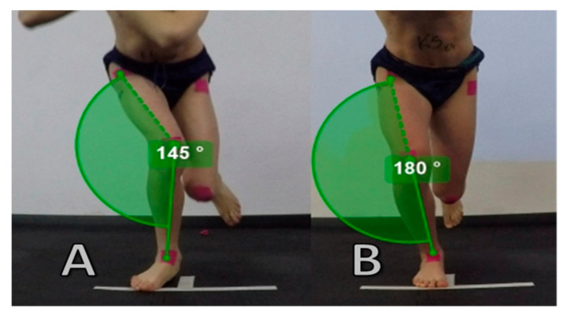
Dynamic Knee Valgus
Considered a predisposing factor for both acute and chronic LE injuries such as non-contact ACL ruptures and PFPS ^{3,4}
Considered to be the primary mechanism for ACL injuries in video analysis and cadaveric studies ^{5,6}
IT band, TFL, and glute max are knee stabilizers in frontal plane
  Increased tension of TFL can affect tibial ABDuction resulting in increased knee valgus ⁷
Notes:
The image on right demonstrates a knee that is in line with the hip and foot as you can see by the straight line passing through all 3 joints
This is considered to be a more stable lower extremity position w/ better neuromuscular control
The image on the left demonstrates medial tracking of the knee that travels beyond the hip and foot line
This is typically associated w/ poor movement strategies, motor control, or strength deficits
Dynamic knee valgus is considered a predisposing factor for both acute and chronic lower extremity injuries such as ACL ruptures and patellofemoral pain syndrome
It has also been found to be the primary mechanism for ACL injuries as seen in video analysis and cadaveric studies
Because valgus is considered to be a predisposing factor for LE injuries, we have traditionally trained people to completely avoid knee valgus which we will talk about in the next slide but is it as bad as we think it is?
An interesting tid bit that I found while researching this topic is that the IT band/TFL/glute max play a significant role in lateral stability of the knee and that increased tension on the TFL can impact tibial ABDuction and increase knee valgus.
So if you are struggling to find a deficit or neuromuscular control is not improving, the TFL and glute max can be great places to further investigate especially since the TFL tends to get overlooked while the glute med tends to be highly prioritized.

Slide 6
Previous Beliefs^{8,9}
Knee valgus is traditionally viewed as the position of the femur at the knee
  Consider the pelvis moving over a fixed femur as well
Assessed via vertical drop jump
  Utilize more single leg stance testing
    Single leg stability
    Single leg squat/step down
    Single leg vertical drop jump
    Single leg hop and landing
    Lateral hopping
    Cutting
There is a correct way to jump, cut, and prevent valgus during functional movements.
  Let people move how they are comfortable moving and refine their patterns. Do not force one absolute pattern on every patient
    NBA players have been categorized into 3 common jumping and landing strategies⁹
Notes:
For this slide, I want to discuss some previously held beliefs and practices that are still held onto today.
The first one being that knee valgus is traditionally viewed as the angle of the femur positioned on the tibia
However, most functional movements occur in closed kinetic chain so it is important to consider how the pelvis moves on a fixed femur.
This also allows us to assess pelvic motion and stability and its function in the kinetic chain as the hip musculature is also responsible for attenuating ground reaction forces that impact joint angles
Another common practice is to assess knee valgus with a vertical drop jump test. This is essentially where a patient steps off of a box approximately 6-12 inches and we assess their ability to absorb forces. Now this test is a fine place to start. However, we all know that athletes and people in general can be excellent compensators. It’s our job to expose these compensatory patterns and asymmetries. We should also be looking at our patients’ ability to not only absorb forces but also their force production and ability to transfer forces as well.
From an evaluative standpoint, single limb stance is a fantastic way to start for both athletes and general population. From here we can observe functional weaknesses that are often conveyed through asymmetrical hip rotation, loading strategies, hip drop, stability, foot position, and hip and knee flexion angles
Now, this last point is one I can certainly say I fell prey to a few years ago and that is the belief that there is a correct way to jump, cut, and move. There is no gold standard for movement as it varies depending on sport or activity specific needs as well as individual anthropometry.
An interesting study I came across was one that categorized NBA players and their jumping and landing strategies. This study found that there were 3 common strategies that were utilized.
Keep in mind that these are the elite and if there was an ideal way to move and improve their performance, they would quickly adopt it.
If there are deviations among the top percentile, why should we pigeonhole our patients into one movement strategy.
Instead we should allow our patients to explore movement patterns and develop their own strategies for it while we refine these patterns.
We want our patients to use strategies that work best for their individual differences and specific needs
There is no need to fit a square peg into a round hole.
Before we move onto the next slide, here is some food for thought.
In gait, it is normal for us to internally rotate, ADDuct, and pronate to propel ourselves forward and generate force.
This sound suspiciously like valgus forces.
So why are these forces so frowned upon during other functional patterns when we commonly see this pattern appear when we need to generate and absorb forces.
It happens at one joint or another. We can see this through increased ankle pronation, knee valgus, and under heavier loading, forward torso lean, resulting in greater hip internal rotation and valgus moments. Just something to consider when we rehabilitate our patients and critically think through movement patterns.

Slide 7
Prevention Screening
Assessing subsystems/slings
  Dynamic movements do not occur in isolation
  Identify deficits but address as a system
  Assess how foot, ankle, hip, and core function together
Biomechanics analysis
  Increased lateral trunk flexion over support leg
  Greater lateral plant leg distance
  Decreased knee flexion at initial contact/during support phase
  Greater initial knee ABDuction angle
  Greater hip IR/ABDuction
Notes:
Regarding prevention screening and evaluation it is important to assess the entire kinetic chain
Assessing subsystems and slings allow for us to determine weak points in their kinetic chain and also to address strength deficits we may have found in isolation in a more functional manner.
This is why it is important to view the foot, ankle, hip, and core during various patterns and see how these individual parts function together
After all, functional movements do not occur in isolation and require coordinating several joints and muscle groups in unison to create stability and power
Utilizing subsystems also helps us to evaluate all contributory factors and planes that impact a functional pattern which gives us the ability to assess for more relevant deficits
Next, I have listed here are some common compensatory findings people demonstrate during single limb or plyometric testing
Increased lateral trunk flexion over the stance leg especially when cutting or w/ lateral movements along with greater plant leg distance is compensation for poor control over their center of mass
Decreased knee flexion can be poor ability to attenuate ground reaction forces which could indicate poor movement strategies and anticipation of forces
Greater hip and knee angles may be due to poor hip neuromuscular control or strength leading to increased valgus angles

Slide 8
Treatment Principles
Kinetic chain and total system tension
Dynamic knee valgus is a multiplanar movement used to manage ground reaction forces
  Consider all factors in the kinetic chain and in each plane
Movements can occur beyond what PTs may traditionally consider “safe” or “normal”
  Consider how each movement may impact tension throughout the body vs if the movement is safe.
Notes:
This slide lists some considerations we should have in mind when addressing lower extremity function
As stated in the previous slide, we should consider the entire kinetic chain as well as total tension throughout the system to ensure patients understand where they are strong and stable
Because we are viewing the entire kinetic chain rather than just isolated body parts, we should be able to better assess and address deficits that occur in various motions and planes that we want to improve upon as functional activities tend to occur in 3d or a combination of planes rather than linearly
Building off of that, dynamic knee valgus is a multiplanar movement that is used to manage ground reaction forces. It is important to understand that the greater the ground reaction force, the greater the instance of potential valgus
We want to address the various forces that occur in all planes to better control contributing factors for valgus forces
Lastly, functional patterns often occur beyond what PTs consider safe or normal. We see this all the time in sports where higher intensities are required. Basketball players demonstrate valgus when jumping and landing. Olympic weight lifters showcase similar patterns during their lifts. Football players demonstrate significant torso lean and valgus angles when cutting and pivoting.
Instead of thinking whether a movement is safe. Try thinking if a movement is stable and strong for our patients.
By doing this, we can start to encourage movement pattern discovery and adopting movement strategies to improve stability and efficiency

Slide 9
Treatment Options
Controlled exposure to valgus
  Discovering movement strategies during these encounters
  Facilitates patient autonomy
  Improves range of controlled motion
  Decreases ACL risk factors
Slings and subsystems
  Great way to assess neuromuscular control and identify deficits in kinetic chain
Strength/endurance training
Plyometric progression
  Leaping
  Bounding
  Hopping
  Multi-directional training
  Dual tasking
Notes:
Here are some treatment options that we can consider to improve outcomes and prevent recurrence of injury
The first option is to have a controlled exposure to valgus
This is where we allow our patients to play with low levels of intensity and explore movement patterns and what feels best for them.
In doing this, we get to refine these patterns and encourage autonomy for our patients as they get to determine what movement strategies best fit their individual needs
Early exposure to valgus does a few things. It allows patients to determine how much movement variability is acceptable for them to still feel safe, strong, and stable
This ensures that patients are familiar with valgus or less ideal positions in a low stress and intensity environment.
If their first exposure to these positions occur as intensity ramps up or even worse, during competition where intensity and fatigue are at their highest, this would not be the ideal scenario to introduce and familiarize a less efficient movement pattern that increases potential risk for injury.
It has also been shown that early exposure to valgus leads to decreased ACL risk factors as well by discovering and understanding these movement strategies.
As we talked about previously, improving functional patterns by via subsystems is a fantastic way to identify and address strength and neuromuscular control deficits in a functional manner
This is also serves as a wonderful opportunity to educate patients on how to create co-contractions and explore various joint angles where they can generate the most stability and power
As PTs, strengthening is often at the forefront of our minds which is great. We need strength for both force production and force absorption. However, a highly overlooked aspect of this is the patient’s endurance to maintain these levels of force production and neuromuscular control.
Previous research has shown that as fatigue accumulates, the hamstrings and calves neuromuscular capacity to limit anterior tibial translation inversely decreases.
Remember that without endurance, all of the strengthening and neuromuscular control training will not be nearly as effective during higher levels of intensity.
Lastly we have plyometric progressions and varying levels of complexity. Adding complexity to these movement patterns improves the athlete’s movement patterns while also challenging them neurocognitively as they problem solve with improved strategies. Complexity can be scale by combining the listed movements of leaping, bounding, and hopping, adding in varied intensities, changes of directions, as well as dual tasking.

Slide 10
Plyometric Definitions
Leaping/jumping
  Bilateral base of support
Skipping/Bounding
  Alternating single leg base of support
Hopping
  Continuous jumping on one leg
Yield
  The amount of tissue deformation that occurs during the amortization phase
Amortization phase
  The period between the eccentric and concentric phases of a plyometric movement
Notes:
In this slide, we breakdown common plyometric terms
Leaping or jumping is a plyometric movement that involves a bilateral base of support so two limbs coming into contact with the ground simultaneously
This can occur in a squared stance or a staggered stance as a progression toward skipping
Skipping is a plyometric movement that involves an alternating single leg base of support
Bounding is a form of skipping that is more akin to exaggerated running
Hopping is a plyometric movement that involves continuous jumping on the same lower extremity
Yield is the amount of tissue deformation that occurs during the amortization phase where we transition from force absorption to force transfer and force generation
Amortization phase is exactly as I stated before but more specifically, it is the period between the eccentric and concentric phases of a plyometric movement.
Think of it as the phase from where you first land and absorb forces to when you are about to begin your take off and generate forces

Slide 11
Principles for Plyometric Training
Goals for plyometrics
  Focus on quality not quantity
    Rhythm and coordination
    Timing and sequence
  Developing movement strategies
High movement variability vs low movement variability
Force absorption vs force production vs force transfer
  Tension/stiffness in the system
    Control lengthened position
      Depth of knee/hip flexion
    Minimize deformation
      Reactivity and ground contact time
    Maintaining momentum with control
      Application to multiple directions with higher force production
Notes:
Here are some overarching goals and considerations we should have when programming plyometrics for our patients
The first being that we need to prioritize quality and not quantity
There are several other ways to improve aerobic capacity for our athletes
Instead, we should focus on the athlete’s rhythm and coordination as well as their timing and sequence
This allows us to better identify their movement strategies and deficits.
For example, we can see how a patient generates force through their lower extremities only versus when using their upper body to help accelerate and decelerate
We can also see how they are able to accept and transfer forces
We often hear about staying stiff during plyometric movements but there is a different between musculotendinous stiffness which requires appropriate sequencing of our muscles versus being rigid when landing
This next question determines the level of intensity and volume for our patients.
High movement variability occurs with low displacement and low intensity with higher volumes where we encourage exploration and freedom to play around with movement patterns and strategies as they warm up and get accustomed to plyometrics
The more intense and greater the displacement, the lower the movement variability should be as the increase in forces also increases the potential risk for injury
The next question determines what our plyometrics should consist of and what we are looking to facilitate. This is broken down into components but we can combine them for more complexity. We should be determining the patient’s level of readiness. If they are newer, it may be more beneficial to begin with higher yielding plyometrics so we can create tissue adaptations with decreased forces and improve on their ability to absorb forces.
Perhaps they are ready to progress and their sport requires decreased contact time. This is where we can utilize pogo jumps or hops to minimize tissue and joint deformation and improve reactivity off of the ground. This allows us to improve efficiency regarding force absorption and force generation
Lastly, we can aim to improve force transfer in multiple directions. First we can string together consecutive broad jumps and progress to transitioning from lateral to saggital planes or add in rotational components while maintaining momentum

Slide 12
Plyometric Variables
Varied yields for different goals
  Deep yield
  Fixed yield
  Minimal yield
Varied intensity levels
  Low intensity
    Low levels of displacement
    High variability in movements
    Learn movement strategies
  Submaximal
  Maximal effort
Progression from double limb to single limb
Squared double limb → staggered double limb → skipping → bounding → hopping
Changes in direction
Cognitive dual tasking
Notes:
Here we have a few variables that we can consider
The first being the amount of yield
First we have deep yield which is where deceleration occurs in the lengthened portion of the movement.
Consider deep squat jumps or lunge jumps where the knee nearly contacts the ground
Fixed yield is where we purposefully stop in the midrange of a motion. This segues as a progression to minimal yield
This is where we have the least amount of tissue deformation and least amount of ground contact time
It is also prudent to consider intensities when we have determined our patient’s preparedness levels
Low intensity is characterized by low levels of displacement, low force production, high movement variability, and the perfect intensity to explore movement patterns and learn new movement strategies
Submaximal is my personal favorite and where I believe most plyometric training for prepared athletes should take place as this is the intensity that most plyometric movements occur in competition
We are able to continue refining strategies with increased intensity and force production.
We can engrain good patterns here because we can also improve their plyometric capacity
Maximal effort should be more rare as most athletes are not quite at the preparedness level to tolerate repeated bouts of maximal effort plyometrics
This is where we can note more progress by determining max force generation and absorption, reactivity, and ability to transfer forces
This is most commonly used during testing
The following are the more often considered variables such as progressing double limb to single limb where we go from a squared stance to a staggered position. This can be done continuously or in an alternating fashion to better simulate skipping. From here we can progress into skipping and bounding which has higher amounts of forces and displacement involved. Lastly we can progress to hopping.
To further add complexity this is where we can combine these progression and move from 3 strides into a hop or a bilateral take off into a lateral hop to overload the limb and add a change in direction. Adding in cognitive tasks such as having a target to land on or using auditory or visual cues or adding in perturbations are great progressions for return to sport athletes
We can add alternating staggered positions as another step and then we can progress

Slide 13
Plyometric Progressions
Leaping
  Hands on hips
  Arm drive
  Split stance
    Transitions to leaping and bounding
  Multiple planes
    Horizontal <--> vertical
    Diagonal movements
Skipping/bounding
  3 skip/bound hop
Hopping
  Cycling
Notes:
Here are some basic progressions I mentioned throughout the presentation just listed out visually
I want to especially highly a few here
Jumping with hands on hips vs with arm drive lets us see coordination of the upper and lower body as well as how the lower body functions when the upper extremities are taken out of the equation. Upper extremities can certainly be used o compensate for poor movement patterns.
Split stances are like I mentioned before an excellent progression toward single limb plyometrics
Skipping and bounding are great but what is often underutilized is combining skips with hops so the pattern is more forgiving but also more cognitively demanding
Lastly we all know what hopping is
But a great way to progress is to also include cycling which is where the hopping leg turns over during the hop to simulate a sprinting stride
We will see a video demonstration of this in the next few slides.

Slide 14
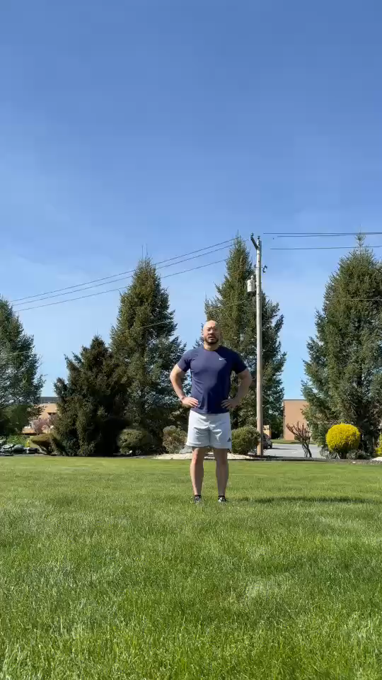
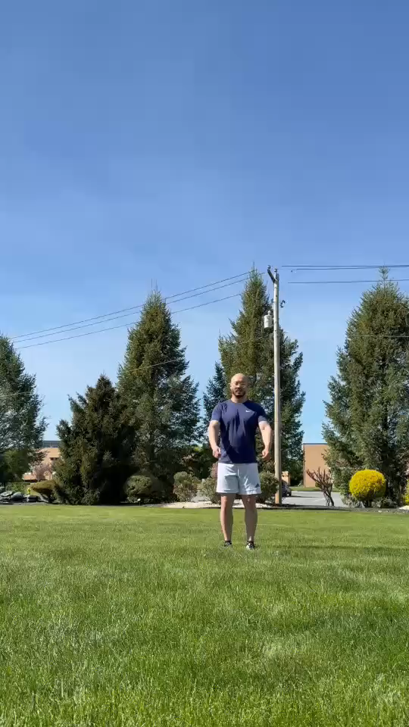
Plyometric Progressions
Notes:
Here on the left hand side, we can see a demonstration of hands on hips followed by varying levels of yield, intensity, and displacement ranging from minimal to high and from low to submaximal
We also can see a continuous leap with sagittal displacement
On the right hand side, we can see a similar progression but now with upper extremity sequencing. Note the sequencing of the upper arms during landing and take off and how they stay consistent regardless of the intensity, displacement, or yield.
Lastly we have continuous low yield leaping with alternating directions

Slide 15
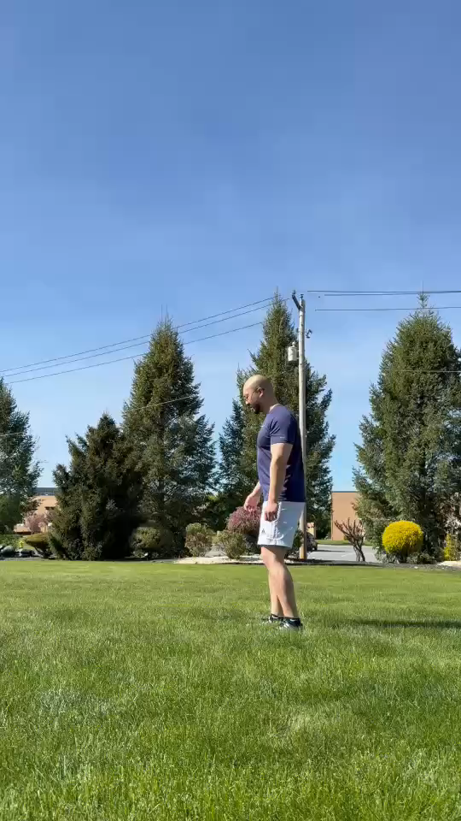
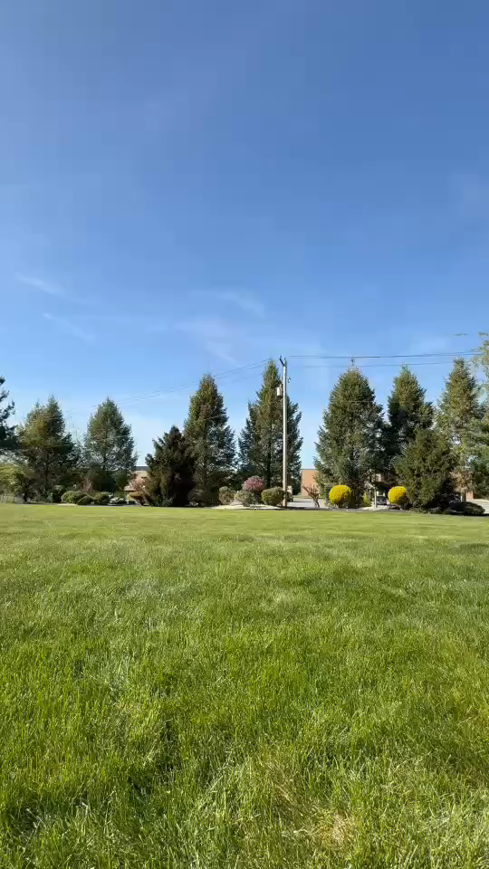
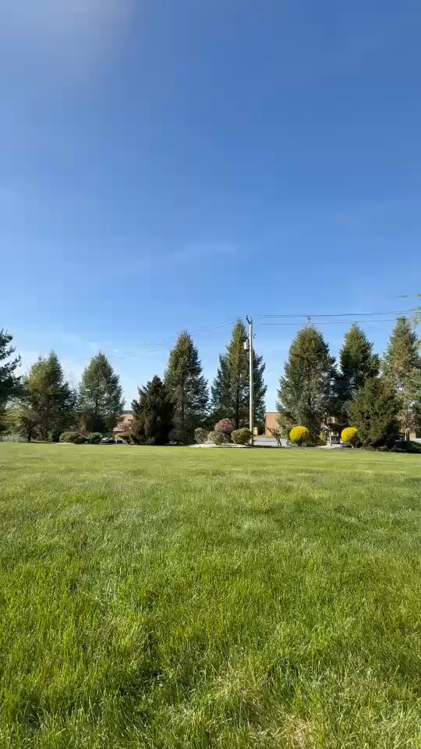
Plyometric Progressions
Notes:
This first video demonstrates staggered leaping with varying yields ranging from minimal to fixed to deep yielding. Take note of the increase in ground reaction times the greater the yield.
Following this, we have a skipping progression ranging from bilateral base of support to low intensity skipping to submaximal skipping followed by bounding.
As you can see there is a change in technique from skipping to bounding but they are both still performed with an alternating unilateral base of support
The second video demonstrates a hopping progressing beginning with a combination of a skip into a hop to avoid consecutive jumps. We then progress to submaximal hopping. Lastly we have maximal effort hopping with a cycle
This last video is an example of how to progress hopping where we transition from a submaximal sprint to a maximal hop with a cycle to improve force transference and preservation of momentum

Slide 16
Decreasing Risk Factors¹⁰
Linear pedagogy
  Universal and ideal movement pattern for everyone (Gold standard)
  Ignores individual differences
  Deviation from ideal pattern is noise and must be reduced
Non-linear pedagogy
  Variability is necessary for learning
  Allows people to discover and adapt movement patterns
  Utilizes variability to help guide people to adaptation
    Multiple movement solutions
  Guides toward adaptation to specific tasks and environmental constraints
Differential learning
  Similar to non-linear pedagogy
  Utilizes maximum variability for self-discovery and adaptation
  Focus on a large and random variety of movements
Notes:
A recent study explored the concept of controlled exposure to valgus.
In this study, they had 3 groups. To keep it simple, you can condense it into two groups.
The first group is linear pedagogy which is where a gold standard of movement was given to this group and everyone was forced to adopt this ideal movement pattern
This falls in line with previous PT practices of completely avoiding valgus movements as it is considered noise and increased risk factors for lower extremity injuries
The other two categories can be grouped together as they both include exposure to a wide variety of movement variability and encourage self-discovery of movement strategies and adaptations that are specific to given tasks or environmental factors

Slide 17
Study Outcomes
Outcomes demonstrate that allowing for movement variability improved control of knee ABDuction angle.
Non-linear pedagogy and differential learning both positively affected risk factors for potential ACL tear
A recent study observed isolated strengthening of glute medius, popliteus, and posterior tibialis had statistically significant changes but results were below MDC¹¹
Notes:
The outcomes of this study demonstrate that increased movement variability improved risk factors for potential ACL tears
Another recent study that I wanted to include was a study that observed isolated strengthening of the glute medius, popliteus, and posterior tibialis in college soccer players
While this study found significant changes in strength, the results were below the minimally detectable change regarding dynamic valgus angles. This means that further studies need to be performed but strengthening in isolation may not have as much carryover for functional patterns unless those patterns are practiced and engrained.

Slide 18
Implications for Clinical Practice
Allow for exploration and the discovery of movement pattern strategies
Refine movement pattern strategies but understand that there is no gold standard of movement
Assess for deficits in isolation and functionally
Okay to address deficits in isolation but reintegrate into functional patterns
Reassess movement strategies
Utilize plyometric progression to facilitate tissue adaptation, power production, and movement strategies
Consider other environmental factors in a patient’s sport
  Visual or auditory cues
  External contact forces
  Uneven or pliable surfaces
  Dual tasking
  Addressing and progressing sport specific neuro-cognitive tasks
Notes:
To wrap things up, here are the following main takeaways I hope everyone got from this lecture.
Allow for exploration and discovery of movement patterns and strategies. This improves outcomes, builds confidence, and facilitates the development of autonomy in our patients
It is important to refine movement patterns but to also understand that there is no gold standard for how each person needs to move
Remember to assess for movement deficits in isolation as well as functionally
It is totally appropriate to improve these deficits in isolation but that we must reintegrate them into functional patterns for improved carry over
Remember to reassess movement strategies as you improve on these deficits to see if other changes need to be made
Utilize appropriate plyometric progressions to facilitate playtime, confidence, neurocognitive skills, tissue adaptation, power production, and force absorption and transference
Lastly, consider other environment factors in a patient’s sport
Utilize visual and auditory cues
Incorporate perturbations
Use uneven and pliable surfaces to better replicate competition
Add dual tasking to increase stimulus and demands that go beyond competition levels of intensity

Slide 19
References
Cowin, J., Nimphius, S., Fell, J. et al. A Proposed Framework to Describe Movement Variability within Sporting Tasks: A Scoping Review. Sports Med - Open 8, 85 (2022).
Wilczyński B, Zorena K, Ślęzak D. Dynamic Knee Valgus in Single-Leg Movement Tasks. Potentially Modifiable Factors and Exercise Training Options. A Literature Review. Int J Environ Res Public Health. 2020;17(21):8208. Published 2020 Nov 6. doi:10.3390/ijerph17218208
Hewett T.E., Myer G.D., Ford K.R. Anterior cruciate ligament injuries in female athletes: Part 1, mechanisms and risk factors. Am. J. Sports Med. 2006;34:299–311. doi: 10.1177/0363546505284183.
Holden S., Boreham C., Delahunt E. Sex Differences in Landing Biomechanics and Postural Stability During Adolescence: A Systematic Review with Meta-Analyses. Sports Med. 2016;46:241–253. doi: 10.1007/s40279-015-0416-6.
Holden S., Boreham C., Delahunt E. Sex Differences in Landing Biomechanics and Postural Stability During Adolescence: A Systematic Review with Meta-Analyses. Sports Med. 2016;46:241–253. doi: 10.1007/s40279-015-0416-6.
Fukuda Y., Woo S.L.-Y., Loh J.C., Tsuda E., Tang P., McMahon P.J., Debski R.E. A quantitative analysis of valgus torque on the ACL: A human cadaveric study. J. Orthop. Res. 2003;21:1107–1112. doi: 10.1016/S0736-0266(03)00084-6.
Winby C.R., Lloyd D.G., Besier T.F., Kirk T.B. Muscle and external load contribution to knee joint contact loads during normal gait. J. Biomech. 2009;42:2294–2300. doi: 10.1016/j.jbiomech.2009.06.019.
Dischiavi SL, Wright AA, Hegedus EJ, Bleakley CM. Rethinking Dynamic Knee Valgus and Its Relation to Knee Injury: Normal Movement Requiring Control, Not Avoidance. J Orthop Sports Phys Ther. 2019;49(4):216-218. doi:10.2519/jospt.2019.0606
Rauch J, Leidersdorf E, Reeves T, Borkan L, Elliott M, Ugrinowitsch C. Different Movement Strategies in the Countermovement Jump Amongst a Large Cohort of NBA Players. International Journal of Environmental Research and Public Health. 2020; 17(17):6394.
Mohammadi Orangi B, Yaali R, Bahram A, et al. Motor learning methods that induce high practice variability reduce kinematic and kinetic risk factors of non-contact ACL injury. Hum Mov Sci. 2021;78:102805. doi:10.1016/j.humov.2021.102805
Wilczyński B, Wąż P, Zorena K. Impact of Three Strengthening Exercises on Dynamic Knee Valgus and Balance with Poor Knee Control among Young Football Players: A Randomized Controlled Trial. Healthcare (Basel). 2021;9(5):558. Published 2021 May 10. doi:10.3390/healthcare9050558
Notes:
Here is a list of my references and that concludes my Grand Rounds presentation.
Thank you everyone for listening.
What questions do you have for me?

