Slide 1
WHAT IS THE FUNDAMENTAL GOAL OF MODERN RADIATION THERAPY?
DELIVER A HIGH DOSE OF RADIATION TO THE CANCER (TARGET) AND MINIMIZE AS MUCH AS POSSIBLE RADIATION DOSE TO THE SURROUNDING NORMAL TISSUES

Slide 2
WHAT IS ADAPTIVE RADIATION THERAPY?
Innovative treatment for patients in which the treatment plan is modified based on the tumor's response to the radiation and the position of the surrounding normal tissues in real-time via rapid re-planning and QA of the treatment as the tumor responds to radiation.
Replanning and QA are done while patient is on the table for each and every fraction during a course of treatment.
Online adaptive treatment

Slide 3
WHAT ARE THE REASONS TO ADAPT?
The adaptive treatment plan provides superior target coverage compared with the non-adaptive treatment plan
AND/OR
The adaptive treatment plan provides superior normal tissue radiation dose avoidance in one or more adjacent organs at risk (OARs) compared with the non-adaptive treatment plan

Slide 4
ADAPTIVE RADIATION THERAPY
WHO IS A CANDIDATE FOR

Slide 5
WHO ARE CANDIDATES FOR ADAPTIVE RADIATION THERAPY?
  Prostate
  Bladder
  Pancreas/biliary tree
  Oligometastatic disease- lymph nodes and bone
  Lung/mediastinum
  Head & neck
  Cervix
  Almost any candidate for SbRT is a candidate for adaptive RT
  Some IMRT patients

Slide 6
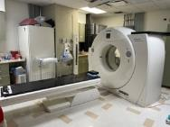
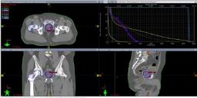
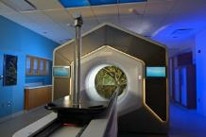
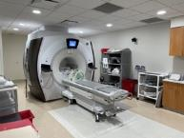
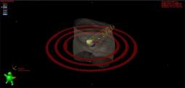
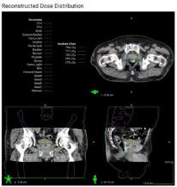
ADAPTIVE RADIATION THERAPY TREATMENT PLANNING WORKFLOW
CT and MRI simulation
Treatment Planning
Clinical set-up and treatment planning
Repeat for each fraction
New daily treatment plan based on current anatomy

Slide 7
IMPLEMENTATION OF ADAPTIVE RADIATION THERAPY
Pre-ART implementation
  Create adaptive RT team
    Physicists
    Therapists
    Physicians
    Administrators
  Need buy in from entire group to suceed
  Establish regular meetings and set program goals/treatment policies
  Coordinate with adaptive trainers

Slide 8
IMPLEMENTATION OF ADAPTIVE RADIATION THERAPY
Pre-ART implementation
  Create adaptive administrative structure
    Clinical documentation
      Treatment planning notes
      Simulation notes
      Procedure notes
      End of Treatment summary
    Physicist documentation
      Include each adaptive session report in chart
      Include QA documentation
    Administrative/finance review structure

Slide 9
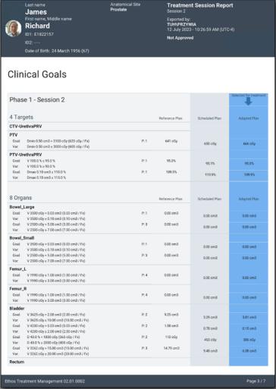
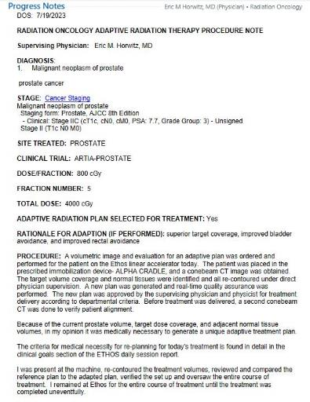
ADAPTIVE CLINICAL DOCUMENTATION
Adaptive Session Report
Adaptive Procedure Note

Slide 10
ADAPTIVE RADIATION THERAPY
DEPARTMENT OF RADIATION ONCOLOGY TREATMENT POLICY
USE OF ADAPTIVE RADIATION THERAPY
Patients being treated on the Ethos linear accelerator shall be treated with the adaptive treatment plan when one or more of the following conditions are met:
The adaptive treatment plan provides superior target coverage compared with the scheduled treatment plan
The adaptive treatment plan provides superior normal tissue radiation dose avoidance in one or more adjacent OARs compared with the scheduled treatment plan

Slide 11
IMPLEMENTATION OF ADAPTIVE RADIATION THERAPY
Clinical ART implementation
  Decide which patients are treated with adaptive RT
  Create clinical coverage schedule/structure
    Physicists
    Physicians
  Crosstrain more staff as team gains experience
    Physicists
    Therapists
    Physicians

Slide 12
IMPLEMENTATION OF ADAPTIVE RADIATION THERAPY
Post-ART implementation
  Discuss progress in multiple settings
    Staff meetings
      Physicians
      Physics
      Therapist
      Nurses
      Department wide
    Chart rounds
  Adaptive RT planning conferences

Slide 13
IMPLEMENTATION OF ADAPTIVE RADIATION THERAPY
Post-ART implementation
During treatments-
Do not be afraid to ask more experienced staff questions

Slide 14
ADAPTIVE LESSONS LEARNED
Adaptive RT learning curve steep but short
Adaptive RT requires commitment and resources of entire department
  Physicists
  Therapists
  Physicians
  Administrators
Adaptive RT extremely time intensive
  Physicians and physicists at linac for entire adaptive process- 15 to 60 minutes

Slide 15
ADAPTIVE LESSONS LEARNED
Adaptive RT requires restructuring of physician and clinic schedules to truly succeed
  Creating block schedules for ART coverage
  Adaptive SbRT doc of the day
Prepare for ART
  Train clinical team
  Train administrative team (documentation)
Entire department/cancer center is involved
Real-time lessons learned

Slide 16
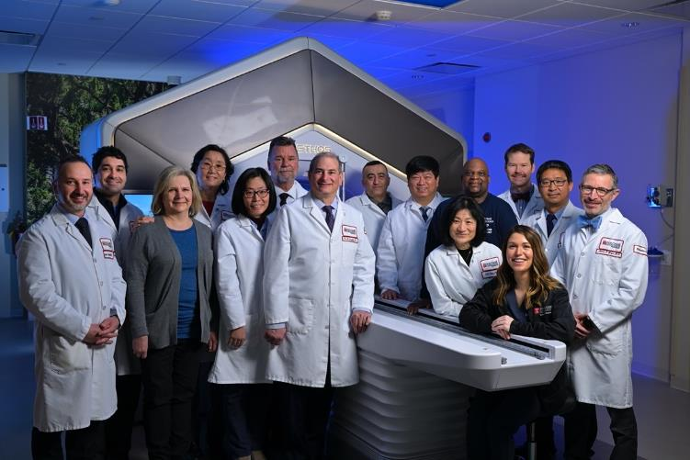
FOX CHASE RADIATION ONCOLOGY CLINCIAL AND RESEARCH ADAPTIVE TEAM

Slide 17
THANK YOU
“YOUR CANCER MOVES, SO WHY SHOULDN’T YOUR TREATMENT?”*
QUESTIONS?
*Credit to Christine Bloom, MHA
Fox Chase Department of Radiation Oncology Senior Director

Slide 18
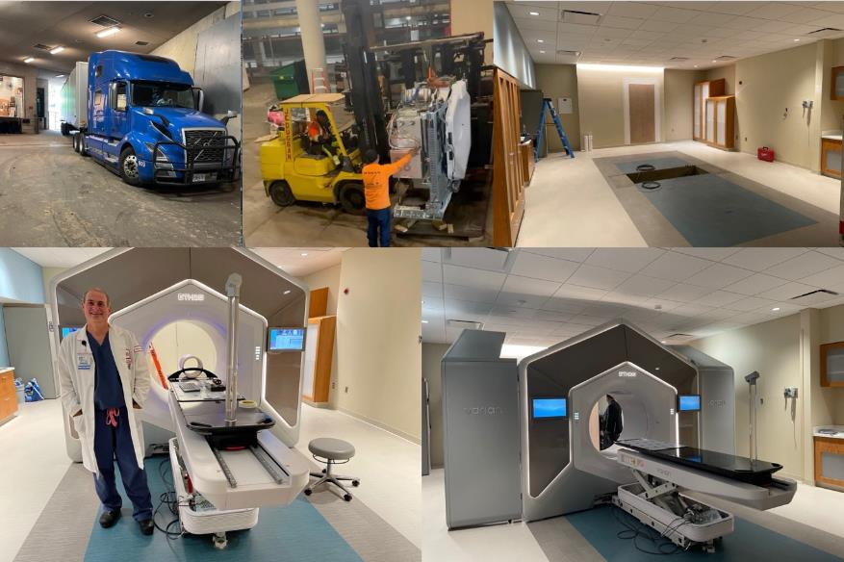
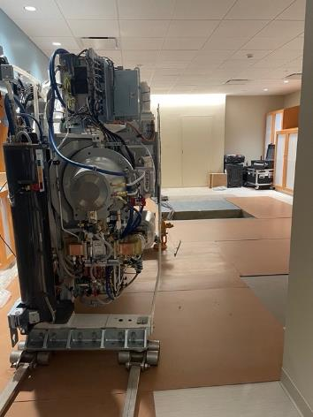
Ethos Arrives 10/1/2022

Slide 19
CURRENT ADAPTIVE VOLUMES
@ 300 adaptive fractions delivered in first 5 months
55 adaptive patients completed treatment
First adaptive protocol opened on 4/12/2023
  1st protocol patient started treatment 4/21/2023
  20 patients signed consent in first 3 months

Slide 20
ADAPTIVE PLANNING SEQUENCE WORKFLOW
Patient place on treatment couch
Conebeam CT generated
Ethos treatment planning software identifies target and surrounding normal structures
Physician reviews contours but makes no changes yet
Physician aligns all generated structures (target and normal organs) to structures on current conebeam CT
Physician modifies all contours (target and normal organs) as needed
Once all contours completed and approved by physician, adaptive treatment plan generated
Adaptive treatment plan compared to scheduled plan
Best treatment plan selected (scheduled or adapted) based on department policy guidelines
If adapted plan selected, new QA generated and checked by physicist
Another conebeam CT generated by radiation therapists and checked by physician to make sure patient hasn't moved during entire process.
Adaptive treatments take between 15 minutes and 1 hour

