Slide 1
Health Promotion,
Prevention and
Genetics
Kathy Henderson, MSN, ANP-BC, ACGN
Department of Clinical Genetics
Fox Chase Cancer Center

Slide 2
Objectives
Define terms related to cancer epidemiology and prevention
Identify leading sites of new cancer cases and deaths
Identify nursing and health related activities that are aimed at primary, secondary, and tertiary prevention
Describe risk factors as well as prevention and screening strategies for the most common cancers

Slide 3
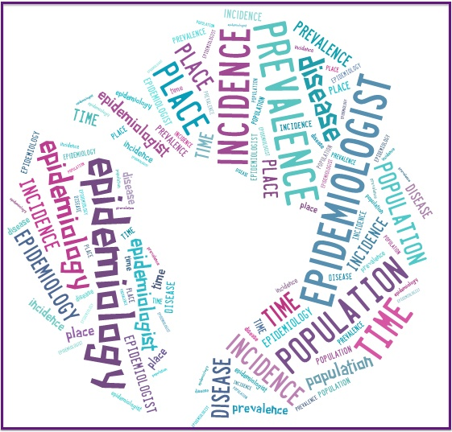
Epidemiology
The study of the distribution and determinants of disease frequency in human populations
Goals
  discover causes of disease
  identify risk factors, high-risk individuals
  evaluate preventive measures
  identify patterns of disease

Slide 4
Epidemiology
Clinicians are concerned about the health of an individual
Epidemiologists are concerned about the collective health of the people in a community

Slide 5
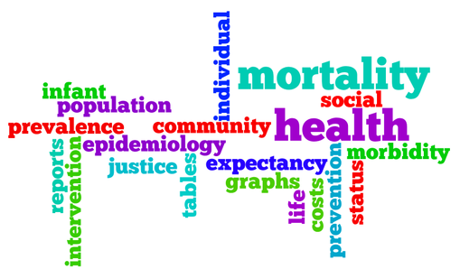
Epidemiological Indicators
  Incidence—number of new cases of cancer that occur during a certain time period among a given population
  Prevalence—percentage of all individuals with cancer at a certain time
  Mortality—number of deaths from cancer during a certain period of time

Slide 6
Cancer Facts - US
Over 18 million Americans were alive with cancer in 2022 (I, P, or M?)
~ 1.9 million new cases of cancer in 2022 (I, P, or M?)
  5,250 new cases every day
~ 1,700 people die of cancer each day (I, P, or M?)
Cancer is the second most common cause of death in US.
5-year survival rate for all cancers is 68% in White people, and 63% in African Americans
(ACS, Cancer Facts and Figures, 2022)

Slide 7
New Cancer Cases by Site
(ACS Cancer Facts and Figures 2023 estimates)
Men
Prostate 288,300 (29%)
Lung 117,550 (12%)
Colorectal 81,860 (8%)
Bladder 62,420 (6%)
Melanoma 58,120 (6%)
Kidney 52,360 (5%)
NHL 44,880 (4%)
Oral cavity 39,290 (4%)
Leukemia 35,670 (4%)
Pancreas 33,130 (3%)
Women
Breast 297,790 (31%)
Lung 120,790 (13%)
Colorectal 71,160 (8%)
Uterine 66,200 (7%)
Melanoma 39,490 (4%)
NHL 35,670 (4%)
Thyroid 31,180 (3%)
Pancreas 30,920 (3%)
Kidney 29,440 (3%)
Leukemia 23,940 (3%)

Slide 8
Cancer Deaths by Site
(ACS Cancer Facts and Figures 2023 estimates)
Men
Lung 67,160 (21%)
Prostate 34,700 (11%)
Colorectal 28,470 (9%)
Pancreas 26,620 (8%)
Liver 19,000 (6%)
Leukemia 13,900 (4%)
Esophagus 12,920 (4%)
Bladder 12,160 (4%)
NHL 11,780 (4%)
Brain 11,020 (3%)
Women
Lung 59,910 (21%)
Breast 43,170 (15%)
Colorectal 24,080 (8%)
Pancreas 23,930 (8%)
Ovary 13,270 (5%)
Uterine 13,030 (5%)
Liver 10,380 (4%)
Leukemia 9,810 (3%)
NHL 8,400 (3%)
Brain 7,970 (3%)

Slide 9
Cancer Health Disparities
Adverse differences in incidence, prevalence, mortality,
survivorship and cancer burden among specific population groups
African Americans have highest mortality rate of cancer, Asian/Pacific Islander men have lowest mortality rate
For breast cancer, white women have highest incidence, but African American women have highest mortality
For cervical cancer, Hispanic women have highest incidence, but African American women have highest mortality
For prostate/lung/colorectal cancers, African American men have highest incidence and mortality
Many cancers diagnosed in later stage among African Americans

Slide 10
Cancer Health Disparities
Persons with lower SES (socioeconomic status) have high cancer burden than those with higher SES
Possible Causes
More likely to engage in behaviors that increase cancer risk (smoking, poor diet)
Have inadequate health insurance, and reduced access to care
Lower literacy and communication barriers
Risk of developing cancer increases with age; 87% of all cancers diagnosed in persons > age 55
Lifetime cancer risk – Women 1 in 3, Men 1 in 2

Slide 11
Sample Question-Epidemiology
A nurse is preparing to give a program to the public on breast cancer. She wants the participants to understand how many women will be affected by a diagnosis of breast cancer in their lifetime. She might begin this by expressing breast cancer statistics for:
  A. women 65 and older
  B. incidence
  C. mortality
  D. case-fatality

Slide 12
Sample Question-Epidemiology
The three leading sites for cancer deaths in the United States are:
  A. lung, stomach, and liver
  B. lung, breast, and prostate
  C. lung, colorectal and pancreatic
  D. lung, skin and colorectal

Slide 13
Cancer Risks
Modifiable risk factors:
Tobacco use- Single, largest preventable cause, 30% of all cancer deaths
Obesity- BMI 30+, ~20% of all cancer deaths
Alcohol- synergistic effect with tobacco
UV radiation
Virus exposure- HPV, HBV/HCV, H pylori, EBV, HIV
Hormonal/chemo agents- HRT, OCP, alkylating agents,
XRT, fertility drugs

Slide 14
Cancer Risks
Non-modifiable risk factors
Radiation exposure- radon, x-rays
Genetics- inherited mutations, 10% cancers
Occupational/environmental exposures- 4% cancers, asbestos

Slide 15
Prevention
Primary – reduce risk factors, limit incidence of cancer
Secondary- early detection, prevent disease progression
  Identify groups at increased risk, provide screening exams, identify precursor stages like polyps, genetic predisposition
Tertiary- effective therapy after diagnosis to decrease morbidity/mortality
The most effective management for cancer is primary prevention

Slide 16


Primary Prevention for Cancer
Tobacco avoidance/Smoking cessation
Dietary guidelines, weight loss programs, increase physical activity and exercise
HPV vaccine, Hepatitis B vaccine
Avoid sun exposure, wear protective clothing, use SPF 30 or higher sunscreen
Prophylactic surgery
Chemoprevention, such as tamoxifen

Slide 17
Secondary Prevention – screening tests
Validity – accuracy of screening to detect those w/wo cancer.
Sensitivity (true positive) – correctly identify people with cancer
100% sensitivity = no false negatives
Specificity ( true negative) – correctly identify people without cancer
100% specificity = no false positives
Predictive value – how likely cancer is present or absent.
Ease of administration- convenient
Acceptability – safe
Availability- cost-effective
Evidence-Based – benefits greater than risks

Slide 18
Breast Cancer Screening
Average risk -
Screening mammogram - annual, begin at age 40
Clinical Breast Exam - every 1-3 years age 25-39; annual age 40+
Breast self-awareness
Increased risk - gene mutation (BRCA1/2, CDH1, PALB2, PTEN, TP53), lifetime risk >20% by risk models, LCIS/atypical hyperplasia, thoracic radiation age 10-30, dense breasts
Begin screening earlier, MRI breasts, CBE every 6-12 mos
(NCCN guidelines, 2.2025)

Slide 19
Colon Cancer Screening
Average risk - age 45-75, small benefit > age 75
Guaiac based testing or FIT - f/u in 1 yr if neg
DNA Stool test - f/u in 3 yrs if neg
Colonoscopy - 10 year f/u with no polyps
Increased risk - hx of adenomatous polyps, fam hx colon ca/adenomas; hx of colitis; genetic risk, hx xrt abd/pelvis or chemo at young age
Colonoscopy beginning earlier age and at more frequent intervals
(USPSTF, 2021)

Slide 20
Cervical Cancer Screening
  Age 21-29 - cytology alone every 3 years
  Age 30-65 - 3 options
    Cytology alone every 3 years
    HPV testing alone every 5 years
    Co-testing (HPV and cytology) every 5 years–
  Age > 65 - No screening after prior negative screening results
  (USPSTF, 2018)

Slide 21
Lung Cancer Screening
Low-dose CT chest recommended
Age 50-80 and > 20 pack-year smoking history, current smoker or quit within 15 years
(USPSTF, 2021)

Slide 22
Prostate Cancer Screening
Average risk < age 55 and > age 75
    PSA not recommended
Average risk - age 55-69
  Shared decision-making to undergo PSA screening every 2 years
Increased risk < age 55 (African American, strong family history of metastatic prostate, breast, ovarian, pancreatic in several family members)
  Individualize screening
  (American Urological Association, 2018)

Slide 23
Prostate Cancer Screening
    Average risk - Age 45-75
    PSA and Digital Rectal Exam, repeat every 2-4 years if normal
    Increased risk - Age 40-75
    African American, gene mutation (BRCA2, HOXB13, BRCA1, ATM, Lynch), family history
    Age > 75 - select patients based on co-morbidities
    (NCCN guidelines, 2.2025)

Slide 24
Screening Controversies
Guidelines differ according to organization - ACS, NCCN, USPSTF
With some screening, no evidence that early detection improves mortality
Screening may be invasive
Some screening (ex, PSA) may have limited specificity and sensitivity

Slide 25
Sample Question - Screening
A nurse recommends that a family at high risk for developing colorectal cancer begin colonoscopy at age 40. This is an example of:
  A. primary prevention
  B. secondary prevention
  C. tertiary prevention

Slide 26
Sample Question-Prevention
Colon cancer primary prevention strategies include which one of the following?
  A. Fecal occult blood test at age 50
  B. Hepatitis B vaccination
  C. Digital rectal exam every two years
  D. Pursuit of a diet rich in fibers and vegetables.

Slide 27
Sample Question - Risk
A nurse is taking a client history and finds that the patient does not practice BSE, is a heavy coffee drinker, has been diagnosed with HPV, and follows a diet high in fat, low in fiber. Which of these has been specifically linked with a type of cancer?
  A. Lack of monthly BSE
  B. Caffeine consumption
  C. HPV infection
  D. A diet high in fat, low in fiber

Slide 28
Sample Question - Prevention
Which of these would be considered a primary prevention strategy to prevent breast cancer?
  A. Yearly mammogram beginning at age 40
  B. Breast awareness with monthly breast self exam
  C. Chemoprevention with tamoxifen
  D. Clinical breast exam with a health care provider

Slide 29
Sample Question - Prevention
Which of these is NOT an example of primary prevention?
  A. PSA and DRE for prostate cancer detection
  B. Flu vaccination among health care workers
  C. Educating teens about seat belt use
  D. Avoiding sun exposure between 10 am and 2 pm

Slide 30
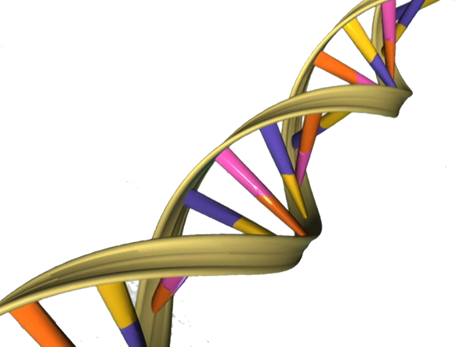
Genetics and Cancer
Cancer caused by >1 genetic change in DNA
    Germline (inherited): present in all cells from birth, passed thru generations
    Somatic (acquired): present in tumor cell due to aging, environment, hormonal, lifestyle
  Genes are individual units of hereditary information, located on a specific position on a chromosome
    Exons code for specific proteins
  10% cancers are caused by germline pathogenic mutations (more than 100 genes)
  Panel testing in 2014 via NGS

Slide 31
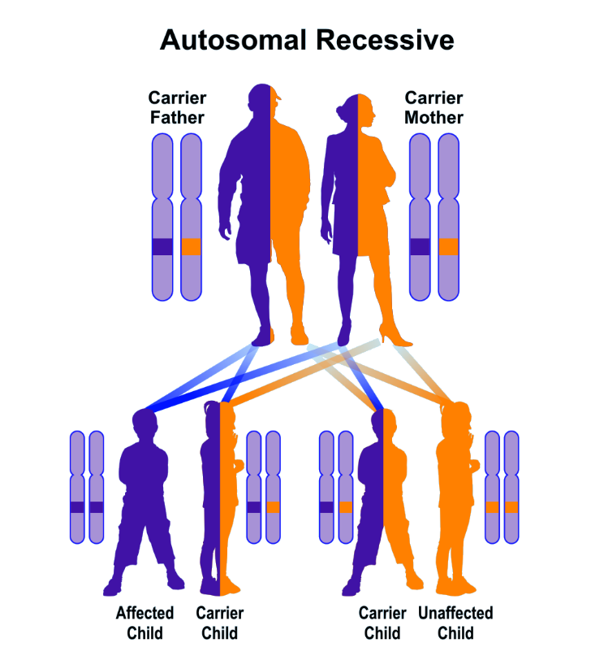
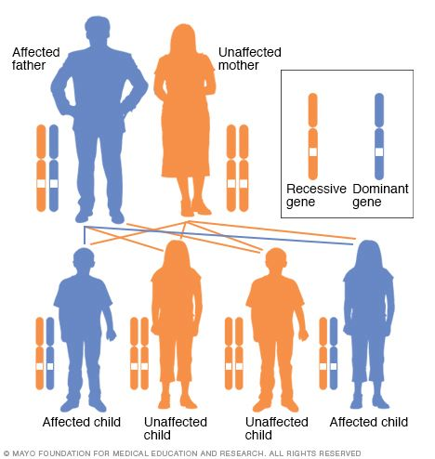
Patterns of Inheritance
Autosomal Dominant
Most genes related to hereditary cancer are inherited in an autosomal dominant way. Only one parent needs to carry the gene mutation to pass it on.
Ex, Tay-Sachs, Cystic Fibrosis, Sickle Cell Anemia Ex, BRCA1/2, Lynch syndrome

Slide 32

Red Flags of Possible Genetic Risk
Family or personal history of
A known deleterious gene mutation (BRCA1/2, Lynch Syndrome)
Early age of cancer onset (ex, breast or colon ca < 50)
Rare cancer histology (ex, adrenocortical cancer)
Cancer in two or more close relatives (either maternal or paternal lineage)
Bilateral cancer (bilateral kidney, breast, ovarian ca, etc)
Multiple primary cancers (colon, uterine and sebaceous adenoma)
Personal hx of high risk findings (adenomatous polyps, pheochromocytoma)
Family hx consistent w/known hereditary syndrome
Populations with certain cancer gene mutations (e.g., Ashkenazi Jewish)
(Lindor, et al, 2008)

Slide 33

Genetic Risk Assessment
Evaluation of family history and lifestyle factors
Goals
  identify cancer risk for patient and family members
  educate regarding personal increased risk behaviors
  set goals for medical management
  Pre and Post Genetic counseling (genetic counselors, NP/MD)
  Most genetic testing involves multigene panels of 40+ genes (100 genes identified)
  GINA (2008)- protects health insurance and employment

Slide 34
Outcomes
Positive – patient tests positive for a gene change (mutation) with increased cancer risk
True negative – patient tests negative for a gene mutation previously identified in the family
Negative/uninformative – patient tests negative for a gene mutation, but has family hx of cancer
Variant of uncertain significance (VUS) – a gene change is found but its clinical significance is unknown

Slide 35
Hereditary Cancer Syndromes
  HBOC – hereditary breast ovarian cancer syndrome - BRCA1/2 genes
  Cancer of the breast, ovary, fallopian tube, prostate, pancreas, melanoma
  Lynch Syndrome – formerly hereditary non polyposis colorectal cancer -MLH1, MSH2, MSH6, PMS2 and EPCAM genes
    Cancer of the colon, rectum, stomach, small intestine, pancreas, biliary tract, brain, uterine, ovary, renal pelvis, sebaceous adenomas
    Cowden Syndrome - PTEN gene
      Macrocephaly, breast cancer, thyroid cancer, endometrial cancer and others
    HDGC – Hereditary Diffuse Gastric Cancer - CDH1 gene
      Gastric cancer, lobular breast cancer
      Li Fraumeni Syndrome – TP53 gene
        Breast cancer, sarcoma, adrenocortical cancer, brain tumors, leukemia
        Peutz-Jeghers Syndrome – STK11 gene
          Breast, ovarian, uterine, colon, gastric and pancreatic cancers

Slide 36
Chemoprevention (risk reduction)
Tamoxifen/raloxifene/AI : breast
    Gail 5-year risk > 1.7%, greatest benefit > 3%
    Tyrer-Cuzick 10-year risk > 5%
OCPs : ovarian
Aspirin and NSAIDs : colorectal
Finasteride : prostate
Tyrer-Cuzick lifetime risk > 20% and extremely dense breasts (> age 50) = screening breast MRI

Slide 37
Hereditary Family Pedigree
BREAST, 33
OVARY, 40
MELANOMA, 90
What are some red flags in this family history?
B/L BREAST , 37, 41
BREAST, 35

Slide 38
Hereditary Family Pedigree
Breast, 82
STOMACH, 57
What concerns do you have about this family history?
What cancer syndromes are on your genetic differential?
UTERUS, 44
COLON, 53
COLON, 32
OVARY, 45
PANCREAS, 50

Slide 39
Sample question-Genetics
A key component of the client history to be obtained during the cancer–directed screening examination is:
  -A. number of siblings
  -B. marital status
  -C. place of birth
  -D. medical and cancer history of relatives

Slide 40
Sample Question - Genetics
A woman presents for risk assessment at the local breast care clinic. Which of these facts from her medical history do not suggest a risk for breast cancer?
  -A. First pregnancy at age 34
  -B. Prior breast biopsy revealing atypical hyperplasia
  -C. Breastfeeding for 12 months
  -D. Mother and sister with breast cancer

Slide 41
Sample Question - Genetics
You are taking a patient’s health history and uncover some facts about her family. Which of these facts do you consider a red flag for the need for genetic assessment (can be more than one correct answer)?
-A. Maternal grandmother diagnosed with breast cancer at 67
-B. Paternal aunt with colon cancer at 38
-C. Personal history of fifteen colon polyps, some hyperplastic
-D. Sister with fibrocystic breast disease
-E. Paternal grandmother with endometrial cancer in her 40’s

Slide 42
Sample Question - Genetics
A 42 yo patient has a strong family history of breast cancer and all of her affected relatives are deceased. She decides to undergo genetic testing for 40+ cancer susceptibility genes herself and no mutation is detected. Which of these statements correctly interprets this finding?
-A. This patient is not at high risk for breast cancer since she had a negative genetic test.
-B. This patient remains at high risk for breast cancer based on family history.
-C. This patient should have another genetic test in case the lab’s findings are inaccurate.
-D. This patient does not need to start mammograms until age 50.

Slide 43
Questions ??

