Slide 1
The Seat of Pain:
Addressing Pain in the Pelvis
Erin Donohue, DPT

Slide 2
Continuing Medical Education (CME)
Disclaimer
Planning Committee members have no financial relationships to disclose
Presenter has no financial relationships to disclose

Slide 3
Learning Objectives
List common diagnoses associated with pelvic pain.
Describe interdisciplinary treatment of pelvic pain.
Identify when a referral to pelvic physical therapy is appropriate.

Slide 4
What is Pelvic Pain?
Pain perceived as coming from the pelvis, anterior abdominal wall, at or below umbilicus, low back (lumbar and/or sacral regions), or buttocks
Based on patient history, symptoms, and exclusion of other causes
Chronic- persists or recurs over at least 3 months
Notes:
Classified as primary pain syndrome when there’s no underlying pathological process
Some sources don’t classify as chronic until 6 months
Severity enough to cause functional disability and medical care

Slide 5
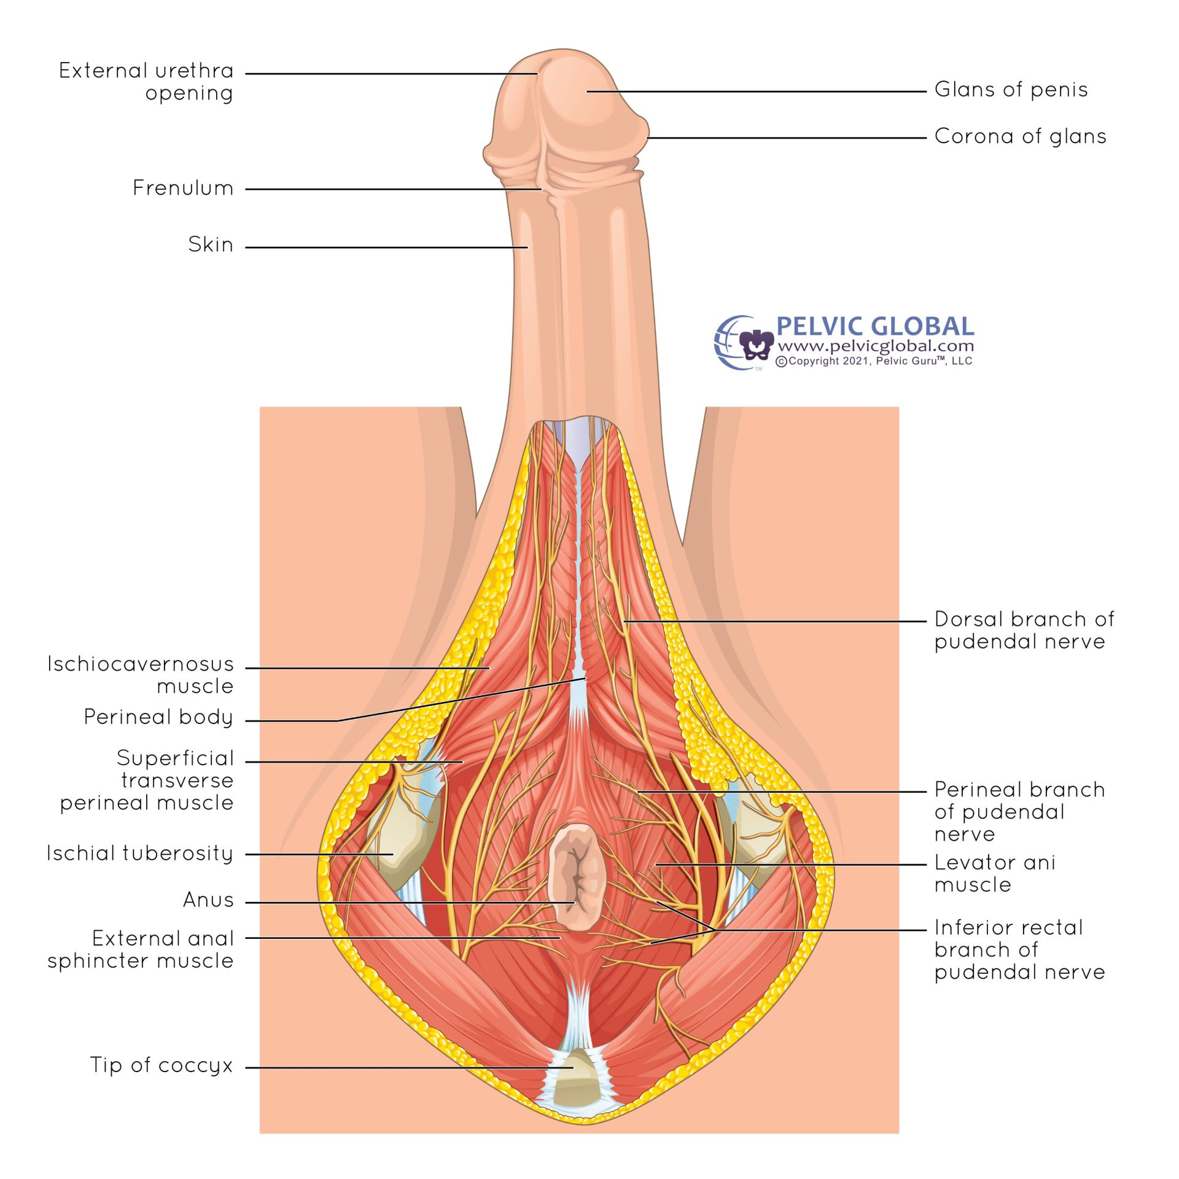
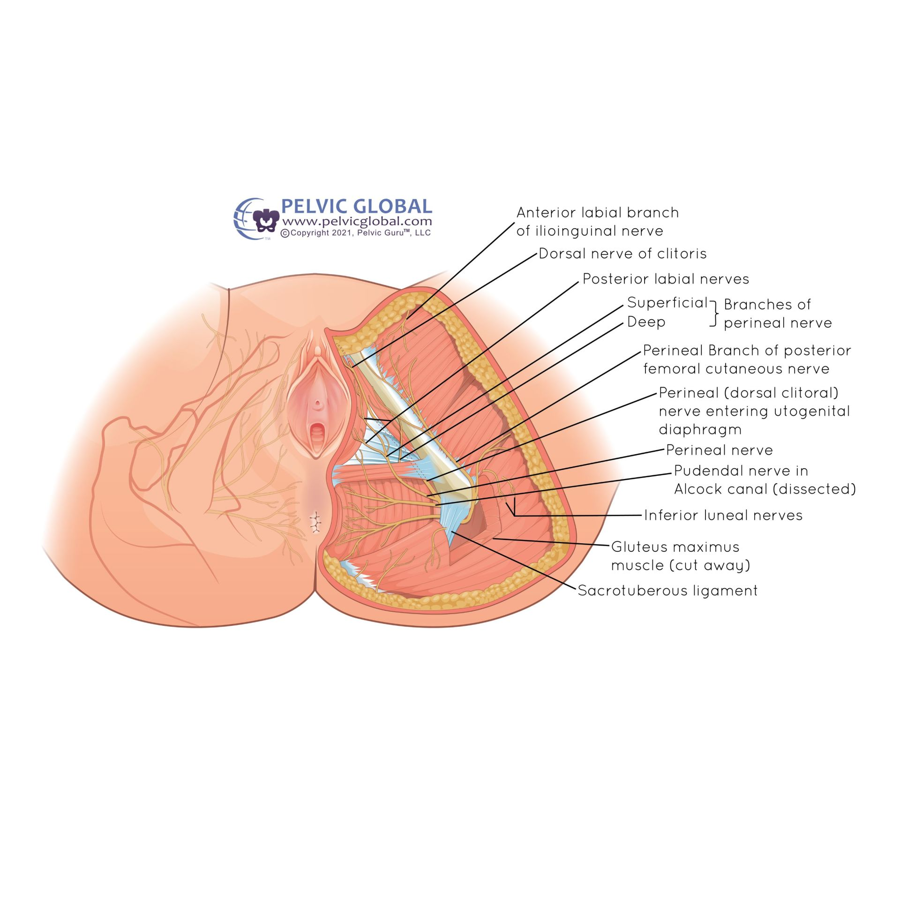
Pelvic Floor Anatomy
Pudendal Nerve Male
Pudendal Nerve Female
Images used with permission from Pelvic Guru®, LLC as a member of the Global Pelvic Health Alliance Membership (GPHAM)

Slide 6
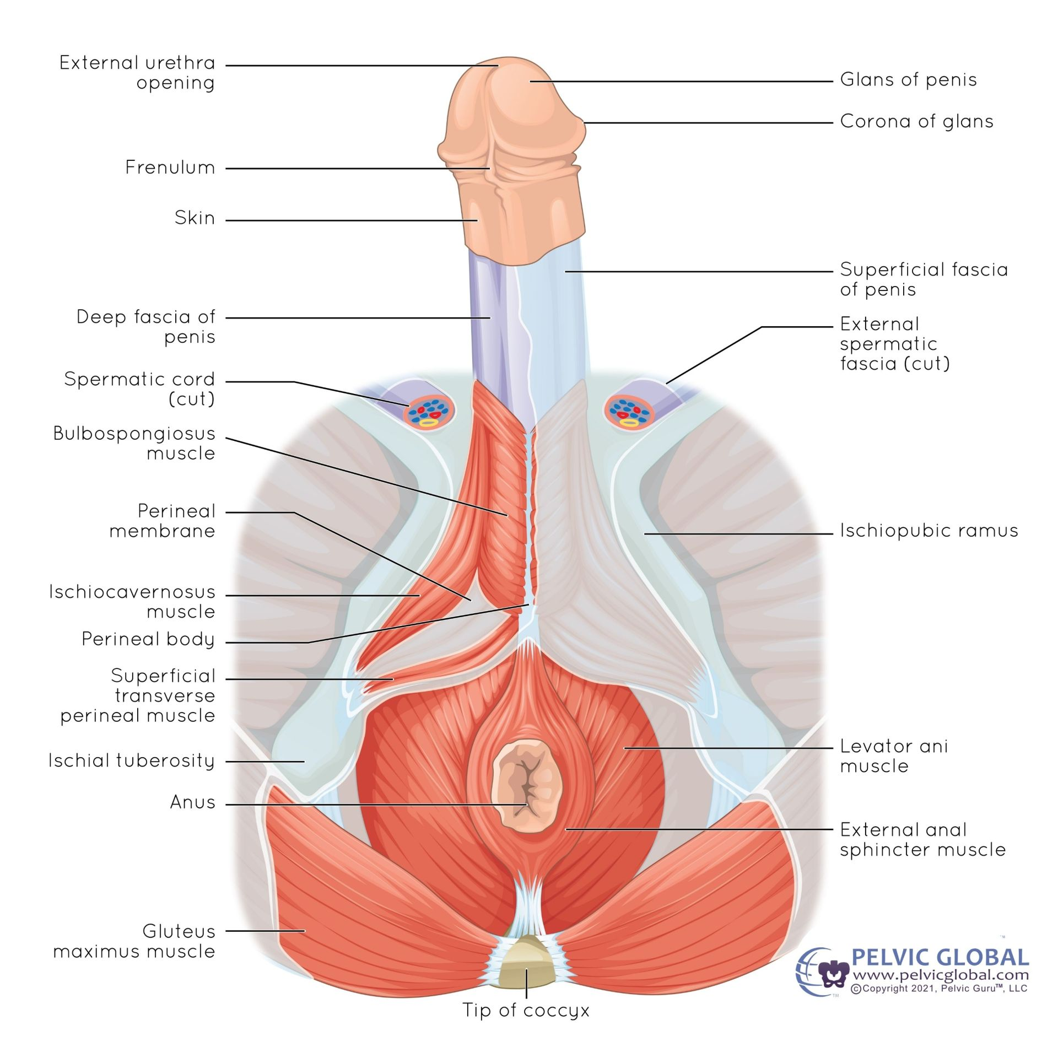
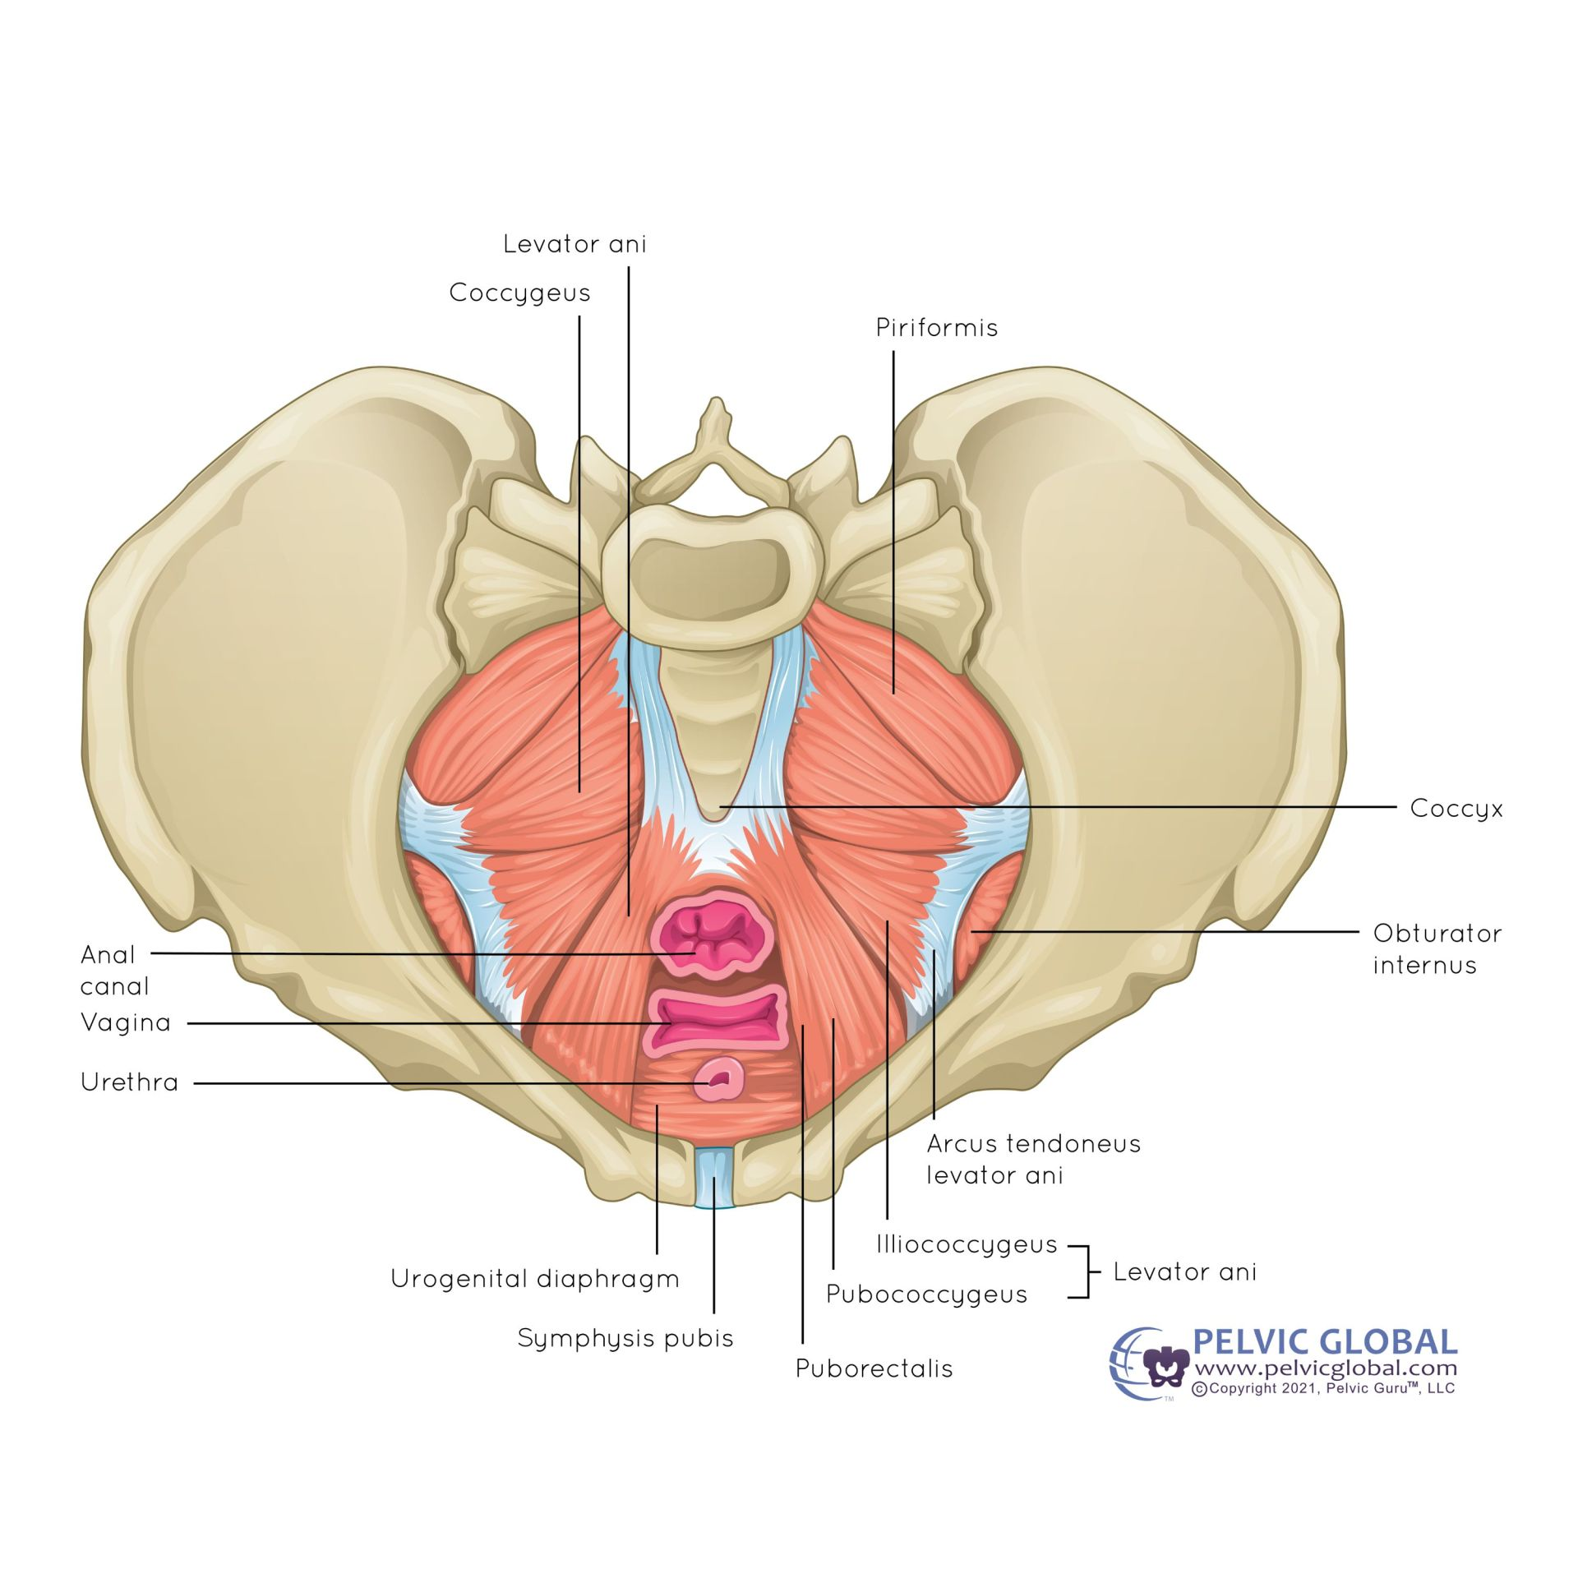
Pelvic Floor Anatomy
Musculoskeletal Male
Musculoskeletal Female
Images used with permission from Pelvic Guru®, LLC as a member of the Global Pelvic Health Alliance Membership (GPHAM)

Slide 7
Common Causes of Pelvic Pain
Adenomyosis
Anorectal pain
Appendicitis
Coccydynia
Colon cancer
Constipation
Crohn’s disease
Dyspareunia
Endometriosis
Inguinal hernia
Interstitial cystitis
Irritable bowel syndrome
Myofascial pelvic pain
Nerve pain
Ovarian cancer
Pelvic inflammatory disease
Polycystic ovarian syndrome
Prostatitis
Ulcerative colitis
Urinary tract infection
Uterine fibroids
Vaginismus
Vulvodynia
Notes:
Not an exhaustive list

Slide 8
Risk Factors/Co-occurring Conditions
IBS
Depression, anxiety, and panic disorder
Pain catastrophizing
Previous history of sexual, physical, or emotional abuse
Abdominopelvic pain, dysmenorrhea, dyschezia, and dyspareunia
Pelvic floor dysfunction
Peripheral inflammation
Peripheral and central sensitization
Impaired quality of life
Fibromyalgia
Chronic fatigue syndrome
Chronic headache
Vulvodynia
Dysfunctional inhibitory pain control
Notes:
IBS seen in 22-31% of patients with CBP, may also have recurring UTIs
Men with CPPPS had mental illness at 2.5x greater than controls, especially anxiety/panic disorders
Men with abuse history 1.7-3.3x greater likelihood of having CPPPS
Men with CPPS have higher incidence of cardiovascular disease, neurologic disease, and sinusitis
Almost ½ of women seeking care for pelvic pain have history of trauma, 1/3 had + screen for PTSD
Abdominopelvic pain, dysmenorrhea, dyschezia, and dyspareunia increased risk in women with endometriosis
May be associated with hypertonic pelvic floor muscles, vulvar trigger points, and shortening of LA

Slide 9
Patient Perspectives
Managing pelvic pain “is like trying to hold a beach ball underwater. You can do it, but you literally can’t do anything else.”
“Pelvic pain controls your life. It is a pain that you just can’t explain properly to others because of the control it has over your every thought and action.”
“It’s impossible to explain. No one gets it.”
“It’s a life-changing thing that’s unfortunately invisible to everyone else.”

Slide 10
Patient Perspectives
“I had to consider realistically if I would be able to continue to maintain a full-time job. I am the sole provider of my livelihood, so I pushed through it to maintain my independence.”
“…it has been very hard to keep up with when dealing with chronic pain that has caused low motivation and stamina and is physically and mentally draining. I just try to get through my days, but if I have more work to do to fight for my own health, it becomes very depleting.”

Slide 11
Chronic Primary Pelvic Pain Syndrome in Men (CPPPSm)
Subtypes: urologic, gastrointestinal, musculoskeletal
Associated with urogenital pain, urinary symptoms, sexual dysfunction, and emotional disturbance
Pelvic pain during 3 of the last 6 months without any identified pathogen or pathology
Notes:
Diagnosis of exclusion
Usually assumed to be prostatitis until it lasts for greater than 3 months
2-10% of men have symptoms of prostatitis, only 5-10% of symptoms explained by bacterial infection
May have started as infection, inflammation and pain still present after infection is gone
Also may have started from history of trauma, autoimmune reaction, or dysfunctional voiding
Prostate inflammation seen in 33% of pts, also have increased nerve growth factor and mast cell tryptase in expressed prostatic secretions, indicating inflammation and possible increase in pain

Slide 12
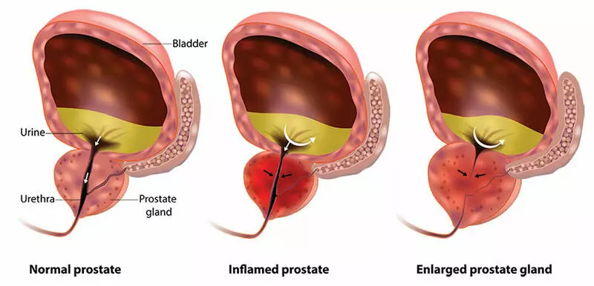
Prostatitis
Affects 35-50% of men during their lifetime
Symptom prevalence in 8.2% of men
4 types:
  I: acute bacterial prostatitis
  II: chronic bacterial prostatitis
  III: chronic prostatitis/chronic pelvic pain syndrome
  IV: asymptomatic inflammatory prostatitis
https://www.froedtert.com/mens-reproductive-sexual-health/enlarged-prostate-bph
Notes:
One source puts prevalence at 10%
I: active infection
II: chronic or recurrent infection, may have UTI
III: no infection, inflammatory subtype has WBC in semen, expressed prostatic secretions, or voided bladder urine after prostatic massage, >90% of cases
IV: inflammation incidentally found in prostate biopsy or WBC in semen or prostatic secretions

Slide 13
Prostatitis
4 domains of symptoms:
Pain: perineum (63%), testicular, suprapubic, penile, lower back, abdominal, inguinal, rectal
Urinary: in 39-68% of patients, problems with voiding and/or storage, urethral burning, hematospermia
Sexual dysfunction: ED (15-55%), ejaculatory dysfunction, decreased libido
Psychosocial: stress, anxiety, depression, decreased quality of life
Notes:
Pain with urination and/or ejaculation, muscle tenderness or dysfunction, nerve pain, possible bowel symptoms
Voiding: weak stream, straining, hesitancy
Storage: urgency, leakage, frequency, nocturia, pain
Sexual dysfunction is self-reported in 46-92% of patients
Ejaculation problems: premature, delayed, pain with or afterward
Activity limitations decrease QoL, as poor as that with congestive heart failure or Crohn’s disease
Has similarities with IC that will be discussed later

Slide 14

Prostatitis/CPPPSm
Treatment guided by UPOINT
U: urinary symptoms
P: psychosocial dysfunction
O: organ-specific findings
I: infection
N: neurological/systemic routes
T: tenderness of muscles
Notes:
Sometimes add S: sexual dysfunction such as problems with ejaculation or erection, pain with or after orgasm
Also guides treatment for CPPPSm
Organ-specific was most common (70% of patients)

Slide 15
Prostatitis/CPPPSm
U: urinary symptoms
Uroflowmetry, bladder diary, cystoscopy, US
α-adrenergic antagonists: improved pain, urinary symptoms, and QoL scores
If ineffective at 4-6 weeks, stop treatment and consider different therapy
May benefit from referral to specialist
Notes:
Best for voiding difficulties such as slow stream and hesitancy
Alpha blockers thought to relax smooth muscle in prostate and bladder neck, helps with urinary symptoms
Multimodal therapy of alpha blockers with antibiotics did not provide any statistically significant improvement over monotherapy

Slide 16
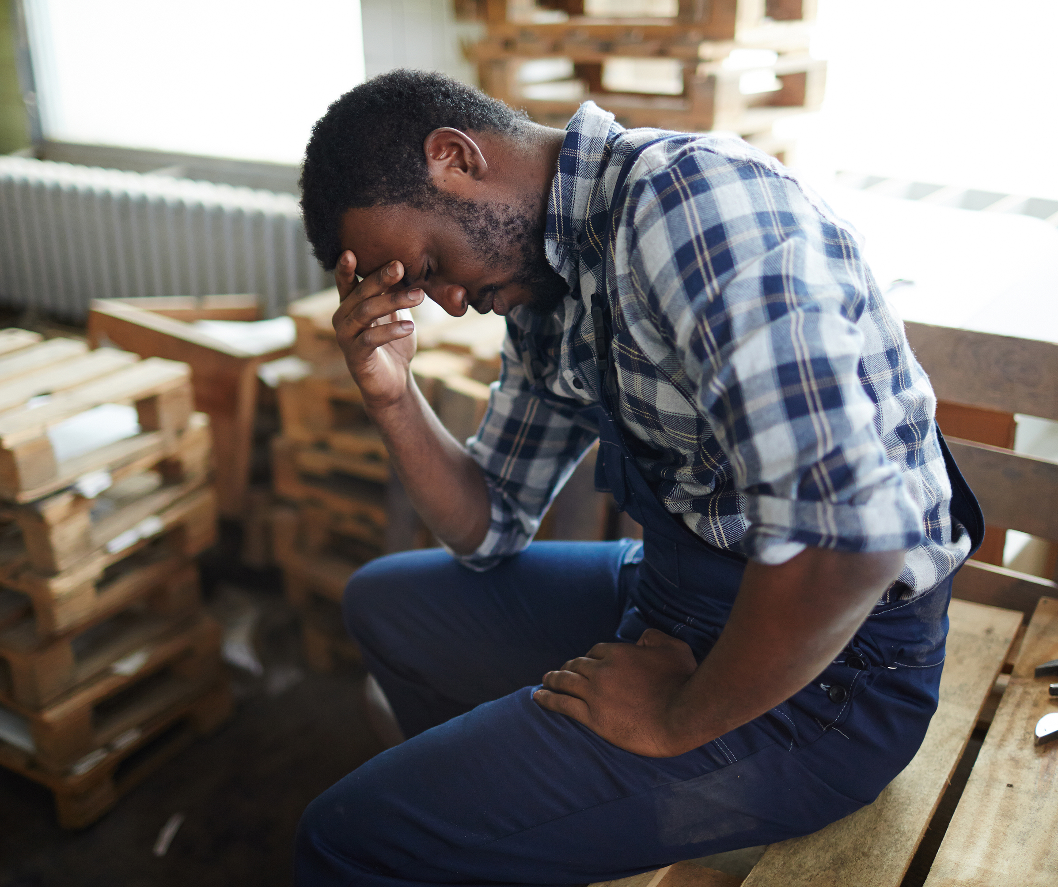
Prostatitis/CPPPSm
P: psychosocial dysfunction
Questionnaires addressing anxiety, depression, quality of life
Stress management
Pain education
Cognitive behavioral therapy
Psychiatry
Notes:
Cureable app
May prescribe tricyclic antidepressants, will be discussed later

Slide 17
Prostatitis/CPPPSm
O: organ-specific findings
Important to rule out other possible generators of pelvic pain
May need additional testing: DRE, PSA, STI screen, uroflow, cystoscopy, ultrasound, culture, MRI, biopsy
Notes:
R/O: prostate, bladder, or rectal cancer, prostate abscess, urinary tract disease, stricture, stone or foreign body, pudendal neuralgia, neuro diseases, epididymo-orchitis

Slide 18
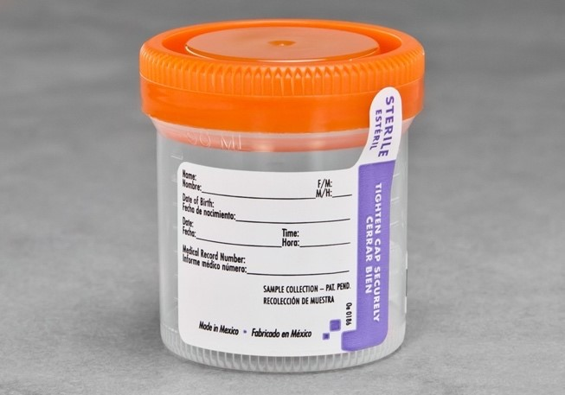
Prostatitis/CPPPSm
I: infection
Culture urine and expressed prostatic secretions
Quinolones considered antibiotics of choice
May have decreased pain even without infection due to anti-inflammatory or anti-neuropathic properties
This Photo by Unknown Author is licensed under CC BY-NC
Notes:
Should be an initial treatment option due to improvement in urinary, pain, and QoL scores (77.5% of patients at 18 month follow up)
Only repeat for another 4-6 weeks IF there is a confirmed bacterial cause or there is partial response to first course
Otherwise consider different treatment or referral to another specialist

Slide 19
Prostatitis/CPPPSm
N: neurological/systemic routes
Neuro screen (dermatomes, myotomes, reflexes)
Sacral nerve stimulation helped reduce pelvic pain
Percutaneous posterior tibial nerve stimulation improved pain and QoL in non-inflammatory chronic prostatitis
Can treat with gabapentinoid, tricyclic antidepressant, SNRI, or quercetin
Notes:
Gabapentin, pregabalin; amitriptyline, nortriptyline, trimipramine; duloxetine
Quercetin- improvement of 35-59%, particularly in pain and QoL scores, does not significantly help urinary scores

Slide 20
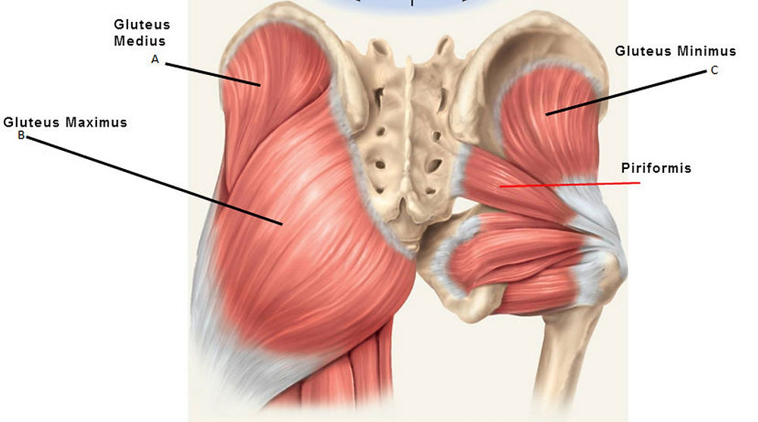
Prostatitis/CPPPSm
T: tenderness of muscles
Palpation of pelvic floor, abdominals, gluteals
Pelvic floor PT
  Biofeedback
  Neuromuscular re-education
  Myofascial trigger point release
  Paradoxical relaxation training
  TENS
  Perineal extracorporeal shock wave therapy (ESWT)
Acupuncture
Phytotherapy: rye pollen extract, quercetin
Injections of Botulinum toxin A (BTA)
https://www.precisionpt.org/post/what-are-the-best-glute-exercises
Notes:
Helpful when pain is from muscle dysfunction, spasm, or tenderness
Pelvic floor PT helped with symptoms and sexual dysfunction
Also stretches, exercise, and bladder retraining
ESWT helps with pain and sexual dysfunction in the short term (up to 12 weeks), did not show long term improvement
Traditional Chinese medicine helps for about 2 months with exception of sexual dysfunction, helps with anxiety/depression, minimal side effects
Phytotherapy helps with pain and QoL but does not have an impact on urinary symptoms
NSAIDS only for short-term or inflammatory flares
Botox helps with CPPPSm but may have hematuria afterward
Insufficient evidence for recommending surgery to treat

Slide 21
Exam for Males
Pain education
Symptoms questionnaire
Physical exam: abdomen, genitalia, perineum
DRE: prostate, muscle tenderness, contract/relax of pelvic floor
Urinalysis
Neurological and musculoskeletal screens
Notes:
We use Natl Institutes of Health Chronic Prostatitis Symptom Index (NIH-CPSI) for questions about pain, LUTS, and QoL
Lifestyle education may include avoiding alcohol and carbonated beverages, spicy foods, cycling, and sitting on cold seats

Slide 22
Chronic Pelvic Pain in Women
Persistent, noncyclic pain perceived as originating in pelvis-related structures, lasting greater than 6 months
Worldwide prevalence of 6-27%
Associated with IBS, IC/PBS, endo, pelvic adhesions

Slide 23

Chronic Pelvic Pain in Women
Red flags
  Postcoital bleeding
  Postmenopausal bleeding or onset of pain
  Unexplained weight loss
  Pelvic mass
  Hematuria

Slide 24
Chronic Pelvic Pain in Women
Assessment
  Pain changes with cycle, intercourse, urination, defecation
  Aggravating and easing factors
  Observation and palpation
    Abdomen
    Pelvis
    External genitalia
  LQS: low back, SI joints, pubic symphysis, hips
  As indicated: lab testing, imaging, urologic eval, laparoscopy
Notes:
Looking for TrP, scars, discharge, POP, masses, infection, tightness
Cotton swab test for external genitalia

Slide 25
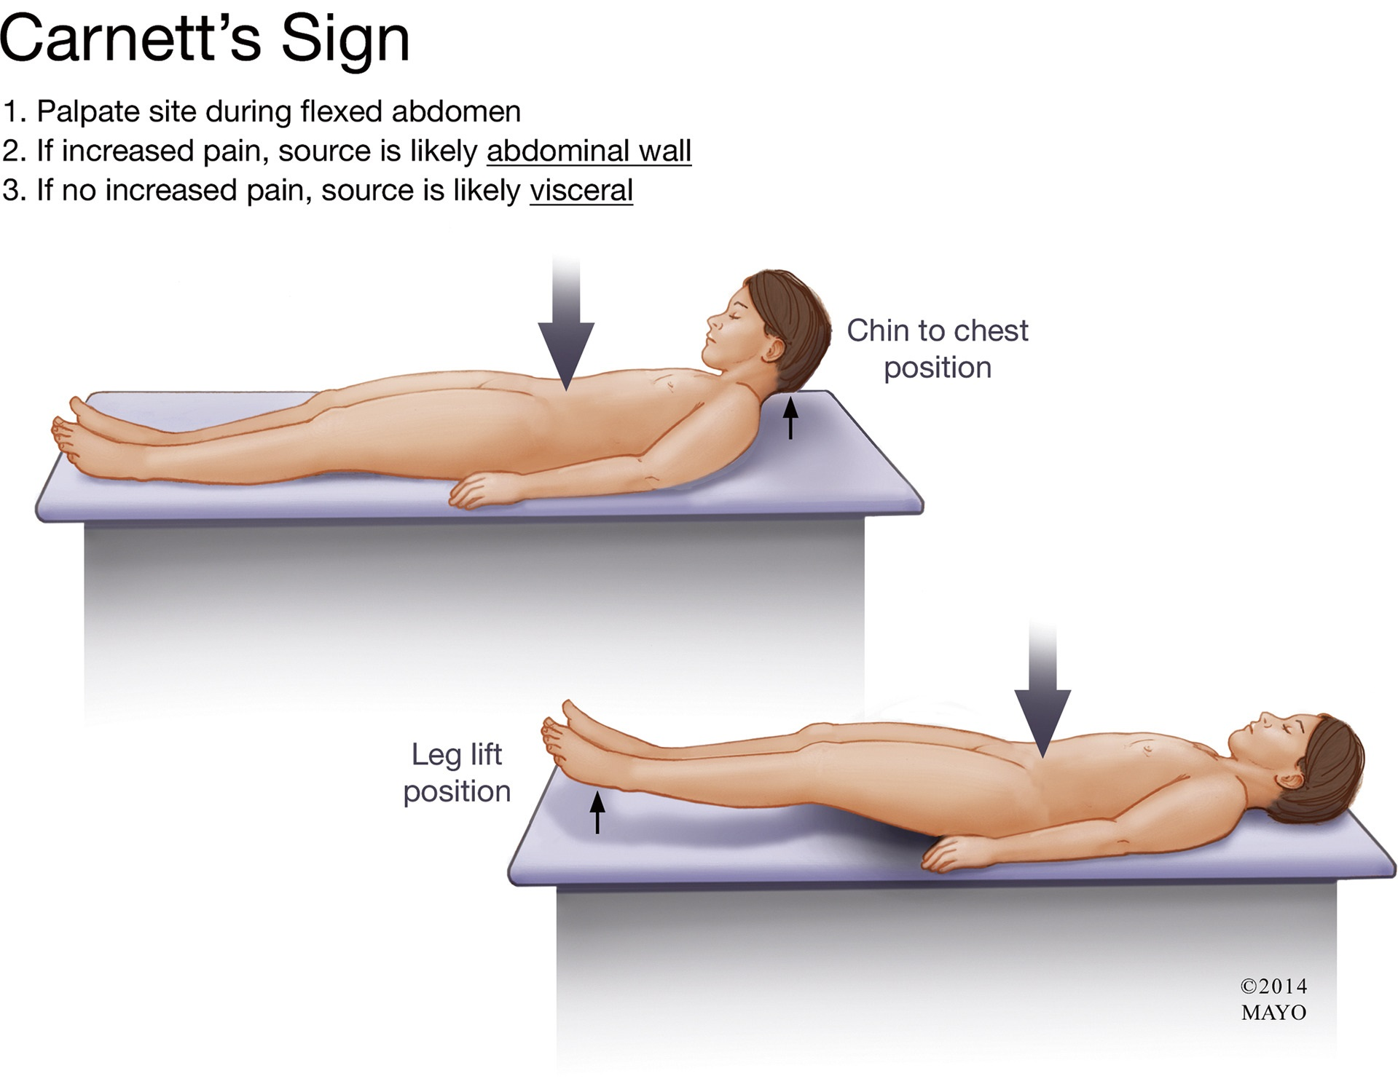
Chronic Pelvic Pain in Women
Carnett test
Pt is supine, raises both legs off table
Examiner palpates painful abdominal site during leg raise
Increased pain: likely myofascial, TrP, nerve, hernia
Less pain: likely visceral source of pain
Kamboj, Hoversten, Oxentenko, 2019.

Slide 26
Chronic Pelvic Pain in Women
Treatment
  Treat any underlying disease process, if found
  Medicine as needed for symptoms relief
  Hysterectomy
  Local injection of steroids as diagnostic tool and treatment
  Pelvic floor PT
  Biofeedback
  Cognitive behavioral therapy
Notes:
NSAIDs not effective with endometriosis
OCs helpful for dysmenorrhea but may not help with nonmenstrual pelvic pain
Moderate evidence for progestogen treatment for CPP
Neuropathic pain- tricyclic antidepressants, SNRI, gabapentin
Opioids as last resort
Hysterectomy offers improvements in about 50% of women, but 40% have persistent pain (3-5x more likely in women with depression) and at least 5% have worse pain
PT helps with tenderness
Biofeedback better at pain relief than estim or massage
CBT improves distress, pain experience, and motor function

Slide 27
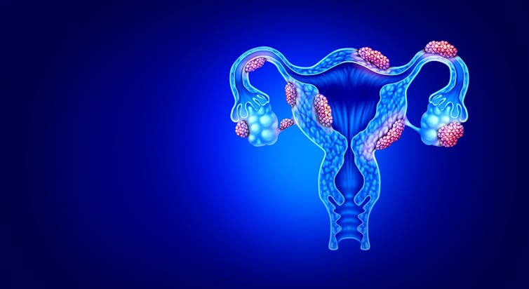
Endometriosis
Ovarian endometrioma
Superficial peritoneal endometriosis
Deep infiltrating endometriosis
  Includes rectovaginal lesions
  Can involve bowel, ureters, and bladder
  >95% of cases have very severe pain
This Photo by Unknown Author is licensed under CC BY-NC-ND
Notes:
Associated pain may be dysmenorrhea, dyspareunia, nonmenstrual pelvic pain, sometimes dyschezia and dysuria
Here we’ll focus on DIE

Slide 28
Endometriosis
Found in 70-90% of female patients with pelvic pain
Hard to diagnose and assess treatment outcomes
Involves reproductive, endocrine, vascular, musculoskeletal, and neuronal systems
Proposed means of pain production:
  Substances like growth factors and cytokines stimulated by cells involved with endo
  Effects of bleeding from endo
  Infiltration or irritation of pelvic nerves from endo tissue
  Central sensitization following communication among peripheral nerves, peritoneal surroundings, and CNS
Notes:
Different instruments to measure pain
Unclear how endometriosis causes pain
Chronic pain may involve other systems outside the reproductive system including central sensitization of the nervous system and myofascial dysfunction
Lesion sites do not always match pain sites
Other concurrent conditions may also cause pain that is attributed to endometriosis
Diagnosis not always reliable with pelvic exam, US, MRI or use of leuprolide acetate to induce a low estrogen state
May take a while to diagnose due to ruling out other diagnoses prior to starting more aggressive treatments for endo
Typically diagnosed via laparoscopy, recommended to treat at time of diagnostic surgery
If ovarian cyst, recommended to excise the cyst
Higher nerve fiber density in deeper endo (especially rectal nodules) than in ovarian or peritoneal lesions, correlates with increased severity of pelvic and period pain
May still have pain even after lesions are removed due to central sensitization and myofascial dysfunction

Slide 29
Endometriosis
Complicated Role of Hormones
  Estrogen: theorized to decrease perception of pain
  Progesterone: higher levels decrease neuron activity for pain
  Ratios of estrogen and progesterone receptors change
  What happens at menopause or low estrogen states?
Notes:
Low estrogen associated with higher levels of pain
High estrogen can grow endo lesions and increase pain
Some improvement in pain because estrogen doesn’t feed the tissue
May still persist due to aromatase activity that can accumulate areas of estradiol

Slide 30
Endometriosis
Surgical excision of lesions
Hysterectomy with bilateral salpingo-oophorectomy
  Last resort
  For women with debilitating symptoms, done with childbearing, failed other therapies
  Causes surgical menopause
  Recommended estrogen and progestogen therapy rather than estrogen alone to help with symptoms
Notes:
Consider when pain doesn’t respond to medical treatment, bowel stenosis or ureteral stricture is present, or when hormonal therapy is contraindicated or refused
Lesion excision improved pain, quality of life, and sexual function, digestive symptoms may persist
Estrogen only may grow endometriosis tissue and increase pain

Slide 31
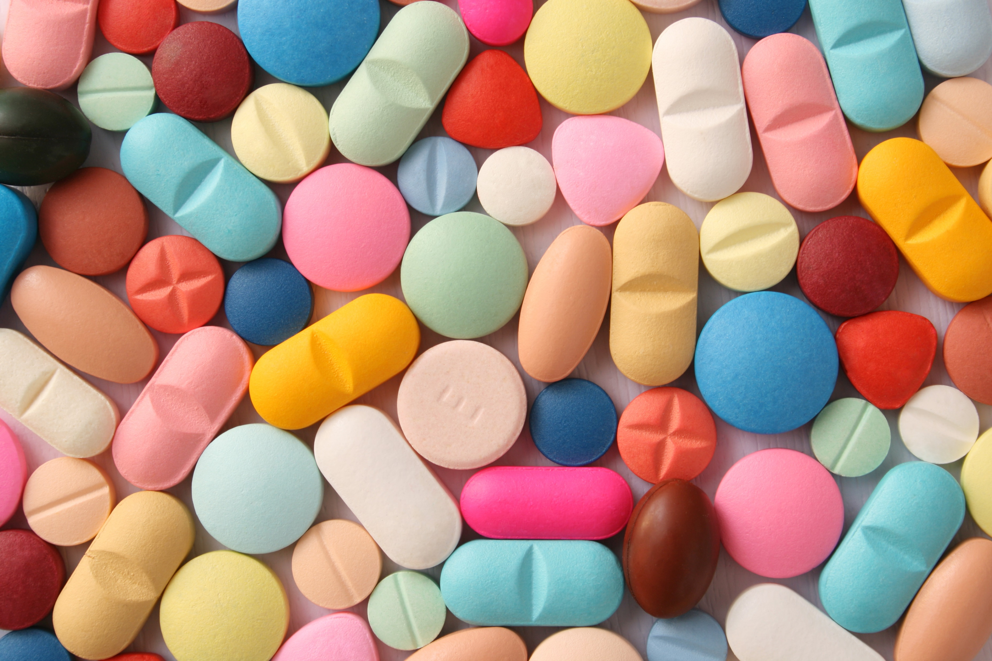
Endometriosis
Medical therapies- usually result in amennorhea
NSAIDs
Combined hormonal contraceptives
Progestogens
Danazol
Gonadotropin-releasing hormone agonists
Notes:
Med therapies- few good RCTs, placebo effect up to 40-45% when outcome is pain, no studies have compared meds vs surgery, consider cost and side effects
NSAIDs- good for dysmennorhea, has not been shown to significantly decrease endo pain
CHC- combined Ocs in both continuous and cyclic low doses improved some pain with endo, helpful for bowel and bladder endo with reducing symptoms and nodule size, recommended as first-line treatment of endo pain, continuous encouraged for those with significant menstrual symptoms
Prog- decreased pain significantly, reduced volume of endometriotic nodules, can improve GI symptoms during menses, some also help with less hot flashes and bone mineral density loss, recommended as first-line treatment of endo pain
CHC with prog reduced densities of sensory nerve fibers in DIE as well as sympathetic and parasympathetic nerve fibers which contribute to centralization of pain
Dan- helped with pain and volume of nodules but had side effects associated with increased T (hirsutism, acne, weight gain, deeper voice)
GnRH-a- helpful for pain relief, nodule volume, and GI symptoms but has low E side effects like hot flashes, vaginal dryness, decreased libido, mood swings, headache, and bone mineral depletion, 53% of recurrence 2 yrs after treatment, “add-back” therapy of E or E and progestogen at a level lower than would stimulate endo symptoms to decrease side effects especially if treatment is greater than 6 months
Hormonal therapy is not a cure, symptoms usually return on cessation of treatment
**If someone asks the question: off label use of aromatase inhibitors, usually used in combo with one of the above drugs, helped dysmenorrhea, physical and social functioning but did not improve pelvic pain or dyspareunia, pain returned after treatment was stopped, for refractory cases or scientific research only

Slide 32
Endometriosis
Other treatments
  Pelvic floor PT
  Mental health referral
  Pain management
  Acupuncture
Notes:
Helpful to deal with stress and depression common with chronic pain
Pain management may include sacral neuromodulation or botox injections
Acupuncture had better pain relief than sham, Chinese herbal medicine had similar relief to some of the drugs with less side effects
Best results with combined treatments
Requires lifelong management

Slide 33
Vaginismus
Combined with dyspareunia in DSM 5 as a genito-pelvic pain/penetration disorder
Cannot tolerate penetration, even if desire is present
Separate from vulvodynia and vestibulodynia
Mentally has fear and anxiety to penetration, physically has vaginal spasm
Notes:
Qtip test to r/o vulvodynia and vestibulodynia
Spasm is at level of introitus
Primary- never experienced non-painful intercourse
Secondary- previously had non-painful intercourse but now has pain
Prevalence is 5-17%

Slide 34

Vaginismus
Symptoms:
  Fear, anxiety, pain of vaginal penetration
  Inability to tolerate tampons
  Inability to remove a stuck tampon
  Severe pain with penetration
  Trying intercourse is like “hitting a wall”
  Inability to tolerate gynecologic exam
  May have high muscle tone
Notes:
Possible to also have behavioral avoidance

Slide 35
Vaginismus
Associated factors
  Traumatic sexual experiences
  Sexual or physical abuse
  Strict religious and/or strict sexual upbringing
  Fear and/or anxiety issues
  Sexual disorder in the male partner
  Being physically restrained during catheterization or enemas at a young age
  Higher levels of stress
  Perceived lower levels of control
  Pain catastrophizing
  Poor self-image
  High need for approval
Notes:
Commonly note they feel shame and embarrassment, may also have disgust toward sexual stimuli
Can lead to marital problems, depression, feelings of isolation
Not tolerated in cultures with arranged marriages due to inability to consummate marriage
Very conservative upbringings placed high value on female virginity, may use fear messaging to discourage sex (pain, loss of social status, shame on family, ruined lives), do not educate regarding sex and the body
Literature is focused on heterosexual relationships and norms
76% of pts in one study felt that it was her fault, important because treatment was longer than if vaginismus was acknowledged as a “common problem”

Slide 36
Vaginismus
Grading
  Lamont grade 1: patient is able to relax for pelvic exam
  Lamont grade 2: patient is unable to relax for pelvic exam
  Lamont grade 3: buttocks lift off table. Early retreat. Toes curl upward
  Lamont grade 4: generalized retreat– buttocks lift up, thighs close, patient retreats
  Pacik grade 5: generalized retreat as in Lamont level 4 plus visceral reaction which may result in any one or more of the following: palpitations, hyperventilation, sweating, severe trembling, uncontrollable shaking, screaming, hysteria, wanting to jump off the table, a feeling of going unconscious, nausea, vomiting, and even a desire to attack the doctor
Notes:
Difficult to accurately assess women in grades 3-5

Slide 37
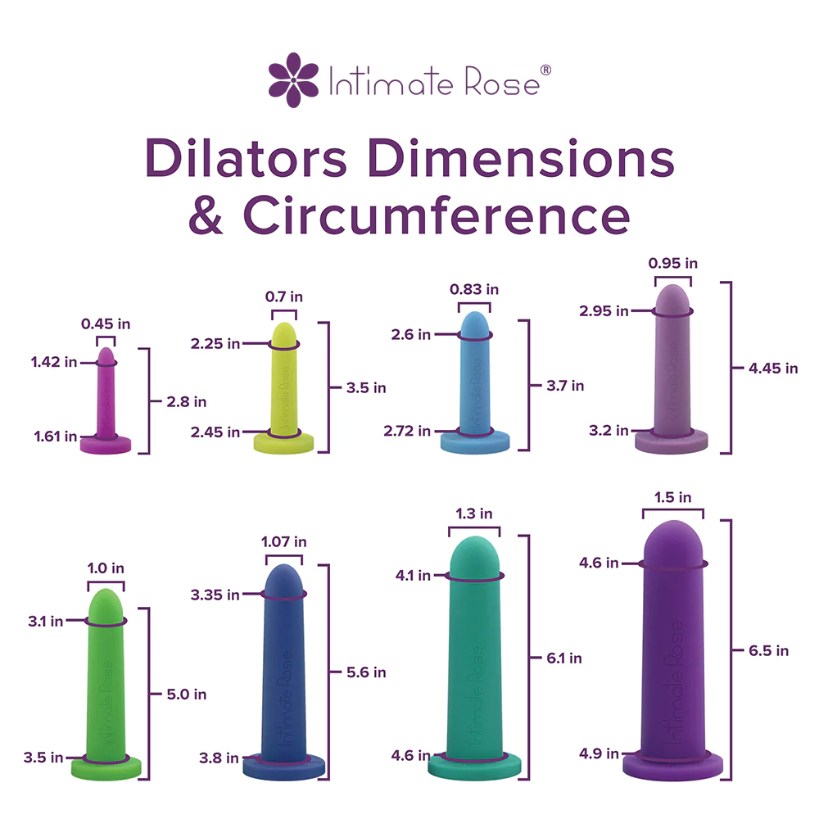
Vaginismus
Treatment
  Vaginal dilators
  Physical therapy
  Biofeedback
  Sex and relationship counseling
  Psychotherapy
  Cognitive behavioral therapy
  Therapist-aided exposure
  Hypnotherapy
  Lubricants
  Botox
  Topical anesthetics
  Medications
https://www.intimaterose.com/products/silicone-vaginal-dilator-set-8-pack
Notes:
Botox injections into submucosal layer and not muscle, may also combine injections with bupivacaine, botox effective for 2-4 months with goal of greater comfort when working with dilator
Anti-anxiety meds, muscle relaxants, anti-depressants, sedatives
May be a combination of approaches

Slide 38
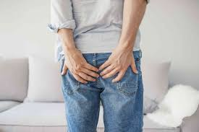
Functional Anorectal Pain
Proctalgia fugax
Levator ani syndrome
Unspecified anorectal pain
https://www.health.com/rectal-pain-7557339
Notes:
Differential DX: anal fissures, hemorrhoids, chronic proctosigmoiditis, abscess, fistula, rectal prolapse
Testing for differential dx as indicated

Slide 39
Proctalgia fugax
Prevalence 8.3% women, 7.5% men
Brief pain, lasting seconds to minutes
Occurs 1x/month or less
Pain is cramping, gnawing, aching, stabbing
Worse with stress, anxiety
Increased smooth muscle contraction of colon and IAS
Notes:
May have constipation
May be hereditary
Treatment is focused on “reassurance and explanation”

Slide 40
Levator Ani Syndrome
Levator ani muscles tender to palpation
More common in women (7.4% to 5.7%)
Average age 30-60 years
Pain is vague, dull, pressure
Lasts greater than 30 minutes
Brought on by prolonged sitting, stress, intercourse, defecation, childbirth, surgery
Responds well to biofeedback
Notes:
May have mm spasm or dyssynergia, need bowel retraining
87% had relief after biofeedback, 45% after estim, 22% after massage, maintained improvements for 12 months
Botox was no different than placebo in this population
Other conservative treatment: sitz bath, massage, muscle relaxers
Surgery not effective to reduce pain and may lead to fecal incontinence

Slide 41
Interstitial Cystitis/
Painful Bladder Syndrome
“an unpleasant sensation (pain, pressure, discomfort) perceived to be related to the urinary bladder, associated with lower urinary tract symptoms (e.g. urinary frequency), and lasting more than 6 weeks in the absence of infection or other identifiable causes” (Society for Urodynamics and Female Urology, 2009)
Notes:
IC may have Hunner ulcers, hemorrhages or glomerulation, increased number of mast cells in detrusor

Slide 42
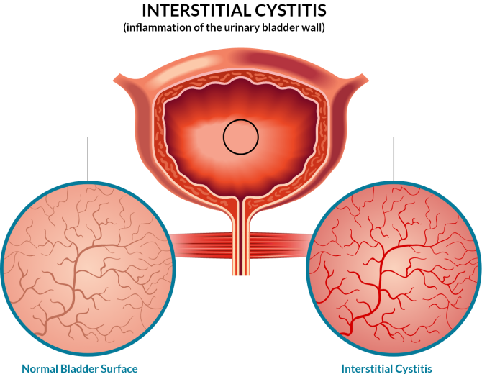
Interstitial Cystitis/
Painful Bladder Syndrome
Thought to be underdiagnosed
Prevalence
  2.7-6.53% of women
  2.9-4.2% of men
For women, annual cost of lost wages average $4216
For women, more pain, sleep dysfunction, catastrophizing, depression, anxiety, difficulty with social functions, and sexual dysfunction
https://libertyptnj.com/interstitial-cystitis/
Notes:
Effect on QoL is severe as that in RA and end stage renal disease
Sexual dysfunction is primary predictor of poor QoL in women in this population

Slide 43

Interstitial Cystitis/
Painful Bladder Syndrome
May have had several bladder infections in childhood
Urinary urgency in adolescence
Pain may be triggered by stress and acidic foods/drinks

Slide 44
Interstitial Cystitis/
Painful Bladder Syndrome
Common symptoms
  Dysuria
  Frequency
  Pain
  Pressure
  Frequency/urgency to relieve pain
  Flares last several hours to weeks
  Tenderness over pelvic floor, bladder, urethra, external genitalia, abdomen
  May be unable to maintain pelvic floor relaxation
Notes:
Low volume, frequent voiding pattern

Slide 45
Interstitial Cystitis/
Painful Bladder Syndrome
Assessment: pain scale, bladder diary, cystoscopy, urodynamics
Treatment
  Modify food/fluid intake
  Avoid tight fitting clothing
  Apply heat/cold for comfort
  Pain meds and neuromodulators
  Bladder instillations with hydrodistention
  Botulinum toxin A might reduce pain and urgency
Notes:
Urge urinary incontinence is overactive bladder, typically no leakage with IC/BPS
Vulvodynia and dyspareunia don’t usually have urinary symptoms
Pentosan polysulfate sodium only oral med approved by US FDA

Slide 46
Myofascial Trigger Points
In pelvic floor, may refer pain to urethra, vagina, rectum, coccyx, sacrum, lower back, lower abs, and posterior thighs
Possible causes: muscle overload or overuse, previous gyn surgeries, childbirth, injury, sexual abuse, dyspareunia, poor body mechanics, visceral disease
Continue pain by decreasing pain threshold, increasing visceral/referred pain, sensitize the nervous system
Notes:
Common in anal sphincter, levator ani, coccygeus, and OI

Slide 47

Myofascial Trigger Points
Treatment
  Deep pressure massage
  Stretching
  Joint mobilization
  Foam roller
  Pain education
  Breathing exercises
  Relaxation techniques
  Botox
Notes:
PT benefitted up to 63% of pts who participated
Dry needling shows good results in other areas of the body such as abdominal wall
Injections can help, relief lasts 3-6 months, good option if myofascial release techniques fail

Slide 48
Coccydynia
Pain located in the coccyx or surrounding tissues
Occurs more frequently in females, all ages
May be due to traumatic injury, prolonged sitting on hard surface, childbirth, obesity, hypermobility, hypomobility, rapid weight loss (gastric bypass), DDD, cancer pain, infection, TB, iatrogenic, previous surgery, excessive calcium salts
May refer to coccyx: pilonidal cysts, perianal abscesses, hemorrhoids, diseases of pelvic organs, LS spine, SI joints, piriformis, sacrum
Notes:
Function of coccyx is 3rd leg of tripod with ischial tubes in sitting
71-90% of patients were female, 5x more likely to have coccydynia than men
Mean age 34.8 to 48.2 years
Trauma in 50-65% of patients, can result in sprain/strain to pelvic floor, fracture, or dislocation
BMI > 27.4 in females, > 29.4 in males
Obesity more likely to have posterior subluxation of coccyx with sitting
Hypermobility is flexion > 25*, more common in thin people and those with spicule
Hypomobility is flexion < 5*

Slide 49
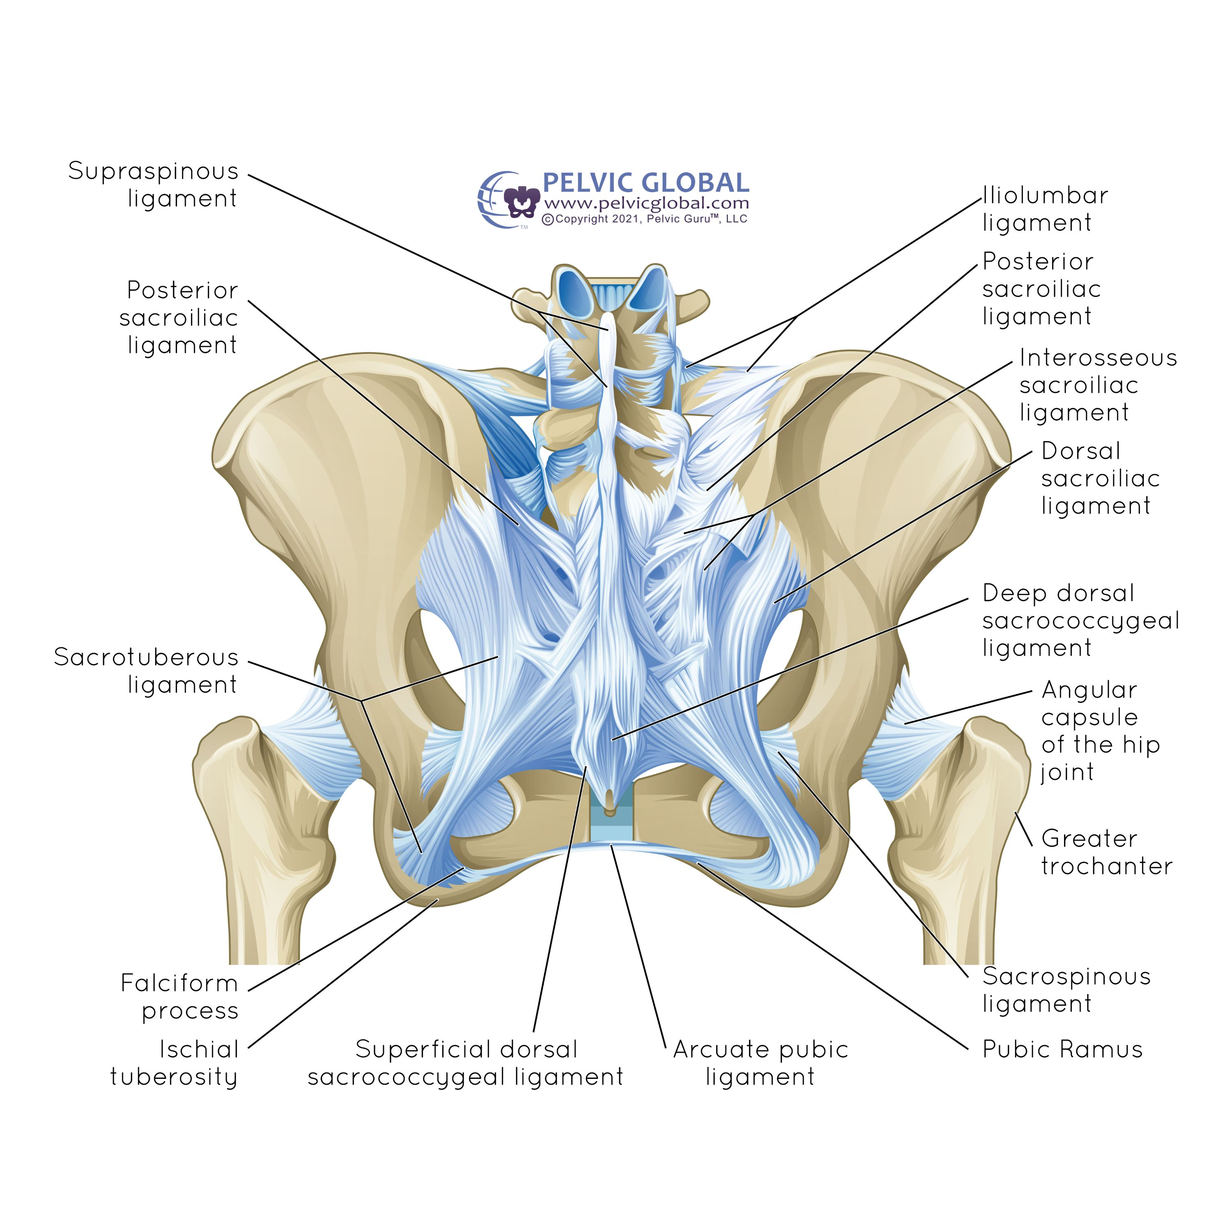
Coccydynia
Attachments on coccyx:
  Levator ani muscles
  Sacrococcygeal ligaments
  Sacrospinous ligament
  Sacrotuberous ligament
  Fibers of gluteus maximus
  Iliococcygeus muscle
Near coccyx:
  Sacrum
  5th sacral nerve
Image used with permission from Pelvic Guru®, LLC as a member of the Global Pelvic Health Alliance Membership (GPHAM)
Notes:
Role in support and defecation
6 anatomical variations of shapes/angulations of coccyx

Slide 50
Coccydynia
Pain improves with conservative treatment in 90% of patients
Pain described as sharp, shooting, or aching pain
Difficulty with sitting on flat or hard surfaces, sometimes with sitting on soft surfaces, intercourse, defecation, pre-menstrual period
Static or dynamic imaging (radiographs, CT, MRI)
Treatment
  Seating modifications
  Stool softeners
  Defecation mechanics
  NSAIDs
  Massage
  Stretching
  PT
  Steroid or anesthetic injections
  Radiofrequency treatments (RFT)
  Extracorporeal shockwave therapy (ESWT)
  Ganglion blocks
  Dextrose prolotherapy
  Surgery
Notes:
Need more ROM for defecation than for sitting, normal ROM is 5-25*, follows lumbar spine
Wedge or U-shaped cushion
Massage both internally to relieve levator ani and externally over glute max
Mobilization often into extension, bimanual
Injections to sacrococcygeal joint, intercoccygeal joints, tender points, ganglion impar
Prolotherapy with 25% dextrose
Surgery is coccygectomy
Complete post-op pain resolution can take months to years
Some degree of relief with all interventions; 60-87% improvement with injections, 75-92% improvement with massage, 85-100% with coccygectomy

Slide 51
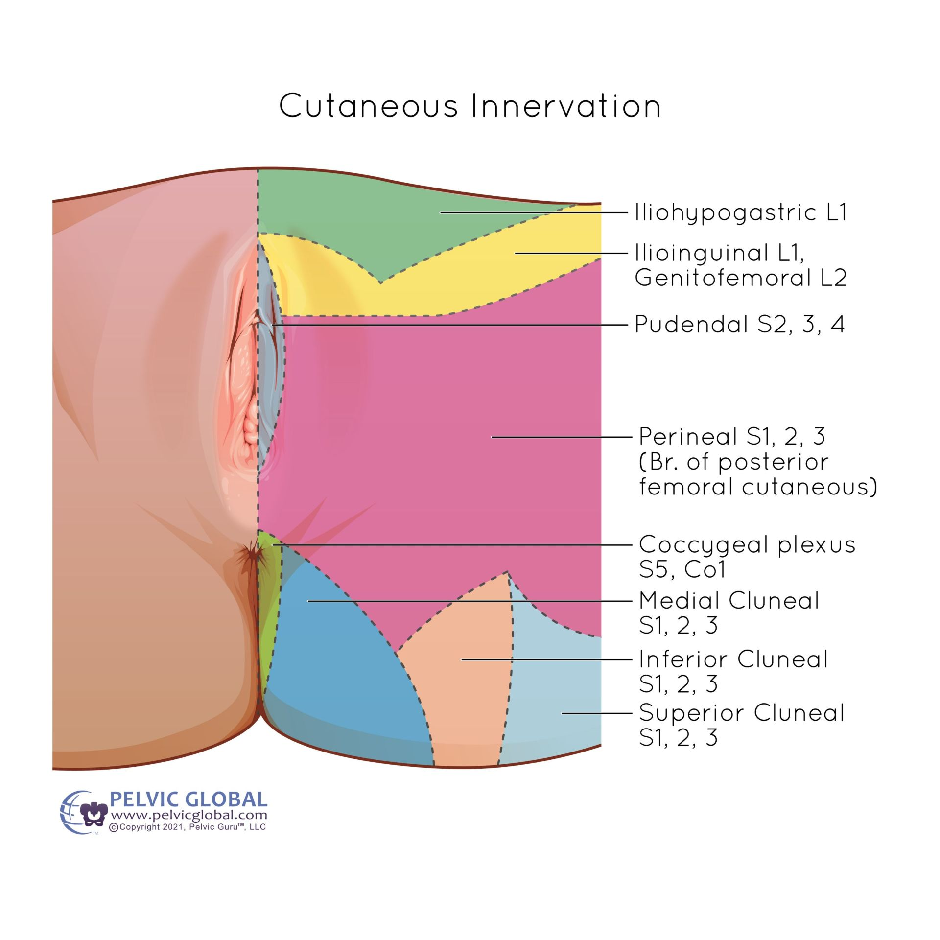
Pudendal Neuralgia
Painful neuropathic condition of pudendal nerve dermatome
Also called Alcock canal syndrome, pudendal nerve compression, or pudendal nerve entrapment
Estimated 4% of patients with chronic pain
Image used with permission from Pelvic Guru®, LLC as a member of the Global Pelvic Health Alliance Membership (GPHAM)
Notes:
Mixed nerve: 50% sensory, 20% motor, 30% autonomic
Incidence 1 in 100,000, likely underestimated, more common in women (60%)
Patients with PN for > 4 years had at least double the pain of other subjects in the study
Long duration of pain correlated with worse prognosis
Pain described as burning, twisting, squeezing, electrical shocks, or sensitivity
Helps with erection and urinary and fecal continence
Pudendal from Latin- “ashamed”
Several patients report suicidal ideation secondary to pain

Slide 52
Pudendal Neuralgia
Possible causes
  Cycling
  Horseback riding
  Pelvic or ortho surgery
  Nerve stretching during childbirth
  Differences in SIJ
  Prolonged sitting
Nantes criteria
  Pain in pudendal nerve territory
  Increased pain while sitting
  Pain does not awaken patient from sleep
  Pain with no objective sensory impairment
  Pain relieved by anesthetic pudendal block
Notes:
7-8% of cyclists get PN with long-distance practice

Slide 53
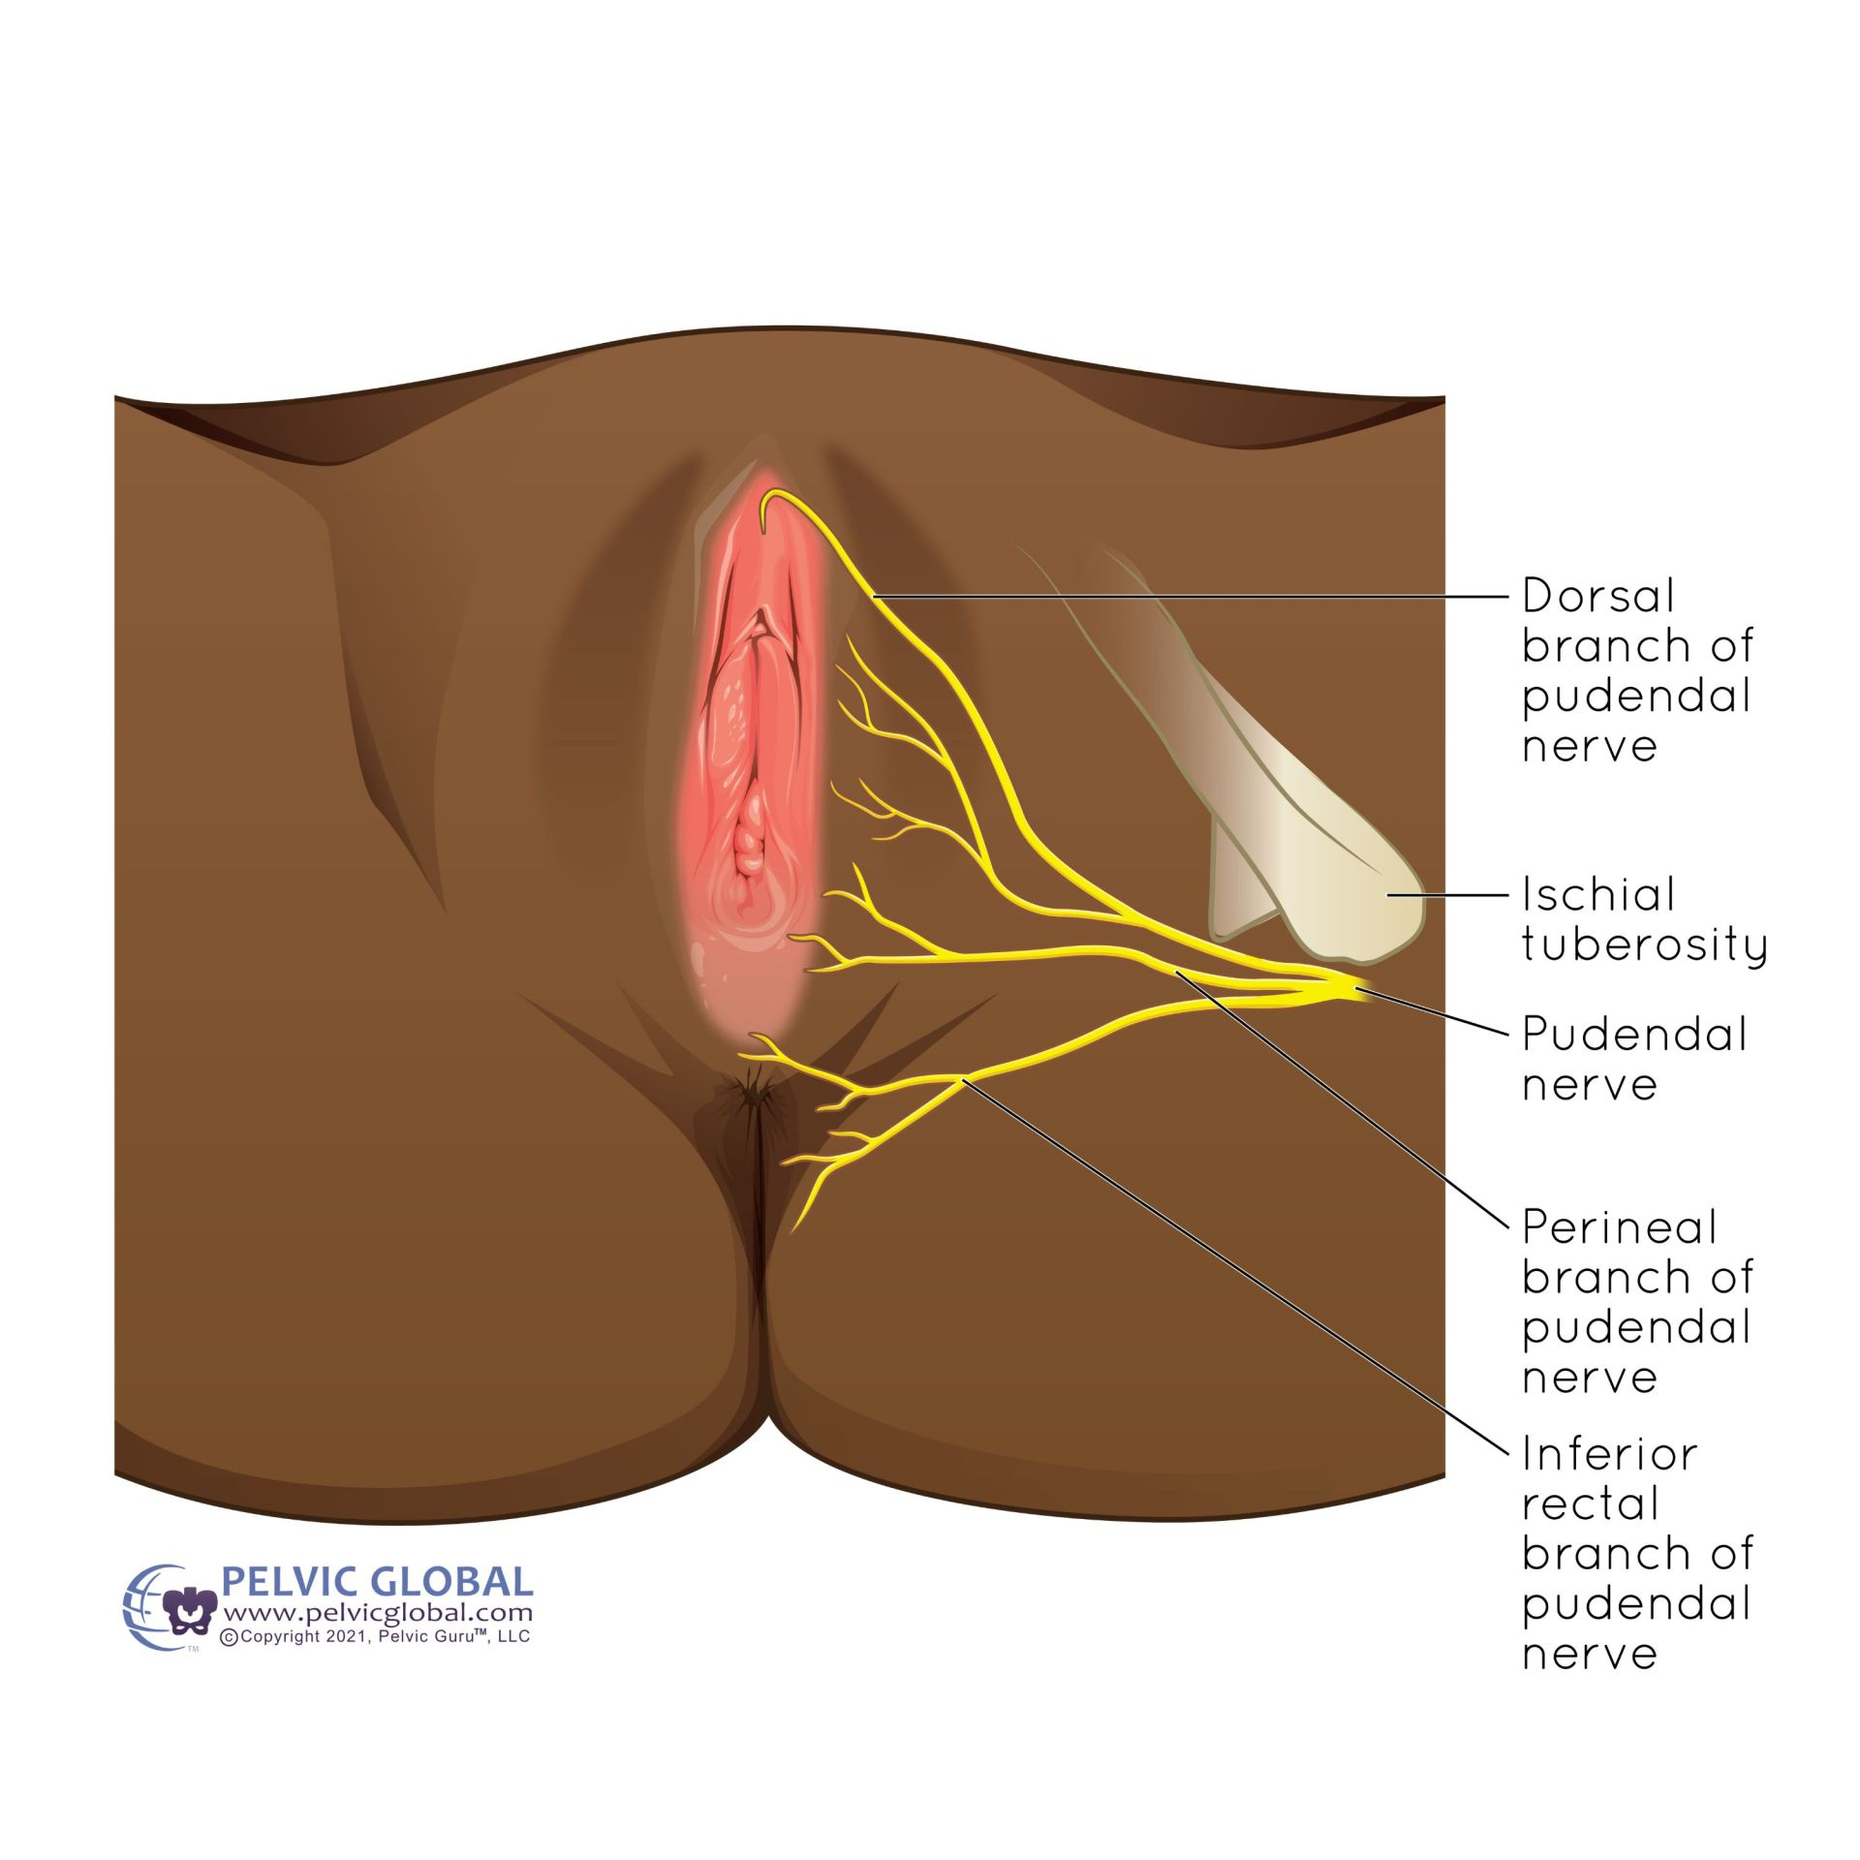
Pudendal Neuralgia
Associated symptoms
  Hyperalgesia
  Allodynia
  Paresthesia
  Hot, stabbing sensation
  Straining/burning with voids
  Urinary urgency and frequency
  Painful intercourse
  Sexual dysfunction
  Anus/rectum symptoms
  Pain increased with sitting
  Mild/no pain upon waking
Image used with permission from Pelvic Guru®, LLC as a member of the Global Pelvic Health Alliance Membership (GPHAM)
Notes:
Consider S3 radiculopathy
In 1 study 72% of patients with PN had sensory deficits at S2-S4

Slide 54
Pudendal Neuralgia
Treatment
  Lidocaine 5%
  Amitriptyline
  Pregabalin
  Tramadol, local muscle relaxers
  Cushions
  Spinal cord stimulation
  Botox
  Local anesthetic and corticosteroid injections
  Pulsed radiofrequency
  Physical therapy or OMT
  Psychotherapy
  Surgery
Notes:
For amitriptyline, number needed to treat is 3 to offer 50% pain relief
Can combine lidocaine with amitriptyline, improved 45%
Tramadol added 35% improvement
Better results to first-time treatment if symptoms are located over perineal branch and pain < 2.5 years
Have some relief with nerve blocks, often need repeated blocks due to only short term effects
Good results with imaging-guided injections, particularly into mid-portion of pudendal canal rather than at ischial spine
According to one study, addition of corticosteroids was no more effective than anesthetic alone
Pulsed radiofrequency compared to nerve block alone- decreased pain up to 3 months, effective rate 92.1% compared to 35.9%, less need for pain medication, decreased depression measured by PHQ-9
PT better with hypertonia or following surgery
Surgery is last resort, pain more than 1 year, transgluteal and laparoscopic decompressions, may identify adhesions during surgery

Slide 55

Multidisciplinary Team
Urologists
Gynecologists
Urogynecologists
Gastroenterologists
Colorectal surgeons
Pain specialists
Nurse specialists
Pelvic floor physical therapists
Occupational therapists
General practitioners
Cognitive behavioral therapists
Psychiatrists
Sexual health specialists
Pharmacists

Slide 56
Physical Therapy for Pelvic Pain
Goal to relax, elongate, and stretch tightened muscles, relieve tender points
Pain relief may occur at local and spinal levels
Helped with some depression, pain catastrophization, and anxiety in presence of pain relief
Help patients understand how to train their muscles to contract and relax
Home exercise program
Improvement in pain at 3 and 9 month follow ups

Slide 57
Patient Resources
Pelvic Pain Support Network: https://www.pelvicpain.org.uk/
A Headache in the Pelvis: A new understanding and treatment for prostatitis and chronic pelvic pain syndromes. David Wise, PhD and Rodney Anderson, MD
Pelvic Pain: The Ultimate Cᴓck Block. Dr. Susie Gronski, DPT, PRPC, WCS
The Way Out: A Revolutionary, Scientifically Proven Approach to Healing Chronic Pain. Alan Gordon, LCSW
Curable app

Slide 58

Questions?

Slide 59

Thank you!

Slide 60
References
Andersen G, Milosevic S, Jensen MM, Andersen M, Simony A, Rasmussen MM, Carreon L. Coccydynia– The efficacy of available treatment options: A systematic review. Global Spine Journal 2022; 12(7): 1611-1623.
Angin AD, Gun I, Sakin O, Cikman MS, Eserdag S, Angin P. Effects of predisposing factors on the success and treatment period in vaginismus. JBRA Assist Reprod. 2020; 24(2): 180-188.
Aredo JV, Heyrana KJ, Karp BI, Shah JP, Stratton P. Relating chronic pelvic pain and endometriosis to signs of sensitization and myofascial pain and dysfunction. Semin Reprod Med. 2017; 35 (1):88-97.
Arora HC, Eng C, Shoskes DA. Gut microbiome and chronic prostatitis/chronic pelvic pain syndrome. Ann Transl Med 2017; 5(2):30.
Bharucha AE, Lee TH. Anorectal and pelvic pain. Mayo Clin Proc 2016; 91(10): 1471-1486.
Fang H, Zhang J, Yang Y, Ye L, Wang X. Clinical effect and safety of pulsed radiofrequency treatment for pudendal neuralgia: a prospective, randomized controlled clinical trial. Journal of Pain Research. 2018: 11; 2367-2374.
Ferrero S, Alessandri F, Racca A, Maggiore ULR. Treatment of pain associated with deep endometriosis: alternatives and evidence. Fertility and Sterility. 2015; 104(4): 771-792.
Franz J, Kieselbach K, Lahmann C, Gratzke C, Miernik A. Chronic primary pelvic pain syndrome in men: Differential diagnostic evaluation and treatment. Dtsch Arztebl Int 2023; 120: 508-518.
Garg B, Ahuja K. Coccydynia- A comprehensive review on etiology, radiological features and management options. Journal of Clinical Orthopaedics and Trauma 2021; 12: 123-129.
Grinberg K, Weissman-Fogel I, Lowenstein L, Abramov L, Granot M. How does myofascial physical therapy attenuate pain in chronic pelvic pain syndrome? Pain Research and Management 2019; 1-11.
Kamboj AK, Hoversten P, Oxentenko AS. Chronic abdominal wall pain: A common yet overlooked etiology of chronic abdominal pain. Mayo Clin Proc. 2019; 94(1): 139-144.
Labat JJ, Riant T, Lassaux A, Rioult B, Rabischong B, Khalfallah M, Volteau C, Leroi A-M, Ploteau S. Adding corticosteroids to the pudendal nerve block for pudendal neuralgia: a randomized, double-blind, controlled trial. BJOG. 2017; 124: 251-260.
Mamlouk MD, vanSonnenberg E, Dehkharghani S. CT-guided nerve block for pudendal neuralgia: Diagnostic and therapeutic implications. AJR. 2014; 203: 196-200.
McEvoy M, McElvaney R, Glover R. Understanding vaginismus: a biopsychosocial perspective. Sexual and Relationship Therapy. 2021.
Moayednia A, Haghdani S, Khosrawi S, Yousefi E, Vahdatpour B. Long-term effect of extracorporeal shock wave therapy on the treatment of chronic pelvic pain syndrome due to non bacterial prostatitis. J Res Med Sci 2014; 19: 293-6.
Murer S, Polidori G, Beaumont F, Bogard F, Polidori E, Kinne M. Advances in the therapeutic approach of pudendal neuralgia: a systematic review. J Osteopath Med. 2022; 122(1): 1-13.
Pacik PT, Geletta S. Vaginismus treatment: Clinical trials follow up 241 patients. Sex Med 2017; 5: e114-e123.
Pereira A, Perez-Medina T, Rodriguez-Tapia A, Rutherford S, Millan I, Iglesias E, Ortiz-Quintana L. Chronic perineal pain: Analyses of prognostic factors in pudendal neuralgia. Clin J Pain. 2014; 30(7):577-582.
The Practice Committee of the American Society for Reproductive Medicine. Treatment of pelvic pain associated with endometriosis: a committee opinion. Fertility and Sterility 2014; 101(4): 927-935.
Rees J, Abrahams M, Doble A, Cooper A. Diagnosis and treatment of chronic bacterial prostatitis and chronic prostatitis/chronic pelvic pain syndrome: a consensus guideline. BJU Int 2015; 116: 509-525.
Speer LM, Mushkbar S, Erbele T. Chronic pelvic pain in women. Am Fam Physician. 2016; 93(5): 380-387.

