Slide 1
Cognitive Hearing Science: Long Term Effects of Untreated Hearing Loss

Slide 2
Designation Statement
It is St. Luke’s Hospital & Health Network policy to ensure balance, independence, objectivity and scientific rigor in all of our sponsored educational programs. Faculty and all others who have the ability to control the content of continuing medical education activities sponsored by the St. Luke’s Hospital & Health Network are expected to disclose to the audience whether they do or do not have any real or apparent conflict(s) of interest or other relationships related to the content of their presentation(s).
The St. Luke’s Hospital & Health Network is accredited by the Pennsylvania Medical Society to provide continuing medical education for physicians.
The St. Luke’s Hospital and Health Network designates this live educational activity for a maximum of 1 AMA PRA Category 1 Credits™. Physicians should only claim credits commensurate to the extent of their participation on the activity.

Slide 3
Disclosure Information
The Planners involved in this activity have no relevant financial relationships to disclose.
The Faculty/Presenters involved in this activity have no relevant financial relationships to disclose.

Slide 4
Learning Objectives
Identify patients with possible hearing loss and/or cognitive decline
Understand the impact of untreated hearing loss long term
Discuss the need for timely and appropriate referral to address the hearing loss.

Slide 5
Audiology: Scope of Practice
Diagnostic audiological testing for infants to adults
Providing correction/rehabilitation of hearing loss
Vestibular assessment, test, and rehabilitation
Electrophysiology assessment and diagnosis
Facial nerve monitoring
Intraoperative monitoring

Slide 6
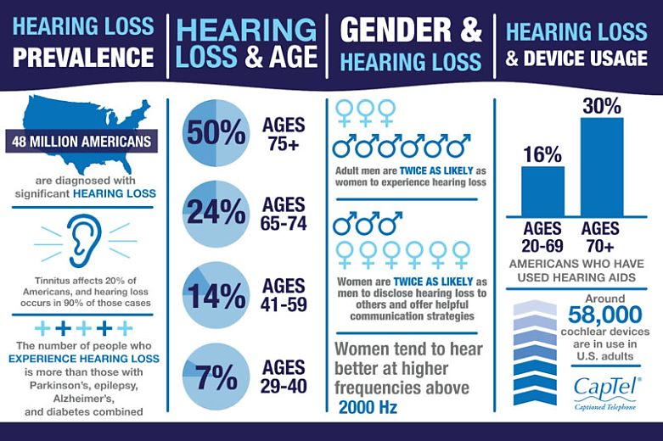
Hearing loss facts
Notes:
48 Million Americans have hearing loss.
The number of people with hearing loss is more than people with Parkinson's, epilepsy, Alzheimer's and Diabetes combine.
Hearing loss is the leading potentially modifiable risk factor for dementia – up to 8% of global cases are estimated as being attributed to hearing loss.
Impact: 20% of the global population – 1.5 billion people

Slide 7
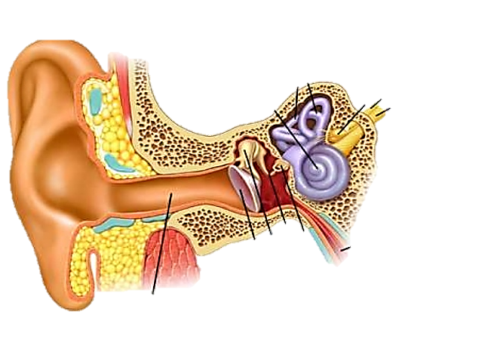

How do you hear?
When we hear sounds (speech, music, noise, etc.) our ear collects these sounds and then sends that information up to the brain where the information is decoded or “heard”
We then perceive that information as speech, music, noise, etc.
Notes:
The ear are simply collect and transport the sound to the brain. The brain then decode the information once received.
Hearing involves two inter-related processes and components of the auditory system – the peripheral system and the central system in addition to non-auditory influences such as cognitive processing, education, situational influences, and self-perception. Both systems need to work in tandem for the person to detect and understand a sound.

Slide 8
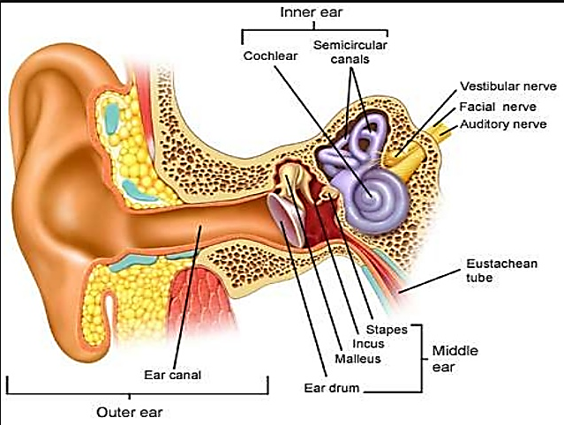
Anatomy of the ear
Outer ear
Ear canal
Middle ear
Eardrum
Inner ear
Cochlea
Semicircular canals
Ossicular chain
Vestibular system
Saccule
Utricle
Notes:
As sound travels from the peripheral system the electrical signal created by the cochlea is sent to the auditory nerve where it is then decoded by the brain. Central hearing is dependent upon the integrity of the auditory signal pass from the peripheral system as well as additional cognitive processing's.
Peripheral hearing – ability to detect sound
Central hearing – the ability for the brain to understand and make sense of environmental sounds, requiring significant higher-level processing (i.e. identifying signals of interest from ambient noise, giving spatial awareness, adding together several pure tone signals to create complex signals such as speech, etc.)

Slide 9
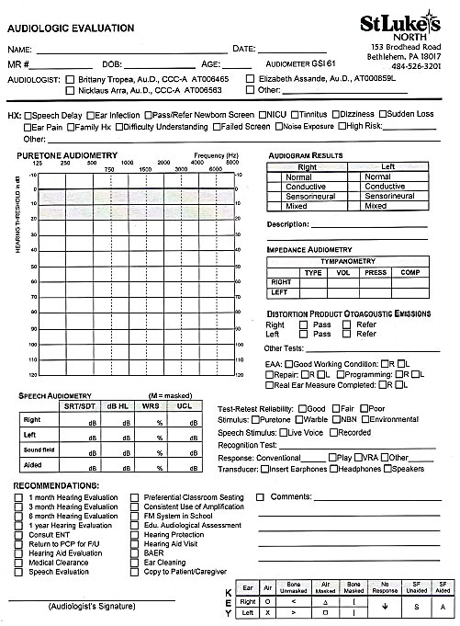
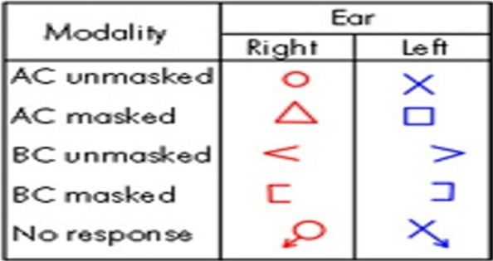
Audiogram
Degree
Normal, Mild, Moderate, Moderately – Severe, Severe, Profound
Configuration
Flat
Sloping
Precipitously sloping
Rising
Trough/Cookie Bite
Notch
Type
Three types of hearing loss – determined by comparing air-conduction thresholds to bone-conduction thresholds.
Sensorineural
Conductive
Mixed

Slide 10
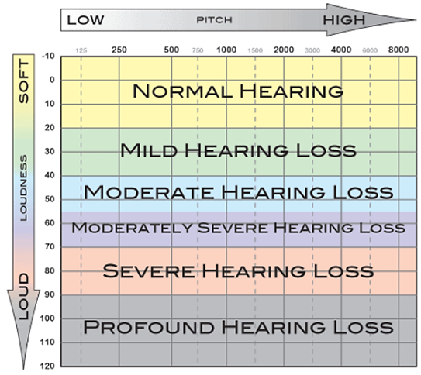
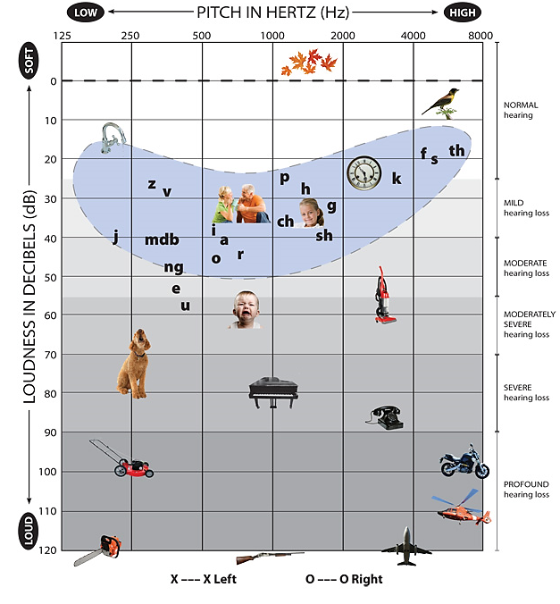
Understanding Hearing Loss

Slide 11
Why do we test speech?
Two parts to hearing:
Did I hear it?
Importance of speech
Although it is important to know the softest sounds (pitches or frequencies) it is also important to know how well you can hear and understand speech.
Detection vs Understanding
We want to make sure the brain is still able to detect and interpret the information it is receiving
Did I understand it?
Word recognition or Speech understanding.
Notes:
Age related hearing loss or presbycusis – outer hair cells and other sensory cells in the cochlea are progressively damage and unable to regenerate.
The results is the impaired encoding of sound, decreased precision and distorted auditory signal sent to the brain.
An individual’s functional performance with their hearing depends on not only their peripheral hearing but also their central hearing ability )(ie. Central auditory processing, speech in noise performance), personal motivation, self-efficacy, listening environments, and demands.

Slide 12
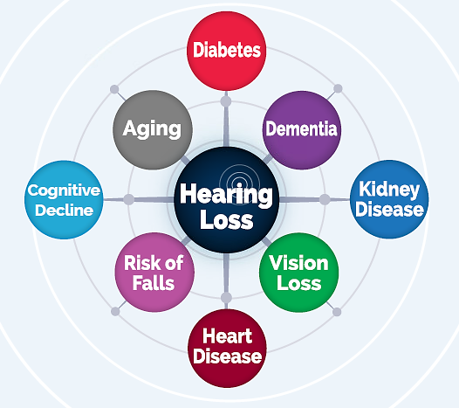
Did you know??
Your hearing health and your quality of life are closely related to many common medical conditions.
  Cognitive Decline
  Dementia
Dementia
Cognitive
Decline
Notes:
A reported pooled relative risk of 1.9 times greater risk of incident dementia among hearing impaired individuals 55 years of age and older compared to those with normal hearing.
Studies have shown an association between hearing loss and declines in global cognitive function, executive function, processing speed and memory.

Slide 13
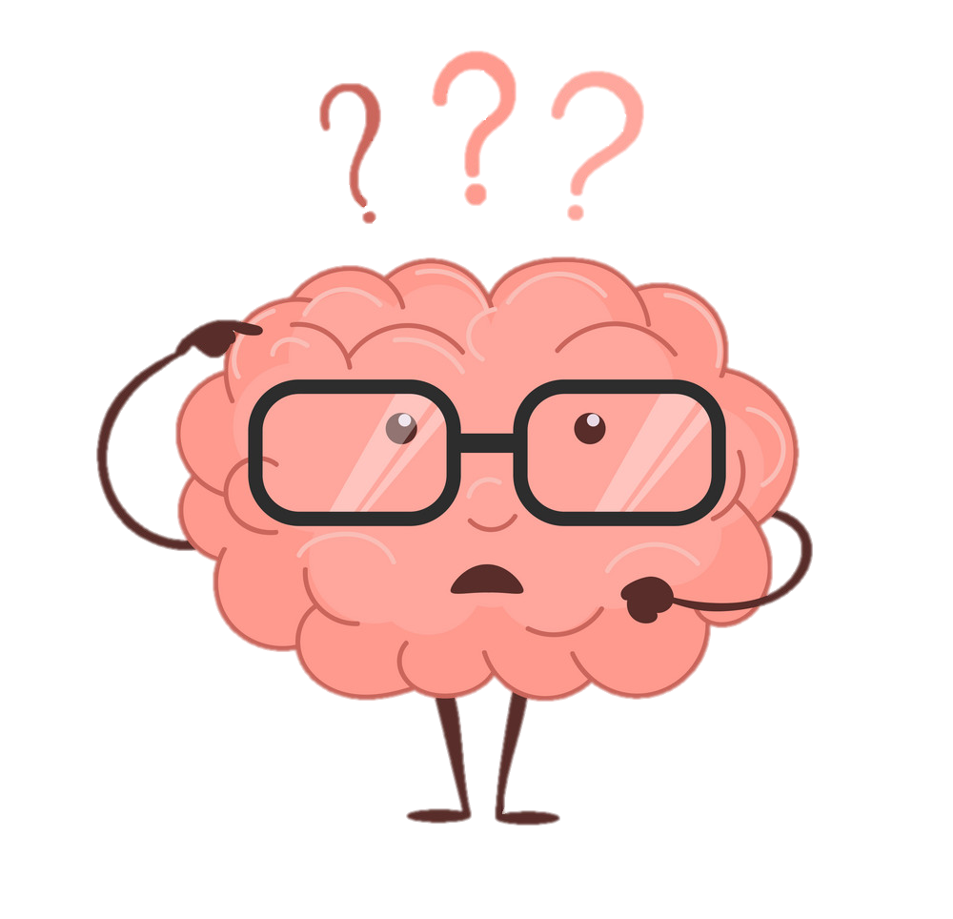
Cognitive Hearing Science
Link between hearing loss and dementia/cognition.
  “The general perception is that hearing loss is a relatively inconsequential part of aging”
  However, recent findings indicate that your hearing plays a much more important role in your brain health.
Notes:
A number of studies have been done over the last decade that have shown a link between hearing loss and dementia/cognition.
“The general perception is that hearing loss is a relatively inconsequential part of aging” says Frank Lin, an otologist-epidemiologist at John Hopkins University.
However, recent findings indicate that your hearing plays a much more important role in your brain health.

Slide 14
Cognitive Hearing Science
Three hypotheses regarding the link/association between hearing loss and cognitive decline.
  Sensory Deprivation Theory
  Information Degradation Theory
  Common Cause Theory

Slide 15
Sensory Deprivation Theory
    Prolonged sensory deprivation
      Changes to brain structure and function
    Resultant reorganization
      Altering critical brain regions
    Reduced gray matter density/volume
Notes:
Studies indicates that prolonged sensory deprivation has an adverse effect on the brain, such as changes to brain structure and function.
Due to auditory deprivation from hearing loss we can see:
neural deafferentation
cortical reallocation of other processes
and atrophy in the speech processing regions of the brain.
The resultant reorganization may add to existing brain pathology at the detriment of general cognitive performance by altering critical brain regions which could otherwise be utilized for higher-level cognitive processing (working memory, etc.).
Reduced gray matter density and reductions in temporal lobe volume are observed in those with peripheral hearing loss as prolonged sensory deprivation may lead to changes and decreases in cortical brain volume in conjunction with that seen with expected cognitive aging or neurodegenerative disease
Even among those older adults considered free of dementia, hearing loss appears to be associated with reduced white matter microstructural
integrity in cortical regions crucial for cognitive processing
This sensory deprivation may necessitate cortical reorganization resulting in further restriction of cortical capacity available for cognitive processing

Slide 16
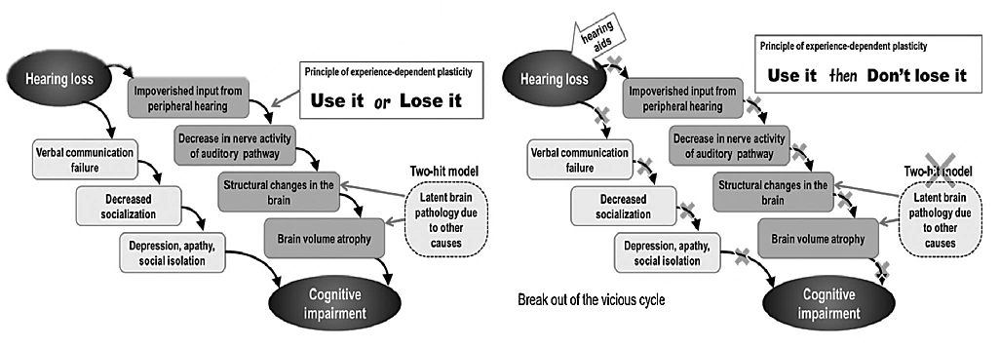
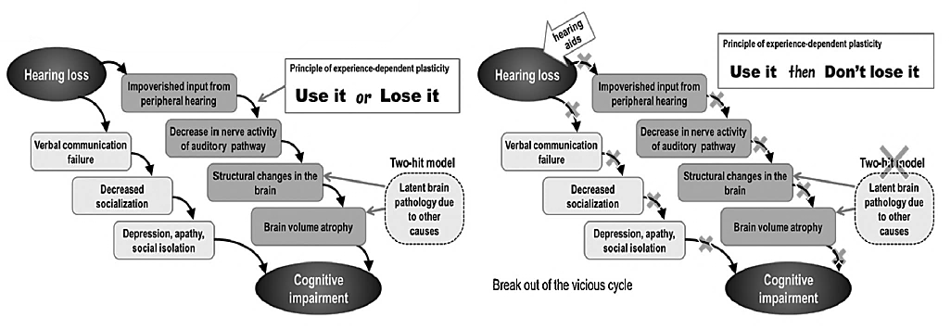
What if we do nothing? What if we wait too long?
Notes:
So the “use-it or Lose-it theory – is suggesting cognitive impairment due to hearing loss is happening in one of two ways.
The first is stating that due to long term auditory deprivation resulting from hearing loss, the areas of the brain, specifically the auditory cortex, start to lose functionality. This is suggesting that there are changes occurring to the gray matter of the brain, causing a decrease in neural activity available to perform cognitive tasks. The reallocation or lack of resources is affecting the brains integrity and overall function. Thusly affecting an individual’s cognitive ability.
The second way is suggesting that with communication breakdown, we see a reduction in quality social interactions, which can lead to social isolation, or withdrawal for activities, which can lead to depression, which has been shown to additionally affect cognitive function.
Research indicates that even perceived social isolation is a risk factor for poorer overall cognitive performance, and faster cognitive decline. These impairments related to HL can cascade direction or indirectly, leading to cognitive impairment.
Cognitive load is the cognitive effort or amount of processing required by an individual to perform a task. The basic idea is that if the task requires to much cognitive ability, the completion of that task will be hindered due to limited cognitive capacity. When talking about people with hearing loss, cognitive load comes into play with listening effort. Listening effort refers to amount of concentration and attention required to understand speech. When a person has hearing loss, auditory signals become degraded, which then requires more cognitive resources, simply for speech perception and understanding (effortful listening vs ease of listening), which then causes a diversion of other cognitive tasks resulting in cognitive reserve depletion.
Studies have repeatedly shown that social isolation is arguably one of the biggest predictors of morbidity and mortality in older adults. Social isolation relates to poorer outcomes through several different pathways. Health and behavioral pathways can be affected by things such as adherence to medical treatments, as well as smoking, diet, and exercise. Psychological pathways are impacted by a person’s self-esteem, self-efficacy, sense of well-being, and their ability to cope.
When verbal communication fails for an individual with hearing loss this can severely reduce that individual’s social interactions. Reduced socialization is known to occur along with loneliness, apathy, and depression. Research has shown that even perceived social isolation is a risk factor of faster cognitive decline, poorer executive functioning, increased negativity, and overall poorer cognitive performance. This is suggesting that social isolation and depression as a result of hearing loss may indirectly or directly cascade and lead to cognitive impairment.

Slide 17
Information Degradation Theory
    Increased demands on cognitive processing to compensate for impoverished sensory input
      Additional processing draws on the same resources needed for higher level cognitive processing
    Increased cognitive demand for auditory stimuli
Notes:
While the sensory deprivation hypothesis suggests physical changes to the brain due to prolonged hearing loss which subsequently impacts cognitive processing, the information degradation hypothesis proposes the association stems from increased demands on cognitive processing in order to compensate for impoverished sensory input. The additional processing required to compensate for degraded auditory perception draws on the same resources needed for other higher level cognitive processing and semantic encoding
These increased cognitive demands required to appropriately encode auditory stimuli requires extensive listening effort particularly with memory, attention, and executive function
With hearing loss, this increased cognitive and listening effort may increase cognitive load at any time of day as the auditory system never “turns off,” thereby drawing on the cognitive buffer of the individual and their ability to compensate for cognitive changes and resulting in earlier presentation of clinical symptoms and dementia

Slide 18
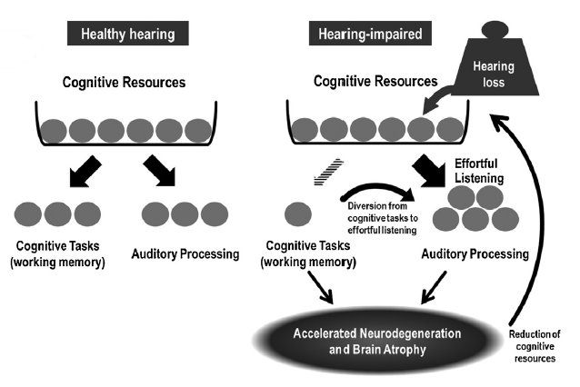
What if we do nothing? What if we wait too long?
Notes:
Cognitive load is the cognitive effort or amount of information processing required by an individual to perform a task. The basic idea is that if the task requires to much cognitive ability, the completion of that task will be hindered due to limited cognitive capacity in working memory. When talking about people with hearing loss, cognitive load comes into play with listening effort. Listening effort refers to amount of concentration and attention required to understand speech. When a person has hearing loss, auditory signals become degraded, which then requires more cognitive resources, simply for speech perception and understanding (effortful listening vs ease of listening), which then causes a diversion of other cognitive tasks resulting in cognitive reserve depletion.
When extra cognitive load has to be devoted to auditory processing on a daily basis, long term structural changes of the brain and neurodegeneration can occur, which can be affect other cognitive processes. Thus starting a cycle in which cognitive resources available to perform tasks are limited or reduced. With regards to hearing impaired people, resources being diverted to auditory processing, are then taking away cognitive resources from other cognitive processes such as working memory. This can then potentially lead to cognitive decline.

Slide 19
Common Cause theory
    Overall neural degeneration common with aging
    Dementia pathology vs degraded peripheral signals
    Early identification and broad hearing-dementia intervention strategies.
Notes:
A potential common mechanism might include the overall neural degeneration common with aging, resulting in both decreased auditory ability and decreased cognitive performance Dementia pathology from a central cause may therefore produce early dysfunction within the central auditory system resulting in impaired hearing ability (i.e., auditory scene analysis or ability in complex listening environments) prior to the presentation of more general cognitive decline or impairments.
As described in the review by Griffiths et al. (2020), it is also possible degraded peripheral signals lead to
dysfunction pattern processing within the central auditory system (particularly the medial temporal lobe) and interact with existing neurodegenerative pathology, resulting in the observed association
With this hypothesis, whether the increased neuronal activity from degraded auditory input causing
or increasing AD pathology, or the degraded auditory input from hearing loss may reduced activity for auditory cognitive processes within the medial temporal lobe remains to be clarified, however, either speculation supports early identification of hearing loss prior to prolonged duration of decreased auditory input and broad hearing-dementia intervention strategies.

Slide 20
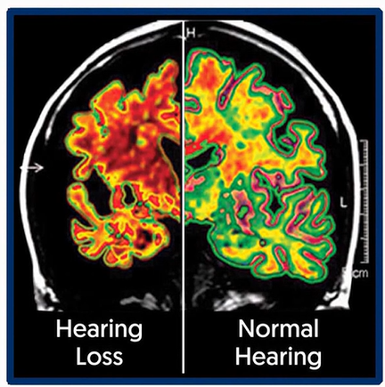
Notes:
With this hypothesis, whether the increased neuronal activity from degraded auditory input causing
or increasing AD pathology, or the degraded auditory input from hearing loss may reduced activity for auditory cognitive processes within the medial temporal lobe remains to be clarified, however, either speculation supports early identification of hearing loss prior to prolonged duration of decreased auditory input and broad hearing-dementia intervention strategies.
Common Cause: Assumes the existence of a common factor that is responsible for age-related deterioration in cognitive and non-cognitive processes and proposes that age-related declines are shared across multiple and seemingly-incongruent functions.

Slide 21
Cognitive Hearing Science Review
Sensory Deprivation Theory
Prolonged sensory deprivation
Information Degradation Theory
Effortful listening
Common Cause Theory
Aging brain neurodegeneration
Diversion of other cognitive tasks
Neurodegeneration
Re-allocation
Functional and structural
Peripheral and central
Changes to brain structure and function
Reduced gray matter density/volume

Slide 22

Social Isolation and Hearing Loss
    Risk factors like loneliness, social isolation, depression, decreased physical activity or frailty
    Hearing loss can cause withdraw from previously enjoyed activities
    Hearing loss can cause reduction in physical activity due to decreased auditory awareness
Notes:
Other risk factors for dementia may also mediate the association of hearing and cognition including: loneliness, social isolation, depression, decreased physical activity, or frailty. Studies have demonstrated the presence of hearing loss leads to increased social isolation and/or loneliness for some older adults as individuals with hearing loss may withdraw from previously enjoyed activities or social interactions due to the inability to engage and communicate with others. Links between social isolation or loneliness and dementia are well established
It is possible hearing loss leads to reduced physical activity and physical functioning, each a known risk factor for dementia, due to decreased auditory awareness with surroundings and anxiety

Slide 23
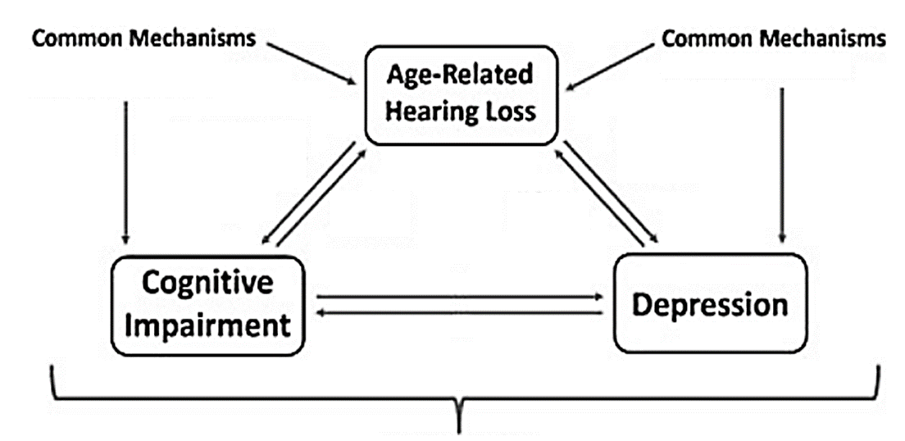
Social Isolation and Depression and hearing loss
Microvascular Disease
Neuropathologic process
Socioeconomic factors
- Cognitive load
- Social Isolation
- Structural Brain
Changes
- Behavioral (e.g. Social)
- Neural
Reverse causation
Reverse causation
Notes:
Studies have repeatedly shown that social isolation is arguably one of the biggest predictors of morbidity and mortality in older adults. Social isolation relates to poorer outcomes through several different pathways. Health and behavioral pathways can be affected by things such as adherence to medical treatments, as well as smoking, diet, and exercise. Psychological pathways are impacted by a person’s self-esteem, self-efficacy, sense of well-being, and their ability to cope.
When verbal communication fails for an individual with hearing loss this can severely reduce that individual’s social interactions. Reduced socialization is known to occur along with loneliness, apathy, and depression. Research has shown that even perceived social isolation is a risk factor of faster cognitive decline, poorer executive functioning, increased negativity, and overall poorer cognitive performance. This is suggesting that social isolation and depression as a result of hearing loss may indirectly or directly cascade and lead to cognitive impairment.

Slide 24
How do we treat?
Researchers suggest that hearing aid use may attenuate cognitive decline accelerated by hearing loss.
Hearing aids may serve not only has dementia prevention buy may present opportunity for Neuropsychiatric symptoms (NPS)
It was reported that by maintaining strong social connections one can prevent cognitive decline and prolong the onset of dementia.
Notes:
Researchers found that elderly adults with hearing loss treated with hearing aids had similar rates of cognitive decline compared to adults with normal hearing sensitivity, suggesting that hearing aid use may attenuate cognitive decline accelerated by hearing loss.
In addition to potentially serving as a dementia prevention strategy, hearing aids may present opportunity for intervention for neuropsychiatric symptoms (NPS) at all stages of dementia and negative health outcomes associated with NPS. Breakdowns in communication between those individuals with dementia/cognitive impairment and their caregivers along with decreased awareness of surroundings may contribute to behavioral changes commonly noted with more progressed disease The use of a hearing assistive device in older adults with cognitive impairment has been
found to result in fewer and less severe NPSs and less severe depressive symptoms Therefore, hearing aid use among dementia patients demonstrate improved communication, reduced NPS, decreased perception of hearing
handicap, and improved quality of life for both individuals and their caregivers
If people voluntarily isolate themselves due to hearing loss and communication failure, can we not say that by wearing hearing aids and being able to maintain a strong social life we can reduce the risk of cognitive decline?

Slide 25
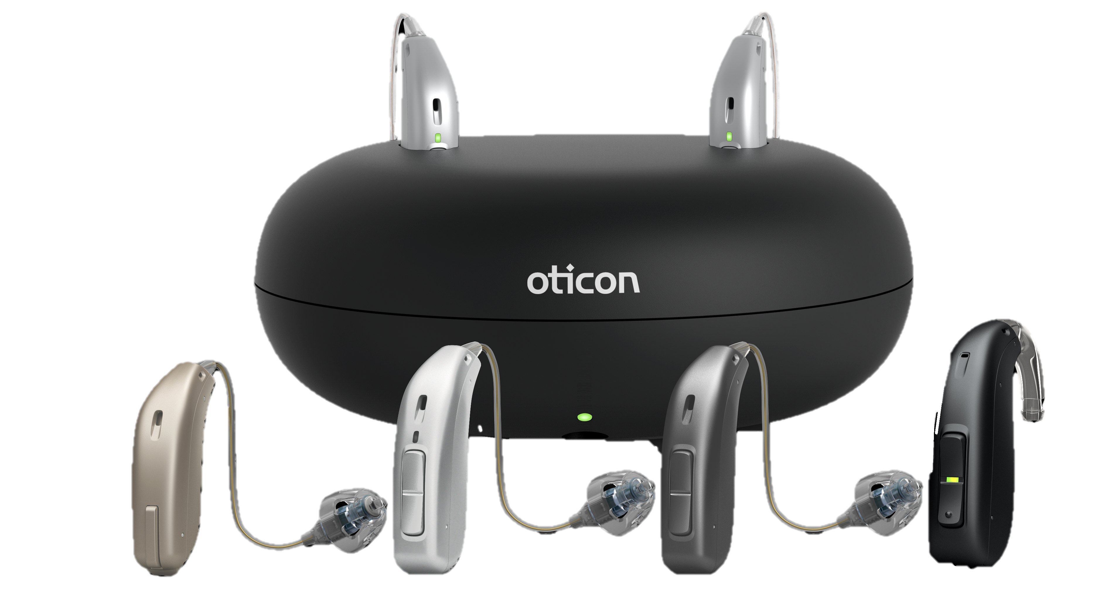
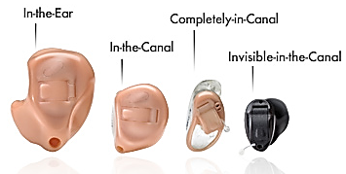
You have a hearing loss – now what?
Hearing Aids?
Assistive listening devices?
Implantable devices?
Bone-anchored hearing aids, Cochlear implants
Do nothing??
“I got this in the mail yesterday”
Big box
OTC / Mail order
Audiologist
Notes:
Hearing Aids come in many shapes and sizes. They also come in many price ranges. Hearing aids are NOT corrective like eye glasses. Their goal is to collect more data for the ear to transmit to the brain to be decoded. What the brain does with that sound, the hearing aid has no control over
The use of hearing management such as hearing aids may support cognition through indirect pathways like improving social engagement and communication yet decreasing cognitive load and strain on central auditory function through improvement of peripheral auditory input, directly preventing dementia would remain elusive.

Slide 26

Only 30% of eligible adults obtain hearing aids in the US
Notes:
on average only 30% of eligible adults obtain hearing aids in the us – management of hearing loss thorught amplification options may not only decrease the risk of nyeropsychiatric conditions, but may also improve treatment adherence, patient satisfaction, and improve overall heath- related quality of life for older adults.
The use of hearing management such as hearing aids may support cognition through indirect pathways like improving social engagement and communication yet decreasing cognitive load and strain on central auditory function through improvement of peripheral auditory input, directly preventing dementia would remain elusive.

Slide 27
Key Take Aways…
A reported pooled relative risk of 1.9 times greater risk of incident dementia among hearing impaired individuals 55 years of age and older compared to those with normal hearing.
Delaying the onset of dementia by just 5 years through intervention could lead to a 57% reduction in the number of dementia cases and 40% lower cost for care and service in 30 years.
Researchers suggest that hearing aid use may attenuate cognitive decline accelerated by hearing loss.
Notes:
Researchers found that elderly adults with hearing loss treated with hearing aids had similar rates of cognitive decline compared to adults with normal hearing sensitivity, suggesting that hearing aid use may attenuate cognitive decline accelerated by hearing loss.
It was reported that hearing aid use is positively associated with episodic memory scores, and that the decline in episodic memory scores was slower after the use of hearing aids. although episodic memory declined with
age; this rate of decline was significantly less after the start of hearing aids.
and may affect a persons overall feeling of self worth and reduced social isolation and/or depression. – creating a vicious cycle.
If people voluntarily isolate themselves due to hearing loss and communication failure, can we not say that by wearing hearing aids and being able to maintain a strong social life we can reduce the risk of cognitive decline?

Slide 28
Food for thought
By 2050 it is estimated that nearly 5 billion people will have hearing loss (1 in 4)
By 2060 nearly 73 million in the US alone.
~However~
Studies suggest that while the overall prevalence of hearing loss is increasing due to the number of older adults – the age specific prevalence of hearing loss in the US appears to be decreasing by ~2%
~Reason
Improvements in health care, access to care, etc.
Notes:
Food for for thought: It was estimated that by 2050 nearly 2.5 billion people will have hearin loss 1 in 4 people. Moreover, by 2060 nearly 73 million in the us alone. However, analysis in a nationally repsentivite sample of older adults suggest that while the overall prevalence of hearing loss is increasing due to the greater number of older adults, the age specific prevalence of hearing loss in the us appears to be decrasing over the last decade by ~2% in adults compared to the prior decade.
This may be due to improvements in health care, access to care and the prevention of known risk factors for hearing loss, improved education, environmental noise protections, and management of vascular or disease risk factors.

Slide 29

Make the referral!
What if…
Hearing aids may not cause better cognition..
Cognitively able individual's vs less cognitively able
  Seek help / treatment
Responsibility to make the referral
Notes:
What if hearing aids aren’t necessarily causing better cognition, but rather, more already cognitively able people may be more likely to seek specialist help, such as an audiologist and may seek hearing aid treatment more readily then less cognitively able people form the start.
This then becomes the responsibility of other health professionals to make the referral when a person is complaining of hearing difficulties

Slide 30

Multi-disciplinary approach
We all are a piece to a patients puzzle. Together we can put these pieces back and give our patients the complete care they need.
PCP
MD
PT
AUD
Notes:
Refer! Ask us! We are a team.

Slide 31

Thank you!
Questions?

