Slide 1
“WHY CAN’T I PROPOSE?”
RELATIONSHIP OCD AND ITS ASSOCIATION WITH DATING INDECISION AND OTHER RELATIONSHIP DIFFICULTIES
RUCHAMA FUND, Ph.D.
drfund@verizon.net
NEFESH CONFERENCE
JAN. 8, 2026

Slide 2
PREVIEW
Description of Relationship OCD in the following relationships: dating, parent of child in shiduchim, engagement, marriage, friendship, parent-child, client-therapist and relationship with Hashem. (70 minutes plus 10 minute Q & A)
Break from 10:50 to 11:05
Assessment and treatment with psychoeducation, ERP, ACT, and EMDR. (75 minutes plus 10 minute Q & A)

Slide 3
ROCD, WHAT IT LOOKS LIKE
(IOCDF.ORG)
Obsessions are unwanted, intrusive thoughts, images, or urges that trigger intensely distressing feelings.
Compulsions are behaviors an individual engages in to attempt to get rid of the obsessions and/or decrease distress.
Disorder: it consumes more than an hour a day or causes significant distress or impairment in functioning.
Relationship: it impairs the individual’s ability to form a relationship or to engage in a relationship.

Slide 4
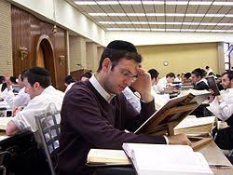
DATING ROCD

Slide 5
ROCD.net
GUY DORON & DANNY DERBY

Slide 6
ROCD OBSESSIONS
Is this person the right one?
Will I regret this? (Regret aversion)
Am I a good mother?
Is my friend a true friend?
Does my therapist care about me?
The defining element is DOUBT.

Slide 7
ROCD COMPULSIONS
Purpose is to reduce stress (temporarily) by neutralizing or counteracting uncomfortable thoughts or resolving doubts:
Analyzing
Reassurance seeking
Repeatedly checking one’s own feelings
Comparing
‘Neutralizing’ or ‘undoing’ behaviors like repeatedly listing the person’s assets
Repeatedly quoting religious reassurances.
Compulsions serve to perpetuate the ROCD by preventing the development of the ability to cope with anxiety, uncertainty, regret, and imperfection.

Slide 8
OVERT ROCD COMPULSIONS
Seeking reassurance from family, friends, therapist that “this is the right one”.
Googling, “How to know it’s the right one”.
Overtly avoiding triggers
Testing the partner
Fixing the partner

Slide 9
DISTINGUISHING INFORMATION-SEEKING FROM REASSURANCE SEEKING
(SAINT LOUIS BEHAVIORAL MEDICINE INSTITUTE)
Repeatedly asks the same question
Asks questions to feel less anxious
Responds to an answer by challenging the answerer, arguing, or insisting the answer be repeated or rephrased
Often asks questions that are unanswerable
Indefinitely pursues information without ever forming a conclusion or making a decision
Often asks people who are unqualified to answer the question

Slide 10
COVERT ROCD COMPULSIONS
Internally testing
Processing of past events
Comparing
Pushing unwanted thoughts out
‘Undoing’ or ‘neutralizing’ by thinking of the positive or repeatedly listing the person’s assets
Repeatedly quoting religious reassurances
Monitoring sexual arousal
Ruminating about doubts

Slide 11
ROCD AVOIDANCE COMPULSIONS
Avoiding making a decision regarding the relationship.
Avoiding intimacy because maybe it won’t be good enough
Avoiding expressing affection because maybe it’s not 100% true
Avoiding looking at attractive people because it might trigger questions about your attraction to your partner

Slide 12
ROCD CHECKING COMPULSIONS
Checking and reassurance seeking:
Checking to assess how attracted you feel
Checking to see how other people feel about your partner
Evaluating everything the other person says to determine how intelligent they are

Slide 13
WE NO LONGER USE THE TERM “PURE O”
Mental compulsions

Slide 14
FORMS OF ROCD
Dating
Engaged
Partner
Parent of child in shidduchim
Friend
Parent-child
Client-Therapist
Relationship with Hashem

Slide 15
TWO TYPES OF ROCD
(DORON & DERBY)
Partner centered
Relationship centered

Slide 16
PARTNER CENTERED ROCD
I obsess/have doubts about my partner because I am afraid he/she is not
Smart enough
Interesting enough
Deep enough
Frum enough
Attractive enough
Competent enough
Similar enough to me
Are his/her social skills good enough?
Is he/she “socially off”?

Slide 17
PARTNER CENTERED ROCD
Is he/she the right one?
Preoccupation with partner’s physical flaws
Evaluating every comment to see if it is intelligent enough
Obsessively comparing my partner to the partners of others

Slide 18
RELATIONSHIP CENTERED ROCD
Will I like someone better?
Do I have the “right” feelings toward him/her?
Does he have the right feelings about me?

Slide 19

ENGAGEMENT
“Why you will marry the wrong person” by Alain de Botton

Slide 20

NOTICING HOW DIFFERENT WE ARE:
BRIDGE

Slide 21
MALE AND FEMALE
“She was acting like a woman for no good reason!”

Slide 22
PARTNER ROCD IN MARRIAGE
Seeking reassurance about love.
Evaluating acts of love to see if they are sincere, sufficient, reciprocal.
Overly “honest” and literal about expressions of affection
“I can’t tolerate if he’s stressed out and not a million % attentive.”

Slide 23
RELATIONSHIP-CENTERED OCD IN MARRIAGE
Worry about the following myths:
The relationship is not a good relationship if
There are disagreements
There are doubts
If you don’t think about/want to spend time with/enjoy conversations with the partner all the time
If I find someone else attractive/interesting
If I find an aspect of my spouse’s appearance unattractive or repulsive
If I feel bored at times

Slide 24
MARRIAGE ROCD TRIGGERS AND MYTHS
My partner’s success reflects on my value/self esteem.
If people perceive my partner negatively, they perceive me negatively.

Slide 25
MARRIAGE ROCD TRIGGERS AND MYTHS
My worth as a person is dependent on how good my relationship is.
I must never disappoint my partner.
I must please my partner 100% of the time.
I can’t let my partner know my flaws.
My partner must love me 100% of the time.

Slide 26
CONSEQUENCES FOR THE RELATIONSHIP
Plagued by trying to figure out if they love the partner.
In the interest of “honesty” the person might say, “I’m not sure I love you.”
In the interest of “honesty” the person does not express affection.
The person is “in their head” and not in the relationship.
The partner feels judged all the time, it effects his/her self esteem.

Slide 27
CORE FEARS IN ROCD
Fear of being trapped and alone in never ending suffering.
Fear of missing out on true love.
Fear of being fooled.

Slide 28
ROCD IN A DIFFICULT RELATIONSHIP:
COMPULSIVE ANALYZING AND SELF-DOUBT
What did I do wrong?
What will he do next?
Trouble accepting the 3 C’s: we didn’t cause it, we can’t control it, we can’t cure it.

Slide 29
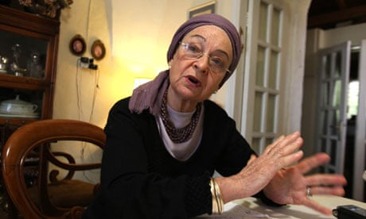
PARENT OF CHILD IN SHIDUCHIM

Slide 30
PARENT OF CHILD IN SHIDUCHIM
Evaluating every characteristic in everyone in the extended family, including grandparents, cousins (intelligence, wealth, health, attractiveness, successfulness)
Being exacting in finding an exact match in terms of family (what kind of headcovering father/mother, siblings, same kind of socks, status)
Belief in one’s need to control
Hyper-responsible OCD; fear of causing harm, exaggerated belief in one’s responsibility

Slide 31
PARENT’S ROCD THOUGHTS
Doubting my own judgment
Is this a good enough reason to say no?
Am I shortchanging my child?
Will I be blamed for my child’s flaws?

Slide 32

CLIENT-THERAPIST ROCD

Slide 33
CLIENT-THERAPIST ROCD
I have to feel better at the end of the session. If I don’t then the session was wasted. If I don’t I will have a bad week.
At the end of the session I have to have resolved any uncertainty and know exactly what to do.
If the therapist forgot something I have to analyze whether she cares.
I better not annoy her, talk about the wrong things, make her think I’m not grateful, because that will harm the relationship.
I have to stay in therapy because otherwise how will I know if I am/ am not OK?

Slide 34
CLIENT-THERAPIST ROCD
Hypervigilance about “not caring”:
“Did you change the timing of the session because another client needed it?”
“You didn’t start the session by asking how I am.”
Using the session for reassurance seeking.
Fear of being fooled; “is my relationship with my therapist a real relationship?”

Slide 35
MECHANISMS THAT PERPETUATE OCD
Misappraisal of intrusive thoughts
Increased attention to intrusive thoughts
Desire for certainty
Desire for the “just right” feeling
Compulsive behaviors, mental rituals

Slide 36
VULNERABILITIES
Self esteem issues and vulnerabilities (feelings of self worth)
Attachment anxiety (hyper-vigilance to attachment threats leads to compulsive reassurance seeking and checking behaviors)
Feelings of incompetence in the relationship domain (negative feedback regarding the ability to maintain a long-term relationship)

Slide 37
NIR LIEBERMAN AND REUVEN DAR’S WORK
(2023)
“Some individuals have difficulty accessing their own internal states (feelings, emotions, preferences, motivations). To circumvent this introspection deficit, they activate “proxies” in the form of rigid rituals.
They get stuck in the process of looping through their proxy search.
They cite research showing that people with OCD are less accurate in gauging their own experienced emotions and report difficulties in assessing everyday internal states such as hunger, interpersonal closeness, preferences and sense of satisfaction.”

Slide 38
LIEBERMAN AND DAR
“We often rely on internal cues to decide when an action should be terminated, when we have done enough (ie handwashing). But for those with OCD, such introspection does not work so they seek rules to instruct them when to stop.
In making a decision, the process is terminated when a satisfactory solution has been found. If the feeling of satisfaction is inaccessible, the person may continue to search forever.”

Slide 39
CONTINGENT SELF-ESTEEM AND THE VULNERABLE SUBTYPE OF NARCISSISM
Need for approval and validation from other in order to maintain or enhance their self-worth.
Such hypersensitive self-esteem may be the core feature associating vulnerable narcissism with sensitivity to negative experiences like failure, rejection, and personal partner features valued as defective.

Slide 40
FRIEND ROCD
Choosing: I will only associate with friends who are cool and well dressed, so my friends will reflect well on me. (I don’t have any friends because when I judge them that way, no one is good enough.)
Checking: Did my friends do something without including me?
Comparing: Number of friends, how close, how many people came to her simcha vs to my simcha.
Testing: Not calling in order to see if she will call me, testing to see if she remembers something I told her.

Slide 41
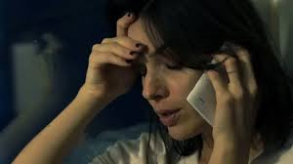
PARENT-CHILD ROCD
Closeness: my value as a mother is determined by how close my married children are to me, how often they call me, how long the conversations are, how soon they tell me about their pregnancies.
Evaluating the child’s goodness, capability, “nachas providing”

Slide 42

CHILD-PARENT ROCD
Keeping score regarding which child my parent favors.

Slide 43
OCD REGARDING RELATIONSHIP WITH HASHEM
“It’s a bug”
Emunah: A Guide for Coping with Questions
Rabbi Dovid Aryeh Kaufman
Emunah@ragua.org

Slide 44
Q and A

Slide 45

BREAK

Slide 46
PART 2
ASSESSMENT AND TREATMENT
Standard assessment including a thorough history of the presenting problem, personal history including trauma, family history (including anxiety disorders), family environment.
Relational history, previous relationships, current relationship.
Information about the triggers of obsessions, their frequency, expected feared outcome, emotions.
Identification of compulsions, avoidance and safety behaviors, time spent on these behaviors.
Identification of maladaptive beliefs.
Identification of the cost of the compulsive behaviors.

Slide 47
ISSUES IN ASSESSMENT AND TREATMENT
Lack of awareness of ROCD (even among therapists), and its confusion with relationship difficulties, attachment issues, narcissism, status seeking, social anxiety, and normal adjustment to marriage. These may all be present in addition to ROCD.
Expect attachment issues (genetics, the attachment wounds inflicted by a parent with OCD), but treat the ROCD first anyway.
The client will doubt the diagnosis. “How do you know it’s OCD? Maybe the relationship is wrong.”
My own experience as a therapist

Slide 48
ASSESSMENT and PSYCHOEDUCATION
Understanding the ROCD cycle: Trigger (the thought “I’m feeling bored.”), Obsession (intrusive thought of “Is he the right one?”), Feeling (anxiety, doubt, uncertainty, shame), Compulsion (overt or covert, reassurance seeking)
Identifying overt and covert compulsions, and assessing their cost and benefit.
Assessment tools, ROCD.net

Slide 49
YBOCS
Sample questions
Why it may not be accurate

Slide 50
OCD ANALYSIS WORKSHEET
OBSESSION:____________________________________________________________________________________________________________________________________________________
TRIGGERS:_____________________________________________________________________________________________________________________________________________________
OBSESSIONAL INTRUSIVE THOUGHTS_____________________________________________________________________________________________________________________________________________________
FEARED CONSEQUENCES_________________________________________________________________________________________________________________________________________________
AVOIDANCE____________________________________________________________________________________________________________________________________________________
RITUALS AND ANXIETY REDUCTION BEHAVIORS_____________________________________________________________________________________________________________________________________________________

Slide 51
ROCI: RELATIONSHIP OC INVENTORY
(DORON AND DERBY, ROCD.NET)
The thought that I don’t really love my partner haunts me.
I keep asking my partner whether she/he loves me.
I ask myself, “Do I have the feeling that this relationship is “just right”?

Slide 52
PROCSI: PARTNER RELATED OC SYMPTOM INVENTORY
(DORON AND DERBY, ROCD.NET)
I repeatedly evaluate my partner’s social functioning.
I can’t stop comparing my partner’s intelligence level to that of other people.

Slide 53
CHILD FOCUSED OC SYMPTOMS
(DORON AND DERBY, ROCD.NET)
I keep examining whether my child acts in a strange manner.
I keep comparing my child to children that are considered successful.

Slide 54
R-GOCI
(DORON AND DERBY, ROCD.NET)
Is my Emunah lacking?
Script From Emunah: A Guide for Coping with Questions by Rabbi Dovid Aryeh Kaufman:
“I must accept the fact that I am human, and whether I like it or not, I may have thoughts of doubt regarding Emunah. I will have to live with this, even if it means that I do not have the level of Emunah that I should, and even if I wonder if I am a maamin at all. In order to overcome this problem, I must continue serving Hashem regardless of my doubts, and realize that this is the way Hashem created human beings. He accepts me with my imperfections, and I need to do so as well.”

Slide 55
RATIONALE FOR TREATMENT
The “danger” of anxiety (hands demo)
Mountain
Exposure mindset-stay open and vulnerable

Slide 56

THE MOUNTAIN BLOCKING THE ROAD:
RADICAL ACCEPTANCE

Slide 57

EXPOSURE LIFESTYLE

Slide 58
TREATMENT
CBT for the philosophy of tolerating uncertainty
Identifying and challenging love myths
ERP
ACT
EMDR
Positive neuroplasticity

Slide 59
ERP PSYCHOEDUCATION
(IOCDF.ORG)
Purposely exposing yourself to things that make you anxious, leaning into the feelings it provokes, sticking with it, and resisting the urge to engage in compulsive behaviors.
You will feel an initial increase in anxiety, uncertainty, and obsessional thoughts.
You will find that these feelings and thoughts are distressing, but also that they can’t hurt you—they are safe and manageable.
When you stop fighting the obsessions and anxiety, these feelings will eventually begin to subside.

Slide 60
ERP PSYCHOEDUCATION II
(IOCDF.ORG)
This natural drop in anxiety that happens when you stay “exposed” and “prevent” the compulsive “response” is called habituation.
You will find that your fears are less likely to come true than you thought.
You will get better at managing “everyday” levels of risk and uncertainty.

Slide 61
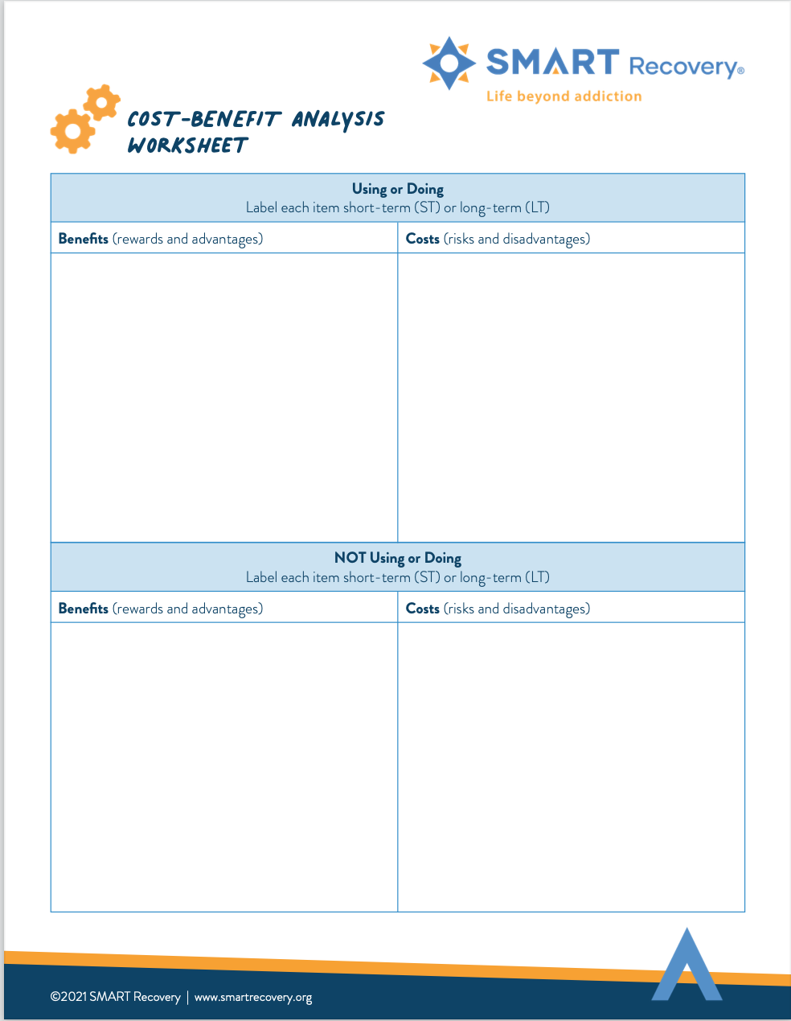
COST BENEFIT ANALYSIS OF DOING ERP
SHORT TERM AND LONG TERM

Slide 62
IS CBT WITH ERP EFFECTIVE?
Only 50-60-% complete the entire therapeutic protocol.
25% refuse ERP.
25% do it but don’t achieve significant benefit.
Relapses are common and need to be planned for.

Slide 63
ERP EXPOSURES
Looking at pictures of partner that are not so flattering
Triggering the doubting thought “I have doubts” and avoid compulsive internet search
Agree with the intrusive thought
Dating or engagement time: expose to weddings, gowns
Rumination redirection
Postponement of compulsive behaviors
Imaginal scripts

Slide 64
GOAL WITH ERP
Habituation vs willingness
Illustration

Slide 65
IDENTIFYING OBSESSIONAL TRIGGERS
(ABRAMOWITZ 2018)
What kinds of situations and objects provoke obsessional fear?
What kinds of situations and objects do you try to avoid?
What kinds of situations and items make you want to perform compulsive rituals?
What situations come up in which you feel the need to seek reassurance?

Slide 66
IDENTIFYING OBSESSIONAL INTRUSIONS
(ABRAMOWITZ 2018)
What persistent unpleasant or senseless thoughts and doubts do you have that provoke anxiety or distress?
What unwanted thoughts or images do you have that you feel you should try to control or resist?
What unwanted thoughts do you have that make you afraid of acting in ways you don’t really want to act?
What upsetting thoughts, images, or ideas do you have that you would prefer not to tell other people about?

Slide 67
IDENTIFYING FEARED CONSEQUENCES
(ABRAMOWITZ 2018)
What is the worst thing that might happen if you faced your triggers and didn’t/couldn’t do any rituals?
Why are your triggers so dangerous?
What might happen if you think certain thoughts and don’t do anything about them?

Slide 68
ANALYZING REASSURANCE-SEEKING RITUALS
(ABRAMOWITZ 2018)
What do you seek reassurance about?
From where or whom do you try to get this reassurance?
People
The media or Google
Therapist
What specifically are you looking to find out?

Slide 69
EXTREME REASSURANCE SEEKING
(ABRAMOWITZ)
“If you’re unable to give up your persistent reassurance-seeking, question-asking, and information-gathering behavior, the problem isn’t that you haven’t found the “right” or “best” information yet. The real problem is that you’re looking for a kind of certainty that’s simply impossible to achieve. You’d like to think that there’s someone, somewhere, who can tell you ONCE AND FOR ALL what you need to know so that you don’t have to worry anymore. But unfortunately, that person-and that information- doesn’t exist. We all have to go on without a guarantee sometimes, and with only a reasonable degree of certainty.”

Slide 70

SITUATIONAL EXPOSURE MENU

Slide 71

IMAGINAL EXPOSURE MENU

Slide 72
ERP SCRIPT
(ANXIETY TRAINING.COM)
Let OCD do the talking. Use lots of details and reasons as to why this deserves your attention.
Record the script.
Listen to the script as you go through your day.

Slide 73

ERP SCRIPT FOR PARTNER ROCD
Sample script

Slide 74
ACT
Reduction of Suds vs Willingness
Values clarification
“I’m having a thought…”
Clipboard
Bus
2 screen method
ACT Matrix

Slide 75

CLIPBOARD

Slide 76
ACKNOWLEDGE AND ADDRESSING CORE FEARS
Incorporate exposure to the core fear into ERP so that the patient develops the ability to face their deepest anxiety without engaging in compulsions.

Slide 77
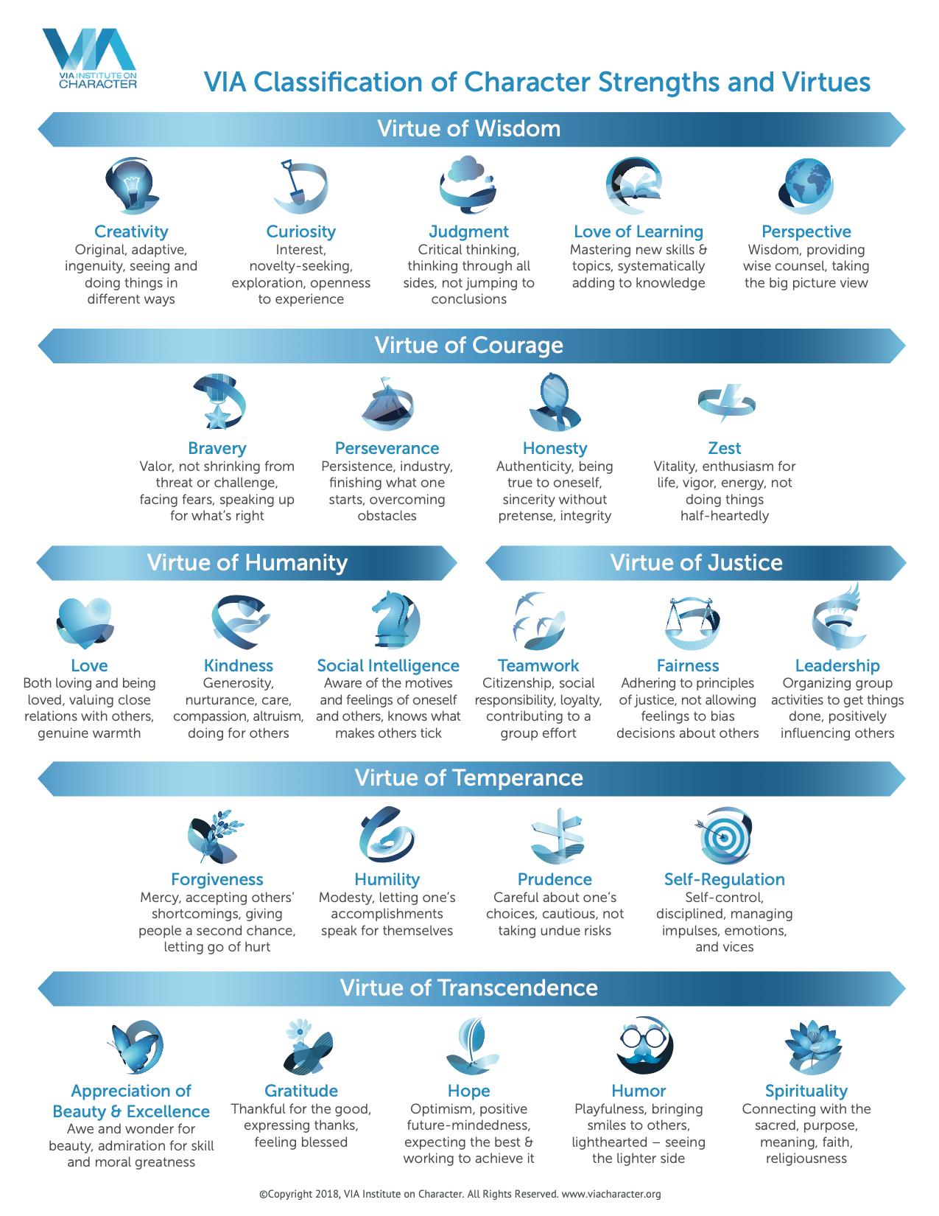
VALUES CLARIFICATION

Slide 78

SCHOOL BUS

Slide 79
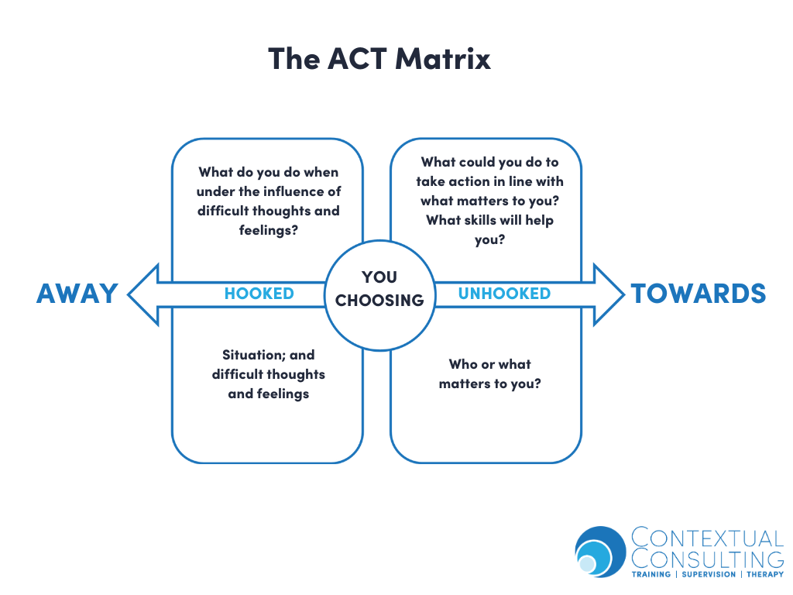
THE ACT MATRIX

Slide 80
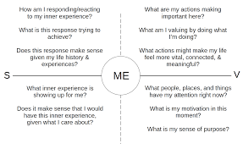
IFS AND THE ACT MATRIX
(theactmatrix.com)

Slide 81
ACT DEFUSION: NAMING THE STORY
“If all these thoughts and feelings were put into a book or song, titled “The SOMETHING SOMETHING Story’, what would you call it?
Each time this story shows up, name it: “Aha, there’s the XYZ story again!”
“The REGRET Story”
“The IS THIS THE RIGHT PERSON? Story”

Slide 82
TWO SCREEN METHOD

Slide 83

EXPOSAPHOBIA

Slide 84
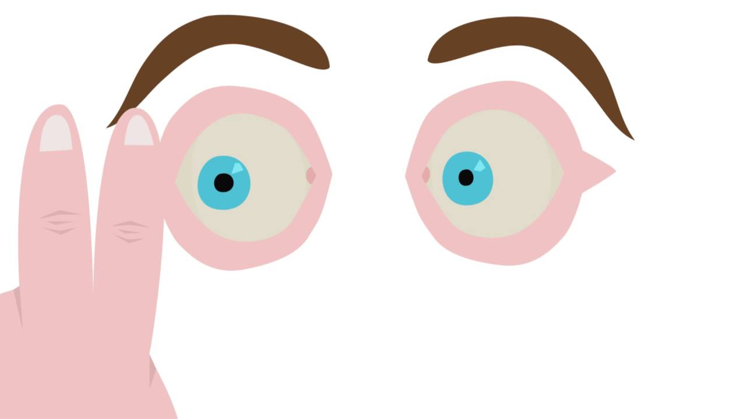
EMDR FOR OCD?

Slide 85
EMDR TO FACILITATE EXPOSURE THERAPY
First trigger or worst trigger
Sliver (tip of pinky)
Body sensations
Shame over having OCD
Jim Knipe (LOUA)
Flash
Standard EMDR (NC, PC)
Future template

Slide 86
ENCOURAGE INVESTING IN RELATIONSHIPS
Focus on being present in the relationship without resorting to compulsions in response to doubting thoughts.

Slide 87
DEFINITION OF ACCEPTANCE REGARDING OCD
(FRED PENZEL)
“Willingness to unconditionally undergo every part of the struggle for recovery, including negative feelings such as anxiety, and in spite of the possibility that setbacks and pain may result.”

Slide 88
ISSUE OF DISCLOSURE
Share the process, not the content of the fear

Slide 89
TREATMENT CHALLENGES
Trusting vs not trusting my brain
Physical triggers such as infection, inflammation, hormones

Slide 90

MEDICATION
Sufficient dose

Slide 91
PSYCHOEDUCATION ABOUT ACCEPTANCE
(FRED PENZEL)
1. OCD is chronic; recovery needs to be maintained.
2. Getting well involves recognizing unpleasant obsessive thoughts and refraining from responding to them with compulsions.
3. Getting well involves hard work and takes time.
4. Being in recovery doesn’t mean you will be 100% symptom free.
5. OCD may have caused you to lose something important in your life that you may not be able to get back.

Slide 92
WHAT NOT TO SAY TO SOMEONE WITH ROCD
Trust your gut.
When it’s the right one “you know”.
You’re too picky.
You have commitment issues.
It’s normal to have such concerns about the relationship. After a while it won’t bother you any more.

Slide 93
REASSURANCE SEEKING: ADVICE TO FAMILY AND FRIENDS

Slide 94
WHAT TO SAY
This might be ROCD, go for an evaluation with an OCD expert.
There is effective treatment.

Slide 95
Q and A

