Slide 1
Integrative Medicine
Cynthia Kilbourn MD
Director of Integrative Medicine Curriculum – Family Medicine Residency – LGH Penn Medicine
Integrative Medicine Fellow - University of Arizona
Obstetrics Fellow - Ventura County Medical Center

Slide 2
Integrative Medicine
“The doctor of the future will give no medicine, but will interest her or his patients in the care of the human frame, in a proper diet, and in the cause and prevention of disease” ~Thomas Edison
“The good physician treats the disease; the great physician treats the patient who has the disease.” ~Sir William Osler

Slide 3
What is Integrative Medicine?
IM is healing-oriented medicine that takes into account the whole person (body, mind, spirit), as well as all aspects of lifestyle.
It emphasizes the therapeutic relationship between patient and provider.
It makes use of all appropriate therapies, both conventional and complementary.
It is not synonymous with alternative medicine or CAM (complementary and alternative medicine).

Slide 4
What is Integrative Medicine?
What changed in my clinical practice after I completed my Integrative Medicine fellowship?
Notes:
After my Integrative Medicine Fellowship:
My APPROACH to patient care changed.
My PRIORITIES in a patient visit were not the same.
I blended this new lens through which I viewed patient care with expanded diagnostic and therapeutic options.
My patients almost uniformly appreciated it.

Slide 5
Medicine is moving in the right direction
More emphasis on
  nutrition as a primary intervention for metabolic disease
  manual therapies for pain control.
More IM education in medical schools and residency programs
Notes:
Nutrition and manual therapy articles published in mainstream guidelines and major medical journals
Still no ACGME requirements for nutrition in family medicine, internal medicine and pediatric residencies.

Slide 6
Medicine is moving in the right direction
Integrative Medicine is slowly becoming mainstream medicine.
Despite our best efforts, this is NOT easy given the present demands on physicians.
This approach is often not our default habit.
Notes:
Obstacles to physicians:
computer charting
short appointment times
Increased administrative demands
In fast paced clinical practice, we rely on default habit to get through the day.

Slide 7
What is Integrative Medicine?
IM does not reject conventional Western medicine.
IM does not accept alternative treatments uncritically.
It is a BLEND of expanded therapeutic options tailored to the unique individual patient.

Slide 8
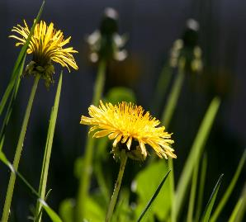
What is Integrative Medicine?
It is focused on PREVENTION OF DISEASE
It seeks to identify the ROOT CAUSE
NOT ALGORITHMIC.
157684488.webloc
Notes:
Prevention not just treatment of disease
Identify root cause of a problem rather than simply treating symptoms
It may be guided by algorithms.

Slide 9

What is Integrative Medicine?
Recognizes that the Mind, Body and Spirit are ONE
              MIND
              BODY SPIRIT
              “Stress can do anything”
              “It’s not all in your head”
Notes:
Mind, body and spirit are truly inseparable.
Rene Descartes (1596 – 1650) did his best to separate the mind from the body to protect the spirit from science. The mind should be the purview of the church and the body should be the purview of medicine.
One basis for the Western Mind – Body separation.

Slide 10
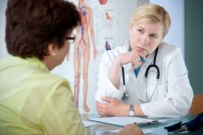
What is Integrative Medicine?
  PATIENT not PROVIDER/COMPUTER CENTERED

Slide 11
What is Integrative Medicine?
  Individualized treatment using Motivational Interviewing techniques.
  NOT PROSCRIPTIVE.
Notes:
Who is speaking more during the patient interview?
Are we making eye contact?
Does the patient feel seen and heard?
We do not simply provide the patient with a list of the things that we want them to do.

Slide 12
Integrative Medicine therapeutic plan
  What is the patient interested in doing?
    Does the patient have confidence in the recommended therapy?
    Is the patient able to incorporate the therapy into their present life?
    What are the patient’s resources?
  Does the patient understand the agreed upon plan and can they describe it to you?
  Print out personalized, simple, basic instructions.

Slide 13
Healing oriented medicine – Healing Curing
Curing Communicable Disease
Healing Non Communicable Disease

Slide 14
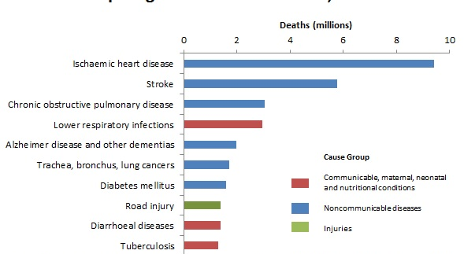
Top 10 global causes of death 2016
Notes:
6 of 10 are chronic non communicable diseases (imported S.A.D. diet, tobacco, etc.).
Only 3 of 10 are communicable diseases.

Slide 15
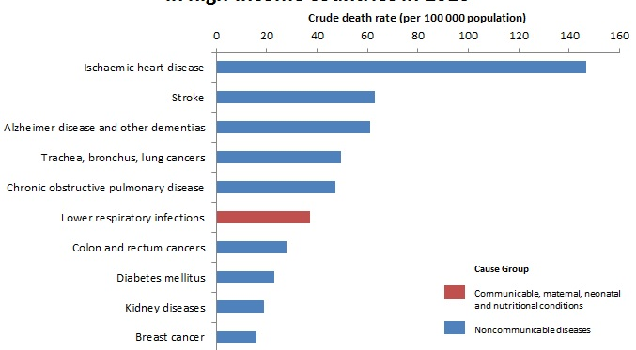
Top 10 causes of deaths in high income countries 2016
Notes:
9 of 10 are chronic non communicable diseases (nutrition, smoking, lack of exercise, high stress environments, lack of sleep).
Only 1 of 10 is communicable.

Slide 16
Healing oriented medicine
Much more effective in managing long term chronic illness.
Origin of the word “Health”
Definition of Healing
One can be healed without being cured.
Notes:
Comes from the Old English word “Hal” – wholeness, soundness, spiritual wellness.
The process of becoming whole or sound, moving from an unbalanced to a balanced state.
It is possible to feel physically, mentally and spiritually whole, i.e. HEALED, with an ongoing chronic illness.

Slide 17
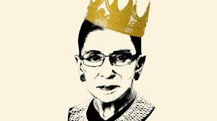
The Face of Resilience:
Healed but not Cured

Slide 18
Healing oriented medicine
Emphasis on the activation of the patient’s innate ability to heal themselves.
  Immune system enhancement
  Focus on Sleep Health
  Focus on Nutritional choices
  Promoting patient confidence in their own resilience.
Notes:
Immune system enhancement with e.g. zinc, medicinal mushroom tinctures, cancer immunotherapy, etc.

Slide 19
Is Integrative Medicine evidence based?
Guided by evidence based medicine but it is not bound by it.
IM uses a sliding scale of evidence in making therapeutic choices.
Preference for natural, less invasive interventions rather than costly, invasive ones when possible.
Notes:
The greater the potential for a treatment to cause harm, the stricter the standard of evidence it should be held to for efficacy.

Slide 20

Is Integrative Medicine evidence-based?
Therapies may be recommended that do not yet have a solid base for efficacy if their potential for harm is low.
Notes:
Examples:
Teaching hypertensive patients breathing techniques to increase parasympathetic tone
Recommending restorative yoga practices for patients with anxiety and/or insomnia

Slide 21
Is Integrative Medicine evidence- based?
Obstacles to applying EBM to IM.
  The individual modalities employed by IM are more difficult to study
  Studies of medications often compare the medication to placebo rather than to a specific lifestyle change.
  Integrative protocols are more individualized making studies more challenging.
Notes:
Studies are more difficult to conduct e.g. nutritional interventions are more difficult to study than conventional medicine.
One study that did compare lifestyle interventions to medications: DPP/ Diabetes Prevention Program

Slide 22

The “Prescription Pad”
In the USA, the primary therapeutic tool of office based providers is –

Slide 23
Blending therapeutic options allows for the use of
    the smallest number of medications
    at the lowest dose
    for the shortest amount of time.
Notes:
As the dose of a medication increases, side effects increase and benefit is not as great.

Slide 24
Why the “Prescription Pad”?
Expediency
Our Education
Patient Expectations
Vestige of the past
Notes:
We use it as a primary tool out of expediency.
We use it because we have been educated that medications are the best way to treat disease.
We have trained our patients to expect it. (and it may discourage them to actively participate in their care)
Vestige of the past when communicable diseases were the mainstay of practice.

Slide 25
Why the “Prescription Pad”?
Big Pharma
Direct to Consumer advertising
No reimbursement
Notes:
Big Pharma funds much of the research on medications. They are studied and promoted.
Direct to Consumer advertising – “Ask your doctor if Humira is right for you? Side effects may include . . . . . “
No reimbursement for other, potentially safer and equally effective, modalities.

Slide 26
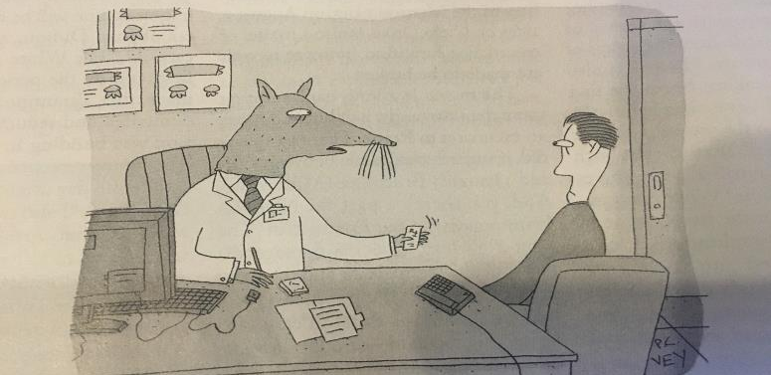
Don’t worry. I wouldn’t prescribe anything I haven’t tested on myself.

Slide 27
An Interesting Question
“If the average doc were asked to manage a case without medication, would they know what to do?”
                Mind Over Meds
                Andrew Weil MD
Notes:
Comment on the priority given to pharmacologic treatment at the expense of other modalities NOT on the ability of practitioners or their interest in other modes of therapy.

Slide 28
Integrative treatment plan:
Modalities to consider
Nutrition – the #1 treatment strategy (the bedrock)
Botanicals
Mind Body Medicine
Exercise (movement)
Supplements
Notes:
Examples of botanicals: Berberine, Red Yeast Rice, CBD, Valerian, etc.
Examples of Mind Body Medicine - meditation, guided imagery, biofeedback (e.g. Heartmath), breath work, nature therapy, restorative yoga, PMR, etc.
Movement – Strength, Flexibility, Balance, and Aerobic
Examples of Supplements – Fish Oil, Magnesium, Coenzyme Q10

Slide 29
Integrative treatment plan:
Modalities to consider
Traditional Systems of Medicine
  Traditional Chinese Medicine
  Ayurveda (traditional Indian medicine; “the science of life”) – based on a system of “doshas”
Aromatherapy
Notes:
TCM
acupuncture/acupressure
Chinese herbs
Tai chi
Ayurveda
Panch karma (detoxification techniques)
Yoga
Nutrition, sleep health, exercise

Slide 30
Integrative treatment plan:
Modalities to consider
Manual Medicine
Energy Medicine
Homeopathy
Counseling – CBT, psychoanalysis, etc.
Notes:
Examples of Manual Medicine: Osteopathic manipulation (OMM), chiropractic manipulation, craniosacral therapy, massage, alignment techniques (Alexander technique, etc.), traditional physical therapy, etc.
Examples of Energy Medicine: Reiki, therapeutic touch, sound therapy, biofield tuning, etc.

Slide 31
Integrative treatment plan:
Modalities to consider
Sleep management
Pharmaceuticals (least number, lowest dose, shortest time)
Surgery
Therapeutic prayer/rituals
Fostering social connection (Loneliness is a major risk factor for poor health)

Slide 32
Examples
Nutrition and CVD and T2DM
Berberine and T2DM
Fish oil/omega 3 fatty acids and depression
Exercise and depression
Mindfulness meditation and pain relief

Slide 33
Nutrition: CVD and T2DM
Nutrition is the #1 modifiable risk factor for death and disability in the United States.
Other Risk Factors:
#2 – Tobacco
#3 – Hypertension
#4 – Elevated BMI
#5 – Increased FBG
Notes:
Resources:
Gaples Institute for Integrative Cardiology
AFP June 2018 Nutrition article

Slide 34
Nutrition: CVD and T2DM
Cardiometabolic disease - heart disease, stroke and T2 DM
Dietary factors associated with Cardiometabolic disease
  Too much
    added sugar
    refined carbohydrate
    Sodium
    processed meat
  Too little
    fiber intake
    vegetable intake
    EPA/DHA (omega 3) intake
    nut and seed intake

Slide 35
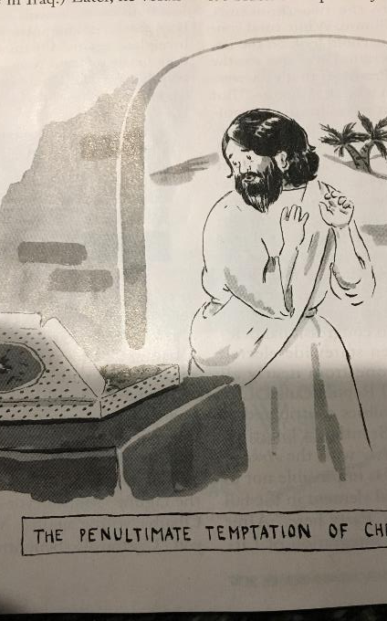
The Standard American Diet

Slide 36
Nutrition: CVD and T2DM
The Remedy: a Whole Foods Diet
  Minimize highly processed foods
  Mediterranean Dietary Pattern
  DASH Dietary Pattern
  Vegetarian Dietary Pattern
  Anti-inflammatory Dietary Pattern
“Eat real food, not too much, mostly plants” – Michael Pollan
Notes:
Highly processed foods are minimized or excluded. (80% have added sugar).
Mediterranean Dietary Pattern: 5 V/ 2 F/ > whole grains and < refined sugars/ > fish and < red meat/ > EVOO and nuts
DASH Dietary Pattern: Similar to the Mediterranean Diet with 8 – 10 servings of V + F and Low fat Dairy
We should be recommending Dietary Patterns to our patients.
The anti-inflammatory diet is a combination of the Mediterranean diet and the Okinawan diet.

Slide 37
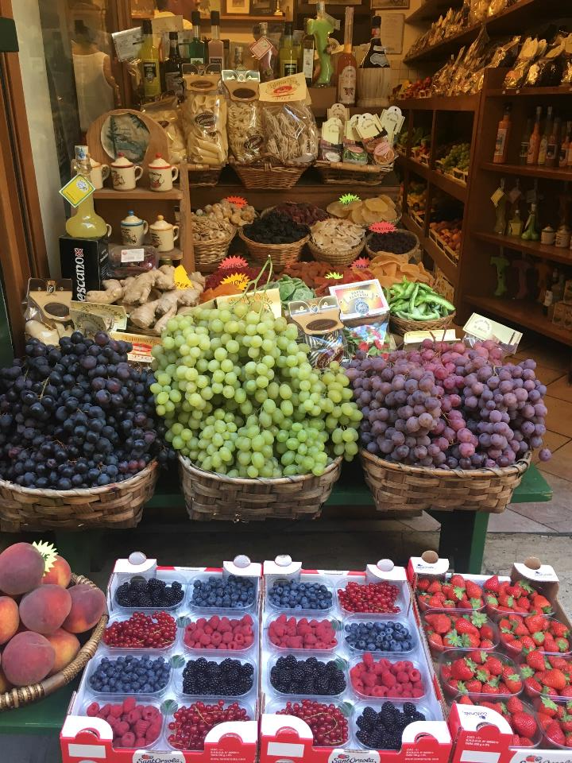
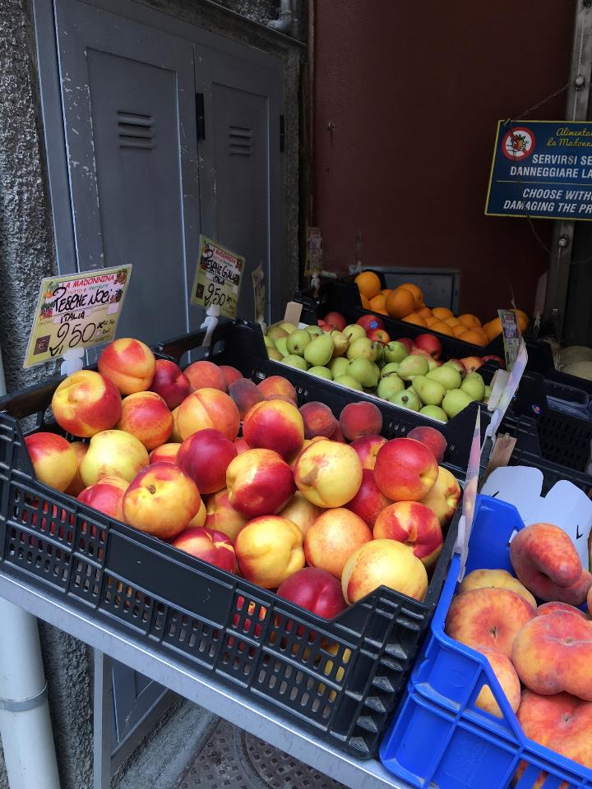
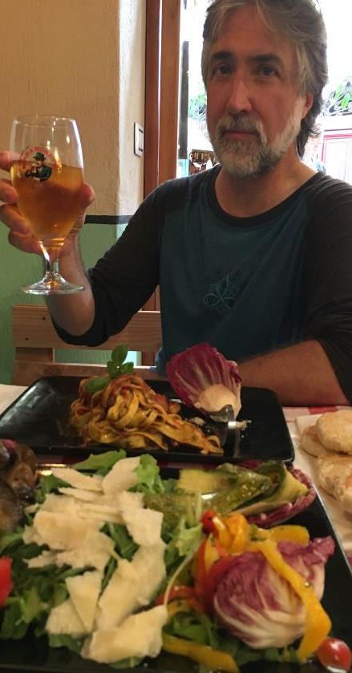

Slide 38
Studies of the Mediterranean Diet
Lyon Mediterranean Diet Study (Circulation 1999)
Secondary Prevention Study
After 5 years, the MD group had ~70% less deaths and nonfatal MIs than the control group.
No significant changes in the lipid profile.
Mechanism: the diet’s anti-inflammatory properties
Notes:
400 patients with heart disease
Compared the MD with a control diet that was similar to the Standard American Diet

Slide 39
Studies of the Mediterranean Diet
PREDIMED Study (NEJM 2013)
Primary Prevention Study
At 4.8 years, there was a 30% decrease in nonfatal MI, cardiac death and stroke in both MD groups compared with the control group.
No significant changes in total cholesterol but there were changes in LDL and HDL
Notes:
3 Groups: Control, MD with extra EVOO and MD with extra nuts
The most significant decrease was in the incidence of stroke.

Slide 40
Dietary Patterns
The Nutrition Source (Harvard School of Public Health)
“There is strong evidence that the traditional Mediterranean Diet is a healthy eating pattern that prevents cardiovascular disease, increases longevity and promotes healthy aging.”

Slide 41
Benefits are big and fast
Adoption of the DASH Diet – Within 2 weeks, an ~11 point reduction in SBP (NEJM 1997)
2015 study: 9 days of sugar restriction in children resulted in significant improvements in:
  DBP
  TG and LDL cholesterol
  Glucose tolerance and insulin levels
Notes:
Sugar restriction was defined as reducing the number of calories from sugar from 30% to 10%, otherwise keeping the number of calories constant.

Slide 42
Can Diet Prevent Type 2 Diabetes?
Dietary changes and movement were twice as effective as metformin.
NNT of ~7 over a 3 year period. (you need to treat 7 patients with diet and movement to prevent one case of T2DM)
DPP (Diabetes Prevention Program) Study (Diabetes Care, 2002)
Notes:
~3000 patients at high risk for T2DM
Metformin decreased progression to T2DM in 31% of patients.
Dietary changes and walking decreased progression in 58% of patients.
You need to treat 7 patients with diet and movement to prevent one case of T2DM

Slide 43
Weight loss
Foods associated with weight gain: Potato chips, potatoes, sugary beverages, processed red meat, unprocessed red meat
Foods associated with weight loss: Vegetables, fruits, whole grains, Yogurt
Other factors: physical activity, alcohol, smoking, too little or disrupted sleep, TV watching
Exercise alone will not result in weight loss (100 calories/mile running
Notes:
121,000 US patients followed for 4 years; NEJM 2011

Slide 44
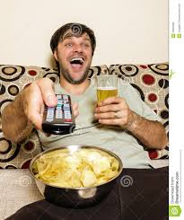

Slide 45
How Processed Food makes us Fat
July 2019 WaPo; NIH Study
Ultraprocessed vs. minimally processed food – IDENTICAL carb/protein/fat ratio
While eating the ultraprocessed foods, subjects ate on average 500 more calories DAILY.
Caloric density and more rapid eating time
Notes:
Ultra processed foods: store bought mac and cheese, frozen pancakes, canned ravioli, chicken nuggets, etc.
Minimally processed foods: oatmeal with nuts and banana, salad with grilled chicken, pasta with shrimp, etc.
Unlimited food access to one of the groups for 2 weeks and then the groups switched
Rapid eating time may have been because ultra processed food is generally softer.

Slide 46
Berberine and T2DM
Many pharmaceutical drugs are derived from plants.
Many of the most effective meds are from plants. (metformin from the French lilac)
Active components are less concentrated in herbal preparations.
Notes:
Many pharmaceutical drugs are derived from plants or are variations of molecules originally discovered in plants. (Amazon rain forest)
Active components are less concentrated in herbal preparations – onset of activity is often slower and side effects often less.

Slide 47
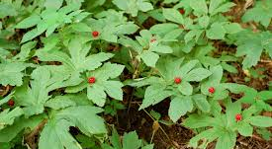
Goldenseal

Slide 48
Goldenseal
Berberine is an alkaloid compound found in goldenseal root
Grows in Pennsylvania
Native American tribes drank the root as a tea for its anti-inflammatory properties
Like many herbal remedies, the list of benefits is quite long and seemingly unrelated.
Notes:
Goldenseal has been used e.g. both an anti-bacterial and treatment for liver disease.

Slide 49
Berberine and T2DM
2012 meta-analysis of 14 RCTs with a total of 1068 participants
  Adding berberine to lifestyle management resulted in lower BG and improved lipid profiles.
  Berberine = Metformin in BG lowering.
Notes:
Lifestyle Modification (LSM) vs. LSM plus berberine: the latter group had significant lowering of BG and improvement in lipid profiles
Metformin and berberine had equivalent effects on BG but berberine also showed improvement in lipid profiles.

Slide 50
Berberine and T2DM
No serious adverse effects; monitor BG levels
Side effects: mild to moderate GI discomfort
Dose: 500 mg BID/TID
Amazing formulas berberine 500 mg capsules; $20 for 120 capsules or ~$10 a month for BID dosing
Notes:
Side effects: mild to moderate GI discomfort (take with food and start at lower doses)

Slide 51
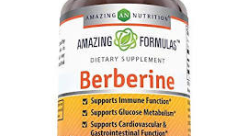
Berberine and T2DM

Slide 52
Consumer Lab
Mission: “to identify the best quality health and nutrition products through independent testing”
They contract with independent labs to evaluate products obtained as a consumer would (online/retail); not directly from the manufacturer
$50 for an annual subscription
Notes:
Website provides meticulous detail on how each product was tested.
Products tested every few years.

Slide 53
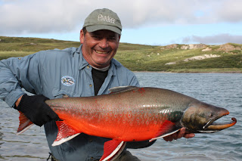
Fish Oil and Depression
“Many studies have evaluated fish oil for depression. Most have shown benefit but some have not. Those that have shown benefit have tended to use larger doses ( ~1500 mg – 3500 mg) that contain at least 60% EPA/DHA in populations not otherwise getting omega 3 FA in their diets.”

Slide 54
Fish Oil and Depression
The antidepressant effect is strongly dependent on EPA content.
Fish oil can be combined with antidepressants to increase their efficacy.
Notes:
American Journal of Psychiatry 2016: “There appears to be an additive effect especially from EPA in doses of 1000 – 2000 mg/day. EPA rich omega 3 fish oil may be recommended for the adjuvant treatment of MDD.”

Slide 55
Fish Oil and Depression
Aug. 2019; Translational Psychiatry
“Compared with placebo, EPA pure and EPA major formulations demonstrated clinical benefits with an EPA dosage ~ 1 g/d whereas DHA pure and DHA major formulations did not exhibit such benefits.”
Notes:
Efficacy of omega-3 PUFAs in depression: A meta-analysis ( 26 studies with 2160 participants)

Slide 56
Fish Oil and Depression
Journal of Clinical Psychiatry Jan. 2012
“The meta-analytic findings provide strong evidence that bipolar depressive symptoms may be improved by adjuvant use of omega 3 FA. The evidence, however, does not support its adjuvant use in attenuating mania.”
Notes:
Omega 3 FA for bipolar disorder: meta-analysis of use in mania and bipolar depression

Slide 57
Fish Oil and Depression
Life Extension Omega Formulations Super Omega 3; 1 softgel = 350 mg EPA and 250 mg DHA ( 58% EPA); $24/120 softgels; for 3 softgels daily - $18 a month
Minami Garden of Life Platinum Omega 3 fish oil; 1 gluten free softgel = 756 mg. EPA and 228 mg. DHA ( 76% EPA ); $42/60 softgels; for 2 softgels daily - $42 a month

Slide 58
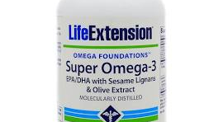
Fish Oil and Depression

Slide 59
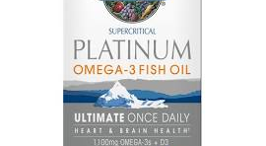
Fish Oil and Depression

Slide 60
Exercise and Depression
Journal of Psychiatric Research June 2016
“Overall, exercise had a large and significant effect on depression. Larger effects were found for aerobic exercise at moderate and vigorous intensity. Our evidence strongly support the claim that exercise is an evidence based treatment for depression.”
Notes:
Exercise as a treatment for depression: A meta-analysis adjusting for publication bias
25 RCTs

Slide 61
Mindfulness meditation and pain relief
Mindfulness meditation engages multiple brain mechanisms to reduce the subjective experience of pain.
After brief training (< 1 week ), participants report significant reductions in pain intensity and “unpleasantness” ratings.
Notes:
Neuroimaging data: Higher order brain regions down regulate ascending nociceptive input at the level of the thalamus through shifts in executive attention.

Slide 62
Mindfulness meditation and pain relief
Long term meditation does not produce changes/differences in pain intensity but influences the “unpleasantness dimension” of self-reported pain.
They interact with an aversive sensation without evaluation/appraisal.
Notes:
There is a decoupling between the sensory and appraisal brain regions.
Significant for the millions of chronic pain patients seeking a narcotic free life.

Slide 63
What is Integrative Medicine?
IM is healing-oriented medicine that takes into account the whole person (body, mind, spirit), as well as all aspects of lifestyle.
It emphasizes the therapeutic relationship between patient and provider.
It makes use of all appropriate therapies, both conventional and complementary.

Slide 64
Resources
Consumer Lab
The Nutrition Source
The Gaples Institute
NIH Office of dietary supplements (NIH ODS)
Integrative Medicine 4th edition David Rakel
Society for Integrative Oncology (SIO)

Slide 66
Why are major medical institutions embracing Integrative Medicine?

Slide 67
Why are major medical institutions embracing IM?
1. It reduces the Cost of medical care
2. There is high Patient Demand
3. It’s just the right thing to do if we want to provide the highest quality care doing the least harm at the best price.

Slide 68
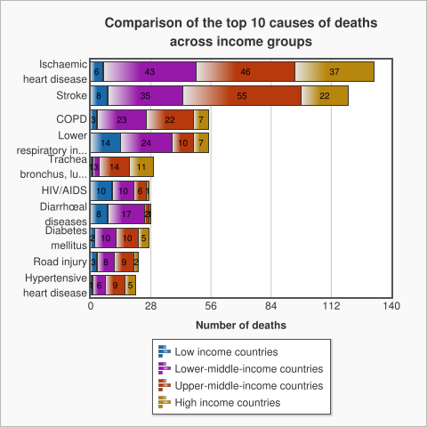
The COST of Medical Care

Slide 69
COST
Among high income, upper middle income, and lower middle income countries, non communicable disease or “lifestyle disease” is the #1 cause of death.
It is only among low income countries that communicable disease remains the #1 cause of death.
“Lifestyle Diseases” - heart disease, stroke, diabetes, COPD, and cancer – are the major drivers of health care costs in this and in most countries.

Slide 70
COST
WHO: 30% of cancer deaths are caused by 5 factors: elevated BMI, low fruit and vegetable intake, lack of exercise, tobacco use, and alcohol use.
The behavioral roots of CV disease and DM are well known (primarily diet and exercise) although we continue to focus on medication as primary therapy.
The 2 most common causes of CKD: HTN and DM, both amenable to lifestyle changes

Slide 71
IM as a Solution to the Current Healthcare Crisis
Integrative Medicine places special emphasis on preventing the “lifestyle diseases” that are the major causes of illness in the U.S. and therefore represent the major health care expenditures in the U.S.
It focuses on lower cost therapies and is not dependent on hi-tech, hi-cost intervention.
Presently, the major tools that practitioners use in the U.S. are the prescription pad and surgery – this is woefully limited in addressing “lifestyle disease”.

Slide 72
Components of Integrative Medicine?
  Conventional Treatments including evidence based screening, pharmaceuticals and surgery, less invasive procedures (e.g. joint injections) and vaccinations
  Nutrition (Food as Medicine) – physicians today generally have almost no training in Nutrition.
  Movement/Exercise
  Mind-Body Modalities for Stress Reduction: the relaxing breath, mindfulness, meditation, biofeedback, yoga, massage and hypnotherapy – physicians today have almost no training in Mind-Body modalities.

Slide 73
Components of Integrative Medicine?
  Botanicals – e.g. valerian (anxiety/stress), bio curcumin (prediabetes), etc.
  Supplements – e.g. probiotics (multiple benefits)
  Manual Medicine – e.g. Strain/Counterstrain, chiropractic, etc.
  Traditional Chinese Medicine (TCM) – acupuncture, Chinese herbs, moxibustion
  Ayurveda (Traditional Indian Medicine)

Slide 74
Components of Integrative Medicine?
Energy Medicine – e.g. Reiki
Aromatherapy – e.g. use of lavender pre and postop
Homeopathy
The IM practitioner is not an expert in all of the modalities listed above but is well versed in them, understands the evidence behind them, and knows how they would be of benefit for individual clinical problems.

Slide 75
Nutrition and Exercise
Sleep Medicine 2011
  Long-term moderate aerobic exercise elicited significant improvements in sleep, quality of life and mood in individuals with chronic primary insomnia.
N Engl J Med 2013
  Among persons at high cardiovascular risk, a Mediterranean diet supplemented with extra-virgin olive oil or nuts reduced the incidence of major cardiovascular events.

Slide 76
Biocurcumin and “Prediabetes”
RCT of 240 patients in Thailand in association with Brigham and Women’s Hospital published in Diabetes Care, vol. 35, November 2012
Conclusion: A 9 month curcumin intervention in a prediabetic population significantly lowered the number of individuals who eventually developed Type 2 Diabetes (750 mg BID)
Extremely safe supplement/ high dose Indian spice

Slide 77
DGL licorice and functional dyspepsia
RCT of 50 patients published in Evidence based Complementary and Alternative Medicine 2011 Jun 16
GutGard (an extract of Glycyrrhiza glabra or licorice) 75 mg BID for 30 days
GutGard showed a significant decrease in total symptom scores on Day 15 and 30 and was safe and well tolerated
DGL licorice is very effective in transitioning patients from PPIs to H2 blockers (1 tablet 20 min prior to meals)

Slide 78
Probiotics and URIs in an adult population
RCT of 272 healthy adult patients published in the European Journal of Nutrition in 2011 Apr; 50(3):203 – 10
12 weeks of 1 billion viable cells daily of a combination of L. plantarum and L. paracasei
Reduction in incidence of URIs from 67% to 55%, number of days with URI Sxs declined from 8.6 to 6.2 days and symptom severity was reduced from 44.4 to 33.6

Slide 79
Motivational Interviewing - the unifying component
Motivational Interviewing is the foundation for discussing Lifestyle Change and underlies much of Integrative Medicine
NOT prescriptive – counterintuitive to physician, NP and PA training
Elicits patient’s interest in change and how they want to proceed (much more of a partnership) –
Eliminates the “noncompliant patient”

Slide 80
IM Treatment Plans
Begins with determining what the patient’s goals are and what the patient is motivated to do.
Incorporates complementary therapies that allow the use of pharmaceuticals to be minimized (lower dose or unnecessary)
Supports the patient longitudinally during the process of lifestyle change (as is mainstream practice with tobacco cessation) – Nutrition, Movement, Stress reduction, Sleep Hygiene
Uses conventional therapies appropriately

Slide 81
Defining characteristics of an IM practitioner
One who values the patient – practitioner relationship
One who respects patient autonomy
One who won’t judge the patient’s choices
One who is familiar with all possible healing modalities
One who reserves more dangerous treatments for situations where safer interventions are not effective enough

Slide 82
Lifestyle Medicine
Provides the first steps toward a fully Integrated Approach to patient health
Four Components: Nutrition, Physical Activity, Stress Reduction and Rest, Social Supports
The Mission of The Institute of Lifestyle Medicine at HMS: “ To reduce Lifestyle-related Death and Disease in Society through Clinician-directed Interventions with Patients”

Slide 83
HMS – The Institute of Lifestyle Medicine
“The Institute of Lifestyle Medicine (ILM) is at the forefront of a broad-based collaborative effort to transform the practice of medicine through lifestyle medicine. This critical transformation is motivated by research indicating that modifiable behaviors — especially physical inactivity and unhealthy eating — are major drivers of death, disease, and healthcare costs. While the medical profession is generally aware of this, there has yet to be a systematic and comprehensive effort to incorporate lifestyle medicine into standard practice. We accomplish this by providing professional education focusing on knowledge, skills, tools, and clinician self care and by creating resources for patients.”

Slide 84
Educational Opportunities
On site courses – e.g. Active Lives: Transforming our Patients and Ourselves
On line courses –
  Nutrition
  Back Pain
  Osteoporosis

Slide 85
Other Integrative Medicine Resources
Jan 2016 – Starnet – Basic Resources to learn how to incorporate MI into practice – Rast and Bollinger
The Nutrition Source – Harvard T.H. Chan School of Public Health
Upenn Mindfulness Center
Natural Standard – Starnet – resource on dietary supplements, natural medicines, etc.

Slide 86
Other Resources
Consumer Labs: independent testing results of supplements, botanicals and nutritional products
NIH/NCCIH: National Center for Complementary and Integrative Health/ similar to US Preventive Services Task Force /recall sliding scale of evidence

Slide 87
Areas requiring Attention
1. Physician Wellness
2. Physician, NP, PA Education
3. Changes in Reimbursement

Slide 88
Physician Heal Thyself
Adult learning style = Experiential
Until medical practitioners themselves have the personal experience of the benefits of excellent nutrition, regular movement, mindfulness and meditation, appropriate botanicals and supplements to reduce medication use, etc., they will unlikely emphasize this to their patients.

Slide 89
Physician Heal Thyself
J R Coll Physicians Edinb. 2009 Dec; 39(4): 290–291.
Physicians' health practices strongly influence patient health practices
One of the strongest predictors of health promotion counseling by primary care physicians is practicing a healthful behavior oneself – it is clear that many physicians report difficulty counseling patients about behaviors they themselves do not practice.1,2
Health promotion counseling by providers is more effective than outsourcing counseling to a specialist or health coach, in part because patients view their longterm GP as the most trusted source of health information.

Slide 90
Capstone Project – Pacific University 2013
Compared to physicians who did not claim healthy habits and/or had a high BMI, physicians with normal BMIs and/or claimed healthier lifestyle habits had:
1. Higher rates of lifestyle counseling
2. Were more likely to initiate weight loss conversations with their obese patients
3. Reported higher confidence in their diet and nutrition counseling
Patients reported higher confidence in health education when it came from a provider who admitted to exercise and healthy nutrition.

Slide 91
Capstone Project – Pacific University 2013
Conclusion: It appears beneficial for providers to engage in healthy habits and weight management. Healthy providers report higher efficacy in their counseling and patients reflect higher confidence and motivation when counseled by healthier providers. Studies are needed to determine if this effect could be maintained long term

Slide 92
Changes in Medical Education
LGH Family Medicine Residency – Medical School Applicants are increasingly inquiring about our Integrative Medicine curriculum.
Recent opinion article: “Replace Organic Chemistry with Nutrition as a premed requirement”
UPenn – Mindfulness based stress management courses are available to all interested students and residents

Slide 93
Medical School Training in Lifestyle Medicine
American Journal of Lifestyle Medicine Sept 2015: “Lifestyle Medicine Education”- Today, the majority of U.S. medical schools do not include Lifestyle Medicine training in their curriculum.
Sept 2013, Lifestyle Medicine Education Collaborative (Medical school deans, content experts, medical students, etc.): “to facilitate the setting of achievable goals, initial curricular areas were limited to physical activity, nutrition, medical student self care and behavioral change.”
In conventional medical education, we are starting from almost NO CURRICULUM in these important areas.

Slide 94
Changes in Reimbursement
Movement to Population Health – keeping people well should also be financially wise
Fee for service reimbursement and patient volume based reimbursement are very entrenched
Both often result in overutilization of higher tech therapies and failure to address the Root Causes of the most prevalent diseases in the US
It takes more time with patients to address the Root Causes of Disease and to introduce lower tech, safer therapies

Slide 95
Options in the present health care environment
1. Cost Shifting
2. Group Visits – coordinated into a program series
3. Working more closely with well trained Advance Practice Providers – the role of the long term primary provider (MD/NP/PA) should not be minimized
4. Concierge Models within an Integrative Health care team
5. Other “self pay” systems

Slide 96
Movement to a new Model of Healthcare
Integrative Medicine provides
The highest quality care
Doing the least harm
At the best price (cost)

Slide 97
Movement to a new Model of Healthcare
SUMMARY:
1. Physician Heal Thyself – practitioners need to personally experience the benefits of caring for themselves in this way
2. Education – practitioners need to have the opportunity to be educated in this model
3. Reimbursement – practitioners need to be supported financially to incorporate this model into their everyday patient care – Give Us Time With Our Patients

Slide 98
How I am currently using Integrative Medicine
Incorporating IM modalities into my current outpatient practice at FMM when patients are interested.
Running the Area of Concentration in Integrative Medicine in the LGH Family Medicine Residency Program – 2 graduates (Drs. Orner and Lee), 4 participants now, 3 interested interns
Offering Integrative Medicine services at ABBCI starting this summer

Slide 99

How I am currently using Integrative Medicine
Leading Wellness Intensives at West End Yoga with Mary Ellen Francescani, CRNP
Offering individual wellness consultations
Middlewaywellness1@gmail.com
Lotus: This plant emerges from the muddy bottom of a pond to flower in the sun. It is a symbol of transformation. This is what we hope to inspire.

Slide 100
HOPE!
Will Conventional Medicine = Integrative Medicine in 20 years? I think so! Lifestyle Medicine is a great start but it does not include some important therapies.
Medical practitioners ARE paying more attention to “integrative” modalities – nutrition, appropriate supplements, mind-body techniques, etc. and this is very encouraging.
Medical Journals are more commonly including “integrative” modalities in their key therapeutic recommendations.

