Slide 1

Case-Based Discussion
Smit Shah, DO
Cardiovascular Fellow PGY5

Slide 2
PMH
56 year-old female with a past medical history of Roux-en-Y gastric bypass surgery, hypothyroidism, anxiety/depression, and LLE DVT.
No significant social or family history.

Slide 3
Covid 19 Infection
01/2022: Mild COVID 19 infection. Did not require any in hospital treatment.

Slide 4
Submassive pulmonary embolus
02/25/2022: ED visit for dyspnea with pleuritic chest pain. Diagnosed with large volume bilateral pulmonary emboli right heart strain (submassive PE). She had required systemic thrombolysis after multiple failed attempts at catheter-directed thrombolysis due to difficulty engaging the pulmonary artery. This was complicated by left facial hematoma.
02/26/2022 Echocardiogram: techniquely challenging study. EF 55-60%. Mildly dilated RV, with reduced systolic function. Small circumferential pericardial effusion without tamponade physiology.
02/28/2022 Echocardiogram: small circumferential pericardial effusion without tamponade physiology, similar to prior study.
3/05/2022, patient was discharged home with recommendations of life long anticoagulation with Xarelto.

Slide 5
Acute decompensated diastolic HF
03/31/2022: ED visit for significant progressive dyspnea with minimal activity over 2–3 days. CTA PE revealed interval resolution of pulmonary emboli, new moderate pericardial effusion, and moderate left and small right pleural effusions.
04/01/2022 Echocardiogram: EF 55%, abnormal septal motion. Small posterior and trace anterior pericardial effusion without hemodynamic compromise.
Cardiology consultation noted that echocardiogram showed evidence of respirophasic abnormal septal motion in some views, although complete evaluation for constriction was not performed. If there is ongoing concern then complete echo evaluation could be obtained.
EKG***
She was diuresed with Lasix IV 20mg bid with the need for midodrine 5mg po TID due to low blood pressure. She was eventually discharged on 4/04/2022, with initiation of Lasix PO 20 mg QD. Weight at discharge was 103.2kg.

Slide 6
Acute decompensated diastolic HF #2
04/09/2022: ED visit complaining of significant exertional dyspnea and chest pain with bilateral ankle swelling, despite compliance to Lasix at home. No significant weight gain. Weight on presentation 103.3kg (compared to discharge weight of 103.2kg from 04/04/2022). Troponin <0.03 x3. EKG NSR without acute ischemic changes. CXR small left sided pleural effusion. Admitted for HF exacerbation.
Treated with Lasix IV 40mg once. Discharged home on 04/11/2022 Lasix po 20mg QD, with a HF clinic appointment the same day.

Slide 7
Outpatient HF decompensation (#3)
04/11/2022: Seen in HF clinic and was noted to be in acute decompensated heart failure with a weight gain of 6lb in the hospital. She was treated with IV Lasix 80mg. Home diuretic increased to Lasix po 40mg QD.
04/18/2022: Telephone call complaining of 2lb weight gain over 1 day. Home diuretic increased to Lasix po 80mg QD.
04/21/2022: Seen in HF clinic again and was noted to be in worsening HF. She was transitioned to Torsemide po 60mg QD.

Slide 8
Fall
04/23/2022 Hospital admission after a fall which was thought to be due to deconditioning from recent hospitalizations and illnesses (critical illness myopathy).
Over the course of the hospitalization, patient continued to gain weight and was noted to have gained 10kgs despite attempts at diuresis with escalating IV Lasix by Internal Medicine Teaching team. Diuresis was becoming challenging due to hypotension which required initiation of midodrine.
04/27/2022 Echocardiogram: EF 50% with abnormal septal motion.
Cardiology eventually consulted for HF management. RHC was recommended. There was again a concern regarding constrictive physiology due to the repeat review of the echo.

Slide 9
RHC
05/04/2022: Right Heart Cardiac Catheterization:
              RA 20/19 (average 19.5)
              RV 35/19 (mean 23)
              PA 30/19 (mean 24)
              PCWP 22/18 (average 20)
              LV 91/19 LVEDP 24
              TD CO/CI = 2.4/1.09
              Fick CO/CI = 3.6/1.6
Final report: Diastolic equalization of pressure, Discordant respiratory variation of RV and LV pressure tracings, square root sign (dip and plateau pattern of RV and LV diastolic tracing) were suggestive of constrictive physiology. Cardiac MRI was recommended for further evaluation.
Diastolic equalization of pressures

Slide 10
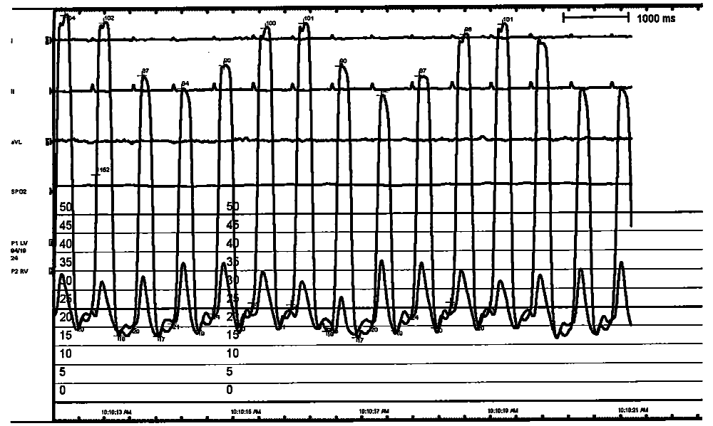
Figure 1. Left ventricular (upper red arrow) and right ventricular (bottom red arrow) pressure tracings demonstrating discordant respiratory variation (exaggerated ventricular interdependence) and square root sign (green arrow).

Slide 11
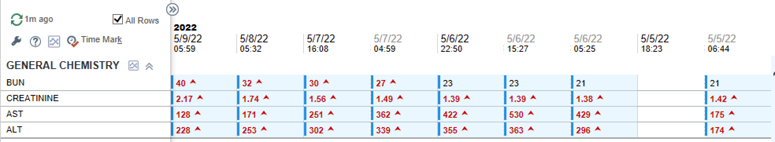
Step up to ICU due to Cardiogenic Shock
05/05: Patient got transferred to the ICU for inotropic support given the low Cardiac Index on RHC. Along with hepatic congestion and worsening renal dysfunction. She was initially started on epinephrine drip although due to elevated SVR, this was switched to milrinone drip at 0.25mcg/hr. She was continued on Lasix drip.

Slide 12
ICU care
CT surgery was consulted for pericardiectomy. In preparation for the procedure, LHC and TEE were requested.
LHC revealed diffuse mild luminal irregularities.
TEE revealed 55% EF. Respirophasic septal motion. Significant respiratory variation of the mitral valve and tricuspid valve inflows. Increased echodensity of the pericardium.

Slide 13
Cardiac MRI
05/09/2022 Cardiac MRI: The pericardium appears mildly and thickened to approximately 3 mm in a relatively diffuse pattern, slightly closer to 4 mm towards the apex. Findings are consistent with constrictive pericarditis. Mild diffuse thickening and subtle enhancement of the pericardium with septal bounce.

Slide 14
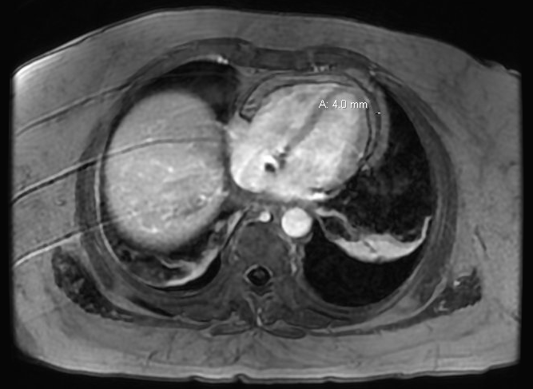
Gadolinium enhanced CMRI (transverse section) showing mild diffuse thickening of the pericardium (arrow).

Slide 15
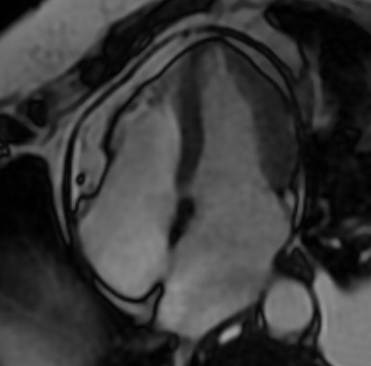
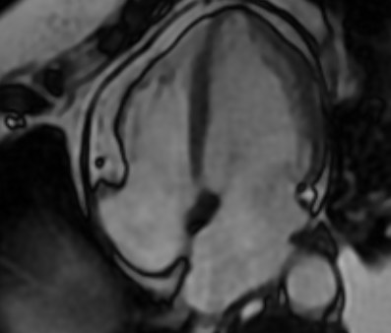

Slide 16
Pericardiectomy
05/10 CTS: Pericardiectomy from right phrenic to left phrenic nerves and resection of a portion of the posterior pericardium. Per the operative note, the pericardium was very thickened and completely adherent.

Slide 17
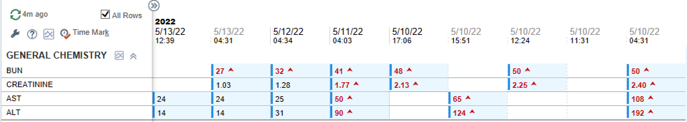
Post OP Course
Patient’s congestive hepatopathy and renal dysfunction improved quickly.

Slide 18
Post OP Course
She had post-op hypotension. was able to be weaned off of milrinone quickly but required phenylephrine for pressor support for a few days before it could be weaned off.
She was eventually weaned off of all pressors and discharged to cardiac rehab.

Slide 19
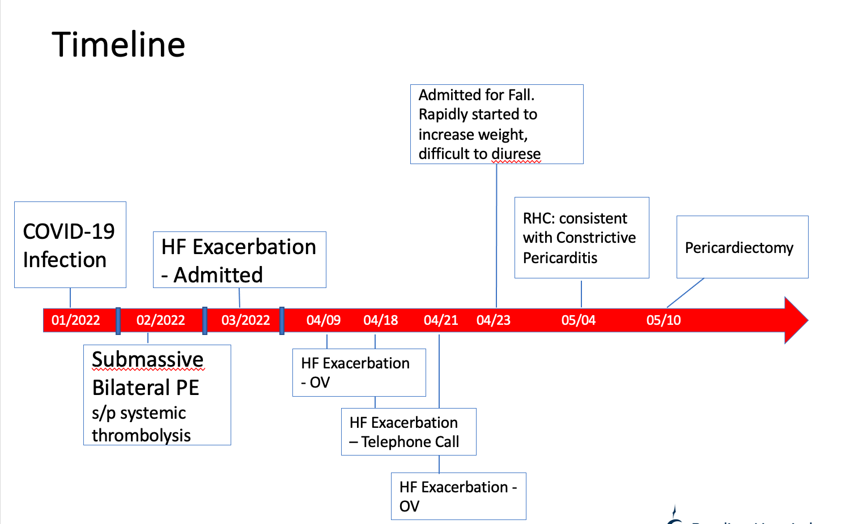

Slide 20
Follow up 07/2022
HF OV: Weights have remained stable since discharge. Her symptoms are progressively improving. Currently on torsemide po 40mg. Renal function has remained stable as well.

Slide 21
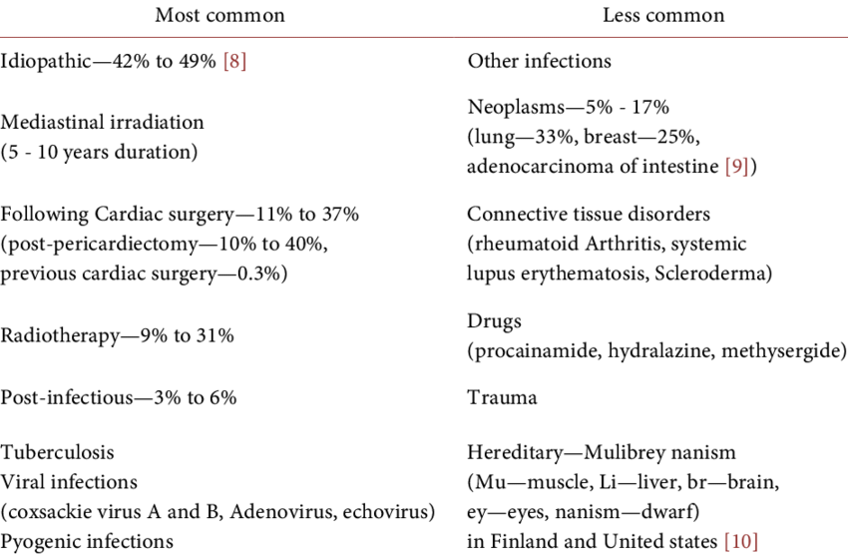
Common Etiology of Constrictive Pericarditis

Slide 22
Pericardial Biopsy
Pericardial biopsy revealed marked fibrosis, mild acute and chronic inflammation with hemosiderin-laden macrophages, and no malignancy.

Slide 23
Proposed Etiology of Constrictive Pericarditis for this case
Suspicion of hemorrhagic pericardial effusion being the etiology of her constrictive pericarditis.
Proposed mechanism:
Treatment of PE with systemic thrombolysis or multiple attempts at catheter-directed thrombolysis resulted in a small-sized hemorrhagic pericardial effusion
Hemorrhagic pericardial effusion triggered pericardial inflammation
Inflammation resulted in pericardial scarring, thickening and formation of adhesions
Eventually leading to constrictive pericarditis.

Slide 24
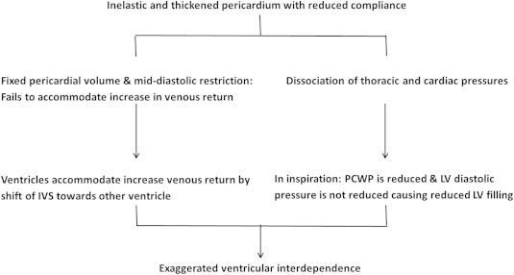
Constrictive Pericarditis is a disorder of impaired cardiac filling caused by an inelastic pericardium that restricts cardiac chamber expansion to a fixed volume

Slide 25
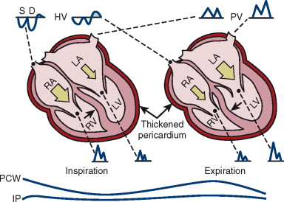

Slide 26
Constrictive Pericarditis
History and Physical exam: Signs and symptoms of heart failure.
- Ranging from peripheral edema to anasarca
Increased JVD (93%)
Pulsus paradoxus (<20%)
Kussmaul sign (20%)
Pericardial Knock (47%)
Hepatomegaly, sider angiomata, palmar erythema, peripheral edema

Slide 27
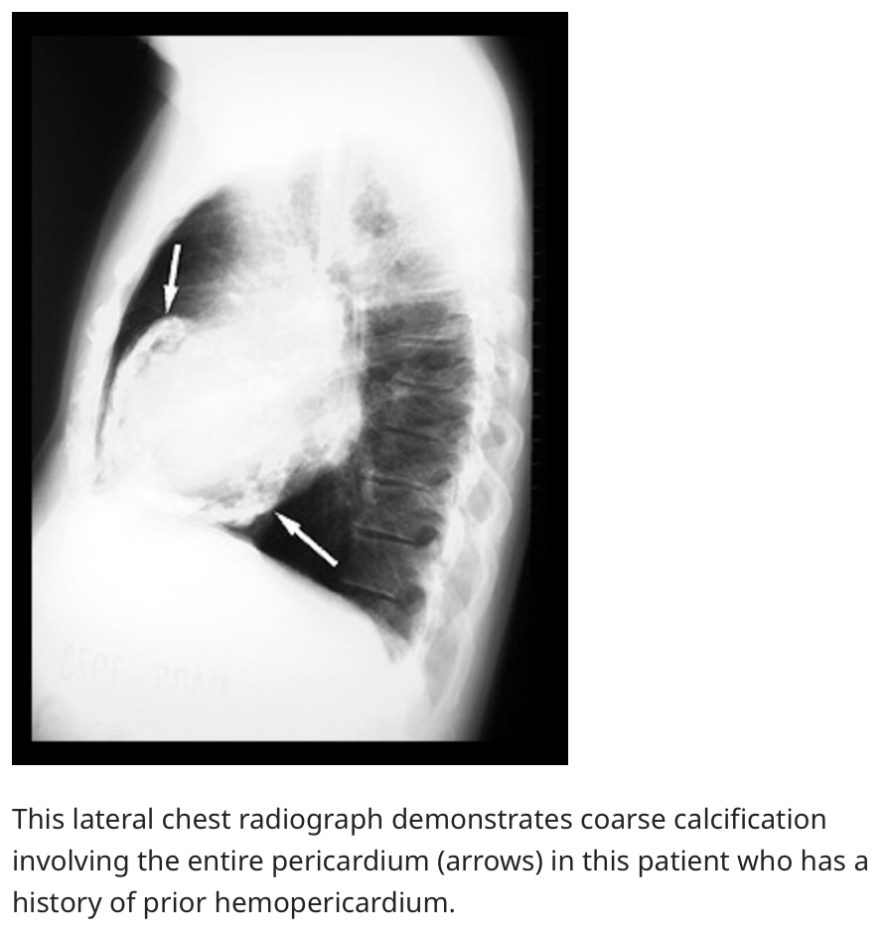
Evaluation
ECG: Nonspecific ST and T wave changes and tachycardia are common, and low voltage may sometimes be present.
CXR: a ring of calcification around the heart is highly suggestive (rare).

Slide 28
Evaluation
Echocardiogram (with expanded Doppler and a respirometer)
        Increased pericardial thickness
        Abnormal septal motion (ie, "bounce")
        Pronounced respiratory variation in mitral/tricuspid valve inflow velocities
        Dilated inferior vena cava and hepatic veins
        Expiratory end-diastolic hepatic vein flow reversal
Cardiac Catheterization
        Kussmaul sign (the lack of an inspiratory decline or an inspiratory increase in central venous pressure)
        "Square root" signs in the RV and LV diastolic pressure tracings (an early diastolic dip followed by a plateau of diastasis; the last stage of diastole just before contraction), also called dip and plateau
        Mirror-image discordance between peak or mean RV and LV systolic pressures during inspiration, another sign of increased ventricular interdependence
        Increased RV end-diastolic pressure and RA pressure
Cardiac CT/MRI
        Delayed hyperenhancement of the pericardium after administration of gadolinium-based contrast suggests pericardial inflammation
        Display real-time respirophasic hemodynamic changes that align with ventricular interdependence

Slide 29
Management
Late (chronic) disease: (common)
  Characterized by advanced and progressive heart failure symptoms
    anasarca, cachexia, hepatic dysfunction, atrial fibrillation, pericardial calcification.
  Diuretics.
  Pericardiectomy is the only definitive/curative treatment option.
  Majority of patients have a significant improvement in symptoms following pericardiectomy. Although, there is high perioperative morbidity and mortality (5-15%).
Early/Subacute disease:
  Characterized by hemodynamic stability, and no evidence of symptoms of late disease.
  Can employ conservative management with NSAID and colchicine for 3 months.
  Patients with refractory symptoms will need CTS evaluation.

Slide 30
Learning Objectives
Identify presenting symptoms and signs of constrictive pericarditis
Management of constrictive pericarditis
Role of multidisciplinary team in management of constrictive pericarditis.

Slide 31
Thank You

