Slide 1
Indwelling Urinary Catheter Indications, Appropriate Urine Cultures, Diagnosis of Asymptomatic Bacteriuria and Urinary Tract Infections
Presented By
Hanan Saab, MPH BSMT CIC
Greta Kolodziej, PharmD RPh

Slide 2
Learning Objectives
Identify appropriate indications for Indwelling Catheter
Recognize how inappropriate urine cultures can lead to patient harm
Outline diagnostic stewardship and the urine culture
Identify patient populations who should and should not be tested and treated for asymptomatic bacteriuria (ASB).
Distinguish asymptomatic bacteriuria from a urinary tract infection (UTI).

Slide 3
Why It Is Important to Learn about Indwelling Urinary Catheters?
Urinary tract infections (UTIs) are one of the most common healthcare-associated infections
Urinary catheters remain one of the most common medical devices experienced by adults in emergency departments and hospitals worldwide
Often, these devices are placed and maintained in use without an appropriate clinical indication to justify the risk compared to the benefit
Of patients who have a urinary catheter placed in the hospital, up to half are placed in patients who may not have an appropriate indication for a urinary catheter
In a 2019 analysis, a study over 5 years, CAUTIs made up an average of 44% of all UTIs in hospitalized patients

Slide 4
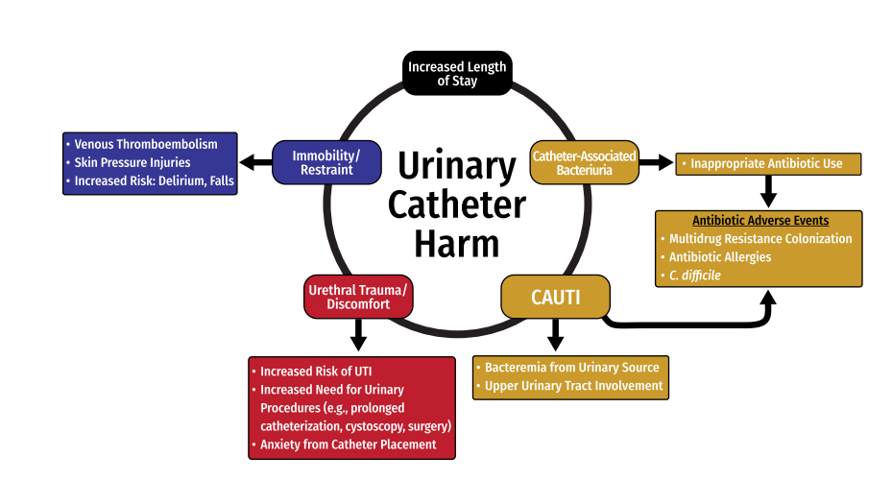
Urinary Catheter Harm

Slide 5
HICPAC Indications for use of Indwelling Catheters
Management of acute urinary retention or obstruction
Perioperative use in selected surgeries (urologic, contiguous structure surgery)
Assistance in healing of severe perineal and sacral wounds in incontinent patients (stage III, IV and Unstageable) when alternative supplies for protective wound or managing incontinence (eg, external urinary catheters, wound dressings) are not feasible
Improve comfort for end of life care
Neurogenic bladder or chronic indwelling catheter (may benefit from suprapubic catheters)
Required strict immobilization for trauma or surgery(e.g., unstable thoracic or lumbar spine, pelvic fractures, etc.)
Accurate measurement of urinary output in critically ill patients (Hourly I&O in intensive care)
HICPAC: is a federal advisory committee appointed to provide advice and guidance to DHHS and CDC regarding the practice of infection control and strategies for surveillance, prevention, and control of healthcare-associated infections, antimicrobial resistance and related events in United States healthcare settings.

Slide 6
Importance of Appropriate Indications of Indwelling Catheters
The daily risk of development of bacteriuria varies from 3% to 7% when an indwelling urethral catheter remains in situ.
Noninfectious complications include nonbacterial urethral inflammation, urethral strictures, mechanical trauma, and mobility impairment
Reduced indwelling urethral catheter use leads to:
  Reduced collection and antibiotic use for positive urine cultures.
  Reduced antibiotic-associated complications, and reduced costs associated with these outcomes
Outbreaks of infections associated with resistant gram-negative organisms attributable to bacteriuria in catheterized patients have been reported

Slide 7
Indwelling Urinary Catheter and Acute Retention/ Obstruction
  Prior to inserting indwelling urinary catheter
  • Bladder scan X3
  • Straight catheterization X3
  Post insertion of indwelling urinary catheter:
  • Continued need for catheterization must be assessed each eight-hour shift
  • Voiding trials as soon as appropriate

Slide 8
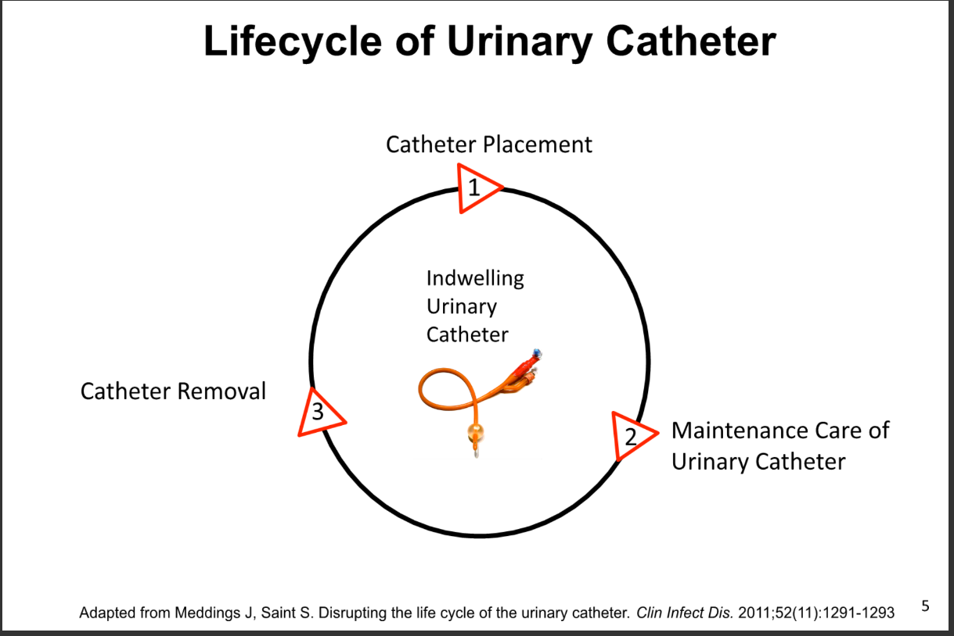

Slide 9
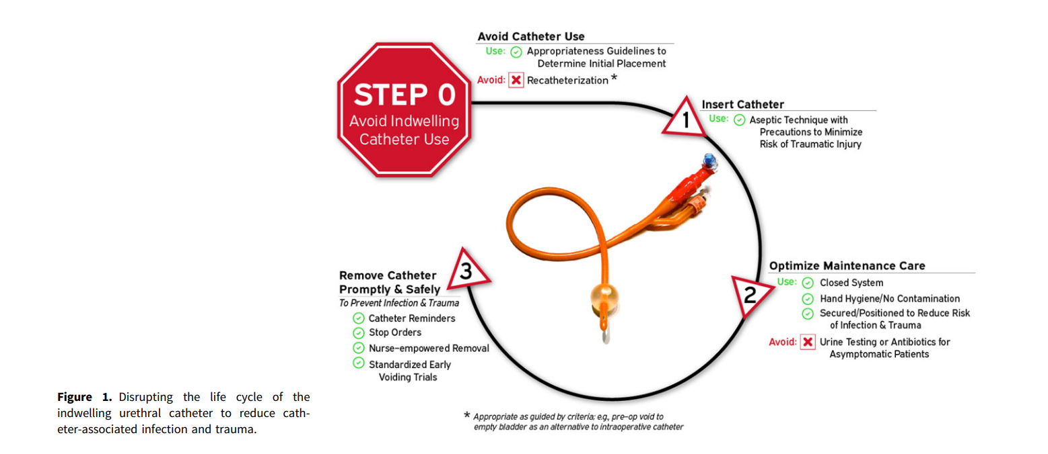
Disrupting the Lifecycle of Urinary Catheters
Encourage and support nurse driven removal protocol

Slide 10
Appropriate uses of urine culture
Presence of symptoms suggestive of a urinary tract infection (UTI):
  Flank pain or costovertebral angle tenderness
  Acute hematuria
  New pelvic discomfort
New onset or worsening sepsis without evidence of another source on history, physical examination, or laboratory testing
Fever or altered mental status without evidence of another source on history, physical examination, or laboratory testing
In spinal-cord-injury patients and other highly complex patients (eg, patients with >40% total body burn, recipients of kidney transplants with graft failure) symptoms may include increased spasticity, autonomic dysreflexia, and/or sense of unease

Slide 11
Inappropriate Urine Culture
•Odorous, cloudy, or discolored urine in the absence of other localizing signs and symptoms
• Sediment in urine
• Reflex urine cultures based on urinalysis results, such as pyuria, in the absence of other indications (absence of pyuria suggests diagnosis other than CAUTI)
• Urine culture to document response to therapy unless symptoms fail to resolve
• Any surveillance screening

Slide 12
Pottstown CAUTI Data FY2024 TD
Month/Yr | Organism | Epithelials/HPF | S&S to meet CAUTI | Reason for culture
Jul-23 | E. coli | 6-10/HPF | Fever | Fever (St. caths at home)
Aug-23 | E. coli | 6-10/HPF | Fever 3 days prior to culture | Leukocytosis (stressed and depressed)
Aug-23 | E. Faecalis | TNTC | Fever | Sepsis
Oct-23 | K. Pneumonia/ Candida | 6-10/HPF | Urgency and Suprapubic Pressure | Change in mental status
Feb-24 | P. agglumerans/ P. mirabilis | 0-5/HPF | Fever (post culture due to Flu) | Cloudy urine
HAI | VBP 2025 Threshold SIR | 2021 National SIR | FY2024 Facility Established Goal (30% reduction in SIR/ Rate) | FYTD2023 HW SIR/ Rate | FY2023 #HAI | FYTD2024 TD HW SIR/ Rate | FY2024 TD #HAI
CAUTI | 0.65 | 0.795 | 0.158 | 0.226 | 1 | 1.5 | 5

Slide 13
Pottstown Urine Culture Contamination Rates
Oct-Dec 2023 Jan- Feb 15th 2024
Urine Source | ED | % Contam | Inpt | % Contam | Facility | Facility % Contam
All Sources | 569 |  | 208 |  | 777
All source Contam | 367 | 64 | 70 | 34 | 437 | 56
Foley/Cath | 46 |  | 59 |  | 105
Foley/Cath contam | 22 | 48 | 3 | 5 | 25 | 24
Straight Cath | 41 |  | 15 |  | 56
Straigh Cath Contam | 17 | 41 | 8 | 53 | 25 | 45
Clean Catch | 361 |  | 79 |  | 440
Clean Catch Contam | 252 | 70 | 40 | 51 | 292 | 66
All other | 121 |  | 55 |  | 176
All other Contam | 76 | 63 | 19 | 35 | 95 | 54
Urine Source | ED | % Contam | Inpt | % Contam | Facility | Facility % Contam
All Sources | 308 |  | 97 |  | 405
All source Contam | 239 | 59 | 41 | 42 | 280 | 69
Foley/Cath | 26 |  | 16 |  | 42
Foley/Cath contam | 6 | 23 | 2 | 12.5 | 8 | 19
Straight Cath | 17 |  | 4 |  | 21
Straigh Cath Contam | 6 | 35 | 0 | 0 | 6 | 29
Clean Catch | 189 |  | 50 |  | 239
Clean Catch Contam | 127 | 67 | 30 | 60 | 157 | 66
All other | 76 |  | 21 |  | 97
All other Contam | 47 | 62 | 9 | 43 | 56 | 58

Slide 14
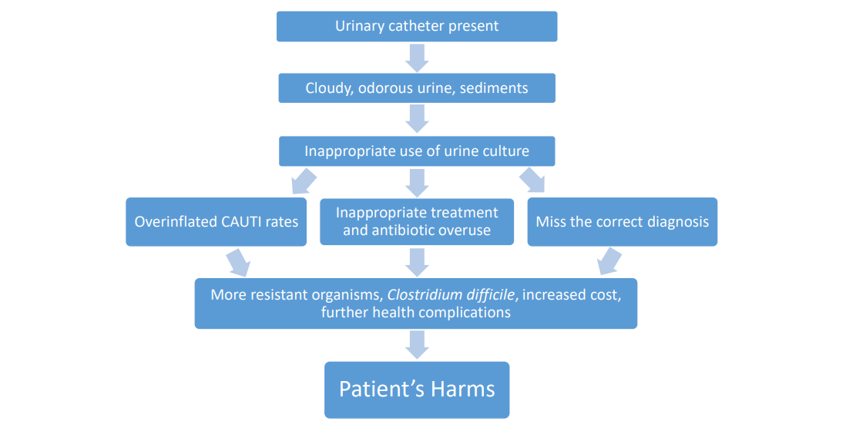
How Can Inappropriate Urine Cultures Lead To Patient
Harm?

Slide 15
Urine Culture Ordering Stewardship
Do not order in the absence of signs and symptoms of UTI, including patients with urinary catheters and those undergoing preoperative evaluation (unless urinary mucosal bleeding anticipated).
Document indication for sending a urine culture.

Slide 16
Positive Urine Culture Stewardship
Ask the patient if he or she is having urinary symptoms before initiating antibiotics.
Ask colleagues why the urine culture was sent (was there a suspicion for UTI at some point?).

Slide 17
Treatment of Asymptomatic Bacteriuria Is Not Beneficial
Randomized, controlled trials have demonstrated a LACK of benefit of antibiotic treatment of ASB in the following populations:
  Healthy, nonpregnant women aged 18–40 years
  Diabetic women
  Patients with long-term indwelling catheters
  Older women in the community
  Elderly nursing home residents
  Renal transplant patients
  Patients undergoing orthopedic surgery

Slide 18
Treatment of Asymptomatic Bacteriuria Recommended
Guidelines recommend screening and treating for ASB in two situations
  1. Pregnant women at 12–16 weeks gestation
    Prevents pyelonephritis, preterm labor, and infant low birth weight
  2. Impending urologic procedure in which mucosal bleeding is expected
    May prevent urosepsis
    This does not include placement of a urinary catheter

Slide 19
Mental Status Changes, ASB, and UTI
Bacteriuria and delirium are both independently common in the elderly.
Although patients with a symptomatic UTI may present with delirium, no evidence suggests that delirium, falls, or confusion are symptoms of a UTI in the absence of urinary symptoms.
If a patient has signs of systemic infection and delirium, empiric antibiotic therapy may be warranted.
Asymptomatic bacteriuria is not associated with a decreased feeling of well-being.

Slide 20
IDSA Recommends assessment for other causes and careful observation
In older patients with functional and/or cognitive impairment with bacteriuria and delirium (acute mental status change, confusion) and without local genitourinary symptoms or other systemic signs of infection (eg, fever or hemodynamic instability)
In older patients with functional and/or cognitive impairment with bacteriuria and without local genitourinary symptoms or other systemic signs of infection (fever, hemodynamic instability) who experience a fall

Slide 21
IDSA Recommends Against Screening for and Treatment of Asymptomatic Bacteriuria
In patients with spinal cord injury (SCI)
In patients with long term or short-term indwelling urethral catheter (<30 days)
In patients undergoing elective nonurological surgery
In patients undergoing implantation of urologic devices or living with implanted urologic devices
In patients with diabetes

Slide 22
IDSA Recommends Against Screening for and Treatment of Asymptomatic Bacteriuria
In older, community-dwelling persons who are functionally impaired,
In older persons resident in long-term care facilities
In renal transplant recipients who have had renal transplant surgery >1 month prior
In patients with nonrenal solid organ transplant (SOT) (This recommendation places a high value on avoidance of antimicrobial use so as to limit the acquisition of antimicrobial-resistant organisms or Clostridioides difficile infection in SOT patients, who are at increased risk for these adverse outcomes)

Slide 23
IDSA Has No Recommendations
In patients with high-risk neutropenia (absolute neutrophil count <100 cells/mm3, ≥7 days duration following chemotherapy), IDSA makes no recommendation for or against screening for or treatment of ASB

Slide 24
Asymptomatic Bacteriuria
Definition: Isolation of significant colony counts of bacteria in the urine from a person WITHOUT symptoms of a UTI.
ASB is a common finding in some healthy female populations and in many women or men with abnormalities of the genitourinary tract that impair voiding..

Slide 25
Bacteriuria Is Not the Same as CAUTI
What is Bacteriuria?
Bacteria in the urine
Bacteriuria means the patient has a positive urine culture
What is the main difference between bacteriuria and CAUTI?
Bacteriuria can be symptomatic or asymptomatic
In older adults the presence of bacteria in urine is usually asymptomatic
CAUTI requires presence of symptoms consistent with UTI

Slide 26
Pyuria Is Not Diagnostic of CAUTI
Pyuria, like bacteriuria, does not help differentiate asymptomatic bacteriuria from CAUTI.
Patients often have pyuria in the absence of CAUTI
Pyuria in the urine is nonspecific
Pyuria can be from:
  The catheter itself
  Bladder distension

Slide 27
Asymptomatic Pyuria
Pyuria is COMMON in patients with ASB.
Population With ASB | Prevalence of Pyuria
Young women | 32%
Pregnant women | 30–70%
Women with diabetes | 70%
Elderly institutionalized patients | 90%
Dialysis patients | 90%
Patients with short-term catheters | 30–75%
Patients with long-term catheters | 50–100%
Pyuria in patients with asymptomatic bacteriuria is not an indication for antibiotic therapy.
Other causes of pyuria to consider: sexually transmitted infections and interstitial nephritis.

Slide 28
Important to Remember
  Common symptoms of cystitis are dysuria, frequency, urgency, and suprapubic pain.
  Common symptoms of pyelonephritis are fever and flank pain.
  Common symptoms of catheter-associated UTI are fever and suprapubic tenderness.
  Foul-smelling or cloudy urine does not indicate a UTI.
  Mental status changes alone do not indicate a UTI.
  Pyuria can be seen in patients with a UTI but is not
  diagnostic of a UTI in the absence of urinary symptoms.

Slide 29
Important to Remember
The optimal definition for CAUTI used for surveillance and quality improvement is one that only captures true instances of symptomatic infection that would benefit from antimicrobial treatment
Urinalysis with Epithelial cells>15-20 cells/hpf or epithelial cells > WBC indicates contamination
Urine culture growing > 2 organism indicates contamination

Slide 30
Important to Remember
Reducing unnecessary catheter placement and minimizing the duration of catheterization are the primary strategies for CAUTI prevention
Bacteremia secondary to CAUTI is infrequent, as demonstrated in a review of 444 episodes of catheter-associated bacteriuria in 308 patients with CAUTI, in which only 3 patients (0.7%) developed bacteremia from a urinary source.
Diagnostic stewardship strategies could be effective in the treatment and prevention of NHSN CAUTI.

Slide 31
References
Strassle PD, Sickbert-Bennett EE, Klompas M, et al. Incidence and risk factors of non–device-associated urinary tract infections in an acute-care hospital. Infect Control Hosp Epidemiol 2019;40:1242–1247
Clinical Practice Guideline for the Management of Asymptomatic Bacteriuria: 2019 Update by the Infectious Diseases Society of America
https://www.cambridge.org/core/journals/infection-control-and-hospital-epidemiology/article/strategies-to-prevent-catheterassociated-urinary-tract-infections-in-acutecare-hospitals-2022-update/7A56FE9DABD0A9C670D728AD16F9FC48

