Slide 1
Case CONFERENCE
December 16, 2025
Megan E. Durham, MD

Slide 2
“Hematology is mostly hypothetical”
Sunil Muthusami (paraphrased)

Slide 3
16 yo female presenting with weakness
HPI: 3 day history of fever (Tmax 104), vomiting, and headaches. Multiple family members have had similar symptoms. Developed lightheadedness on day of presentation, with a syncopal episode that occurred when she rose from standing, and another that occurred while sitting. Parents called EMS.
EMS: Hypotensive (SBP in the 80s), received NS bolus en route to LGH ER.
ROS:
  Pertinent positives: Reports fever, vomiting, headaches
  Pertinent negatives: Denies cough, congestion, sore throat, rhinorrhea, diarrhea, rashes

Slide 4
16 yo female presenting with weakness
PMH: Hereditary spherocytosis, followed by Nemours Hematology (last seen 7/2015). Per dad, she has never had a blood transfusion.
Surgical History: none
Medications: none
Immunizations: partially immunized (received DTaP, Hib, HepB, IPV, HepA, VZV, and PCV series, but not MMR or meningococcal vaccines), last vaccines given at age 1
Allergies: NKDA

Slide 5
Physical exam
Vitals: Temp 103.1, HR 139, RR 19, BP 119/58
Constitutional: She is toxic appearing, pale, and listless. She is not diaphoretic.
HEENT: Normocephalic, atraumatic. PERRL, EOMI, normal conjunctivae. Dry mucous membranes. Clear oropharynx. Normal ROM of neck, supple.
Cardiovascular: Tachycardic, 2+ radial pulses bilaterally, 3/6 systolic murmur best heard at LLSB
Pulmonary: SpO2 97% on RA. Tachypneic to RR 20, dyspneic but without increased work of breathing or retractions, lungs clear to auscultation bilaterally, good air exchange
Abdominal: Non-tender, non-distended. Normoactive bowel sounds in all four quadrants. Splenomegaly present (palpable nearly to pelvis, approximately 15 cm below costal margin)
Skin: Warm and dry, skin is jaundiced and pale. Cap refill > 3 seconds.
Neurological: Lethargic, able to follow commands and answer questions, though slow to respond. No muscle weakness or abnormal tone, symmetric facial movements.

Slide 6
Physical exam
Vitals: Temp 103.1, HR 139, RR 20, BP 119/58, SpO2 97% on RA
Constitutional: She is toxic appearing, pale, and listless. She is not diaphoretic.
HEENT: Normocephalic, atraumatic. PERRL, EOMI, normal conjunctivae. Dry mucous membranes. Clear oropharynx. Normal ROM of neck, supple.
Cardiovascular: Tachycardic, 2+ radial pulses bilaterally, 3/6 systolic murmur best heard at LLSB
Pulmonary: Slightly tachypneic to RR 20, dyspneic but without increased work of breathing or retractions, lungs clear to auscultation bilaterally, good air exchange
Abdominal: Non-tender, non-distended. Normoactive bowel sounds in all four quadrants. Splenomegaly present (palpable nearly to pelvis, approximately 15 cm below costal margin)
Skin: Warm and dry, skin is jaundiced and pale. Cap refill > 5 seconds.
Neurological: Lethargic, able to follow commands and answer questions, though slow to respond. No muscle weakness or abnormal tone, symmetric facial movements.

Slide 7








What workup do you want?

Slide 8
CBC & retic
WBC 3.2
  59% PMNs, 31% lymphs, 8% monos, 1% eos, 1% basos, ANC 1880
Hgb 3.6
  MCV 75.7, 2+ Hypochromasia, 2+ Spherocytes, 1+ Microcytes, 1+ Macrocytes
Hct 10.3
Plt 103
Retic 2.8% (Normal 0.5-2.5%)

Slide 9
CMP
Na 136
K 3.9
Cl 108
Bicarb 23.6
BUN 20
Cr 0.51
Glu 108
Ca 7.8
Protein 5.9
Albumin 3.8
AST 46
ALT 40
Alk Phos 34
Bili 3.2

Slide 10
RVP
Negative

Slide 11
Coombs and Haptoglobin
Coombs: Negative
Haptoglobin: < 30

Slide 12
Coags
PTT 30.9
INR 1.4

Slide 13
Ferritin
2,548

Slide 14
Viral testing
Monospot negative
EBV: negative IgM, negative early antigen, equivocal IgG, positive EBNA
Parvovirus B19: IgM negative, IgG negative

Slide 15
Differential Diagnosis?

Slide 16
Differential Diagnosis?
In the setting of known HS:
Aplastic crisis
Splenic sequestration
Hemolytic anemia in the setting of infection
Nutrient deficiencies
Without a known diagnosis of HS:
Hereditary elliptocytosis
G6PD
Autoimmune hemolytic anemia
Sickle cell disease

Slide 17
Differential Diagnosis?
In the setting of known HS:
Aplastic crisis
Splenic sequestration
Hemolytic anemia in the setting of infection
Nutrient deficiencies
Without a known diagnosis of HS:
Hereditary elliptocytosis
G6PD
Autoimmune hemolytic anemia
Sickle cell disease

Slide 18
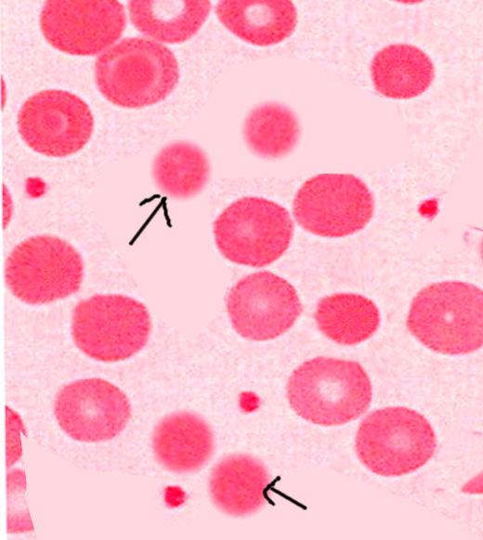
Hereditary spherocytosis
- Most common RBC membrane disorder
- Caused by mutations in one of five genes that encode membrane proteins, which interrupts membrane skeleton linking to the lipid bilayer
- Inheritance: Autosomal dominant (65-70%), Autosomal recessive (5-15%), de novo (15-20%)
- Reduced deformability → impaired passage through microcirculation → splenic trapping → hemolysis by splenic macrophages

Slide 19
Presentation and when to suspect
Wide range of clinical severity
Neonatal-1 year old
  Jaundice in first 24 hours
  Normal Hgb at birth, but anemia in first 2-3 weeks as splenic circulation increases
  Erythropoietic response often not sufficient in first year of life, so many are transfusion dependent in first year, even if not transfusion dependent later on
Older children
  Incidental findings of spherocytes, splenomegaly, jaundice, pigment gallstones
  Hemolytic anemia may be worse during the following conditions:
    Infections
    Nutritional deficiencies
    Pregnancy

Slide 20
Lab findings
  Hemolytic anemia
    Coombs negative
    Increased MCHC (>36)
    Elevated reticulocytes
    Elevated bilirubin
    High LDH
    Low haptoglobin
    Spherocytes on peripheral smear (may not be very evident in newborns initially)
  Confirmatory testing
    Osmotic fragility test (correct answer on the test, but not the most specific or sensitive)
    EMA binding
    Osmotic gradient ektacytometry
    DNA sequencing (through Mayo or Cincinnati Childrens)

Slide 21
Management and monitoring
Babies with a family history of HS
  Need frequent monitoring for jaundice in the first 24 hours
Children with confirmed HS
  Need annual monitoring after a baseline Hgb has been established
  Should get increased Hgb monitoring during viral illnesses
  May benefit from folic acid supplementation
Transfusions
  EPO may decrease need for transfusions in first year of life
  Transfusion volume depends on severity of anemia, typically dictated by hematology
Splenectomy
  In cases of severe hemolysis
  Ideally done > 5 yo so sepsis risk is decreased once they complete the vaccine series for encapsulated organisms
  If cholecystectomy is done, often done at the same time

Slide 22
16 yo female presenting with weakness
Admitted to 4Fred, received a total of 2.5 units PRBCs
Workup for HLH/MAS negative
Given ceftriaxone due to concern for sepsis
Despite multiple transfusions and Lasix, unable to get Hgb above 4.6
Transferred to Nemours for subspecialty care
At Nemours, IgM and IgG for Parvovirus B19 were positive
Received 5 units PRBCs at Nemours, and underwent splenectomy

Slide 23
Questions?

