Slide 1

Sports Medicine Dermatitis
Andrew Westbrook, DO
University of Kansas School of Medicine- Wichita
Sports Medicine Fellowship at Ascension Via Christi
Notes:
Please leave the title slide, objectives slide, and last two slides as they are.

Slide 2
Objective
Explain the treatment of common sports-related skin issues.
This is not a comprehensive review.

Slide 3
Let’s break it down…
Environmental
Pathologic
Mechanical

Slide 4
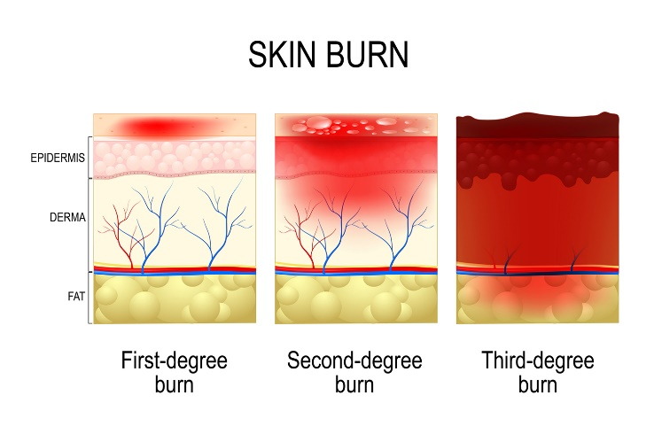
Environmental
Sunburn
  Prevention¹:
    Sunscreen: at least SPF 30
      MUST RE-APPLY every 1-2 hours; even in winter
    Coverage: UPF clothing, sunglasses, hats, scarves, gloves
    Limit outdoor training times between 10am-2pm
B.
A.

Slide 5
Environmental
Sunburn
  Treatment¹:
    Cold Compresses, Hydration
    Oral Anti-inflammatories (NSAIDs, corticosteroids)
  Factors that sensitize the skin
    Medications and topicals:
      Tetracyclines, sulfas, phenothiazines, wrinkle and acne medications (oral and topical)
  Return to Play
    As Tolerated
Notes:
1st Degree: particularly affects water sports and long distance runners and is usually treated with cold compresses and topical cooling gels/lotions.
2nd Degree: Affect Deeper dermal layers and cause bullae to be present; oral corticosteroids and topical anesthetics may be necessary

Slide 6
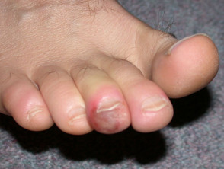
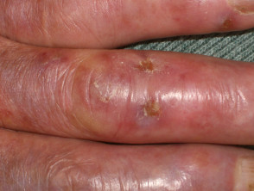
Environmental
Pernio a.k.a. chilblains¹
  Presentation:
    Blotchy, red/purple, pruritic/painful bumps that present several hours after cold exposure
  Etiology:
    vascular constriction during cold exposure followed by blood leakage into surrounding tissues with re-warming
  Treatment:
    Topical or oral corticosteroids
    Protect from further cold exposure
  At risk population:
    cyclists, barefoot runners, tri-athletes
D.
D.
Notes:
An Event of Extreme Vasoconstriction followed by Vasodilation

Slide 7
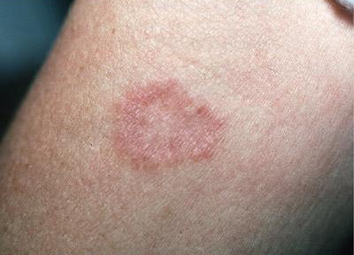
Pathologic
Fungal
  Tinea Corporis (Ringworm), Tinea Cruris (Jock Itch)
    Raised patch/plaque, scaly, blistering, erythematous leading border, often with central clearing
    Etiology: microsporum, trichophyton, epidermophyton
    Tx:
      mild-moderate: topical antifungal creams 2-4wk
      severe:
        itraconazole 200mg QD x7d
        terbinafine 250mg QD x7d
    Return-to-play:
      72 hours tx
      Coverage required for lesions
C.
Notes:
Pathology: usually forms in wet environments

Slide 8
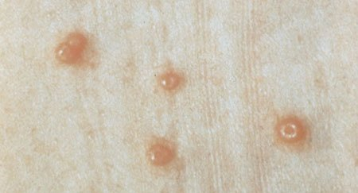
Pathologic
Viral
  Molluscum contagiosum
    Multiple dome-shaped papules with umbilicated center
    Etiology: viral infection transmitted via direct contact
    Tx:
      Cryotherapy
      Curettage, excision
      Topical salicylates
      Topical cantharidin applied in office
      If many lesions consider Cimetidine 400mg TID x 6-12w
    Return to play:
      Coverage Required
D.

Slide 9
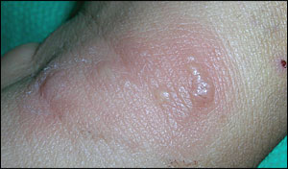
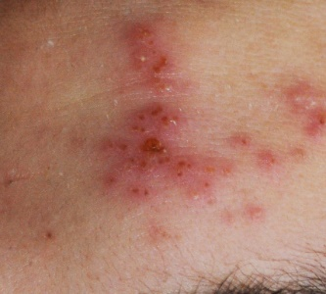
Pathologic
E.
Viral
  Herpes gladiatorum
    Vesicular/pustular lesions or ulcerations on erythematous base (early-mid) or crusting (healing)
    Etiology: HSV-1
    Treatment:
      Cover area (non-wrestlers, eg soccer)
      Antivirals
F.
 | valacyclovir | acyclovir
1st episode | 1g BID x7-10d | 400mg TID x7-10d
Recurrence | 1q QD x5d | 400mg TID x5d
Suppression | 1g QD | 400mg BID QD
Prophylactic | 500mg/1g QD | 500mg BID
Notes:
Athletes may have a prodrome of flu-like symptoms or itching and burning in the area 2-24 hours prior to outbreak

Slide 10
Pathologic
Viral
  Herpes gladiatorum
    Return to play:
      Wrestlers:
        antiviral therapy for 5 days (120 hours)
        no new lesions for 72 hours
        all lesions dry or crusted over
    Prevention:
      Showering after practice
      Cleaning mats directly after use with bleach
      After first outbreak consider team ppx antivirals daily during season
      Topical skin shielding foams/gels

Slide 11
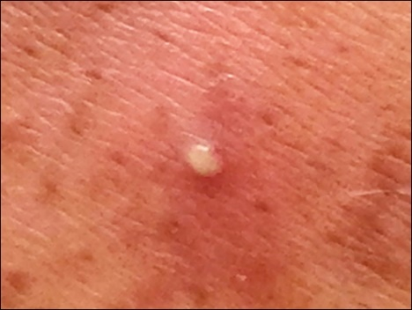
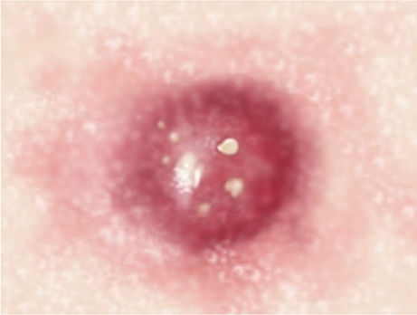
Pathologic
Bacterial
  Furuncle (singular), carbuncle (coalescence)
  Etiology: most commonly s. aureus
    Be sure to ask hx of MSSA or MRSA or recent hospitalizations
G.
H.

Slide 12
Pathologic
Bacterial
  If fluctuant: I&D with packing
  Non-MRSA/MSSA
    Tx: cephalexin 500mg QID x7days
  Methicillin Resistant S. Aureus (MRSA)
    Tx: TMP-SMX DS BID x14d (alt. doxycycline)
    Intranasal mupirocin 2% BID x5days
    Hibiclens daily to every other day for 10-14 days

Slide 13
Pathologic
Bacterial
  Return-to-play:
    At least 72 hours of treatment
    No new lesions for 48 hours
    Coverable, dry lesions, no drainage
    MRSA should be completely healed

Slide 14
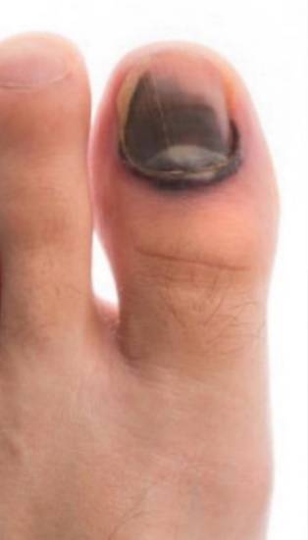
Mechanical
Hematomas
  Subungual hematomas
    Friction associated blood blister under the nail
    Drain only if very painful and inhibiting activity due to risk of infection
    Tx: pad area well with friction resistant material, needle evacuation, cautery or I&D
I.

Slide 15
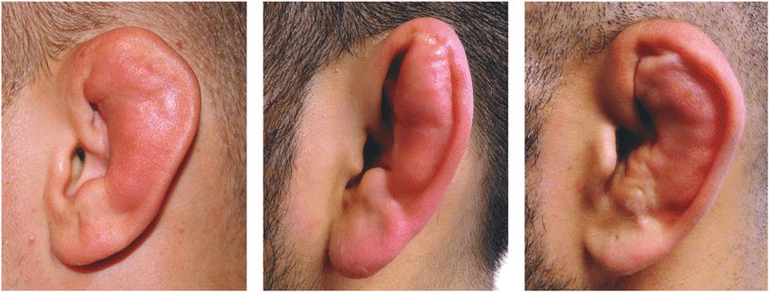
Mechanical
Hematomas
  Auricular hematoma
    Friction associated blood blister in the subperichondrial space
    If left untreated can develop into cauliflower ear
J.

Slide 16
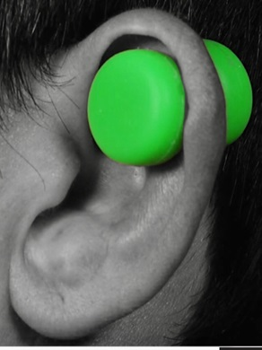
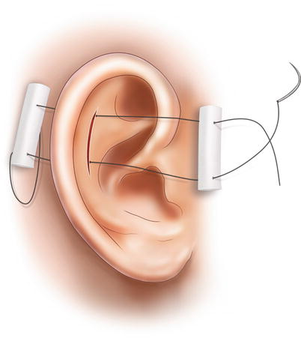
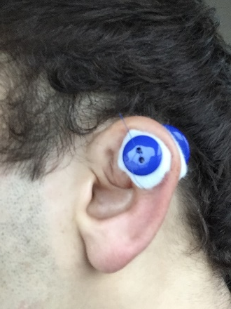
Mechanical
Hematomas
  Auricular hematoma
    Tx: evacuation by needle or I&D followed by sutured pressure dressing or magnets
    Return to play: once pressure dressing removed
    Prevention: head gear for practice and competition
K.
Photo used with patient permission
L.
Notes:
Picture: https://wikem.org/wiki/Auricular_hematoma
https://www.researchgate.net/profile/Christoffer_Ingvaldsen/publication/313021206/figure/fig1/AS:579139678806016@1515089067135/An-untreated-auricular-haematoma-can-lead-to-cauliflower-ear-Above-three-patients-with.png
https://www.teamusa.org/USA-Wrestling/Features/2017/June/22/Preventing-cauliflower-ear-with-Caulicure
https://link.springer.com/chapter/10.1007/978-1-4939-2507-0_58

Slide 17
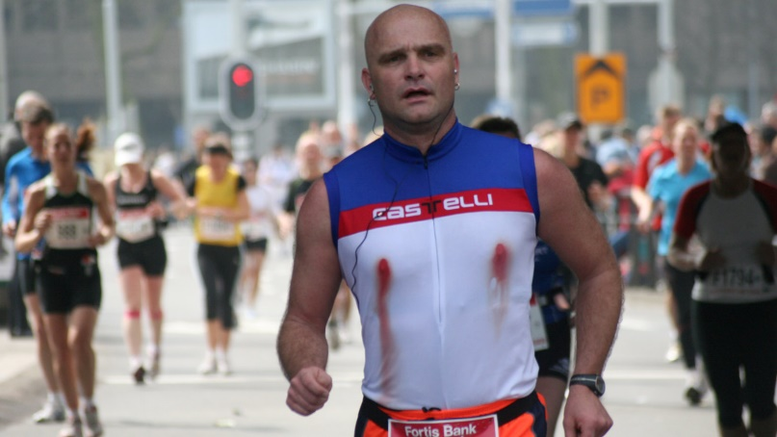
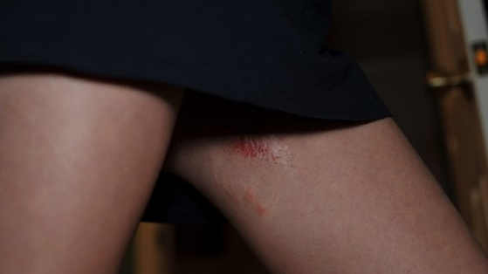
Mechanical
Chafing
  Most commonly affected areas:
    Axillae
      Throwing sports
    Nipples
      Runners, track and field
    Inner thighs/groin
      Runners, track and field
  Treatment: keep area clean and dry, loose fitting clothing, petroleum jelly
  Prevention: anti-chafing gels, loose fitting clothing
M.
N.

Slide 18
Summary
When assessing an athlete dermatitis think:
  Activity
  Mechanism
    Is it mechanical, pathological, or environmental?
  Treat accordingly
  Make activity recommendations
    Return to play
    Change in mechanism factors (clothing, coverings, padding, etc.)
  Appropriate follow-up

Slide 19
References
1. Bannerman, Elana MD; Stevenson, John Herbert MD, CAQ. Dermatology Issues in Sports. Current Sports Medicine. July/August 2017 - Volume 16 - Issue 4 - p 219-220.

Slide 20
References
Pictures
  A.https://www.google.com/search?q=tan+lines&tbm=isch&ved=2ahUKEwiRrvmns-noAhUBL60KHSJzAuQQ2-cCegQIABAA&oq=tan+lines&gs_lcp=CgNpbWcQAzICCAAyAggAMgIIADICCAAyAggAMgIIADICCAAyAggAMgIIADICCAA6BAgjECc6BAgAEEM6BQgAEIMBUNPbA1i15ANgtuUDaABwAHgAgAGTAYgB1AWSAQM4LjGYAQCgAQGqAQtnd3Mtd2l6LWltZw&sclient=img&ei=knOWXpGdH4HetAWi5omgDg&bih=578&biw=1280&rlz=1C1GCEB_enUS879US879&safe=active&ssui=on#imgrc=26n0tQam0cn5cM
  B. https://dermnetnz.org/topics/chilblains/
  C. http://www.dermatlas.net/atlas/imageinfo.cfm?image=910
  D. https://www.strnotderm.com/articles/aad_education_library/589388-molluscum-contagiosum
  E. https://www.aafp.org/afp/2010/1101/p1075.html
  F. https://www.consultant360.com/articles/why-16-year-old-repeatedly-breaking-out
  G. https://www.aafp.org/afp/2015/0915/p474.html
  H. https://www.dabur.com/daburarogya/dermatology/boils-and-carbuncles.aspx

Slide 21
References
Pictures
  I. https://www.orthopedicsri.com/blog-items/subungual-hematoma/
  J. https://wikem.org/wiki/Auricular_hematoma
  K. https://www.teamusa.org/USA-
  L. Wrestling/Features/2017/June/22/Preventing-cauliflower-ear-with-Caulicure
  M. https://www.runsociety.com/health-injuries/nipple-tape-how-to-prevent-nipple-chafing-for-long-distance-runners/
  N. https://www.skincareorg.com/chafing-thighs/how-to-stop-chafing-thighs-after-swimming-during-pregnancy-from-walking-and-running/

Slide 22


