Slide 1
Gene Therapy for Sickle Cell Disease and Beta Thalassemia
Robert Kribs
Assistant Professor of Medicine
Division of Hematologic Malignancies & Cellular Therapeutics
University of Kansas Medical Center
7/27/24

Slide 2
Currently Available Products
Condition | Gene Therapy | FDA approval | Cost
Sickle cell disease | Casgevy (exagamglogene autotemcel) | 12/2023 | $2.2 million
Sickle cell disease | Lyfgenia (Lovotibeglogene autotemcel) | 12/2023 | $3.1 million
β-thalassemia | Zynteglo (Betibeglogene autotemcel) | 8/2022 | $2.8 million
β-thalassemia | Casgevy (exagamglogene autotemcel) | 1/2024 | $2.2 million

Slide 3
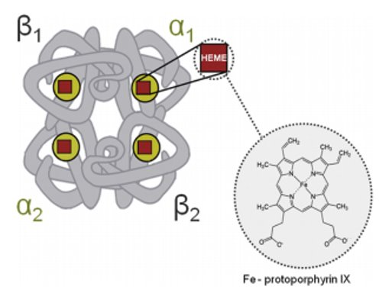
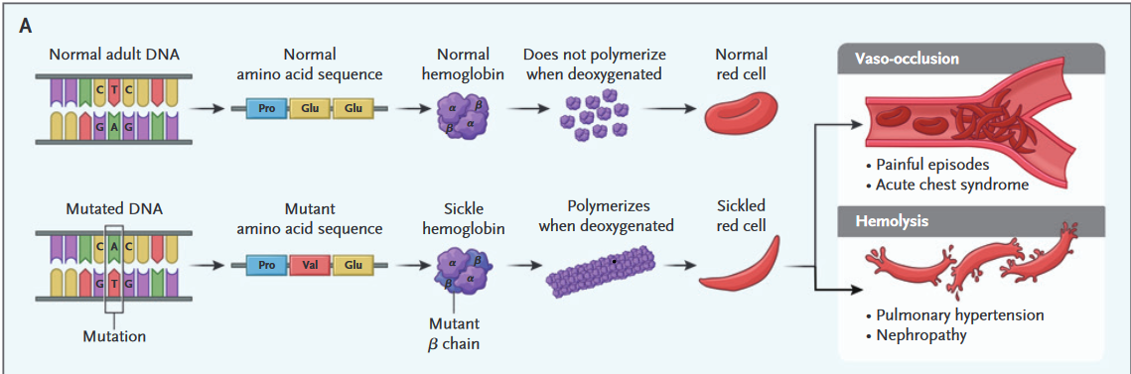
Pathophysiology- Sickle Cell Disease
G. Zadora, A. Menzyk / Trends in Analytical Chemistry 105 (2018) 137-165​
Steinberg, MH. N Engl J Med 2022;386:689-691.

Slide 4
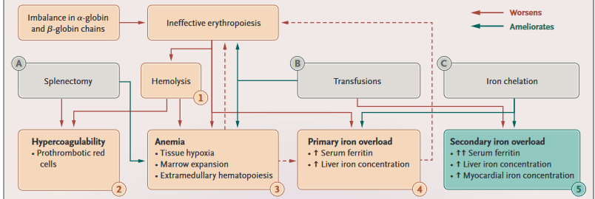
Pathophysiology- Beta Thalassemia
G. Zadora, A. Menzyk / Trends in Analytical Chemistry 105 (2018) 137-165​
Taher, A. et al. β-Thalassemias. N Engl J Med 2021;384:727-43.

Slide 5
Condition | Gene Therapy | FDA approval | Cost
Sickle cell disease | Casgevy (exagamglogene autotemcel) | 12/8/23 | $2.2 million
Sickle cell disease | Lyfgenia (Lovotibeglogene autotemcel) | 12/8/23 | $3.1 million
β-thalassemia | Zynteglo (Betibeglogene autotemcel) | 8/17/22 | $2.8 million
β-thalassemia | Casgevy (exagamglogene autotemcel) | 1/16/24 | $2.2 million

Slide 6
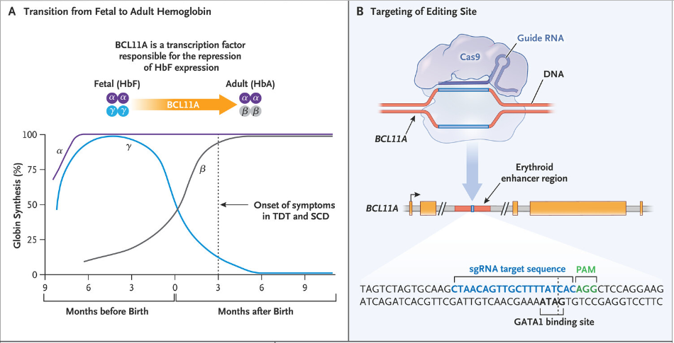
Exagamglogene Autotemcel
Frangoul, H. et al. N Engl J Med 2021;384:252-60.

Slide 7
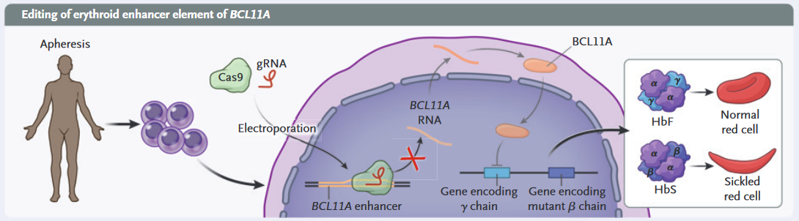
Exagamglogene Autotemcel
Steinberg, MH. N Engl J Med 2022;386:689-691.

Slide 8
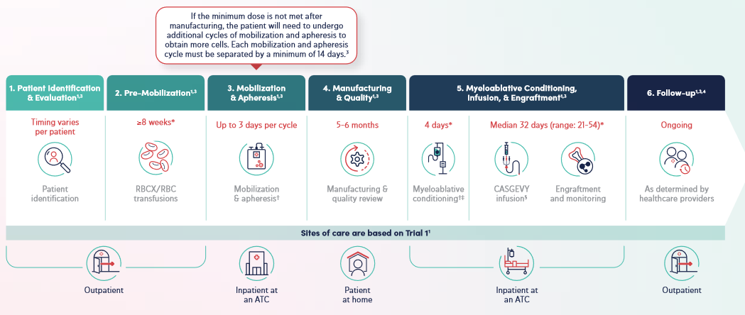
Exagamglogene Autotemcel
​https://www.casgevyhcp.com/sites/default/files/hcp-treatment-journey.pdf

Slide 9
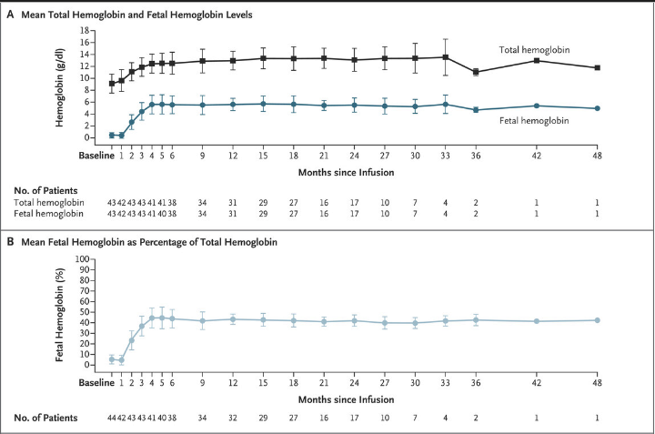
Exagamglogene Autotemcel
Frangoul H et al. N Engl J Med 2024;390:1649-62.

Slide 10
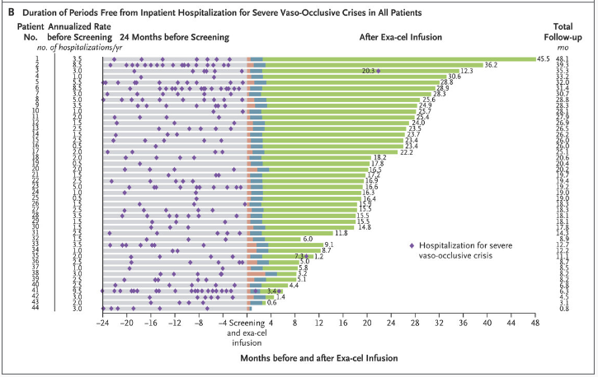
Exagamglogene Autotemcel – Sickle Cell Disease
Frangoul H et al. N Engl J Med 2024;390:1649-62.

Slide 11
Condition | Gene Therapy | FDA approval | Cost
Sickle cell disease | Casgevy (exagamglogene autotemcel) | 12/8/23 | $2.2 million
Sickle cell disease | Lyfgenia (Lovotibeglogene autotemcel) | 12/8/23 | $3.1 million
β-thalassemia | Zynteglo (Betibeglogene autotemcel) | 8/17/22 | $2.8 million
β-thalassemia | Casgevy (exagamglogene autotemcel) | 1/16/24 | $2.2 million

Slide 12
Pathophysiology- Beta Thalassemia
G. Zadora, A. Menzyk / Trends in Analytical Chemistry 105 (2018) 137-165​
Taher, A. et al. β-Thalassemias. N Engl J Med 2021;384:727-43.

Slide 13
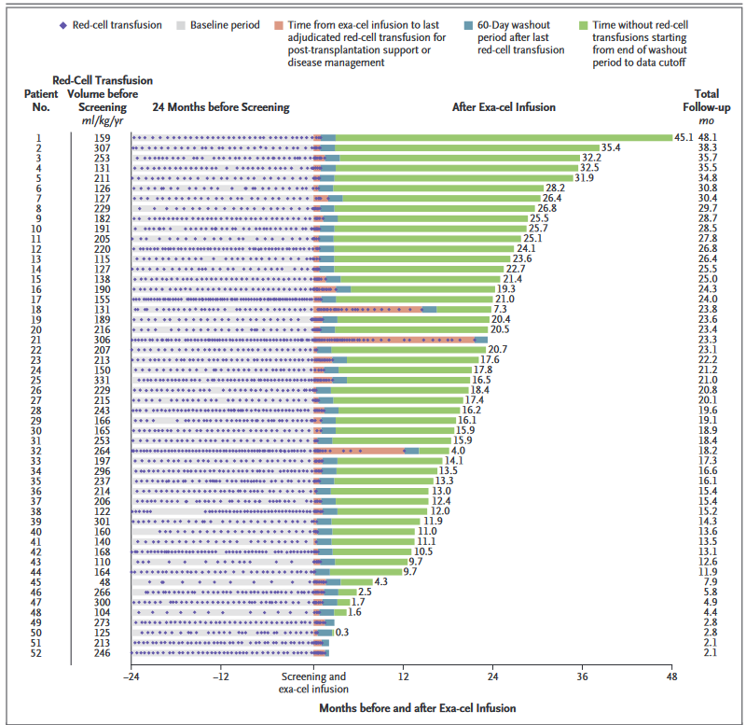
Locatelli, F et al. N Engl J Med 2024;390:1663-76.

Slide 14
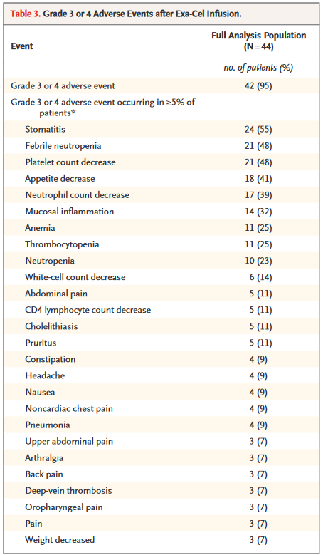
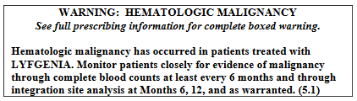
Side Effect Profile
Frangoul H et al. N Engl J Med 2024;390:1649-62.

Slide 15
Thank You
Condition | Gene Therapy | FDA approval | Cost
Sickle cell disease | Casgevy (exagamglogene autotemcel) | 12/8/23 | $2.2 million
Sickle cell disease | Lyfgenia (Lovotibeglogene autotemcel) | 12/8/23 | $3.1 million
β-thalassemia | Zynteglo (Betibeglogene autotemcel) | 8/17/22 | $2.8 million
β-thalassemia | Casgevy (exagamglogene autotemcel) | 1/16/24 | $2.2 million

