Slide 1
Collaboration:
Elements of sustainable relationships
Dr. John Yeast, MD, MSPH
Dr. Denise Fryzelka, PhD, CNM, APNP, FACNM

Slide 2
Objectives
Describe the history and position of ACNM and ACOG professional organizations regarding collaborative practice arrangements.
Define and discuss the development of collaborative practice models and agreements Describe and discuss
Discuss measures and barriers to impact collaborative practice relationships and outcomes of professional and patient satisfaction and outcomes
Review strategies for additional interdisciplinary and community collaboration

Slide 3
History and Experience
Hhostro of

Slide 4
ACNM/ACOG position statements
ACNM 1992- 2014
  Definitions of midwifery scope of care
    Consult /Collaborate /Referral/lTransfer/ Co-Management
Joint efforts with ACOG
ACOG
  1995 Guidelines for Implementing Collaborative Practice by ACOG
  2014 Task force
  2015 - 2019 more recent opinion statements

Slide 5
Collaboration
What is it
How does it work
Models
Benefits/needs that need to be met for each collaborating partner and patients
How to develop a collaborative practice and agreement
Generational considerations

Slide 6
Models of collaborative practice
CNM- MFM
CNM-OB Private practice
CNM-FMOB
CNM-OB Academic residency program
  Attending OBs/ OB residents
Other Models

Slide 7
How to develop a collaborative practice
Team-based care (Education, skill building, continuous evaluation, team member dedication)
  What is team-based care
  Foundational guiding principles
  Key considerations in assessing the need of a practice in implementing team-based care and how emerging technologies can be used to support and facilitate on-site and virtual care
  Licensure and scope of practice laws that govern practice relations between team members and how these care state to state and regulatory frameworks
  Opportunities for implementing team-based collaborative care

Slide 8
Legislation and policy
Independent practice in 31 states including DC
  Full practice authority
Collaborative practice
Supervisory practice

Slide 9


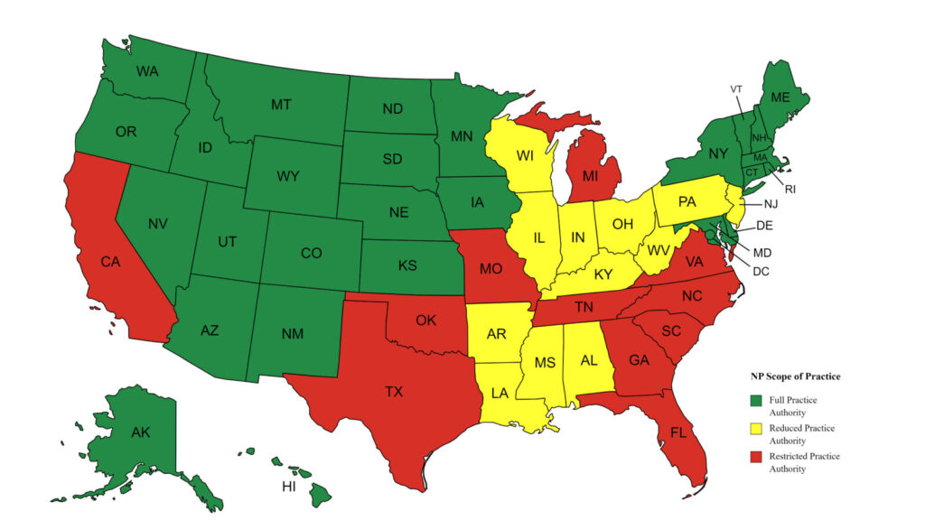




Slide 10
Interdisciplinary Collaboration and Teamwork with other Disciplines
OB/Gyn - ER triage – coverage
Out of hospital practice protocols for transport
Examples from different institutions and states perinatal review committees -
  KS and MO perinatal morbidity and mortality cases
  Currently guidelines CDC and recommendations

Slide 11
Barriers and Measures to Impact Collaboration
Many considerations related to legislative and policy
Hospital Credentialing and privileges
Liability concerns
  Vicarious Liability
Educational/Mentoring/Precepting
  Surveyed responses from CNMs/MDs/Residents
Shifting attitudes and generational /gender influences/perspectives

Slide 12
Wrap up: questions and answers

Slide 13
References
ACNM, Divison of Standards and Practice, 2014. ( July 27, 1992; revised: August 1997; updated and revised, May 2013, updated September 2014). American College of Nurse-Midwives. Definition of midwifery and scope of practice of certified nurse midwives and certified-midwives. Available at: http://www.midwife.org/ACNM/files/ACNMLibraryData/UPLOADFILENAME/000000 000266/Definition%20of%20Midwifery%20and%20Scope%20of%20Practice%20of%20 CNMs%20and%20CMs%20Feb%202012.pdf
ACNM Collaborative Manangement in Midwifery Practice for Medical, Gynecologic and Obstetric Conditions
American College of Nurse-Midwives. Definition of midwifery and scope of practice of certified nurse midwives and certified-midwives. http://www.midwife.org/ACNM/files/ACNMLibraryData/UPLOADFILENAME/000000 000266/Definition%20of%20Midwifery%20and%20Scope%20of%20Practice%20of%20 CNMs%20and%20CMs%20Feb%202012.pdf. Updated February 6, 2012. Accessed September 16, 2014.
ACOG, 2016. Collaboration in practice: implementing team-based care/developed under the direction of the Task Force on Collaborative Practice. Available at: http: //lccn.loc.gov/2016001385
ACOG, 2019 Clincial guidelines and standardization of proactice to improve outcomes. ACOG committee Opinion No. 792. American College of Obstetircian and gyneclogists. Obstet Gynecol 2019 1134: e 122-4
ACOG, 2019. Interpregnancy Care . Obstetric Care No. 8. American College of Obstetircian and gyneclogists. Obstet Gynecol 2019. 133e 51-72.
https://www.ncsbn.org/nursing-regulation/practice/aprn/aprn-consensus-implementation-status/cnm-independent-practice-map.page

