Slide 1

Cost of illness
Talal Nassar PharmD.
Pharmacy Department

Slide 2
Disclosure
The author has nothing to disclose

Slide 3
Objectives
Define evaluation of cost of a disease
Discuss methods of valuing paid and unpaid time in health production
Present recommendation to evaluate cost of illness studies

Slide 4
What Do We Mean By Evaluating The Cost Of A Disease?
One of the most common types of economic study
The purpose: identify and measure all of the costs associated with a disease (stroke, MI, ..etc)
Consist of an estimate, quantified and valued in monetary units, of a series of effects of a disease (or a group of diseases, or a risk factor) on resources and other variables that have a presumed effect on the well-being of individuals and society as a whole.
Notes:
For example, governments may use COI research to estimate the financial impact of a disease on public budgets and to determine if the cause is worthwhile for the greater good, while pharmaceutical companies may determine if the societal burden is large enough to justify directing their research efforts toward a disease’s treatment.
They are often used in conjunction with other types of economic analyses, namely cost-effectiveness or budgetary impact analyses.
Let us take invasive pneumococcal disease and noninvasive all-cause pneumonia in hospitalized US adults. Salini Mohanty et al study published 2024
The mortality rate in hospitalized adults with invasive pneumococcal disease (IPD) was 8.2%
IPD and noninvasive all-cause pneumonia admissions resulted in high hospital costs.
Total hospital cost per admission, USD median (IQR)
Noninvasive ACP = $9746 ($5461, $19,893)
IPD = $13,194 ($7527, $26,051)
Estimated LOS
Noninvasive ACP = 7.7 (7.5, 7.9) days
IPD = 9.1 (8.7, 9.4) days

Slide 5
Effects Of Illness On Well-being
Any illness has a series of effects on the well-being of the individuals who suffer it and on society
    Direct effects on health in the form of premature death, years of life lost or reduced quality of life
    Indirect effects on productive capacity as a result of changes in health status
    Intangible effects on the well-being of individuals other than the sick person

Slide 6
Direct Costs: Health And Non-health Costs
Costs of prevention, diagnosis and treatment: costs directly related to all aspects of the intervention, costs of complications and adverse effects
Non-health expenditure caused by the disease
Costs of research, training and administration
Costs in terms of the patient’s and his or her family’s time, or time dedicated to voluntary work (value of unpaid time)
Time spent by the patient in receiving health care

Slide 7
Indirect Costs
Productivity costs
One of the main sources of controversy in economic evaluation
Loss due to premature mortality or disability attributable to the disease (Morbidity)
The main objective is to value the opportunity cost of time (the value of paid time)
    Mortality costs: production that would have occurred from the time of death to the age of retirement
    Morbidity costs: loss or restriction of the ability to work as a result of absence from work due to sickness

Slide 8
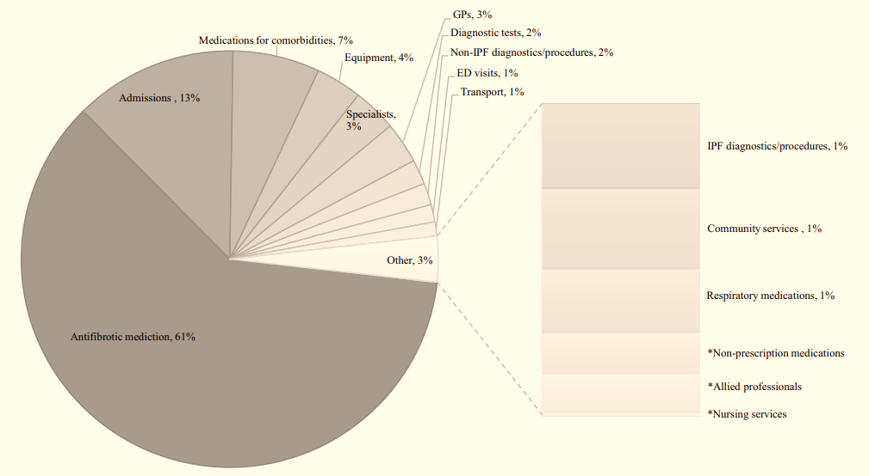
The economic burden of idiopathic pulmonary fibrosis in Australia: a cost of illness study
Cox, I. A., de Graaff, B., Ahmed, H., Campbell, J., Otahal, P., Corte, T. J., ... & Palmer, A. J. (2023). The economic burden of idiopathic pulmonary fibrosis in Australia: a cost of illness study. The European Journal of Health Economics, 24(7), 1121-1139.
Notes:
Example:
The economic burden of idiopathic pulmonary fibrosis in Australia: a cost of illness study: 2022 by Cox et al.
The average annual total direct costs per person with IPF was $31,655 (: $27,723– $35,757)
Extrapolating costs based on prevalence estimates:
the total annual costs in Australia are projected to be $299 million (95% CI: $262 million–$338 million)
Costs were mainly driven by antifbrotic medication, hospital admissions and medications for comorbidities

Slide 9
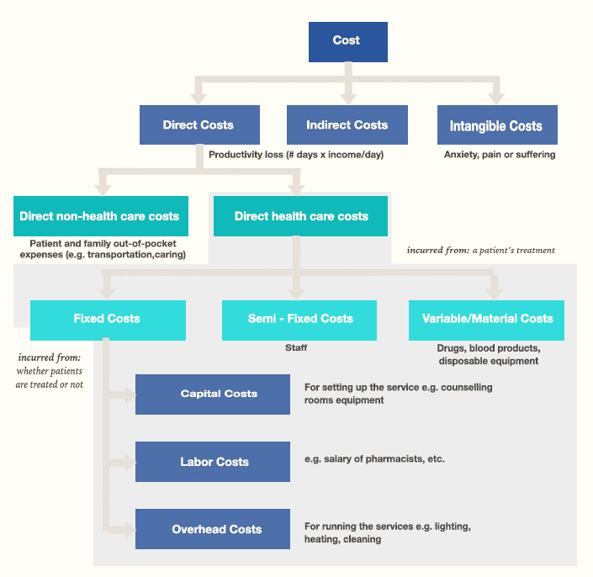
Intangible Costs
Effects of illness that lead to a welfare loss for society
Psycho-social costs
Effects on the deterioration of the quality of life of patients and their loved ones: pain, incapacity, anxiety, loss of self-esteem and comfort
Marksman

Slide 10
Types of cost of illness studies(COI)
COI studies can be described according to:
Epidemiological data used: prevalence versus incidence approach;
Methods chosen to estimate the economic costs: top-down versus bottom-up;
Retrospective versus prospective studies
Notes:
The top-down approach, also known as the epidemiological or attributable risk approach, measures the proportion of a disease that is due to exposure to the disease or risk factor
The bottom-up approach estimates costs by calculating the average cost of treatment of the illness and multiplying it by the prevalence of the illness.

Slide 11
Epidemiological Approaches
Method of estimation of cost of illness
The prevalence approach
  Overall cost of the disease that is incurred in a particular time period (1-2 years)
  In a particular geographical area (e.g., one country)
  Macroeconomic approach
  Direct costs and morbidity costs are allocated to the year in which they occur
  Mortality costs are allocated to the year in which the death occurs
The incidence approach
  Costs generated by the incidence of a disease over time (or the set of new cases of that disease appearing in a given time period)
  Microeconomic approach
  The costs of a disease are allocated to the year in which they begin to be incurred
  The incidence approach allocates all direct and productivity (mortality and morbidity) costs to the year in which the disease under evaluation appears or is diagnosed

Slide 12
Epidemiological Approaches
The prevalence approach
To draw an attention from the health policy planners or decision-makers for conditions whose burden has been somehow underestimated
To design cost containment policies. The study provides decision makers with a picture of the global burden
The incidence approach
Considering preventive measures
Analyzing the illness management during the entire period. Through this approach researchers can develop the clinical and therapeutic guideline

Slide 13
Prevalence Vs. Incidence
The main difference between these two approaches lies in the aspect of the disease that is examined (its prevalence or its incidence) and the time frame that is taken as a reference the duration of the disease for a particular time-period (prevalence) or the entire duration of the individual’s life (incidence)

Slide 14
Methods For Calculating The Cost Of Illness
Disease A:
  The incidence of a disease A (number of new cases diagnosed during a stated period usually one year) is one person per year
  Direct cost: DC-A
  Morbidity cost: MB-A
  Mortality cost: MT-A (capital approach)
  Life-expectancy of the individuals with the disease A is 4 years and will die at the beginning of year 5
  Each year there will be 4 individuals with the disease and the annual mortality will be 1 person
  Premature death as a result of the disease implies a loss of 10 life years per individual
  The discount rate is 6%
Example: Hemophilia is a rare genetic bleeding disorder. People with hemophilia B have a deficiency in clotting human coagulation Factor IX.
Annual costs per individual may be more than $600,000 and as high as $1.1 million, not including indirect costs such as outpatient care and managing uncontrolled bleeds.
The High Price of Hemophilia | ASH Clinical News | American Society of Hematology (ashpublications.org)

Slide 15
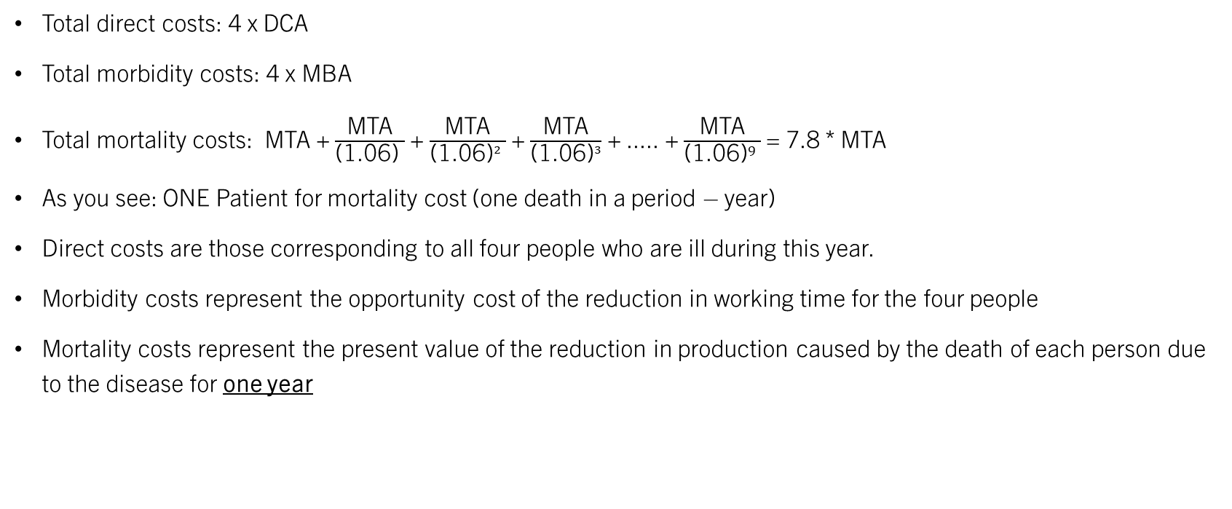
Prevalence Approach
Total direct costs: 4 x DCA
Total morbidity costs: 4 x MBA
Total mortality costs: MTA + $\frac{\text{MTA}}{\text{(}\text{1.06}\text{)} }$ + $\frac{\text{MTA}}{\text{(}\text{1.06}\text{)}² }$ + $\frac{\text{MTA}}{\text{(1.06)}³}$ + ..... + $\frac{\text{MTA}}{{\text{(}\text{1.06}\text{)}}^{9} }$ = 7.8 * MTA
As you see: ONE Patient for mortality cost (one death in a period – year)
Direct costs are those corresponding to all four people who are ill during this year.
Morbidity costs represent the opportunity cost of the reduction in working time for the four people
Mortality costs represent the present value of the reduction in production caused by the death of each person due to the disease for one year

Slide 16
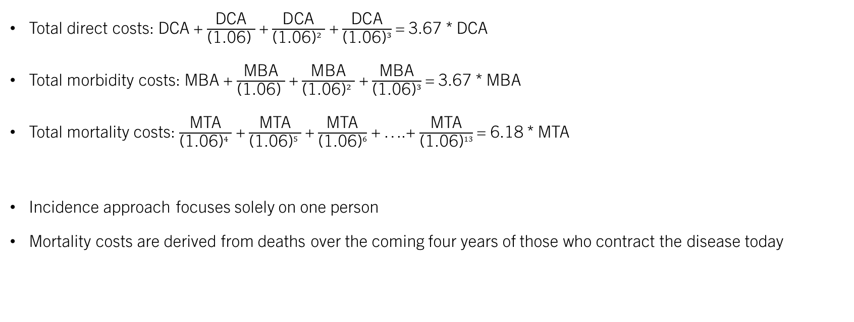
Incidence Approach
Total direct costs: DCA + $\frac{\text{DC}\text{A}}{\text{(}\text{1.06}\text{)} }$ + $\frac{\text{DC}\text{A}}{\text{(}\text{1.06}\text{)}² }$ + $\frac{\text{DC}\text{A}}{\text{(1.06)}³}$ = 3.67 * DCA
Total morbidity costs: MBA + $\frac{\text{MBA}}{\text{(}\text{1.06}\text{)} }$ + $\frac{\text{MBA}}{\text{(}\text{1.06}\text{)}² }$ + $\frac{\text{MBA}}{\text{(1.06)}³}$ = 3.67 * MBA
Total mortality costs: $\frac{\text{MTA}}{\text{(}\text{1.06}\text{)}4 }$ + $\frac{\text{MTA}}{\text{(}\text{1.06}\text{)}5 }$ + $\frac{\text{MTA}}{\text{(1.06)}6}$ + ….+ $\frac{\text{MTA}}{\text{(1.06)}13}$ = 6.18 * MTA
Incidence approach focuses solely on one person
Mortality costs are derived from deaths over the coming four years of those who contract the disease today

Slide 17

Conclusion:
Prevalence Vs. Incidence
The prevalence approach yields a higher estimate of the cost of illness than the incidence approach
Pixabay

Slide 18
Welfare Loss
The welfare loss suffered by a particular population owing to the presence of a disease can be even greater than the cost of illness
In the case of communicable diseases, when preventive behaviors are elastic with respect to the prevalence of the disease, the welfare loss is actually greater than the cost of illness
The effect on the well-being of the population is not limited to the cost of the individuals who suffer the disease but there is a second component to the welfare loss
The cost of the change in preventive behaviors of those who do not suffer the disease (distortions in people’s behaviors, mostly affecting how they spend their time)
Prevalence elasticity

Slide 19
Question-1
What might be some of the direct cost components of influenza in the US?
Direct costs include: physician service costs, diagnostic/laboratory testing costs, vaccination costs, physician service costs in emergency departments, number of cases treated, prescription drug costs, OTC costs, and costs for treating complications
Direct costs include: physician services costs, diagnostic/laboratory testing costs, vaccination costs, physician services costs in emergency departments, prescription drug costs, OTC costs, and costs for treating complications
Direct costs include: physician services costs, diagnostic/laboratory testing costs, vaccination costs, physician services costs in emergency departments, prescription drug costs, OTC costs, and value of caregivers’ productivity losses
Direct costs include: value of productivity losses from morbidity, physician services costs, diagnostic/laboratory testing costs, vaccination costs, physician services costs in emergency departments, prescription drug costs, OTC costs, and costs for treating complications

Slide 20
Question-2
Will the results of a cost of illness (COI) study that is based on estimating direct and indirect or productivity cost components reflect the full economic burden of influenza in the US?
Yes
No

Slide 21
Indirect Costs = Productivity
How to calculate or value paid and unpaid time?
Value paid time
The human capital approach (wage)
The friction cost approach (replacement cost)
The US Panel approach (the relationship between time and quality of life)
Willingness to pay (WTP)

Slide 22
Indirect Costs = Productivity
The US Panel approach (The Washington Panel)
Travel, waiting and intervention or treatment time
The cost of training and education of the new worker who replaces the sick
The difference in productivity between the sick and the new if the wage is identical

Slide 23
Indirect Costs = Productivity
How to calculate or value paid and unpaid time?
Value unpaid time
Most economic evaluations include the time cost when the time that is lost is work time; clearly, if working time is lost, a cost is incurred.
What if that time is a leisure time or non-labor time?
Failing to include the value of unpaid time in economic evaluations because it is difficult to estimate may cause us to introduce major biases against adopting certain treatments

Slide 24
Indirect Costs = Productivity
Value unpaid time
How should we estimate the amount of time spent in different care-giving activities?
    Conducting an interview or questionnaire with sufficient detail
How should we measure leisure time devoted to care-giving?
    The cost of replacing the activity that is forgone
    The opportunity cost of free time (the value of working time (VWT) is equal to the value of leisure time (VLT), and that both these are equal to the wage (W)) vs VLT* (average for n people) = VLT × 100 / % of willing to carry the work
    Valuing the impact on carers’ well-being, measured in quality- adjusted life years (QALYs)

Slide 25
Increasing healthcare costs in inflammatory bowel disease 2007–2020 in Sweden
To assess costs, including productivity losses, in patients with prevalent Crohn's disease (CD) or ulcerative colitis (UC) in Sweden between 2007 and 2020.
Between 2007 and 2020, absolute mean annual societal costs in working-age (18–64 years) individuals decreased by 17% in CD (−24% in the comparators) and by 20% in UC (−27% in comparators), due to decreasing costs from sick leave and disability, a consequence of stricter sick leave regulations.
BUT:
Absolute and excess costs increased in paediatric and elderly patients. Overall, costs for TNF inhibitors/targeted therapies increased by 274% in CD and 638% in UC, and the proportion treated increased from 5% to 26% in CD, and from 1% to 10% in UC
Everhov, Å. H., Söderling, J., Befrits, G., Khalili, H., Bröms, G., Neovius, M., ... & Olén, O. (2023). Increasing healthcare costs in inflammatory bowel disease 2007–2020 in Sweden. Alimentary Pharmacology & Therapeutics, 58(7), 692-703.

Slide 26
Recommendation To Evaluate Cost Of Illness Studies
A consensus-based checklist for the critical appraisal of cost-of-illness (COI) studies
Schnitzler, L., Roberts, T. E., Jackson, L. J., Paulus, A. T. G., & Evers, S. M. A. A. (2023). A consensus-based checklist for the critical appraisal of cost-of-illness (COI) studies. International journal of technology assessment in health care, 39(1), e34. https://doi.org/10.1017/S0266462323000193

Slide 27
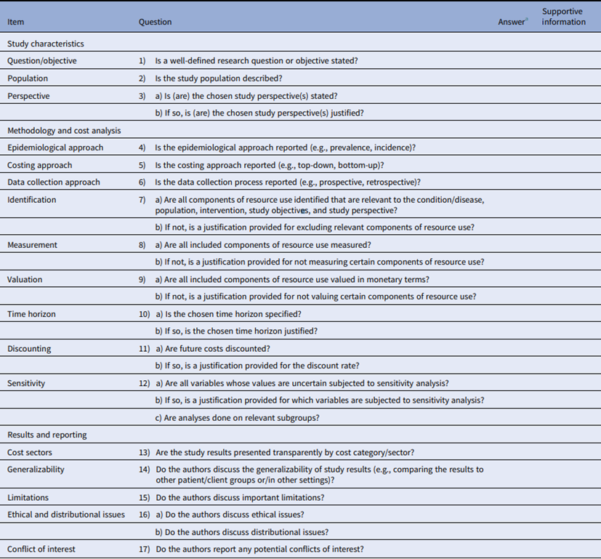
Recommendation To Evaluate Cost Of Illness Studies
Six different checklists and guidelines were identified:
The BMJ Checklist
The CHEC-list
The CHEERS checklist, the
Drummond 10-point checklist
The Drummond Methods for the Economic Evaluation of Health Care Programs
The Guide to Critical Evaluation by Larg and Moss

Slide 28


Slide 29
References
Byford, S., Torgerson, D. J., & Raftery, J. (2000). Economic note: cost of illness studies. BMJ (Clinical research ed.), 320(7245), 1335. https://doi.org/10.1136/bmj.320.7245.1335
Costa, N., Derumeaux, H., Rapp, T., Garnault, V., Ferlicoq, L., Gillette, S., ... & Molinier, L. (2012). Methodological considerations in cost of illness studies on Alzheimer disease. Health economics review, 2, 1-12.
Durand-Zaleski, I. (2008). Why cost-of-illness studies are important and inform policy. Vascular Medicine, 13(3), 251-253.
Jo C. (2014). Cost-of-illness studies: concepts, scopes, and methods. Clinical and molecular hepatology, 20(4), 327–337. https://doi.org/10.3350/cmh.2014.20.4.327
Tarricone, R. (2006). Cost-of-illness analysis: what room in health economics?. Health policy, 77(1), 51-63.
Weinstein, M. C., Siegel, J. E., Gold, M. R., Kamlet, M. S., & Russell, L. B. (1996). Recommendations of the panel on cost-effectiveness in health and medicine. Jama, 276(15), 1253-1258.
Weintraub, W. S. (2023). The Economic Burden of Illness. JAMA Network Open, 6(3), e232663-e232663

