Slide 1
Death Certification for Coroners
Harley Schainost, MD
Forensic Pathologist
Sedgwick County Deputy Coroner/Medical Examiner

Slide 2
Death Certificates…Why should I care?
Important for families
  Want to know COD
  Settling estates, life insurance payouts
Public health
  Local, state, national statistics
    Research, funding, mortality reduction strategies, etc.
Physicians
  Research, clinical practice changes

Slide 3
What is a “cause of death”
Cause of death: Disease or injury that initiated the chain of events leading directly to death OR the circumstances of the accident or violence that produced the fatal injury
Sequence of events leading to death can be listed in Part I on DC’s
Other conditions significantly contributing to death listed in Part II

Slide 4
Manner of Death
Natural
  Natural deaths are due solely or nearly totally to disease and/or the aging process
    People often die from their chronic disease (ASCVD, HTN, COPD, diabetes, etc.), there does NOT need to be a documented acute exacerbation to list it as the COD
Accident
  Accident applies when an injury or poisoning causes death and there is little or no evidence that the injury or poisoning occurred with intent to harm or cause death.
Suicide
  Suicide results from an injury or poisoning as a result of an intentional, self-inflicted act committed to do self harm or cause the death of one’s self
Homicide
  Homicide occurs when death results from a volitional act committed by another person to cause fear, harm, or death. Intent to cause death is a common element but is not required for classification as homicide. The classification of Homicide for the purposes of death certification is a “neutral” term and neither indicates nor implies criminal intent, which remains a determination within the province of legal processes
Undetermined
  Undetermined or “could not be determined” is a classification used when the information pointing to one manner of death is no more compelling than one or more other competing manners of death in thorough consideration of all available information
In general, when death involves a combination of natural processes and external factors such as injury or poisoning, preference is given to the non-natural manner of death.

Slide 5
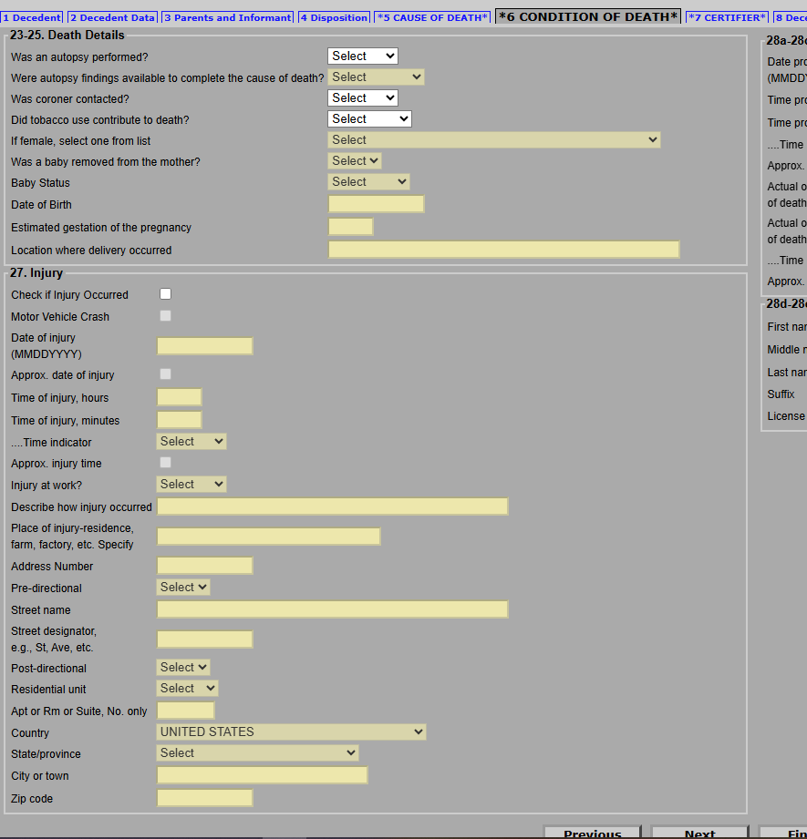

Slide 6
Proximate vs immediate cause of death
Proximate: Underlying cause of death, condition which STARTED the chain of events leading to death
Immediate: The disease or injury that actually causes death
Which is most important?

Slide 7
Proximate vs immediate examples
Sepsis, due to urinary tract infection, due to quadriplegia, due to remote gunshot wound of spine
Sepsis, due to community acquired pneumonia
Myocardial infarction, due to atherosclerotic and hypertensive cardiovascular disease

Slide 8
Think about remote trauma/injury that could cause death at a much later time
Paralysis/quadriplegia
Traumatic brain injury
Seizure disorders
Sepsis
Cerebral Palsy

Slide 9
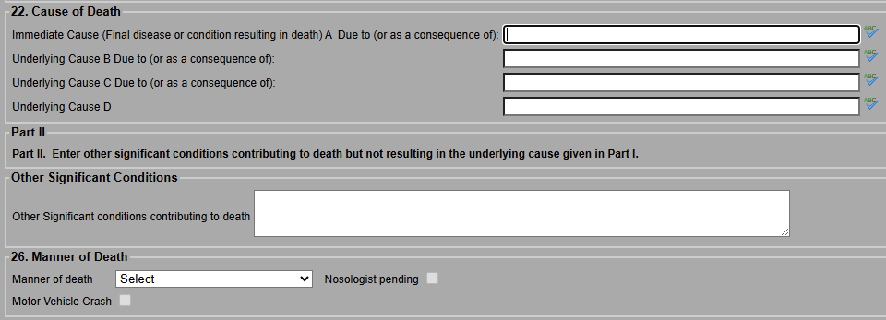
Due to
Due to
Due to

Slide 10
What not to put on a DC
Cardiac arrest
Cardiopulmonary arrest
Pulmonary arrest
Respiratory failure
Anoxic brain injury – not specific, what caused it?

Slide 11
Part II
Other significant conditions contributing to death
  Other important diseases or conditions that were present at the time of death and contributed to death, but did not lead to the underlying cause of death
Non-natural contributing factors will change the manner
  Toxic effect of a drug
  Blunt trauma – hip fracture, subdural hemorrhage, etc.

Slide 12
Part II Examples
COD: ASCVD/HASCVD
  Part II: Obesity/Morbid obesity, diabetes, Emphysema/COPD
COD: Chronic ethanol use
  Part II: ASCVD/HASCVD
COD: End stage renal disease due to Type I diabetes
  Part II: HASCVD, obesity
COD: Complications of recent cholecystectomy
  Part II: HASCVD

Slide 13
What not to put on Part II
NOT a laundry list of all of their medical diagnoses
If it didn’t contribute MECHANISTICALLY to death, leave it off!
Examples:
  Depression/anxiety
  Gout
  GERD
  Ingrown toenail

Slide 14
Chronic vs acute substance and EtOH use
Chronic ethanol use and chronic drug use are NATURAL deaths
  Hepatic cirrhosis
  Endocarditis
  Sepsis due to injection site infections
Acute ethanol or drug intoxication with OR without chronic use is usually accidental (sometimes suicide, very rarely homicide)

Slide 15
Drugs
You can die WITH drugs in your system and NOT OF the drugs in you system.
Just because toxicology is positive for a drug, does NOT mean it goes ANYWHERE on the DC!
  The drug has to mechanistically contribute to death in order for it to go on the DC

Slide 16
Right or Wrong? Some DC examples
Cause of death: Down syndrome
Dysphagia

Slide 17
Cause of death: Decline
Coronary artery disease
Cerebrovascular disease
Atherosclerotic vessel disease

Slide 18
Cause of death: Cardiac Arrest
Unknown-Coroner did not want autopsy

Slide 19
Cause of death: Cancer

Slide 20
Cause of death: Liver cell carcinoma

Slide 21
Cause of death: Unknown
Part II: Sleep apnea, hyperthyroidism, schizoaffective disorder, alcohol use disorder

Slide 22
Cause of death: Metastatic small cell lung cancer
Neuroendocrine carcinoma
Tobacco use disorder
Bipolar disorder
Part II: Post traumatic stress disorder

Slide 23
Cause of death: Pancreatic cancer
Acute renal failure
Hyperglycemia
Hypokalemia

Slide 24
Cause of death: Parkinsons Disease
Rectal prolapse

Slide 25
Cause of death: Ischemic colitis
Cardiogenic shock
Cardiac tamponade
Coronary artery disease

Slide 26
Cause of death: Congestive heart failure
Substance abuse
Sepsis

Slide 27
Cause of death: Adenocarcinoma of the esophagus
Diabetes mellitus
Coronary artery disease
Hypertension
Part II: Post traumatic stress disorder

Slide 28
Cause of death: Chronic lymphocytic leukemia
Part II: Diabetes, hypertension, peripheral vascular disease, basal cell carcinoma

Slide 29
Cause of death: Unknown
Atherosclerosis
Diabetes
Tick borne illness

Slide 30
Cause of death: Traumatic Brain Injury
Subdural hemorrhage
Subarachnoid hemorrhage
Intraparenchymal hemorrhage
Manner of death: Natural

Slide 31
Part II: Hypertension, congestive heart failure, diabetes mellitus, hyperlipidemia, benign prostatic hypertrophy, hard of hearing, atrial fibrillation, dysphagia

Slide 32
How would you sign?
32 yo M, history of type I diabetes, and substance use, involved in a motor vehicle collision; blunt trauma includes skull fractures, subdural hemorrhage, bilateral displaced rib fractures with hemopneumothoraces, and pelvic fractures
BAC 0.125%
Cause and Manner? OSC?

Slide 33
Cause: Blunt trauma
OSC: None
Manner: Accident

Slide 34
How would you sign?
74 yo M, history of hypertension, hyperlipidemia, suddenly collapses in a parking lot. EMS arrives and pronounces him dead at the scene.

Slide 35
Cause: Atherosclerotic and hypertensive cardiovascular disease
OSC: None (diabetes, obesity, COPD would be appropriate here if they had a history of it)
Manner: Natural

Slide 36
How would you sign?
32 yo M, history of diabetes, substance abuse, presents to ED in DKA, dies at hospital. Toxicology positive for methamphetamine

Slide 37
Cause: Diabetic ketoacidosis
OSC: Toxic effects of methamphetamine
Manner: Accident

Slide 38
How would you sign?
72 yo F, history of dementia, hyperlipidemia, hypertension, recent fall with hip fracture, with downward decline

Slide 39
Cause: Dementia
OSC: Atherosclerotic and hypertensive cardiovascular disease, hip fracture
Manner: Accident

Slide 40
How would you sign?
67 yo M, history of BPH, PTSD, gout, anal fissures, hypertension, diabetes, recent right great toe fracture

Slide 41
Cause: Hypertensive cardiovascular disease (or HASCVD)
OSC: Diabetes
Manner: Natural

Slide 42
How would you sign?
52 yo M, previous suicidal ideations, found with gunshot wound of head in secure residence, gun is found in his lap, no note, recent financial stress
Toxicology: Methamphetamine 324 ng/mL; fentanyl 0.23 ng/mL, ethanol 0.233% w/v

Slide 43
Cause: Gunshot wound of head
OSC: None
Manner: Suicide

Slide 44
How would you sign?
45 yo M, history of paraplegia, recurrent UTIs, well controlled hypertension; hospitalized with sepsis from a UTI, dies in the hospital

Slide 45
Further investigation into the cause of paraplegia reveals a gunshot wound of the spine during a robbery 20 years ago

Slide 46
Cause: Sepsis, due to Urinary tract infection, due to paraplegia, due to remote gunshot wound of back (OR Complications of remote gunshot wound)
OSC: None
Manner: Homicide

Slide 47
How would you sign?
30 yo F, history of “cerebral palsy”, muscle spasticity, non-verbal, wheelchair bound

Slide 48
Look into the history of cerebral palsy
  Often used as a wastebasket diagnosis
  Cerebral palsy is a group of neurological disorders that affect movement, balance, and posture
    As a result of birth complications is a Natural
    As a result of trauma as an infant is NOT natural (accident vs homicide depending on circumstances)

Slide 49
CP from anoxia during birth
Cause: Complications of cerebral palsy
OSC: None
Manner: Natural
CP from “shaken baby syndrome” at 2 months of age
Cause: Remote head trauma/ Remote abusive head trauma
OSC: None
Manner: Homicide

Slide 50
How would you sign?
55 year old male with a history of hypertension, and coronary artery disease; is at a bar and starts yelling at wait staff, security staff escorts him out of the bar and the decedent starts a physical altercation with security (no restraint used); during this altercation, the decedent collapses and is unresponsive. He is taken to the hospital, there is no significant trauma, labs and studies indicate a STEMI; BAC 0.155%

Slide 51
Cause: Complications of atherosclerotic and hypertensive cardiovascular disease in the setting of a physical altercation
OSC: Acute ethanol toxicity
Manner: Homicide
This does NOT assign fault, and does NOT indicate that charges should be pressed against the security staff, the decedent was the aggressor, but it is still a homicide
  Important to discern if restraint maneuvers where used during the altercation, as this could change the cause to an asphyxial event

Slide 52
How would you sign?
44 year old male, no significant medical history, does have a BMI of 55 kg/m2

Slide 53
Cause: Complications of morbid obesity
OSC: None
Manner: Natural
Morbid obesity can be a cause of death, I was trained with a cutoff of 40 kg/m2
  Morbid obesity causes heart disease (hypertension, cardiomegaly) and often hepatic steatosis
  Can result in sudden death of relatively young individuals, especially if obese since childhood

Slide 54
Resources
COMEC (CDC-Collaborating Office for Medical Examiners and Coroners)
  https://www.cdc.gov/nchs/nvss/writing-cause-of-death-statements.htm
CDC Death Certification Handbook; 2023 Revision:
  www.cdc.gov/nchs/data/nvss/handbook/2023-physicians-mcod-handbook.pdf
Cause of Death and the Death Certificate
  https://www.health.state.mn.us/people/vitalrecords/physician-me/docs/capcodbook.pdf
Principles and Pitfalls: a Guide to Death Certification
  https://www.ncbi.nlm.nih.gov/pmc/articles/PMC4504663/
National Association of Medical Examiners
  https://www.thename.org/death-certification
NAME Guide for Manner of Death Classification
  name.memberclicks.net/assets/docs/MANNEROFDEATH.pdf

Slide 55
Vital Statistics: www.kdhe.ks.gov
  Kdhe.registrationsecrtion@ks.gov
  Online training: https://www.train.org/ks/
    Create an account
    KDHE Electronic Death Registering System – Course #1063488
    Quality Cause of Death 2024 – Course #1095073

Slide 56
My contact information
Harley Schainost, MD
  Harley.Schainost@Sedgwick.gov
Regional Forensic Science Center
  316-660-4800
  https://www.sedgwickcounty.org/forensic-science/

