Slide 1
Revascularization in
Heart Failure with reduced Ejection Fraction
Prince Sethi, MD, FACC, RPVI
Assistant Professor of Clinical Medicine, University of Missouri
Interventional and Structural Cardiology
Mercy Clinic Cardiology and Heart Hospital,
Springfield, MO

Slide 2
Disclosures:
No relevant disclosures

Slide 3
Revascularization in Heart Failure with reduced ejection fraction (HFrEF)
For this discussion, we will limit to chronic syndromes and not acute syndromes (shock, or acute coronary syndromes)
Notes:
ESC 2021
Cardiac magnetic resonance (CMR) imaging with late gadolinium
enhancement (LGE), T1 mapping and extracellular volume
will identify myocardial fibrosis/scar, which are typically subendocardial
for patients with ischaemic heart disease (IHD) in contrast
to the mid-wall scar typical of dilated cardiomyopathy (DCM). In
addition, CMR allows myocardial characterization in, e.g. myocarditis,
amyloidosis, sarcoidosis, Chagas disease, Fabry disease, LV
non-compaction CMP, haemochromatosis, and arrhythmogenic
cardiomyopathy (AC).

Slide 4
Goals of therapies for HFrEF
There are three major goals of treatment for patients with HFrEF:
Reduction in mortality,
Prevention of recurrent hospitalizations due to worsening HF,
Improvement in clinical status, functional capacity, and QOL
Where does revascularization fit into these goals ?

Slide 5
Causes of HF
Stage A HF includes a large section of US population.
115 million are at risk for HF/Stage A due to risk factors
Stage B and worse-
  Most common cause:
    Ischemic heart disease (1)

Slide 6
What does revascularization (CABG or PCI) do ?
Hypothesis:
  Acute or Chronic ischemia→ Hibernating myocardium in addition to injury. Can hibernating myocardium be recruited ? (2)
1983-88→
  CASS (Coronary Artery Surgery Study) trial,
  The VA CABG Cooperative Study group and
  European Coronary Surgery Study
    Established the role of CABG in treatment of angina
Unknown: Revascularization in reduced LVEF

Slide 7
STITCH trial 2000s
(Surgical Treatment for Ischemic Heart Failure) (3)
1212 patients with LVEF </=35%: CABG + GDMT (610) vs GDMT (602). Median Follow up 56 months
Primary outcome 36% vs 41% (hazard ratio with CABG, 0.86; 95% confidence interval [CI], 0.72 to 1.04; P=0.12).
  No significant difference at median 4.8 years
  However, 9.8 year follow up→ CABG showed survival benefit (more deaths until 2 years) (2)
Post hoc analyses of the STICH trial suggested that neither myocardial viability, angina, nor ischemia were related with outcomes after revascularization
Notes:
More liberal inclusion criteria
The Heart Failure Revascularisation Trial (HEART) was under-powered, with only 138 of the planned 800 patients to be enrolled, and failed to show differences in outcomes between HF patients receiving CABG orMT
No benefit post 60 Age

Slide 8
Percutaneous Coronary Intervention
Does it have a role ?

Slide 9
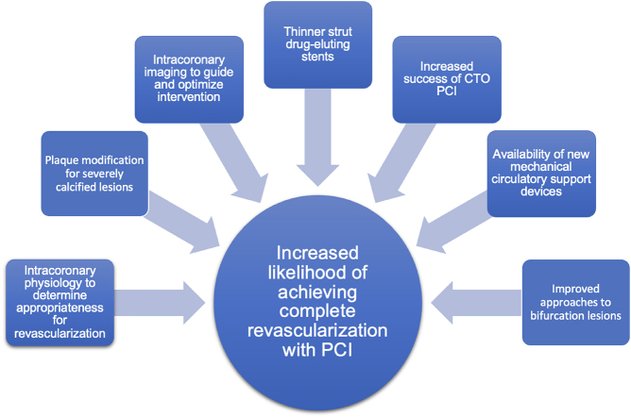
Notes:
https://pmc.ncbi.nlm.nih.gov/articles/PMC11307477/#bib12

Slide 10
Percutaneous Coronary Intervention- Does it have a role ?
Non-randomized controlled trial data emerged
PROTECT II: Randomized controlled trial→ Impella 2.5 vs IABP for protected high risk PCI → Terminated prematurely
  → No significant difference in all cause mortality or MACE.
Post Hoc Analysis → 184 consecutive patients across both groups →Reverse remodeling studied
  →(absolute improvement in the LVEF of ≥5%)
  →93 of 184 patients (51%)
  →LVEF improved by 13.1% (95% CI 10.2-16.2%, P < .001).
→More often in patients treated with extensive 2- or 3-vessel PCI than in those treated with 1-vessel PCI (P = .04)
→ Improved LVEF → Fewer MACE ( 9.7 vs 24.2% , P = .009)
Notes:
The randomized PROTECT II trial compared the Impella 2.5 LV assist device (Abiomed Inc) with the IABP in patients undergoing elective high-risk PCI,⁸ including those with unprotected left main disease or last remaining patent coronary artery with an LVEF of ≤35% or 3-vessel disease with an LVEF ≤30%.
The components of this composite endpoint were all-cause death, nonfatal MI (with procedural MI defined as creatine-kinase-MB or troponin >3× normal), stroke/transient ischemic attack, repeat revascularization, need for cardiac or vascular surgery, acute renal insufficiency, severe intraprocedural hypotension, cardiopulmonary resuscitation, ventricular tachycardia requiring cardioversion or defibrillation, aortic insufficiency, and angiographic failure of PCI. The trial was terminated prematurely for futility after 448 of the 654 expected participants were enrolled. At 30 days, the primary endpoint occurred in 35.1% versus 40.1% of patients assigned to Impella and to IABP, respectively, with no significant difference between the 2 groups (P = .28). At 90 days, the composite endpoint of major adverse events occurred in 40.6% versus 49.3% in same groups, again with no significant difference between the group in in the intention-to-treat population (P = .066). In the prespecified per-protocol population, defined by patients receiving the assigned support device, the difference in major adverse events at 90 days was statistically significant (51.0% with the IABP versus 40.0% with the Impella, P = .02). The difference in all-cause mortality between the 2 groups was not statistically significant at 30 days (5.9% with the IABP versus 7.6% with the Impella, P = .47) or 90 days (8.7% with the IABP versus 12.1% with the Impella, P = .24). There was no difference in the rate of limb ischemia or the need for cardiac or vascular operations between the 2 groups (P = .63), nor was there any occurrence of aortic insufficiency or damage to the aortic valve.

Slide 11
Registry data (2)
2126 patients from New York State Registries
Multivessel disease and an LVEF ≤35%
Everolimus-eluting stents or CABG.
→ PCI was associated with a similar risk of death as CABG at 2.9 years (HR 1.01, 95% CI 0.81-1.28; P = .91)
→PCI: lower risk of stroke (HR 0.57; 95% CI, 0.33-0.97; P = .04)
higher risk of both MI (HR 2.16; 95% CI, 1.42-3.28; P = .0003) & repeat revascularization (HR 2.54; 95% CI, 1.88-3.44; P < .0001).
→If complete revascularization. No MI difference (p 0.002)

Slide 12
Registry from Ontario (conflicting data) (2,4)
2008→2016 cohort. 12113 patients with CAD and LVEF </=35%
PCI → Higher mortality (HR 1.6, CI 1.3-1.7)
  → CV death (HR 1.4, CI 1.1-1.6)
  → hospitalization for MI (HR 3.2, CI 2.6-3.8)
  →MACE (HR 2.0, CI 1.9-2.2)
  → Subsequent revascularization (HR 3.7, CI 3.2-4.3)

Slide 13
First RCT for PCI vs Medical therapy - 2022
Percutaneous Revascularization for Ischemic Left Ventricular Dysfunction (REVIVED-BCIS2) (5)
700 patients ( 347 PCI vs 353 OMT) with
  Extensive CAD (British CIS score >/=6)
  and LVEF </=35%
Median follow up 41 months
Primary outcome (death or HF hospitalization): 37.2% vs 38.0% (hazard ratio, 0.99; 95% confidence interval [CI], 0.78 to 1.27; P=0.96).
LVEF similar at 6 and 12 months (increased in both arms)
Better QOL with PCI at 6 and 12 months but diminished effect at 24 months.
Notes:
The extent of revascularization was characterized by the British Cardiovascular Intervention Society jeopardy score and anatomical revascularization index, which was calculated as follows: [(the pre-PCI jeopardy score minus the post-PCI jeopardy score) divided by (the pre-PCI jeopardy score)]×100, with 100% indicating complete revascularization of all angiographically significant coronary disease.⁹
Demonstrable viability in at least four dysfunctional myocardial segments amenable to revascularization with PCI. Patients were excluded if they had had an acute myocardial infarction in the 4 weeks before randomization or acute decompensated heart failure or sustained ventricular arrhythmias within 72 hours before randomization

Slide 14
Critique of this study (6)
EF improved in both groups, and an improvement of >4.7% was associated with a reduction in death or CHF (HR 0.62, 95% CI: 0.41-0.95; p=0.029)
Low rate of spontaneous MI with PCI 5.2% vs 9.3% (p=0.04) → Especially important with limited reserve LV function.
Trend for reduced need for automatic implantable cardioverter defibrillator termination of ventricular arrhythmias in the PCI group.

Slide 15
Selection bias- critical multivessel CAD may have been treated with revascularization outside of the study, as per guideline recommendations (previous).
Despite being a trial of low EF, only 25% of patients enrolled in the REVIVED-BCIS2 study had NYHA Class >II symptoms.
Furthermore, 67% of patients had no angina and 31% had CCS class I-II angina.
Although viability study performed. Study did not assess how many had mixed or non ischemic cardiomyopathy
No physiological study. <70% gets a ‘0’ jeopardy score and all ischemic areas may not have been revascularized.
Median treated lesions 2 and half had revascularization index of <80%.
Ambitious primary end point (30% reduction in primary end point)
Short duration of follow up. Benefit only seen at ~10 years with CABG.
UK only trial

Slide 16
What’s the current recommendation ?

Slide 17
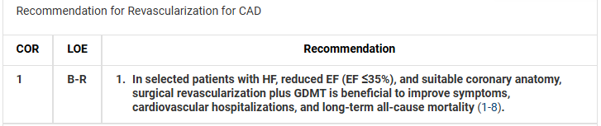
ACC 2022 Heart Failure guidelines (7)

Slide 18
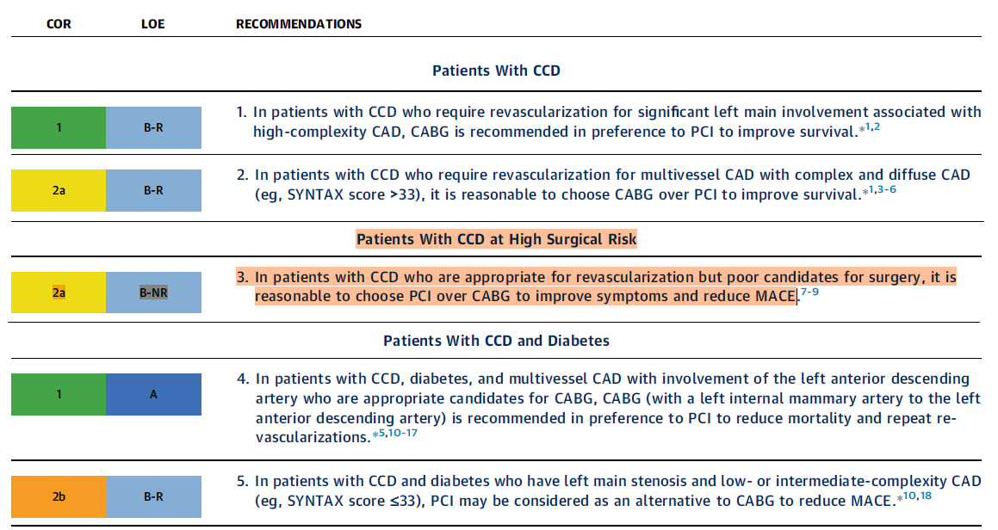
ACC 2023 guidelines (8)

Slide 19
ESC 2024 guidelines (9)

Slide 20
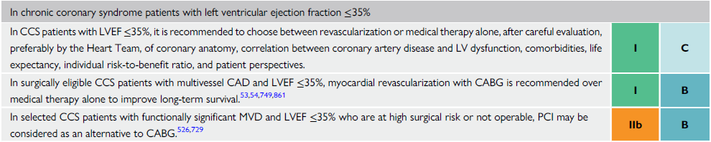

Slide 21
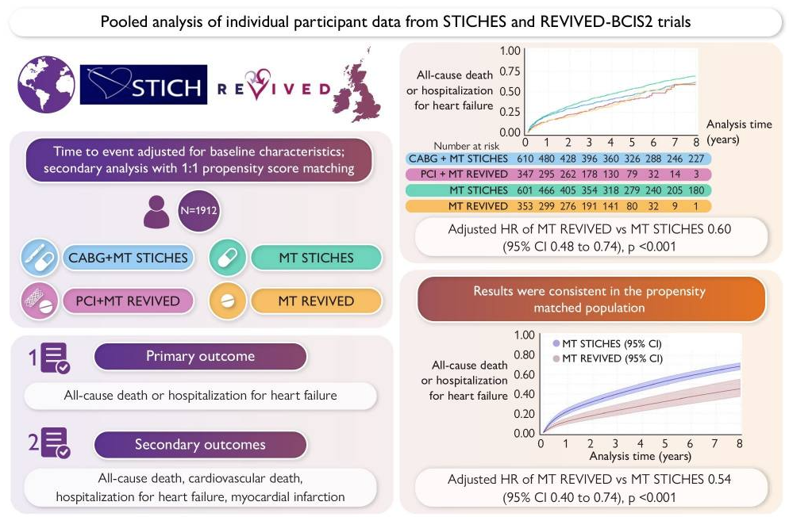
Medical therapy and outcomes in REVIVED-BCIS2 and STICHES: an individual patient data analysis (10)

Slide 22
Pooled analysis of adjusted individual participant data
The propensity score was calculated on
  age, sex, diabetes, chronic kidney disease, extent of CAD, and LVEF, thought to be the most clinically important.
Notes:
Between-trial differences in baseline characteristics were compared with unpaired t-tests or Mann–Whitney tests, depending on the normality of distribution. Kaplan–Meier survival plots were used to estimate and present cumulative event rates for all four groups. Parametric survival models using the Weibull method were used to examine differences in the outcome across the four groups of interest. We used a maximum likelihood estimation parametric regression survival time model, with a Weibull distributional form of the error term.

Slide 23
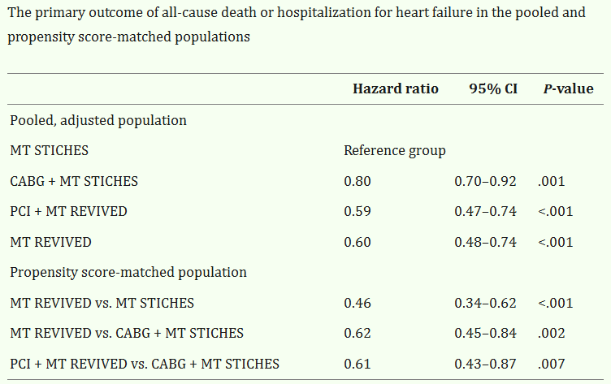

Slide 24
Medical therapy (with or without PCI) in REVIVED-BCIS2 had better outcomes than those in STICHES, with or without CABG surgery.
? Comparing Apples to Oranges ?
There have been no RCTs directly comparing CABG and PCI in patients with ischemic HF.
More unknowns:
  Role of Physiology assisted PCI (FFR/non hyperemia indices)
  CTO improvements
  Mechanical circulatory devices- ability to perform more complex interventions
  More careful patient selection in terms of mixed cardiomyopathy
Need more robust data to understand this complex clinical syndrome and how to best manage.
Notes:
There have been no RCTs directly comparing CABG and PCI in patients with ischaemic HF. A meta-analysis of 21 studies, mostly observational except three including STICH, published between 1983 and 2016, supported CABG and PCI on a background of GDMT in appropriate patients with multivessel disease and LV systolic dysfunction; revascularization with either CABG or PCI improved long-term survival compared with GDMT, but compared with PCI, CABG provided a survival benefit and a lower risk of MI or repeat revascularization, with a slightly higher incidence of stroke.
Add info from 3470 page
ESC 2024
?Reduced future MI ? Reduced incidence --? Mechanism of CABG benefit
?More complete revasc with CABG

Slide 25
ESC says it the best:

Slide 26
Summary
Guideline directed medical therapy plays a vital role.
CABG over PCI when feasible and with heart team discussion (CTS, IC and NI). Decision made with shared decision-making model.
?Hybrid Revascularization (CABG + PCI). Not enough data. (Trial; NCT03089398) was prematurely discontinued due to slow enrolment, with only 200 patients in 5 years.
Notes:
In MASS II (Medicine, Angioplasty, or Surgery Study), the 10-year
rates of cardiac death were lower after CABG or PCI than after medical therapy alone

Slide 27
References
Heidenreich PA, Bozkurt B, Aguilar D, Allen LA, Byun JJ, Colvin MM, Deswal A, Drazner MH, Dunlay SM, Evers LR, Fang JC, Fedson SE, Fonarow GC, Hayek SS, Hernandez AF, Khazanie P, Kittleson MM, Lee CS, Link MS, Milano CA, Nnacheta LC, Sandhu AT, Stevenson LW, Vardeny O, Vest AR, Yancy CW. 2022 AHA/ACC/HFSA Guideline for the Management of Heart Failure: Executive Summary: A Report of the American College of Cardiology/American Heart Association Joint Committee on Clinical Practice Guidelines. J Am Coll Cardiol. 2022 May 3;79(17):1757-1780. doi: 10.1016/j.jacc.2021.12.011. Epub 2022 Apr 1. PMID: 35379504.
Ahmad Y, Petrie MC, Jolicoeur EM, Madhavan MV, Velazquez EJ, Moses JW, Lansky AJ, Stone GW. PCI in Patients With Heart Failure: Current Evidence, Impact of Complete Revascularization, and Contemporary Techniques to Improve Outcomes. J Soc Cardiovasc Angiogr Interv. 2022 Apr 11;1(2):100020. doi: 10.1016/j.jscai.2022.100020. PMID: 39132568; PMCID: PMC11307477.
Velazquez EJ, Lee KL, Deja MA, Jain A, Sopko G, Marchenko A, Ali IS, Pohost G, Gradinac S, Abraham WT, Yii M, Prabhakaran D, Szwed H, Ferrazzi P, Petrie MC, O'Connor CM, Panchavinnin P, She L, Bonow RO, Rankin GR, Jones RH, Rouleau JL; STICH Investigators. Coronary-artery bypass surgery in patients with left ventricular dysfunction. N Engl J Med. 2011 Apr 28;364(17):1607-16. doi: 10.1056/NEJMoa1100356. Epub 2011 Apr 4. PMID: 21463150; PMCID: PMC3415273.
Sun LY, Gaudino M, Chen RJ, Bader Eddeen A, Ruel M. Long-term Outcomes in Patients With Severely Reduced Left Ventricular Ejection Fraction Undergoing Percutaneous Coronary Intervention vs Coronary Artery Bypass Grafting. JAMA Cardiol. 2020 Jun 1;5(6):631-641. doi: 10.1001/jamacardio.2020.0239. Erratum in: JAMA Cardiol. 2020 Jun 1;5(6):732. doi: 10.1001/jamacardio.2020.1655. PMID: 32267465; PMCID: PMC7142806.
Perera D, Clayton T, O'Kane PD, Greenwood JP, Weerackody R, Ryan M, Morgan HP, Dodd M, Evans R, Canter R, Arnold S, Dixon LJ, Edwards RJ, De Silva K, Spratt JC, Conway D, Cotton J, McEntegart M, Chiribiri A, Saramago P, Gershlick A, Shah AM, Clark AL, Petrie MC; REVIVED-BCIS2 Investigators. Percutaneous Revascularization for Ischemic Left Ventricular Dysfunction. N Engl J Med. 2022 Oct 13;387(15):1351-1360. doi: 10.1056/NEJMoa2206606. Epub 2022 Aug 27. PMID: 36027563.
Perera D, Marshall JJ, Grines CL. PCI has no role in patients with heart failure and reduced ejection fraction: pros and cons. EuroIntervention. 2023 Dec 18;19(11):e887-e889. doi: 10.4244/EIJ-E-23-00035. PMID: 38105716; PMCID: PMC10719735.
Heidenreich PA, Bozkurt B, Aguilar D, Allen LA, Byun JJ, Colvin MM, Deswal A, Drazner MH, Dunlay SM, Evers LR, Fang JC, Fedson SE, Fonarow GC, Hayek SS, Hernandez AF, Khazanie P, Kittleson MM, Lee CS, Link MS, Milano CA, Nnacheta LC, Sandhu AT, Stevenson LW, Vardeny O, Vest AR, Yancy CW. 2022 AHA/ACC/HFSA Guideline for the Management of Heart Failure: A Report of the American College of Cardiology/American Heart Association Joint Committee on Clinical Practice Guidelines. J Am Coll Cardiol. 2022 May 3;79(17):e263-e421. doi: 10.1016/j.jacc.2021.12.012. Epub 2022 Apr 1. Erratum in: J Am Coll Cardiol. 2023 Apr 18;81(15):1551. doi: 10.1016/j.jacc.2023.03.002. PMID: 35379503.
Writing Committee Members; Virani SS, Newby LK, Arnold SV, Bittner V, Brewer LC, Demeter SH, Dixon DL, Fearon WF, Hess B, Johnson HM, Kazi DS, Kolte D, Kumbhani DJ, LoFaso J, Mahtta D, Mark DB, Minissian M, Navar AM, Patel AR, Piano MR, Rodriguez F, Talbot AW, Taqueti VR, Thomas RJ, van Diepen S, Wiggins B, Williams MS. 2023 AHA/ACC/ACCP/ASPC/NLA/PCNA Guideline for the Management of Patients With Chronic Coronary Disease: A Report of the American Heart Association/American College of Cardiology Joint Committee on Clinical Practice Guidelines. J Am Coll Cardiol. 2023 Aug 29;82(9):833-955. doi: 10.1016/j.jacc.2023.04.003. Epub 2023 Jul 20. Erratum in: J Am Coll Cardiol. 2023 Oct 31;82(18):1808. doi: 10.1016/j.jacc.2023.09.794. Erratum in: J Am Coll Cardiol. 2024 Apr 30;83(17):1716. doi: 10.1016/j.jacc.2024.03.399. PMID: 37480922.
Vrints C, Andreotti F, Koskinas KC, Rossello X, Adamo M, Ainslie J, Banning AP, Budaj A, Buechel RR, Chiariello GA, Chieffo A, Christodorescu RM, Deaton C, Doenst T, Jones HW, Kunadian V, Mehilli J, Milojevic M, Piek JJ, Pugliese F, Rubboli A, Semb AG, Senior R, Ten Berg JM, Van Belle E, Van Craenenbroeck EM, Vidal-Perez R, Winther S; ESC Scientific Document Group. Linee guida ESC 2024 per la gestione delle sindromi coronariche croniche [2024 ESC Guidelines for the management of chronic coronary syndromes]. G Ital Cardiol (Rome). 2024 Dec;25(12 Suppl 1):e1-e132. Italian. doi: 10.1714/4375.43725. PMID: 39611224.
Ryan M, Petrie MC, Kontopantelis E, Dodd M, Tong G, Marquis-Gravel G, Docherty KF, Clayton T, Lansky AJ, Mamas MA, Rouleau JL, Velazquez EJ, Perera D. Medical therapy and outcomes in REVIVED-BCIS2 and STICHES: an individual patient data analysis. Eur Heart J. 2025 Jun 9;46(22):2052-2062. doi: 10.1093/eurheartj/ehaf080. PMID: 40048661; PMCID: PMC12146480.

Slide 28
Thank you
Notes:
In the ISCHEMIA (International Study of Comparative Health Effectivenesswith Medical & Invasive Approaches) trial, 5,179 patients with stable CAD and site-determined moderate- severe ischemia on stress testing (patients with $50% left main stenosis on CCTA, left ventricular ejection fraction [LVEF] <35%, and unacceptable angina on medical therapy were excluded)
No difference was observed at w3.3 years of follow-up Angina symptoms improved in both the conservative and invasive treatment arms, although improvements were larger in the invasive arm, particularly with more frequent angina at baseline
In a secondary analysis of the ISCHEMIA trial, although ischemia severity on noninvasive testing was associated with all-cause death, no treatment interaction was observed when participants were stratified by mild, moderate, or severe ischemia
At 7-year follow-up, a reduction in cardiovascular mortality with revascularization was observed

