Slide 1


Autonomic testing and findings in the genetic (hATTR, WT-ATTR, Gelsolin, and Apolipoprotein-A1) and Acquired Amyloidoses
Matthew Varon, MD
Assistant Professor
Department of Neurology
University of Kansas Medical Center
Kansas City, KS
Multidisciplinary Amyloid Symposium
December 13, 2025
Kansas City, KS

Slide 2
Disclosures
None

Slide 3

Disclosures
None

Slide 4
Objectives
Review basic function of the autonomic nervous system.
Discuss commonly employed tests to assess autonomic function.
Recognize the autonomic symptoms associated with acquired and genetic amyloidosis.

Slide 5
Case
76 year old male presents to clinic for progressive weakness.
Has sensory loss and leg weakness that is progressive over 4 months.
ROS: Also notes lightheadedness when standing, changes in sweating, and difficulty with erections.
Exam: Weakness at ankle dorsiflexion (MRC 4-/3). Absent reflexes at ankles, knees, 2 in the arms. Distal asymmetric sensory losses.
Edx: EMG shows evidence for an axonal sensorimotor polyneuropathy

Slide 6
Case
Localization: peripheral nerve
DDx:
  Inflammatory
  Autoimmune
  DM
  Nutritional
Polyneuorpathy + autonomic symptoms

Slide 7
Autonomic nervous system
Part of the nervous system that controls involuntary processes.
  Heart rate, digestion, blood pressure, sweating
Divisions:
  Parasympathetic – “rest and digest”
  Sympathetic – “fight or flight”
Why are we talking about this?
  Very commonly affected in the context of amyloidosis.
  75% of AL-amyloid patients. 82% of ATTRv amyloid patients.
Orphanet J Rare Dis. 2019;14(1):34.
BMC Neurol. 2021(21(1):70.

Slide 8
Autonomic Symptoms
Wide range of clinical manifestations. May be difficult to recognize due to varied presentation.
Cardiovascular - hypotension
Gastrointestinal – constipation, diarrhea, early satiety
Genitourinary – erectile dysfunction, neurogenic bladder
Secretomotor – dry eyes, dry mouth, impaired sweating
May be seen without sensory symptoms or can be seen together with sensory symptoms suggestive of polyneuropathy.

Slide 9
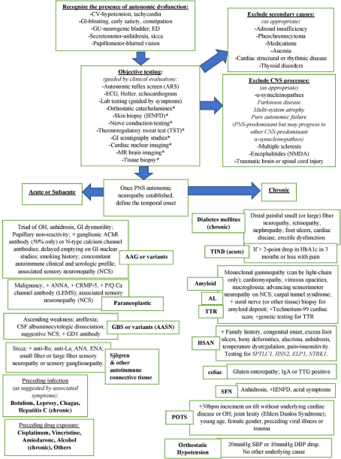
Diagnostic Approach
Symptoms
Clinical suspicion
Confirm autonomic problem
Refine differential based on history, timing, and associated symptoms.
Muscle nerve Aug 2020

Slide 10
Specific Syndromes
Acquired
  AL
  WT-ATTR
Genetic
  h-ATTR
  Gelsolin
  Apolipoprotein A1

Slide 11
AL Amyloidosis
Autonomic symptoms in 75%.
2010 retrospective review
  65 patients: 43 systemic amyloidosis, 22 familial amyloid
  Latency of autonomic symptoms 7 mos. Mean diagnosis 24 months.
  Symptoms:
    Orthostatic intolerance 74%
    GI 71%
    Erectile dysfunction 67%
    Secretomotor (dry eyes, dry mouth) 54%
  Autonomic testing - One or more autonomic test was abnormal in all subjects, including 4 subjects without autonomic symptoms.

Slide 12
h-ATTR
Common, upwards of 75% of affected patients.
  Severity and phenotype varies based on specific mutation.
    Val30Met – Present earlier and in higher rates
Clinical features:
  Orthostatic hypotension
  GI – Weight loss, early satiety, diarrhea, constipation, nausea
Limited data to guide specific test results in the disease. Studies are mostly small and retrospective.

Slide 13
h-ATTR
Autonomic symptoms often occur early in disease course.
Early recognition may help avoid diagnostic delays.
Orthostatic hypotension is particularly common and usually precedes other symptoms.

Slide 14
WT-ATTR
Mostly cardiac presentations.
Neurologic syndromes:
  Carpal tunnel
  No confirmed cause for neuropathy
  Not associated with autonomic dysfunction

Slide 15
Other genetic amyloidoses
Gelsolin (Finnish type)
  Very rare. Fewer than 600 total cases described.
  Onset 25-40 years.
  PNS symptoms are most prominent.
    Facial paresis, neuropathy, carpal tunnel
    Autonomic involvement is variable
Apolipoprotein A1
  Onset early 40s-late 50s.
  Nephropathy (87%), polyneuropathy.
  Slow progressive.
  Limited data on autonomic involvement/testing.

Slide 16
Autonomic testing
Why order testing?
  Determine whether an autonomic process is present.
  Assess involvement (selective vs diffuse) of different autonomic components.
  Assess severity of the autonomic deficit.
  Possibly monitor treatment response.

Slide 17
Autonomic testing
Test components
  Tilt table
    Sympathetic – Vascular and cardiac adrenergic
  Heart rate variability with deep breathing
    Parasympathetic – cardio vagal function
  Valsalva testing
    Sympathetic – Vascular and cardiac adrenergic
  Quantitative sudomotor axon reflex testing (QSART)
    Sympathetic post-ganglionic sudomotor
  Thermoregulatory sweat test (TST)
    Unable to differentiate pre vs post ganglionic deficit.
Gastric emptying
Urodynamics

Slide 18
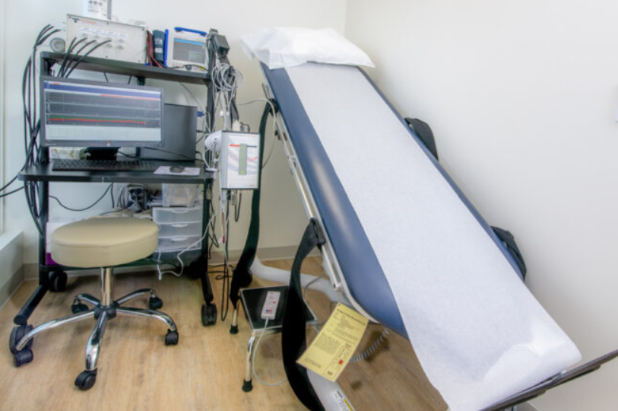
Tilt table
Physiology:
  25-30% of venous blood shifts with tilt
  Decreases cardiac filling
  Decrease stroke volume
  Compensatory increase in HR
    Initially due to less parasympathetic tone
    Later increased sympathetic tone.
OH – SBP drop >20mm Hg or DBP >10mm Hg within 3 minutes
How does HR/BP respond to orthostatic stress (tilt).
Syncope, OH, inappropriate tachycardia (POTS)

Slide 19
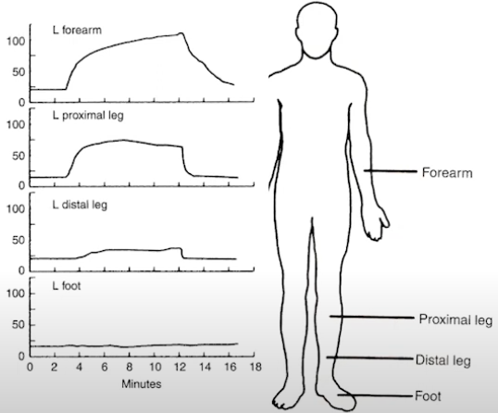
QSART
Assesses sweat function
10% solution of Ach with iontophoresis at 4 sites.
  Forearm, proximal leg, distal leg, foot.
Measuring sweat volume.
Pattern helps:
  Global – autoimmune
  Patchy – medications
  Length dependent – neuropathies

Slide 20
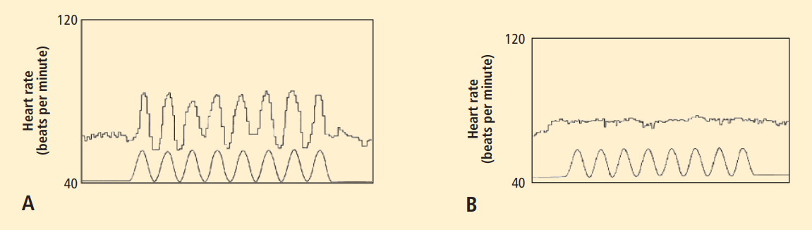
HRVDB
Assess cardiovagal or parasympathetic function.
HR increases with inspiration and decreases with expiration.
Reduced variation in patients with autonomic disorders.
Cleve Clin J Med. 2009 Apr;76

Slide 21
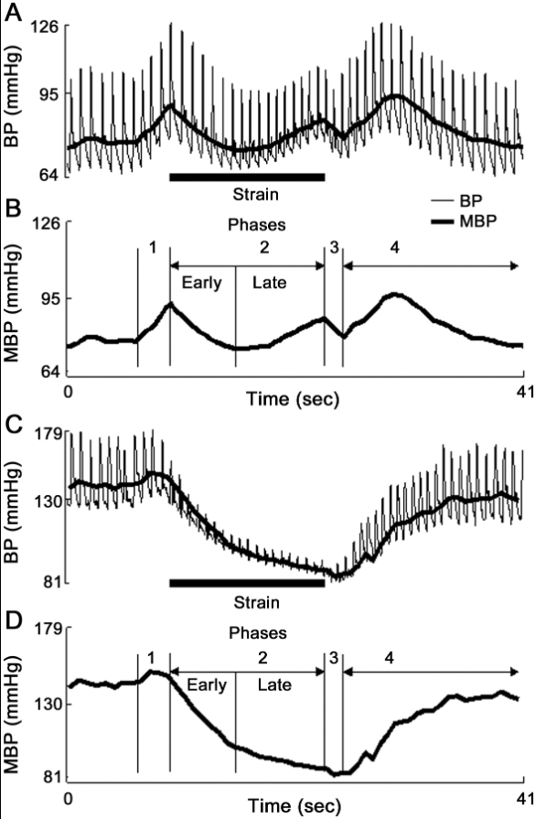
Valsalva testing
Neurology June 2011
Sympathetic. Vascular and cardiac adrenergic.
Sensitive test for adrenergic failure.
Non invasive and widely available.
Forced exhalation against resistance.
Monitor BP, HR, symptoms, EKG.

Slide 22
Other tests of autonomic function
Gastric emptying studies
Urodynamic studies

Slide 23
Final notes
Autonomic dysfunction is very common in amyloidosis and symptoms often occur early in the disease process.
Consider amyloidosis as a potential etiology in patients with new autonomic symptoms, particularly in the presence of a neuropathy.
Autonomic testing may be abnormal even in asymptomatic patients.
Very common with AL amyloidosis and hATTR.
Early recognition of autonomic symptoms may shorten diagnostic delays and aid in earlier treatment.

