Slide 1

2018 AHA/ACC Updated Cholesterol Guidelines
Deborah Caraballo, PharmD, PhC, BCPS AQ Cardiology
Wilson Cardiology Conference
September 28th 2019

Slide 2

Disclosure
I do not have any relevant financial relationships to disclose.

Slide 3


Patient Case 1
62YOM with h/o DM2, HTN, HLD, presenting with CP, SOB. 89kg, BP 140/82, HR-80. ECG- STE in anterior/lateral leads.
PCI w/DES x2. LV gram- EF 60%
PTA meds- lisinopril 40, ASA, atorva 80, metformin 1g BID
Current lipid panel: LDL- 71, HDL- 45, TG- 130, TC- 198
(Previous LDL- 160, HDL-40, TG- 190, TC- 230)
LFTs WNL, VSS
Metoprolol 50 mg BID added, Effient 10 mg daily
Is the statin dose adequate? Any changes? Why?

Slide 4
What’s new
LDL-C targets have been re-introduced (% decrease remains emphasized)
CAC for further determining risk in uncertain cases
Risk-enhancing factors (DM and age 40-75YO)
Increased weight on risk discussion with patients (intermediate risk, low risk)
Recommendations for PCSK9i

Slide 5
Risk assessment tools
Major RFs include- cigarette smoking, HTN, dysglycemia, lipoprotein abniormalities, and advancing age
Framingham Heart Study
2013 ACC/AHA cholesterol guidelines compilation of data from 5 community-based cohorts representative of US population- the Pooled Cohort Equation (PCE)
Validated in large community-based US population
Other factors that associate with ASCVD- Risk enhancing factors (REFs)

Slide 6

Statin intensity
Low intensity (LI) – <30%
Lova 20
Simva 10
Prava 10-20
Fluva 20-40
Moderate intensity (MI)- 30-49%
Atorva 10-20
Rosuva 5-10
Prava 40-80
Lova 40-80
High intensity (HI)- >/=50%
Atorva 80 (may dec to 40)
Rosuva 20

Slide 7
Definitions
ASCVD
ACS (MI, UA, stable angina)
Coronary or Arterial revascularization
PAD, including aortic aneurysm, all of atherosclerotic origin
HR-ASCVD
Multiple ASCVD events
h/o ACS w/in 12 months
h/o MI
h/o CVA or TIA
Sx PAD (claudication
1 ASCVD + HR conditions)

Slide 8

Definitions, cont.
HR conditions
  >/= 65 YO
  FH
  PCI/CABG
  DM2
  HTN
  CKD eGFR < 60/ml/min
  +Tob
  LDL> 100 on maximally tolerated statin +/- ezetimibe
  HF

Slide 9
Bottom Line: Four Risk Groups
Secondary Prevention in Patients with Clinical ASCVD
1
>75
< 75
Very HR ASCVD
Severe Hypercholesterolemia
2
LDL > 190
LDL >100 on tx
FH
Diabetes Mellitus
3
DM-Specific REFs
Primary Prevention Over Lifespan
4
PCE (40-75)
ASCVD REFs
CAC

Slide 10
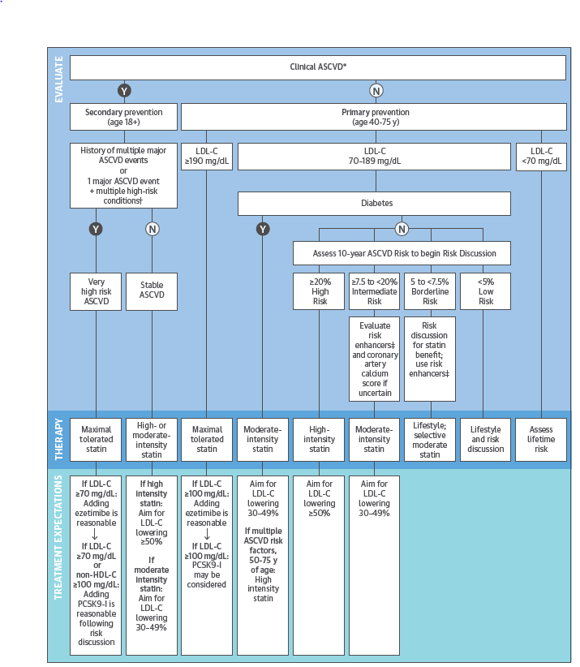

Slide 11
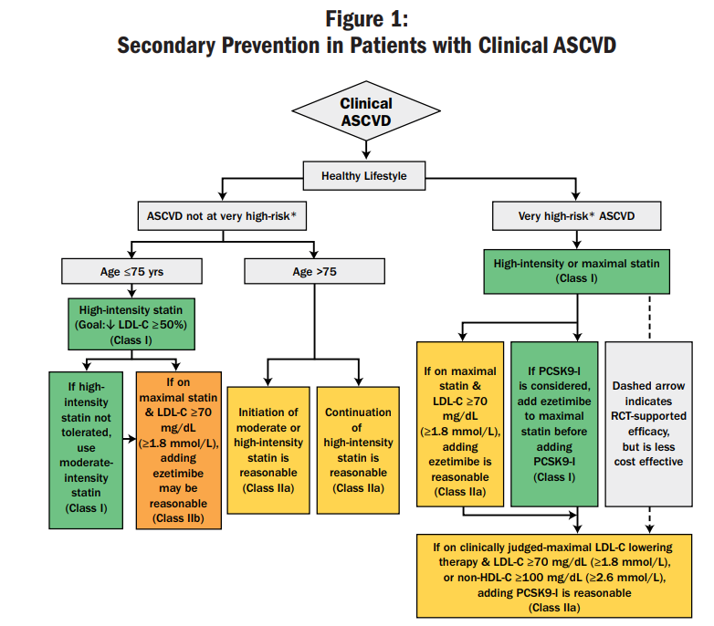
https://www.acc.org/~/media/Non-Clinical/Files-PDFs-Excel-MS-Word-etc/Guidelines/2018/old_Guidelines-Made-Simple-Tool-2018-Cholesterol.pdf

Slide 12
https://www.acc.org/~/media/Non-Clinical/Files-PDFs-Excel-MS-Word-etc/Guidelines/2018/old_Guidelines-Made-Simple-Tool-2018-Cholesterol.pdf

Slide 13
https://www.acc.org/~/media/Non-Clinical/Files-PDFs-Excel-MS-Word-etc/Guidelines/2018/old_Guidelines-Made-Simple-Tool-2018-Cholesterol.pdf

Slide 14
Primary Prevention
Primary Prevention:
Assess ASCVD Risk in Each Age Group Emphasize Adherence to Healthy Lifestyle
LDL-C ≥190 mg/dL (≥4.9 mmol/L) No risk assessment; High- intensity statin
(Class I)
Diabetes mellitus and age 40-75 y
Moderate-intensity statin
(Class I)
Age 0-19 y
Lifestyle to prevent or reduce ASCVD risk Diagnosis of Familial
Hypercholesterolemia
statin
Age 20-39 y Estimate lifestyle risk to encourage lifestyle to reduce ASCVD risk
Consider statin if family history, premature ASCVD and LDL-C ≥160 mg/dL (≥4.1 mmol/L)
Age 40-75 y and LDL-C ≥70 to <190
mg/dL
(≥1.8 - <4.9 mmol/L) without
diabetes mellitus 10-year ASCVD risk percent begins
risk discussion
Diabetes mellitus and age 40-75 y
Risk assessment to consider high-intensity statin
(Class IIa)
ASCVD Risk Enhancers:
•Family history of premature ASCVD
•Persistently elevated LDL-C ≥160 mg/dL (≥4.1 mmol/L)
•Chronic kidney disease
•Metabolic syndrome
•Conditions specifc to women (e.g. preeclampsia, premature menopause)
•Infammatory diseases (especially rheumatoid arthritis, psoriasis, HIV)
•Ethnicity factors
(e.g. South Asian ancestory)
Lipid/Biomarkers:
•Persistently elevated triglycerides (≥175 mg/mL)
In selected individuals if measured:
•hs-CRP ≥2.0 mg/L
•Lp(a) levels >50 mg/dL or
>125 nmol/L
•apoB ≥130 mg/dL
•Ankle-brachial index (ABI) <0.9
Age >75 y
Clinical assessment, Risk discussion
<5%
“Low Risk”
5% - <7.5%
“Borderline Risk”
≥7.5% - <20%
“Intermediate Risk”
≥20%
“High Risk”
Risk Discussion:
Emphasize lifestyle to reduce risk factors Class (I)
If Risk enhancers present then risk discussion regarding moderate- intensity statin therapy
Class (IIb)
Risk Discussion:
If risk estimate + risk enhancers favor statin, initiate moderate- intensity statin to reduce
LDL-C by 30% - 49%
Class (I)
Risk Discussion:
initiate statin to reduce LDL-C ≥50%
Class (I)
If risk decision is uncertain: Consider measuring CAC in selected adults:
CAC = zero (lowers risk; consider no statin, unless diabetes, family history of premature CHD, or cigarette smoking are present)
CAC = 1-99 favors statin (especially after age 55)
CAC = 100+ and/or ≥75th percentile, initiate statin therapy
https://www.acc.org/~/media/Non-Clinical/Files-PDFs-Excel-MS-Word-etc/
Guidelines/2018/old_Guidelines-Made-Simple-Tool-2018-Cholesterol.pdf

Slide 15
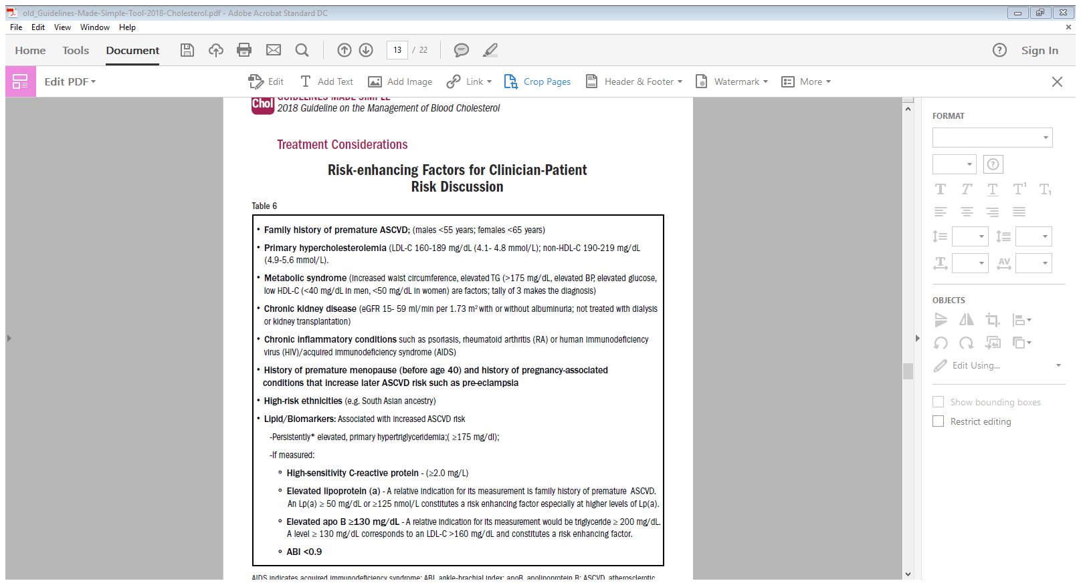
https://www.acc.org/~/media/Non-Clinical/Files-PDFs-Excel-MS-Word-etc/Guidelines/2018/old_Guidelines-Made-Simple-Tool-2018-Cholesterol.pdf

Slide 16
https://www.acc.org/~/media/Non-Clinical/Files-PDFs-Excel-MS-Word-etc/Guidelines/2018/old_Guidelines-Made-Simple-Tool-2018-Cholesterol.pdf

Slide 17
Patient Case 1
62YOM with h/o DM2, HTN, HLD, presenting with CP, SOB. 89kg, BP 140/82, HR-80. EKG- STEMI.
PCI w/DES x2. LV gram- EF 60%
PTA meds- lisinopril 40, ASA, atorva 80, metformin 1g BID
Current lipid panel: LDL- 71, HDL- 45, TG- 130, TC- 198
(Previous LDL- 160, HDL-40, TG- 190, TC- 230)
LFTs WNL, VSS
Metoprolol 50 mg BID added, Effient 10 mg daily
Is the statin dose adequate? Any changes? Why?

Slide 18
Patient Case 2
65 YOF with h/o CABG x 2 in 2015, recent NSTEMI 9/2018 – managed medically, DM2, HLD, HTN presenting to clinic routine CV visit.
Has been very compliant with diet and meds. Lost 15 lbs over last year. Exercises 20 min 3x/wk.
Meds- atorvastatin 80 mg, ezetimibe 10 mg (started 1/2019), ASA 81mg, Plavix 75 mg, enalapril 20 mg BID, carvedilol 12.5 mg BID.
7/1/19 lipid panel: TC- 189, TG- 133, LDL- 35, HDL- 52
1/18/2019 lipid panel: TC – 199, TG- 145, LDL- 78, HDL- 40
Is the LDL concerning? Why?

Slide 19

A CLOSER LOOK AT PCSK9i
A Quick Overview of PCSK9i Landmark Outcomes Trials

Slide 20
ODYSSEY- OUTCOMES
Schwartz G.G, et al. NEJM. Epub ahead of print 11/2018. nejm.org.
N= 18,924, DB, MC, RCT
Inclusion Criteria:
  >/= 40YO, ACS w/in 1-12 mo prior to enrollment, LDL>70 mg/dL or non-HDL > 100 mg/dL, or Apo B > 80 mg/dL, HI statin (or maximum tolerated dose)
Pre-randomization run-in phase pts received instructions in injecting themselves with PLCB and lipid levels were measured for eligibility
Alirocumab (ALI) SQ 75 mg q 2 wks
Dose titration to goal LDL 25-50. If LDL < 15 mg/dL→ switch to PLCB (All blinded)

Slide 21
ODYSSEY-OUTCOMES, Cont.
1 Endpoint-
Composite of death from CHD, NF MI, fatal or NF ischemic stroke, or UA requiring hospitalization
1
2 Endpoint- Pre-specified:
2
Any CHD event; Major CHD event; Any CV event;
Composite of death from any cause, NF MI, or NF ischemic stroke;
Individual components of 1 endpoint;
Hospitalization for CHF
Death from, CHD; Death from CV causes; Death from any cause;

Slide 22
ODYSSEY-OUTCOMES, Cont.
Median F/u- 2.8 yrs; ITT analysis; Designed for 50% reduction in LDL by ALI which would translate in RRR 15% in 1 Endpoint. Required 1613 events in 18000 pts over median of 3 yrs for 90% power.
Composite 1 Endpoint occurred in 9.5% in ALI v 11.1% in PLCB (HR 0.85; 95% CI 0.78-0.93; P <0.001).
Absolute benefit from Ali was greater among pts with BL LDL-C of > 100 v lower.
Rate of ADEs was same except for injection site reaction (itching, redness, swelling).

Slide 23
FOURIER
Sabatine M.S., et al. Evolocumab and Clinical Outcomes in Patients with Cardiovascular Disease. N Engl J Med 2017;376:1713-22.
N= 27,564; DB, MC, RCT
2/2013-6/2015
Inclusion Criteria- 40-85YO, clinically evident ASCVD (h/o MI, non-hemorrhagic CVA, symptomatic PAD, as well as additional characteristics that place them at higher CV risk; LDL > 70 or non-HDL > 100 mg/dL while on optimized remien of lipid-lowering therapy (LLT)
LLT- preferably a HI statin but must have been at least atorvastatin at a dose of 20 mg daily or equivalent, with or without ezetimibeinical

Slide 24
FOURIER, Cont.
1 Endpoint- Composite of CV death, MI, CVA, hospitalization for UA, or coronary revascularization
1
2 Endpoint- Composite of CV death, MI, or CVA
2

Slide 25
FOURIER, Cont.
1630 events (key secondary endpoint) were required to provide 90% power to detect a 15% RRR in 2 endpoint
Median f/u- 2.2 yrs
Evolocumab significantly reduced the risk of the primary endpoint 9.8% v 11.3% (CI 0.79-0.92; P< 0.001)
Significantly decreased the risk of the secondary endpoint 5.9% v 7.4% (CI 0.73-0.88; P< 0.001)
Results were consistent across BL LDL-C levels
No difference in ADEs, except injection site reactions (2.1% v 1.6%)

Slide 26
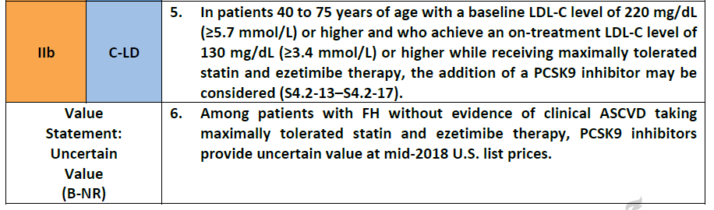
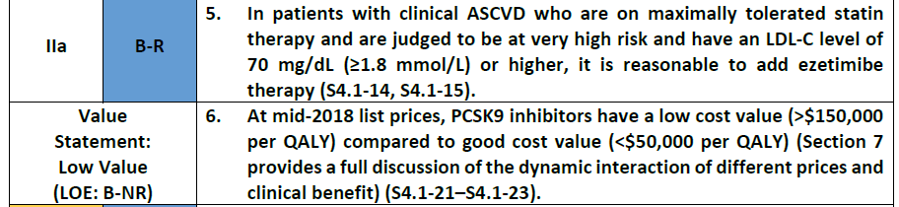
Place In Therapy for PCSK9i- Current Recommendations
Notes:
It is so great to see the integration of CV outcomes in the mgmt. of other disease states, particularly, DM2 and AF, which are such prevalent comorbidities associated with HF.

Slide 27

Considerations
Longer duration may translate into more event/risk reduction
SQ injections
PCSK9i CV trials took place at the same time as IMPROVE-IT
Infrequent use of ezetimibe in both trials
Unclear if effect will be as marked
Guidelines suggest max dose statin and ezetimibe
Even consider BA sequestrants
Cost effectiveness not proven at current pricing
Cost effectiveness has been evaluated in 7 published simulation models.
  Low value
  Mid 2018 cost $14,000/yr

Slide 28
Important Questions Answered
How low is too low?
  We still don’t know, but increased confidence in ‘Lower IS better’
Are there neurocognitive side effects to very low LDL-C?
  Both FOURIER and ODYSSEY-OUTCOMES showed no difference in incidence of neurocognitive ADEs in respective treatment groups vs PLCB

Slide 29
Some Unanswered Questions
How low is too low?
Long-term safety
Cost effectiveness
Would longer tx duration result in more marked benefit
PCSK9i v ezetimibe

Slide 30
Patient Case 2
65 YOF with h/o CABG x 2 in 2015, recent NSTEMI 9/2018 – managed medically, DM2, HLD, HTN presenting to clinic routine CV visit.
Has been very compliant with diet and meds. Lost 15 lbs over last year. Exercises 20 min 3x/wk.
Meds- atorvastatin 80 mg, ezetimibe 10 mg (started 1/2019), ASA 81mg, Plavix 75 mg, enalapril 20 mg BID, carvedilol 12.5 mg BID.
7/1/19 lipid panel: TC- 189, TG- 133, LDL- 35, HDL- 52
1/18/2019 lipid panel: TC – 199, TG- 145, LDL- 78, HDL- 40
Is the LDL concerning? Why?

Slide 31
Patient Case 2
65 YOF with h/o CABG x 2 in 2015, recent NSTEMI 9/2018 – managed medically, DM2, HLD, HTN presenting to clinic routine CV visit.
Has not been compliant with diet and meds. Gained 25 lbs over last year. Declined CR.
Meds- atorvastatin 80 mg, ezetimibe 10 mg (started 1/2019), ASA 81mg, Plavix 75 mg, enalapril 20 mg BID, carvedilol 12.5 mg BID.
7/1/19 lipid panel: TC- 189, TG- 133, LDL- 119, HDL- 34
1/18/2019 lipid panel: TC – 199, TG- 145, LDL- 135, HDL- 30
Is this pt Clinical ASCVD or Very High Risk?
What alternatives do you have?

Slide 32
References
E. Stroes , et al. Anti-PCSK9 antibody effectively lowers cholesterol in patients with statin intolerance: the GAUSS-2 randomized, placebo-controlled phase 3 clinical trial of evolocumab. J Am Coll Cardiol 2014; 63: 2541-8.
G.G. Schwartz, et al. Alirocumab and Cardiovascular Outcomes After Acute Coronary Syndromes. NEJM.org. Accessed 11/20/2018.
Gundy, et al. 2018 AHA/ACC/AACVPR/AAPA/ABC/ACPM/ADA/AGS/APhA/ASPC/NLA/PCNA guideline on the management of blood cholesterol: executive summary: a report of the American College of Cardiology/American Heart Association Task Force on Clinical Practice Guidelines. Circulation. 2018.
M.J. Tikkanen, et al.Total cardiovascular disease burden: comparing intensive with moderate statin therapy insights from the IDEAL (Incremental Decrease in End Points Through Aggressive Lipid Lowering) trial. J Am Coll Cardiol, 54 (2009), pp. 2353-2357.
M.J. Tikkanen, et al. Total Cardiovascular Disease Burden: Comparing Intensive with Moderate Statin Therapy. J Am Coll Cardiol 2009;54:2353-7.
M.S. Sabatini, et al. Evolocumab and Clinical Outcomes in Patients with Cardiovascular Disease. N Engl J Med 2017;376:1713-22.
N.J. Stone, et al. 2013 ACC/AHA guideline on the treatment of blood cholesterol to reduce atherosclerotic cardiovascular risk in adults: a report of the American College of Cardiology/American Heart Association Task Force on Practice Guidelines. Circulation 2014; 129: Suppl 2: S1-S45
S.A. Murphy, et al.Reduction Reduction in total cardiovascular events with ezetimibe/simvastatin post-acute coronary syndrome: the IMPROVE-IT Trial. J Am Coll Cardiol, 67 (2016), pp. 353-361.

