Slide 1
Principles of Mechanical Ventilation
Matt Hegewald, MD
Intermountain Medical Center
University of Utah

Slide 2
Principles of Mechanical Ventilation
Design features
  Breath design
  Modes
Respiratory system mechanics

Slide 3
Spontaneous vs. Positive-Pressure Breathing
I
E
I
E
Pressure
Pressure
Time
Volume
Spontaneous
Positive Pressure
Notes:
15
Let’s examine the pressure and volume curves typical of a spontaneous and a positive-pressure breath delivered via a mechanical ventilator. On the left, which is the spontaneous breath, we can see the application of information we just discussed. The inspiratory phase has a slight negative pressure; then, on exhalation there is a positive deflection. From our recent discussion of positive-pressure ventilation, notice that the pressure remains positive during the entire inspiratory phase. It is easy to see how spontaneous ventilation, which generates a negative intrathoracic pressure, aids venous blood flow to the heart. Also, positive-pressure ventilation may decrease venous blood flow, and thus some patients may require intravenous volume.
Now, we'll take a moment to define ventilator parameters and then review some of the basic ventilator settings.

Slide 4
Breath Characteristics
3 “Ts”
Trigger
  What initiates a breath
  Machine timer (control) vs patient effort (assist)
Gas delivery target or limit
  What governs gas flow
  Flow target vs pressure target
Cycle
  What terminates the breath
  Volume, time, flow, pressure

Slide 5
Breath Characteristics
Trigger
Controlled – machine timer
Assisted – patient effort
  Pressure trigger – effort produces pressure drop in vent circuit
  Flow trigger – effort draws gas out of a continuous flow through the vent circuit

Slide 6
A
B
L/sec
L
cm/H2O
cm/H2O
Flow
Vol
Paw
Pes

Slide 7
Breath Characteristics
Gas Delivery Target
Set pressure
Airway
Pressure
+
0
-
Set flow
Either Set t_{i} or
Set minimal flow
(cycle off)
in
Flow
0
out
Set volume
(cycle off)
increasing
Volume

Slide 8
Understanding the Flow-Time Waveform
There are two components to the flow-time waveform
  The inspiratory arm:
    Active in nature
    The character is affected by the ventilator mode, patient effort, and total system resistance and compliance.
  The expiratory arm:
    Passive in nature
    The character is determined mainly by elastic recoil of the patients lungs and airway resistance.
    Also affected by patient respiratory effort (if any)
There are two commonly used types of flow patterns available on most ventilators
  The ’square wave’ or ‘constant flow’ pattern
  The ‘ramp’ (decelerating) type pattern

Slide 9
The‘Square Wave’Flow Pattern
Inspiratory
arm
The inspiratory flow rate remains constant over the entire inspiration
Flow
The expiratory flow is passive and is
determined by airways resistance and the elastic recoil of the lungs
Time
Inspiratory time = Tidal volume
Flow rate
Expiratory
arm

Slide 10
The‘Decelerating Ramp’Flow Pattern
Inspiratory
arm
The inspiratory flow rate decelerates as a function of time to reach zero flow at end inspiration
Flow
For a given tidal volume, the inspiratory time is higher in this type of flow pattern as compared to the square wave pattern
Time
Inspiratory time = Tidal volume
Flow rate
Expiratory
arm

Slide 11
30
PIP
Ti
Paw
cmH₂O
Trigger Effort
Sec
1
2
3
4
5
6
.
V
-10
Notes:
12
12
12
12
12
12
The Pressure-Time curve depicts not only the shape of the curve but displays any PEEP present, the PIP, as well as any inspiratory trigger effort as seen in the second pressure curve.
This Pressure-Time curve shows the different types of pressure curves associated with different types of flow delivery.
a. the linear rapid rise to pressure produced by a square
flow wave
b. the curved gradual rise to pressure resulting from a
descending flow wave
c. the curved “shark’s fin” pressure wave with a long
inspiratory plateau

Slide 12
Breath Characteristics
Cycle
Three common types
  Reach set volume
  Reach set time
  Reach specified flow reduction
Airway pressure as “backup” cycle
  Pressure alarm and cycle with occlusion or expiratory efforts

Slide 13
Breath Characteristics
 | TRIGGER | TARGET/LIMIT | CYCLE
Volume control (VC) Volume assist (VA) Pressure control (PC) Pressure assist (PA) Pressure support (PS) | Time Effort Time Effort Effort | Flow Flow Pi** Pi** Pi** | Vol* Vol* Time* Time* Flow*
Set pressure
Set pressure
Set pressure
Airway
Pressure
+
0
-
Set flow
Set flow
Set Ti
Set Ti
Set minimal
flow
in
Flow
0
out
Set volume
Set volume
increasing
Volume
Machine
triggered
Patient
triggered
Machine
triggered
Patient
triggered
Patient
triggered

Slide 14
Ventilator Modes
Volume Assist/Control (VAC)
  Set parameters: inspiratory flow rate (usually 60 L/min), frequency, Vt, PEEP, FIO₂
  Flow, Vt and frequency determine TI, TE and I:E ratio
  Patient triggered breaths result in same flow and Vt as control breaths – this changes I:E ratio and can create auto-PEEP
  Advantages: constant Vt guaranteed, mode used in ARMA trial demonstrating reduced mortality in ARDS
  Pplat = Vt/Crs + PEEP

Slide 15
Ventilator Modes
Pressure Assist/Control (PCV)
  Set parameters: Inspiratory pressure, I:E ratio, frequency, PEEP, FIO2
  Inspiratory flow rate is matched to patient effort – may improve patient-ventilator synchrony and comfort
  Variable Vt (lung-protective Vt not assured) but predictable Ppeak and Pplat (could lessen VILI); Ppeak may not equal alveolar pressure with obstruction
  Vt = (Pinsp-PEEP) x Crs

Slide 16
Positive Pressure Ventilation
VAC vs. PCV
VAC
Volume delivery constant
Inspiratory pressure varies
Inspiratory flow constant
Inspiratory time determined by set flow and V_{T}
PCV
Volume delivery varies
Inspiratory pressure constant
Inspiratory flow varies
Inspiratory time set by clinician
Notes:
23
The delivered volume is constant in volume ventilation; in pressure ventilation, volume varies with changes in resistance and compliance. In volume ventilation, inspiratory pressure varies with changes in compliance and resistance; with pressure ventilation, the inspiratory pressure is set and remains constant. Inspiratory flow is constant in volume ventilation but varies in pressure ventilation. In volume ventilation, inspiratory time is determined by the set flow and tidal volume; in pressure ventilation the inspiratory time is set by the clinician.
Let’s move on to our discussion of Pressure Control Ventilation.

Slide 17
Ventilator Modes
Pressure Regulated Volume Control (PRVC)
  Set parameters: Vt, I:E ratio, frequency, PEEP, FIO2
  Pressure-preset mode with set TI (time cycled)
  Ventilator continually adjusts Pinsp to deliver desired Vt
  ? Best features of VAC (guarantees Vt) and PCV (inspiratory flow rate determined by patient, improving comfort)
  Most common mode used at SCMC

Slide 18
Ventilator Modes
Pressure-Support Ventilation (PSV)
  Set parameters: Inspiratory pressure, PEEP, FIO2
  Patient must trigger all breaths
  Ventilation is determined by Pinsp, patient determined frequency, patient effort, respiratory mechanics (Crs, R)
  Cycling determined by flow – Pinsp delivered until flow decreasing to 25% of initial flow (flow threshold for cycling can be adjusted)
  Work of breathing may be increased in patients with obstruction
  Often used to “exercise” patients and as a weaning mode

Slide 19
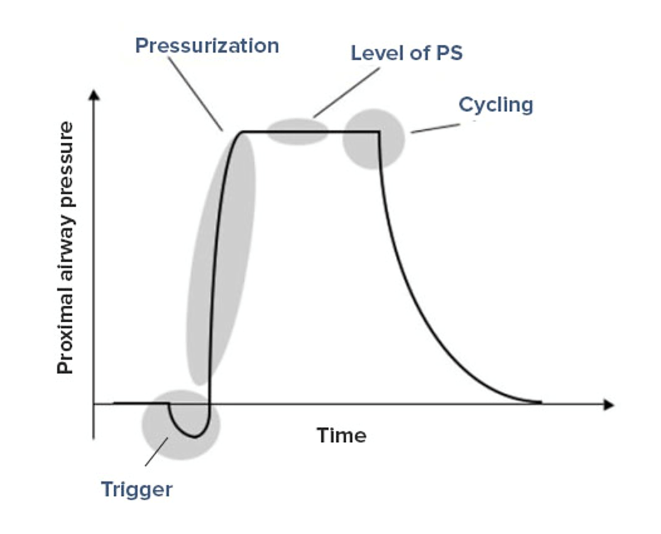
PSV

Slide 20
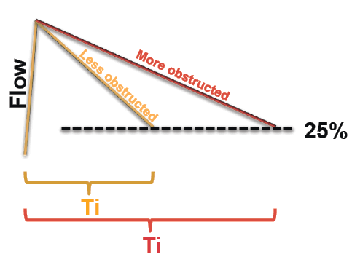
PSV in Obstruction
Expiratory time depends on R,C
Ti varies widely
Some ventilators allow configuration of the threshold for switching off PSV

Slide 21
Other Modes - Not Discussed
CPAP
SIMV
APRV
Volume or Pressure IRV
HFOV
PAV

Slide 22
Is One Mode Better than Another?
Studies comparing VAC and PCV have not shown differences in mortality, oxygenation or work of breathing
PCV may improve patient-ventilator synchrony

Slide 23
Patient/Ventilator Synchrony
Volume ventilation delivering a preset flow and volume
30
*Adequate flow gives a smooth, linear rise to pressure
Adequate Flow
PIP
Paw
cmH₂O
Patient Effort
Sec
1
2
3
4
5
6
.
V
-10
Notes:
12
12
12
12
12
12
The Pressure-Time curve depicts not only the shape of the curve but displays any PEEP present, the PIP, as well as any inspiratory trigger effort as seen in the second pressure curve.
This Pressure-Time curve shows the different types of pressure curves associated with different types of flow delivery.
a. the linear rapid rise to pressure produced by a square
flow wave
b. the curved gradual rise to pressure resulting from a
descending flow wave
c. the curved “shark’s fin” pressure wave with a long
inspiratory plateau

Slide 24
Patient/Ventilator Synchrony
The patient is outbreathing the set flow
30
*Insufficient flow results in an erratic rise to pressure with a lower PIP
Paw
Air Starvation
cmH₂O
PIP
Patient Effort
Sec
1
2
3
4
5
6
What can be done to improve comfort?
-10
Notes:
12
12
12
12
12
12
The Pressure-Time curve depicts not only the shape of the curve but displays any PEEP present, the PIP, as well as any inspiratory trigger effort as seen in the second pressure curve.
This Pressure-Time curve shows the different types of pressure curves associated with different types of flow delivery.
a. the linear rapid rise to pressure produced by a square
flow wave
b. the curved gradual rise to pressure resulting from a
descending flow wave
c. the curved “shark’s fin” pressure wave with a long
inspiratory plateau

Slide 25
Patient/Ventilator Synchrony
The patient is outbreathing the set flow
30
*Insufficient flow results in an erratic rise to pressure with a lower PIP
Paw
Air Starvation
cmH₂O
PIP
Patient Effort
Sec
1
2
3
4
5
6
-10
1. Increase inspiratory flow 2. Change mode to PCV
Notes:
12
12
12
12
12
12
The Pressure-Time curve depicts not only the shape of the curve but displays any PEEP present, the PIP, as well as any inspiratory trigger effort as seen in the second pressure curve.
This Pressure-Time curve shows the different types of pressure curves associated with different types of flow delivery.
a. the linear rapid rise to pressure produced by a square
flow wave
b. the curved gradual rise to pressure resulting from a
descending flow wave
c. the curved “shark’s fin” pressure wave with a long
inspiratory plateau

Slide 26
Understanding the pressure-time waveform using a ‘square wave’ flow pattern
P_{peak}
Pressure
P_{res}
Ventilator
P_{plat}
P_{res}
R_{ET tube}
Time
+
P_{res}
R_{airways}
Diaphragm

Slide 27
Now let’s look at some different pressure-time waveforms using a ‘square wave’ flow pattern
Ppeak = Flow x Resistance + Volume
Compliance
Scenario # 1
Normal values:
P_{peak} < 40 cm H₂O
P_{plat} < 30 cm H₂O
P_{res} < 10 cm H₂O
P_{peak}
Pressure
P_{res}
P_{plat}
P_{res}
‘Square wave’
flow pattern
Time
This is a normal pressure-time waveform with normal peak pressures ( P_{peak}), plateau pressures (P_{plat} ) and airway resistance pressures (P_{res})
Flow
Time

Slide 28
Waveform showing increased airways resistance
Ppeak = Flow x Resistance + Volume + PEEP
Compliance
Scenario # 2
P_{peak}
Normal
e.g. ET tube
blockage
Pressure
P_{res}
P_{res}
P_{plat}
‘Square wave’
flow pattern
Time
The increase in the peak airway pressure is driven entirely by an increase in the airways resistance pressure. Note the normal plateau pressure.
Flow
Time

Slide 29
Waveform showing high airway resistance due to high flow rates
Ppeak = Flow x Resistance + Volume + PEEP
Compliance
Scenario # 3
P_{peak}
Normal
e.g. high
flow rates
Pressure
P_{res}
P_{res}
P_{plat}
‘Square wave’
flow pattern
Time
Flow
The increase in the peak airway pressure is driven entirely by an increase in the airways resistance pressure caused by excessive flow rates. Note the shortened inspiratory time and high flow.
Normal (low)
flow rate
Time

Slide 30
Waveform showing decreased lung compliance
Ppeak = Flow x Resistance + Volume + PEEP
Compliance
Scenario # 4
P_{peak}
Normal
e.g. ARDS
Pressure
P_{res}
P_{plat}
P_{res}
‘Square wave’
flow pattern
Time
The increase in the peak airway pressure is driven entirely by the decrease in the lung compliance. Increased airways resistance is often also a part of this scenario.
Flow
Time

