Slide 1
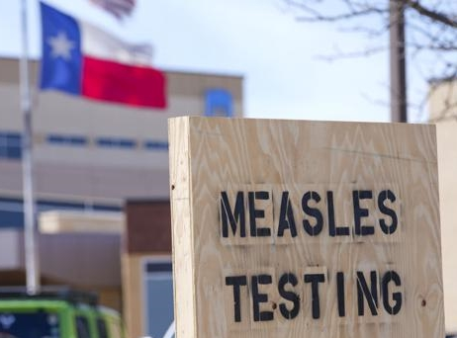
Measles in Texas: What’s old is new again
Zachary Most, MD, MSc
Assistant Professor
Division of Pediatric Infectious Disease, UTSW
Associate Medical Director of Infection Prevention and Control, Children’s Medical Center
Notes:
“Against those measles, which we disdain” – Shakespeare Corilionus

Slide 2
Objectives
Describe the method of transmission and clinical presentation of patients with measles
Describe the current 2025 measles outbreak in Texas
Review methods to prevent measles infection

Slide 3
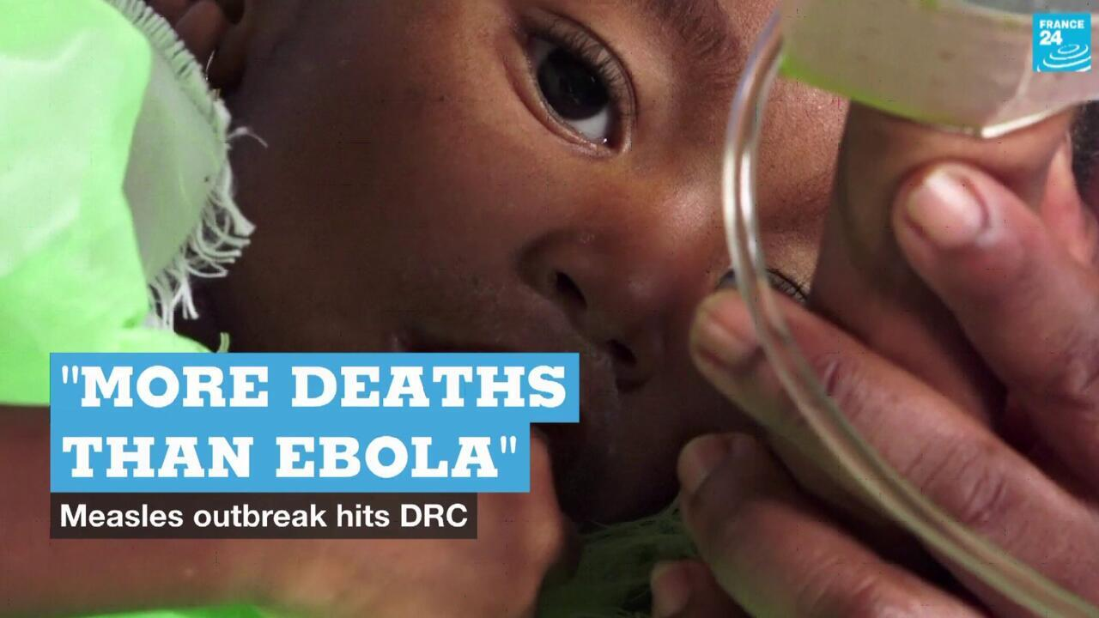
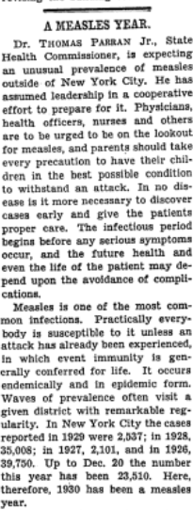
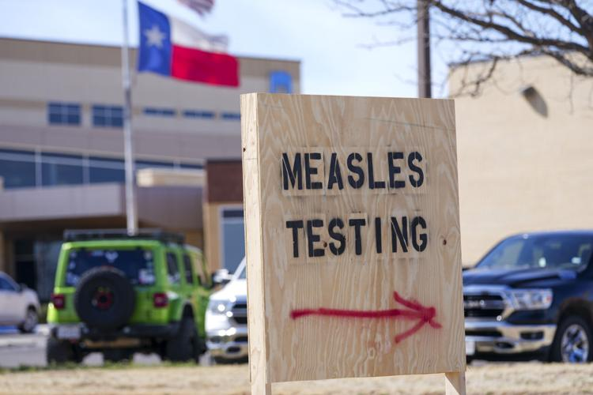
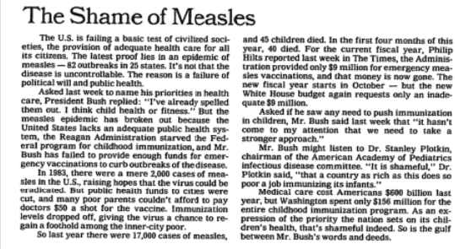
Measles in the news
New York Times – Dec 27, 1930
New York Times – May 22, 1990
BALL Samuel
Julio Cortez - AP
Notes:
Everyone at this presentation today must be aware of measles in the headlines. There is an outbreak of measles currently ongoing that started in the South Plains region in west Texas. What makes this outbreak so remarkable? Why are we talking about it so much today?
I think what is so unique about measles is that more than almost any other disease we view measles as an ailment of the past, one that we have overcome. We expect to read about measles from old headlines, not to see it it the news today.
Yet, here it is. Measles is in Texas. And measles is all over the globe. Measles outbreaks in the Democratic Republic of the Congo killed tens of thousands of children in the just the past few years. Even during the Ebola epidemic in DRC, more children died from measles than ebola.
And measles was still with is in 1990, ‘The Shame of Measles’ – this idea that it should have been in our past, yet was in our present
Even going back to the 1930s, I think this headline exemplifies what it was like to live when measles was “Still around”, ‘a measles year’ – epidemics would recur every few years and tear through schools and younger children one city at a time.

Slide 4
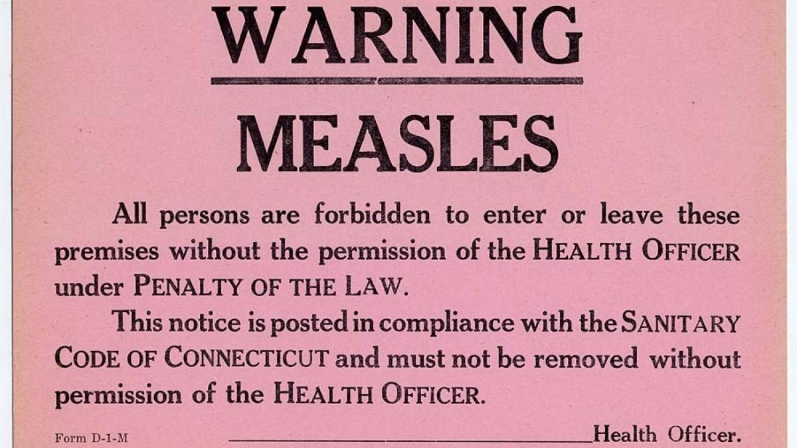
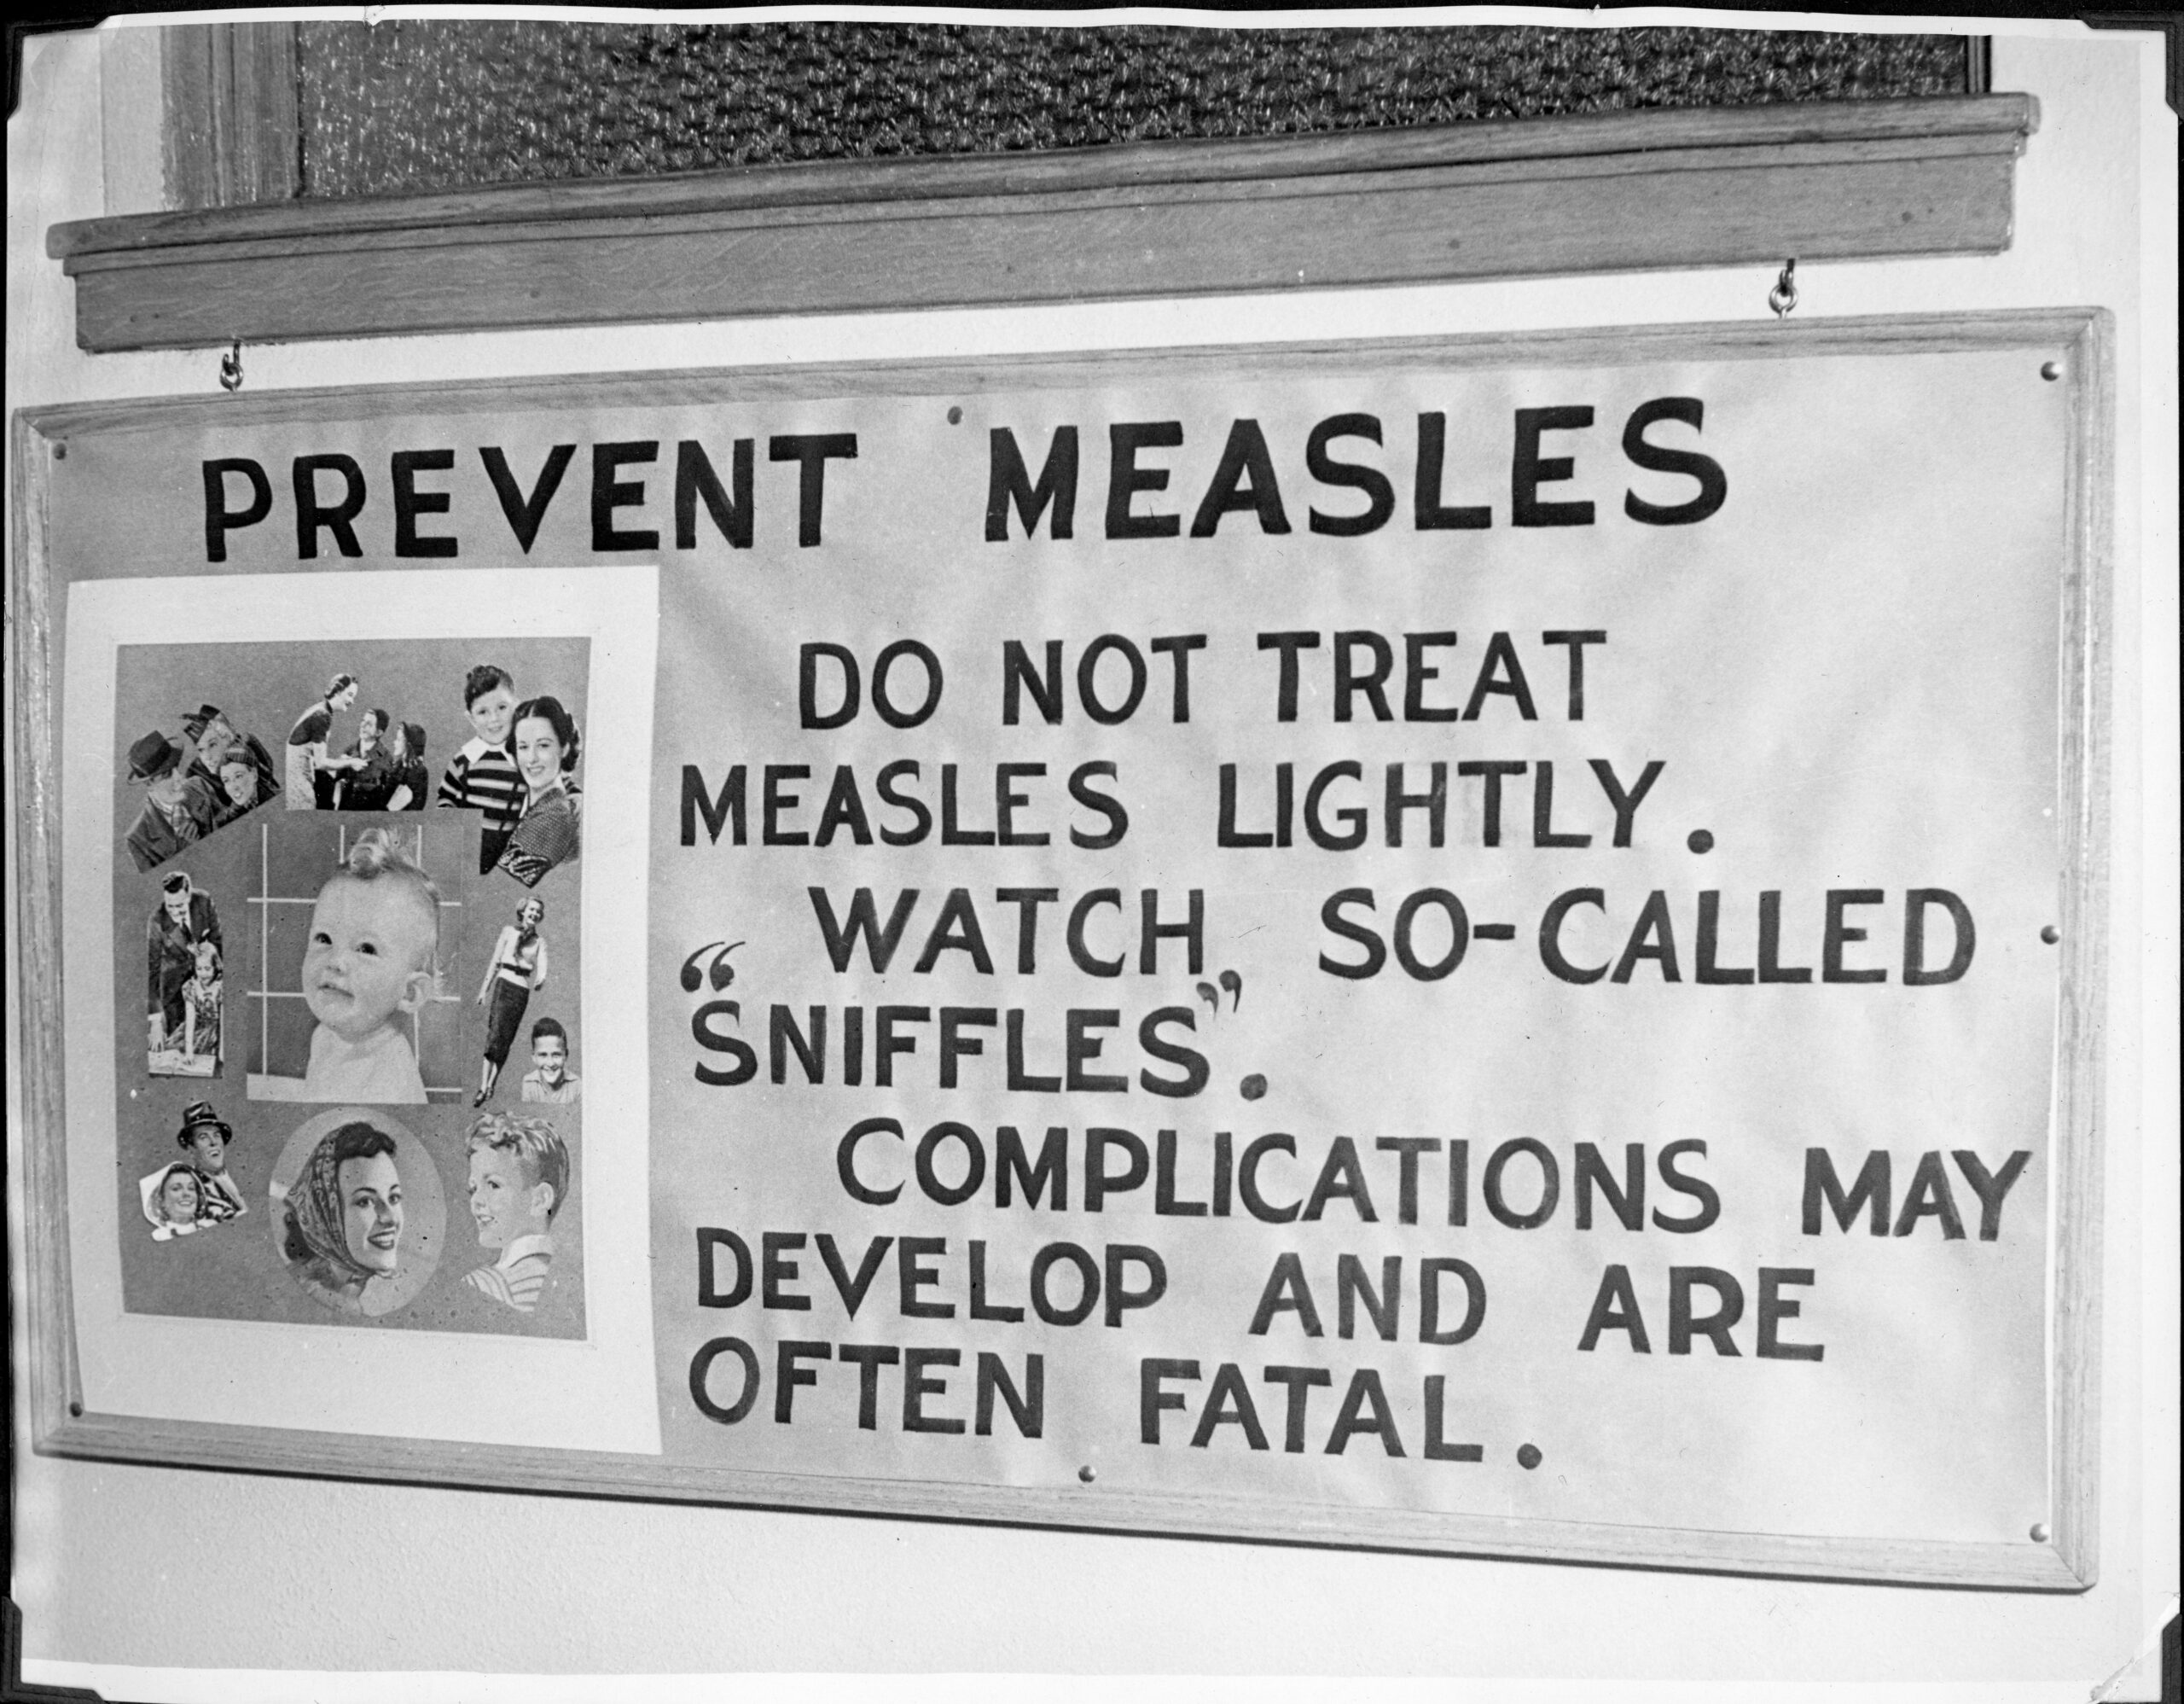
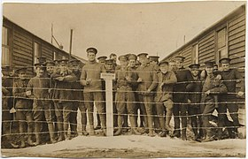
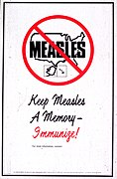
What was life like with measles?
Moss WJ. Measles. Lancet. 2017;390: 2490-502
Notes:
-Measles used to be a ubiquitous disease that would recur in epidemics every 3 to 5 years. It would sweep through schools primarily infected young children, since adults had already been infected before and were immune.
-What the experience was for people living in times of measles outbreaks (outbreaks every few years would sweep through schools and young children) – try to find old newspaper clips for measles outbreaks
-1905 Conneccticut Health Code – required quarantine of people with measles and all contacts
-1914 – Measles troops in quarantine during WWI (Canada -

Slide 5
Epidemiology and Transmission

Slide 6
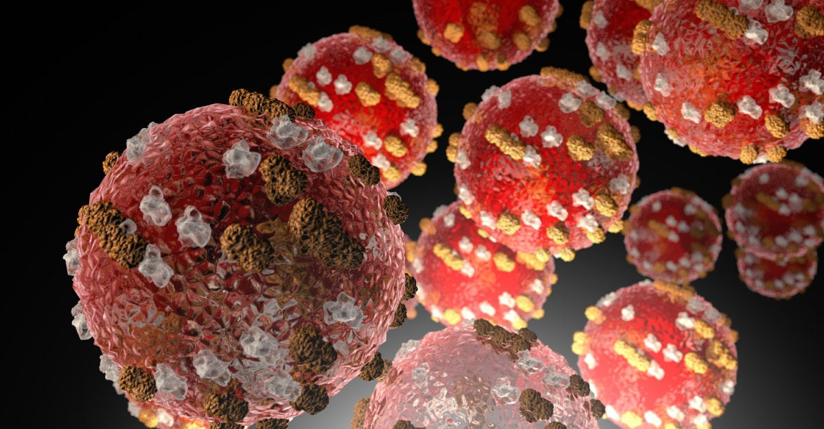
Measles (Rubeola) virus
Image: CDC
Notes:
Enveloped, non-segmented, single stranded negative sense RNA virus
Paramyxoviridae → morbillivirus
Inhalation of virus into alveoli of lungs, virus enters lymphatic system and spreads throughout virtually every organ of the body and replicates, the transfers back across respiratory epithelium into airway.

Slide 7
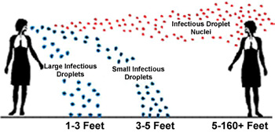
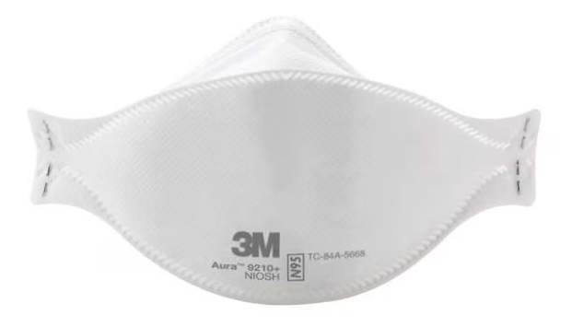
Transmission of measles
HIGHLY CONTAGIOUS respiratory virus
Droplet nuclei remain suspended in air and capable of transmitting infection for up to 2 hours after infected individual leaves
Notes:
Focus on mechanism and distance: droplets, small nuclei, short or long distance
-large droplets at short range to mucosal surfaces, OR small droplet nuclei suspended in air inhaled (infections documented up to 2 hours after an infectious individual left the room).
Everyone in a shared space is at risk

Slide 8
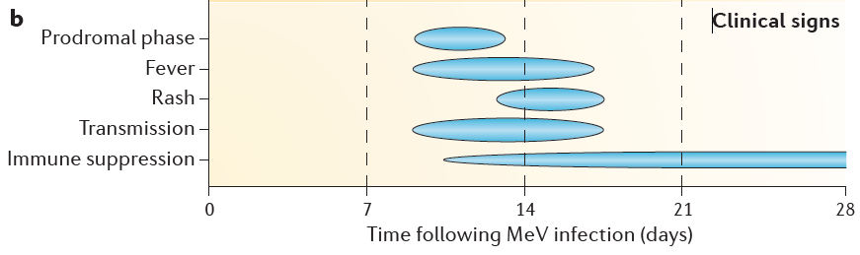



Transmission dynamics
Incubation Period: 10-14 days (up to 21 days)
Infectious Period: 4 days before to 4 days after rash onset
R₀ = 18
90%
Rota PA et al. Measles. Nature Reviews Disease Primers. 2016;2
Notes:
Incubation period 10-14 days
-But rash usually stars around Day 4
Duration of infectiousness (-4 days to +4 days from rash onset): makes measles very difficult to control because prodromal phase is similar to other respiratory infections
Attack rate
Reproductive numbers

Slide 9
Demographics
Prior to vaccination (and in countries with low vaccination rates) most infants or toddlers got infected with measles
In areas with measles elimination, risk factors are
  Non-immune
  Travel to endemic area
Notes:
Who typically gets infected with measles

Slide 10
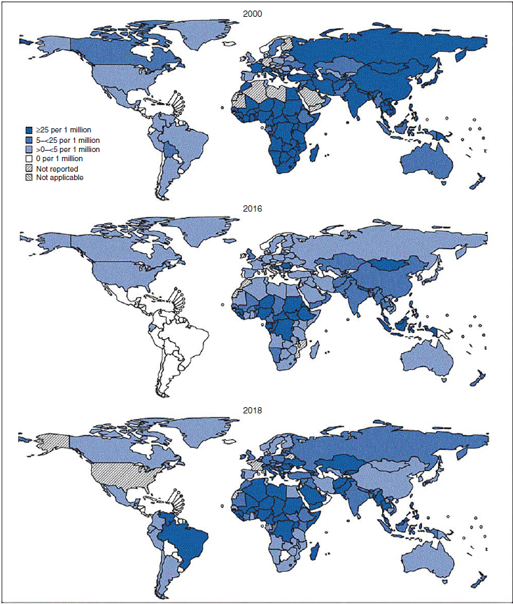
Global Status of measles
In 2023
107,000 measles deaths
  75,000 in Africa
  15,000 in Asia
  15,000 in Eastern Mediterranean
  1 in the Americas
Maldonado YA. Rubeola virus. In Principles and Practice of Pediatric Infectious Disease. Ed Long. 6th edition.
Minta AA. Progress towards measles elimination worldwide – 2000 to 2023. MMWR. 2024;73(45):1036-42.
Notes:
Internationally where endemic transmission and mortality is common. Most deaths are in young children
For comparison, ~1. 5million TB deaths, ~ 600,000 HIV deaths, ~ 600,000 malaria deaths

Slide 11
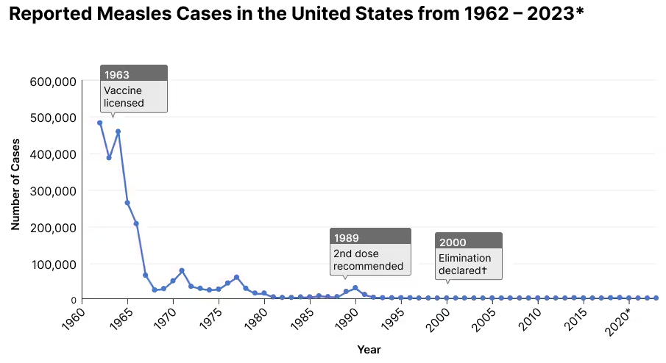
Measles in the USA
Measles disease burden before vaccine licensure (1963)
  Estimated 3 to 4 million cases per year in the U.S.
  48,000 hospitalizations
  1,000 encephalitis cases
  400 to 500 deaths
Source: CDC
Notes:
In USA

Slide 12
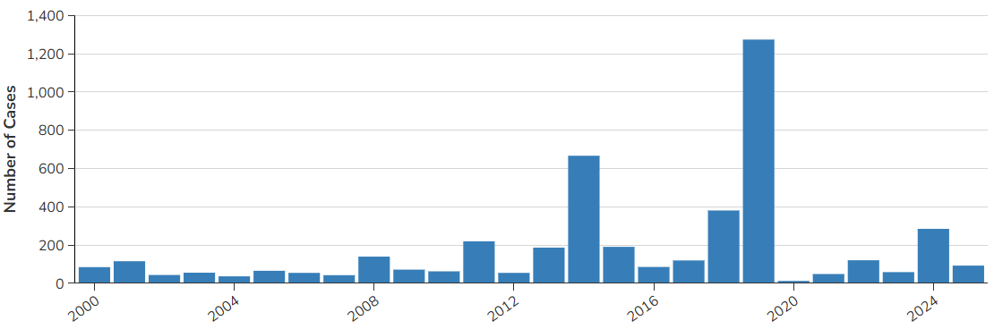
Measles in the USA
Measles disease burden before vaccine licensure (1963)
  Estimated 3 to 4 million cases per year in the U.S.
  48,000 hospitalizations
  1,000 encephalitis cases
  400 to 500 deaths
Source: CDC
Notes:
So why is measles returning now?

Slide 13

Epidemics
R₀ = 3
Notes:
Let’s model how an infection spreads through a community and becomes and epidemics.
For example let’s use an infection where R0 is 3

Slide 14

Epidemics
R₀ = 3
Notes:
In this case, the Epidemic grows exponentially. 1 case becomes 3, which becomes 9

Slide 15
Epidemics
R₀ = 3

Slide 16
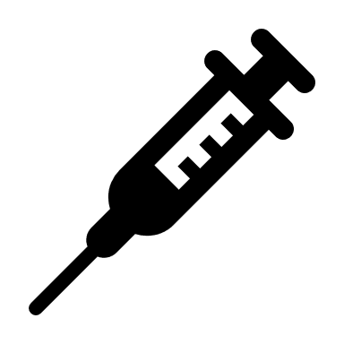

Epidemics
R₀ = 3
Notes:
Imagine a scenario where 2/3 of the population is immune to the disease, either through vaccination or prior infection. The virus and mixing patterns having R0 of 3, but due to immunity of 2/3 of the population, the Rt is down to 1. As seen by 3 potential exposures, but only one gets sick

Slide 17
Epidemics
R₀ = 3
Notes:
In this case, unlike in our first example, the epidemic does not grow. If Rt is less than one the prevalence will decrease over time

Slide 18
Herd Immunity Threshold
Herd Immunity Threshold (HIT) = 100%*(1 - 1/R₀)
  E.g. R₀ = 18, then HIT = 94%
Fine PEM (1993). “Herd Immunity: History, Theory Practice.“ Epidemiologic Reviews. 15(2): 265-302.
Notes:
Herd immunity is an important concept to understand and is frequently misinterpreted in the lay media
The term herd protection refers to the extra, or indirect protection, afforded to individuals based on the immunity of others
The herd immunity threshold is an epidemiologic term that is intended to be used by vaccination campaigns. It is equal to 1 minus the inverse of the basic reproduction number. The previous image shows why this is case. The HIT is the proportion of the population that must be immune to infection to reduce to Rt to 1, and therefore the epidemic cannot grow. The usefulness of this term is in regards to vaccination programs. The HIT represents a target threshold of which you must immunize above the HIT to eliminate a disease from a population. This term is very useful for infections that are endemic in the population or have regular epidemics, but is much trickier to use in newly emerging of epidemic diseases for several reasons:
-Inaccurate measures of R0
-Changing value of R0 as effective contact rates change due to NPIs
-Changing value of R0 as effective contact rates change due to virus mutation/new variants
-Incomplete vaccine efficacy
-Waning immunity

Slide 19
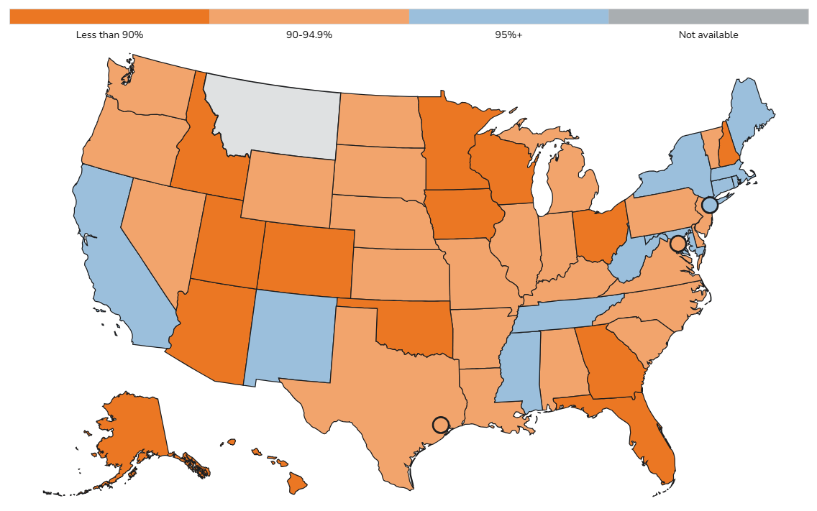
Declining Vaccination Rates
MMR Vaccine Coverage at Kindergarten Entry — 2023-24
94.3%
Notes:
Declining vaccine coverage in USA (in particular Texas) – can look up Texas vaccine exemption rate by school district
NIS data

Slide 20
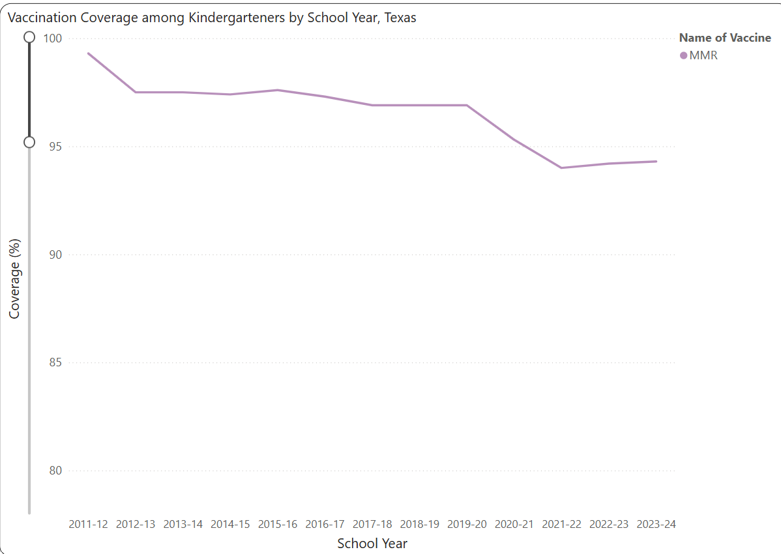
Declining Vaccination Rates
Source: CDC SchoolVaxView
Notes:
Note that this is just data for children in school. The rates of vaccination are lower for home schooled children. MMR update at least one dose by 3 years old was ~92% on NIS average of past two years

Slide 21
2025 South Plains Measles Outbreak

Slide 22
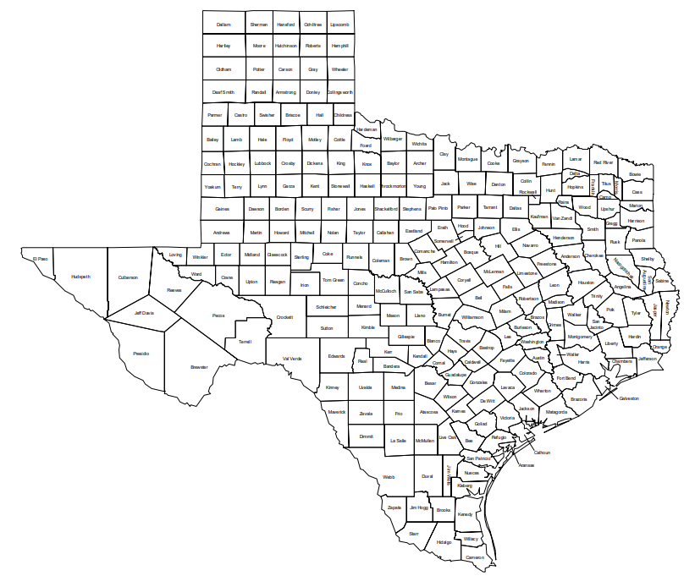
South Plain Outbreak: Jan 2025 to Present
Largest measles outbreak in Texas in over 30 years
258 (223 TX, 33 NM, 2 OK) cases linked to South Plains region outbreak reported as of 3/11/25
29 patients hospitalized
  1 death in an unvaccinated school-aged child in TX
  1 death reported in an unvaccinated adult in NM
Outbreak cases
2025 non-associated cases
Notes:
~1000 cases in Texas in 1992

Slide 23
South Plain Outbreak: Jan 2025 to Present
250 individuals (98%) unvaccinated or vaccine status unknown
187 individuals (73%) under 18 years old
2025 measles cases in Texas not-related to current outbreak
  2 in Harris County in January
  1 in Rockwall in February
  1 in Austin in February
Outbreak cases
2025 non-associated cases
Notes:
~1000 cases in Texas in 1992

Slide 24
Current Status
Texas Department of State Health Services declared outbreak in 6 counties
  Gaines
  Dawson
  Lynn
  Martin
  Terry
  Yoakum
Has spread to neighboring counties in New Mexico and Oklahoma
No current transmission in Dallas County or North Texas
  But this can change quickly with measles
In North Texas we are preparing for an outbreak

Slide 25
Clinical manifestations, diagnosis, management, and prevention

Slide 26
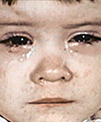
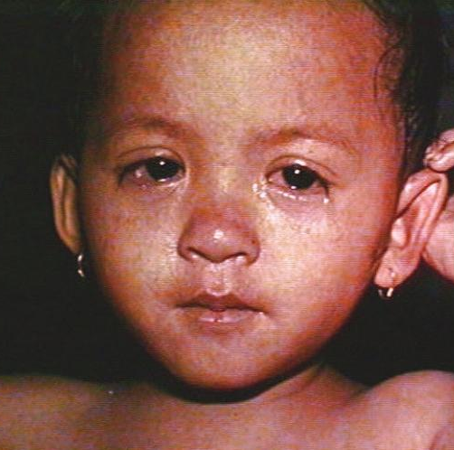
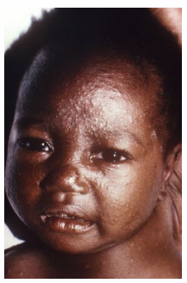
Clinical Manifestations
Acute viral respiratory illness
Prodrome of fever (as high as 105ºF), malaise and the 3 “C”s
  Cough, coryza, and conjunctivitis
Pathognomonic enanthema (Koplik spots)
Followed by a maculopapular rash
CDC video frame
CDC photo
(Public Health Information Library)
CDC photo
(Public Health Information Library)
Notes:
Include slide showing time course

Slide 27
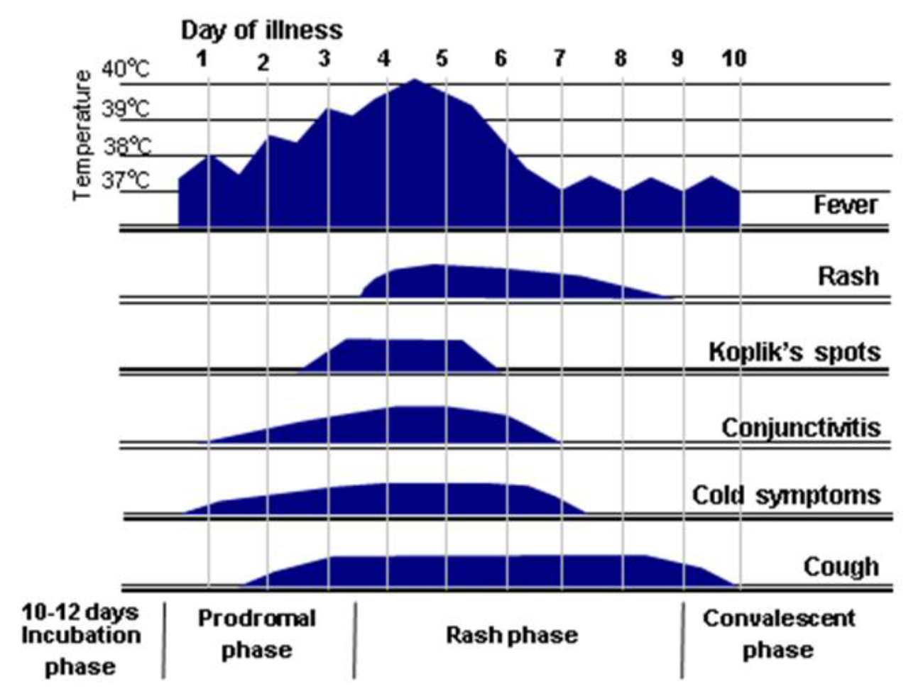
Progression of Symptoms

Slide 28
Prodromal Phase
Fever, progressively higher
URI symptoms
  Prominent cough
  Profuse rhinorrhea
  Prominent conjunctivitis (late in prodromal phase)
Enanthema (Koplik spots) develop late in prodromal phase
  Well-defined erythematous spots
  Central white-blue coloration\
  Not petechial or exudative
Notes:
Description of symptoms
Difficult to diagnose, overlaps with many viral illnesses
Images of Koplik spots (but these don’t appear until shortly before the rash)

Slide 29
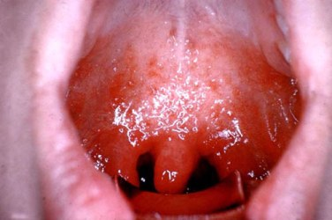
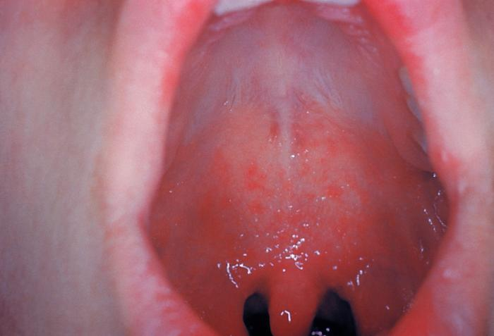
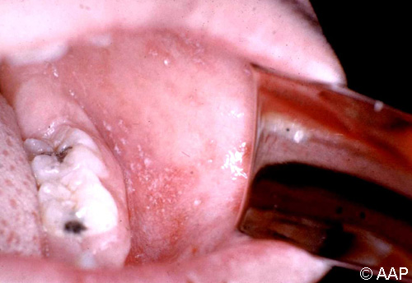
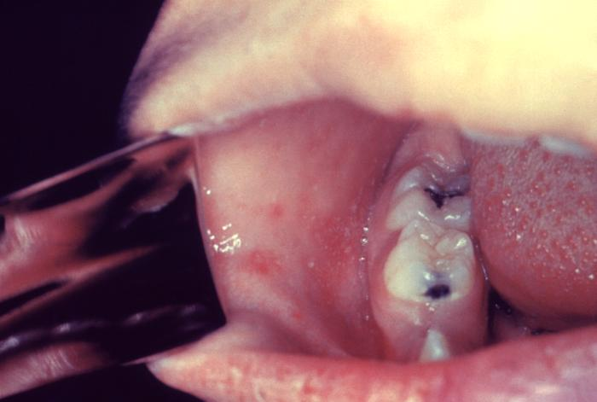
Koplik Spots
AAP photo (Red Book Online Visual Library)
CDC photo (Public Health Information Library)
AAP photo (Red Book Online Visual Library)
CDC photo (Public Health Information Library)

Slide 30
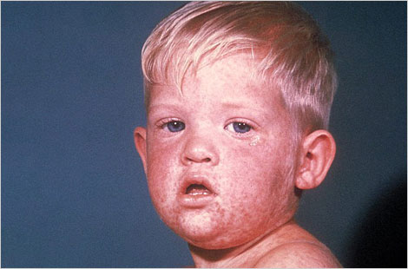
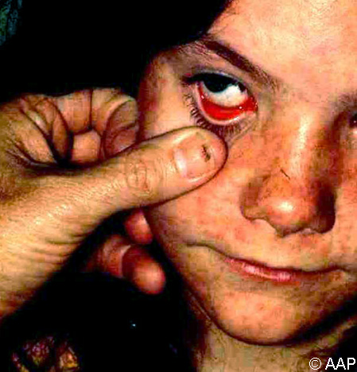
Rash Phase
Usually appears about 14 days exposure and 3-5 days after prodrome begins
Begins as flat red spots that appear on the face at the hairline
Spreads downward to the neck, trunk, arms, legs, and feet
Some immunocompromised patients may not develop rash
AAP photo (Red Book Online Visual Library)
CDC photo (Public Health Information Library)
Notes:
Describe progression of rash
Picture of measles rash

Slide 31
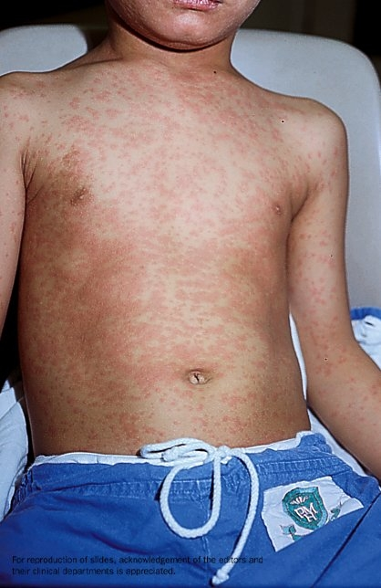
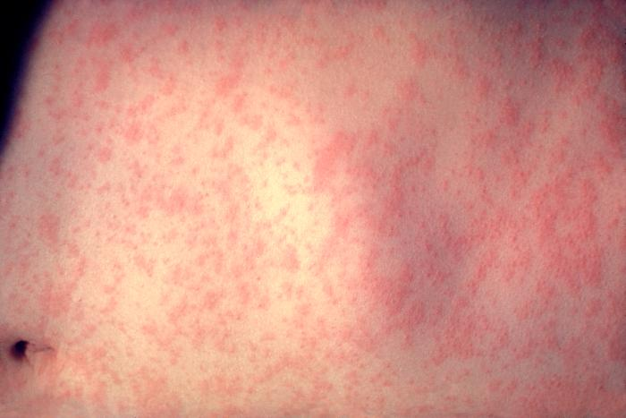
Rash Phase
Small raised bumps may appear on top of flat red spots
Spots may coalesce as rash spreads
Fever may spike when rash appears
Fever and rash subside over several days
Photo: Dr. CW Leung, Dept of Paediatrics and Adolescent
Medicine, Princess Margaret Hospital, Hong Kong
CDC photo (Public Health Information Library)

Slide 32
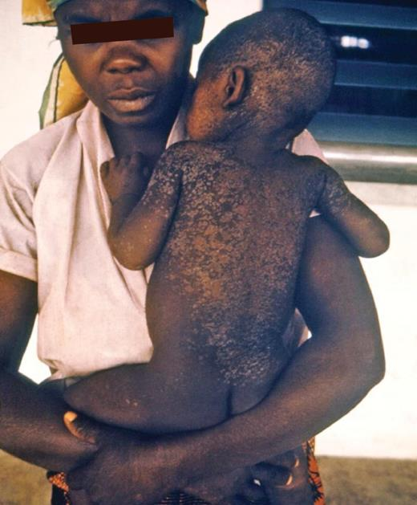
Resolution
Rash lasts 3-5 days
Fades from red to copper to brown, cephalocaudally
Fine desquamation often occurs
AAP photo (Red Book Online Visual Library)
Notes:
Skin hyperpigemntation

Slide 33
Alternate Presentations Measles
“Modified Measles”
  More mild but more prolonged symptoms (up to 20 days)
  Occurs in patients with “partial” immunity
    Infants <9 months old with maternal antibodies
    Previously vaccinated with vaccine “failure”
    Received immunoglobulin for post-exposure prophylaxis
“Atypical Measles”
  Rash starts on extremities, has “yellowish hue”, more systemic symptoms like abdominal and joint pains
  Occurs in patients who received killed vaccine btw 1963 - 1968
Maldonado YA. Rubeola virus. In Principles and Practice of Pediatric Infectious Disease. Ed Long. 6th edition.
Cherry JD. Measles Virus. In Feigin and Cherry Textbook of Pediatric Infectious Disease. Ed Cherry. 9th edition.

Slide 34
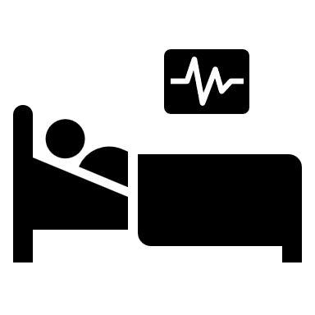
Complications
High-risk groups
  <5 years old or >20 years old
  Pregnant women
  Immunocompromised
  Malnourished
Otitis media (1:10)
Diarrhea (1:10)
Pneumonia (1:100)
Encephalitis (1:1000)
Hemorrhagic (rare)
Subacute sclerosing panencephalitis (1:10,000)
Death (1-2 : 1,000)
Maldonado YA. Rubeola virus. In Principles and Practice of Pediatric Infectious Disease. Ed Long. 6th edition.
Cherry JD. Measles Virus. In Feigin and Cherry Textbook of Pediatric Infectious Disease. Ed Cherry. 9th edition.
Notes:
AOM
Pneumonia (bronchiolitis in younger patients)
Encephalitis (last two are often what leads to death)
Mortality rate

Slide 35

Subacute Sclerosing Panencephalitis
4 to 8 years after measles infection
Stage I: neuropsychiatric decline over 6+ months
Stage II: seizures and motor disorders
Stage III: spasticity, coma, death
Maldonado YA. Rubeola virus. In Principles and Practice of Pediatric Infectious Disease. Ed Long. 6th edition.
Cherry JD. Measles Virus. In Feigin and Cherry Textbook of Pediatric Infectious Disease. Ed Cherry. 9th edition.

Slide 36

Diagnosis – Clinical Suspicion (non-outbreak)
Evaluating a patient presenting with rash when there is no local measles transmission
START HERE
Needs ALL 3:
Fever²
Generalized, maculopapular rash
No vesicular lesions / vesicles³
No
Measles unlikely. If vesicular rash, consider varicella or alternative cause of rash.
Yes
Epidemiologic risk for measles in the 21 days before rash?
ANY of the following:
International travel in last 21 days
Domestic travel in last 21 days to an area with known measles transmission
Known exposure to measles
Measles clinical criteria?⁴
Fever² and rash
AND
Cough, runny nose, OR conjunctivitis
Measles unlikely.
If measles still suspected, contact state or local health department for guidance.
No
No
Yes
Received MMR vaccine in the last 21 days?
Yes
Likely a reaction to MMR vaccination⁵
Yes
No
Suspect measles.
Immediately contact local or state health department to discuss testing options.
See Testing Recommendations.
Measles uncommon among people with age-appropriate vaccination. Measles can occur among vaccinated people, but generally during intense exposure (e.g., daycare or household exposure).
If measles suspected based on clinical presentation or severity of illness, contact state or local health department for guidance.
No
Prior measles vaccination?
Age ≤6 years: 1 dose MMR*
Age >6 years: 2+ doses MMR
Yes
*or other measles-containing vaccine
Notes:
In Texas, must report suspected measles cases to local health department immediately (24/7)

Slide 37
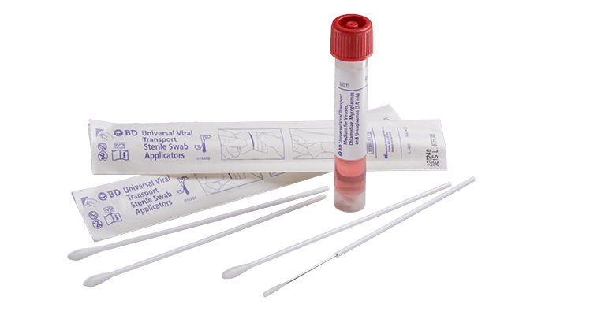
Diagnosis - Testing
Measles PCR
  Throat swab (preferred) OR nasopharyngeal swab
  Polyester fiber tipped with viral transport media
    Same as used for respiratory virus PCR testing
  Can consider PCR from urine and blood
Measles serology
  IgM: acute infection
  IgG: immunity
  and convalescent titers
Maldonado YA. Rubeola virus. In Principles and Practice of Pediatric Infectious Disease. Ed Long. 6th edition.
Cherry JD. Measles Virus. In Feigin and Cherry Textbook of Pediatric Infectious Disease. Ed Cherry. 9th edition.
Notes:
Measles PCR
-respiratory (throat > NP)
-blood, urine options
Measles IgM
-acute infection
-false positives
Measles IgG
-immunity
-convalescent for confirmation of recent infection
MMR vaccine
-Leads to positive PCR *** days after vaccine and positive IgM *** days after vaccine

Slide 38
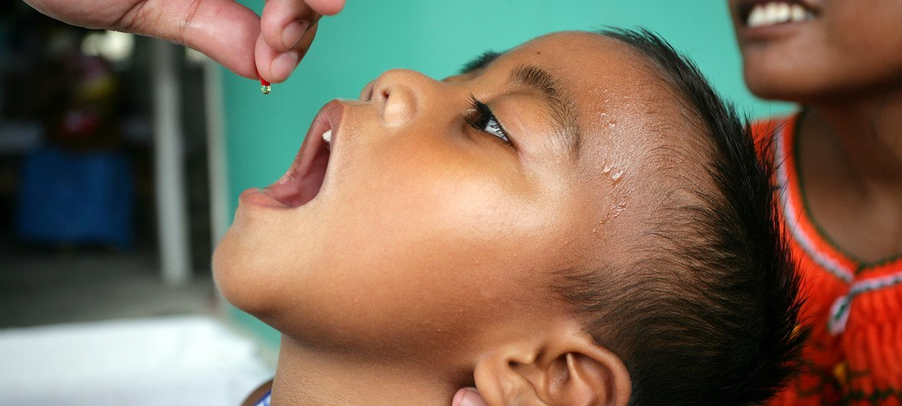
Management
Supportive care
No antiviral therapy
Vitamin A
  Recommended by WHO for all patients with measles
  In USA:
    all hospitalized patients
    all with suspected vitamin A deficiency
    consider for those treated outpatient
  Vitamin A does not prevent acquisition of measles
No alternative therapies proven to improve outcomes in patients with measles
© UNICEF/UN0205064/Pirozzi
Maldonado YA. Rubeola virus. In Principles and Practice of Pediatric Infectious Disease. Ed Long. 6th edition.
Cherry JD. Measles Virus. In Feigin and Cherry Textbook of Pediatric Infectious Disease. Ed Cherry. 9th edition.
Notes:
Supportive care
Vitamin A?
Mention things like cod oil and other stuff in the news

Slide 39
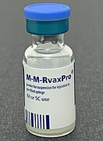
Prevention
MMR vaccine is the only effective way to prevent measles
Routine vaccination series
  Dose 1: 12-15 months old (93% immune)
  Dose 2: 4-6 years old (97% immune)
Can give MMR as young as 6 months old
  Prior to international travel
  During outbreaks
  This dose does not count towards routine series
Can give 2nd dose of MMR 28 days after first dose
Source: Whispyhistory – Wikimedia commons
Maldonado YA. Rubeola virus. In Principles and Practice of Pediatric Infectious Disease. Ed Long. 6th edition.
Cherry JD. Measles Virus. In Feigin and Cherry Textbook of Pediatric Infectious Disease. Ed Cherry. 9th edition.
Notes:
MMR vaccine (MMRV also)
Routine schedule

Slide 40
MMR Vaccine
Contraindications
  History of allergy to MMR vaccine component
  Severe immunocompromise
  High dose corticosteroid therapy for 14+ days
  Pregnancy
Adverse events
  Fever + measles-like rash (1:20)
  Febrile seizures (1:3000)
  Anaphylaxis (1:100,000)
  ITP (rare)
Notes:
MMR → rash is not measles, is not transmittible. It is expected. PCR and IgM will be positive at that time.
Rate of febrile seizures higher with MMRV

Slide 41

Evidence of Immunity
Documentation of age-appropriate vaccination with live measles vaccine
Laboratory evidence of immunity (IgG)
Laboratory confirmation of prior infection
Born prior to 1957*
  For healthcare personnel, one of the first three criteria are required
Measles. In: AAP Redbook 2024-2027.
Notes:
Not 100% immunity, but very good

Slide 42
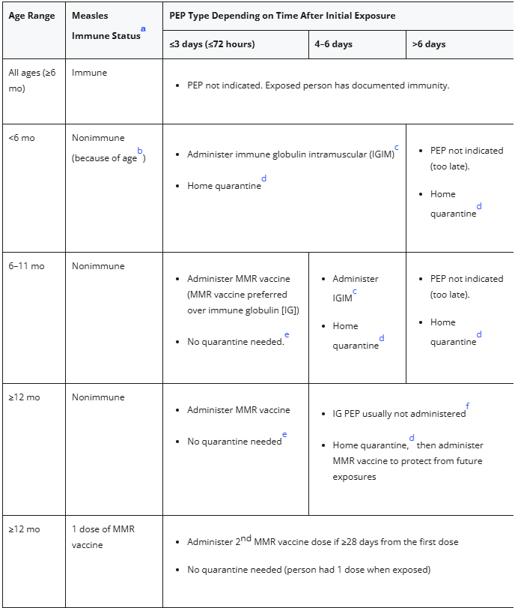
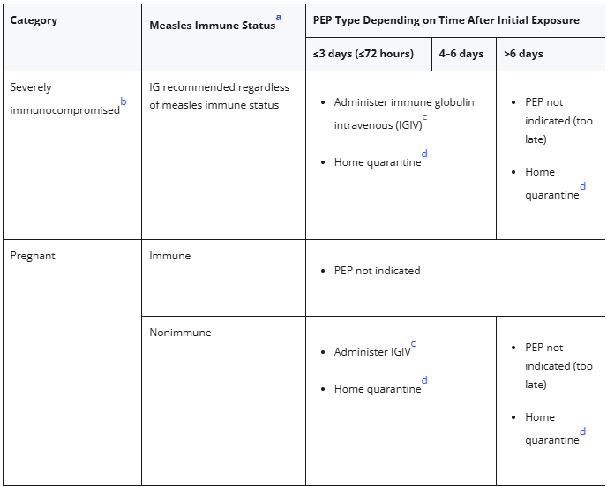
Post-exposure Prophylaxis
Measles. In: AAP Redbook 2024-2027.

Slide 43
Isolation and Quarantine
Confirmed or suspected measles
  Isolate at home for 4 days after rash first appears
Exposed, non-immune individuals
  Exclude from school and childcare settings for 21 days
  If hospitalized, requires “airborne precautions” from Day 5 through Day 21 after exposure
  Healthcare personnel excluded from work from Day 5 through Day 21 after exposure
Exposed, immune individuals
  No quarantine
Texas administrative code. Rule 97.7
Clinical overview of Measles. CDC. https://www.cdc.gov/measles/hcp/clinical-overview/index.html Accessed March 9, 2025

Slide 44
Prevention in Healthcare Settings
Immunity
  Require all healthcare personnel (HCP) to document immunity to measles
Screening
  Pre-arrival
  Upon arrival
Immediate isolation when measles suspected
  Provide patient with mask
  Place in single room with closed door
    Airborne infection isolation room (AIIR) if one is available
Measles. In: AAP Redbook 2024-2027.
Interim Infection Prevention and Control Recommendations for Measles in Healthcare Settings. CDC. https://www.cdc.gov/infection-control/hcp/measles/index.html. Accessed March 9, 2025
Notes:
Transmission in healthcare settings is common. Even people who share a waiting room are at risk (even cases of patients who entered waiting room 1 hour after infectious patient left). Best way to prevent it is still vaccination, but we take additional steps to further reduce the chances of transmission.
Occ health – require measles immunity
Screening: if pre-arrival concern for measles is identified, give patient instructions on how to enter facility (e.g. avoid waiting room). Upon arrival – ask patients screening questions for measles (symptoms – fever, rash; exposure to measles)
Mask on patient, consider distance
Place in AIIR (negative pressure with increased air exchanges)
PPE (airborne precautions) – N95

Slide 45
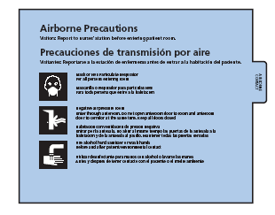
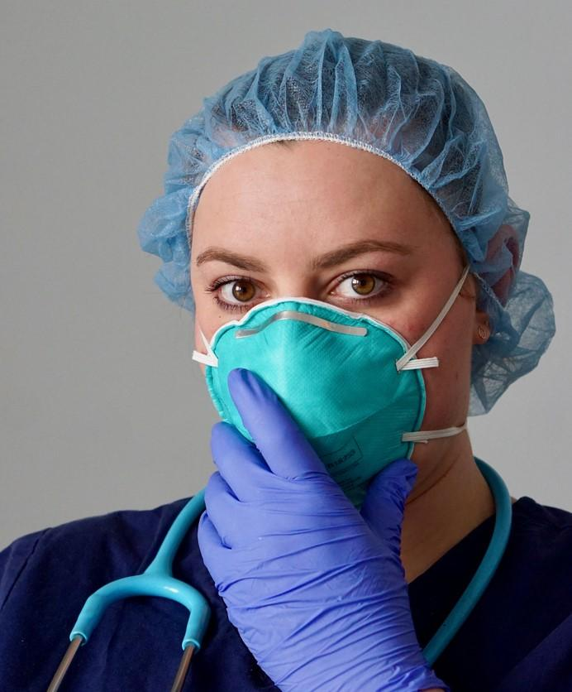
Prevention in Healthcare Settings
Airborne precautions
  Placement in an AIIR
  All healthcare personnel must wear N95 or equivalent respirator
Respiratory hygiene and cough etiquette
Limit patient transfers
Samara Heisz - iStock
Notes:
Occ health – require measles immunity
Mask on patient, consider distance
Ventilation
PPE (airborne precautions) – airborne isolation room

Slide 46
How to prepare for a measles outbreak?
Communication
  With healthcare providers: signs/symptoms, protocols
    Most pediatric providers have never seen a patient with measles
  With public: MMR vaccine is the best protection
Healthcare personnel protection
  Review measles immunity requirements for HCP
  Ensure adequate PPE (N95 masks)
Screening
  Ask screening questions to all patients: symptoms, exposures, travel
  Determine feasible of pre-arrival screening
Isolation
  Available airborne infection isolation rooms
  Plan for immediate isolation of suspected case
    Get patient out of waiting room immediately!
Testing
  Review testing recommendations
  Determine if you have a safe space to test
  Determine if testing will go to state lab or private lab

Slide 47
What happens next?
Current outbreak
  ???
Future
  Sporadic outbreaks likely due to declining vaccination rates
  USA may lose measles elimination status

Slide 48
Key Takeaways
Measles is a highly contagious respiratory virus
MMR vaccine is the best way to prevent measles
Decline in MMR vaccine coverage is leading to re-emerging measles outbreaks in the USA
Early recognition and isolation of patients with suspected measles is needed to prevent transmission
  Key clinical signs:
    Prodromal phase: fever, cough, congestion, coryza
    Diffuse maculopapular rash spreads cephalocaudally
    Exposure to measles
    Non-immune
In healthcare settings: airborne precautions
  Negative pressure room
  N95 respirator

Slide 49
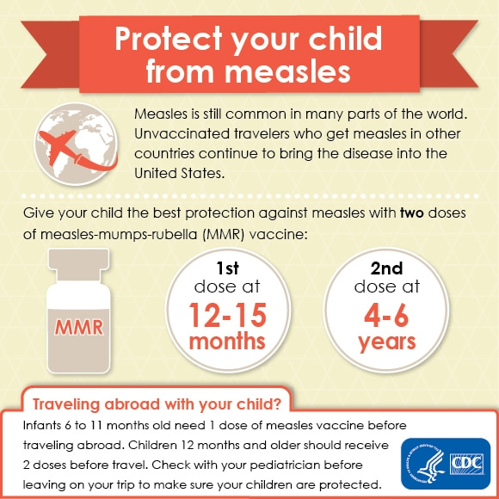
Questions?
Please reach out to me by email:
  zachary.most@utsouthwestern.edu
Thank you!
Notes:
Add image about vaccination/vaccine campaign

